Slide 1
Cuda Streams
Presented by
Savitha Parur Venkitachalam

Slide 2
Page locked memory / Pinned memory
malloc() was used to allocate memory in the host
malloc() allocates pageable host memory
cudaHostAlloc() allocates a buffer of page-locked memory
cudaHostAlloc( (void**)&a, size * sizeof( *a ), cuda HostAllocDefault ) ;
cudaFreeHost ( a );
Pagelocked memory guarentees that data will reside in the physical memory i.e OS will never page this memory out to disk

Slide 3
When using a pageable memory (malloc()) CPU copies data from pageable memory to a page locked memory
GPU uses direct memory access (DMA) to copy the data to or from the host’s page locked memory buffer
copy happens twice when using malloc()
Using a pagelocked memory (CudaHostAlloc()) the first copying is not needed
Pagelocked memory is fast but uses physical memory (not on the disk)
Should be restricted or system may run out of memory

Slide 4
Cuda Streams
Streams introduce task parallelism
Plays an important role in accelerating the applications
A Cuda Stream represents a queue of GPU operations that can be executed in a specific order
The order in which the operations are added to a stream specifies the order in which they will be executed

Slide 5
Steps – using one stream
Device should support the property ‘device overlap’.
Use CudaGetDeviceProperties (&prop , device) to know if the device support device overlap
cudaDeviceProp prop;
int whichDevice;
HANDLE_ERROR( cudaGetDevice( &whichDevice ) );
HANDLE_ERROR( cudaGetDeviceProperties( &prop, whichDevice ) );
if (!prop.deviceOverlap) {
printf( "Device will not handle overlaps");
return 0;
GPU supporting device overlap possesses the capacity to execute a kernel while performing a copy between device and host memory

Slide 6
Create the stream using cudaStreamCreate()
// initialize the stream and create the stream
cudaStream_t stream;
HANDLE_ERROR( cudaStreamCreate( &stream ) );
Allocate the memory on the host and GPU
//pagelocked memory at GPU
HANDLE_ERROR( cudaMalloc( (void**)&dev_a, N*sizeof(int) ) );
// allocate page-locked memory
HANDLE_ERROR( cudaHostAlloc( (void**)&host_a, FULL_DATA_SIZE*sizeof(int), cudaHostAllocDefault ) );
Copy the data from CPU to GPU using cudaMemcpyAsync() .When the call returns there is no gurantee that the copy is completed
HANDLE_ERROR( cudaMemcpyAsync( dev_a, host_a+i, N*sizeof(int), cudaMemcpyHostToDevice, stream ) );

Slide 7
Kernel launch
kernel <<< N/256, 256, 0, stream >>> (dev_a, dev_b, dev_c) ;
copy back data from device to locked memory
HANDLE_ERROR( cudaMemcpyAsync( host_c+i, dev_c, N*sizeof(int), cudaMemcpyDeviceToHost, stream ) );
Stream synchronization - waiting for the stream to be finished
cudaStreamSynchronize (stream);
Free the memory allocated and destroy the stream
cudaFreeHost (host_a)
cudaFree (dev_a)
cudaStreamDestroy (stream)

Slide 8
Multiple Streams
Kernels and Memory copies can be performed concurrently as long as they are in multiple streams
Some GPU architectures support concurrent memory copies if they are in opposite directions
The concurrency with multiple streams improves performance.

Slide 9
Execution time line for 2 streams

Slide 10
GPU Work Scheduling
Hardware has no notion of streams
Hardware has separate engines to perform memory copies and an engine to execute kernels
These engines queues commands that result in a task scheduling
When using multiple streams the structure of the program will affect the performance

Slide 11
GPU Scheduling
Stream0 : memcpy A
Stream0 : memcpy B
Stream0 : memcpy C
Stream1 : memcpy A
Stream1 : memcpy B
Stream1 : memcpy C
Kernel 0
Kernel 1

Slide 12
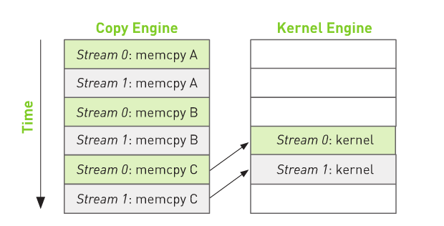
More efficient way

Slide 13
References
CUDA BY Example – Jason Sanders , Edward Kandrot
http://developer.download.nvidia.com/CUDA/training/StreamsAndConcurrencyWebinar.pdf
http://www.ece.umn.edu/~wxiao/ee5940/lecture5-2.pdf
http://www.ciemat.es/EUFORIA/recursos/doc/pdf/363464881_1510201010035.pdf

Slide 14
Questions

