Slide 1
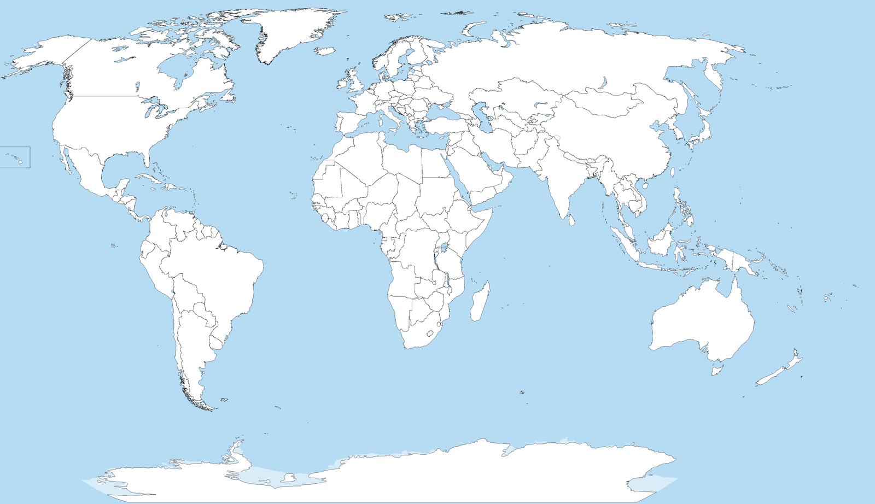
7(1.39%)
4(1.39%)
9(0%)
14
16
46
78
1(16.6%)
56
54
28
8(5.56%)
2(23%)
10(23%)
5(0%)
14
50
3(16.6%)
6
6(16.6%)

