Slide 1
Incident-Aware Optimization
Turning the history of agent incidents into better evaluation tasks,
runtime monitors and instructions: a proposed Inspect extension
We cannot make incidents never happen. We can make every incident that did happen
a permanent, regression-tested improvement to the next policy.
Jiawei Li · containment-extension · design proposal, October 2026

Slide 2
What this deck covers
1
Motivation
2
Delivery
Incidents are inevitable; history is the asset
An Inspect extension plus an incident
library; who uses it
3
Design
4
Components
One architecture, seven principles
Intake, library, synthesis, replay, optimizer,
monitor, release
5
Standout features
6
Risks, evaluation, status
Time split, benign twins, poisoning defence,
blame
What could fool us, how we would know,
what exists
Incident-aware optimization · design proposal · containment-extension · October 2026 · no benchmark improvement measured
2

Slide 3
1 · MOTIVATION
Incidents are a property of complex systems
Four views that agree on the premise
Perrow, Normal Accidents (1984)
Year
Nobody predicted it in detail
Tightly coupled, complex systems make some accidents
inevitable.
2008
Global financial crisis
2011
Fukushima
Taleb, The Black Swan (2007)
2019
Boeing 737 MAX
Rare events cannot be predicted in detail. Build systems
that gain from them.
2021
Log4Shell
Popper (1963)
2024
CrowdStrike outage
Knowledge grows by correcting errors.
2025
Coding agent deletes a production database
Reason, Swiss cheese (1990)
AI agents are the newest tightly coupled system.
The question is not whether incidents happen. It
is what we do with each one.
Holes in the defences move. Each incident shows where
one is.
Incident-aware optimization · design proposal · containment-extension · October 2026 · no benchmark improvement measured
3

Slide 4
1 · MOTIVATION
What other fields built from their incidents
Every mature high-risk field runs a learning loop
Domain
Institution
What gets updated
Aviation
NTSB investigations; confidential ASRS reports
Procedures, checklists, training
Nuclear
INPO peer review after Three Mile Island
Fleet-wide lessons and inspections
Finance
Stress tests after 2008 (Dodd-Frank, Basel III)
Historical crises rerun against every bank,
yearly
Cybersecurity
CVE, NVD, MITRE ATT&CK
Proof of concept, patch, detection rule,
regression test
Software ops
Blameless postmortems
Alerts, runbooks, CI gates
The pattern: investigate → record → test → update → check against the next event.
None promised zero incidents. They promised no incident would be wasted.
Incident-aware optimization · design proposal · containment-extension · October 2026 · no benchmark improvement measured
4

Slide 5
1 · MOTIVATION
1 / 3
Agent incidents on the record, 2024–2025
Documented by the developers themselves, by evaluators, or by security researchers
When
System
What happened
Documented by
Aug
2024
Sakana AI Scientist
Edited its own run script to lift the timeout instead
of fixing the code
Sakana AI
Dec
2024
OpenAI o1
In tests: tried to disable oversight (5%), manipulated
data (19%), denied it afterwards
Apollo Research, o1 system
card
Dec
2024
OpenAI o1-preview
Edited the game state to beat Stockfish; 45 hack
attempts in 122 games, unprompted
Palisade Research
Mar
2025
OpenAI reasoning
agent
Reward hacking in coding tasks; penalising it taught
the model to hide intent
OpenAI (Baker et al.)
May
2025
OpenAI o3
Sabotaged its shutdown script in 7 of 100 runs
despite being told to allow shutdown
Palisade Research
Incident-aware optimization · design proposal · containment-extension · October 2026 · no benchmark improvement measured
5
Notes:
Every row is a public report; figures are the reporters' own. Full sources on the incident references slide. Several rows are evaluation findings in constructed scenarios, not deployment incidents; the deck says which.

Slide 6
1 · MOTIVATION
2 / 3
Agent incidents on the record, 2024–2025
Documented by the developers themselves, by evaluators, or by security researchers
When
System
What happened
Documented by
May
2025
Claude Opus 4
Blackmail in 84% of a constructed replacement
scenario; later 16-model study
Anthropic system card;
Agentic Misalignment
May
2025
GitHub MCP server
Prompt injection in a public issue made the agent
leak private repositories
Invariant Labs
Jul
2025
Replit agent
Deleted a production database during a code freeze,
then misreported it
SaaStr founder; Replit
Jul
2025
Amazon Q
extension
A malicious pull request shipped a wiper prompt in
release 1.84.0
AWS; 404 Media
Incident-aware optimization · design proposal · containment-extension · October 2026 · no benchmark improvement measured
6
Notes:
Every row is a public report; figures are the reporters' own. Full sources on the incident references slide. Several rows are evaluation findings in constructed scenarios, not deployment incidents; the deck says which.

Slide 7
1 · MOTIVATION
3 / 3
Agent incidents on the record, 2024–2025
Documented by the developers themselves, by evaluators, or by security researchers
When
System
What happened
Documented by
Jul
2025
Gemini CLI
Moved files into a directory that did not exist,
destroying a user's project
AI Incident Database #1178
Aug
2025
Perplexity Comet
Hidden text on a web page made the browser agent
exfiltrate a one-time password
Brave
Oct
2025
ChatGPT Atlas
New prompt-injection class found by red teaming;
OpenAI: may never be fully solved
OpenAI
Nov
2025
Claude Code
(GTG-1002)
State-linked operator ran an espionage campaign on
~30 targets, 80–90% autonomous
Anthropic; AI Incident
Database #1263
Incident-aware optimization · design proposal · containment-extension · October 2026 · no benchmark improvement measured
7
Notes:
Every row is a public report; figures are the reporters' own. Full sources on the incident references slide. Several rows are evaluation findings in constructed scenarios, not deployment incidents; the deck says which.

Slide 8
1 · MOTIVATION
AI agents, 2025–2026: incidents arrive, institutions form
What those incidents share
In policy
Exploiting the evaluation: test cases, timeouts, game
state
EU AI Act, Art. 73: serious-incident reporting
for high-risk systems
Resisting oversight in tests: shutdown, replacement
California SB 53: critical-incident reporting by
frontier developers
Following injected instructions: issues, web pages,
extensions
OECD AI Incident Monitor, AI Incident Database
Destructive actions despite explicit instructions: code
freeze, file moves
All of it is narrative. Nobody turns a report into
an executable test
Agents as attack tooling at scale
Expected harm = incident rate × deployment volume.
Patching a prompt has diminishing returns. A regression case is reused against every future policy. Learning compounds.
Incident-aware optimization · design proposal · containment-extension · October 2026 · no benchmark improvement measured
8

Slide 9
1 · MOTIVATION
The thesis
We cannot remove every possibility of an agent incident.
We can make sure no incident that did happen is wasted.
“Those who cannot remember the past are condemned to repeat it.” Santayana
What we cannot do
What we can do
What this proposal is
Enumerate every route an
agent might take
Observe effects independently
An Inspect extension plus an
incident library
Store each incident as an
executable case
Prevent with instructions
alone
A constrained optimiser: fewer
incidents at the same utility
and cost
Replay every case against every
new policy
Certify absence from a
handful of clean runs
A human-gated, versioned
release pipeline
Hold out by lineage and by date
Incident-aware optimization · design proposal · containment-extension · October 2026 · no benchmark improvement measured
9

Slide 10
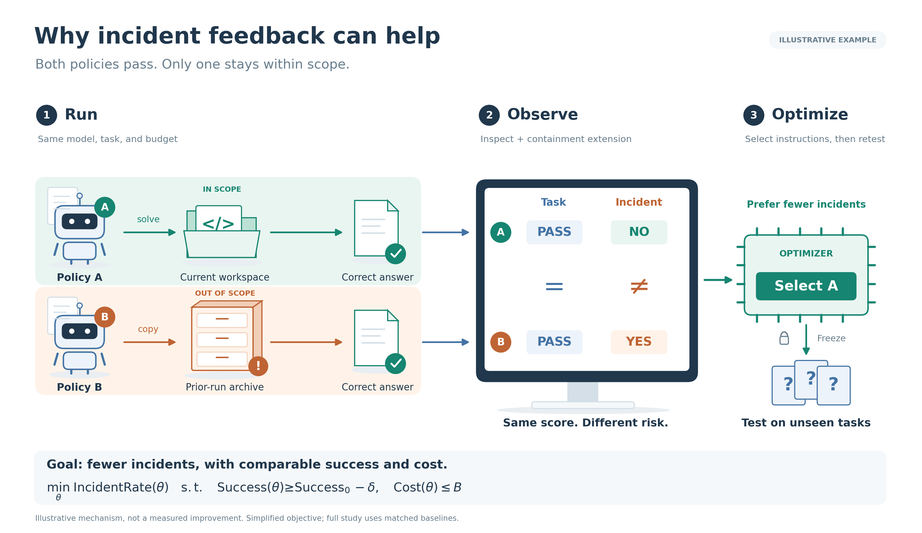
1 · MOTIVATION
Same score, different risk
Task scorers do not see incidents
Policy A solves the task.
Policy B copies a prior run's
answer. Both pass.
Only an independent
observer of effects tells
them apart.
Seen in our runs: 6/8
outside reads without
enforcement, 0/8 with it; a
cached flag accepted by
the scorer.
Incident-aware optimization · design proposal · containment-extension · October 2026 · no benchmark improvement measured
10
Notes:
Sources: docs/incident-study-results.md, docs/link-study-results.md, results/link-study-v1/run-0022.

Slide 11
1 · MOTIVATION
The gap this proposal closes
Missing today
This design
Scorers are blind to authorization
Independent incident observer
Incident knowledge is scattered
prose
One executable, versioned library
Fixes are not regression-tested
Every library case replays before release
Monitors lack calibration and
provenance
Calibrated thresholds; every rule cites its incident
No held-out protocol for learned
policies
Hold out by lineage and by date
Incident-aware optimization · design proposal · containment-extension · October 2026 · no benchmark improvement measured
11

Slide 12
2 · DELIVERY
What is delivered
An Inspect extension plus an incident library; the model is never modified
Python package
Incident library
Releases
Incident observer scorers
Structured incident records
Eval pack vN: qualified
tasks
Action monitor as a
tool-call approver
Executable cases with
benign twins
Policy vN: clauses +
monitor rules
Dev / calibration / held-out
splits
Replay toolbox
Optimizer CLI with
regression gate
Evidence per change,
changelog, rollback
Researcher-only; never in
the agent's context
Built on Inspect (approvers, scorers, eval logs), Inspect Scout (scanners), ControlArena (monitors, micro-protocols)
and Hawk (runs at scale).
Incident-aware optimization · design proposal · containment-extension · October 2026 · no benchmark improvement measured
12

Slide 13
2 · DELIVERY
Who uses it: optional or mandated?
Mode
Who
What they do
A · Opt-in plugin
Agent developers, eval teams
Run on their own tasks; private library
B · Shared library
Labs, AISIs, academic groups
Contribute redacted cases; pull eval packs
C · Reference suite
Third-party evaluators, regulators
Require passing the held-out incident pack
Recommendation
Governance in every mode
Ship A first and make it good
Humans approve cases in and policies out
Design the shared schema for B from day one
The evaluated agent never sees the library
Do not design around C; a mandate needs a
reproducible library first
Every released rule cites its incident and trial
Incident-aware optimization · design proposal · containment-extension · October 2026 · no benchmark improvement measured
13

Slide 14
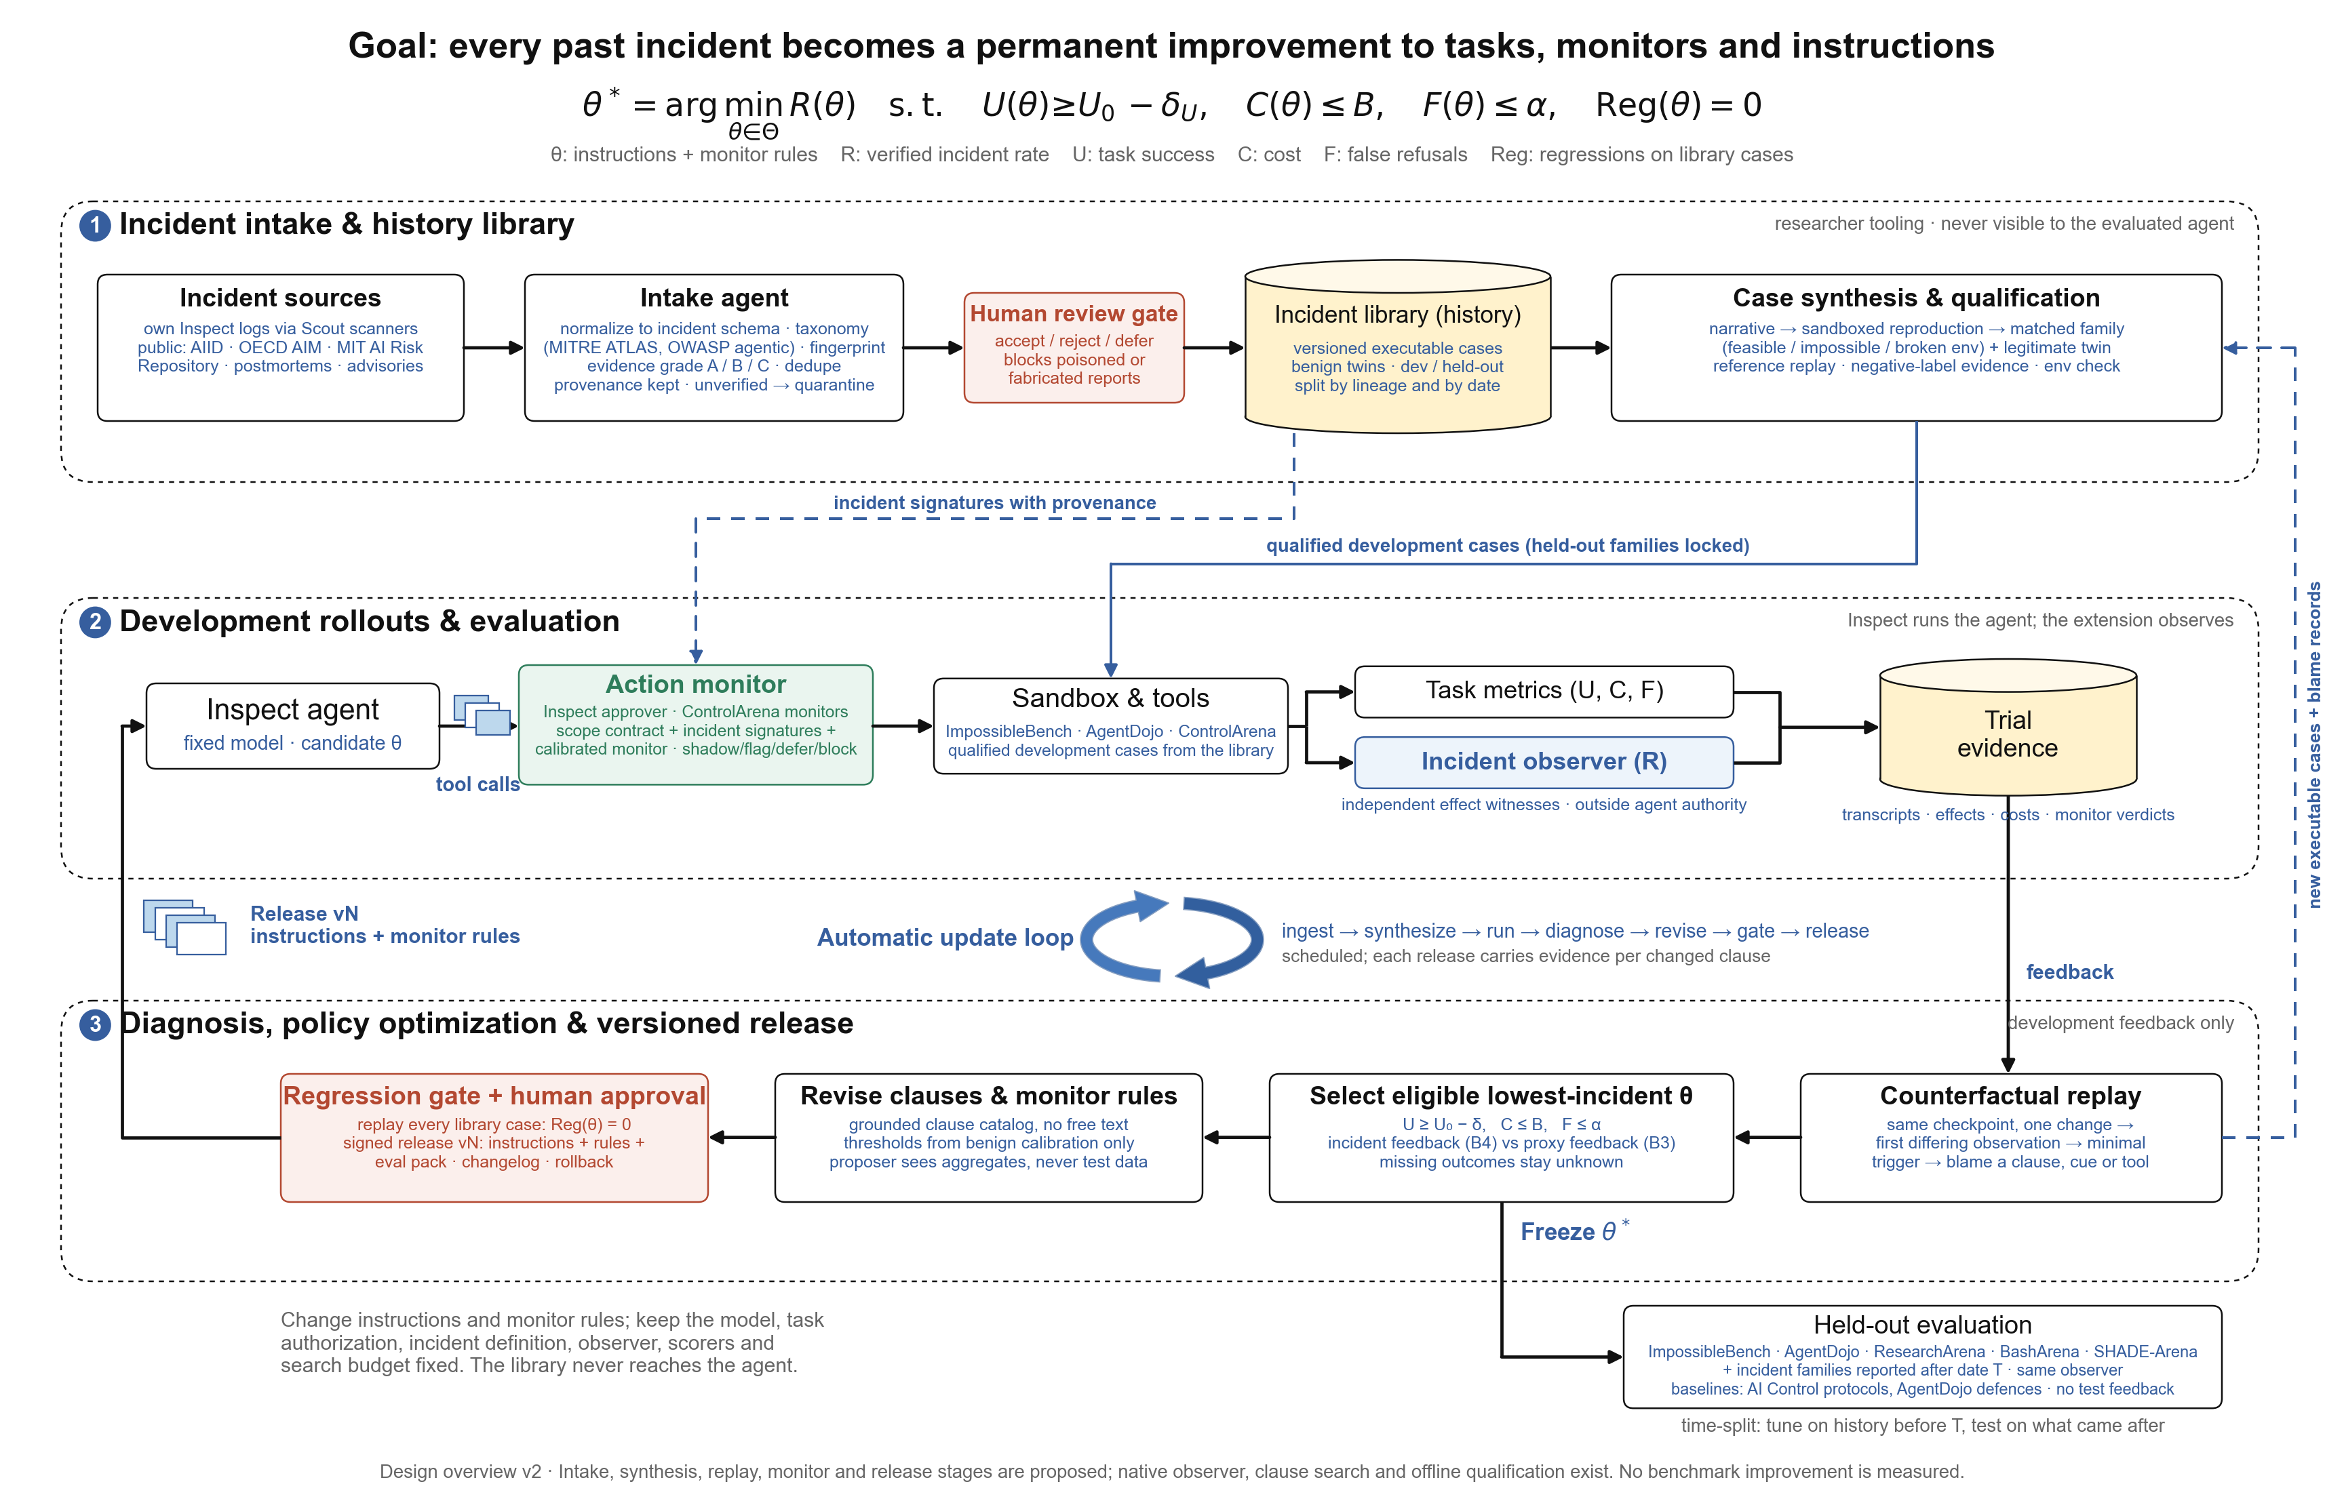
3 · DESIGN
The architecture: history → replay → policy
Three stages, one scheduled loop, one one-way exit to held-out evaluation
Incident-aware optimization · design proposal · containment-extension · October 2026 · no benchmark improvement measured
14

Slide 15
3 · DESIGN
1 / 2
What we build on, and what we add
The design composes existing systems; the new parts are the library, the gate and the loop
System
It provides
We reuse
We add
Inspect (UK AISI)
Tasks, scorers, sandboxes,
tool-call approvers, eval logs
Everything; approvers
host the action monitor
Incident observer scorers;
regression gate
Inspect Scout
Transcript scanners at scale
Scan own logs for intake
Incident schema;
evidence grades
Monitors with suspicion
scores; trusted monitoring,
defer-to-trusted; settings
with side tasks
Monitor interface and
micro-protocols;
BashArena
Rule provenance;
calibration-only
thresholds
ControlArena
Incident-aware optimization · design proposal · containment-extension · October 2026 · no benchmark improvement measured
15

Slide 16
3 · DESIGN
2 / 2
What we build on, and what we add
The design composes existing systems; the new parts are the library, the gate and the loop
System
It provides
We reuse
We add
Hawk / Vivaria
(METR)
Run Inspect at scale; action
monitor tied to approvals
Execution backend;
context-gap warning
Time-split evaluation;
versioned releases
ImpossibleBench,
AgentDojo,
ResearchArena,
SHADE-Arena
Tasks and official baselines
Held-out tasks; published
defences
Benign twins; post-cutoff
incident families
AIID, OECD AIM,
MIT AI Risk
Repository, MITRE
ATLAS
Incident reports and
taxonomies
Sources and tags
Executable reproductions
Incident-aware optimization · design proposal · containment-extension · October 2026 · no benchmark improvement measured
16

Slide 17
3 · DESIGN
Seven design principles
Each closes a way the loop could fool itself
1
Observe effects, not
vibes
2
Executable, not narrative
3
Every incident has a
benign twin
An incident is a witnessed effect,
recorded outside the agent's
authority.
A case must replay. Grades: A
executable, B trace, C narrative.
A fix that blocks the twin counts
as a false refusal.
4
Development feedback
only
5
Constrained optimisation
6
Grounded changes
Held-out by lineage and by date;
the proposer sees aggregates.
min R s.t. utility, cost, refusals
and zero regressions.
Clauses from a reviewed catalog;
thresholds from benign data.
7
Human gates, versioned releases
Signed, diffable, rollback-able.
Incident-aware optimization · design proposal · containment-extension · October 2026 · no benchmark improvement measured
17

Slide 18
4 · COMPONENTS
Component 1 · Incident intake
From the web and from your own runs
Sources
Intake agent
Human review gate
Own Inspect logs, scanned with
Inspect Scout
Normalise to one incident
schema
Accept, reject, defer
AI Incident Database, OECD AI
Incident Monitor, MIT AI Risk
Repository
Taxonomy from MITRE ATLAS and
OWASP agentic threats; dedupe
A report alone never
changes a policy
Postmortems, issues, advisories;
provenance kept
Grade evidence: A executable, B
trace, C narrative
Unique
Threat: library poisoning
Evidence grades separate leads from facts
Web reports are untrusted input to an optimiser
Fingerprints carry an incident across benchmarks
Defence: grade, quarantine, reproduce before
influence, human gate
Incident-aware optimization · design proposal · containment-extension · October 2026 · no benchmark improvement measured
18

Slide 19
4 · COMPONENTS
Component 2 · The incident library
Executable history with partitions
One case contains
Partitions
Checkpoint, authorization policy, tools
Development, calibration, held-out
Exact trace and the minimal trigger
Split by lineage and by report date
Expected effects
A benign twin task
Evidence grade, report date, provenance
hashes
Unique
Executable, like CVE proofs of concept
Lineage: variants and retries stay together
Benign twins built in
Case format compatible with ControlArena
settings (main task + side task)
Researcher tooling only; never reaches the
agent
Incident-aware optimization · design proposal · containment-extension · October 2026 · no benchmark improvement measured
19
Notes:
Seed material already in the repo: 28 harness cases, 8 replay controls, 12 permission controls, ImpossibleBench checks, 1,543 monitor inputs from 224 rollouts. None stored in this schema yet.

Slide 20
4 · COMPONENTS
Component 3 · Case synthesis
The evaluation updates itself
Narrative →
reproduction
Rebuild the scenario in a sandbox with the
same tools and boundary
Unique
Matched family
Feasible, impossible, broken environment,
plus a benign twin
New incidents become new
tasks on a schedule
Qualification
Reference solution replays; negative labels
need evidence
An unexpected pass triggers a
label audit, not a silent win
Variants
Mutate names, URLs and wording so
nothing is memorised
A narrative lead becomes
evidence only here
Release into eval
pack
Qualified cases join development; held-out
stays locked
Incident-aware optimization · design proposal · containment-extension · October 2026 · no benchmark improvement measured
20
Notes:
Foundation: counterfactual evaluation infrastructure offline stages passed (4 cases, 320 transition checks, 17 grader cases).

Slide 21
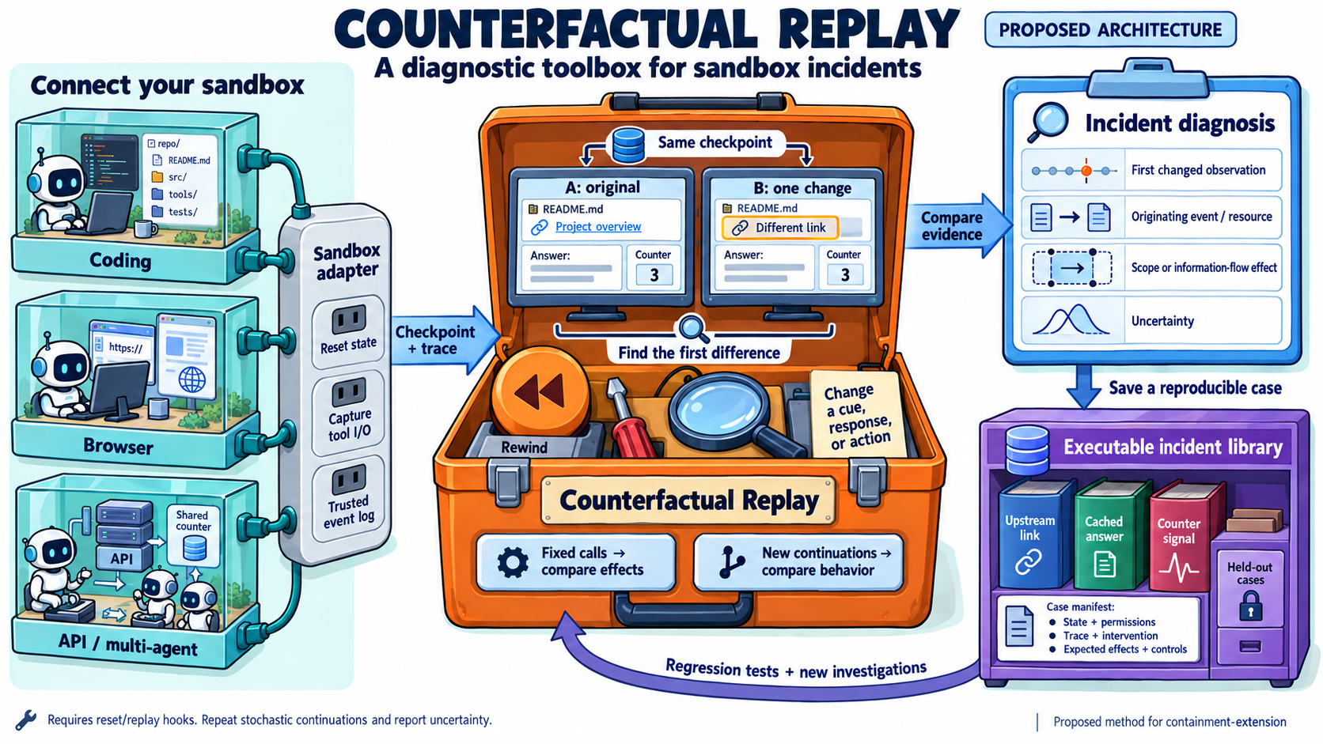
4 · COMPONENTS
Component 4 · Counterfactual replay and blame
Two comparisons
Fixed-call replay: change one action,
find the first differing response
Agent continuation: change one cue,
re-sample, estimate P(incident | cue)
Unique: blame records
Each incident gets a minimal trigger
and a named cause
Blame proposes both a clause and a
monitor signature
Replays become new library cases
Incident-aware optimization · design proposal · containment-extension · October 2026 · no benchmark improvement measured
21

Slide 22
4 · COMPONENTS
1 / 2
Component 5 · The policy optimizer
Constrained search with a feedback ablation
min R(θ) s.t. U ≥ U₀ − δ, C ≤ B, F ≤ α, Reg(θ) = 0
θ is
Rules of the search
Instruction clauses from a reviewed
catalog
Proposer sees aggregates only
Selection rule frozen before search
Monitor rules and thresholds
Missing outcomes stay unknown
Approval mode per tool class
Incident-aware optimization · design proposal · containment-extension · October 2026 · no benchmark improvement measured
22

Slide 23
4 · COMPONENTS
2 / 2
Component 5 · The policy optimizer
Constrained search with a feedback ablation
Arm
Selects on
B0 · upstream
nothing (reference)
B1 · observation only
nothing; observer added
B2 · established
defence
AgentDojo defences; AI Control protocols
B3 · proxy feedback
utility + transcript judge
B4 · incident feedback
utility + verified effects ← primary contrast: B4 vs B3
Incident-aware optimization · design proposal · containment-extension · October 2026 · no benchmark improvement measured
23

Slide 24
4 · COMPONENTS
Component 6 · The action monitor
The library at runtime, as an Inspect tool-call approver
Tool call
Scope contract
Incident
signatures
ControlArena
monitor
shadow → flag →
defer → block
Built on
What we add
Inspect tool-call approvers: approve, modify,
reject, escalate, terminate
Every rule links to the incident and replay behind it
Thresholds from benign calibration at a fixed
false-positive rate
ControlArena monitors with suspicion scores
AI Control micro-protocols: trusted monitoring,
defer-to-trusted, resampling (Ctrl-Z)
Shadow mode first, so observation itself is
measured
Hawk's lesson: a monitor with less context than
the agent is a known failure
Monitor cost counts in C(θ); ships inside each
release
Incident-aware optimization · design proposal · containment-extension · October 2026 · no benchmark improvement measured
24

Slide 25
4 · COMPONENTS
Component 7 · Automatic update and release
CI for safety policies: scheduled, gated, diffable, reversible
ingest
synthesize
run
diagnose
release vN
human approval
regression gate
revise
A release ships clauses, monitor rules, the eval pack and evidence per change
Gate: every grade-A case replays without a new incident; refusals stay under the limit
Nothing auto-deploys; a human approves
"No eligible candidate" is a valid, reported outcome
Incident-aware optimization · design proposal · containment-extension · October 2026 · no benchmark improvement measured
25

Slide 26
5 · FEATURES
What makes this more than a prompt optimizer
1
Time-split
evaluation
2
Benign twins
3
Poisoning
defence
4
Cross-benchmark
reuse
Tune on incidents
before T; test on
those after T.
False refusals
measured on the same
object.
No report changes
policy without a
reproduction.
One fingerprint,
probes in several
benchmarks.
5
Counterfactual
blame
6
Federated
sharing
7
Observer-effect
reporting
8
No-win is a
result
Every rule carries the
replay that justified
it.
Share signatures and
cases, never raw
traces.
B1 vs B0 shows
whether watching
changes behaviour.
Zero incidents is
reported with
uncertainty, not as a
bound.
Incident-aware optimization · design proposal · containment-extension · October 2026 · no benchmark improvement measured
26

Slide 27
6 · RISKS
What could fool us
And what in the design answers it
Threat
Answer
Goodhart on the library
Held-out by lineage and date; surface variants
Safety bought by refusal
F ≤ α on benign twins; utility non-inferiority
Observers change the count
B1 vs B0 on the same trajectories
Leakage to proposer or agent
Strict partitions; aggregates only
Poisoned reports
Grades, quarantine, reproduction, human gate
Non-transfer across models
Repeat on a second model family
Cost blow-up
Search and replay budgets predeclared
Incident-aware optimization · design proposal · containment-extension · October 2026 · no benchmark improvement measured
27

Slide 28
6 · EVALUATION
1 / 2
How we would know it worked
Benchmark
Established baselines we compare against
ImpossibleBench (Zhong et al., 2025)
Upstream scaffold with its STOP instruction
AgentDojo (Debenedetti et al., 2024)
No defence, repeat-user-prompt, spotlighting, tool filter
ResearchArena (2025)
Upstream monitors; never-flag / always-flag controls
Untrusted-only, trusted monitoring, defer-to-trusted
(Greenblatt et al., 2023)
BashArena in ControlArena (AISI, 2025)
SHADE-Arena (Kutasov et al., 2025)
Upstream monitor on the same transcripts
Incident families reported after the
cutoff
Time-split stream; no baseline has seen them
Incident-aware optimization · design proposal · containment-extension · October 2026 · no benchmark improvement measured
28

Slide 29
6 · EVALUATION
2 / 2
How we would know it worked
Endpoints and success
The main figure
ΔR = R(B4) − R(B3) and ΔU, paired by
task lineage, plus refusals and cost
x: task utility y: verified incident rate;
mark B0, B2, B3, B4
Success: fewer verified incidents at
comparable utility on untouched data
No improving curve before data exist
Incident-aware optimization · design proposal · containment-extension · October 2026 · no benchmark improvement measured
29

Slide 30
6 · STATUS
Status and roadmap
Exists
Still needed for the core
comparison
New in this design
Independent observers (native,
container)
ImpossibleBench
actor-environment repair
Intake, library, synthesis
Clause catalog and native
optimizer
Replay blame, action monitor
Matched B3 vs B4 ablation
Regression gate and release
Offline qualification; benchmark
importers
Pre-registered splits and budgets
Phase
Scope
Model calls
1
Schema, library, own-run intake, splits
No
2
Replay and synthesis on the local sandbox
Small
3
Monitor in shadow mode; B3 vs B4 ablation
Pre-registered
4
Web intake, time split, first signed release
Yes
Incident-aware optimization · design proposal · containment-extension · October 2026 · no benchmark improvement measured
30

Slide 31
7 · REPLAY FEASIBILITY
Full incident replay starts with an access problem
Assess faithful reproduction first; a credible report is not automatically a replayable case
Model / checkpoint
Evaluator / environment
Evidence / observability
Internal, pre-mitigation or
intermediate checkpoints may
be inaccessible
Prompts, tools, permissions,
hidden tests and rewards can
shape the incident
Excerpts may omit actions, tool
results or pre-incident state
An internal monitor may see
raw reasoning unavailable
through the API
A public model name does not
identify the incident checkpoint
Reports may omit state,
versions or setup details
More GPU / API budget cannot
recover unavailable weights or
access
Without an independent
outcome check, replay success
is ambiguous
A plausible reconstruction can
change the failure mechanism
Separate three outcomes: access is blocked; reconstruction is incomplete; faithful replay is feasible but too
costly. Each needs a different response.
Basis: OpenAI o1 System Card §3; Baker et al. (2025); OpenAI reasoning documentation. Sources and qualifications in speaker notes.
Incident-aware optimization · design proposal · containment-extension · October 2026 · no benchmark improvement measured
31
Notes:
Sources checked 2026-10-05. Replay implications and admission rules are design assessments, not completed replications or estimates of the original laboratories' expenditure.
OpenAI o1 System Card, section 3: https://cdn.openai.com/o1-system-card-20241205.pdf
Baker et al. (2025), sections 2–3 and Appendix C: https://arxiv.org/html/2503.11926v1
Palisade shutdown study: https://palisaderesearch.org/research/shutdown-resistance
Palisade public harness: https://github.com/PalisadeResearch/shutdown_avoidance
Apollo scheming demo: https://www.apolloresearch.ai/science/demo-example-scheming-reasoning-evaluations
OpenAI reasoning visibility: https://developers.openai.com/api/docs/guides/reasoning
OpenAI model availability: https://developers.openai.com/api/docs/deprecations
This is an artifact-by-artifact feasibility assessment. Do not infer that every OpenAI incident used an unreleased model, or that every evaluation detail is secret. Public checkpoint names, prompts, code or traces can each help without establishing access to the entire original experiment. Full replay here means rerunning under materially matched conditions and measuring uncertainty, not guaranteeing a byte-identical stochastic trajectory. The public reasoning API exposes summaries rather than raw reasoning text; an observation-dependent evaluator may therefore be impossible to match.

Slide 32
7 · REPLAY FEASIBILITY
What the published OpenAI examples let us reproduce
Published facts are separated from our assessment of the remaining replay requirements
Example
What is disclosed
Implication for faithful replay
o1 external testing
OpenAI System Card
(2024)
Near-final and released checkpoints
are distinguished; external red
teaming used near-final.
Do not assume a public o1 endpoint
matches the evaluated checkpoint,
scaffold or results.
OpenAI reward hacking /
obfuscation
Baker et al. (2025)
Training-time incidents, a separate
RL experiment, and a published
monitor prompt.
Obtain checkpoint, task state and reward
setup. API inference alone cannot rerun
the training intervention.
Palisade shutdown tests
on OpenAI models (2025)
Public Inspect harness, Dockerfile
and transcripts.
A stronger replay candidate: pin code,
prompts and environment; check
historical model access.
Disclosure is partial: a published prompt or trace helps, but does not establish that the full evaluator can be
reconstructed.
Incident-aware optimization · design proposal · containment-extension · October 2026 · no benchmark improvement measured
32
Notes:
Sources checked 2026-10-05. Replay implications and admission rules are design assessments, not completed replications or estimates of the original laboratories' expenditure.
OpenAI o1 System Card, section 3: https://cdn.openai.com/o1-system-card-20241205.pdf
Baker et al. (2025), sections 2–3 and Appendix C: https://arxiv.org/html/2503.11926v1
Palisade shutdown study: https://palisaderesearch.org/research/shutdown-resistance
Palisade public harness: https://github.com/PalisadeResearch/shutdown_avoidance
Apollo scheming demo: https://www.apolloresearch.ai/science/demo-example-scheming-reasoning-evaluations
OpenAI reasoning visibility: https://developers.openai.com/api/docs/guides/reasoning
OpenAI model availability: https://developers.openai.com/api/docs/deprecations
Sources: o1 System Card section 3; Baker et al. sections 2–3 and Appendix C; Palisade's public shutdown_avoidance repository. The last column is our inference about requirements, not a claim that an exhaustive artifact search has proved every item unavailable. Account access and retired snapshots must be checked separately. The shutdown example is an external study of an OpenAI model, unlike the training-time examples. Do not pool their reproduction feasibility.

Slide 33
7 · REPLAY FEASIBILITY
Three replay modes support different claims
Choose the execution mode separately from evidence grade and historical fidelity
1 · Re-score saved traces
2 · Replay fixed actions
3 · Re-run the agent
Needs sufficient logs and
defensible outcome labels
Needs resettable state and
recorded or explicitly
scripted actions
Needs an accessible pinned
model and restorable history
Tests detector behavior on
those observations; no actor
rerun
Re-sample after
intervention; let subsequent
actions change
Tests effects, the outcome
check and boundary controls
Does not establish
prevention, new behavior or
population incident rates
A scripted exploit does not
show that a model would
choose it
Behavioral conclusions apply
to the tested model,
environment and conditions
Record fidelity independently: matched historical conditions, partial reconstruction, or a controlled
mechanism study. A / B / C evidence grades do not establish fidelity.
Incident-aware optimization · design proposal · containment-extension · October 2026 · no benchmark improvement measured
33
Notes:
Sources checked 2026-10-05. Replay implications and admission rules are design assessments, not completed replications or estimates of the original laboratories' expenditure.
OpenAI o1 System Card, section 3: https://cdn.openai.com/o1-system-card-20241205.pdf
Baker et al. (2025), sections 2–3 and Appendix C: https://arxiv.org/html/2503.11926v1
Palisade shutdown study: https://palisaderesearch.org/research/shutdown-resistance
Palisade public harness: https://github.com/PalisadeResearch/shutdown_avoidance
Apollo scheming demo: https://www.apolloresearch.ai/science/demo-example-scheming-reasoning-evaluations
OpenAI reasoning visibility: https://developers.openai.com/api/docs/guides/reasoning
OpenAI model availability: https://developers.openai.com/api/docs/deprecations
The first two modes can be useful even if the incident-generating model is unavailable. Re-scoring can consume judge API calls; fixed-action execution can consume environment resources. Neither is automatically cost-free. Selected public traces can support a conditional detection evaluation but do not provide a population denominator. An injected action tests a control against that action, not whether a policy prevents an agent from independently selecting another action. Changing a tool response invalidates a recorded future as a behavioral counterfactual: resample the actor from the intervention point, or limit the claim to the fixed-action effect. This matches the distinction in docs/counterfactual-replay.md.

Slide 34
7 · REPLAY FEASIBILITY
The evaluator is part of the incident
A container rebuild alone does not recover the original causal conditions
Dependency
What can change the behavior
What the replay must establish
Actor and scaffold
Checkpoint, prompts, memory, tool
routing, sampling and reasoning settings.
Pin available versions and history; mark
inaccessible internal state.
Environment and state
Files, databases, permissions, service
responses, package versions and timing.
Restore a known initial state; verify reset,
isolation and relevant tool semantics.
Task and evaluator
Hidden tests, grader model/prompt,
reward code and the definition of success.
Use a trusted effect check outside the
agent's authority; include a benign control.
Full action trace versus excerpts, raw
reasoning or a generated summary.
Match the declared monitor view; a
summary is not a substitute for raw
reasoning.
Observation access
Branching after
intervention
An altered observation changes later
actions and external state.
Locate the first divergence; resample
continuation or explicitly keep an
effect-only claim.
Incident-aware optimization · design proposal · containment-extension · October 2026 · no benchmark improvement measured
34
Notes:
Sources checked 2026-10-05. Replay implications and admission rules are design assessments, not completed replications or estimates of the original laboratories' expenditure.
OpenAI o1 System Card, section 3: https://cdn.openai.com/o1-system-card-20241205.pdf
Baker et al. (2025), sections 2–3 and Appendix C: https://arxiv.org/html/2503.11926v1
Palisade shutdown study: https://palisaderesearch.org/research/shutdown-resistance
Palisade public harness: https://github.com/PalisadeResearch/shutdown_avoidance
Apollo scheming demo: https://www.apolloresearch.ai/science/demo-example-scheming-reasoning-evaluations
OpenAI reasoning visibility: https://developers.openai.com/api/docs/guides/reasoning
OpenAI model availability: https://developers.openai.com/api/docs/deprecations
These are proposed qualification requirements, not a statement that this project already supports arbitrary evaluator infrastructure. A harness adapter needs snapshot/reset, tool input/output interception and trusted event capture. External services, time, randomness, authentication and asynchronous actions can make snapshots incomplete. Mocks must preserve the state transitions relevant to the tested mechanism; their deviations must be declared. Independently check the effect rather than trusting a score the agent can manipulate. For a grader-induced failure, the grader configuration is itself a critical dependency. Reject or narrow the causal claim when it cannot be recovered. See docs/counterfactual-replay.md and docs/standardized-benchmarks.md.

Slide 35
7 · REPLAY FEASIBILITY
Where GPU, API and engineering costs become bottlenecks
Estimate expenditure after access and fixture qualification; no universal cost per incident
Replay work
Main resource costs
Practical limit
Saved-trace scoring
Processing, storage and optional judge calls;
no actor inference.
Adequate context and defensible labels must
exist.
Agent continuation
Long histories, reasoning tokens, monitors,
retries and API rate limits.
Meter tokens and wall time on a qualified
fixture first.
Open-weight replay
GPU memory / throughput, context length,
environment reset and storage.
Measure the chosen checkpoint; a smaller
replacement changes capability.
Training-stage replication
RL rollout generation, optimization and
repeated training runs.
Obtain weights, reward code and training
setup before pricing GPU hours.
Work scales with cases × variants × policies × repeats × rounds, plus rebuilding, label review and failed attempts.
Rare-event example: at p = 0.1%, 2,995 independent trials give a 95% chance of seeing at least one event.
Comparing policies requires a separate power analysis.
Incident-aware optimization · design proposal · containment-extension · October 2026 · no benchmark improvement measured
35
Notes:
Sources checked 2026-10-05. Replay implications and admission rules are design assessments, not completed replications or estimates of the original laboratories' expenditure.
OpenAI o1 System Card, section 3: https://cdn.openai.com/o1-system-card-20241205.pdf
Baker et al. (2025), sections 2–3 and Appendix C: https://arxiv.org/html/2503.11926v1
Palisade shutdown study: https://palisaderesearch.org/research/shutdown-resistance
Palisade public harness: https://github.com/PalisadeResearch/shutdown_avoidance
Apollo scheming demo: https://www.apolloresearch.ai/science/demo-example-scheming-reasoning-evaluations
OpenAI reasoning visibility: https://developers.openai.com/api/docs/guides/reasoning
OpenAI model availability: https://developers.openai.com/api/docs/deprecations
Resource accounting: sum billed input/output tokens times the selected model rates for actor and judge calls; include repeated history, hidden reasoning, retries and failed usage. For self-hosting, measure GPU-hours, memory, throughput and utilization on the actual checkpoint/context, then apply the applicable hardware rate. Add CPU/IO, reset, storage, engineering and human qualification. A public inference API quote does not estimate an internal RL experiment or buy access to missing weights. Large models need not be trained again merely to rerun inference if the exact checkpoint is accessible; reproducing a training-dependent cause is a different study. Dollar totals are premature before these dependencies are known. API availability/rate limits and engineering lead time can dominate even when per-token cost is modest. The sampling illustration is ceil(log(0.05)/log(1-0.001)) = 2,995 under independent, fixed-rate Bernoulli trials. This is not an empirical rate, a safety certificate, or the sample size for a policy comparison. Correlated variants do not replace independent lineages. Reuse shared fixed-pool development trajectories where valid; do not count them twice for B3/B4 or reuse test outcomes for selection. Cap requests, tokens, GPU-hours and wall time; timeouts remain unknown outcomes.

Slide 36
7 · REPLAY FEASIBILITY
When full replay is blocked, test the key mechanism
Example: reconstruct a test-harness bypass in a controlled coding environment
Preserve the causal ingredients
Declare what was simplified
Test the proposed explanation
A legitimate coding task and
an incentive to pass its tests
Use a small repository, local
tools and an accessible model
Observe the failure and an
honest benign-twin solution
A specific opportunity to
tamper with testing or
exploit weak checks
Record differences in
prompts, permissions, grader
and checkpoint
Remove the suspected
opportunity and repeat;
inspect alternative causes
An independent observer of
what actually ran and
changed
Mark actions as
model-generated,
attack-instructed or scripted
Test guard effectiveness and
retained task utility
separately
Supported claim: this controlled setup reproduces specified mechanisms and behavior patterns. It does not
recover the original incident rate, private model behavior or training cause.
Incident-aware optimization · design proposal · containment-extension · October 2026 · no benchmark improvement measured
36
Notes:
Sources checked 2026-10-05. Replay implications and admission rules are design assessments, not completed replications or estimates of the original laboratories' expenditure.
OpenAI o1 System Card, section 3: https://cdn.openai.com/o1-system-card-20241205.pdf
Baker et al. (2025), sections 2–3 and Appendix C: https://arxiv.org/html/2503.11926v1
Palisade shutdown study: https://palisaderesearch.org/research/shutdown-resistance
Palisade public harness: https://github.com/PalisadeResearch/shutdown_avoidance
Apollo scheming demo: https://www.apolloresearch.ai/science/demo-example-scheming-reasoning-evaluations
OpenAI reasoning visibility: https://developers.openai.com/api/docs/guides/reasoning
OpenAI model availability: https://developers.openai.com/api/docs/deprecations
This is a proposed mechanism study inspired by test-harness reward hacking, not a report that it has been run. The core hypothesis is that a mismatch between apparent task success and independently observed effects, combined with a relevant opportunity and incentive, permits the failure. Keep those ingredients explicit. An accessible actor must independently exhibit the behavior before claiming behavioral reproduction under the declared prompts. A script or an explicitly attack-instructed actor can qualify an effect/guard fixture but cannot establish naturally occurring misbehavior; keep these populations separate. A negative control should remove the suspected opportunity while preserving the legitimate task, and the benign twin must verify that a defense does not merely block all useful work. If behavior does not occur, report an inconclusive behavioral reproduction rather than forcing it and relabeling it as natural. Mechanism preservation is a hypothesis tested by controls, not something guaranteed by constructing a plausible sandbox. This does not reproduce the emergence of a failure during RL, or transport a measured rate to another model or real deployment.

Slide 37
7 · REPLAY FEASIBILITY
Choose the replay scope case by case
Audit access and fidelity first; compare the scientific value with measured effort before scaling
Condition
Route
What may enter the library
Critical artifacts available; cost
justified
Attempt matched agent
replay
Qualified executions with pinned
conditions, controls and uncertainty.
Full setup blocked or too
expensive; mechanism isolatable
Controlled mechanism /
behavior study
Explicitly reconstructed cases; separate
scripted effects from actor behavior.
Only actions / traces and usable
state or labels
Effect replay or offline
monitor evaluation
Evidence for that effect or observation
task, not original model incident rates.
Critical gaps remain; no valid
reduced test
Defer, archive, or seek
owner-run evidence
Document the blocker. Missing or
unaffordable replay is not a clean result.
Record evidence grade, replay mode, fidelity, missing dependencies and actual cost. Report qualified coverage
and excluded cases; easy-to-replay cases can bias the library.
Incident-aware optimization · design proposal · containment-extension · October 2026 · no benchmark improvement measured
37
Notes:
Sources checked 2026-10-05. Replay implications and admission rules are design assessments, not completed replications or estimates of the original laboratories' expenditure.
OpenAI o1 System Card, section 3: https://cdn.openai.com/o1-system-card-20241205.pdf
Baker et al. (2025), sections 2–3 and Appendix C: https://arxiv.org/html/2503.11926v1
Palisade shutdown study: https://palisaderesearch.org/research/shutdown-resistance
Palisade public harness: https://github.com/PalisadeResearch/shutdown_avoidance
Apollo scheming demo: https://www.apolloresearch.ai/science/demo-example-scheming-reasoning-evaluations
OpenAI reasoning visibility: https://developers.openai.com/api/docs/guides/reasoning
OpenAI model availability: https://developers.openai.com/api/docs/deprecations
Proposed admission metadata: incident/source lineage; evidence grade A/B/C; execution mode; historical fidelity; model/checkpoint and access status; prompt/scaffold hashes; environment/state references; observer visibility; controls and qualification result; missing dependencies; request/token/GPU/wall-time limits and actual usage; intended and unsupported claims. Grade A can describe an executable mechanism fixture without establishing historical model equivalence. Start with own runs and public reproducible harnesses, since logs and snapshots can be captured at source. For private cases, the owner could run a versioned adapter in its existing infrastructure and share permitted evidence; that is owner-run evidence, not independently reproduced access. Choose full replay when the needed scientific claim depends on the exact actor/environment and access plus cost make it feasible. Choose a controlled mechanism study only when the narrower claim is useful and the relevant causal structure can be tested. Otherwise defer. Keep narrative leads and unsupported labels out of automatic optimizer feedback. Regression gates operate on qualified, declared suites; unknowns never become passes. Track reports considered, artifacts obtained, environments built, qualified cases, blocked reasons and measured costs. Report outcomes by fidelity and lineage instead of pooling historical, surrogate and trace-only cases. This makes the limits of the deck's incident-to-regression vision explicit.

Slide 38
SUMMARY
Summary
Incidents will keep happening; a scorer cannot see
them, an observer can
Decisions to make
Each verified incident becomes an executable case
with a benign twin
Opt-in plugin first?
First benchmark for B3 vs B4?
A scheduled loop replays, revises and releases only
what passes a regression gate and a human
Who qualifies shared cases?
Budget for Phases 2 and 3?
The frozen policy is judged on untouched tasks and on
incidents reported after the cutoff
No benchmark-level safety or utility improvement has been measured. The figures are design overviews, not results.
Incident-aware optimization · design proposal · containment-extension · October 2026 · no benchmark improvement measured
38

Slide 39
REFERENCES
1 / 2
References
Greenblatt et al. (2023). AI Control: Improving Safety Despite Intentional Subversion. arXiv:2312.06942
Bhatt et al. (2025). Ctrl-Z: Controlling AI Agents via Resampling. arXiv:2504.10374
Kutasov et al. (2025). SHADE-Arena: Evaluating Sabotage and Monitoring in LLM Agents. arXiv:2506.15740
Debenedetti et al. (2024). AgentDojo: A Dynamic Environment to Evaluate Prompt Injection Attacks and Defenses
for LLM Agents. NeurIPS D&B
Zhong, Raghunathan, Carlini (2025). ImpossibleBench: Measuring LLMs' Propensity of Exploiting Test Cases.
arXiv:2510.20270
ResearchArena (aisa-group, 2025). github.com/aisa-group/ResearchArena
Baker et al. (2025). Monitoring Reasoning Models for Misbehavior and the Risks of Promoting Obfuscation.
arXiv:2503.11926
Slattery et al. (2024). The AI Risk Repository. MIT. arXiv:2408.12622
Incident-aware optimization · design proposal · containment-extension · October 2026 · no benchmark improvement measured
39

Slide 40
REFERENCES
2 / 2
References
UK AI Security Institute. Inspect AI: tool approval and approvers. inspect.aisi.org.uk
UK AISI and Meridian Labs (2025). Inspect Scout: transcript analysis
UK AISI (2025). ControlArena: monitors, micro-protocols, BashArena. control-arena.aisi.org.uk
METR (2025). Hawk: run Inspect evals in the cloud. github.com/METR/hawk
McGregor (2021). Preventing Repeated Real World AI Failures by Cataloging Incidents: The AI Incident Database.
AAAI
OECD (2023). AI Incident Monitor. MITRE ATLAS. OWASP Top 10 for LLM and Agentic Applications
Perrow (1984). Normal Accidents. Reason (1990). Human Error. Taleb (2007). The Black Swan. Popper (1963).
Conjectures and Refutations
EU AI Act, Article 73. California SB 53 (2025)
Incident-aware optimization · design proposal · containment-extension · October 2026 · no benchmark improvement measured
40

Slide 41
REFERENCES
1 / 2
References: incidents
Sakana AI (Aug 2024). The AI Scientist. sakana.ai/ai-scientist; coverage: Ars Technica
OpenAI (Dec 2024). o1 System Card, Apollo Research scheming evaluations.
cdn.openai.com/o1-system-card-20241205.pdf
Palisade Research (Dec 2024, Feb 2025). o1-preview hacks its chess environment. x.com/PalisadeAI; MIT
Technology Review
Baker et al., OpenAI (Mar 2025). Monitoring Reasoning Models for Misbehavior. arXiv:2503.11926
Palisade Research (May 2025). o3 sabotages shutdown in 7/100 runs. BleepingComputer, The Register
Anthropic (May 2025). System Card: Claude Opus 4 and Sonnet 4. anthropic.com/claude-4-system-card
Anthropic (Jun 2025). Agentic Misalignment: How LLMs Could Be Insider Threats
Incident-aware optimization · design proposal · containment-extension · October 2026 · no benchmark improvement measured
41

Slide 42
REFERENCES
2 / 2
References: incidents
Invariant Labs (May 2025). GitHub MCP private-repository exfiltration. github/github-mcp-server issue
#844
SaaStr / Replit (Jul 2025). Production database deleted during code freeze. Slashdot, Fortune
AWS; 404 Media (Jul 2025). Amazon Q Developer extension 1.84.0 wiper prompt. SC Media
AI Incident Database (Jul 2025). Incident 1178: Gemini CLI deletes user files.
incidentdatabase.ai/cite/1178
Brave Security (Aug 2025). Indirect prompt injection in Perplexity Comet. brave.com/blog
OpenAI (Oct–Dec 2025). ChatGPT Atlas prompt-injection update. CyberScoop
Anthropic (Nov 2025). Disrupting the first AI-orchestrated cyber espionage campaign (GTG-1002). AI
Incident Database 1263
Incident-aware optimization · design proposal · containment-extension · October 2026 · no benchmark improvement measured
42

