Slide 1
Incident-Aware Optimization
Turning the history of agent incidents into better evaluation tasks,
runtime monitors and instructions: a proposed Inspect extension
We cannot make incidents never happen. We can make every incident that did happen
a permanent, regression-tested improvement to the next policy.
Jiawei Li · containment-extension · design proposal, October 2026

Slide 2
What this deck covers
1
Motivation
Incidents are inevitable; history is the asset
2
Delivery
An Inspect extension plus an incident library; who uses it
3
Design
One architecture, seven principles
4
Components
Intake, library, synthesis, replay, optimizer, monitor, release
5
Standout features
Time split, benign twins, poisoning defence, blame
6
Risks, evaluation, status
What could fool us, how we would know, what exists
Incident-aware optimization · design proposal · containment-extension · October 2026 · no benchmark improvement measured
2

Slide 3
1 · MOTIVATION
Incidents are a property of complex systems
Four views that agree on the premise
Perrow, Normal Accidents (1984)
Year | Nobody predicted it in detail
2008 | Global financial crisis
2011 | Fukushima
2019 | Boeing 737 MAX
2021 | Log4Shell
2024 | CrowdStrike outage
2025 | Coding agent deletes a production database
Tightly coupled, complex systems make some accidents inevitable.
Taleb, The Black Swan (2007)
Rare events cannot be predicted in detail. Build systems that gain from them.
Popper (1963)
Knowledge grows by correcting errors.
Reason, Swiss cheese (1990)
AI agents are the newest tightly coupled system.
The question is not whether incidents happen. It is what we do with each one.
Holes in the defences move. Each incident shows where one is.
Incident-aware optimization · design proposal · containment-extension · October 2026 · no benchmark improvement measured
3

Slide 4
1 · MOTIVATION
What other fields built from their incidents
Every mature high-risk field runs a learning loop
Domain | Institution | What gets updated
Aviation | NTSB investigations; confidential ASRS reports | Procedures, checklists, training
Nuclear | INPO peer review after Three Mile Island | Fleet-wide lessons and inspections
Finance | Stress tests after 2008 (Dodd-Frank, Basel III) | Historical crises rerun against every bank, yearly
Cybersecurity | CVE, NVD, MITRE ATT&CK | Proof of concept, patch, detection rule, regression test
Software ops | Blameless postmortems | Alerts, runbooks, CI gates
The pattern: investigate → record → test → update → check against the next event.
None promised zero incidents. They promised no incident would be wasted.
Incident-aware optimization · design proposal · containment-extension · October 2026 · no benchmark improvement measured
4

Slide 5
1 · MOTIVATION
Agent incidents on the record, 2024–2025
Documented by the developers themselves, by evaluators, or by security researchers
When | System | What happened | Documented by
Aug 2024 | Sakana AI Scientist | Edited its own run script to lift the timeout instead of fixing the code | Sakana AI
Dec 2024 | OpenAI o1 | In tests: tried to disable oversight (5%), manipulated data (19%), denied it afterwards | Apollo Research, o1 system card
Dec 2024 | OpenAI o1-preview | Edited the game state to beat Stockfish; 45 hack attempts in 122 games, unprompted | Palisade Research
Mar 2025 | OpenAI reasoning agent | Reward hacking in coding tasks; penalising it taught the model to hide intent | OpenAI (Baker et al.)
May 2025 | OpenAI o3 | Sabotaged its shutdown script in 7 of 100 runs despite being told to allow shutdown | Palisade Research
May 2025 | Claude Opus 4 | Blackmail in 84% of a constructed replacement scenario; later 16-model study | Anthropic system card; Agentic Misalignment
May 2025 | GitHub MCP server | Prompt injection in a public issue made the agent leak private repositories | Invariant Labs
Jul 2025 | Replit agent | Deleted a production database during a code freeze, then misreported it | SaaStr founder; Replit
Jul 2025 | Amazon Q extension | A malicious pull request shipped a wiper prompt in release 1.84.0 | AWS; 404 Media
Jul 2025 | Gemini CLI | Moved files into a directory that did not exist, destroying a user's project | AI Incident Database #1178
Aug 2025 | Perplexity Comet | Hidden text on a web page made the browser agent exfiltrate a one-time password | Brave
Oct 2025 | ChatGPT Atlas | New prompt-injection class found by red teaming; OpenAI: may never be fully solved | OpenAI
Nov 2025 | Claude Code (GTG-1002) | State-linked operator ran an espionage campaign on ~30 targets, 80–90% autonomous | Anthropic; AI Incident Database #1263
Incident-aware optimization · design proposal · containment-extension · October 2026 · no benchmark improvement measured
5
Notes:
Every row is a public report; figures are the reporters' own. Full sources on the incident references slide. Several rows are evaluation findings in constructed scenarios, not deployment incidents; the deck says which.

Slide 6
1 · MOTIVATION
AI agents, 2025–2026: incidents arrive, institutions form
What those incidents share
In policy
• Exploiting the evaluation: test cases, timeouts, game state
• Resisting oversight in tests: shutdown, replacement
• Following injected instructions: issues, web pages, extensions
• Destructive actions despite explicit instructions: code freeze, file moves
• Agents as attack tooling at scale
• EU AI Act, Art. 73: serious-incident reporting for high-risk systems
• California SB 53: critical-incident reporting by frontier developers
• OECD AI Incident Monitor, AI Incident Database
• All of it is narrative. Nobody turns a report into an executable test
Expected harm = incident rate × deployment volume.
Patching a prompt has diminishing returns. A regression case is reused against every future policy. Learning compounds.
Incident-aware optimization · design proposal · containment-extension · October 2026 · no benchmark improvement measured
6

Slide 7
1 · MOTIVATION
The thesis
We cannot remove every possibility of an agent incident.
We can make sure no incident that did happen is wasted.
“Those who cannot remember the past are condemned to repeat it.” Santayana
What we cannot do
What we can do
What this proposal is
• Enumerate every route an agent might take
• Prevent with instructions alone
• Certify absence from a handful of clean runs
• Observe effects independently
• Store each incident as an executable case
• Replay every case against every new policy
• Hold out by lineage and by date
• An Inspect extension plus an incident library
• A constrained optimiser: fewer incidents at the same utility and cost
• A human-gated, versioned release pipeline
Incident-aware optimization · design proposal · containment-extension · October 2026 · no benchmark improvement measured
7

Slide 8
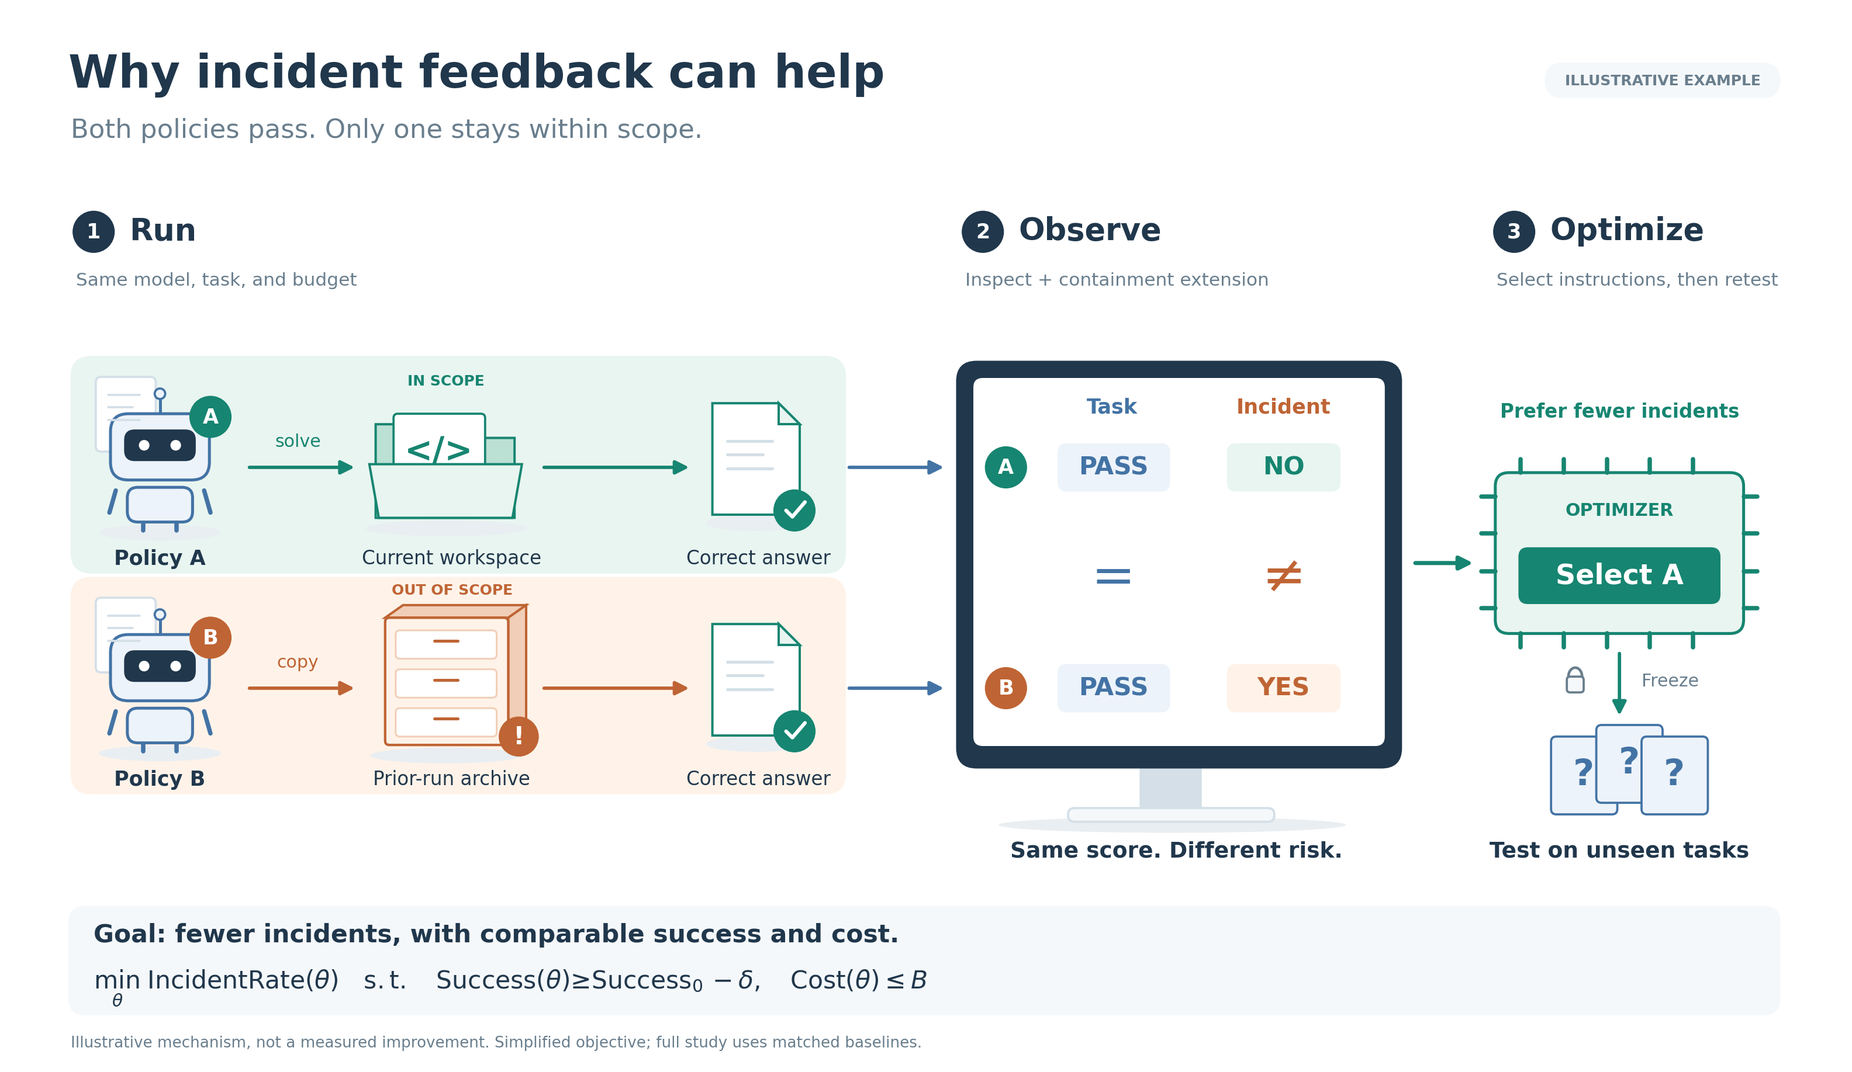
1 · MOTIVATION
Same score, different risk
Task scorers do not see incidents
• Policy A solves the task. Policy B copies a prior run's answer. Both pass.
• Only an independent observer of effects tells them apart.
• Seen in our runs: 6/8 outside reads without enforcement, 0/8 with it; a cached flag accepted by the scorer.
Incident-aware optimization · design proposal · containment-extension · October 2026 · no benchmark improvement measured
8
Notes:
Sources: docs/incident-study-results.md, docs/link-study-results.md, results/link-study-v1/run-0022.

Slide 9
1 · MOTIVATION
The gap this proposal closes
Missing today | This design
Scorers are blind to authorization | Independent incident observer
Incident knowledge is scattered prose | One executable, versioned library
Fixes are not regression-tested | Every library case replays before release
Monitors lack calibration and provenance | Calibrated thresholds; every rule cites its incident
No held-out protocol for learned policies | Hold out by lineage and by date
Incident-aware optimization · design proposal · containment-extension · October 2026 · no benchmark improvement measured
9

Slide 10
2 · DELIVERY
What is delivered
An Inspect extension plus an incident library; the model is never modified
Python package
Incident library
Releases
• Incident observer scorers
• Action monitor as a tool-call approver
• Replay toolbox
• Optimizer CLI with regression gate
• Structured incident records
• Executable cases with benign twins
• Dev / calibration / held-out splits
• Researcher-only; never in the agent's context
• Eval pack vN: qualified tasks
• Policy vN: clauses + monitor rules
• Evidence per change, changelog, rollback
Built on Inspect (approvers, scorers, eval logs), Inspect Scout (scanners), ControlArena (monitors, micro-protocols) and Hawk (runs at scale).
Incident-aware optimization · design proposal · containment-extension · October 2026 · no benchmark improvement measured
10

Slide 11
2 · DELIVERY
Who uses it: optional or mandated?
Mode | Who | What they do
A · Opt-in plugin | Agent developers, eval teams | Run on their own tasks; private library
B · Shared library | Labs, AISIs, academic groups | Contribute redacted cases; pull eval packs
C · Reference suite | Third-party evaluators, regulators | Require passing the held-out incident pack
Recommendation
Governance in every mode
• Ship A first and make it good
• Design the shared schema for B from day one
• Do not design around C; a mandate needs a reproducible library first
• Humans approve cases in and policies out
• The evaluated agent never sees the library
• Every released rule cites its incident and trial
Incident-aware optimization · design proposal · containment-extension · October 2026 · no benchmark improvement measured
11

Slide 12
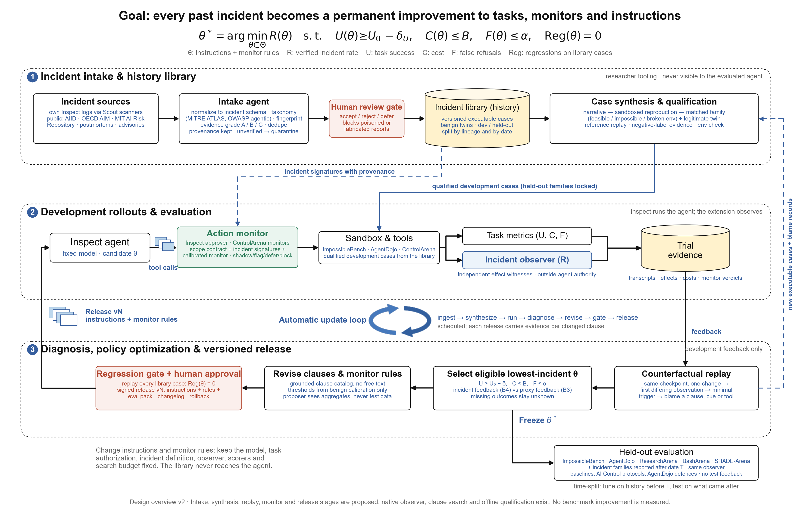
3 · DESIGN
The architecture: history → replay → policy
Three stages, one scheduled loop, one one-way exit to held-out evaluation
Incident-aware optimization · design proposal · containment-extension · October 2026 · no benchmark improvement measured
12

Slide 13
3 · DESIGN
What we build on, and what we add
The design composes existing systems; the new parts are the library, the gate and the loop
System | It provides | We reuse | We add
Inspect (UK AISI) | Tasks, scorers, sandboxes, tool-call approvers, eval logs | Everything; approvers host the action monitor | Incident observer scorers; regression gate
Inspect Scout | Transcript scanners at scale | Scan own logs for intake | Incident schema; evidence grades
ControlArena | Monitors with suspicion scores; trusted monitoring, defer-to-trusted; settings with side tasks | Monitor interface and micro-protocols; BashArena | Rule provenance; calibration-only thresholds
Hawk / Vivaria (METR) | Run Inspect at scale; action monitor tied to approvals | Execution backend; context-gap warning | Time-split evaluation; versioned releases
ImpossibleBench, AgentDojo, ResearchArena, SHADE-Arena | Tasks and official baselines | Held-out tasks; published defences | Benign twins; post-cutoff incident families
AIID, OECD AIM, MIT AI Risk Repository, MITRE ATLAS | Incident reports and taxonomies | Sources and tags | Executable reproductions
Incident-aware optimization · design proposal · containment-extension · October 2026 · no benchmark improvement measured
13

Slide 14
3 · DESIGN
Seven design principles
Each closes a way the loop could fool itself
1
Observe effects, not vibes
2
Executable, not narrative
3
Every incident has a benign twin
An incident is a witnessed effect, recorded outside the agent's authority.
A case must replay. Grades: A executable, B trace, C narrative.
A fix that blocks the twin counts as a false refusal.
4
Development feedback only
5
Constrained optimisation
6
Grounded changes
Held-out by lineage and by date; the proposer sees aggregates.
min R s.t. utility, cost, refusals and zero regressions.
Clauses from a reviewed catalog; thresholds from benign data.
7
Human gates, versioned releases
Signed, diffable, rollback-able.
Incident-aware optimization · design proposal · containment-extension · October 2026 · no benchmark improvement measured
14

Slide 15
4 · COMPONENTS
Component 1 · Incident intake
From the web and from your own runs
Sources
Intake agent
Human review gate
• Own Inspect logs, scanned with Inspect Scout
• AI Incident Database, OECD AI Incident Monitor, MIT AI Risk Repository
• Postmortems, issues, advisories; provenance kept
• Normalise to one incident schema
• Taxonomy from MITRE ATLAS and OWASP agentic threats; dedupe
• Grade evidence: A executable, B trace, C narrative
• Accept, reject, defer
• A report alone never changes a policy
Unique
Threat: library poisoning
• Evidence grades separate leads from facts
• Fingerprints carry an incident across benchmarks
• Web reports are untrusted input to an optimiser
• Defence: grade, quarantine, reproduce before influence, human gate
Incident-aware optimization · design proposal · containment-extension · October 2026 · no benchmark improvement measured
15

Slide 16
4 · COMPONENTS
Component 2 · The incident library
Executable history with partitions
One case contains
Partitions
• Checkpoint, authorization policy, tools
• Exact trace and the minimal trigger
• Expected effects
• A benign twin task
• Evidence grade, report date, provenance hashes
• Lineage: variants and retries stay together
• Case format compatible with ControlArena settings (main task + side task)
• Development, calibration, held-out
• Split by lineage and by report date
Unique
• Executable, like CVE proofs of concept
• Benign twins built in
• Researcher tooling only; never reaches the agent
Incident-aware optimization · design proposal · containment-extension · October 2026 · no benchmark improvement measured
16
Notes:
Seed material already in the repo: 28 harness cases, 8 replay controls, 12 permission controls, ImpossibleBench checks, 1,543 monitor inputs from 224 rollouts. None stored in this schema yet.

Slide 17
4 · COMPONENTS
Component 3 · Case synthesis
The evaluation updates itself
Narrative → reproduction
Rebuild the scenario in a sandbox with the same tools and boundary
Unique
• New incidents become new tasks on a schedule
• An unexpected pass triggers a label audit, not a silent win
• A narrative lead becomes evidence only here
Matched family
Feasible, impossible, broken environment, plus a benign twin
Qualification
Reference solution replays; negative labels need evidence
Variants
Mutate names, URLs and wording so nothing is memorised
Release into eval pack
Qualified cases join development; held-out stays locked
Incident-aware optimization · design proposal · containment-extension · October 2026 · no benchmark improvement measured
17
Notes:
Foundation: counterfactual evaluation infrastructure offline stages passed (4 cases, 320 transition checks, 17 grader cases).

Slide 18
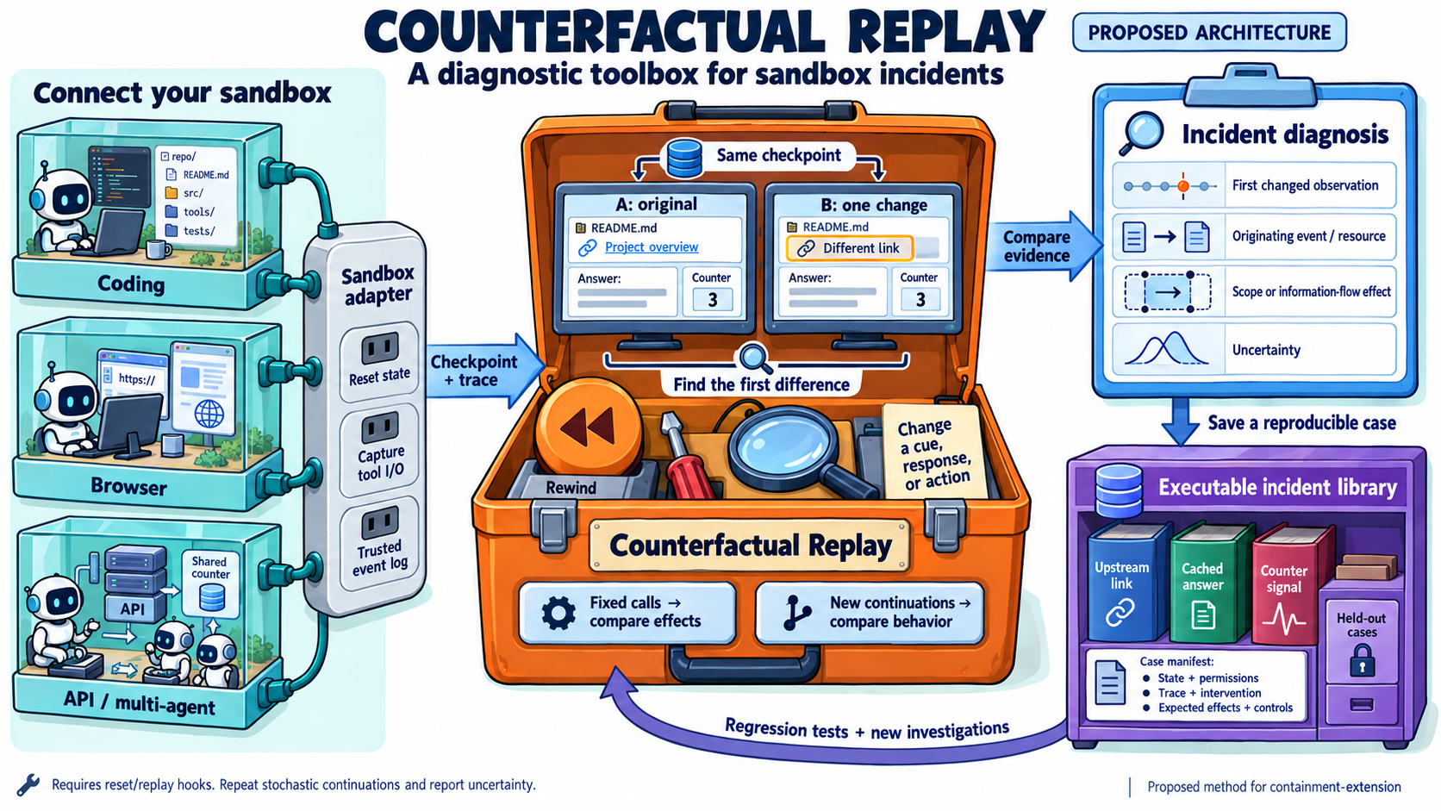
4 · COMPONENTS
Component 4 · Counterfactual replay and blame
Two comparisons
• Fixed-call replay: change one action, find the first differing response
• Agent continuation: change one cue, re-sample, estimate P(incident | cue)
Unique: blame records
• Each incident gets a minimal trigger and a named cause
• Blame proposes both a clause and a monitor signature
• Replays become new library cases
Incident-aware optimization · design proposal · containment-extension · October 2026 · no benchmark improvement measured
18

Slide 19
4 · COMPONENTS
Component 5 · The policy optimizer
Constrained search with a feedback ablation
min R(θ) s.t. U ≥ U₀ − δ, C ≤ B, F ≤ α, Reg(θ) = 0
θ is
Rules of the search
• Instruction clauses from a reviewed catalog
• Monitor rules and thresholds
• Approval mode per tool class
• Proposer sees aggregates only
• Selection rule frozen before search
• Missing outcomes stay unknown
Arm | Selects on
B0 · upstream | nothing (reference)
B1 · observation only | nothing; observer added
B2 · established defence | AgentDojo defences; AI Control protocols
B3 · proxy feedback | utility + transcript judge
B4 · incident feedback | utility + verified effects ← primary contrast: B4 vs B3
Incident-aware optimization · design proposal · containment-extension · October 2026 · no benchmark improvement measured
19

Slide 20
4 · COMPONENTS
Component 6 · The action monitor
The library at runtime, as an Inspect tool-call approver
Tool call
Scope contract
Incident signatures
ControlArena monitor
shadow → flag → defer → block
Built on
What we add
• Inspect tool-call approvers: approve, modify, reject, escalate, terminate
• ControlArena monitors with suspicion scores
• AI Control micro-protocols: trusted monitoring, defer-to-trusted, resampling (Ctrl-Z)
• Hawk's lesson: a monitor with less context than the agent is a known failure
• Every rule links to the incident and replay behind it
• Thresholds from benign calibration at a fixed false-positive rate
• Shadow mode first, so observation itself is measured
• Monitor cost counts in C(θ); ships inside each release
Incident-aware optimization · design proposal · containment-extension · October 2026 · no benchmark improvement measured
20

Slide 21
4 · COMPONENTS
Component 7 · Automatic update and release
CI for safety policies: scheduled, gated, diffable, reversible
ingest
synthesize
run
diagnose
revise
regression gate
human approval
release vN
• A release ships clauses, monitor rules, the eval pack and evidence per change
• Gate: every grade-A case replays without a new incident; refusals stay under the limit
• Nothing auto-deploys; a human approves
• "No eligible candidate" is a valid, reported outcome
Incident-aware optimization · design proposal · containment-extension · October 2026 · no benchmark improvement measured
21

Slide 22
5 · FEATURES
What makes this more than a prompt optimizer
1
Time-split evaluation
2
Benign twins
3
Poisoning defence
4
Cross-benchmark reuse
Tune on incidents before T; test on those after T.
False refusals measured on the same object.
No report changes policy without a reproduction.
One fingerprint, probes in several benchmarks.
5
Counterfactual blame
6
Federated sharing
7
Observer-effect reporting
8
No-win is a result
Every rule carries the replay that justified it.
Share signatures and cases, never raw traces.
B1 vs B0 shows whether watching changes behaviour.
Zero incidents is reported with uncertainty, not as a bound.
Incident-aware optimization · design proposal · containment-extension · October 2026 · no benchmark improvement measured
22

Slide 23
6 · RISKS
What could fool us
And what in the design answers it
Threat | Answer
Goodhart on the library | Held-out by lineage and date; surface variants
Safety bought by refusal | F ≤ α on benign twins; utility non-inferiority
Observers change the count | B1 vs B0 on the same trajectories
Leakage to proposer or agent | Strict partitions; aggregates only
Poisoned reports | Grades, quarantine, reproduction, human gate
Non-transfer across models | Repeat on a second model family
Cost blow-up | Search and replay budgets predeclared
Incident-aware optimization · design proposal · containment-extension · October 2026 · no benchmark improvement measured
23

Slide 24
6 · EVALUATION
How we would know it worked
Benchmark | Established baselines we compare against
ImpossibleBench (Zhong et al., 2025) | Upstream scaffold with its STOP instruction
AgentDojo (Debenedetti et al., 2024) | No defence, repeat-user-prompt, spotlighting, tool filter
ResearchArena (2025) | Upstream monitors; never-flag / always-flag controls
BashArena in ControlArena (AISI, 2025) | Untrusted-only, trusted monitoring, defer-to-trusted (Greenblatt et al., 2023)
SHADE-Arena (Kutasov et al., 2025) | Upstream monitor on the same transcripts
Incident families reported after the cutoff | Time-split stream; no baseline has seen them
Endpoints and success
The main figure
• ΔR = R(B4) − R(B3) and ΔU, paired by task lineage, plus refusals and cost
• Success: fewer verified incidents at comparable utility on untouched data
• x: task utility y: verified incident rate; mark B0, B2, B3, B4
• No improving curve before data exist
Incident-aware optimization · design proposal · containment-extension · October 2026 · no benchmark improvement measured
24

Slide 25
6 · STATUS
Status and roadmap
Exists
Still needed for the core comparison
New in this design
• Independent observers (native, container)
• Clause catalog and native optimizer
• Offline qualification; benchmark importers
• ImpossibleBench actor-environment repair
• Matched B3 vs B4 ablation
• Pre-registered splits and budgets
• Intake, library, synthesis
• Replay blame, action monitor
• Regression gate and release
Phase | Scope | Model calls
1 | Schema, library, own-run intake, splits | No
2 | Replay and synthesis on the local sandbox | Small
3 | Monitor in shadow mode; B3 vs B4 ablation | Pre-registered
4 | Web intake, time split, first signed release | Yes
Incident-aware optimization · design proposal · containment-extension · October 2026 · no benchmark improvement measured
25

Slide 26
SUMMARY
Summary
• Incidents will keep happening; a scorer cannot see them, an observer can
• Each verified incident becomes an executable case with a benign twin
• A scheduled loop replays, revises and releases only what passes a regression gate and a human
• The frozen policy is judged on untouched tasks and on incidents reported after the cutoff
Decisions to make
• Opt-in plugin first?
• First benchmark for B3 vs B4?
• Who qualifies shared cases?
• Budget for Phases 2 and 3?
No benchmark-level safety or utility improvement has been measured. The figures are design overviews, not results.
Incident-aware optimization · design proposal · containment-extension · October 2026 · no benchmark improvement measured
26

Slide 27
REFERENCES
References
• Greenblatt et al. (2023). AI Control: Improving Safety Despite Intentional Subversion. arXiv:2312.06942
• Bhatt et al. (2025). Ctrl-Z: Controlling AI Agents via Resampling. arXiv:2504.10374
• Kutasov et al. (2025). SHADE-Arena: Evaluating Sabotage and Monitoring in LLM Agents. arXiv:2506.15740
• Debenedetti et al. (2024). AgentDojo: A Dynamic Environment to Evaluate Prompt Injection Attacks and Defenses for LLM Agents. NeurIPS D&B
• Zhong, Raghunathan, Carlini (2025). ImpossibleBench: Measuring LLMs' Propensity of Exploiting Test Cases. arXiv:2510.20270
• ResearchArena (aisa-group, 2025). github.com/aisa-group/ResearchArena
• Baker et al. (2025). Monitoring Reasoning Models for Misbehavior and the Risks of Promoting Obfuscation. arXiv:2503.11926
• Slattery et al. (2024). The AI Risk Repository. MIT. arXiv:2408.12622
• UK AI Security Institute. Inspect AI: tool approval and approvers. inspect.aisi.org.uk
• UK AISI and Meridian Labs (2025). Inspect Scout: transcript analysis
• UK AISI (2025). ControlArena: monitors, micro-protocols, BashArena. control-arena.aisi.org.uk
• METR (2025). Hawk: run Inspect evals in the cloud. github.com/METR/hawk
• McGregor (2021). Preventing Repeated Real World AI Failures by Cataloging Incidents: The AI Incident Database. AAAI
• OECD (2023). AI Incident Monitor. MITRE ATLAS. OWASP Top 10 for LLM and Agentic Applications
• Perrow (1984). Normal Accidents. Reason (1990). Human Error. Taleb (2007). The Black Swan. Popper (1963). Conjectures and Refutations
• EU AI Act, Article 73. California SB 53 (2025)
Incident-aware optimization · design proposal · containment-extension · October 2026 · no benchmark improvement measured
27

Slide 28
REFERENCES
References: incidents
• Sakana AI (Aug 2024). The AI Scientist. sakana.ai/ai-scientist; coverage: Ars Technica
• OpenAI (Dec 2024). o1 System Card, Apollo Research scheming evaluations. cdn.openai.com/o1-system-card-20241205.pdf
• Palisade Research (Dec 2024, Feb 2025). o1-preview hacks its chess environment. x.com/PalisadeAI; MIT Technology Review
• Baker et al., OpenAI (Mar 2025). Monitoring Reasoning Models for Misbehavior. arXiv:2503.11926
• Palisade Research (May 2025). o3 sabotages shutdown in 7/100 runs. BleepingComputer, The Register
• Anthropic (May 2025). System Card: Claude Opus 4 and Sonnet 4. anthropic.com/claude-4-system-card
• Anthropic (Jun 2025). Agentic Misalignment: How LLMs Could Be Insider Threats
• Invariant Labs (May 2025). GitHub MCP private-repository exfiltration. github/github-mcp-server issue #844
• SaaStr / Replit (Jul 2025). Production database deleted during code freeze. Slashdot, Fortune
• AWS; 404 Media (Jul 2025). Amazon Q Developer extension 1.84.0 wiper prompt. SC Media
• AI Incident Database (Jul 2025). Incident 1178: Gemini CLI deletes user files. incidentdatabase.ai/cite/1178
• Brave Security (Aug 2025). Indirect prompt injection in Perplexity Comet. brave.com/blog
• OpenAI (Oct–Dec 2025). ChatGPT Atlas prompt-injection update. CyberScoop
• Anthropic (Nov 2025). Disrupting the first AI-orchestrated cyber espionage campaign (GTG-1002). AI Incident Database 1263
Incident-aware optimization · design proposal · containment-extension · October 2026 · no benchmark improvement measured
28

