Slide 1

SIGIR 2017, Tokyo
LoSHa: A General Framework for Scalable Locality Sensitive Hashing
Jinfeng Li, James Cheng, Fan Yang, Yuzhen Huang, Yunjian Zhao, Xiao Yan, Ruihao Zhao

Slide 2
Motivation
Many types of real-world data are represented as high-dimensional vectors
Texts, images, audios, DNA sequences, …
Similarity search on high-dimensional data is a fundamental problem
De-duplication
Similar item retrieval
Entity resolution
Sequence matching
…

Slide 3
Motivation
LSH is a well-recognized solution with guaranteed performance
Remove the curse of dimensionality effectively
Provide sublinear or even constant query complexity
Guarantee the quality of retrieved results

Slide 4
Motivation
There are many LSH algorithms
Distance metrics
Memory constraints
Efficiency constraints
Processing LSH workloads with distributed systems become necessary
Large-scale datasets
Concurrent queries
Quick implementations
Notes:
LSH algorithms: work for different scenarios, exhibit different tradeoffs
Datasets: cannot fit into memory of single machine
of various LSH algorithms
Concurrent queries: require low latency
Different LSH Suit for different application scenas

Slide 5
Motivation
Existing systems are not dedicated for LSH workloads
Unsatisfactory performance
Programming operators are not specifically optimized for LSH workloads
High development cost
There are no dedicated programming interfaces for LSH workloads and users have to do the translation
Users have to optimize executions by themselves
Notes:
Design the DAG, Meanwhile, optimize the executions

Slide 6
Motivation
Our solution: LoSHa
Reduces the development cost by designing a tailor-made, general programming interface
Achieves high performance by exploring LSH-specific system implementations and optimizations

Slide 7
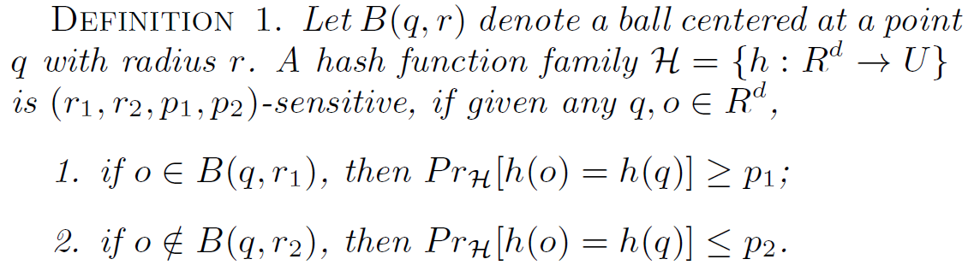
Preliminaries
In the preprocessing, items will be hashed corresponding buckets
In the querying, queries will be sent to corresponding buckets to probe.

Slide 8
LoSHa framework
Queries
Item
In pre-processing, item instances are created
Id of each item will be sent to associated buckets
Bucket
Item ids and signatures will trigger the creation of buckets instances
Query
Query instances are created
q1
q2
q3
query
answer
Items
Buckets
i1
i2
i3
b1
b2
mapping

Slide 9
Programming interface
A program subclasses Query and Item classes
Execution logic is defined in two virtual functions, i.e. query and answer
Query processing is iterative functional calls to query, mapping, and answer
Queries
q1
q2
q3
query
answer
Items
Buckets
i1
i2
i3
b1
b2
mapping

Slide 10
Programming - Factory
For different hash functions with regard to distance metrics
Three key functions
calDist: return the distance of two points
calProjs: return actual projected hash values
calSigs: return L signatures

Slide 11
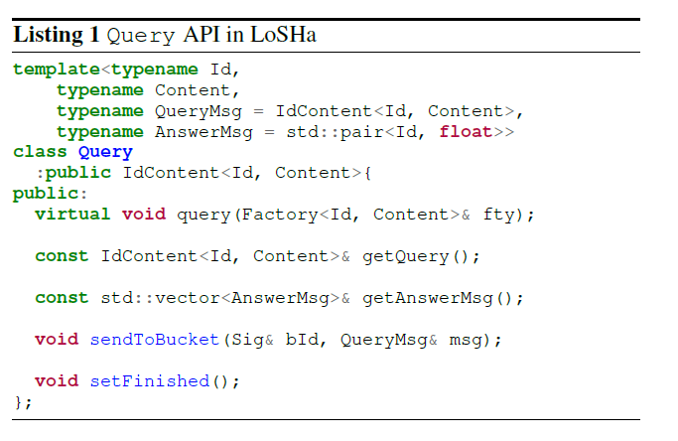
Programming - Query

Slide 12
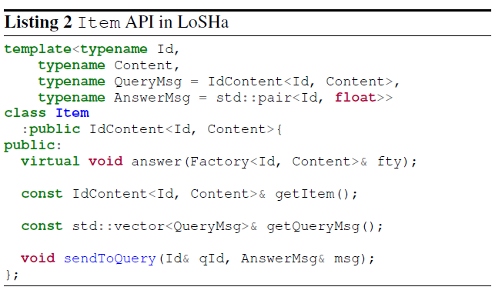
Programming - Item

Slide 13
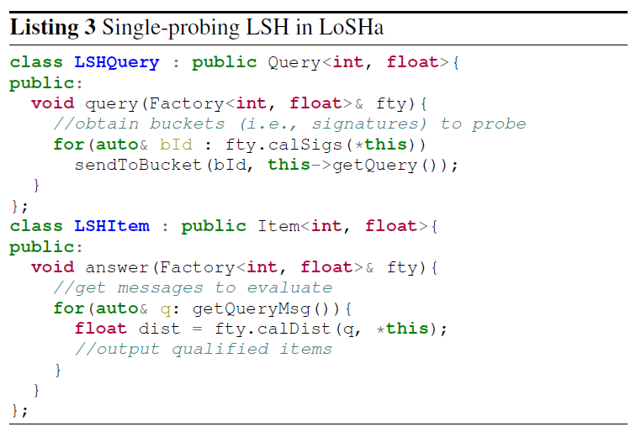
App: single-probing LSH

Slide 14
Support of state-of-the-art algorithms
Conventional single-probing LSHs
One-bucket-per-table probing
Can not guarantee to return answers
Require tens or even hundreds of hash tables that exhaust the memory
Recent multi-probing LSHs (e.g. Multi-probe LSH, Hamming Ranking and C2LSH)
Multiple-buckets-per-table probing
Effectively return answers
Require less hash tables (e.g. about 10 times)
Notes:
As a tradeoff, the implementation becomes much more complicated, let us see how LoSHa reduces the development cost

Slide 15
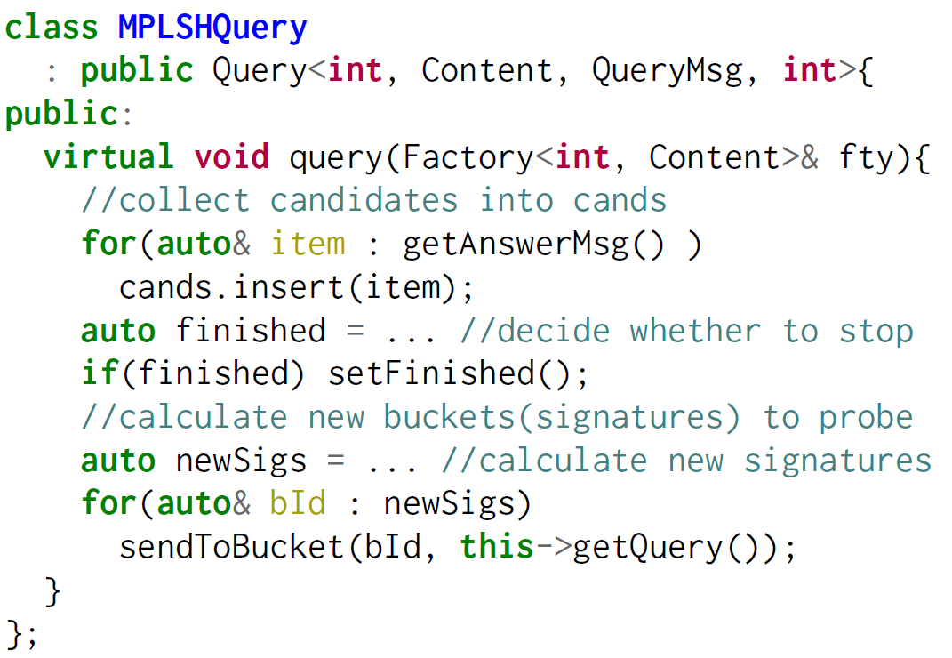
Programming – Multi-probing LSH

Slide 16
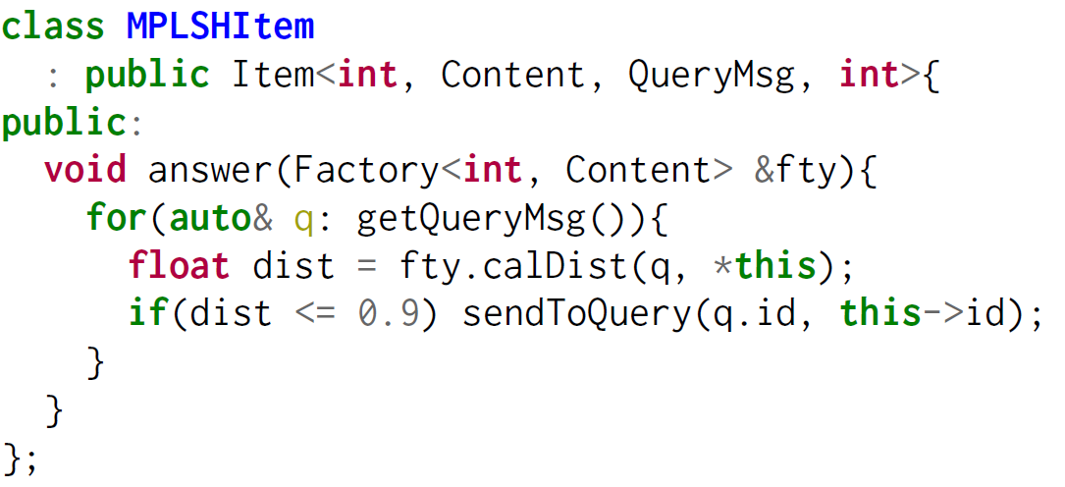
Programming – Multi-probing LSH

Slide 17
Optimizations
Message Reduction
Broadcast query content
The content of a query can be directly retrieved in local machine
Message combiner
Query messages sent to multiple objects in the same machine can be combined to one message
Notes:
When an item calculates the distance to a received query, the content of that query can be directly retrieved in local machine
Avoid attach query content in the query messages
Significant reduce the communication cost especially for multi-probing LSH
If query messages sent to multiple objects in the same worker are the same, only one query message will be sent
Effective when many hash tables are deployed

Slide 18
Optimizations
De-duplication
Item-side de-duplication
Avoid duplicate evaluations
Require more memory
Suitable for dense vector
Query-side de-duplication
Cannot avoid neither duplicate evaluations
Require less memory
Suitable for sparse vector
Notes:
For multi-probing LSH algorithms, an item may be revisited more than once by the same query, especially when L is large. LoSHa handles de-duplication flexibaly

Slide 19
Evaluations
Experimental settings
20 machines
1G network adapter
48G memory
Datasets
For each dataset, we sample 1000 items as queries
 | Item# | Dim# | Entry#
SIFT1B | 1,000,000,000 | 128 | 128
Tweets1B | 1,050,000,000 | 500,000 | Avg 7.5
Glove2.2M | 2,196,017 | 300 | 300

Slide 20
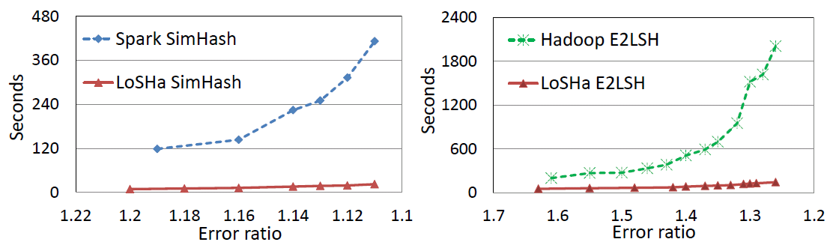
Comparison with LSH on Spark/Hadoop
Spark v.s QLSH
Hadoop v.s. QLSH
Smaller error ratio means higher quality of returned results
Notes:
We take open-source Spark/Hadoop implementations, without dedicated operators and optimizations

Slide 21
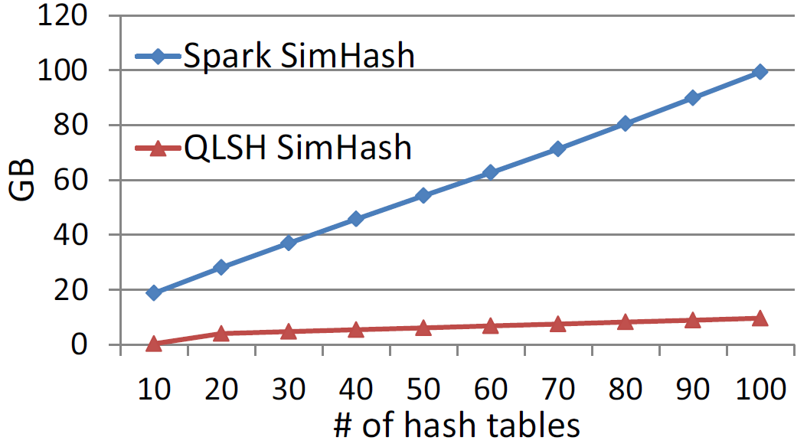
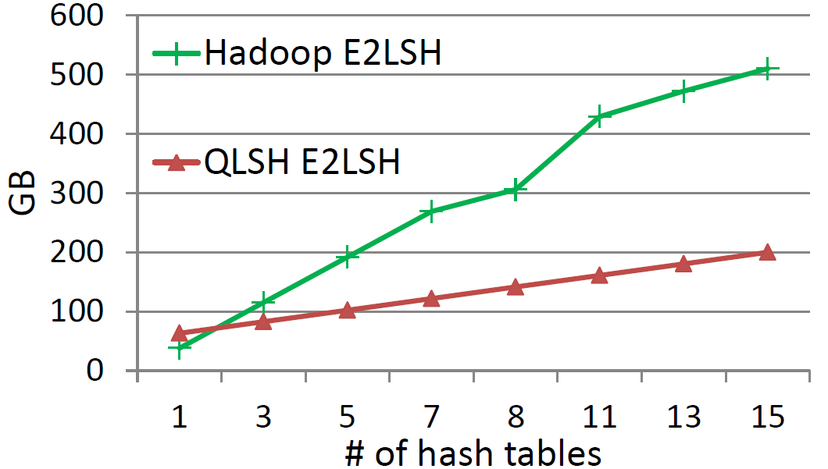
Network traffic
Spark v.s QLSH
Hadoop v.s. QLSH

Slide 22
Support of multi-probing LSH
PLSH
Fastest implementation of SimHash
A single-probing LSH algorithm for Angular distance
Similarity search over 1 billion tweets of a high recall (i.e. 86%)
Deploy 780 hash tables
Require 100 machines with totally 6.4TB memory
Notes:
6.4 TB memory is a big budget of the company
Not applicable to small cluster of tens of machines

Slide 23
Support of multi-probing LSH
SimHash on LoSHa
Support maximum 55 hash tables due to memory insufficiency (0.96TB in our cluster, much less than 6.4TB required by PLSH)
Achieve a recall of 27.4% (far away from 86%)
Multi-probing SimHash on LoSHa
Probe multiple buckets inside each hash table
Improve the recall from 27.4% to 86.8%

Slide 24
Support of multi-probing LSH
Average querying time
Development cost
About 200 lines of code
No need to handle distributed executions as PLSH does
Notes:
Although multiple-probing LSH can save memory, distribtued implementation is much more complicated
200 lines of code

