Slide 1

SIGMOD 2018, Houston
A General and Efficient Querying Method for Learning to Hash
Jinfeng Li, Xiao Yan, Jian Zhang, An Xu, James Cheng, Jie Liu, Kelvin Ng, Ti-Chung Cheng

Slide 2
Similarity Search
Many types of real-world data are represented as high-dimensional vectors
Texts, images, audios, artificial neurons, DNA sequences, …
Similarity search on high-dimensional data has extensive applications
Recommendation
Neural network dropout
Entity resolution
Multi-class prediction
…

Slide 3
Learning to Hash for Similarity Search
Hashing based similarity search is a well-recognized solution due to sublinear query complexity
Learning to Hash tailors hash functions to a given dataset
Unsupervised Hashing
Supervised Hashing
Online Hashing
Distributed Hashing
Deep Hashing
…

Slide 4
Learning to Hash - Key Operations
Projection
Projects an item to an low-dimensional vector of real numbers
Quantization
Discretizes the projected vector into a binary code by thresholding
Items similar in the original space tend to have similar binary codes (within small hamming distance)
0.3
0.1
O3
O2
-0.1
O1
0
h

Slide 5



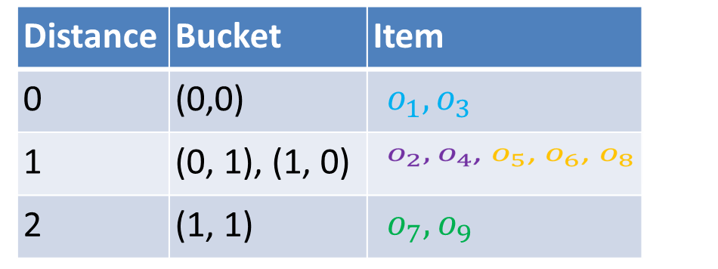







Querying by Hamming Ranking
Items with the same binary code are organized into the same bucket
A query probes buckets with smaller hamming distance first
(0, 1)
(1, 1)
(0, 0)
(1, 0)
Notes:
LSH algorithms: work for different scenarios, exhibit different tradeoffs
Datasets: cannot fit into memory of single machine
of various LSH algorithms
Concurrent queries: require low latency
Different LSH Suit for different application scenas

Slide 6

Problem of Hamming Ranking
Hamming distance is too coarse-grained
Bucket (0, 1) and (1, 0) have the same hamming distance 1 to the query $q_{1}$
(0, 1)
(1, 1)
(0, 0)
(1, 0)

Slide 7

Quantization Distance (QD)
Quantization losses some similarity information
Quantization Distance
$dist\left(q, b\right)= \sum_{i=1}^{m}{\left(c_{i}\left(q\right)⨁b_{i}\right)∗|p_{i}(q)|}$
(0, 1)
(1, 1)
Bucket | HD | QD
(0, 0) | 0 | 0
(1, 0) | 1 | 0.2
(0, 1) | 1 | 0.8
(1, 1) | 2 | 1
(0.2, 0.8)
(0, 0)
(1, 0)

Slide 8
Generate-to-probe Algorithm
Ranking many buckets by Quantization Distance is expensive
A query generates buckets to probe
Buckets are generated in ascending order of their quantization distances to the query
Querying stops after probing a few buckets

Slide 9
Experiments – Accuracy
PCAH on Tiny5M dataset (left) and SIFT10M dataset(right)

Slide 10
Experiments – Efficiency
PCAH on Tiny5M (left) and SIFT10M(right)

Slide 11
Experiments – Benefits to Other algorithms
Iterative Quantization Hashing (ITQ) on Tiny5M (left) and SIFT10M(right)

Slide 12
Experiments – Benefits to Other algorithms
Spectral Hashing (SH) on Tiny5M (left) and SIFT10M(right)

Slide 13
Summary
Quantization Distance
Generate-to-probe algorithm
GQR is able to improves the performance of various learning to hash algorithms
No extra overhead to the learning process

Slide 14


More
GQR is open-source in Github
Support different learning to hash algorithms (e.g. ITQ, PCAH, SH, Sperical Hashing, Kmeans Hashing, Isotropic Hashing,…)
Distributed GQR has been released on LoSHa (a distributed system for similarity search)
I am looking for a job in distributed computing systems or large-scale similarity search

