Slide 1

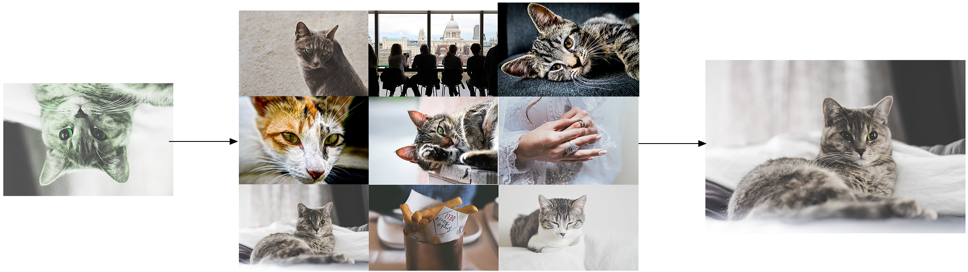
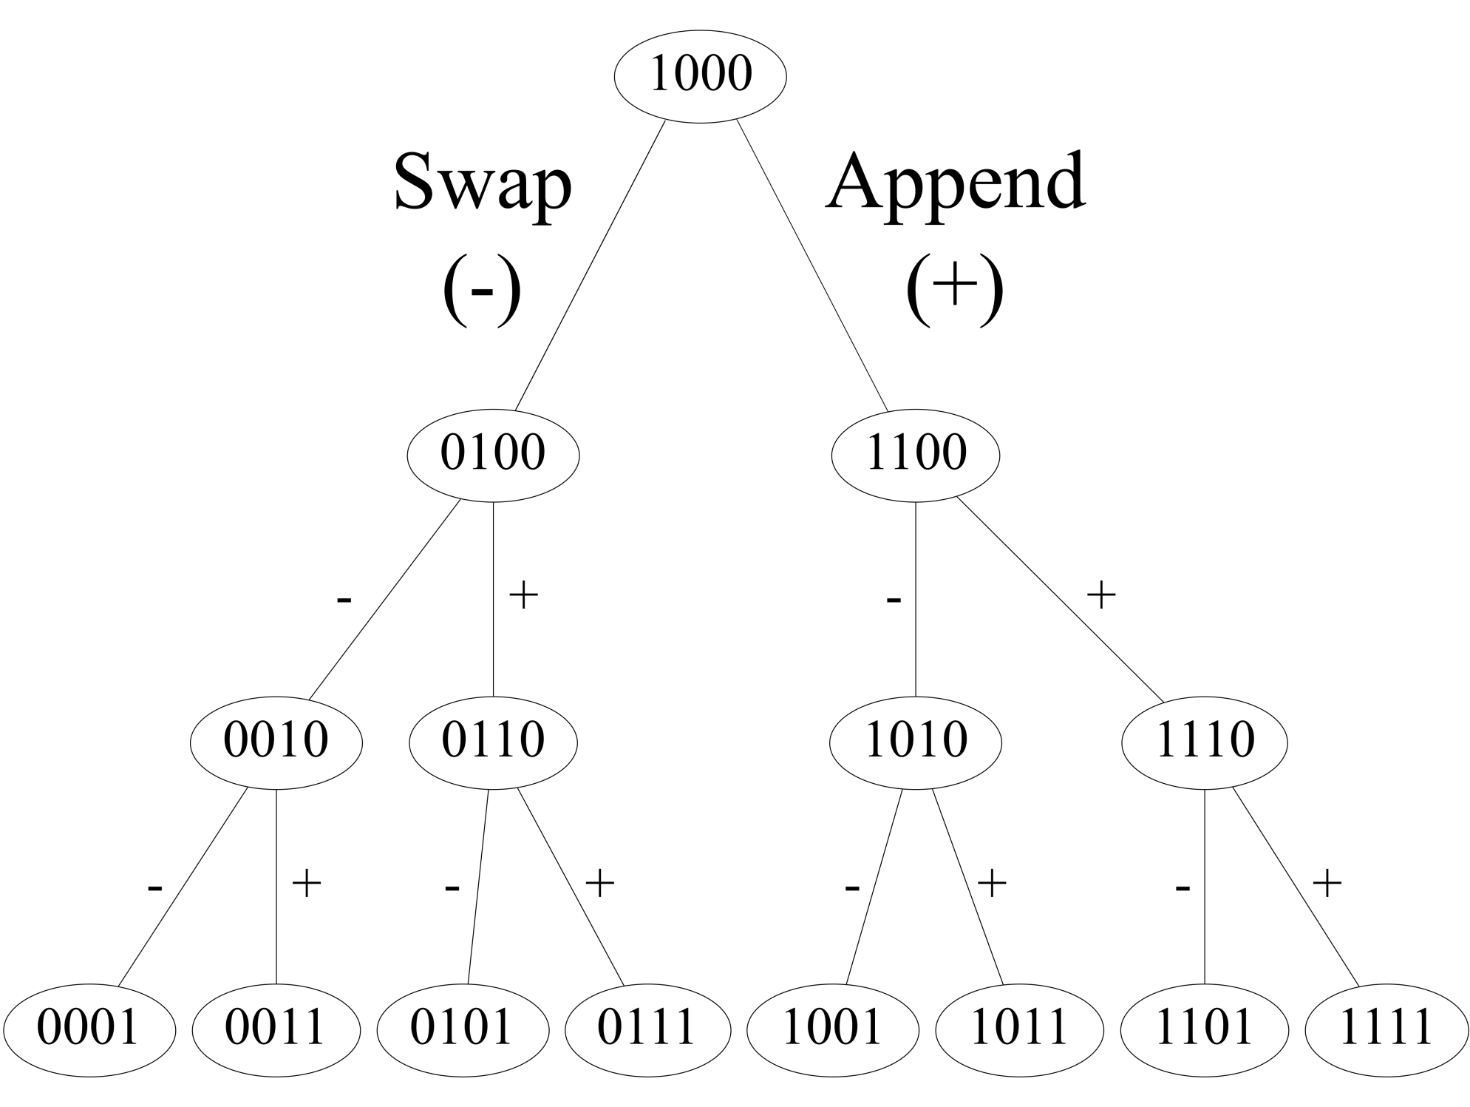



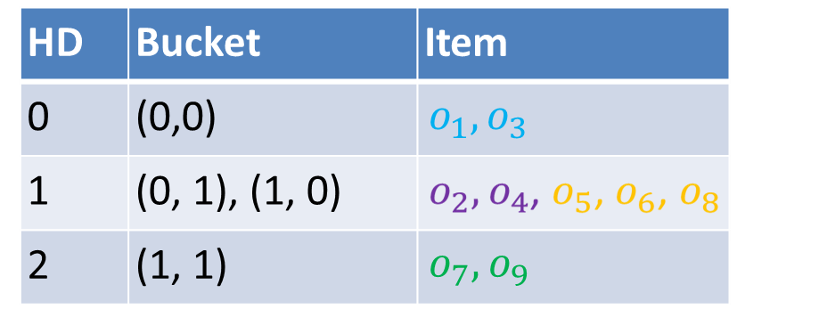










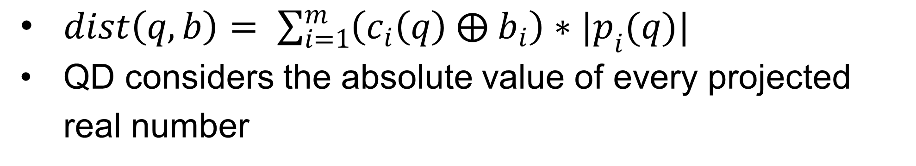

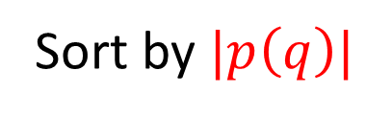
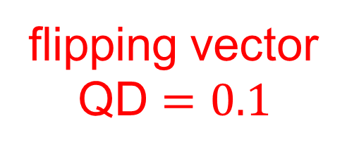


A General and Efficient Querying Method for Learning to Hash
Jinfeng Li, Xiao Yan, Jian Zhang, An Xu, James Cheng, Jie Liu, Kelvin Ng, Ti-Chung Cheng
Query Image
Retrieved Image
Learning to Hash for Similarity Search
Generate-to-probe Algorithm
Extensive applications
Image retrieval, Synonym, Entity resolution, Neural network dropout, Multi-class prediction, …
Numerous algorithms
Unsupervised hashing, Supervised hashing, Online hashing, Distributed hashing, Deep hashing, …
Ranking all the buckets by their quantization distances is expensive, thus a query generates buckets to probe by need.
Sort the elements inside a projected vector by their absolute values
$$c(q)$$
$$|p\left(q\right)|$$
$$c^{′}(q)$$
$$|p\left(q\right)|$$
flipping vector
QD $=0.1$
0
0.2
1
0.1
1
1
0.1
Sort by $|p\left(q\right)|$
0
0.2
$$⊕$$
0
Similar Items Map to Similar Binary Codes
0
0.5
1
0.3
0
Projection : hashes a high-dimensional data to a low-dimensional real number
1
0.3
0
0.5
0
0.3
Quantization: discretizes the projected number to a binary bit
0.1
O2
O3
Apply the flipping vectors organized as a tree to obtain buckets
-0.1
h
O1
0
Querying by Ranking Hamming Distance (HD)
Items with the same binary code are organized into the same bucket
A query probes buckets with smaller hamming distance first
Experiments
Improvements over PCAH on SIFT10M dataset
(0, 1)
(1, 1)
(0, 0)
(0.2, 0.8)
(1, 0)
Fine-grained Quantization Distance (QD)
Work for extensive Learning to Hash algorithms
$dist\left(q, b\right)= \sum_{i=1}^{m}{\left(c_{i}\left(q\right) ⨁{ b}_{i}\right)∗|p_{i}(q)|}$
QD considers the absolute value of every projected real number
Github Open-source Repository
ITQ, PCAH, SH, Kmeans Hashing, Spherical Hashing, Isotropic Hashing, …
Distributed implementation on LoSHa (a general system for similarity search)
Bucket | HD | QD
(0, 0) | 0 | 0
(1, 0) | 1 | 0.2
(0, 1) | 1 | 0.8
(1, 1) | 2 | 0.2 + 0.8
Jinfeng Li
jfli@cse.cuhk.edu.hk

