Slide 1
Construct species phylogenic tree for Saccharomyces sensu stricto using BUSCO genes
Jing Li
April 30
Notes:
Saccharomyces is yeast genus, since the genome is small. It’s widely used as a model to research on eukaryotic genome.
First, I will give a short introduction of the saccharomyces genus, and then talk about my project objectives. Then focus on my method, result and discussion.

Slide 2
Introduction
Saccharomyces sensu stricto:
S. cerevisiae
S. paradoxus
S. mikatae
S. kudriavzeii
S. arboricolus
S. uravum
S. bayanus
S. eubayanus
Notes:
Yeast is widely used in winemaking, baking, brewing, and other fermentation process.
There are many species in the Saccharomyces genus, and each species have many strains. Here, I find 8 species with good assembly genome in this genus.
The first one, S. cerevisiae, is the most famous species in the genus. It’s widely used for next gerneration sequencing and genome research, and it’s also the reference genome for other species assembly and annotation in this genus. The reference strain is S288C in this species.
S.Paradoxus is known as the most closest relative species to S. cerevisiae.
There are many hybridization events happened in this genus. S. bayanus is an example. Some paper said it’s a hybrid from S.uravum, S. eubayanus, and s. cerevisiae. But some only mention its from S.uravum and eubayanus. In this genus, the hybrid usually has chromosome loss, replacement, or rearrangement. So the genome sequence may be very different from their parents. We don’t know S.bayanus is more similar to which parent.

Slide 3
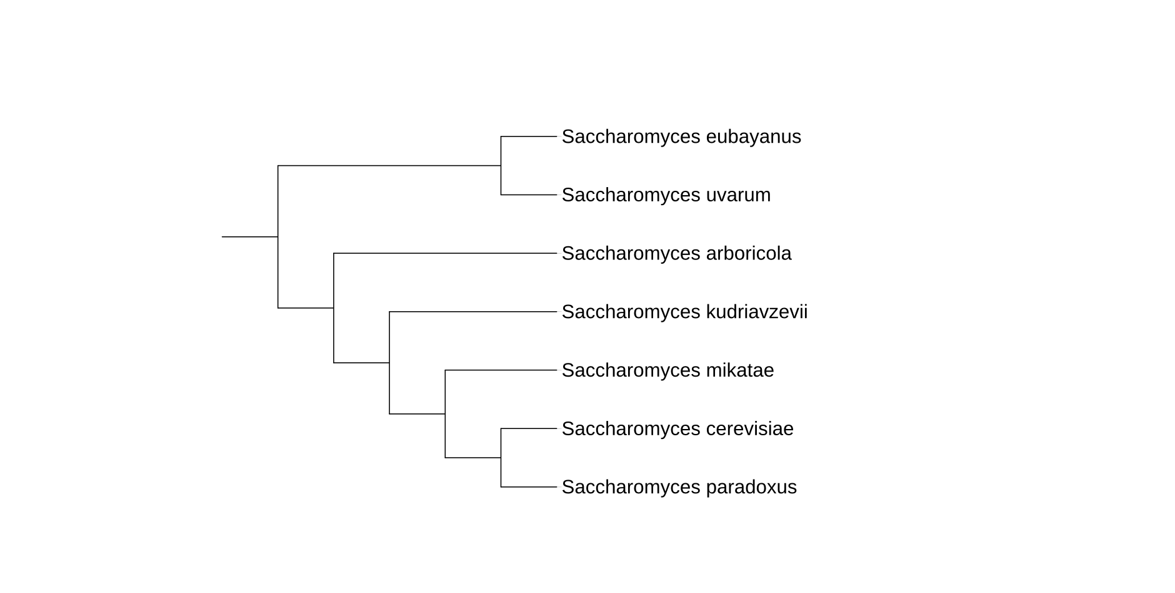
Introduction
Saccharomyces sensu stricto:
(Borneman et al., 2015)
Notes:
Here is the published phylogenic tree I found from most of Saccharomycces paper. There are 7 species, lack of S.bayanus. Since it’s a hybrid, I didn’t find any paper have phylogenic tree for all these 8 species. I only found some paper with S.bayanus in gene tree, and different gene has very different tree.

Slide 4
Objective
Construct a species phylogenic tree for 8 Saccharomyces species.
Compare our constructed tree with the published tree.
Determine S.bayanus is closed to which species
Notes:
Here, I have three objectives.

Slide 5
Method
DATA COLLECTION
Genome sequence from NCBI database
BUSCO orthologs dataset for Saccharomycetales from BUSCO web.
Notes:
The most important thing is data collection.
I collect all the genome sequence from NCBI database.
As we known, We cannot use the whole genome sequence to construct a phylogenic tree.
Normally we used gene to build a tree. But which gene we should choose?
If the genes we used are species specific gene or only in a small part of species, the result will be inaccurate.
So here, I use BUSCO to extract the ancient gene in Saccharomycetale family.
Here we download the ortholog dataset for Saccharomycetale family. If the genome assembly is perfect, the genome will include all the BUSCO gene. We can use these BUSCO gene to construct our phylogenic tree.

Slide 6
METHOD
BUSCO: Benchmarking Universal Single-Copy Orthologs
Assess genome assembly and annotation completeness
Provides all the ancient or common gene orthologs in a certain family.
Notes:
BUSCO is …
It’s a software to assess genome assembly and annotation completeness.
It provide all ancient or common gene orthologs in a certain family. For example, all ancient gene in plant or in animal. Using the whole genome sequence map to the ancient ortholog, to check how many ancient gene are missing in this genome, so that we can know whether the genome assembly is good or not.

Slide 7
METHOD
GENE ALIGNMENT
Multiple sequence alignment using protein sequence
MAFFT algorithm by Guidance
Notes:
Then, next step is gene alignment, We did multiple sequence alignment using protein sequence. Since protein sequence is much flexible than nucleotide sequence.
And using the MAFFT algorithm by Guidance.
This software provide three algorithm, prank, and clustalW I just choosethe default and common algorithm. Also the method we used in our lab.

Slide 8
METHOD
GENE TREE CONSTRUCTION
Construct gene trees for each antient gene
Maximum likelihood approach by RAxML
Bootstrap analysis with 100 replicate
JTT model for amino acid sequence
Notes:
Next, After get alignment for the BUSCO gene, I constructed gene trees for each antient gene.
Using the maximum likelihood approach in RAxML. I didn’t using the new version RAxML-NG we used for our lab, because yeast genome is small, and each gene is short, raxml is enough for my project.
I used bootdtrap analysis with 100 replication.
JTT model for amino acid sequence, this is the common and default model for protein sequence.

Slide 9
METHOD
SPECIES TREE CONSTRUCTION
Combine all the gene trees
Generate coalescent-based final species tree by ASTRAL
Notes:
The last step is to construct the species tree.
After getting the best scoring ML tree, I combined all the gene trees in one file, and then generate the final species tree by ASTRAL. It’s a software using the coalesent model to construct species tree.

Slide 10
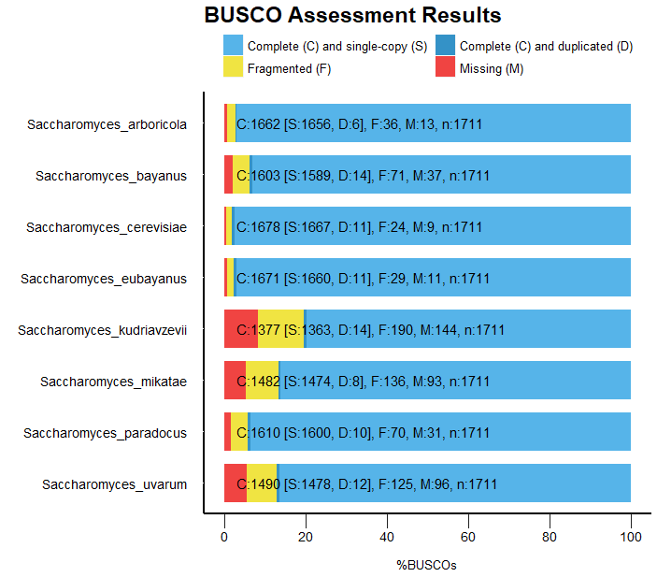
result
BUSCO RESULT
Figure 1. BUSCO analysis for eight genomes. The light blue bar means the proportion of genes with complete and single-copy sequence match to the antient Saccharomycetales genes. Dark blue bar means the proportion of genes with complete and duplicate-copy sequence. Yellow bar means the proportion of genes with fragmented sequence. Red bar means the proportion of antient genes missing in the species.
Notes:
Next section is the result.
Here is the BUSCO assessment result.
As I mention before, BUSCO is used to assess the genome assembly.
We can know how many ancient gene in the species genome.
The total number of ancient gene in the saccharomycetale family is 1711.
Blue….
All this genome are good assembly, with only a little missing genes, The best is eubayanus.

Slide 11
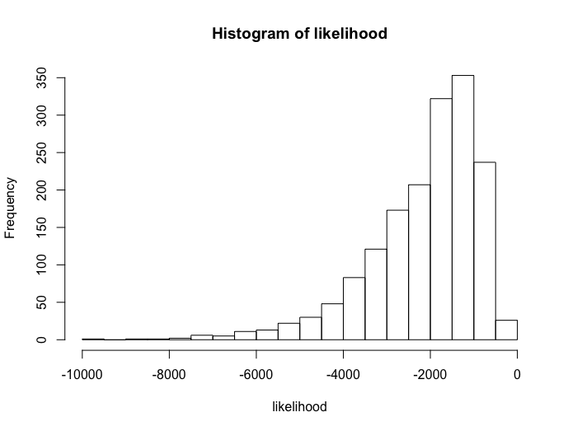
result
ML GENE TREE
Figure 2. Histogram of likelihood for 1,662 best scoring ML gene trees. X-axis is the likelihood of gene trees, y-axis is the frequency of the likelihood for every 500 breaks. The distribution is left-skewed.
Notes:
From the BUSCO result, 1662 genes are existing in at least two speciesm So we used these gene to construct ML trees. Here is the likelihood for these tree. From -9642 to -324. The distribution is left skewed, that’s mean most tree have high likelihood.
At the beginning, I think maybe the bad one is the tree with less species, but when I checking the tree, the bad some of the bad tree include 8 species, and some include 4 or 5 species, there is no obvious bias. And the good tree with high likelihood also include 8 species.

Slide 12
result
ML GENE TREE
1,223 antient gene trees with 8 species
38 different types of topological trees
Size from 470 to 1
Notes:
Since not every anient gene with all

Slide 13
ML GENE TREE

Slide 14
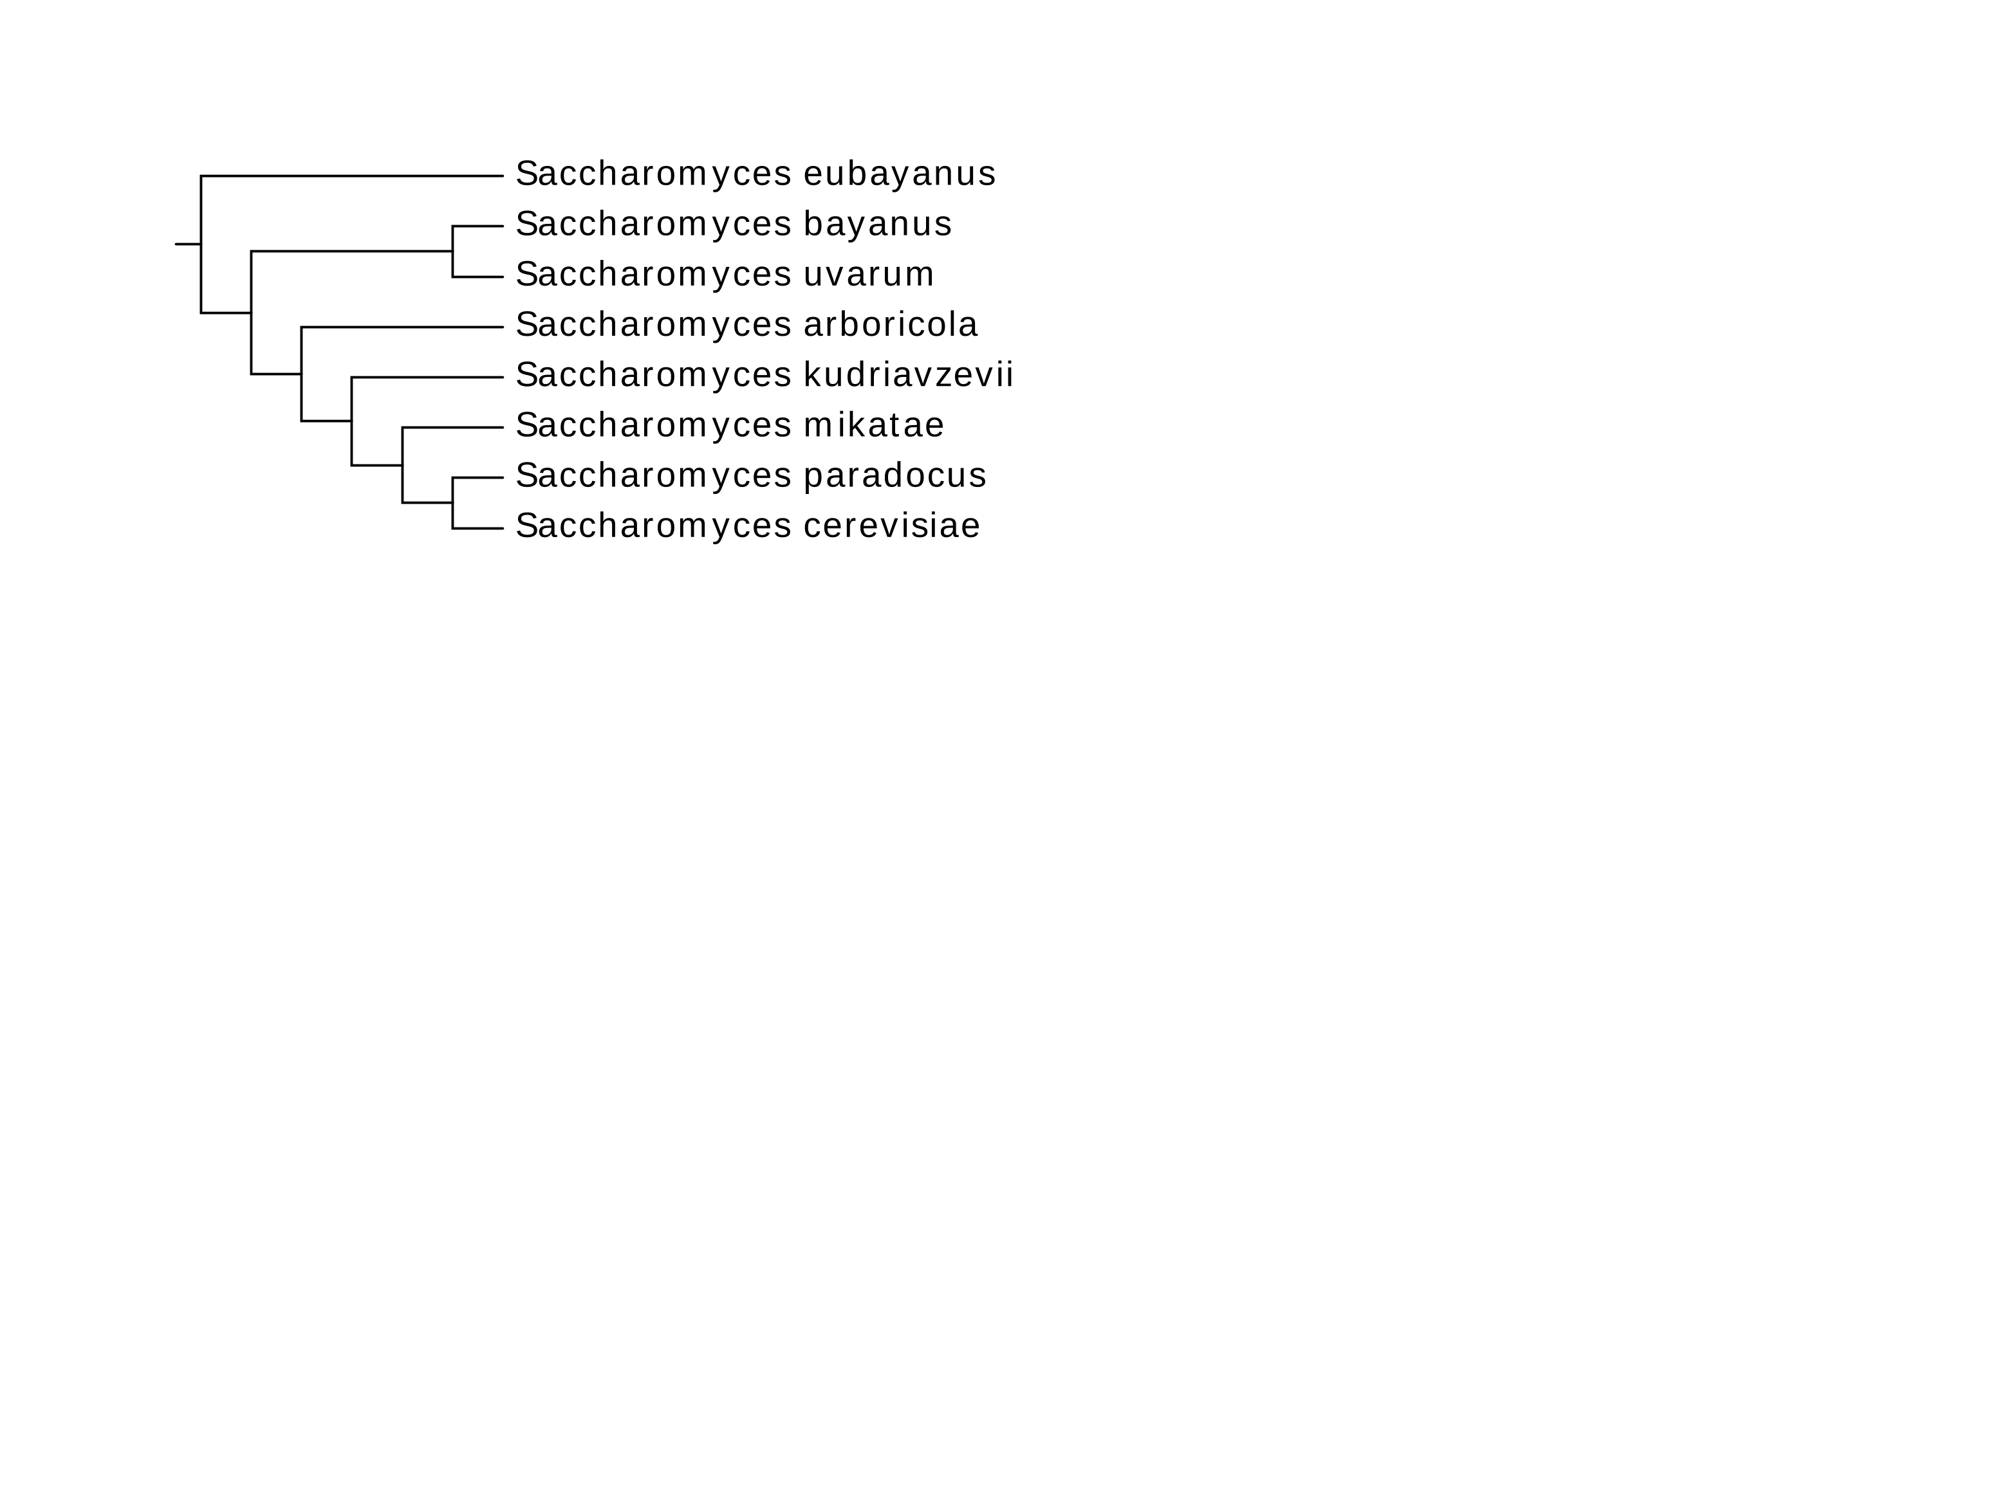
result
ASTRAL SPECIES TREE
Figure 3. ASTRAL species tree for 8 species in Saccharomyces sensu stricto. The tree obtained by combined 1,662 best scoring ML gene trees, and ignore the branch length.

Slide 15
DISCUSSION
GENE TREES VS SPECIES TREE
Any gene tree is topological different from the species tree
Possible reasons:
Genes can have unequal rates of evolution
Gene loss and gene duplication are common
Gene flow can occur between lineages after their separation
Recombination between neighboring regions

Slide 16
DISCUSSION
OUR RESULT VS PUBLISHED SPECIES TREE
Species tree from ASTRAL in this project
Species tree from Borneman et al., 2015

Slide 17
conclusion
Our species tree almost similar to the published phylogenic tree
S. bayanus may be more closed to S. uravum
We can explore the gene evolutional way from the individual gene tree

Slide 18
THANK YOU!

