Slide 1
Optimizing Triton Kernel Launch Overhead
INTJ, an INcompatible Triton JIT launcher
Li Jinpei · 2026-10-15

Slide 2
Agenda
1
Motivation
2
Method
3
Results: performance and AITER adoption
4
Implementation details
5
Discussion
2

Slide 3
Most of a Triton launch is Python, before the driver
Host path dominates. kernel[grid](*args) binds, keys, looks up and checks in Python: 75–78% of a launch on all three machines.
It scales with arguments. 0 → 64 tensor arguments: 4.9 → 129.2 µs of host time per launch (MI308X).
No single hot spot. The cost is a long tail spread across the call, not one slow function.
Small kernels turn host-bound. AITER's fused KDA decode runs 13.0 µs on the GPU, yet each eager call takes 32.6 µs (MI350X).
Triton launch time per call (µs)
host path (grid=(0,))
driver launch + rest
Source: data/headline_launch.csv (grid=(0,) vs grid=(1,)); data/sweep_args_wide.csv; data/aiter_kda_decode.csv, aiter_summary.csv (batch 1).
3
Notes:
Host share = Triton grid=(0,) / grid=(1,): Triton binds, keys and looks up, then skips the driver call on the empty grid. The 'long tail' observation is from the intj README: studying JITFunction showed no low-hanging fruit.

Slide 4
Re-implement the launch path in C, rendered per kernel
What JITFunction does on every call
@make_launcher
key = hash(source, args, options, knobs)
kernel = cache.get_or_create(key,
lambda: compile(source, args, ...))
grid = grid_func(args)
launch(kernel, device, stream, grid, args)
Records the kernel and options. No GPU query, no torch import.
first call
Render · compile · load
entry.c.jinja → .so, then swap the launcher's ml_meth to the entry.
every later call
1
Delegate to C as soon as possible
Native entry (C)
The Python call lands directly in a rendered METH_FASTCALL C entry, specialized to the kernel's signature.
intj args -> spec-key
cache lookup
grid
driver launch
2
Change the interface where it costs time
miss → Python callback → triton.compile → insert
Device, stream and grid are passed in; features that need per-call Python are refused. Hence INcompatible.
Invariant: same intj spec key ⟹ same Triton specialization
Source: README.md (How does it work?), AGENTS.md (The invariant), intj/render/entry.c.jinja.
4
Notes:
A key finer than Triton's costs a redundant compile; a coarser one launches the wrong binary silently. test_spec_key_is_never_coarser_than_triton guards it, and a mutation test shows it can fail.

Slide 5
Usage example: AITER's fused KDA decode on intj
Kernel: decorate once
Call site: device, stream, grid, then positional
_triton_kernels/.../fused_conv_recurrent_norm.py
gated_delta_net/fused_kda_decode.py
import triton
import triton.language as tl
+from intj import make_launcher
+@make_launcher(dynamic_options=("num_warps",))
@triton.jit
def fused_conv_recurrent_norm_kernel(
x_ptr, conv_weight_ptr, conv_state_ptr, ...,
T: tl.int64,
H: tl.constexpr, K: tl.constexpr, ...,
stride_x_tok: tl.int64, ...,
):
grid = (batch, H)
-fused_conv_recurrent_norm_kernel[grid](
+dev, stream = current_device_stream()
+fused_conv_recurrent_norm_kernel(
+ dev, stream, grid,
+ _decode_num_warps(), # dynamic option
mixed_qkv, conv_weight, conv_state, ...,
- H=H, K=K, V=V, W=W,
- stride_x_tok=mixed_qkv.stride(0), ...,
- num_warps=2 if get_arch() == "gfx942" else 4,
+ H, K, V, W,
+ mixed_qkv.stride(0), ..., # stride_x_tok
)
@make_launcher
dynamic_options
current_device_stream()
4.5×
Records the kernel; the C entry is built on the first call.
num_warps is passed per call, right after the grid, and keyed.
AITER's helper: the current device and its raw stream.
host time 31.8 → 7.0 µs; eager 2.4–2.6× (MI350X)
Source: aiter 874d253dd3..5d710e670 (condensed diff); data/aiter_kda_decode.csv, data/aiter_summary.csv. Outputs bitwise equal on every shape.
5
Notes:
Diff condensed from aiter 874d253dd3..5d710e670: '...' marks elided arguments, and dev, stream and grid sit on separate lines in the original. Kernel: aiter/ops/triton/_triton_kernels/gated_delta_rule/decode/fused_conv_recurrent_norm.py. Call site: aiter/ops/triton/gated_delta_net/fused_kda_decode.py. _decode_num_warps() returns 2 on gfx942, else 4. current_device_stream() is torch.cuda.current_device() and its raw stream. Numbers: data/aiter_kda_decode.csv and aiter_summary.csv, MI350X.

Slide 6
3.5–6.2× faster launches; intj's own host time is ~0.03 µs
Per launch incl. driver, grid=(1,), µs (lower is better)
Host path, no driver, 4 tensor args (µs)
Triton JITFunction
intj
 | Triton | intj
MI308X | 13.78 | 0.031
MI350X | 9.03 | 0.021
RTX 4080 SUPER | 5.97 | 0.022
Triton: grid=(0,) launch, skips only the driver.
intj: no_gpu launcher, driver call compiled out.
Driver: ~3 µs on HIP, ~1.2 µs on CUDA.
Source: data/headline_launch.csv (chart); data/sweep_args_wide.csv (table: triton_host, intj_host). Triton 3.8.0, intj 05e25a9.
6
Notes:
Machines: MI308X (Xeon 8480C), MI350X (EPYC 9965), RTX 4080 SUPER (Ryzen 9 7950X3D); each pinned to one core. gfx950 hipModuleLaunchKernel flips between ~2.3 and ~3.1 us, so MI350X launch rows move by +-0.7 us. Bar chart kernel: bench_launch.noop, 3 tensors + 2 scalars + 1 constexpr. Host-path table: the sweep's empty kernel with 4 tensor arguments. Triton's host path is a launch on grid=(0,), which binds, keys and looks up, then skips the driver. intj's is a no_gpu launcher on CPU tensors: the real entry with the driver call compiled out. intj on grid=(0,) is not used here because it returns before decoding any argument; _C_spec_key is not used because it also builds a Python (bytes, int) result. Entering C alone (0 arguments): 0.014-0.022 us. Reading tensors through the interpreter (INTERPRETER mode) adds 0.27-0.83 us to intj args -> spec-key.

Slide 7
intj stays flat as arguments, constexprs and cached kernels grow
Triton JITFunction
intj
MI308X, per launch incl. driver (µs)
Tensor arguments
Constexpr arguments (+4 tensors)
Cached kernels, hit at random
Triton 8.7 → 136.0 µs
intj 3.2 → 7.3 µs host only 0.022 → 0.298
Triton 17.9 → 22.3 µs
intj 3.5 → 3.5 µs host only 0.031 → 0.085
Triton 17.8 → 18.8 µs
intj 3.5 → 3.9 µs host only 0.035 → 0.046
Source: data/sweep_args_wide.csv, sweep_constexpr_wide.csv, sweep_cache_wide.csv (MI350X and RTX 4080 SUPER rows have the same shape). Empty @triton.jit kernels.
7
Notes:
Host-only intj = a no_gpu launcher on CPU tensors: intj args -> spec-key and cache lookup. Tensor args, host only: Triton 4.9 -> 129.2 us on MI308X, 3.5 -> 87.5 on MI350X, 4.1 -> 27.7 on RTX 4080 SUPER; intj 0.022 -> 0.298, 0.014 -> 0.130, 0.018 -> 0.123 us. Cache sweep: one constexpr takes K values in a fixed random order, so K kernels are cached and hit at random.

Slide 8
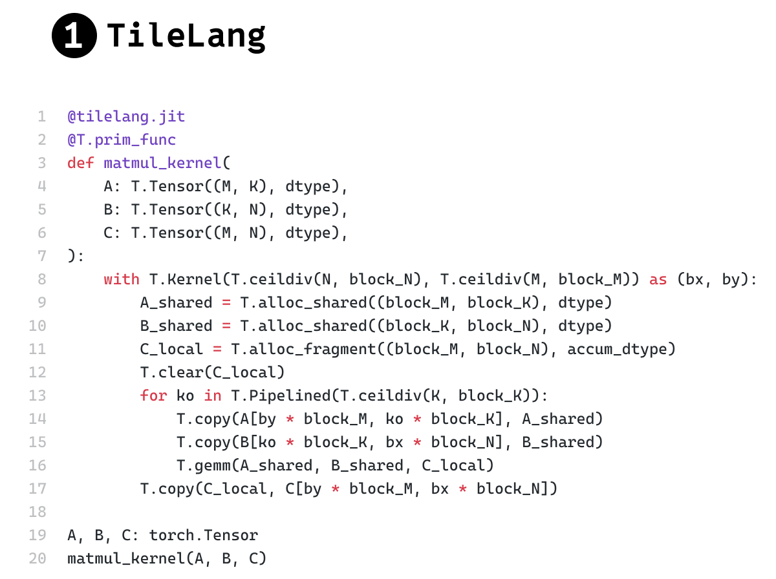
Prior work: TileLang moves the host code into generated C++
Dec 11, 2025
TileLang × TVM FFI · tilelang.com/blog/2025/12/11/ffi.html
“
Every time the user accesses torch.Tensor.shape (or device, stride, …) in Python, it adds around 0.1–1 µs of overhead, which is painful when kernels are very fast.
“
… after the SplitHostDevice pass, TileLang splits the IR into device and host parts. … Finally, via codegen, we generate the C++ host code.
“
For a DSL, CPU overhead is mostly kernel host and cache; TileLang leaves very little headroom in these two parts. (In contrast, due to design choices, Triton is weaker on these two aspects. In our experience Triton compiles faster, but its runtime CPU overhead is higher. We won’t benchmark here; please feel free to try.)
Figure 2 (TileLang half): TileLang vs Triton matmul kernel
Source: tilelang.com/blog/2025/12/11/ffi.html, “TileLang x TVM FFI: Reducing Host Overhead and Building an FFI‑Based Compiler” (LeiWang1999, Dec 11, 2025).
8
Notes:
Quotes are verbatim from the blog; '…' marks a cut. The second quote condenses: "Taking the matmul kernel as an example: after the SplitHostDevice pass, TileLang splits the IR into device and host parts. The host IR looks like this: [listing] Finally, via codegen, we generate the C++ host code, which can be retrieved with matmul_kernel.get_host_source()". The figure is the TileLang half of the blog's Figure 2, unmodified apart from the crop (the Triton half is the usual matmul_kernel[grid](...) with strides and BLOCK constexprs). Images: ppt/data/tilelang_ffi_blog/.

Slide 9
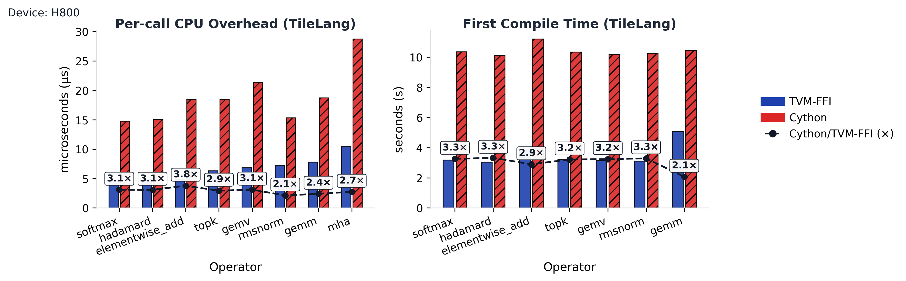
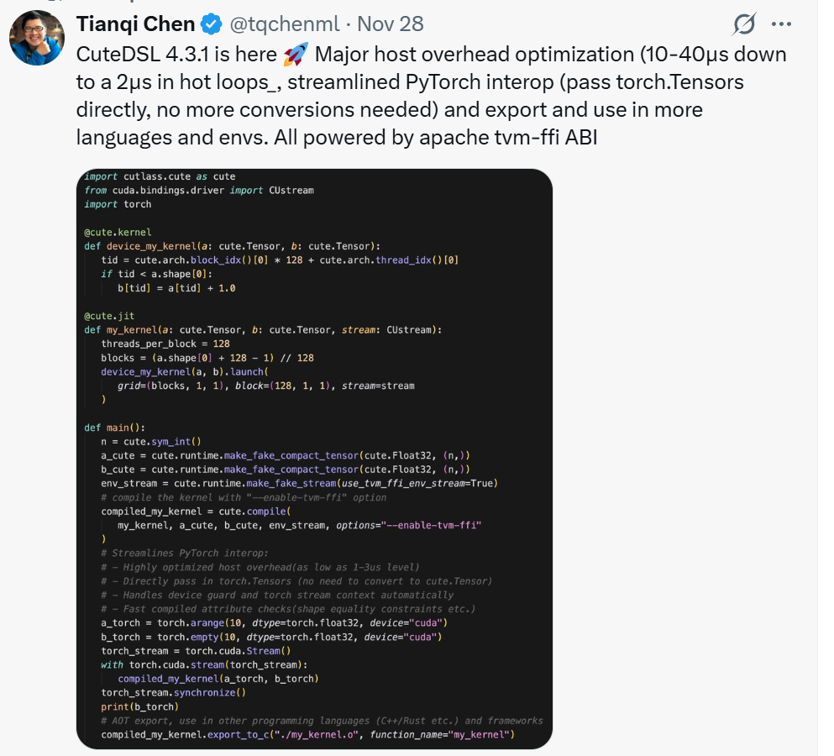
TVM FFI: TileLang host overhead 2.1–3.8× lower; CuTeDSL ~2 µs
Dec 11, 2025
TileLang × TVM FFI · tilelang.com/blog/2025/12/11/ffi.html
Figure 3: CPU host overhead reduction with TVM FFI
TileLang: Cython → TVM FFI host code, 2.1–3.8× less CPU overhead per call, kernel launch included.
CuTeDSL 4.3.1: host overhead 10–40 µs → ~2 µs in hot loops, on the tvm-ffi ABI.
Triton: not benchmarked there; its host path measures 6.0–13.8 µs here (4 tensor args).
Figure 4: CuTeDSL results adopting tvm‑ffi
Source: tilelang.com/blog/2025/12/11/ffi.html, “TileLang x TVM FFI: Reducing Host Overhead and Building an FFI‑Based Compiler” (LeiWang1999, Dec 11, 2025). Triton host path: data/sweep_args_wide.csv.
9
Notes:
Figure 3 (TileLang on an H800): per-call CPU overhead and first compile time, TVM FFI host code vs the earlier Cython wrapper; the blog: "improving kernel overhead by 2.1–3.8× (this time even includes kernel launch!)". Figure 4 is a post by Tianqi Chen (Nov 28) the blog cites: CuteDSL 4.3.1, "Major host overhead optimization (10-40µs down to a 2µs in hot loops)", powered by the apache tvm-ffi ABI. The blog does not benchmark Triton; this deck's Triton host path, 4 tensor arguments, is 5.97-13.78 us (data/sweep_args_wide.csv). Different GPUs and kernels, so not a like-for-like comparison.

Slide 10
Same binary: intj matches TVM FFI and beats Triton by 2.8–4.9×
Same binary, 1 tensor argument (µs)
By argument count, different binaries (µs)
Triton
TVM FFI
intj
TVM FFI
intj
MI308X
MI350X
RTX 4080 SUPER
intj takes torch tensors; TVM FFI gets preconverted TensorViews. At 0 arguments FFI's kernel takes a cheaper stream path.
Source: data/same_binary_1arg.csv (one HSACO / cubin per machine), data/ffi_sweep.csv (different binaries). Triton 3.8.0, intj 05e25a9.
10
Notes:
Left: one Triton binary per machine of an empty kernel with one tensor argument (HSACO on the MI308X and MI350X, cubin on the RTX 4080 SUPER), launched by TVM FFI, Triton and intj. TVM FFI loads it with hipModuleLoadData on ROCm and with its own cubin launcher (TVM_FFI_EMBED_CUBIN) on CUDA, as in its examples/cubin_launcher; intj reuses Triton's loaded function. On the MI350X one of three rounds caught the low hipModuleLaunchKernel state (2.2-2.3 us on both sides). Right: ffi_sweep, empty kernels with N arguments, where TVM FFI and intj launch different binaries; at 0 arguments FFI's kernel takes a cheaper stream path. TVM FFI gets preconverted TensorViews, intj takes torch tensors. apache-tvm-ffi 0.1.14.post1.

Slide 11
AITER ops: 2–4.5× less host time per call, outputs bitwise equal
Host time per eager call (µs), best upstream path vs intj
4.5×
upstream
intj
KDA decode host time, 31.8 → 7.0 µs
1.9×
FlashKDA vs AITER's own _FastLaunch (3.6× vs Triton JIT)
2.4×
fp8_mqa_logits host time, 35.4 → 14.8 µs
Eager time where upstream is host-bound: 2.37–2.60× KDA decode (batch ≤ 16), 2.35–2.39× fp8_mqa_logits. GPU kernels unchanged.
Source: data/aiter_*.csv, data/aiter_summary.csv, MI350X. FlashKDA: T ≤ 1024, 2 kernels per call. Medians over shapes.
11
Notes:
_FastLaunch is AITER's hand-written Python launch cache for FlashKDA; intj still halves its host time. Kernel times from rocprofv3 --kernel-trace are the same on both sides; outputs are bitwise equal on every shape. AITER 874d253dd3 (upstream) vs 5d710e670 (intj).

Slide 12
KDA decode, fp8_mqa_logits: upstream floors at 33–36 µs
upstream (Triton JIT)
intj
intj + leaner wrapper (prototype)
GPU kernel time
Fused KDA decode, H = 12: eager µs per call vs batch
Fused KDA decode
Upstream: flat 32.6–33.4 µs to batch 32
intj: 12.6–25.3 µs, the kernel's own time
fp8_mqa_logits, H = 64: eager µs per call vs q = kv
fp8_mqa_logits
Upstream: flat 35.4–35.7 µs to q = kv 1024
intj: 14.9–15.2 µs, its own host time; launch 3.5 µs
Outside intj: −inf fill 4.9 · config 3.2 · slice 0.9 · free 0.7 · checks 1.4 µs
Prototype: 10.0–11.0 µs to q = kv 512; config cached, slice skipped
Source: data/aiter_kda_decode.csv, aiter_fp8_mqa_logits.csv, aiter_summary.csv (rocprofv3, regime), aiter_fp8_mqa_logits_breakdown.csv, aiter_fp8_mqa_logits_prototype.csv. MI350X.
12
Notes:
MI350X. Eager time: 32 back-to-back calls timed by GPU events, about max(host, GPU). Host-bound means the upstream call's host time exceeds its GPU kernel time (data/aiter_summary.csv regime). Larger shapes stay GPU-bound on both sides: KDA decode batch 128 / 256 at 83 / 157 us, fp8_mqa_logits q = kv 4096 / 8192 at 127 / 425 us. fp8_mqa_logits at q = kv <= 1024: intj sits at its call's own host time (~15 us), above the 6-17 us kernels (the Gluon kernel plus torch's fill). Host time per call, intj tree, medians over q = kv 128-1024 and 3 processes, timed per section of an instrumented copy of the wrapper checked bitwise-equal to it: −inf fill 4.87 us, config 3.21 us, slice 0.93 us, free 0.65 us, checks 1.37 us, launch 3.52 us. The prototype is the same wrapper with the gfx950 config cached per shape and the logits slice skipped when seq_len_kv is 256-aligned (all but 128); clean_logits=True, outputs bitwise equal on every shape. Dropping the -inf fill too (clean_logits=False) measured ~5.5 us host; not shown, it changes the output contract.

Slide 13
AITER moved to intj: 426 launchers, 11 launches left on Triton
109
426
200
−402
commits, 2026-09-24 → 10-14
@make_launcher decorators (0 before)
.py files import intj
net kernel[grid](…) launch lines
Still on Triton, by reason
How it was checked
3
num_ctas > 1 (CGA / multicast)
Check sweep: all 424 launchers check and build on intj 20e578f.
Differential test: 247 kernels, ~7,300 launches vs Triton, bitwise equal (except atomic_add and two self-nondeterministic cases; at intj 429d8e1).
gfx942 host time: rope 68.8 → 19.1 µs, flash_attn_func fwd 102.7 → 45.1 µs, attn_res_gate 20.0 → 12.2 µs.
Untested: CUDA; gfx1250 is compile-identity only.
3
Iris multi-GPU helpers
3
torch.compile graphs
2
PDL (launch_pdl)
Source: aiter 874d253dd3..5d710e670 (git rev-list / git grep), aiter docs/intj_launch_exceptions.md, MIGRATION_GAP.md.
13
Notes:
Diff 874d253dd3..5d710e670: 338 files, +15,670 / -7,271. Four make_launcher( calls declare 11 more launchers. 144 FlyDSL .launch sites in 77 files are out of scope (different launch ABI). The -402 is a regex count (445 removed, 43 added).

Slide 14
Incompatible launch syntax: no per-call grid or kernel[grid]
# Triton: device and stream implicit; keywords, defaults
kernel[(triton.cdiv(n, 128),)](x, y, o, n, BLOCK=128)
# intj: device, stream, grid passed in; positional only
k = make_launcher(kernel)
k(dev, stream, (triton.cdiv(n, 128),), x, y, o, n, 128)
# Triton's kernel[grid] (triton/runtime/jit.py)
def __getitem__(self, grid) -> T:
return lambda *args, **kwargs: self.run(
grid=grid, warmup=False, *args, **kwargs)
Gain
Host ns per call
Nothing is queried per call: device, stream and grid come from the caller.
grid_arg / grid_cpp compute the grid in C; grid_py is opt-in.
 | MI308X | MI350X | RTX 4080 SUPER
triton.cdiv(n, 128) | 989 | 602 | 809
(x + y - 1) // y | 35 | 20 | 34
intj grid_cpp: cdiv in C | +3 | ≈0 | ≈0
kernel[grid] alone | 131 | 80 | 120
kernel[grid](...) over run(...) | 420 | 240 | 322
Price
Every call site is rewritten; defaulted parameters are passed explicitly.
Refused: TensorWrapper, tuples, Gluon layout objects, num_ctas > 1, scratch, PDL, launch hooks.
Undeclared cache-invalidating knobs freeze at the first call.
kernel[grid] builds that lambda on every launch; calling it packs *args and **kwargs, then unpacks them into run(). intj's grid_cpp is the extra over passing the grid in.
Source: data/incompatible_micro.csv (scripts/bench_incompatible.py, 3 processes per machine), README.md, docs/Usage.md, MIGRATION_GAP.md.
14
Notes:
Micro-benchmarks (ppt/scripts/bench_incompatible.py): each statement inline in a timeit loop, 200k calls x 9 samples, minus the same loop around pass; median of 3 processes per machine. triton.cdiv is a ConstexprFunction: every host call runs an import, unwraps args and kwargs in comprehensions, and checks knobs; (x + y - 1) // y is its body, timed inline (as a plain def call: 52 / 32 / 52 ns). kernel[grid] returns a new lambda per call; calling it re-packs *args and **kwargs into run(grid=..., warmup=False, ...). To time only that layer, run is replaced by a stub on a fresh JITFunction, and the same arguments are passed to the stub directly. intj's grid_cpp: no_gpu launchers on CPU tensors (decode, key, lookup), grid passed in vs computed in C. Triton sites blocked by intj's refusals (MIGRATION_GAP.md): tuples ~41, Gluon layouts ~75, TensorWrapper 14; parameter defaults alone block 0.

Slide 15
Incompatible ptr_range: 0.9–1.3 µs per tensor in Triton
# Triton, per tensor argument, per launch (HIPBackend)
if hasattr(arg, "ptr_range"): # duck-typed objects
return arg.ptr_range() <= 2**31-1
if isinstance(arg, torch.Tensor):
return arg.untyped_storage().size() <= 2**31-1
Triton's per-tensor check, MI308X, ns per call
intj: the storage size is read through PyTorch's C++ structures, in C, as part of intj args -> spec-key.
1.94 µs
4.3 ns
Triton host time per tensor argument, MI308X (1.31 MI350X; 0.37 RTX 4080 SUPER, which has no S bit)
intj host time per tensor argument, MI308X (1.8 MI350X, 1.6 RTX 4080 SUPER), range included
MI350X: 857 / 260 / 73 / 43 / 14 ns. The rest of is_within_2gb is isinstance, a second hasattr and the call itself.
Source: data/incompatible_micro.csv (scripts/bench_incompatible.py), data/sweep_args_wide.csv (per-tensor slopes), triton/backends/amd/compiler.py (Triton 3.8.0).
15
Notes:
On AMD, Triton adds the S bit (storage < 2 GiB) to every tensor's specialization: its native specializer calls HIPBackend.get_tensor_specialization (Python) for each tensor argument of each launch, which checks knobs.amd.use_buffer_ops and calls is_within_2gb. Micro-benchmarks: ppt/scripts/bench_incompatible.py, GPU tensor of 4096 floats, median of 3 processes. Per tensor argument from the host-only sweep slope (0 -> 64 tensors): Triton 1.94 / 1.31 / 0.37 us on MI308X / MI350X / RTX 4080 SUPER, where CUDA has no S bit; intj reads data pointer, dtype, alignment and storage size in C for every tensor. The MI350X host had a load average of ~8 during its run.

Slide 16
Lazy building: make_launcher records; the first call builds
1
@make_launcher
Gain
Records the kernel and options: no GPU, no torch import.
import intj loads neither triton nor torch; decorating needs no GPU.
Hit path unchanged: 0.4–3.0 ns faster on every untuned row after the change.
Swapping ml_meth beat a custom callable type by 1.4–5 ns per call.
2
launcher.__self__.check()
Optional: runs delayed= and every GPU-free refusal now.
3
First call
delayed= (if check() did not), render, compile, load, swap ml_meth: 0.6–1.9 s cold, 8.5 ms with the .so on disk.
4
Every later call
The native entry, even through references taken before the build.
Price
AITER: an option that needs the GPU goes in delayed=
First call pays the build: 0.6 s, or 1.9 s for STATIC_COMPILE.
Refusals move to check() or the first call.
Thread-safe first call: a build lock.
ARM64: publishing the built entry to other threads is unverified (TODO).
_triton_kernels/attention/chunked_pa_prefill.py
def _decode_launch_keywords(): # runs on the first call
from aiter.ops.triton.utils._triton import arch_info
if arch_info.get_arch() == "gfx950": # queries the GPU
return {"options": {"num_warps": 1, "waves_per_eu": 2, ...}}
return {}
@make_launcher(grid_arg=2, delayed=_decode_launch_keywords)
Source: README.md (build times, MI300X), benchmarks/journals/2026-09-28_lazy-task5_0_8d95e66.md, docs/superpowers/specs/2026-10-13-delayed-launcher-options-design.md, commit 8d9d5d5.
16
Notes:
Each launcher is a PyCFunction over a PyMethodDef embedded in its launcher object; the first call swaps ml_meth from the build shim to the rendered entry. A cache miss costs ~300 ns more than before (benchmark 404.6 -> ~707 ns, ~+180 ns in production). docs/Usage.md quotes ~250 ms for a build; the README's 0.6-1.9 s is used here. The AITER example is condensed: the gfx950 options also set num_stages=1, and the import sits inside the function because arch_info queries the GPU when imported. Build lock: one thread builds, the others wait detached from the interpreter; a call from inside the launcher's own build raises RuntimeError instead of deadlocking (runtime/intj_lazy.c). ARM64: the build release-stores ml_meth, but CPython reads it with a plain load; x86-64 keeps the order, a free-threaded ARM64 build may not (TODO.md). intj runs on x86-64 only today.

Slide 17
Autotune and heuristics need a chain of hash tables, not one key
# intj tests/test_tuned.py::test_two_level_chain, condensed
@triton.autotune(configs=[Config({"BLOCK": 32}), Config({"BLOCK": 64})],
key=["N"])
@triton.heuristics({"ALIGNED": lambda a: a["stride"] % a["BLOCK"] == 0})
@triton.jit
def aligned_tag(x, out, N, stride, BLOCK: tl.constexpr, ALIGNED: tl.constexpr): ...
launch = make_launcher(aligned_tag)
for stride in (128, 130, 192):
launch(dev, stream, 1, x, out, 8, stride) # N = 8
ALIGNED needs BLOCK, which only tuning for N picks: it cannot be keyed before a lookup.
Keying stride itself would tune again per stride; Triton tunes once per N.
So: level 0 keyed by N holds BLOCK; level 1 keyed by ALIGNED.
Call, N = 8 | Level 0: cache[N] | C computes ALIGNED | Level 1: child[ALIGNED] | Python
stride 128 | miss → Triton tunes: BLOCK = 64 | 128 % 64 == 0 → 1 | miss → compile (64, 1) | tune + compile
stride 130 | hit: BLOCK = 64 | 130 % 64 == 2 → 0 | miss → compile (64, 0) | compile, no re-tune
stride 192 | hit: BLOCK = 64 | 192 % 64 == 0 → 1 | hit → launch | none
+6.2 ns
2.46 ns
40 cases
tuned hit vs plain intj, MI308X
child-map hit, map-only benchmark
never-coarser test, plus its mutation test
Source: tests/test_tuned.py::test_two_level_chain, intj/tuning.py, docs/superpowers/specs/2026-09-26-autotune-heuristics-design.md, journal 2026-09-26_autotune-task5.
17
Notes:
No Triton tutorial or example reads an unkeyed argument together with a tuned value in a heuristic. Triton's matmul (ops/matmul.py) keys K, so its EVEN_K = K % (BLOCK_K * SPLIT_K) == 0 is fixed per level-0 record and needs one lookup (tests/test_tuning.py::test_matmul_needs_one_lookup); Triton's test_decorator.py reads src.data_ptr() but no tuned value, which keys at level 0. The example is intj's tests/test_tuned.py::test_two_level_chain, run on a GPU: a bench that prefers BLOCK=64, calls N=8 with strides 128, 130, 192, asserting outputs 641, 640, 641, one tuning run (bench calls [32, 64]) and a two-key chain. A miss at either level runs a private copy of Triton's autotune/heuristics chain; its Autotuner cache already holds N=8, so a level-1 miss compiles without re-tuning. Level-0 map: spec words + exact N, swappable backend; child maps: intj's own map, 2 words per computed key, 4 slots to start; non-final records on the heap. Tuned hit vs plain intj +6.2 ns (MI308X); child-map hit 2.46 ns (map-only); never-coarser test over 40 cases plus its mutation test. Not measured: a Triton @autotune hit, a full two-level lookup end to end.

Slide 18
Reading CPython, PyTorch and Triton internals, version-gated
Torch access mode: intj args -> spec-key per call, 3 tensors, MI308X
INTERPRETER
923 ns
RUNTIME_SHIM
92 ns
STATIC_COMPILE
94 ns
pointer and storage size through CPython calls
torch's structs at offsets from a verified table
compiled against torch's headers (the default)
Dependency | What intj reads | How it is guarded
CPython int | ob_digit (≤ 3.11); lv_tag, PyUnstable_Long_* (3.12+) | PY_VERSION_HEX branches, 30-bit static_assert, boundary tests
CPython calls | vectorcall; the ml_meth swap; sizeof(PyObject) 16 / 32 (free-threaded) | allowlist 3.8–3.14, 3.13t, 3.14t; module keyed by exact version + build
Torch tensor | cdata; TensorImpl storage, offset, numel, dtype | 13 measured layouts (2.2–2.14), checked from C++; offset check at load
Triton | native_specialize_impl, canonicalize_dtype, 3 knobs | ≥ 3.7 gate; version + libtriton.so in the key; never-coarser tests
Layouts drift: cdata moved 8 → 0 at torch 2.10, storage_offset 152 → 144 at 2.13. An unknown version is refused, never borrowed from a neighbour. Offsets are x86-64 only.
Source: CONCETPS.md, intj/python_intf/, intj/torch_intf/torch_abi.toml, intj/_imports.py, TODO.md. intj args -> spec-key per call: data/headline_decode_by_access_mode.csv.
18
Notes:
Default: STATIC_COMPILE when its toolchain is available, else RUNTIME_SHIM when a verified layout exists, else INTERPRETER; an explicitly chosen unavailable mode raises. torch_abi.toml rows are generated by abi_detect and cross-checked by cpp_detect, never hand-edited. Gap: cache-invalidating knobs beyond debug / instrumentation / fpsan are not keyed yet (TODO.md).

Slide 19
Test matrix: 149 GPU-free CI jobs, the full suite on two GPUs
15
13
149
1,075
OS × Python cells on 6 base images
torch pins, 2.2 → 2.14
jobs, each in all 3 access modes
tests collected on gfx942
Python | Cells | Torch pins
3.8 | 1 | 2.2–2.4
3.9 | 2 | 2.2–2.8
3.10 / 3.11 / 3.12 | 2 / 3 / 3 | 2.2–2.14
3.13 | 1 | 2.5–2.14
3.14 / 3.14t | 2 / 1 | 2.9–2.14
Testing without a GPU
Stub driver: the real rendered module, built with cc, records grid, block, stream and params.
no_gpu=True: no target query, no driver dlopen; only intj args -> spec-key and the cache lookup run.
Fake driver: tests patch the driver to device 0, stream 0, a hip / host target.
No-GPU-query proof: the target query is patched to raise.
On GPUs: full suite on MI308X (triton 3.7.1, 3.8.0) and RTX 4080 SUPER (869 passed, 21 skipped at 9682f5c).
Ubuntu 22.04 / 24.04 / 26.04, Debian 12, AlmaLinux 9, manylinux_2_28. 3.13t: local script only.
Source: ci/matrix.json, ci/image.py, ci/AGENTS.md, tests/test_runtime.py, tests/test_compat.py, README.md.
19
Notes:
Each CI job installs the wheel, pins torch, and runs test_runtime.py in all three access modes: 446 job x mode runs. torch 2.9.1 on 3.14t skips INTERPRETER. Python 3.8 / 3.9 cells build without triton, since every triton >= 3.7 needs Python >= 3.10. gpu.yml has 12 ROCm cells for a self-hosted gfx942 runner, untested until one is registered. 1,075 is pytest --collect-only, not a pass count.

Slide 20
Micro optimization: the call, and a map built for 1–8 entries
1
Specialized entry + FASTCALL
183 → 118 ns
2
Hash table for a sparse load
107 → 69 ns
32 int args, same key (c7c1be5)
32 constexpr args, same key (7ad507d)
METH_FASTCALL lets CPython specialize the call site to CALL_BUILTIN_FAST.
Open addressing, values inline, 50% max load; real launchers hold 1–8 entries.
A one-entry memo of the last hit is compared before hashing.
Map hit (ns) vs live entries, 2-word key
Hit at 8 entries (ns), by key length
intj
tsl::robin_map
absl::flat_hash_map
 | intj | tsl | absl
1-word key | 1.59 | 2.10 | 4.36
2-word key | 1.79 | 2.56 | 5.04
5-word key | 3.20 | 3.41 | 9.48
Same keys, hash precomputed, no last-key memo; MI308X host (Xeon 8480C).
The loop: bench_launch.py --no-gpu | --sweep | --last-key on a pinned core; 5 interleaved processes; a row regresses at > 3% and > 2 ns.
Source: benchmarks/journals/2026-09-28_mix-history_0_6e0d4bc.md (1, 2), data/kernel_cache_map.csv (tests/bench_kernel_cache.cpp, journal 2026-10-14_full-suite_0_bc8caf7.md).
20
Notes:
Map numbers: tests/bench_kernel_cache.cpp (google/benchmark, map only, no last-key memo, hash precomputed by the caller, uniformly random keys), from benchmarks/journals/2026-10-14_full-suite_0_bc8caf7.md (MI308X host, Xeon 8480C, 3 rounds); data/kernel_cache_map.csv. intj: open addressing, linear probing, values stored inline, 16 slots to start, doubling at 50% load, an empty slot is one whose value reads as zero. tsl = tsl::robin_map, absl = absl::flat_hash_map, the swappable kernel_cache backends. hit/1 always touches slot 0 (a permanently hot line). Real launchers hold 1-8 specializations. A typical key is 2 words (one word of per-parameter code bytes, one constexpr value).

Slide 21
TVM FFI: one unordered_map lookup per argument
PyObject* → TVMFFIAny: a hash lookup per argument
Isolated, ns per argument (4-argument call)
// python/tvm_ffi/cython/tvm_ffi_python_helpers.h, SetArgument
PyTypeObject* py_type = Py_TYPE(py_arg);
auto it = arg_dispatch_map_.find(py_type); // unordered_map
if (TVM_FFI_PREDICT_TRUE(it != arg_dispatch_map_.end())) {
TVMFFIPyArgSetter setter = it->second;
// if error happens, propagate it back
if (TVM_FFI_PREDICT_FALSE(setter(ctx, py_arg, out) != 0)) return -1;
} ...
 | MI308X | MI350X | RTX 4080 SUPER
find, light (6 entries) | 3.46 | 2.52 | 1.36
find, heavy (1,030 entries) | 3.46 | 1.86 | 1.36
direct type compare | 1.17 | 0.53 | 0.46
testing.nop, ns per call (map: 2 / 1,026 types)
TVMFFIAny → DLTensor / int: a type-driven cast, no lookup
 | MI308X | MI350X | RTX 4080 SUPER
nop() | 102 | 62 | 69
nop(i, i, i, i), light | 191 | 116 | 122
nop(i, i, i, i), heavy | 190 | 116 | 123
per int argument | 22.0 | 13.6 | 13.4
// include/tvm/ffi/any.h
std::optional<T> opt = TypeTraits<T>::TryCastFromAnyView(&data_);
Lookup cost: 0.9–2.3 ns per argument over a direct type compare, about a tenth of TVM FFI's 13–22 ns per int argument.
Heavy load: 1,000+ entries cost the same as 2 in steady state.
intj: each parameter's check is compiled in; intj args -> spec-key has no lookup.
Median of 3 processes per machine; isolated rows built with the machine's g++.
Source: data/ffi_dispatch.csv (scripts/bench_unordered_map_lookup.cpp, scripts/bench_ffi_dispatch.py), apache-tvm-ffi 0.1.14.post1 tvm_ffi_python_helpers.h, include/tvm/ffi/any.h.
21
Notes:
TVM FFI apache-tvm-ffi 0.1.14.post1 (PyPI wheel). Every Python argument goes through TVMFFIPyCallManager::SetArgument: Py_TYPE(arg), then std::unordered_map<PyTypeObject*, setter>::find (thread-local, reserve(32)); a type seen first goes through TVMFFICyArgSetterFactory and is emplaced. On the C++ side, Any -> T is TypeTraits<T>::TryCastFromAnyView: a type-index switch, no lookup. Isolated: ppt/scripts/bench_unordered_map_lookup.cpp, built with each machine's g++ -O2 (13.3 / 15.2 / 16.2 -- the wheel's own build is not this code, so read the isolated rows as the shape of the cost), keys are PyTypeObject-sized heap blocks, 4 lookups per call, 20M x 9 samples, median of 3 processes; light = 6 entries, heavy = 1,030 (1,493 buckets); spread keys (4,096 draws over all entries) read 4.3 / 2.4-2.5 / 1.4-1.5 ns. End to end: ppt/scripts/bench_ffi_dispatch.py, testing.nop inline in timeit, light = the 2 types this run uses, heavy = after 1,024 distinct int subclasses. A heavily loaded map costs the same in steady state: the bucket and node of a hot type stay cached. 4 CPU tensors through TVM FFI: 541 / 332 / 327 ns per call, ~110 / ~68 / ~65 ns per tensor (DLPack exchange); intj's per-tensor host cost is 1.6-4.3 ns (sweep slopes).

Slide 22
Annotation: state facts, compile exactly those
launch = make_launcher(kernel, extra_annotation={
"x": Argument(type=tl.pointer_type(tl.float32),
specialize=NEVER,
bind_value=BindValue.TENSOR),
"BLOCK": Constexpr(type=tl.int64,
power_of_two_or_zero=True)})
bound = launch.__self__.bind(x=tensor)
bound(device, stream, grid, *rest)
# AITER pa_mqa_logits
kv = Exactly(Aligned(16)) if padded else NEVER
Facts: EqualTo(1), Aligned(16), PointerRange(32); a torch.Tensor annotation makes the argument tensor-only.
Smaller key: Exactly and NEVER add 0 key bytes; baked and bound values leave the call.
Power of two or zero: Constexpr(power_of_two_or_zero=True) keys a BLOCK-style constexpr in 1 byte, not an 8-byte word: 0 → 0, 2**k → k+1, −2**k → 0x80 | (k+1).
Exact binaries: AITER's pa_mqa_logits needs 6 Triton compiles instead of 15, identical HSACO on gfx942 and gfx950.
Price, trust: a false promise selects the wrong binary unless verify_annotation=True. Upstream's Aligned(16) on a stride of 36 was one.
AUTO
NEVER
measured per call, keyed
not specialized
Host-only ns per call, MI308X
none | baked | tensor-annotated | typed int
39.8 | 37.5 | 39.4 | 43.7
Assume
Exactly
listed facts promised, rest AUTO
listed facts promised, rest NEVER
Host time is about neutral; the win is the key and the binaries.
Source: docs/Usage.md, intj/annotation.py, tests/test_annotation.py, benchmarks/journals/2026-10-14_full-suite_0_bc8caf7.md, aiter docs/intj_launch_exceptions.md.
22
Notes:
Argument(type, specialize, value, bind_value) and Constexpr(type, power_of_two_or_zero, value), inline on the kernel or via extra_annotation. verify_annotation=True costs 41.7-43.1 ns in the same benchmark. aiter 23bf3e29b dropped the false Aligned(16) on stride_scale_seq; the HSACO was unchanged. Exactly arrived in intj 20e578f. power_of_two_or_zero (docs/Usage.md): an integer constexpr promised to be 0 or +-2**k is keyed in one byte (0 -> 0, 2**k -> k+1, -2**k -> 0x80 | (k+1)) instead of one 8-byte value word; verify_annotation=True rejects other values, the unchecked default trusts the promise. No host-time measurement of it on its own.

Slide 23
Discussion: next steps
1
Merge the AITER PR
2
Better docs and source code
Branch codex/intj-all-launches onto ROCm/aiter main: 109 commits, 426 launchers across 200 files.
247 kernels checked bitwise equal against Triton.
11 launches stay on Triton: num_ctas > 1, Iris, torch.compile, PDL.
intj is 12.5K lines of source plus 12.9K of tests, mostly agent-generated.
Docs a newcomer can follow from first launch to annotation.
Source a human reviewer can read and own.
Source: AITER adoption slide (aiter 874d253dd3..5d710e670); git ls-files intj / tests | xargs wc -l.
23
Notes:
1. The AITER migration: branch codex/intj-all-launches on lijinpei-amd/aiter (head 5d710e670 measured; 23bf3e29b is one commit later), base 874d253dd3 on ROCm/aiter main; the PR number was not looked up (no token access to the ROCm org here). Numbers from the AITER adoption slide. 2. Line counts: git ls-files intj | xargs wc -l, without torch_abi.toml: 12,488 (8,028 Python, 4,147 C / header / Jinja); git ls-files tests | xargs wc -l: 12,886. Most of it was written by coding agents.

