Slide 1
与陈老师组能谱的second check
参与者：张瑞 郭莹莹 冯有亮 赵世平 张毅 袁强

Slide 2
我们能谱的做法
1、统计点源活时间
实验数据范围： 2019-1227——2020-0408
cross check: 使用陈老师组filelist
2、点源轨迹产生点源模拟数据
消去立体角影响
事例乘以crab在天顶角θ上活时间作为权重
归算流强到gamma模拟数据
gamma模拟数据
实验数据统计活时间
点源轨道修正
>>点源模拟数据
点源实验数据能谱拟合
单个能量点流强

Slide 3
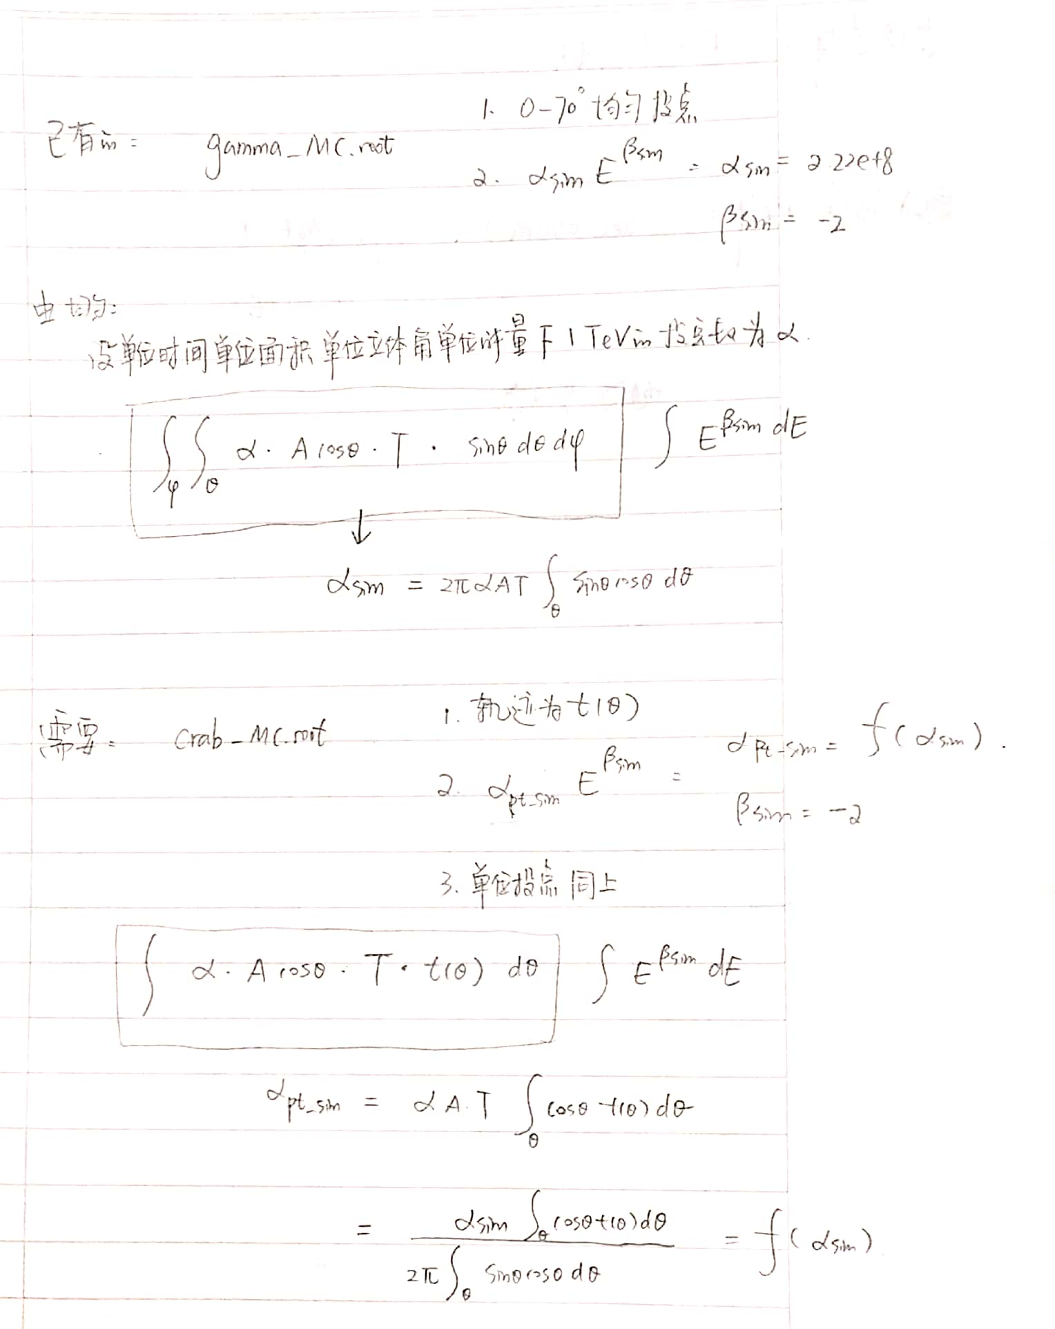
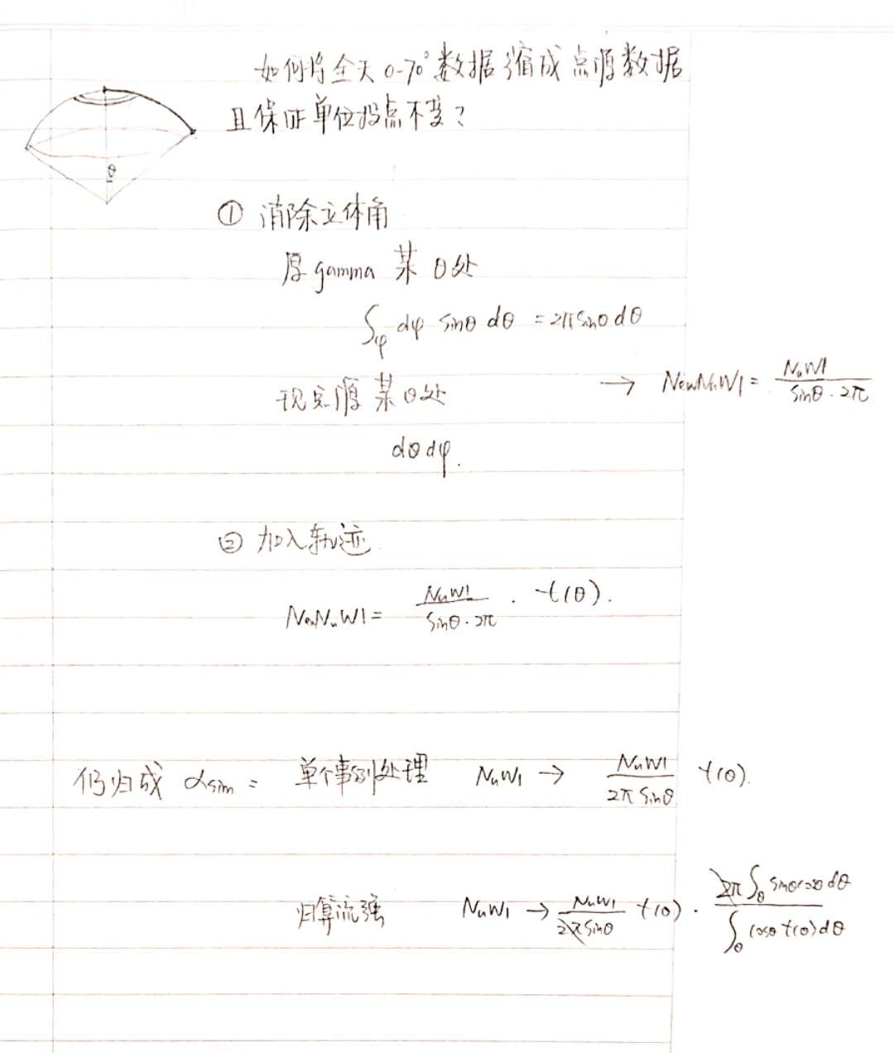
检验能谱绝对流强-操作步骤解释

Slide 4
我们能谱的做法
3、点源实验数据能谱拟合
确定能标参数N=f(NfiltE)，并分段;
实验在能标参数N的某个bin内的观测gamma事例数为为Ns_ob[bin]，模拟在该bin内的gamma事例数为Ns_fit[bin];
能谱模型包括单幂律，双幂律，log抛物线等；
不断迭代模拟模型的幂律参数使各bin的实验与模拟事例数的联合chi2最小，得到该点源的能谱结果；
4、单个能量点流强（like hawc）
Ns_ob[bin]相对拟合出的Ns_fit[bin]点出流强（like hawc）；
能量点取该能标参数N某bin内的最可几能量/log-mean能量
gamma模拟数据
实验数据统计活时间
点源轨道修正
>>点源模拟数据
点源实验数据能谱拟合
单个能量点流强

Slide 5
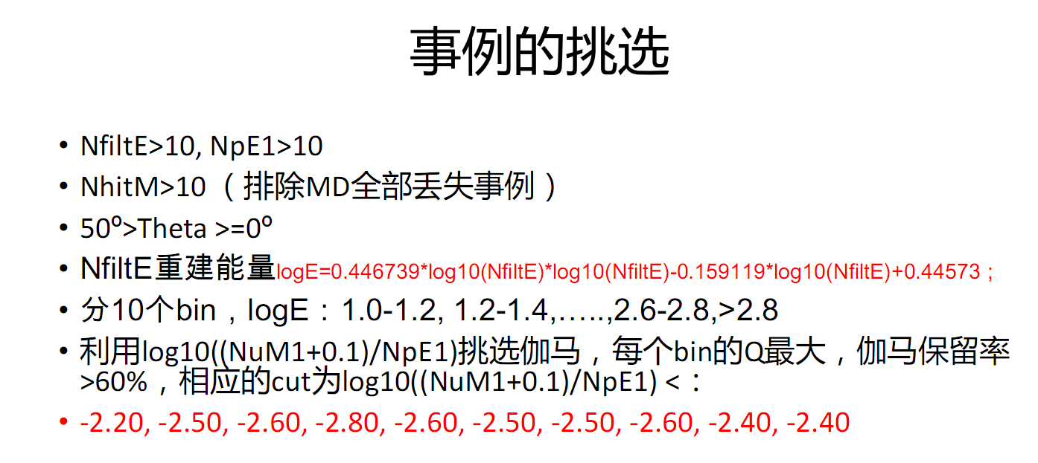
能标参数N

Slide 6
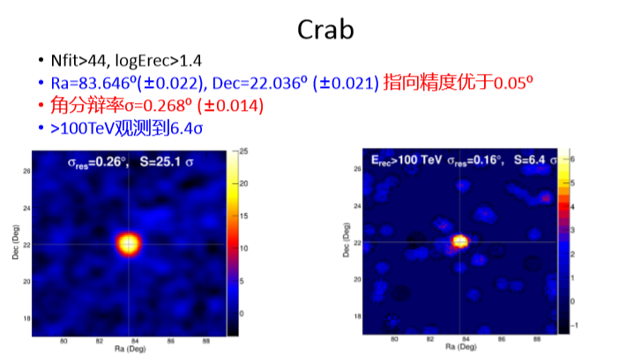
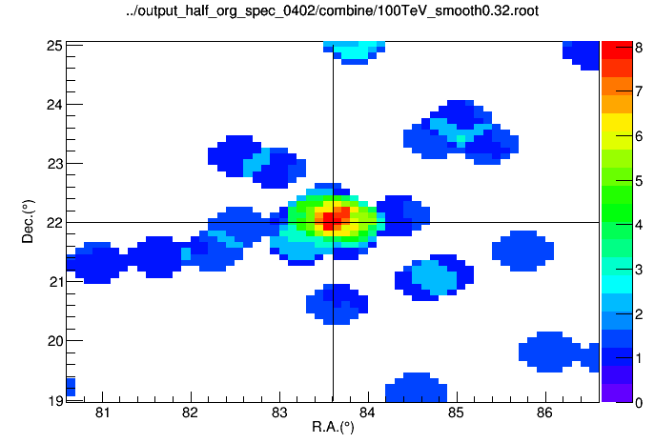
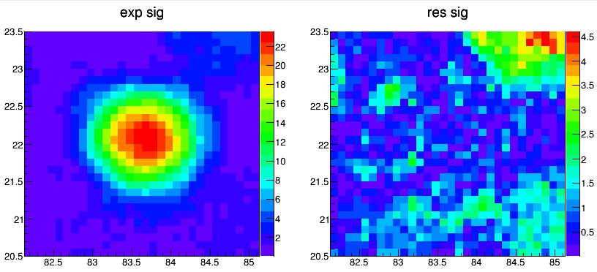
点源位置确定：Crab NE>44
Sig=8
Fitted sig=8.46476
平滑Sig_max=23.6
Fitted sig=25.377
sigma: 0.271+-0.019
ra: 83.641+-0.031
dec: 22.027+-0.029
角分辨和定位差不多

Slide 7
crab数据 蓝色全天区数据，红色点源数据
crabra=83.65;
crabdec=22.00;
bin | 能标N | Non |  | Noff |  | sig |  | sw | est
0 | 1-1.2 | 12697 | 11990 | 11507.8 | 10845.8 |  | 10.4 | 1.075 | -2.2
1 | 1.2-1.4 | 751 | 715 | 430.1 | 405 |  | 13.2 | 0.525 | -2.5
2 | 1.4-1.6 | 184 | 173 | 42.1 | 37 |  | 15.0 | 0.475 | -2.6
3 | 1.6-1.8 | 89 | 85 | 8.7 | 7.75 |  | 14.3 | 0.625 | -2.8
4 | 1.8-2.0 | 22 | 20 | 1.16 | 0.92 |  | 8.0 | 0.475 | -2.6
5 | 2.0-2.2 | 9 | 8 | 0.53 | 0.42 |  | 4.95 | 0.525 | -2.5
6 | 2.2-2.4 | 4 | 4 | 0.065 | 0 |  |  | 0.325 | -2.5
7 | 2.4-100 | 2 | 1 | 0.34 | 0 |  |  | 0.275 | -2.6
全天区的显著性是多少？

Slide 8
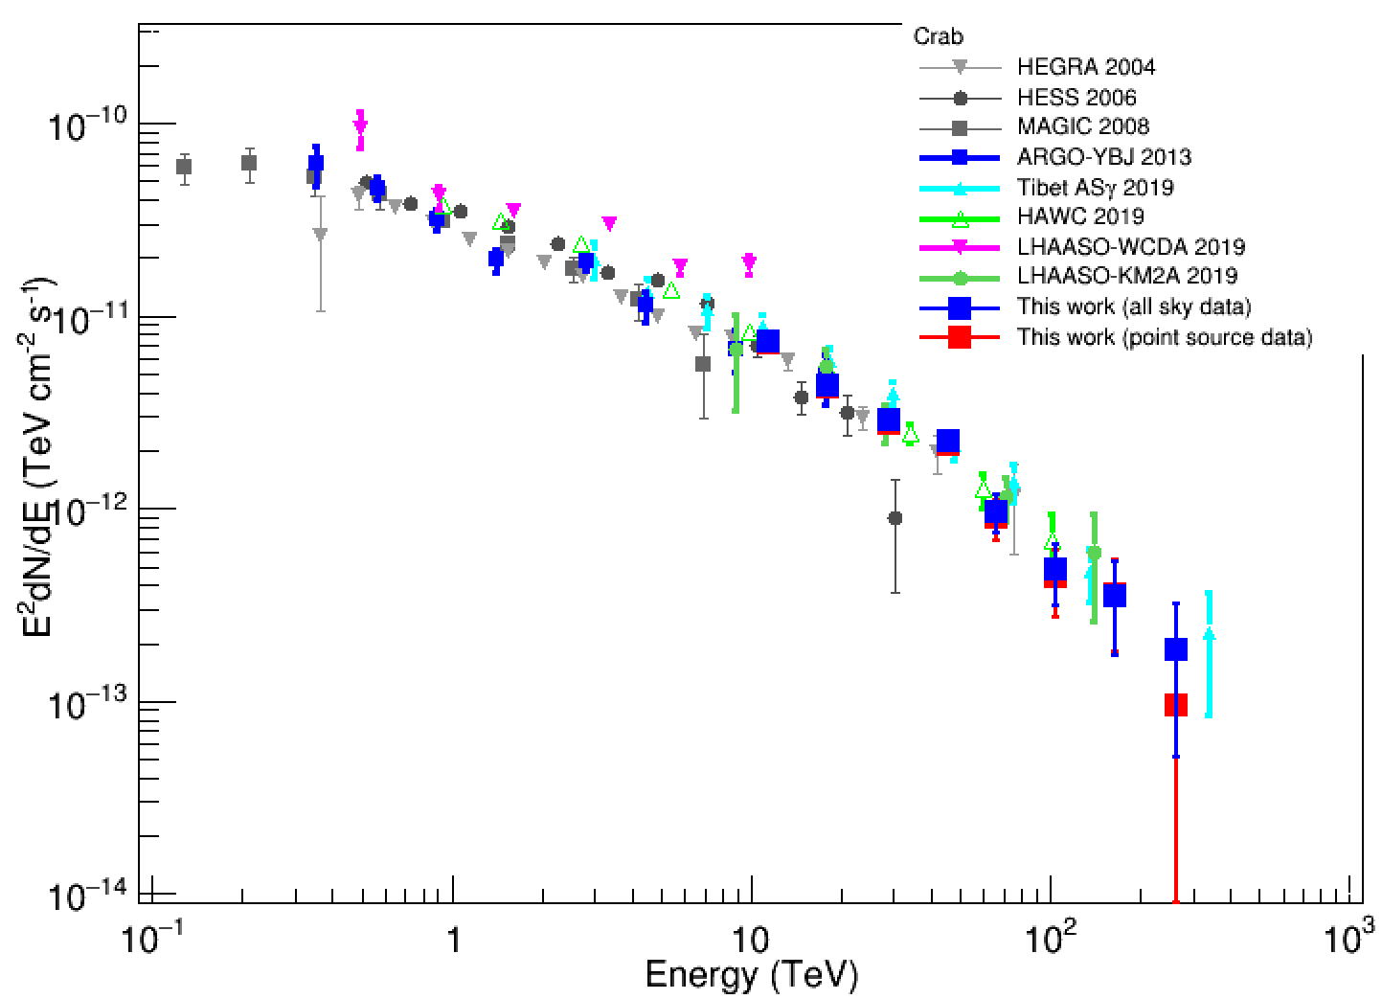
crab能谱验证——单幂律能谱结果
crab(zen:0-50.0 position:[83.65 22.00]), CRs 2.247980e+06
全天区数据能谱
alpha：1.10e-10 ±6.09e-12
beta：-3.097 ±0.067
点源数据能谱
alpha：1.21e-10 ±6.91e-12
beta：-3.14 ±0.067
Notes:
1.10088e-10 6.09224e-12 -3.09742 0.066932
1.20986e-10 6.91054e-12 -3.14129 0.0665214

Slide 9
具体结果
全天区数据能谱
alpha：1.10e-10 ±6.09e-12
beta：-3.097 ±0.067
点源数据能谱
alpha：1.21e-10 ±6.91e-12
beta：-3.14 ±0.067
E: 11.4815 flux_hawc:7.43368e-12(+-)7.04368e-13
E: 18.197 flux_hawc:4.34297e-12(+-)3.70901e-13
E: 28.8403 flux_hawc:2.86149e-12(+-)2.73468e-13
E: 45.7088 flux_hawc:2.23087e-12(+-)2.61992e-13
E: 66.0693 flux_hawc:9.68802e-13(+-)2.18012e-13
E: 104.713 flux_hawc:4.86194e-13(+-)1.72291e-13
E: 165.959 flux_hawc:3.51344e-13(+-)1.78583e-13
E: 263.027 flux_hawc:1.85566e-13(+-)1.33654e-13
E: 11.4815 flux_hawc:7.17523e-12(+-)7.12073e-13
E: 18.197 flux_hawc:4.21386e-12(+-)3.71952e-13
E: 28.8403 flux_hawc:2.75422e-12(+-)2.68731e-13
E: 45.7088 flux_hawc:2.1545e-12(+-)2.58108e-13
E: 66.0693 flux_hawc:8.93531e-13(+-)2.09797e-13
E: 104.713 flux_hawc:4.38422e-13(+-)1.63877e-13
E: 165.959 flux_hawc:3.5888e-13(+-)1.7944e-13
E: 263.027 flux_hawc:9.59708e-14(+-)9.59708e-14
Notes:
1.10088e-10 6.09224e-12 -3.09742 0.066932

Slide 10
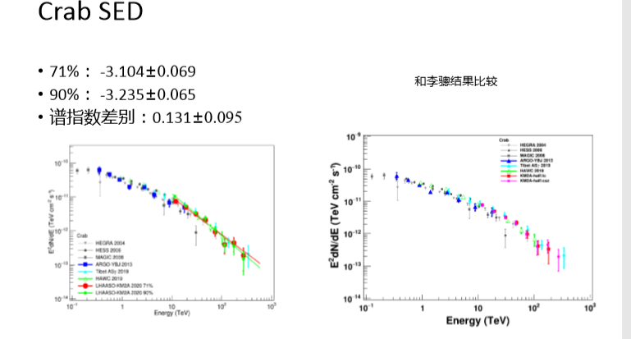
陈老师组 crab

Slide 11
对比结果
我们组点源数据与全天区数据的能谱基本一致，点源最后一个bin误差过大；
两组关于crab能谱幂律结果基本接近；

Slide 12
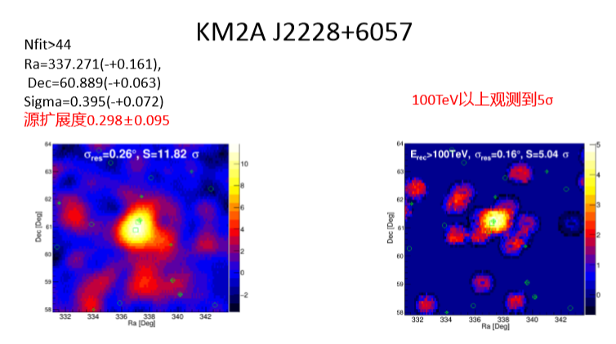
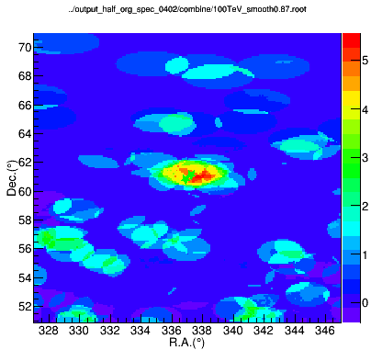
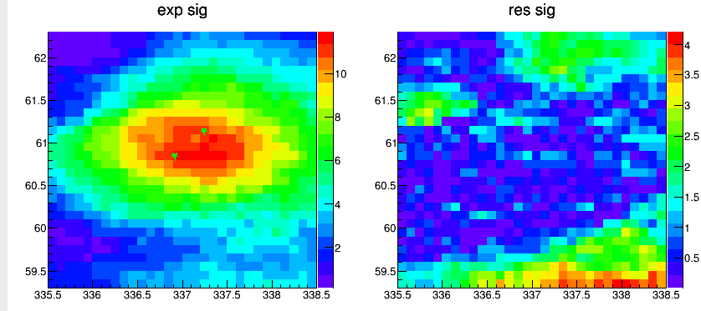
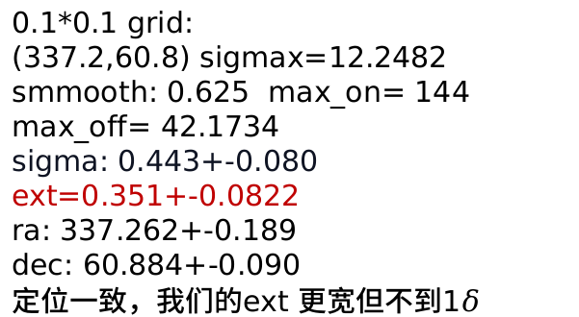
VER2227 NE>44
Sig=5.5
0.05*0.05：
sigma: 0.445+-0.082
ra: 337.265+-0.192
dec: 60.885+-0.091
和0.1的格子结果一致
0.1*0.1 grid:
(337.2,60.8) sigmax=12.2482 smmooth: 0.625 max_on= 144 max_off= 42.1734
sigma: 0.443+-0.080
ext=0.351+-0.0822
ra: 337.262+-0.189
dec: 60.884+-0.090
定位一致，我们的ext 更宽但不到1$δ$
Notes:
337.55 * 60.90861 * 11 * 1.1117071 * 0 * 0.0010000 * 5.5360076 *

Slide 13
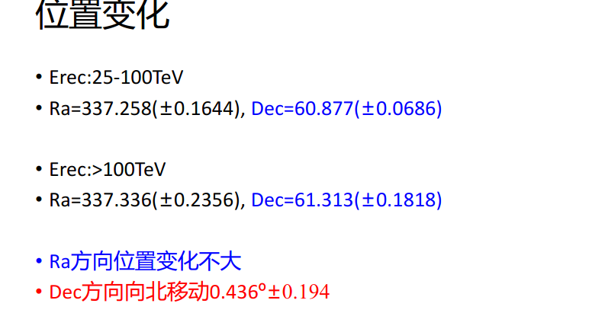
VER227 位置变化
25-100TeV：
ra: 337.137+-0.276 dec: 60.902+-0.096
>100TeV:
ra: 337.622+-0.503 dec: 61.105+-0.204

Slide 14
J2227数据 蓝色ext=0.3，红色ext=0.5,均为全天区数据
J2227_608ra=337.25;
J2227_608dec=60.80;
bin | 能标N | Non |  | Noff |  | sw |  | est
0 | 1-1.2 | 7010 | 9912 | 6843.1 | 9727.9 | 1.23 | 1.47 | -2.2
1 | 1.2-1.4 | 826 | 1298 | 699.97 | 1149.2 | 1.00 | 1.28 | -2.5
2 | 1.4-1.6 | 115 | 173 | 57.12 | 111.4 | 0.82 | 1.15 | -2.6
3 | 1.6-1.8 | 41 | 55 | 6.94 | 13.5 | 0.82 | 1.14 | -2.8
4 | 1.8-2.0 | 12 | 16 | 1.46 | 2.98 | 0.75 | 1.09 | -2.6
5 | 2.0-2.2 | 5 | 5 | 0.45 | 1.05 | 0.71 | 1.07 | -2.5
6 | 2.2-2.4 | 1 | 3 | 0.13 | 0.33 | 0.71 | 1.07 | -2.5
7 | 2.4-2.6 | 1 | 2 | 0.021 | 0.07 | 0.71 | 1.07 | -2.6
8 | 2.6-100 | 1 | 1 | 0.086 | 0.13 | 0.71 | 1.07 | -2.4
sw不是由crab的psf来的？
Notes:
Double_t nhitEdges_NfiltE[bin+1] ={1.0,1.2,1.4,1.6,1.8,2,2.2,2.4,2.6,100};
Double_t EST[bin] ={-2.2,-2.5,-2.6,-2.8,-2.6,-2.5,-2.5,-2.6,-2.4};
Double_t sw[bin] ={1.47 , 1.28 , 1.15, 1.14, 1.09, 1.07, 1.07, 1.07 , 1.07};
Double_t newNon[bin] ={9912,1298,173,55,16,5,3,2,1+0};
Double_t newNoff[bin] ={9727.89,1149.21,111.358,13.4689,2.98231,1.04504,0.334757,0.0700654,0.133252+0};
Double_t sw[bin] ={1.23, 1.00, 0.82, 0.82 , 0.75, 0.71, 0.71, 0.71 ,0.71};
Double_t newNon[bin] ={7010,826,115,41,12,5,1,1,1+0};
Double_t newNoff[bin] ={6843.1,699.974,57.1241,6.94404,1.45707,0.452082,0.12851,0.0214169,0.0858367+0};

Slide 15
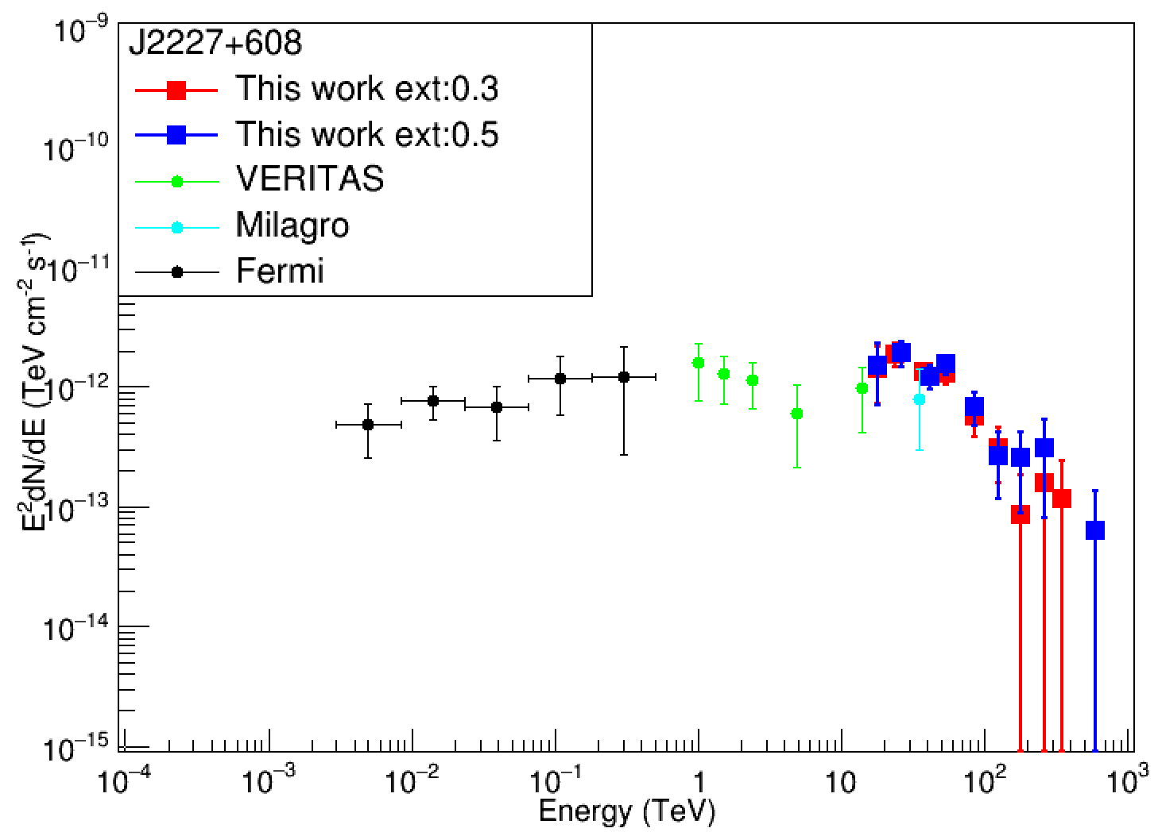
J2227单幂律能谱结果
J2227+608(zen:0-50.0 position:[337.25 60.80]), CRs 2.315230e+06
全天区数据ext0.3：
alpha:4.57754e-11 (+-)5.03656e-12
beta:-3.00517 (+-)0.119968
chi2/ndf:9.09057/7=1.29865
全天区数据ext0.5：
alpha:3.68769e-11 (+-)4.29754e-12
beta:-2.91534 (+-)0.119682
chi2/ndf:8.57083/7=1.2244
Notes:
ext0.3：4.57754e-11 5.03656e-12 -3.00517 0.119968
ext0.5：3.68769e-11 4.29754e-12 -2.91534 0.119682

Slide 16
单幂律模型结果
全天区数据能谱 ext=0.3
alpha：4.57754e-11 ±5.03656e-12
beta：-3.00517 ±0.119968
全天区数据能谱 ext=0.5
alpha：3.68769e-11 ±4.29754e-12
beta：-2.91534 ±0.119682
E: 18.197 flux_hawc:1.43182e-12(+-)7.18276e-13
E: 23.9883 flux_hawc:1.86864e-12(+-)4.26143e-13
E: 38.0189 flux_hawc:1.31287e-12(+-)2.43262e-13
E: 54.9541 flux_hawc:1.29331e-12(+-)2.43166e-13
E: 87.0964 flux_hawc:5.63067e-13(+-)1.85007e-13
E: 125.893 flux_hawc:3.10277e-13(+-)1.52554e-13
E: 181.97 flux_hawc:8.53542e-14(+-)9.79405e-14
E: 263.027 flux_hawc:1.58377e-13(+-)1.61843e-13
E: 346.737 flux_hawc:1.15995e-13(+-)1.26886e-13
E: 18.197 flux_hawc:1.5092e-12(+-)8.16114e-13
E: 26.3027 flux_hawc:1.91995e-12(+-)4.64894e-13
E: 41.6869 flux_hawc:1.22035e-12(+-)2.60395e-13
E: 54.9541 flux_hawc:1.53115e-12(+-)2.73418e-13
E: 87.0964 flux_hawc:6.77576e-13(+-)2.08202e-13
E: 125.893 flux_hawc:2.62647e-13(+-)1.48496e-13
E: 181.97 flux_hawc:2.53653e-13(+-)1.6484e-13
E: 263.027 flux_hawc:3.0402e-13(+-)2.2278e-13
E: 602.56 flux_hawc:6.22727e-14(+-)7.18463e-14

Slide 17
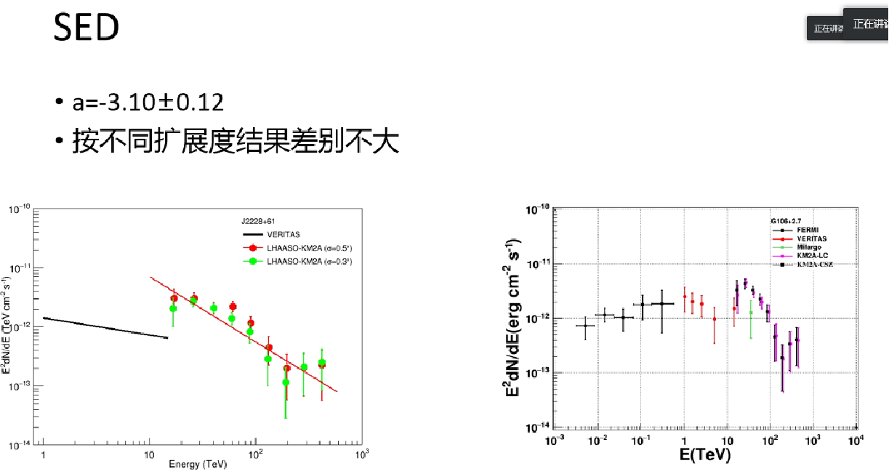
陈老师组 J2227

Slide 18
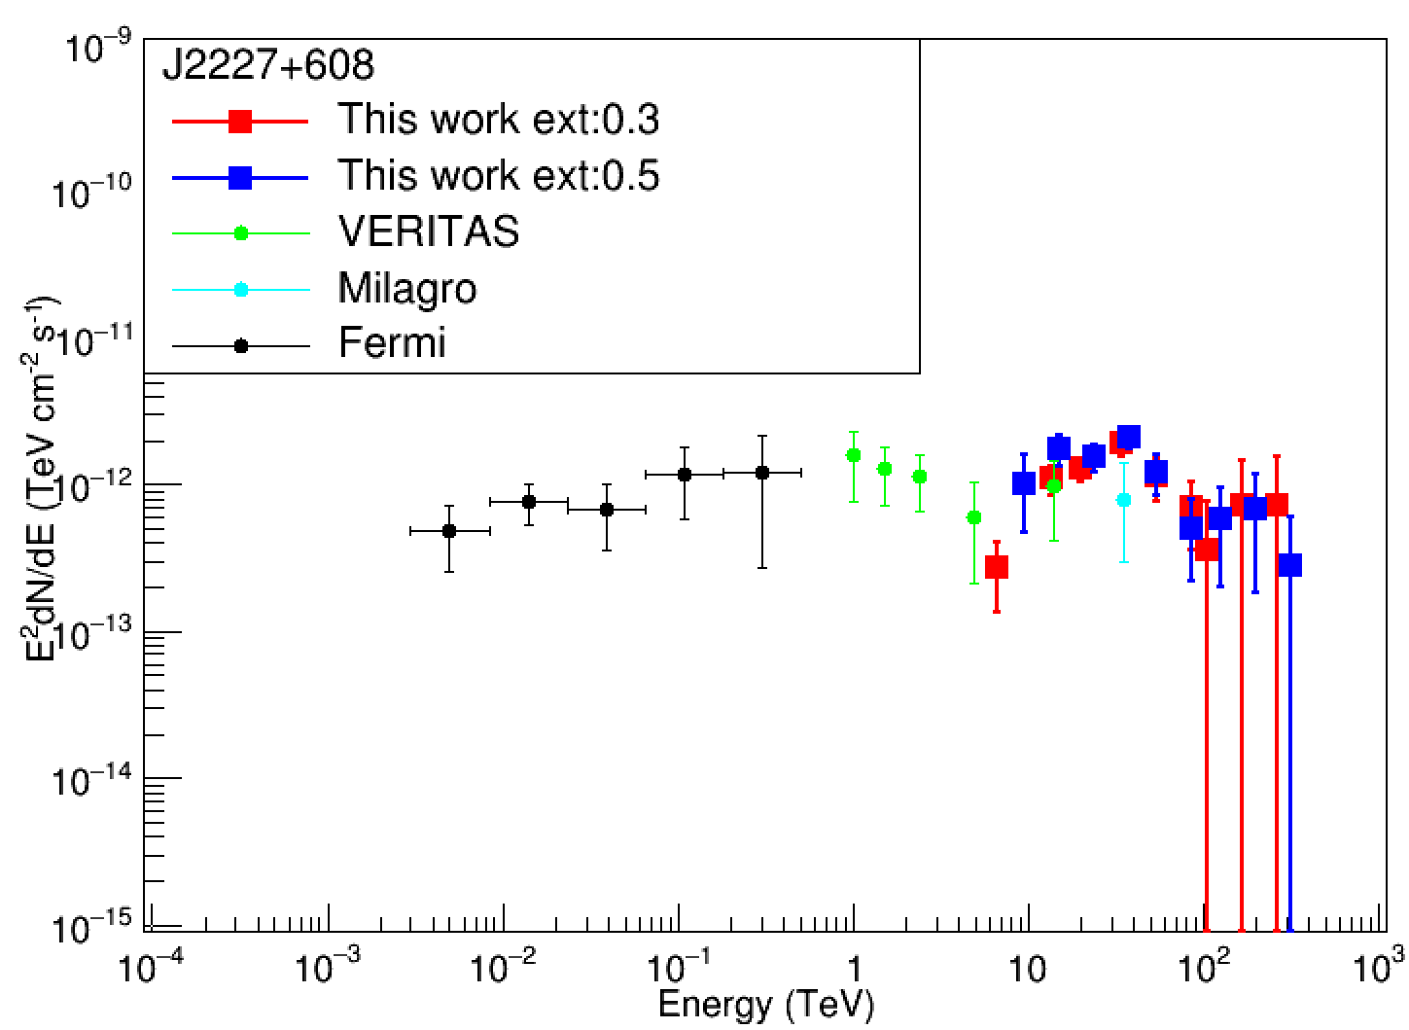
J2227log抛物线能谱结果
全天区数据ext=0.3：
alpha:7.34219e-12 (+-)1.17662e-12
beta:-2.4221 (+-)0.441972
beta2:-0.765967 (+-)0.508886
chi2/ndf:2.60679/6=0.434464
全天区数据ext=0.5：
alpha:9.79295e-12 (+-)1.83269e-12
beta:-2.49585 (+-)0.396315
beta2:-0.483448 (+-)0.46493
chi2/ndf:5.0094/6=0.834901
Notes:
alpha:7.34219e-12 (+-)1.17662e-12
beta:-2.4221 (+-)0.441972
beta2:-0.765967 (+-)0.508886
E: 6.60693 flux_hawc:2.72767e-13(+-)1.36834e-13
E: 13.8038 flux_hawc:1.09456e-12(+-)2.49615e-13
E: 19.9526 flux_hawc:1.286e-12(+-)2.38283e-13
E: 34.6737 flux_hawc:1.90461e-12(+-)3.581e-13
E: 54.9541 flux_hawc:1.14818e-12(+-)3.77259e-13
E: 87.0964 flux_hawc:7.06474e-13(+-)3.47351e-13
E: 104.713 flux_hawc:3.53696e-13(+-)4.05852e-13
E: 165.959 flux_hawc:7.25345e-13(+-)7.41219e-13
E: 263.027 flux_hawc:7.30341e-13(+-)7.98918e-13
alpha:9.79295e-12 (+-)1.83269e-12
beta:-2.49585 (+-)0.396315
beta2:-0.483448 (+-)0.46493
E: 9.54993 flux_hawc:1.02174e-12(+-)5.52515e-13
E: 15.1356 flux_hawc:1.76857e-12(+-)4.28239e-13
E: 23.9883 flux_hawc:1.54274e-12(+-)3.29184e-13
E: 38.0189 flux_hawc:2.10719e-12(+-)3.7628e-13
E: 54.9541 flux_hawc:1.21519e-12(+-)3.73396e-13
E: 87.0964 flux_hawc:5.04526e-13(+-)2.85251e-13
E: 125.893 flux_hawc:5.75748e-13(+-)3.74159e-13
E: 199.526 flux_hawc:6.82575e-13(+-)5.00176e-13
E: 316.228 flux_hawc:2.8303e-13(+-)3.26542e-13

Slide 19
log抛物线模型结果
ext=0.3
alpha:7.34219e-12 (+-)1.17662e-12
beta:-2.4221 (+-)0.441972
beta2:-0.765967 (+-)0.508886
chi2/ndf:2.60679/6=0.434464
E: 6.60693 flux_hawc:2.72767e-13(+-)1.36834e-13
E: 13.8038 flux_hawc:1.09456e-12(+-)2.49615e-13
E: 19.9526 flux_hawc:1.286e-12(+-)2.38283e-13
E: 34.6737 flux_hawc:1.90461e-12(+-)3.581e-13
E: 54.9541 flux_hawc:1.14818e-12(+-)3.77259e-13
E: 87.0964 flux_hawc:7.06474e-13(+-)3.47351e-13
E: 104.713 flux_hawc:3.53696e-13(+-)4.05852e-13
E: 165.959 flux_hawc:7.25345e-13(+-)7.41219e-13
E: 263.027 flux_hawc:7.30341e-13(+-)7.98918e-13
ext0.5
alpha:9.79295e-12 (+-)1.83269e-12
beta:-2.49585 (+-)0.396315
beta2:-0.483448 (+-)0.46493
chi2/ndf:5.0094/6=0.834901
E: 9.54993 flux_hawc:1.02174e-12(+-)5.52515e-13
E: 15.1356 flux_hawc:1.76857e-12(+-)4.28239e-13
E: 23.9883 flux_hawc:1.54274e-12(+-)3.29184e-13
E: 38.0189 flux_hawc:2.10719e-12(+-)3.7628e-13
E: 54.9541 flux_hawc:1.21519e-12(+-)3.73396e-13
E: 87.0964 flux_hawc:5.04526e-13(+-)2.85251e-13
E: 125.893 flux_hawc:5.75748e-13(+-)3.74159e-13
E: 199.526 flux_hawc:6.82575e-13(+-)5.00176e-13
E: 316.228 flux_hawc:2.8303e-13(+-)3.26542e-13

Slide 20
J2227数据 蓝色ext=0.3，红色ext=0.5,均为全天区数据
J2227_608ra=337.25;
J2227_608dec=60.80;
bin | 能标N | Non |  | Noff |  | sw |  | est
0 | 1-1.4 | 7010+ 826 | 9912+ 1298 | 6843.1+ 699.97 | 9727.9+ 1149.2 | 1.23 | 1.47 | -2.2
1 | 1.4-1.6 | 115 | 173 | 57.12 | 111.4 | 0.82 | 1.15 | -2.6
2 | 1.6-1.8 | 41 | 55 | 6.94 | 13.5 | 0.82 | 1.14 | -2.8
3 | 1.8-2.0 | 12 | 16 | 1.46 | 2.98 | 0.75 | 1.09 | -2.6
4 | 2.0-100 | 5+ 1+ 1+ 1 | 5+ 3+ 2+ 1 | 0.45+ 0.13+ 0.021+ 0.086 | 1.05+ 0.33+ 0.07+ 0.13 | 0.71 | 1.07 | -2.5
Notes:
Double_t nhitEdges_NfiltE[bin+1] ={1.0,1.2,1.4,1.6,1.8,2,2.2,2.4,2.6,100};
Double_t EST[bin] ={-2.2,-2.5,-2.6,-2.8,-2.6,-2.5,-2.5,-2.6,-2.4};
Double_t sw[bin] ={1.47 , 1.28 , 1.15, 1.14, 1.09, 1.07, 1.07, 1.07 , 1.07};
Double_t newNon[bin] ={9912,1298,173,55,16,5,3,2,1+0};
Double_t newNoff[bin] ={9727.89,1149.21,111.358,13.4689,2.98231,1.04504,0.334757,0.0700654,0.133252+0};
Double_t sw[bin] ={1.23, 1.00, 0.82, 0.82 , 0.75, 0.71, 0.71, 0.71 ,0.71};
Double_t newNon[bin] ={7010,826,115,41,12,5,1,1,1+0};
Double_t newNoff[bin] ={6843.1,699.974,57.1241,6.94404,1.45707,0.452082,0.12851,0.0214169,0.0858367+0};

Slide 21
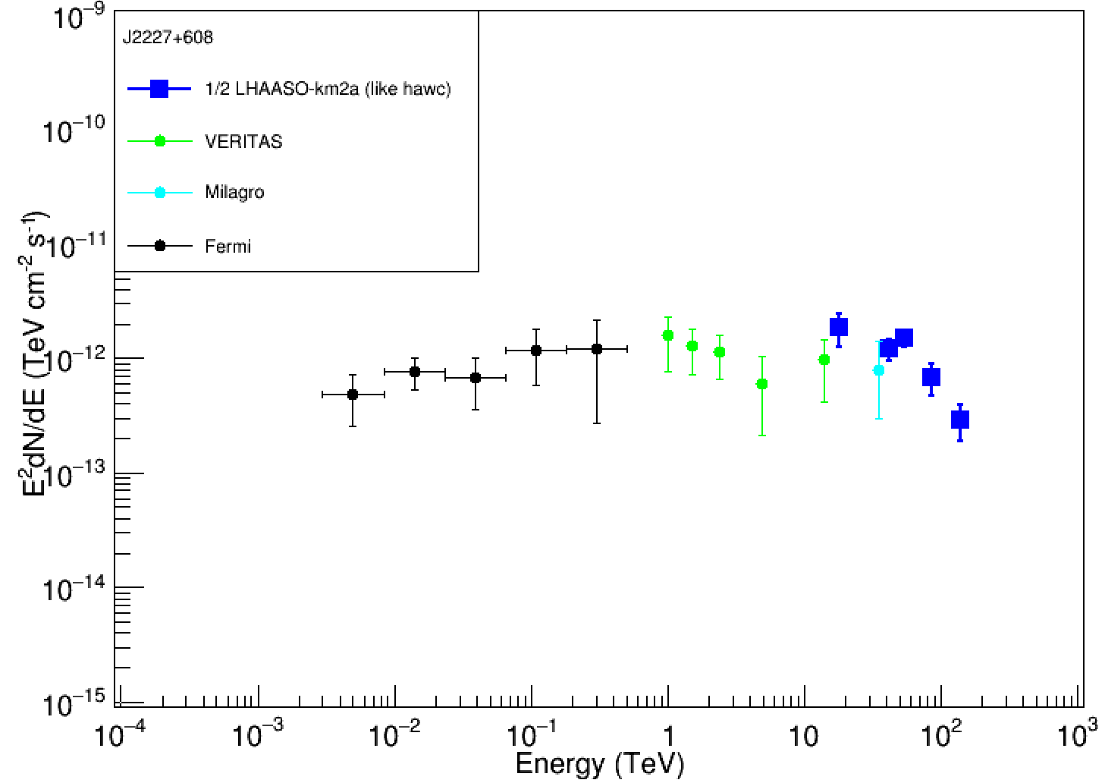
调整bin 单幂律ext0.5
trueobsNon= {11210.0, 173.0, 55.0, 16.0, 11.0 };
trueobsNoff= {10877.1, 111.4, 13.5, 3.0, 1.6 };
trueNs_ob= {332.9, 61.6, 41.5, 13.0, 9.4 };
trueNs_err= {105.9, 13.2, 7.4, 4.0, 3.3 };
trueNs_ob/err= {3.1, 4.7, 5.6, 3.3, 2.8 };
alpha:3.28592e-11 (+-)4.18492e-12
beta:-2.89052 (+-)0.126828
chi2/ndf:7.31521/3=2.4384
E: 18.197 flux_hawc:1.85234e-12(+-)5.89128e-13
E: 41.6869 flux_hawc:1.21866e-12(+-)2.60033e-13
E: 54.9541 flux_hawc:1.52415e-12(+-)2.72167e-13
E: 87.0964 flux_hawc:6.75356e-13(+-)2.0752e-13
E: 138.038 flux_hawc:2.92402e-13(+-)1.02984e-13

Slide 22
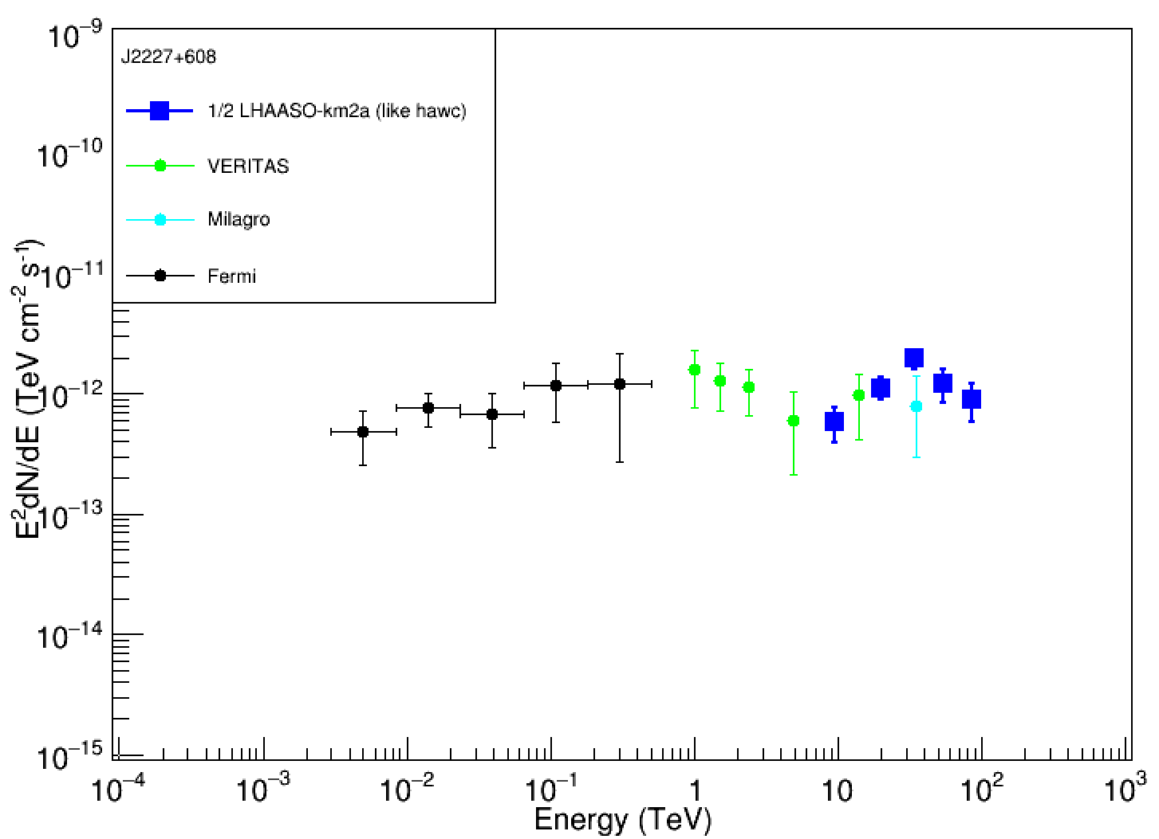
调整bin log抛物线ext0.5
alpha:3.32857e-12 (+-)5.64443e-13
beta:-2.20269 (+-)0.570955
beta2:-0.685221 (+-)0.510208
chi2/ndf:1.96975/2=0.984873
E: 9.54993 flux_hawc:5.76989e-13(+-)1.83509e-13
E: 19.9526 flux_hawc:1.12341e-12(+-)2.39709e-13
E: 34.6737 flux_hawc:1.96716e-12(+-)3.51276e-13
E: 54.9541 flux_hawc:1.20947e-12(+-)3.71639e-13
E: 87.0964 flux_hawc:8.93158e-13(+-)3.1457e-13

Slide 23
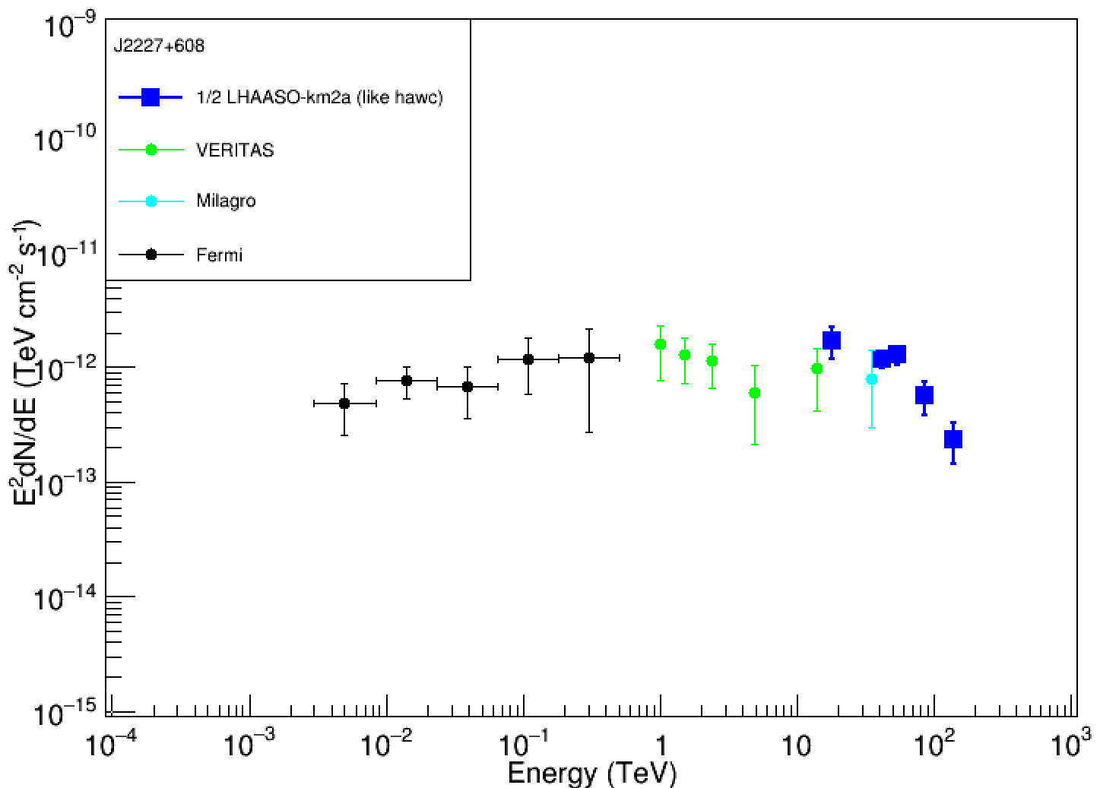
调整bin 单幂律ext0.3
trueobsNon= {7836.0, 115.0, 41.0, 12.0, 8.0 };
trueobsNoff= {7543.1, 57.1, 6.9, 1.5, 0.7 };
trueNs_ob= {292.9, 57.9, 34.1, 10.5, 7.3 };
trueNs_err= {88.5, 10.7, 6.4, 3.5, 2.8 };
trueNs_ob/err= {3.3, 5.4, 5.3, 3.0, 2.6 };
alpha:3.60287e-11 (+-)4.34916e-12
beta:-2.94468 (+-)0.126232
chi2/ndf:6.9168/3=2.3056
E: 18.197 flux_hawc:1.70519e-12(+-)5.15303e-13
E: 41.6869 flux_hawc:1.19472e-12(+-)2.21369e-13
E: 54.9541 flux_hawc:1.28088e-12(+-)2.40827e-13
E: 87.0964 flux_hawc:5.59451e-13(+-)1.83819e-13
E: 138.038 flux_hawc:2.35207e-13(+-)9.09808e-14

Slide 24
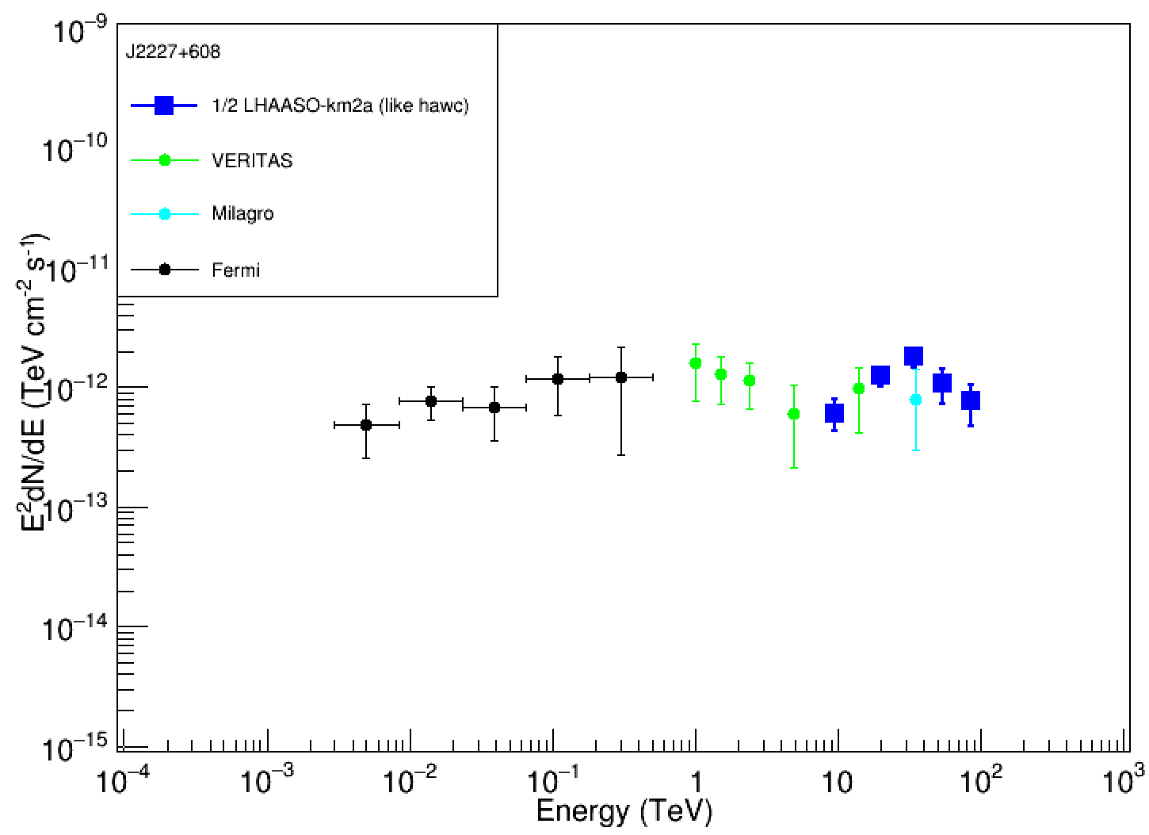
调整bin log抛物线ext0.3
alpha:5.25993e-12 (+-)8.70472e-13
beta:-2.34566 (+-)0.481049
beta2:-0.695601 (+-)0.485934
chi2/ndf:1.05527/2=0.527634
E: 9.54993 flux_hawc:6.08708e-13(+-)1.83949e-13
E: 19.9526 flux_hawc:1.23325e-12(+-)2.28508e-13
E: 34.6737 flux_hawc:1.78372e-12(+-)3.35371e-13
E: 54.9541 flux_hawc:1.06427e-12(+-)3.49689e-13
E: 87.0964 flux_hawc:7.56642e-13(+-)2.92678e-13

Slide 25
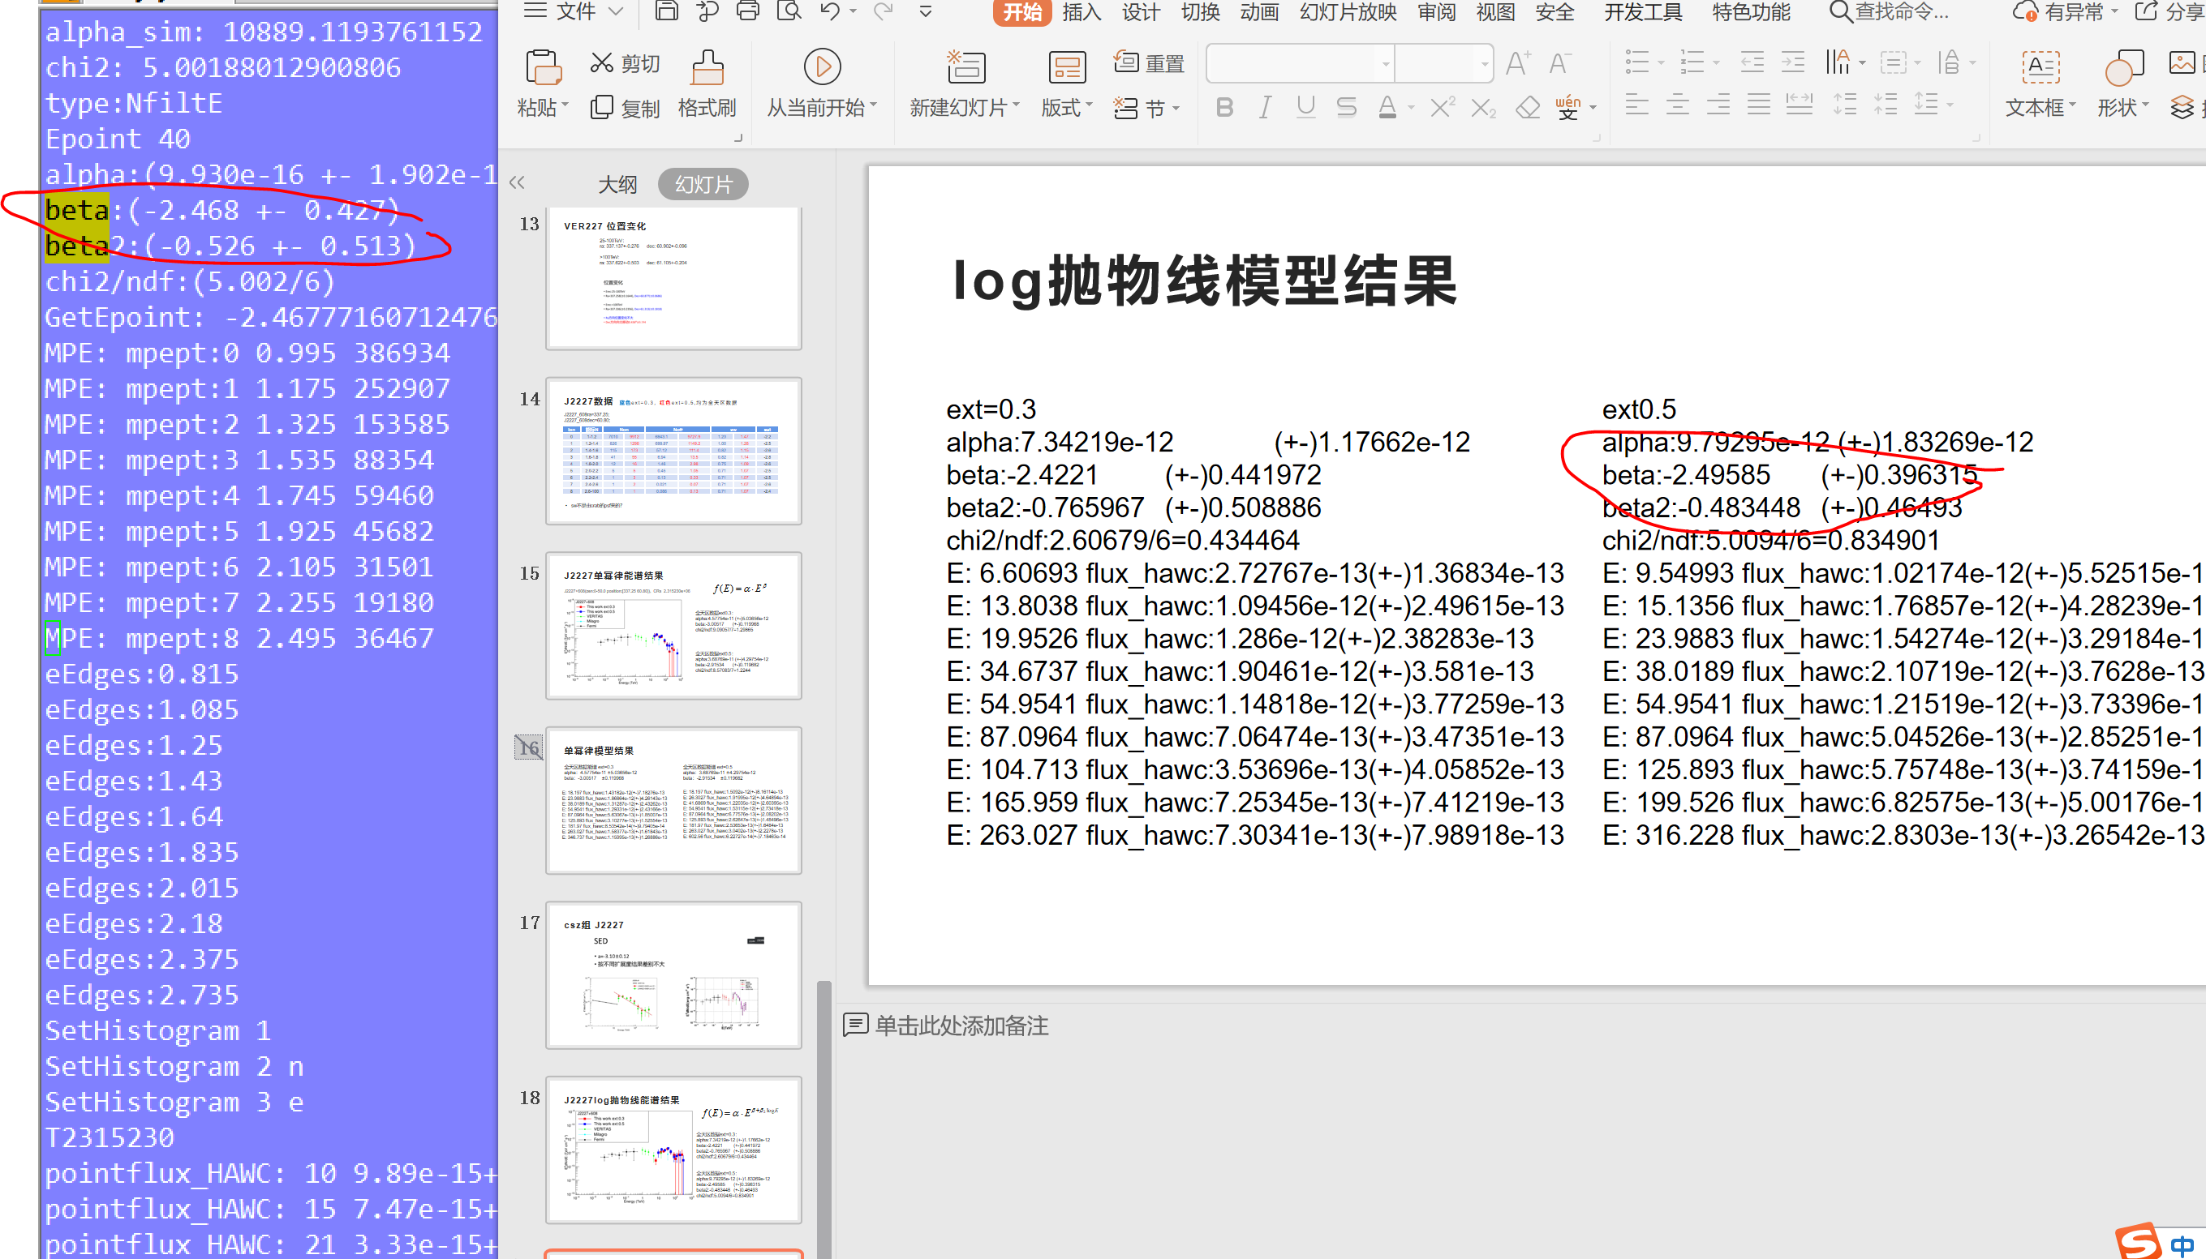
差异

