Slide 1
Exploring Language Models for Query-Document Relevance Prediction on the QBQTC Dataset
CS5242 Group6
Dong Suhong, Li Han, Li Junfeng, Wang Yifei, Wang Hao
Notes:
Good [morning/afternoon] everyone, Today our group is going to present our project titled ‘Exploring Language Models for Query-Document Relevance Prediction on the QBQTC Dataset’. This work is part of CS5242, and our focus is to evaluate how different deep learning architectures perform in identifying how relevant a document title is to a given search query.

Slide 2
Introduction
01
Background
Predicting relevance between a user query and a document title is critical for improving web search and information retrieval systems.
Problems Definition
Goal: Predict the relevance level (Poor, Moderate, High) between a query and a document title.
Challenge: Capture subtle semantic relationships and contextual cues from short text pairs.
Approach: Compare different neural architectures to identify the most effective model for relevance prediction.
Dataset: QQ Browser Query Title Corpus(QBQTC)
Notes:
Let me begin with some background.
In modern search engines, understanding whether a document is truly relevant to a user’s query is crucial. However, this is not a trivial task — queries are often short, and titles may vary in length and structure. The QBQTC dataset, developed by the QQ Browser team, provides labelled query-title pairs. Each pair is annotated with one of three relevance levels: Poor, Moderate, or High.
The problem we aim to solve is: Can we build a model that predicts the relevance level between a query and a title?
The main challenge is to capture the semantic relationships between short text pairs. So, in this project, we compare several neural network architectures — including RNNs, Transformers, and pretrained BERT models — to see which is most effective.

Slide 3
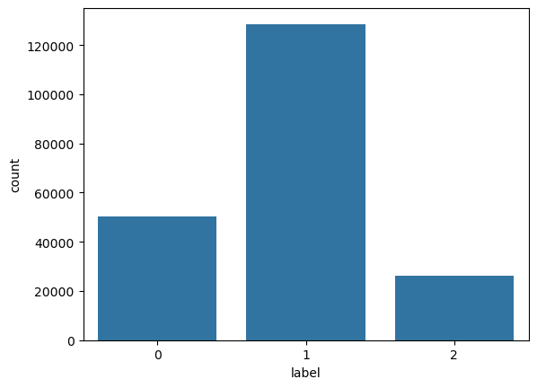
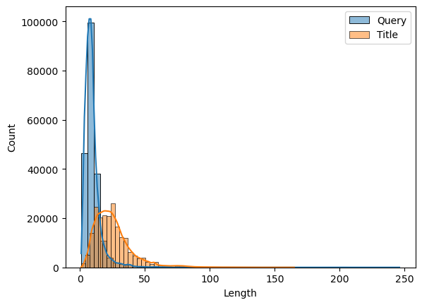
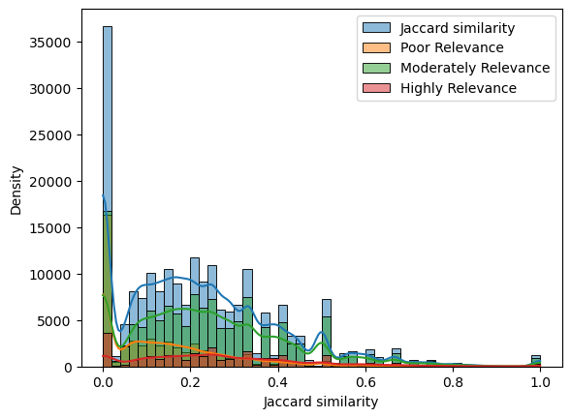
02
EDA
Distribution of Labels
Unbalanced dataset
The number of Label1 is about twice that of the others
Distribution of Document Lengths
Query averages around 9.6 words
Title averages around 25.4 words
But some are extremely long
Overlap between query and title
No strong or consistent patterns
No word-level method
Highline the challenge of this dataset
Notes:
To understand our data better, we started with Exploratory Data Analysis.
First, we noticed the dataset is unbalanced — the ‘Moderate relevance’ class (Label 1) is roughly twice as frequent as the others. We also analyzed the length distributions. On average, queries contain about 9.6 words, while titles average around 25 words — though some titles are extremely long.
Interestingly, we found no strong or consistent word overlap between queries and titles. This highlights the limitations of simple word-matching techniques and underscores the importance of using models that understand context and semantics, which is exactly what we explore next.

Slide 4
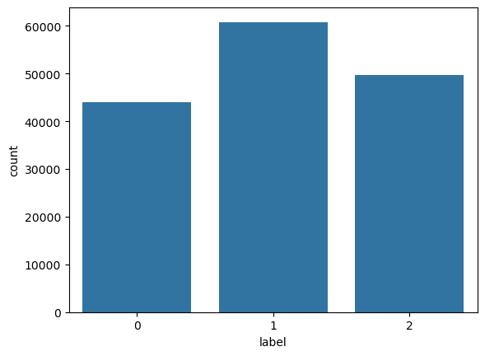
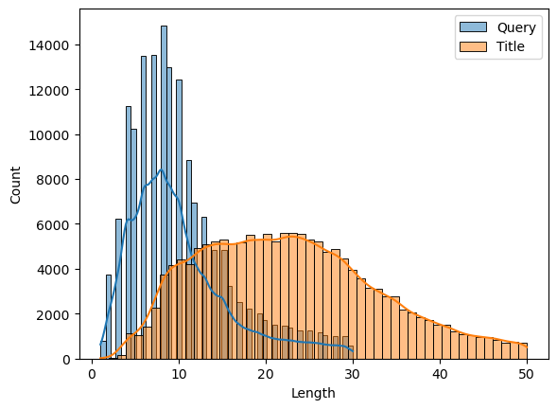
03
Pre-processing
Filtering out the Outliers
Query Length: 30 characters
Title Length: 50 characters
Sampling of the training data via LLMs
Drop 50% of the data with Lable1
Use the LLM to rephrase all the data with Label2
Notes:
In preprocessing, we made several adjustments to ensure cleaner, more balanced data for training.
We filtered out extreme outliers — long or noisy queries and titles beyond a certain length threshold. Then, to address the class imbalance, we applied sampling strategies: we dropped 50% of the over-represented 'Moderate' samples.
Finally, for the highly relevant class, we used a language model to rephrase titles — this not only helped augment the data but also introduced more lexical variety, which can help models generalize better during learning.

Slide 5
03
Model
Naive Method
MLP
1d CNN
Recurrent Neural Network
RNN
LSTM
GRU
Transformer
BERT
BGE
LLM(Qwen2.5)
Notes:
We explored a wide range of models, from simple naive methods like MLP and CNN, to Recurrent Neural Networks including RNN, LSTM, and GRU, and finally to Transformer-based models like BERT, BGE, and Qwen.

Slide 6
03
Model: Naive Method
MLP
Word Embedding
Mean Pooling
MLP Layers
Output Layer
CNN
Word Embedding
TextCNN Model Architecture
Convolution Layers
Concatenation
Dropout Layer
Fully Connected Layer
Notes:
Starting with naive methods:
For the MLP, we used word embeddings, performed mean pooling, and passed the result through multiple MLP layers.
For CNN, we adopted a TextCNN architecture with convolutional layers, concatenation, dropout, and fully connected layers. These models provided a baseline but lacked the ability to model sequential relationships or long-term context."

Slide 7
03
Model: Recurrent Neural Network
Recurrent Neural Networks (RNNs) are designed to handle sequential data by maintaining hidden states across time steps
RNN: Basic recurrent structure, suffers from vanishing gradient issues.
LSTM (Long Short-Term Memory): Introduces gating mechanisms to better capture long-term dependencies.
GRU (Gated Recurrent Unit): A simplified version of LSTM, balances performance and computational efficiency.
Notes:
We explored different RNN variants:
Basic RNNs capture sequences but suffer from vanishing gradients.
LSTMs introduce gates to retain long-term dependencies.
GRUs simplify LSTMs slightly while maintaining performance. Recurrent models improved over naive baselines but still faced challenges with very long sequences."

Slide 8
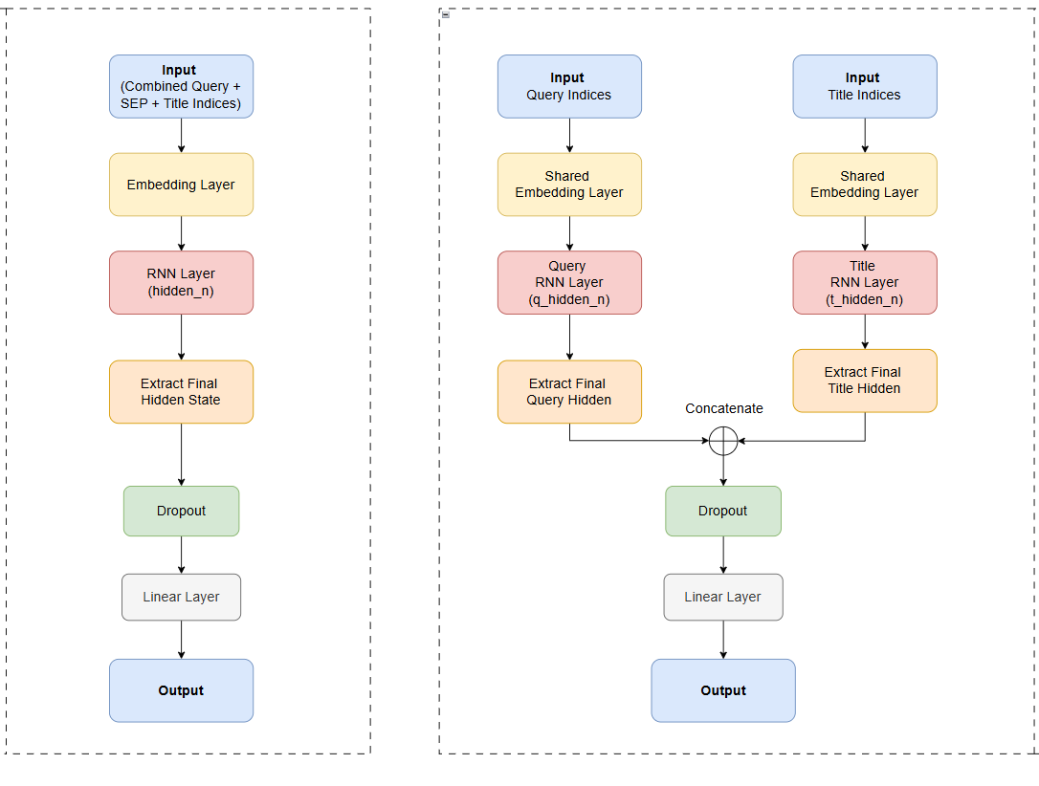
03
Model: Type of Encoder
Single Tower(Encoder)
Merges the query and title
Interaction between query and title
Use Only One Encoder
Double Tower(Encoder)
Encoding the query and title separately
Concatenate the representations for relevance prediction
Notes:
Next, we moved to Recurrent Neural Networks. We experimented with two architectures:
The Single Tower model encodes the merged query and title using a single encoder.
The Double Tower model encodes queries and titles separately, then concatenates the embeddings before classification. This separation allowed better modeling of the individual structures of queries and titles.

Slide 9
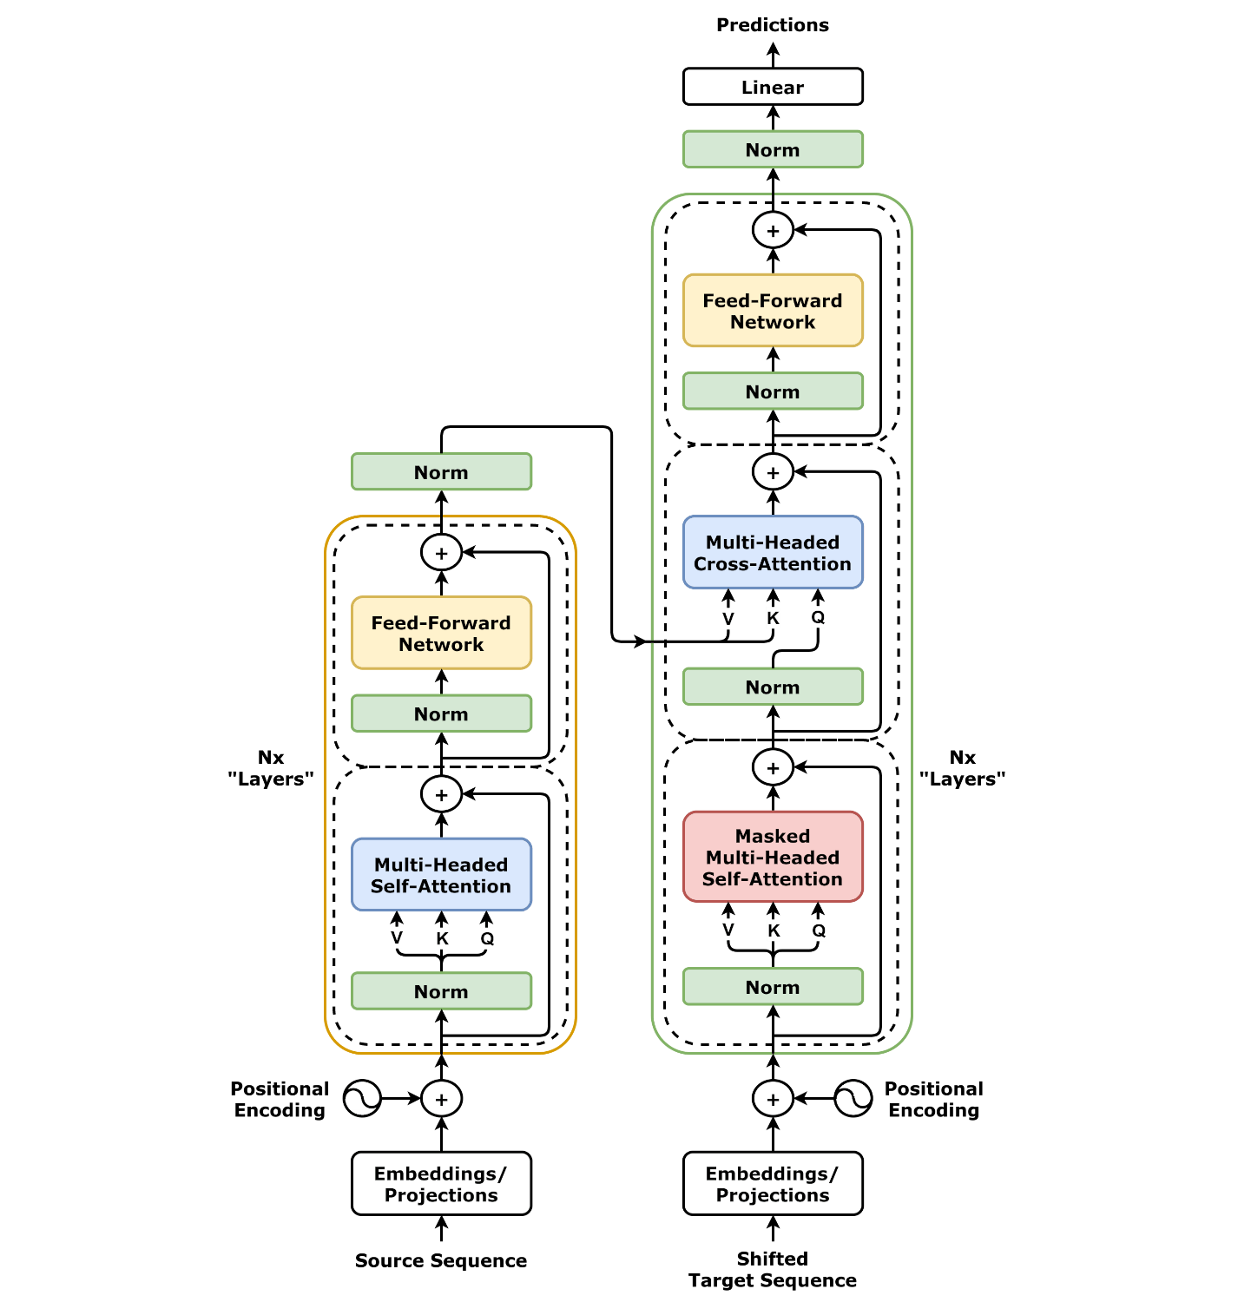
03
From RNNs to Transformer
RNNs struggle with capturing long-range dependencies and are hard to parallelize training
Structure of a Transformer:
Multi-Head Self-Attention: Learns different types of relationships between tokens.
Feed-Forward Network: Enhances representation learning.
Residual Connections + Layer Normalization: Help stabilize and speed up training.
Notes:
However, RNNs still struggled with capturing long-range dependencies and were slow to train due to their sequential nature. To overcome these, we moved to Transformer models. Transformers use multi-head self-attention to capture relationships between all tokens, feed-forward networks for feature transformation, and residual connections plus normalization for training stability.

Slide 10
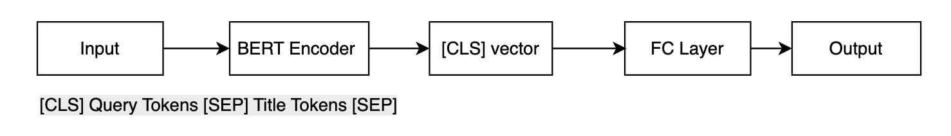
03
Model: BERT
Input Processing:
Used BertTokenizer to tokenize queries and titles.
Added special tokens [CLS] (classification token) and [SEP] (separator token).
Generated attention masks to indicate valid tokens.
Model Architecture:
Adopted BertForSequenceClassification for fine-tuning.
Set up a 3-class classification head to predict different matching levels.
Fine-tuning leverages BERT’s semantic understanding while adapting it to our specific task.
Notes:
BERT was our first Transformer-based model. We tokenized the inputs with BertTokenizer, added [CLS] and [SEP] special tokens, and generated attention masks. We used BertForSequenceClassification to fine-tune BERT on our three-class relevance task. Fine-tuning allowed BERT to retain its strong pre-trained semantic understanding while adapting to our specific dataset.

Slide 11
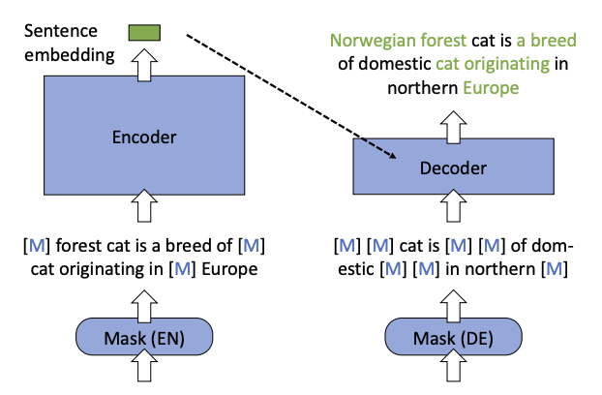
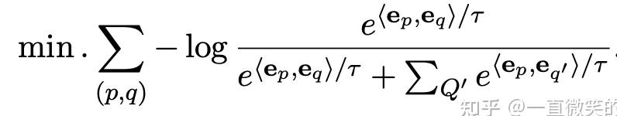
Model: BGE Model
Removal of the NSP Task
Eliminated the Next Sentence Prediction task to avoid noise
Integration of the RetroMAE Module
Incorporated the Retrieval-oriented Masked AutoEncoder (RetroMAE) to reconstruct hidden representations
Incorporation of Contrastive Learning
Notes:
We also explored BGE, a variant of BERT. BGE removes the Next Sentence Prediction task to avoid noise. It incorporates RetroMAE for better hidden representation reconstruction and adds contrastive learning objectives to enhance retrieval quality. These changes aimed to improve robustness and relevance modeling further.

Slide 12
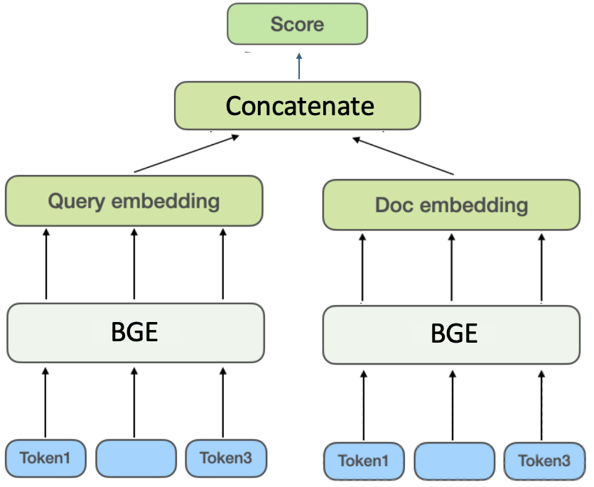
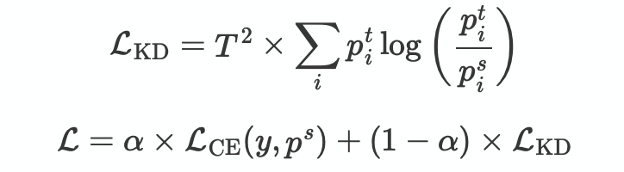
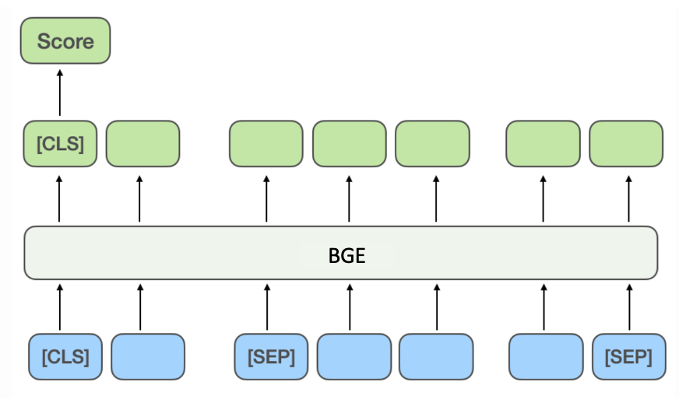


Model: BGE Knowledge Distillation
p^{s}= [0.5,0.3,0.2]
P^{t}=[0.2,0.3,0.5]
Student Model
Accuracy : 67.26% (66.84%, w/o distillation)
F1-Macro:53.68%(50.86% w/o distillation)
23,953,920 * 2 parameters
Teacher Model
Accuracy : 70.20%
F1-Macro: 55.78 %
102,267,648 parameters
Notes:
To make the model lighter, we applied knowledge distillation. The student model achieved about 67% accuracy with a macro F1 of 53.68%, while the teacher model was slightly better but much heavier in parameters. This tradeoff shows that smaller models can still retain decent performance with proper training.

Slide 13
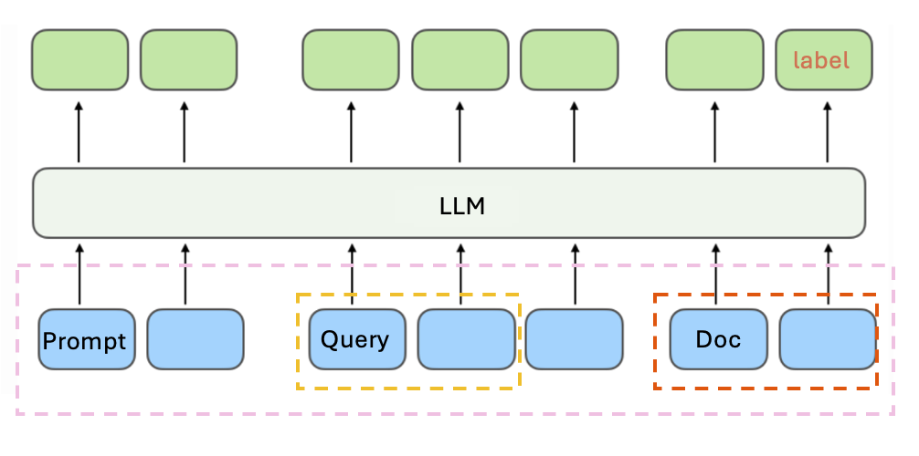
Model Module – Large Language Model
Example
System: You are a search engine. You need to judge the relevance between a given user query and a document.
Score according to the following rules, range 0–2: 0 – Not relevant; 1 – Somewhat relevant; 2 – Relevant. User:
Query:{<Query>} Document:{<Document>} Please give the relevance score (just the number):
Assistant:
1(Label)
Large Language Model(Qwen2.5-0.5B)
Accuracy: 55.48 %
F1-Macro: 43.68 %
494,032,768 parameters
Notes:
We also tested Qwen2.5, a large language model with around 0.5 billion parameters. Its performance was moderate, achieving 55.48% accuracy and 43.68% macro F1. Despite its size, without specific fine-tuning for relevance tasks, its performance lagged behind BERT-based models.

Slide 14
Result
Best Performing Model: BERT, benefits from pre-trained task(Next Sentence Prediction)
Pre-trained Transformers significantly outperform simpler models in document relevance classification, thanks to better semantic understanding and long-range dependency modelling.
Recurrent Models: Double-layer architectures outperformed single-layer ones
Naive Method: struggled, especially on "Highly relevant" examples
Notes:
Now for the results: BERT achieved the best macro F1-score of 0.6546, thanks to its pre-training with Next Sentence Prediction, which closely matches our task. Naive methods like MLP and CNN performed poorly, especially on 'Highly Relevant' examples. Recurrent models benefited from deeper architectures but still couldn't match Transformers in handling long dependencies. Incorporating BGE further improved performance, demonstrating the benefit of retrieval-augmented techniques.

Slide 15

Thanks For Your Attention!
Notes:
That concludes our presentation. Thank you for your attention, and we are happy to take any questions!

