Slide 1
Exploring Language Models for Query-Document Relevance Prediction on the QBQTC Dataset
CS5242 Group6
Dong Suhong, Li Han, Li Junfeng, Wang Yifei, Wang Hao
Notes:
Good [morning/afternoon] everyone, Today our group is going to present our project titled ‘Exploring Language Models for Query-Document Relevance Prediction on the QBQTC Dataset’. This work is part of CS5242, and our focus is to evaluate how different deep learning architectures perform in identifying how relevant a document title is to a given search query.

Slide 2
Introduction
01
Background
Predicting relevance between a user query and a document title is critical for improving web search and information retrieval systems.
Problems Definition
Goal: Predict the relevance level (Poor, Moderate, High) between a query and a document title.
Challenge: Capture subtle semantic relationships and contextual cues from short text pairs.
Approach: Compare different neural architectures to identify the most effective model for relevance prediction.
Dataset: QQ Browser Query Title Corpus(QBQTC)
Notes:
Let me begin with some background.
In modern search engines, understanding whether a document is truly relevant to a user’s query is crucial. However, this is not a trivial task — queries are often short and ambiguous, and titles may vary in length and structure. The QBQTC dataset, developed by the QQ Browser team, provides labelled query-title pairs specifically for this purpose. Each pair is annotated with one of three relevance levels: Poor, Moderate, or High.
The problem we aim to solve is: Can we build a model that accurately predicts the relevance level between a query and a title?
The main challenge is to capture the nuanced semantic relationships between short text pairs. So, in this project, we compare several neural network architectures — including RNNs, Transformers, and pretrained BERT models — to see which is most effective.

Slide 3
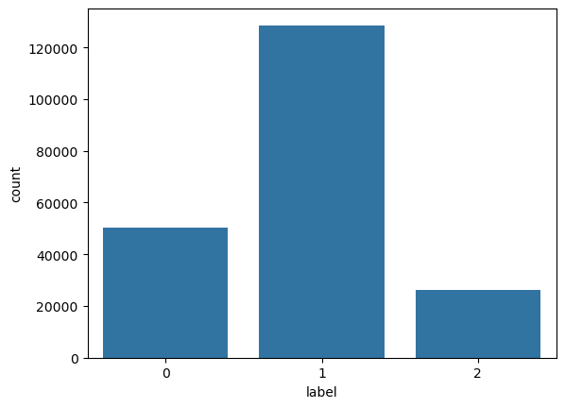
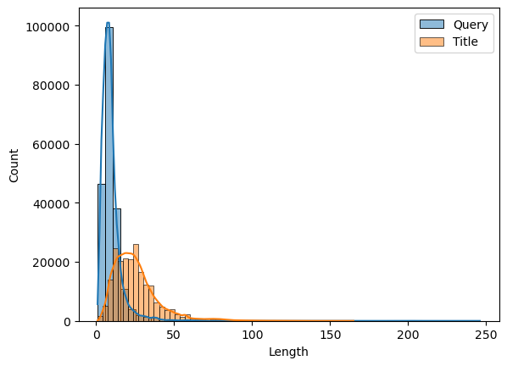
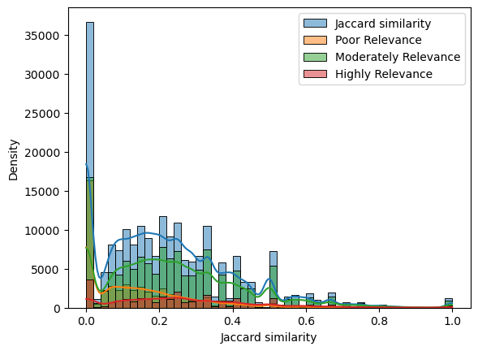
02
EDA
Distribution of Labels
Unbalanced dataset
The number of Label1 is about twice that of the others
Distribution of Document Lengths
Query averages around 9.6 words
Title averages around 25.4 words
But some are extremely long
Overlap between query and title
No strong or consistent patterns
No word-level method
Highline the challenge of this dataset
Notes:
To understand our data better, we started with Exploratory Data Analysis.
First, we noticed the dataset is unbalanced — the ‘Moderate relevance’ class (Label 1) is roughly twice as frequent as the others. We also analyzed the length distributions. On average, queries contain about 9.6 words, while titles average around 25 words — though some titles are extremely long.
Interestingly, we found no strong or consistent word overlap between queries and titles. This highlights the limitations of simple word-matching techniques and underscores the importance of using models that understand context and semantics, which is exactly what we explore next.

Slide 4
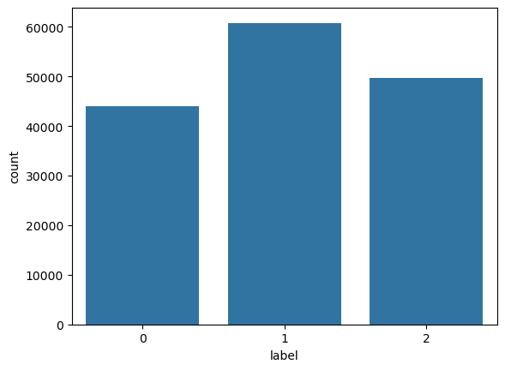
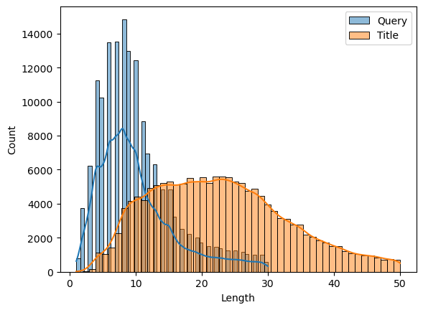
03
Pre-processing
Filtering out the Outliers
Query Length: 30 characters
Title Length: 50 characters
Sampling of the training data via LLMs
Drop 50% of the data with Lable1
Use the LLM to rephrase all the data with Label2
Notes:
In preprocessing, we made several adjustments to ensure cleaner, more balanced data for training.
We filtered out extreme outliers — long or noisy queries and titles beyond a certain length threshold. Then, to address the class imbalance, we applied sampling strategies: we dropped 50% of the over-represented 'Moderate' samples.
Finally, for the highly relevant class, we used a language model to rephrase titles — this not only helped augment the data but also introduced more lexical variety, which can help models generalize better during learning.

Slide 5
04
Model Module - MLP
Vocabulary Building and Text Encoding
Vocabulary Construction
Count word frequencies across training and development data.
Build vocabulary with a maximum size of 10,000 words.
Reserve special tokens `<pad>` and `<unk>`.
Text Encoding
Concatenate `query` and `title` for each sample.
Map words to vocabulary indices.
Pad short sequences to a minimum length if needed.
Embedding Initialization
Embedding Matrix
Size: `(vocab_size, 100)`.
Initialization: Random normal distribution (`mean=0`, `std=0.6`).
Reserve special tokens `<pad>` and `<unk>`.
Embedding Layer
Load the embedding matrix into a non-trainable `nn.Embedding` layer.

Slide 7

Thanks For Your Attention!

