Slide 1
LSI, SVD and Data Management

Slide 2
SVD - Detailed outline
Motivation
Definition - properties
Interpretation
Complexity
Case studies
Additional properties

Slide 3
SVD - Motivation
problem #1: text - LSI: find ‘concepts’
problem #2: compression / dim. reduction

Slide 4
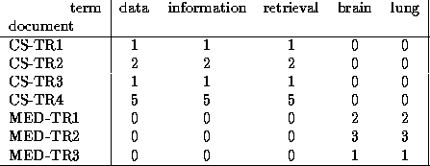
SVD - Motivation
problem #1: text - LSI: find ‘concepts’

Slide 5
SVD - Motivation
problem #2: compress / reduce dimensionality

Slide 6
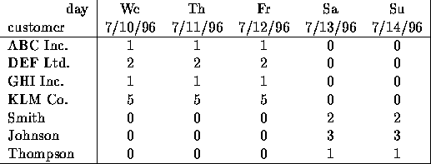
Problem - specs
~10**6 rows; ~10**3 columns; no updates;
random access to any cell(s) ; small error: OK

Slide 7
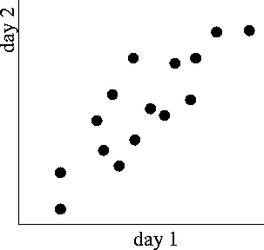
SVD - Motivation

Slide 8
SVD - Motivation

Slide 9
SVD - Definition
A_{[n x m]} = U_{[n x r]} Λ _{[ r x r]} (V_{[m x r]})^{T}
A: n x m matrix (eg., n documents, m terms)
U: n x r matrix (n documents, r concepts)
Λ: r x r diagonal matrix (strength of each ‘concept’) (r : rank of the matrix)
V: m x r matrix (m terms, r concepts)

Slide 10
SVD - Properties
THEOREM [Press+92]: always possible to decompose matrix A into A = U Λ V^{T} , where
U, Λ, V: unique (*)
U, V: column orthonormal (ie., columns are unit vectors, orthogonal to each other)
  U^{T} U = I; V^{T} V = I (I: identity matrix)
Λ: singular values, non-negative and sorted in decreasing order

Slide 11
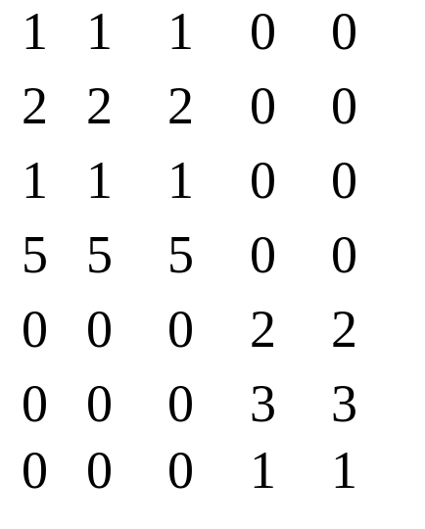
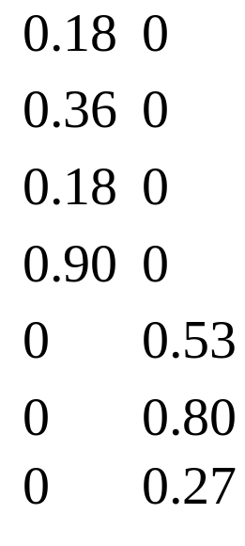
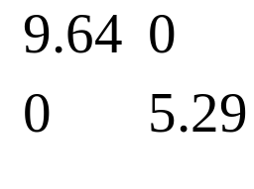
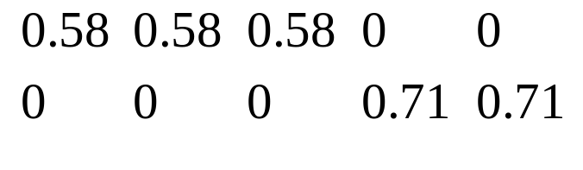
SVD - Example
A = U Λ V^{T} - example:
retrieval
inf.
lung
data
brain
CS
=
x
x
MD

Slide 12
SVD - Example
A = U Λ V^{T} - example:
retrieval
CS-concept
inf.
lung
MD-concept
data
brain
CS
=
x
x
MD

Slide 13
SVD - Example
doc-to-concept
similarity matrix
A = U Λ V^{T} - example:
retrieval
CS-concept
inf.
lung
MD-concept
data
brain
CS
=
x
x
MD

Slide 14
SVD - Example
A = U Λ V^{T} - example:
retrieval
inf.
‘strength’ of CS-concept
lung
data
brain
CS
=
x
x
MD

Slide 15
SVD - Example
A = U Λ V^{T} - example:
term-to-concept
similarity matrix
retrieval
inf.
lung
data
brain
CS-concept
CS
=
x
x
MD

Slide 16
SVD - Example
A = U Λ V^{T} - example:
term-to-concept
similarity matrix
retrieval
inf.
lung
data
brain
CS-concept
CS
=
x
x
MD

Slide 17
SVD - Detailed outline
Motivation
Definition - properties
Interpretation
Complexity
Case studies
Additional properties

Slide 18
SVD - Interpretation #1
‘documents’, ‘terms’ and ‘concepts’:
U: document-to-concept similarity matrix
V: term-to-concept sim. matrix
Λ: its diagonal elements: ‘strength’ of each concept

Slide 19
SVD - Interpretation #2
best axis to project on: (‘best’ = min sum of squares of projection errors)

Slide 20
SVD - Motivation

Slide 21
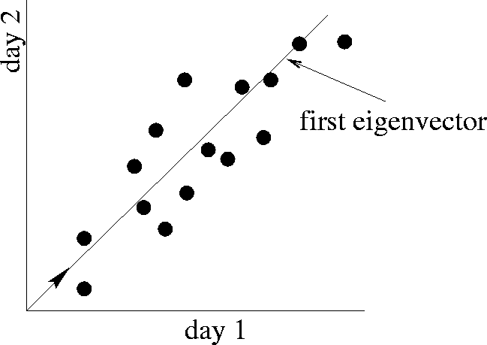
SVD - interpretation #2
SVD: gives
best axis to project
v1
minimum RMS error

Slide 22
SVD - Interpretation #2

Slide 23
SVD - Interpretation #2
A = U Λ V^{T} - example:
=
x
x
v1

Slide 24
SVD - Interpretation #2
A = U Λ V^{T} - example:
variance (‘spread’) on the v1 axis
=
x
x

Slide 25
SVD - Interpretation #2
A = U Λ V^{T} - example:
  U Λ gives the coordinates of the points in the projection axis
=
x
x

Slide 26
SVD - Interpretation #2
More details
Q: how exactly is dim. reduction done?
=
x
x

Slide 27
SVD - Interpretation #2
More details
Q: how exactly is dim. reduction done?
A: set the smallest singular values to zero:
=
x
x

Slide 28
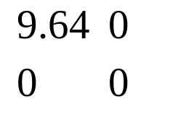
SVD - Interpretation #2
~
x
x

Slide 29
SVD - Interpretation #2
~
x
x

Slide 30
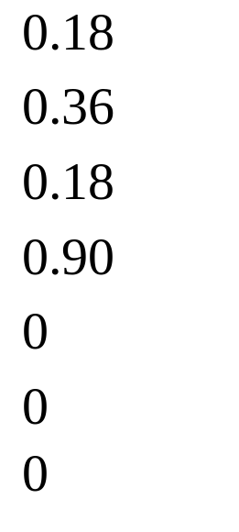
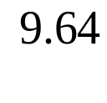
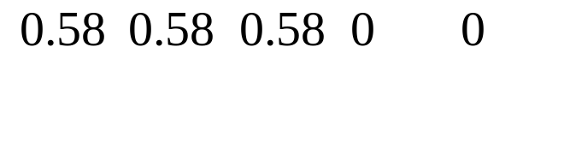
SVD - Interpretation #2
~
x
x

Slide 31
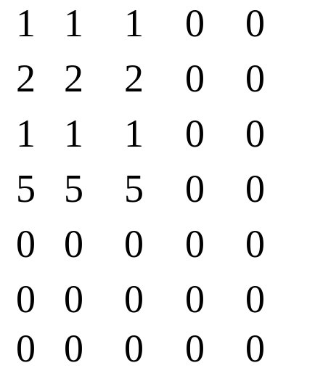
SVD - Interpretation #2
~

Slide 32
SVD - Interpretation #2
Equivalent:
‘spectral decomposition’ of the matrix:
=
x
x

Slide 33
SVD - Interpretation #2
Equivalent:
‘spectral decomposition’ of the matrix:
λ₁
=
u₁
u₂
x
x
λ₂
v₁
v₂

Slide 34
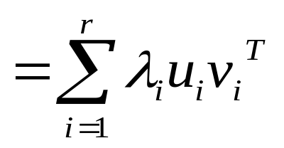
SVD - Interpretation #2
Equivalent:
‘spectral decomposition’ of the matrix:
m
=
λ₁
u₁
v^{T}₁
+
λ₂
u₂
v^{T}₂
+...
n

Slide 35
SVD - Interpretation #2
‘spectral decomposition’ of the matrix:
m
r terms
=
λ₁
u₁
v^{T}₁
+
λ₂
u₂
v^{T}₂
+...
n
n x 1
1 x m

Slide 36
SVD - Interpretation #2
approximation / dim. reduction:
by keeping the first few terms (Q: how many?)
m
To do the mapping you use V^{T}
X’ = V^{T} X
=
λ₁
u₁
v^{T}₁
+
λ₂
u₂
v^{T}₂
+...
n
assume: λ₁ >= λ₂ >= ...

Slide 37
SVD - Interpretation #2
A (heuristic - [Fukunaga]): keep 80-90% of ‘energy’ (= sum of squares of λ_{i} ’s)
m
=
λ₁
u₁
v^{T}₁
+
λ₂
u₂
v^{T}₂
+...
n
assume: λ₁ >= λ₂ >= ...

Slide 38
LSI
A_{[n x m]} = U_{[n x r]} Λ _{[ r x r]} (V_{[m x r]})^{T}
^{then} ^{map to}
A_{[n x m]} = U_{[n x k]} Λ _{[ k x k]} (V_{[m x k]})^{T}
k concepts are the k strongest singular vectors
^{A matrix has rank k}

Slide 39
LSI Querying (Map to Vector Space)
Documents can be represented by the rows of: A’ = U_{[n x k]} Λ _{[ k x k]}
Query now is mapped to k-concept space
  q’ = q_{[1 x m]} V_{[m x k]} Λ _{[ k x k]} ⁻¹
Now, we can use cosine similarity between vectors A’ and q and find the most simialr

Slide 40
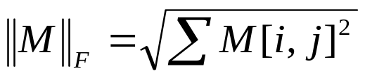

Optimality of SVD
Def: The Frobenius norm of a n x m matrix M is
(reminder) The rank of a matrix M is the number of independent rows (or columns) of M
Let A=UΛV^{T} and A_{k} = U_{k} Λ_{k} V_{k}^{T} (SVD approximation of A)
A_{k} is an nxm matrix, U_{k} an nxk, Λ_{k} kxk, and V_{k} mxk
Theorem: [Eckart and Young] Among all n x m matrices C of rank at most k, we have that:

Slide 41
SVD - Complexity
O( n * m * m) or O( n * n * m) (whichever is less)
less work, if we just want singular values
or if we want first k left singular vectors
or if the matrix is sparse [Berry]
Implemented: in any linear algebra package (LINPACK, matlab, Splus, mathematica ...)

Slide 42
Random Projections
Based on the Johnson-Lindenstrauss lemma:
For:
  0< ε < 1/2,
  any (sufficiently large) set S of n points in R_{m}
  k = O(ε⁻²log n)
There exists a linear map f:S →R_{k}, such that
  (1- ε) D(S,T) < D(f(S),f(T)) < (1+ ε)D(S,T) for S,T in S
Random projection is good with constant probability

Slide 43
Random Projection: Application
Set k = O(ε⁻²log n)
Select k random n-dimensional vectors
  (an approach is to select k gaussian distributed vectors with variance 1 and mean value 0: N(0,1) )
Project the original points into the k vectors.
The resulting k-dimensional space approximately preserves the distances with high probability

Slide 44
LSI by random Projection
We can reduce the cost of LSI using RP
First perform random projection and go from m to l >k dimensions
Apply LSI using O(k) concepts (more than k because of RP but constant factor)

Slide 45
LSI: Theory
Theoretical justification [Papadimitriou et al. ‘98]
If the database consists of k topics, each topic represented by a set of terms, each document comes from one topic by sampling the terms associated with the topic, and topics and documents are well separated
then LSI works with high probability!
Random Projections and then LSI using the correct number of dimensions for each step, is equivalent to LSI!
Christos H. Papadimitriou, Prabhakar Raghavan, Hisao Tamaki, Santosh Vempala: Latent Semantic Indexing: A Probabilistic Analysis. PODS 1998: 159-168

