Slide 1
T-Fuzz: fuzzing by program transformation
Hui Peng, Yan Shoshitaishvili, Mathias Payer
Oakland’18
Presenter: Kai Li

Slide 2
Dilemma of existing fuzzers
Mutational based (AFL, honggfuzz)
Stuck in complex/sanity checks
Symbolic execution based
Path explosion
Augmented Fuzzers (Driller): using symbolic execution to bypass complex checks.
not scalable
failed to solve ‘hard’ checks

Slide 3
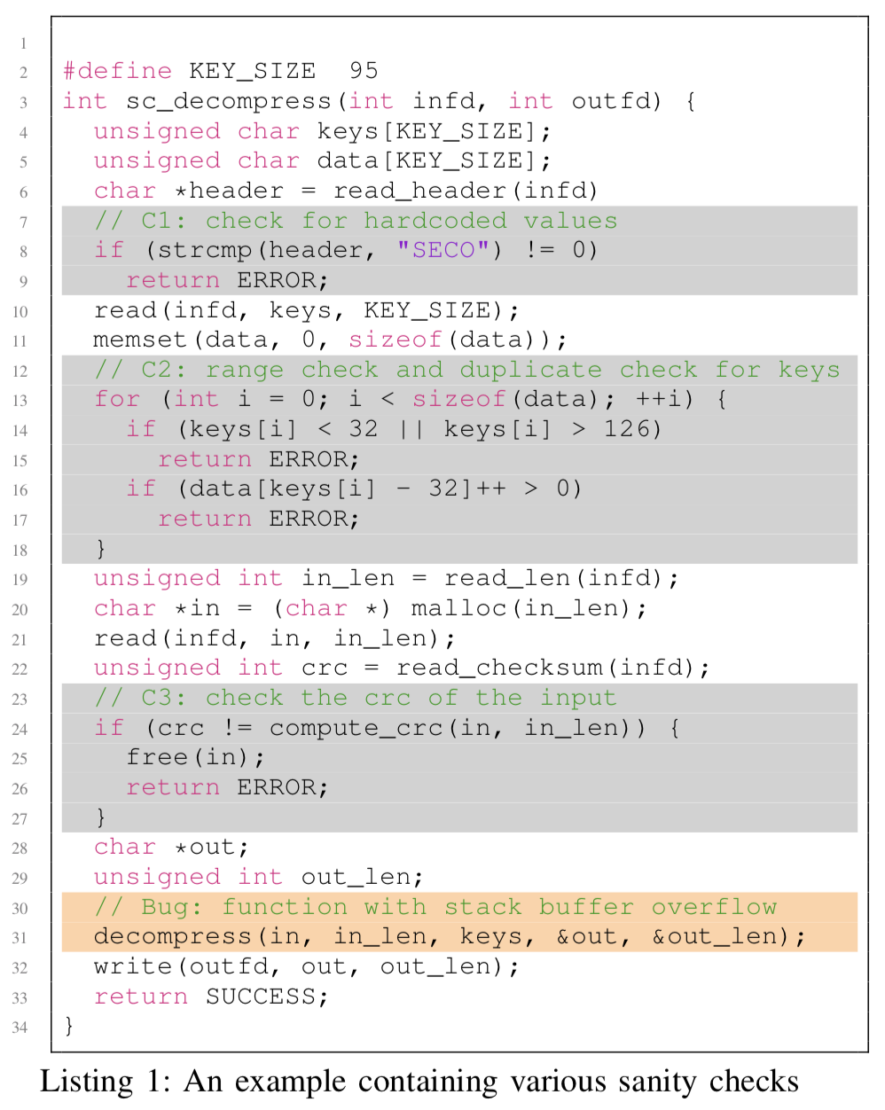
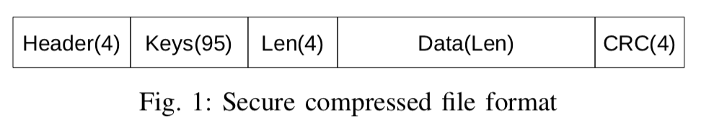
Example of Sanity Checks
L8: check on the magic values of the header field in line 8.
L13-18: check for range and uniqueness on the next 95-byte Keys field.
L24: check on the CRC field for potential data corruption.

Slide 4
Intuition
This work takes a different angle.
How about transform the program by removing the checks?
Problem: may introduce false positives.
To remove false positives, using symbolic execution to check whether the crashed input (in transformed program) still satisfies the path constraints in the original program.

Slide 5
Sanity checks
Critical checks (CC)
Length check in TCP
…
Non-critical checks (NCC) – widely exists
magic value
Hash
Checksum

Slide 6
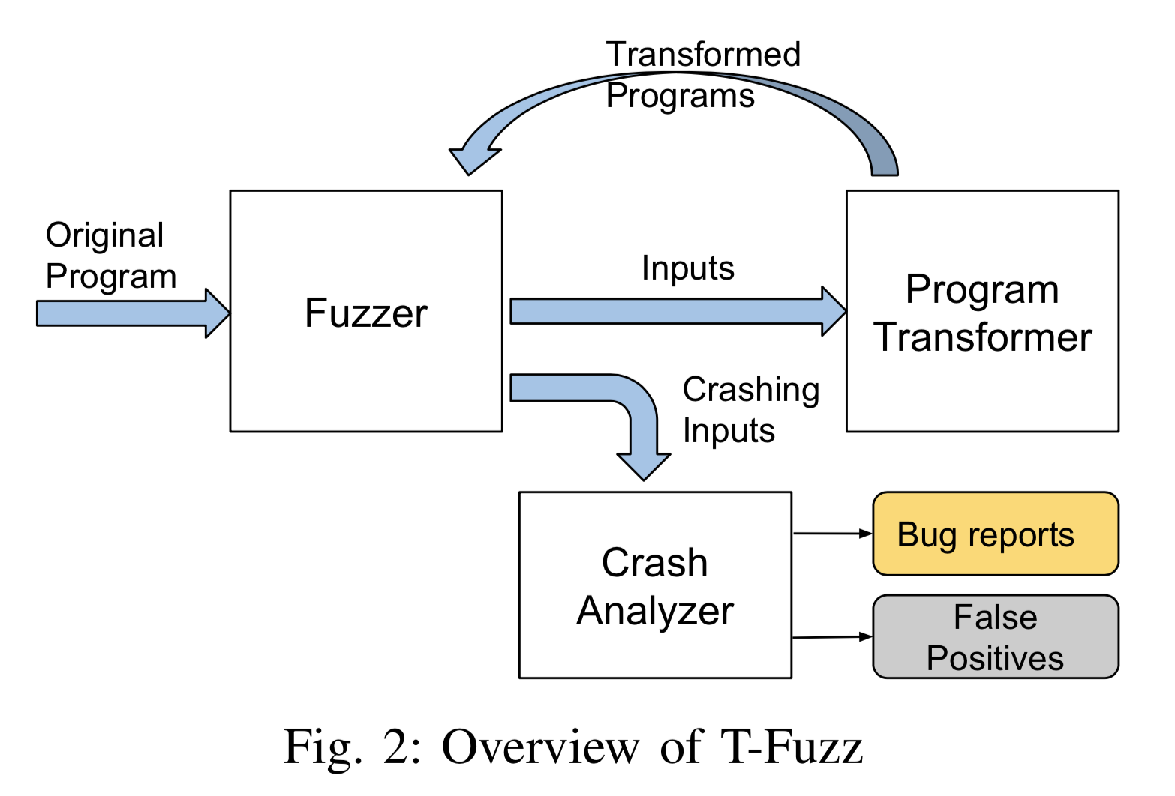
System workflow

Slide 7
Design
Detect NCCs
all the checks that fuzzer-generated inputs could not bypass and leverage an imprecise, light-weight dynamic tracing based approach to detect them.
Program transform
Binary rewriting by removing the checks (replaced with negated conditional jump)
Will introduce false positives
Post-processing
symbolic analysis to verify the crashed input satisfies the path constraints
along with manual analysis (for “hard” checks)

Slide 8
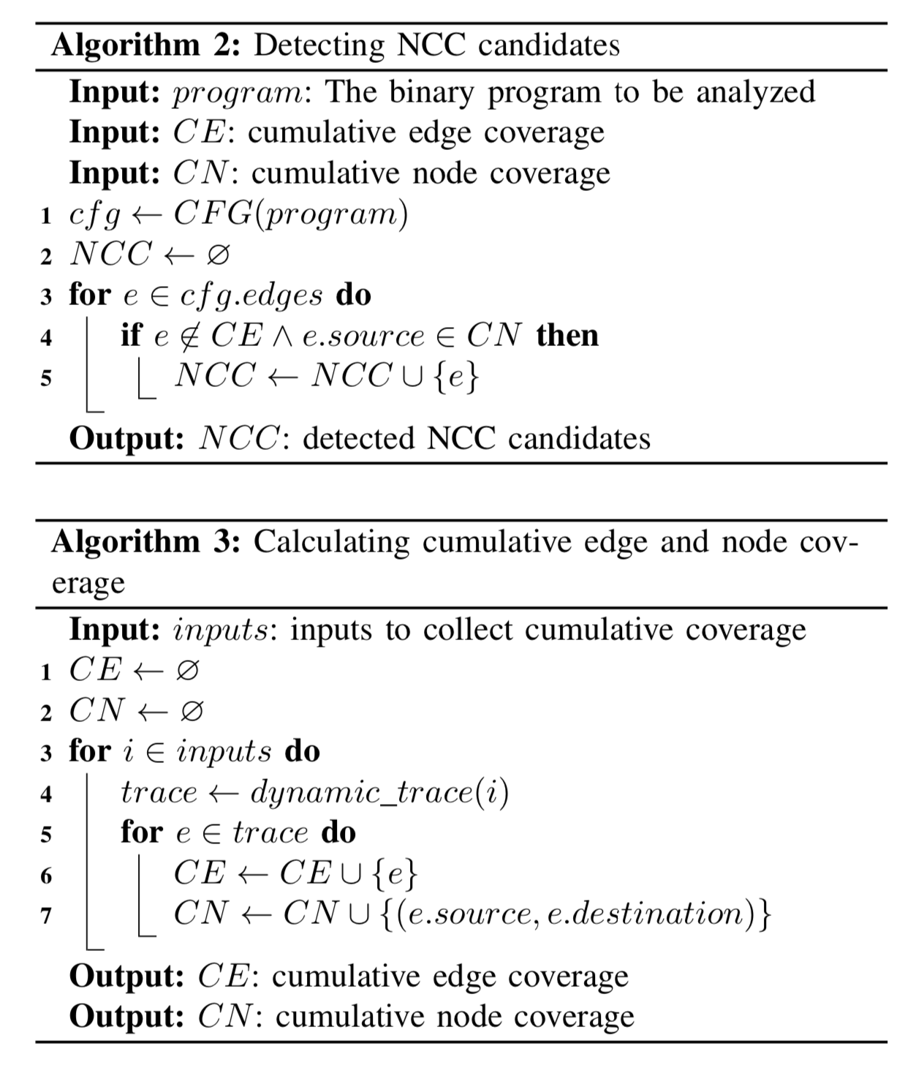
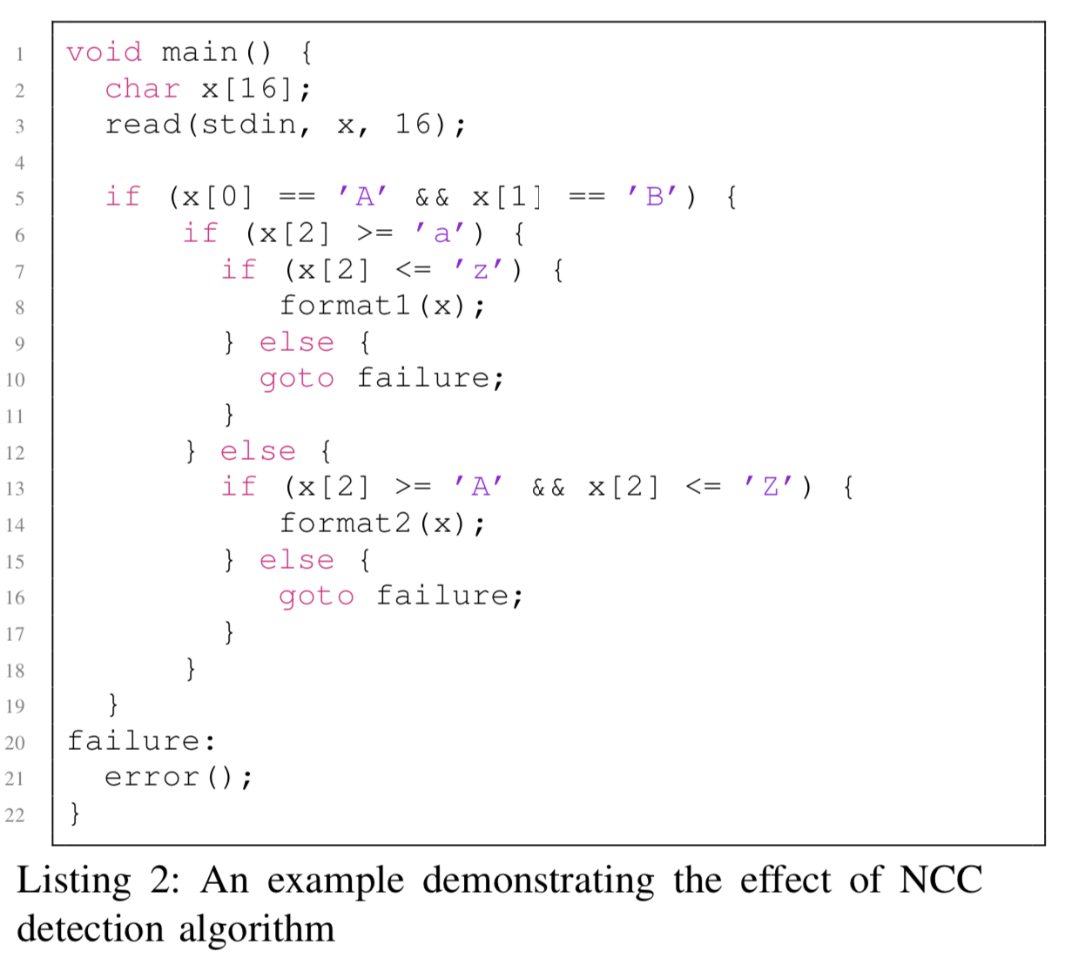
Detect NCCs

Slide 9
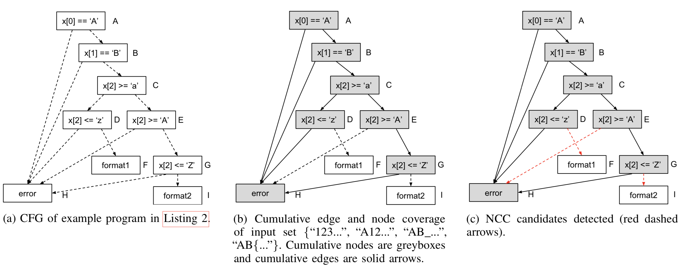
Detect NCCs

Slide 10
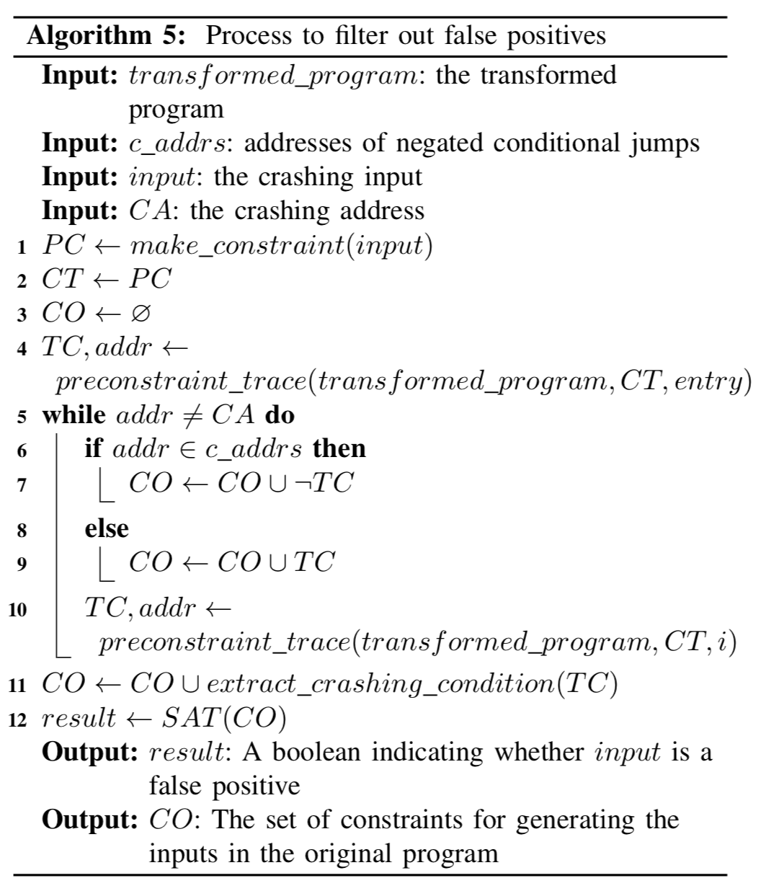
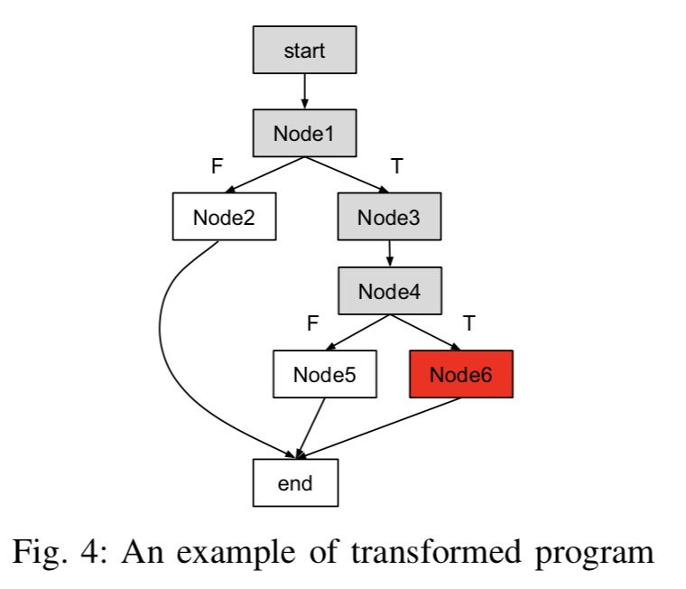
Filter false positives

Slide 11
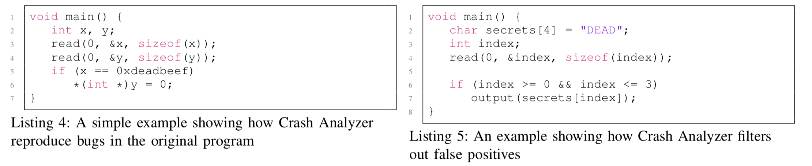
True positive & False positive

Slide 12
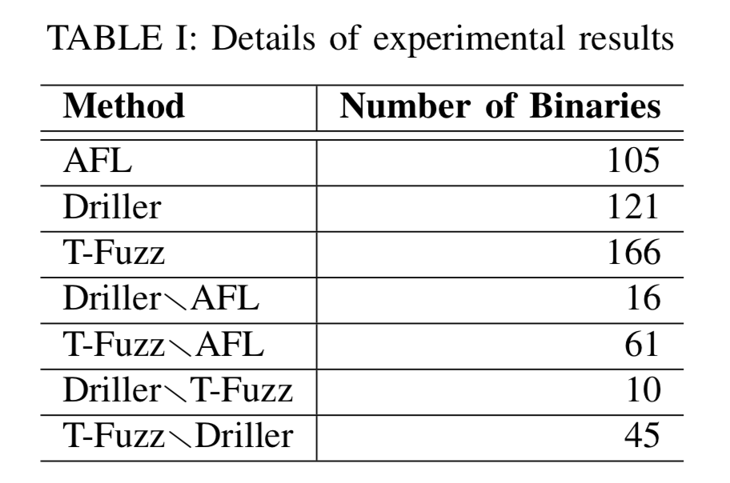
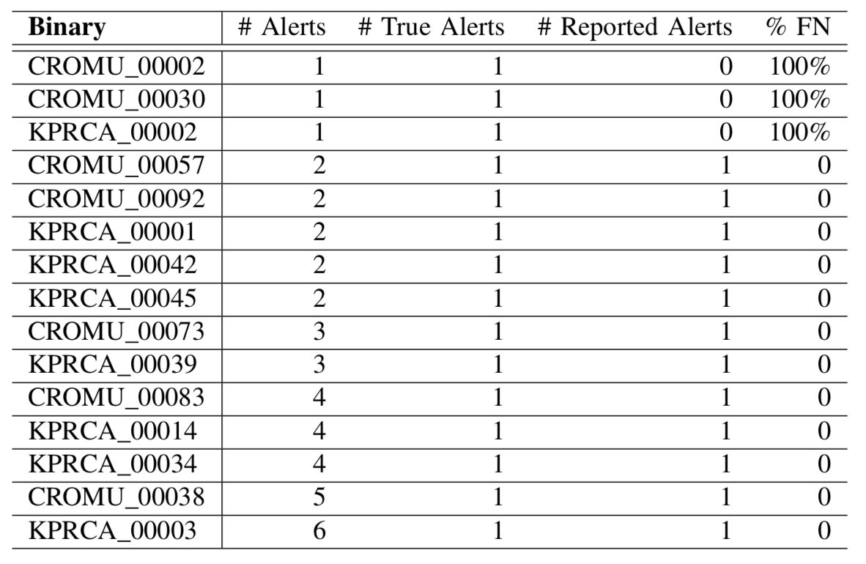
Evaluation
Implementation: AFL + angr
DARPA CGC

Slide 13
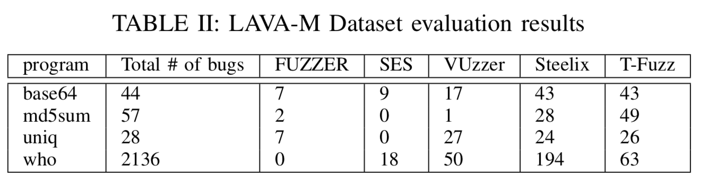
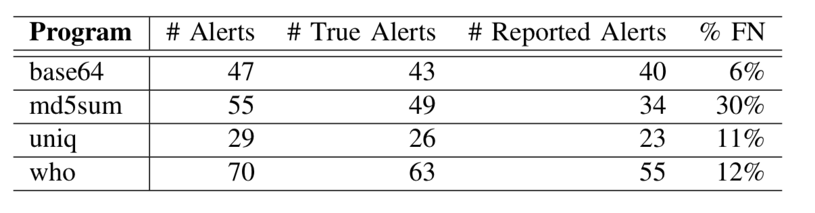
Evaluation
LAVA-M

Slide 14
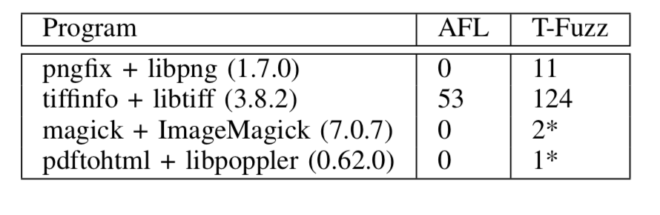
Evaluation
Real-world programs

Slide 15

Thank you! Q&A

