Slide 1
Explaining and Harnessing Adversarial examples
Ian J. Goodfellow, Jonathon Shlens and Christian Szegedy
ICLR’15
Presenter: Kai Li

Slide 2
Background
Machine learning models misclassify examples that are only slightly different from correctly classified examples from the data distribution.
In many cases, a wide variety of models with different architectures trained on different subsets of training data misclassify the same adversarial example.
This suggests that adversarial examples expose fundamental blind spots in our training algorithms.

Slide 3
What is the cause?
Someone hypothesize it is due to extreme nonlinearity of deep neural networks, perhaps combined with insufficient model averaging and insufficient regularization of the purely supervised learning problem?
However, the paper proves linear behavior in high-dimensional spaces is sufficient to cause adversarial examples.

Slide 4
Linear explanation
Digital images often use 8 bits per pixel and discard all information below 1/2⁸ of the dynamic range.
Formally, consider x’ = x+η, we expect that the classifier to assign the same label to x and x’ so long as ||η||∞ < ε, where ε is small enough to be discarded.
For a weight vector w, the activation is:
wx' = wx + wη.
If w has n dimentions and the average magnitude of an element of the weight vector is m, then the deviation is εmn.
Therefore, for high dimentional problems, make tiny changes to the input can result in large output change.

Slide 5
Fast gradient sign method
Let θ be the parameters of a model, x the input to the model, y the targets associated with x (for machine learning tasks that have targets) and J (θ, x, y) be the cost used to train the neural network. We can linearize the cost function around the current value of θ, obtaining an optimal max-norm constrained pertubation of
η = εsign (∇_{x}J(θ, x, y))

Slide 6
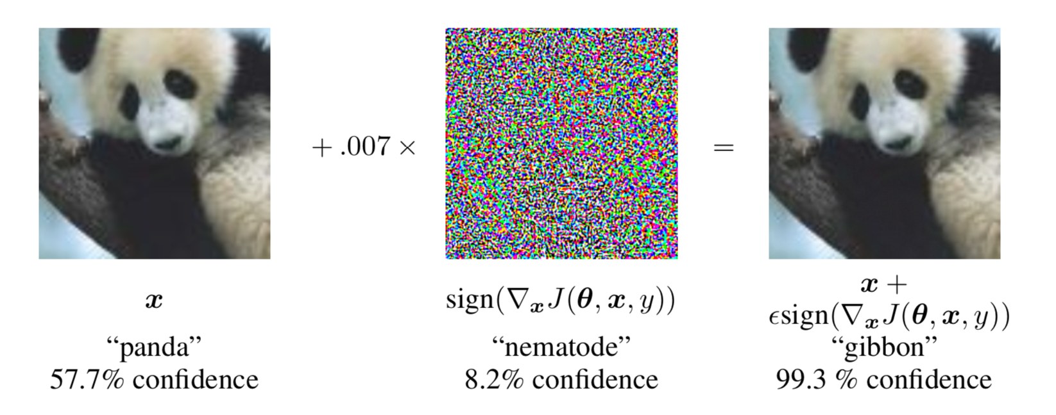
Examples on non-linear models
Fig 1. adversarial example generation applied to GoogLeNet on ImageNet.
1. ε = .25, we cause a shallow softmax classifier to have an error rate of 99.9% with an average confidence of 79.3%
on the MNIST test set.
2. ε = .25, a maxout network misclassifies 89.4% of our adversarial examples with an average confidence of 97.6%.
3. ε = .1, we obtain an error rate of 87.15% and an average probability of 96.6%
assigned to the incorrect labels when using a convolutional maxout network on a preprocessed version of the CIFAR-10.

Slide 7
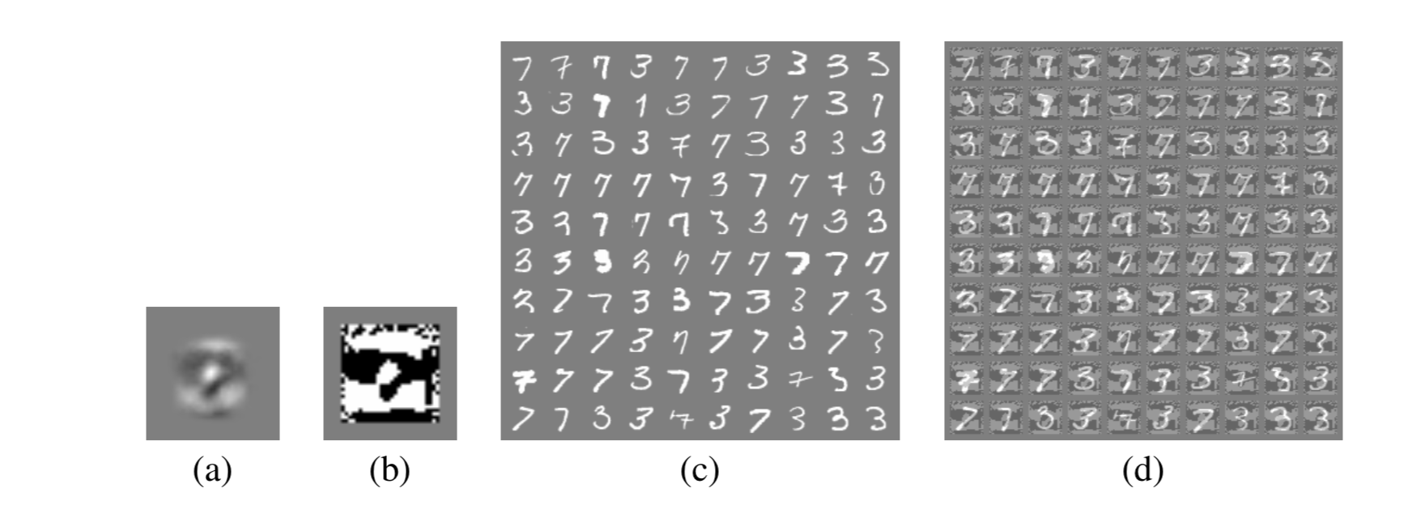
Examples on linear model
Fig 2. The fast gradient sign method applied to logistic regression
The weights of a logistic regression model trained on MNIST.
The sign of the weights of a logistic regression model trained on MNIST. this perturbation is not readily recognizable to a human observer as having anything to do with the relationship between 3s and 7s.
MNIST 3s and 7s. The logistic regression model has a 1.6% error rate on the 3 versus 7 discrimination task on these examples.
Fast gradient sign adversarial examples for the logistic regression model with ε = .25. The logistic regression model has an error rate of 99% on these examples.

Slide 8
Adversarial training of deep networks
Existing research shows that by training on a mixture of adversarial and clean examples, a neural network could be regularized somewhat. However
At the time, this procedure was never demonstrated to improve beyond dropout on a state-of-the-art benchmark.
It was difficult to experiment extensively with expensive adversarial examples
An effective regularizer by fast gradient sign method.

Slide 9

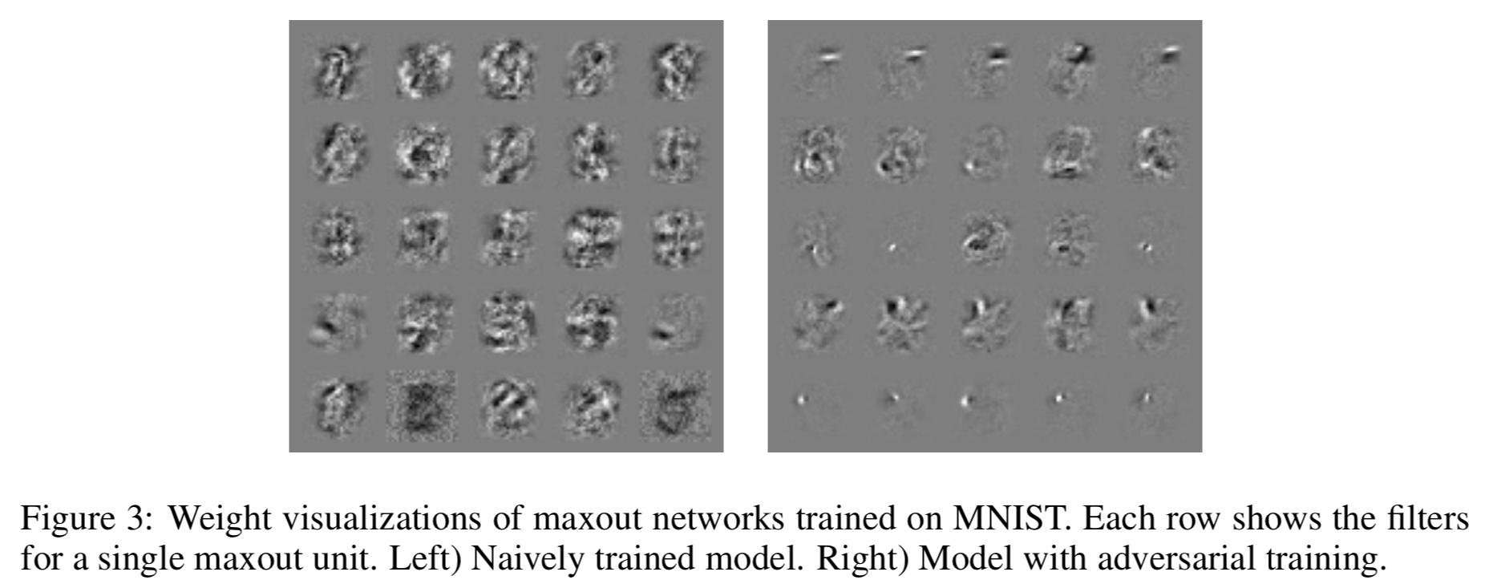
Adversarial training of deep networks
Results
For a maxout network, it had an error rate of 89.4% on adversarial examples generated by fast gradient sign method. After adversarial training, the error rate fell to 17.9%.
After the maxout network is regularized with dropout, we were able to reduce the error rate from 0.94% without adversarial training to 0.84% with adversarial training.

Slide 10
Why Do AEs generalize?
An adversarial example generated for one model is often misclassified by other models.
Explanations:
Adversarial examples occur in broad subspace. The direction η need only have positive dot product with the gradient of the cost function, and ε need only be large enough.
Classification weights classifier is able to learn approximately the same classification weights when trained on different subsets of the training set.

Slide 11
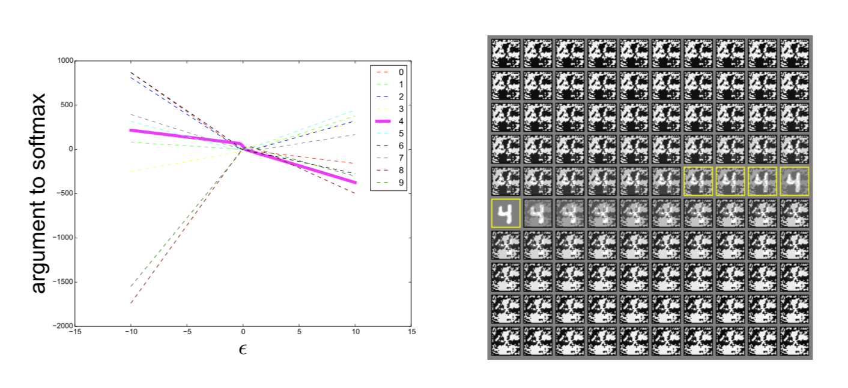
Why it is generalizable

Slide 12
Summary
Adversarial examples can be explained as a property of high-dimensional dot products caused by linear properties.
Generalization on different models.
Large subspace to generate perturbation.
different models learning similar functions when trained to perform the same task.
A family of fast methods for generating adversarial examples .
Adversarial training can result in regularization.

Slide 13

Thank you! Q&A

