Slide 1
EthBMC: A Bounded Model Checker for Smart Contracts
Joel Frank, Cornelius Aschermann, and Thorsten Holz
Usenix ’20
Presenter: Kai Li

Slide 2
Background
Ethereum
Smart contract: programs written by Turing-complete language - solidity
Ethereum Virtual Machine (EVM)
Stack-based machine (pop/push)
Each value having a 256-bit (32 bytes) word size
Three different types of memory:
Storage: a persistent key-value store, mapping 256-bit keys to 256-bit values.
Calldata: a users input in the ‘data’ field of a transaction
Execution memory: volatile memory, like a heap.

Slide 3
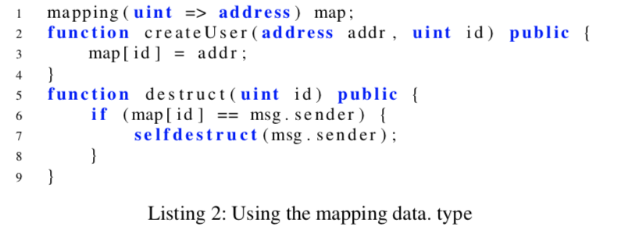
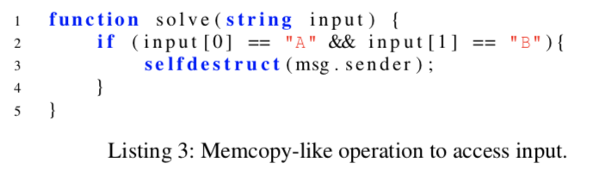
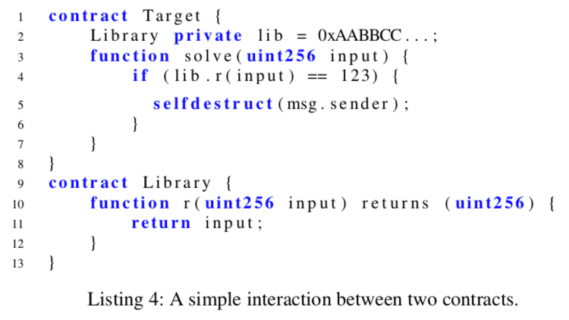
Challenges of Analysis
1. Keccak
Used to address KVs in a mapping
2. Memcopy-like Instructions
String is an unbounded data
CALLDATACOPY instruction to copy
the entire input to execution memory
3. Inter-Contract Communication

Slide 4
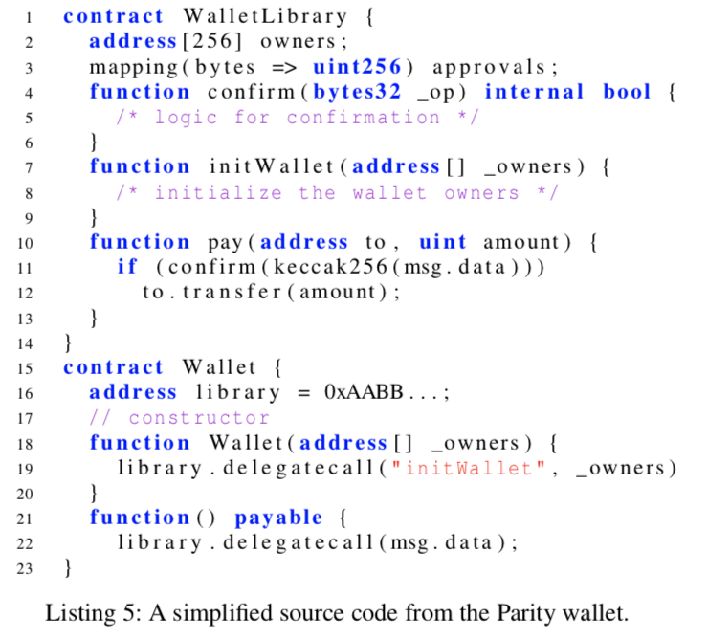
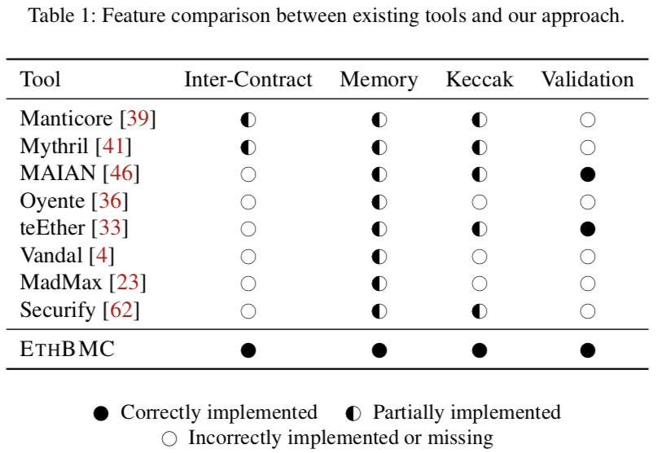
Parity Bug & Existing Analyzers

Slide 5
Modeling the Memory
Represent the memory as a graph representation, connecting different memory regions when we copy from one to the other.
Based on the work of Sinz et al. It models memory as a series of updates called the memory modification graph. We extend this graph notation to accommodate for the EVM characteristics, such as multiple memory regions.

Slide 6
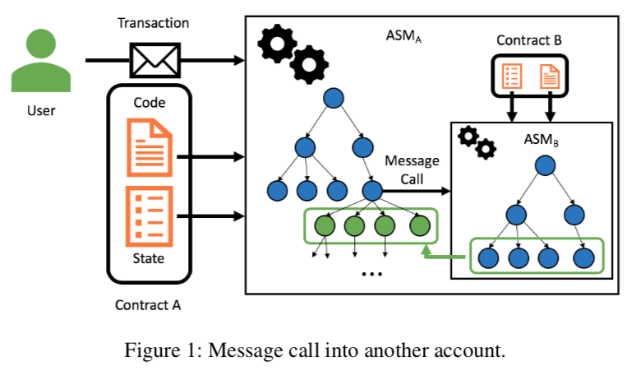
Solution to Inter-communication
First setup an ASMA to simulate the execution of contract A, resulting in an execution tree for A
When encounter a message call to contract B, set up ASMB, run through the entire execution and then fork the execution tree for each state σi ∈ σh

Slide 7
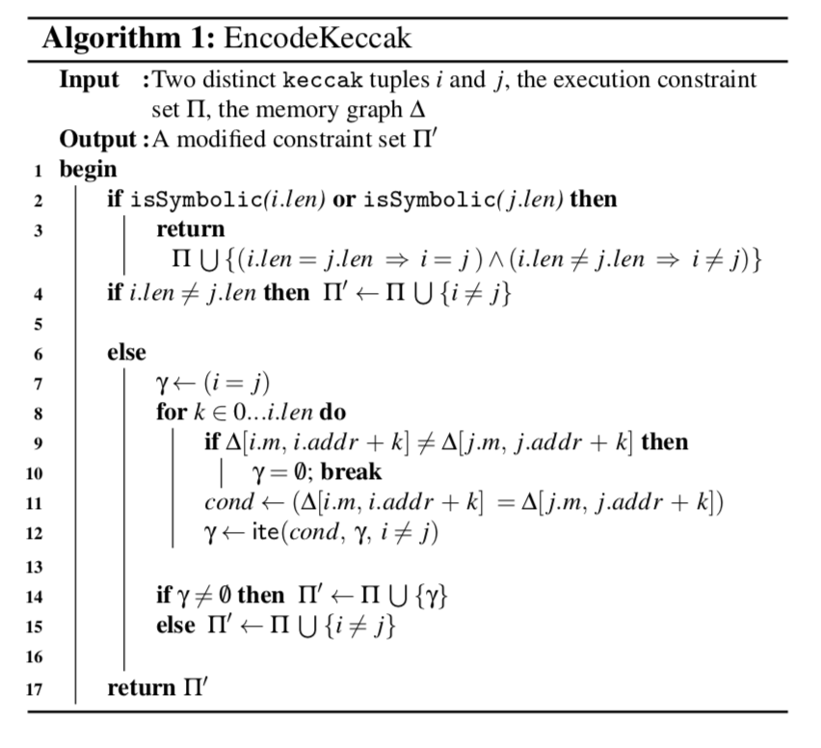
Solution to Keccak
A special encoding scheme based on the idea that Keccak is a binding function.

Slide 8
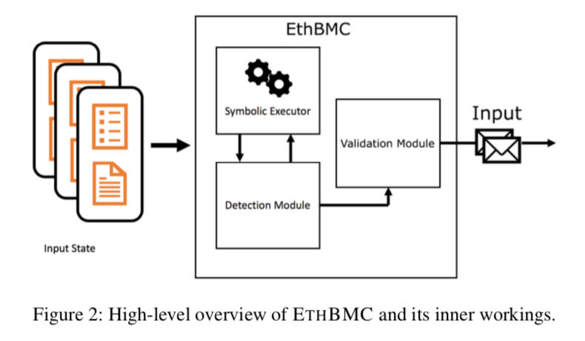
Implementation
Symbolic Executor
Explores the contract in a breadth-first search.
To assert satisfiability of a given code path query the backend SMT solver, Yices2.
Detection Module
Encode the attacker’s goal using additional path constraints (balance increased!)
Validation Module
Use SMT to generate valid transactions for every state
Simulate the attack in an offline fashion (private chain)

Slide 9
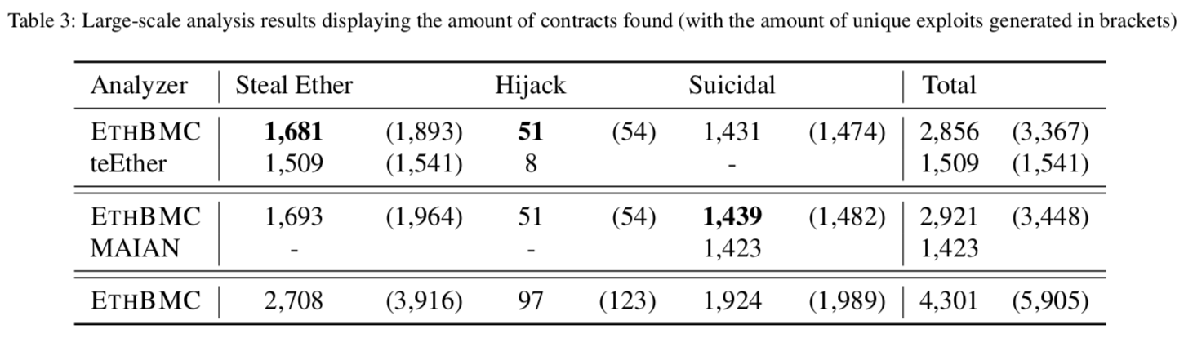
Evaluation – Large Scale

Slide 10
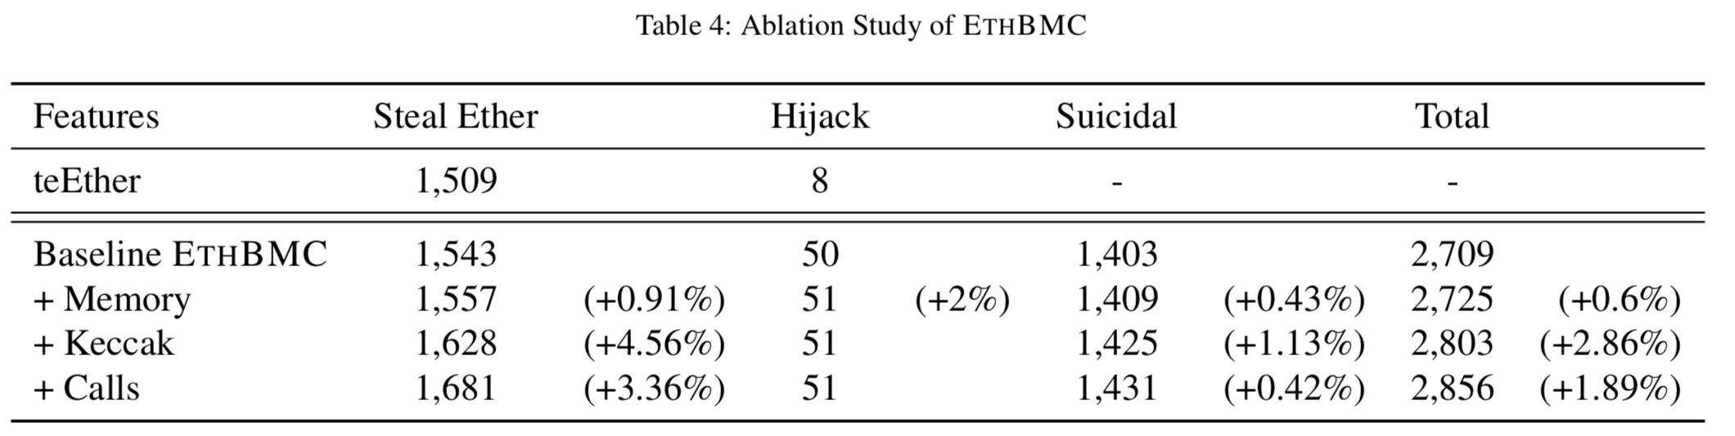
Ablation Study

Slide 11

Thank you! Q&A

