Slide 1
AC-Key: Adaptive Caching for LSM-based Key-Value Stores
Fenggang Wu, Ming-Hong Yang, Baoquan Zhang, and David H.C. Du
ATC ‘20
Presenter: Kai Li

Slide 2
Background
In enterprise workloads, read operations exhibit “hot spots” in LSM-tree-based KVSs (LSM-KVS) for both point lookups and range queries.
Caching “hot spots” can improve read performance.
Three type of entries that can be cached in LSM-KVS: Block, Key-Value (KV), and Key-Pointer (KP).

Slide 3
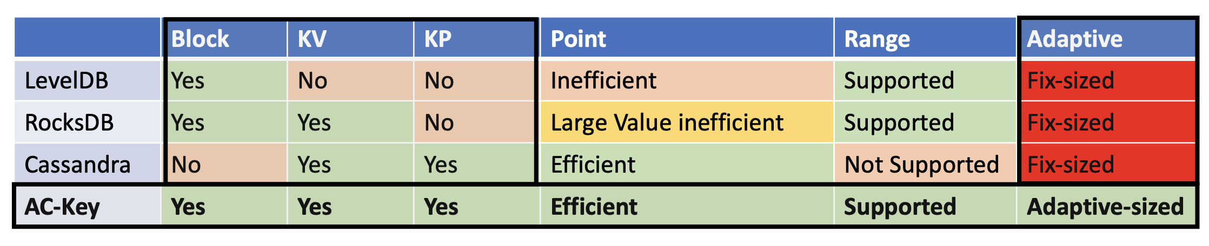
Motivation
Caching LSM-KVS is challenging
Data have different sizes/levels -> different cache costs/benefits
Cache a record at a deeper level can bring more benefits, as it reduces more storage IOs
Different type of read: point lookup, range query
Cache a block favors range query
Cache a KV/KP favors point query
When value size is large
Cache a KP is more space-efficient than cache a KV
Existing caching schemes are not effective
Only consider one or two types of entries to cache among KV, KP, and block
Fixed allocated cache size for one type of entry
Not efficient for dynamic workloads
Source: https://www.usenix.org/system/files/atc20-paper107-slides-wu.pdf

Slide 4
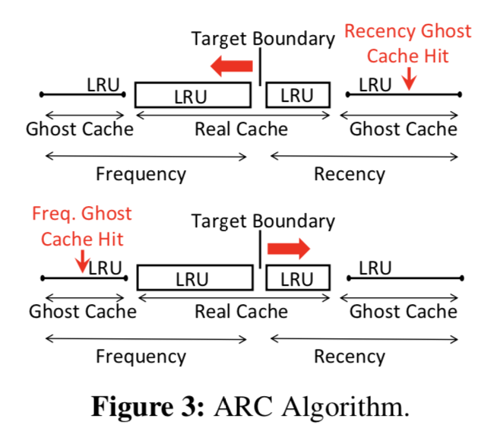
Cache Size Adjustment with Ghost Cache
Adaptive Replacement Cache (ARC)
Real Cache + Ghost Cache
Ghost Cache hit will push the
boundary
Adaptive to different cache components

Slide 5
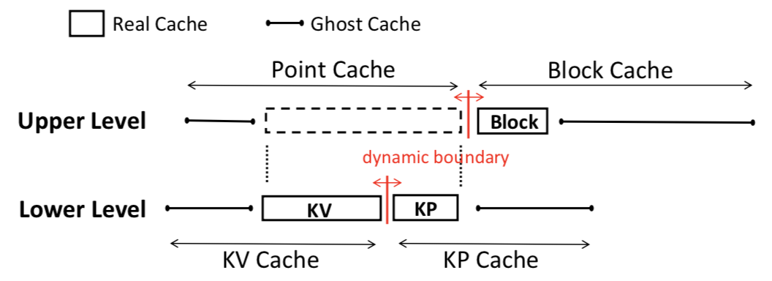
AC-Key: Hierarchical Adaptive Caching
Upper Level: Point Cache vs Block Cache
Lower level: KV Cache vs KP cache

Slide 6
Get Handling
Case I: Hit in KV Cache
The value is returned without any I/O incurred.
Case II: Miss in KV Cache but hit in KP Cache.
Check Block Cache (and bring to Block Cache if missing)
Promote KP Cache to KV Cache
Case III: Miss both in KV Cache and KP Cache.
Search every sorted run level by level
Move into KP Cache

Slide 7
Flush and Compaction
Sync the caches only in flushing time, not during Put
AC-Key updates KP and block Caches when compaction affects any of cached KP entries or blocks

Slide 8
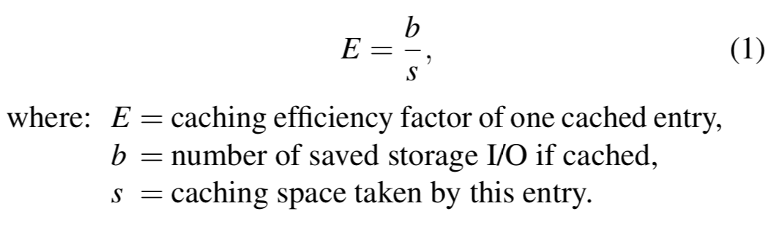
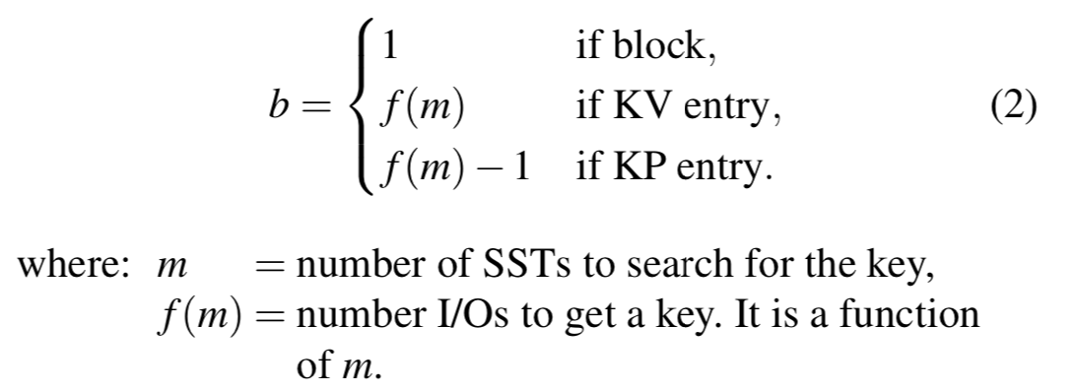
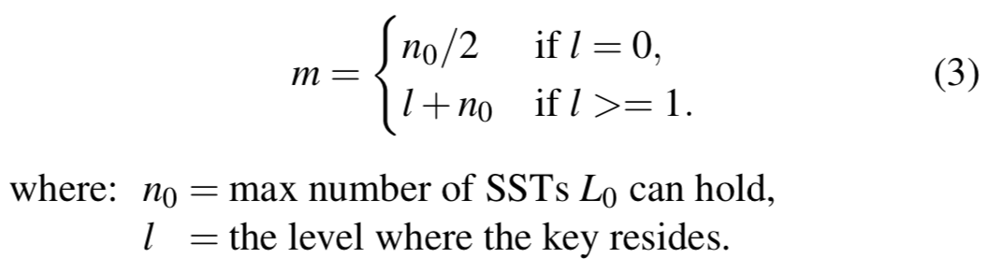
Caching Efficiency Factor
To quantitively analyze the trade-off between the costs and benefits of the cache entries
Target Boundary Adjustment by Caching Efficiency Factor E
Adjustment ∆ = kE

Slide 9
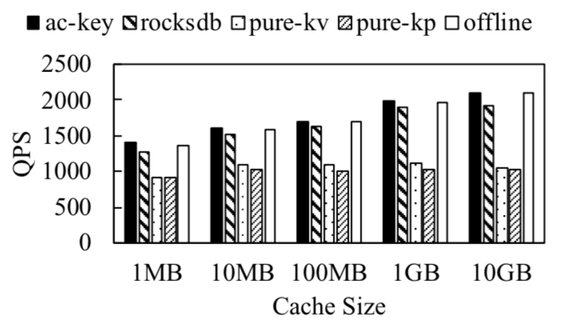
Evaluation
Implementation on RocksDB, 5.6K LoC.
Compare AC-Key with pure-kv, pure-kp, rocksdb, offline

Slide 10
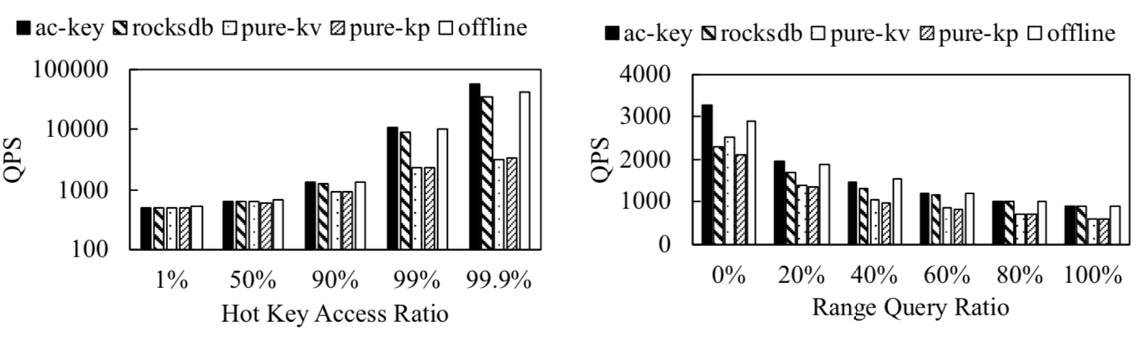
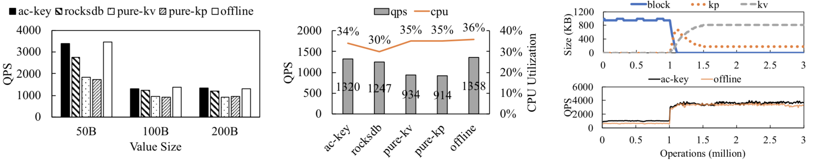
Extensive Evaluations

Slide 11

Thank you! Q&A

