Slide 1
遗传算法
马宁，11821050

Slide 2
遗传算法简介
借鉴生物进化论，遗传算法将要解决的问题模拟成一个生物进化的过程，通过复制、交叉、突变等操作产生下一代的解，并逐步淘汰掉适应度函数值低的解，增加适应度函数值高的解。这样进化N代后就很有可能会进化出适应度函数值很高的个体。
例如，使用遗传算法解决“0-1背包问题”的思路：0-1背包的解可以编码为一串0-1字符串（0：不取，1：取） ；首先，随机产生M个0-1字符串，然后评价这些0-1字符串作为0-1背包问题的解的优劣；然后，随机选择一些字符串通过交叉、突变等操作产生下一代的M个字符串，而且较优的解被选中的概率要比较高。这样经过G代的进化后就可能会产生出0-1背包问题的一个“近似最优解”。

Slide 3
遗传算法参考文献
1.Adaptation in Natural and Artificial Systems；MIT Press
2.An Introduction to Genetic Algorithms；Jenna Carr
3.Safe Mutations for Deep and Recurrent Neural Networks through Output Gradients；Joel Lehman, Jay Chen, Jeff Clune, and Kenneth O. Stanley
4.Training Feedforward Neural Networks Using Genetic Algorithms ；David J. Montana and Lawrence Davis ；IJCAI

Slide 4
遗传算法参考文献
5.Genetic Algorithms for Evolving Deep Neural Networks；Eli (Omid) David，Iddo Greental；ACM Genetic and Evolutionary Computation Conference (GECCO), pages 1451–1452, Vancouver, Canada, July 2014.
6.Scalable training of artificial neural networks with adaptive sparse connectivity inspired by network.Nature Commputations,Decebal Constantin Mocanu,Elena Mocanu,Peter Stone;DOI: 10.1038/s41467-018-04316-3,2018

Slide 5
Scalable Training of Artificial Neural Networks with Adaptive Sparse Connectivity Inspired by Network
ieda:
Biological neural networks have good properties(e.g. sparsity, scale-freeness)
Artificial neural networks should not have fully-connected layers
Propose sparse evolutionary training of artificial neural networks

Slide 6
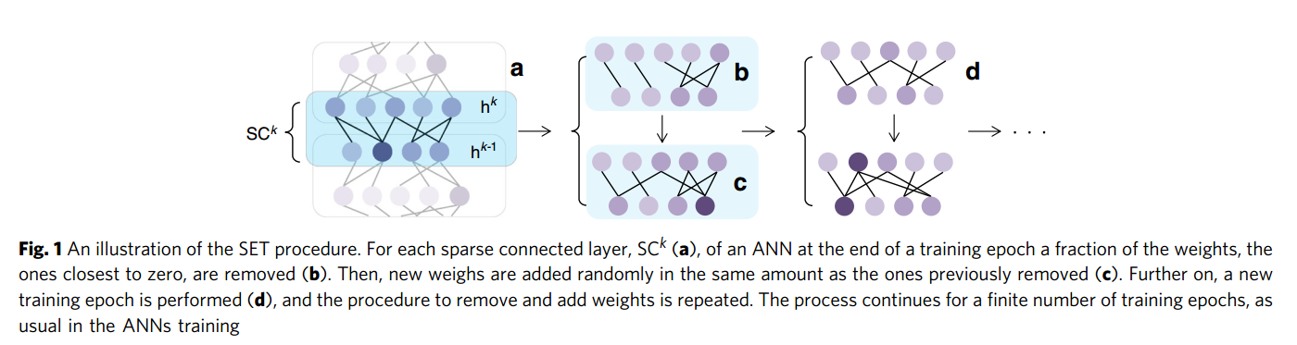
SET(Sparse Evolutionary Training)

Slide 7
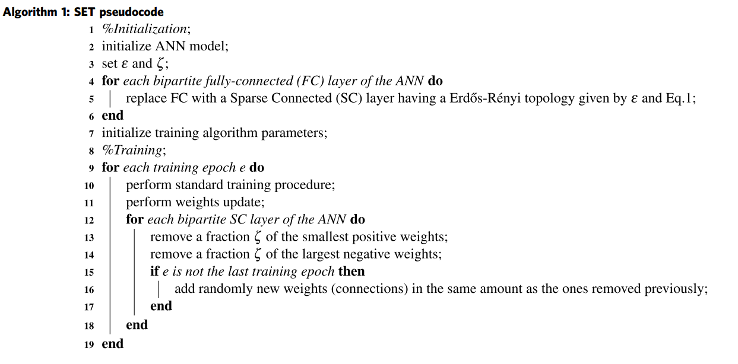
Sparse evolutionary training (SET) pseudocode

Slide 8
Sparse evolutionary training (SET) pseudocode

Slide 9
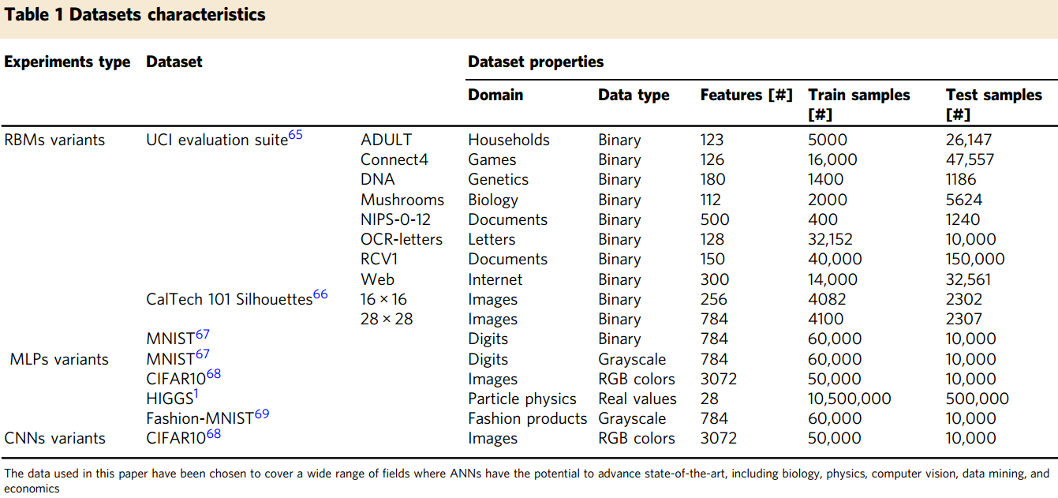
Datasets characteristics

Slide 10
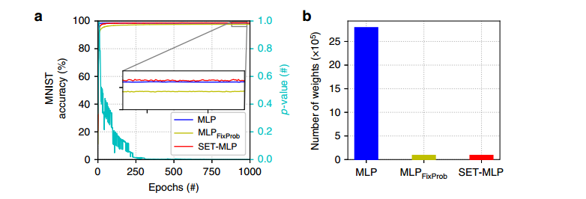
Performance on MLPs

Slide 11
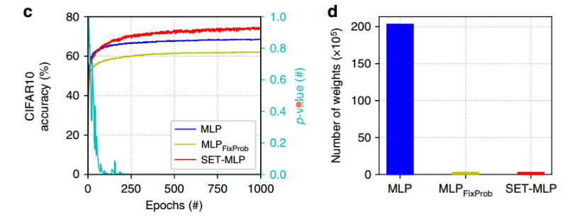
Performance on MLPs

Slide 12
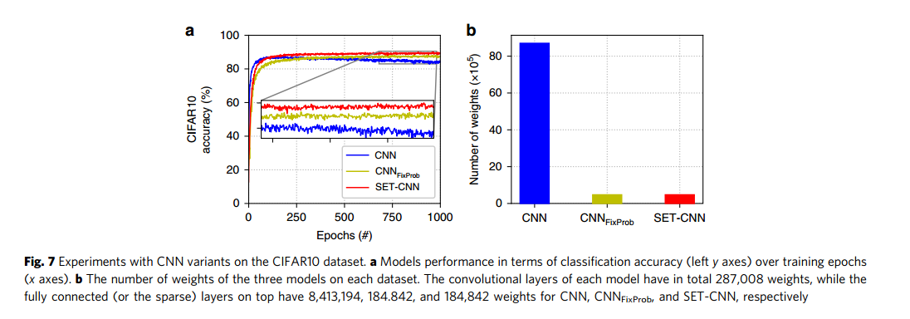
Performance on CNNs

