Slide 1
Deep Learning Graph Compilers
© 2020 Rajarshi Chattopadhyay
linkedin.com/in/likarajo | likarajo.github.io

Slide 2
Motivation
Considering how Deep Learning (DL) can be useful in Artificial Intelligence, e-commerce, smart city, drug discovery etc., plenty of DL frameworks are available for use. Having huge amount of data available for gaining knowledge, DL can be used to extract the value from the data.
The DL models use features (data) of huge sizes. In order to perform DL efficiently, the process of training needs to be made faster through parallelization. CPUs and GPUs should not be the first choice for such parallelisation. In their place, specially designed accelerator chips, with custom programming language supported by libraries can be used.
However, for each accelerator/hardware back-end, the software stack to interact with the DL frameworks needs to be rebuilt separately for each hardware-framework pair. This is not a desirable technique. As a result, it is important to enable DL models generation using DL frameworks on diverse DL hardware. This can be fulfilled using DL compilers.
DL compilers take the DL models described in different DL frameworks as input, and then generate optimized codes for diverse DL hardware as output. Several DL compilers have been proposed from both industry and academia such as TensorFlow XLA and TVM.
Here, we describe how Graph compilers optimizes the Deep Neural Network graphs and then generates an optimized code for a target hardware/backend, thus accelerating the training and deployment of DL models. We specifically focus on TVM Apache.

Slide 3
Overview
Background
Neural Networks as Graph
Deep Learning
Deep Learning Frameworks and Architecture
CPUs and GPUs
Accelerators
Optimized Deep Learning Architecture Chips
Drawback of hardware specific libraries
Deep Learning Compilers
Deep Learning Software and Hardware Requirements
Deep Learning Optimization Stack
Computational Graph Optimization
Tensor Expression Language
Schedule Optimizations
Tensorization Challenge
Problem Statement: Why TVM?
Tensor Virtual Machine (TVM)
Apache TVM
End to End Optimization Stack
Key Features
Usage
Automated End to End Optimizing Compiler

Slide 4
Background

Slide 5
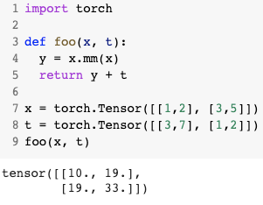
Neural Networks as Graphs
Neural Networks are graphs where each node in the graph is some mathematical operation that works on weights, which are matrices.
These operations involve Matrix Multiplications, Convolutions, etc.
x
t
MatMul
Add

Slide 6
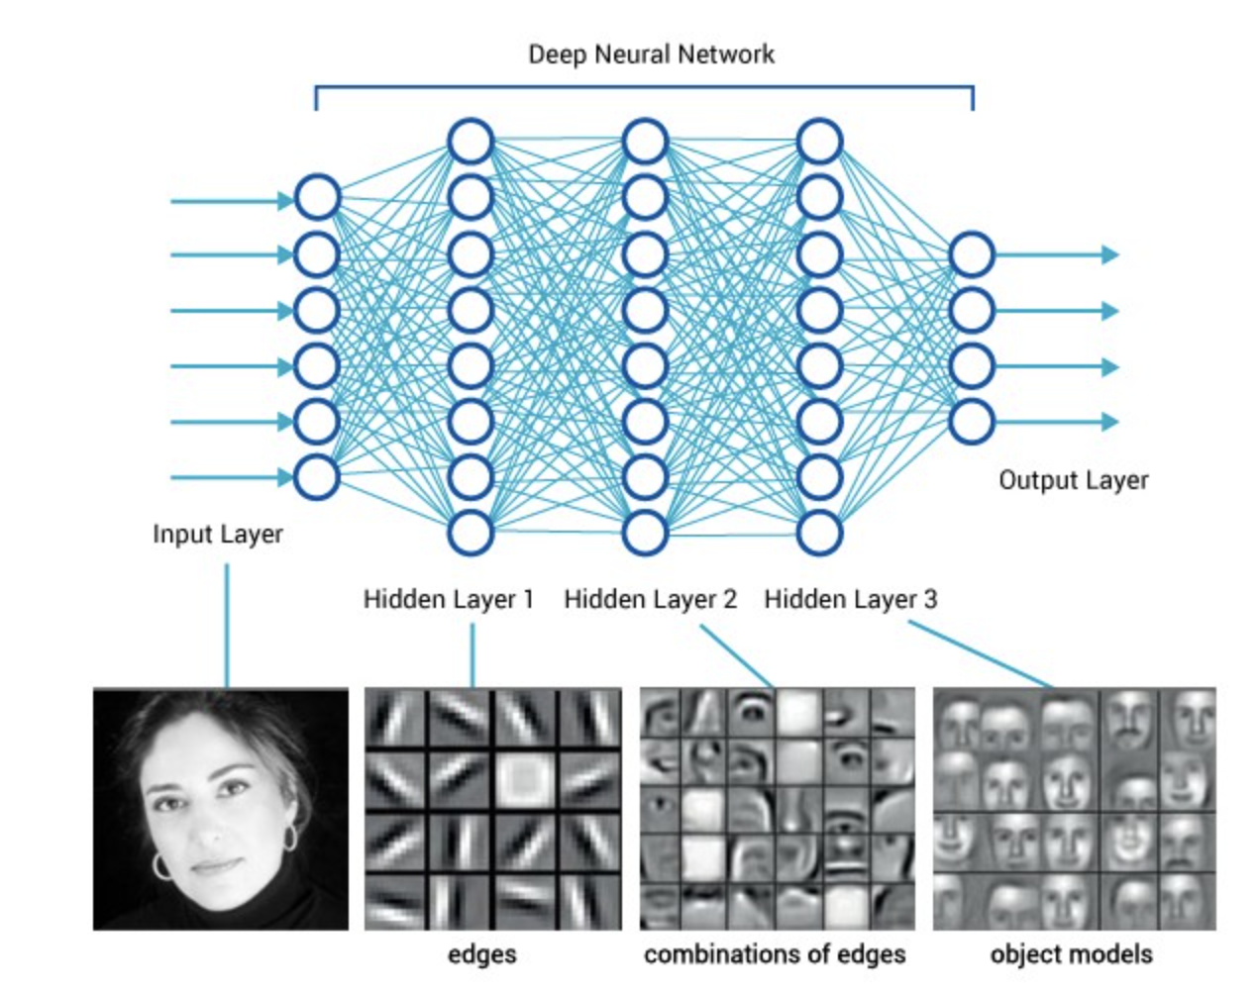
Deep Learning
Uses of deep learning:
Artificial intelligence
Natural Language Processing
Computer Vision
e-commerce
smart city
Drug Discovery
Versatile deep learning models:
Convolutional neural network (CNN)
Recurrent neural network (RNN)
Long short-term memory (LSTM)
Generative adversarial network (GAN)
Cannot afford to be
inefficient!
https://miro.medium.com/max/1232/1*Uhr-4VDJD0-gnteUNFzZTw.jpeg

Slide 7
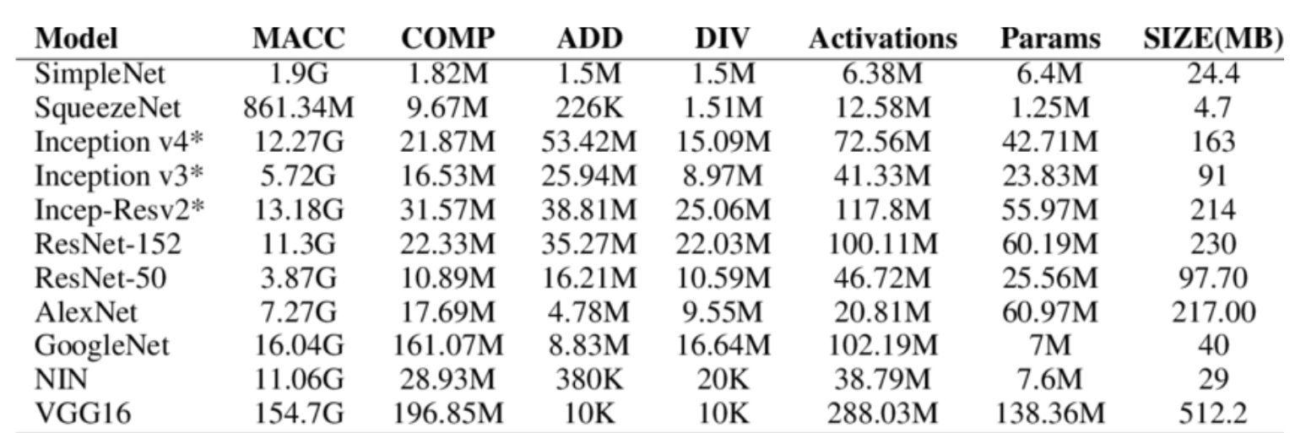
Deep Learning Frameworks and Architectures
Frameworks
TensorFlow
PyTorch
MXNet
CNTK
ONNX
Architectures
ResNet
GoogleNet
Stats: https://www.researchgate.net/figure/Flops-and-Parameter-Comparison-of-Models-trained-on-ImageNet_tbl4_306376794
Deep Learning require a lot of compute power as they often work on large weight matrices. For example, ResNet50 operates on ~100 MB of weights.
Can be made faster by parallelizing!

Slide 8
CPUs and GPUs
Tasks of CPUs and GPUs:
Exception handling
Dynamix dispatch using vtables
Load port forwarding optimizations
Branch predictions
Out of order engines
Caches
Matrix Multiplications are regular and expose lots of parallelism.
Specially designed Accelerator Chips can be used.
Use of CPUs and GPUs is an overkill for the purpose of
just extracting parallelism.
All these are not required to extract parallelism.
There is no need to waste power/area on useless features

Slide 9
Accelerators
Accelerators are more than Hardware:
Have many arithmetic execution units
Use dedicated local memories – Software Managed SRAMs, not caches
Reduce the arithmetic bit-widths – work on fp16 or int8, not higher floating-point numbers
Software Stack
Accelerator
Software stack needed on top of the accelerator
for it to work with different DL frameworks

Slide 10
Optimized Deep Learning Architecture Chips
Uses a specialized programming model – custom or domain specific language, not general-purpose programming languages.
Chip architectures
Google TPU
Hisilicon NPU
Apple Bonic
NVIDIA Turing
Intel NNP
Amazon Inferentia
Alibaba Hanguang
Cambricon
Graphcore
Support Libraries
Basic Linear Algebra Subprograms (BLAS): for efficient computation
MKL
MKL-DNN
CuBLAS
cuDNN
TensorRT: supports graph optimization (e.g., layer fusion) and low-bit quantization with large collection of highly optimized GPU kernels.
Specially optimized libraries support the chips to make use of the accelerated DL models.

Slide 11
Drawback of hardware specific libraries
Need to optimize the DL models on each DL accelerator manually.
Need to rebuild entire software stack to work with the DL frameworks.
Fall behind the rapid development of Deep Learning models.
Fail to utilize the Deep Learning chips efficiently.
Deep Learning Compilers
TVM
Tensor Comprehension
Glow
NGraph
XLA
Domain Specific Compilers are used to address the drawback of DL libraries and tools

Slide 12
Deep Learning Compilers

Slide 13
Deep Learning Software Requirements
DAG of High-level Operators
Early-Binding to compute
Mixed Memory and Compute requirements
Deep Learning Hardware Requirements
Heterogeneous hardware
Optimize workload for different h/w
Layered Memory hierarchy
Complex scheduling
Parallel computation
Single Instruction Multiple Data
Single Instruction Multiple Threads

Slide 14
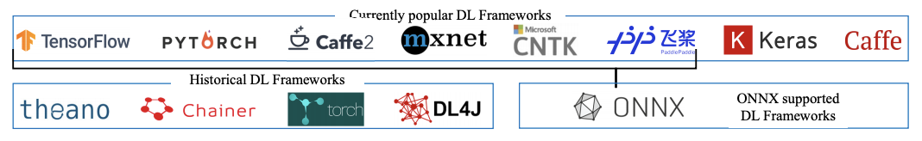
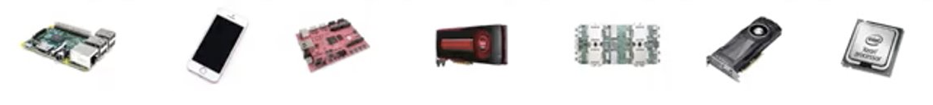
Deep Learning Optimization Stack
Compilers are a bridge to lower the programs supporting the DL frameworks automatically or semi-automatically to the accelerators.
Computational Graph Optimizations
Tensor Expression Language
Schedule Optimizations

Slide 15
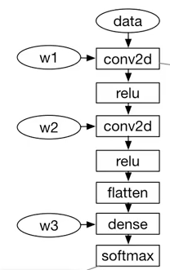
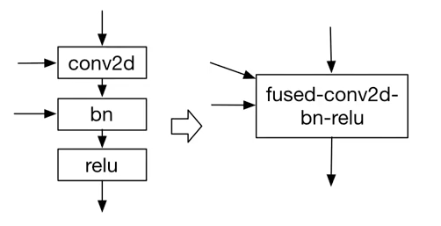
Computational Graph Optimization
High level representation of computation using primitive tensor operators
Equivalent transformation to early-binding compute for graph optimization
Need to build and optimize memory plan, operator fusion, data layout variations, precision, threading patterns, etc.
The implementation of tensor operations is opaque!

Slide 16

Tensor Expression Language
Lower-level representation that can be used to express the computations.
Support automatic code generation.
Each compute operation is described in an index formula expression.
Each compute operation specifies both the shape of the output tensor and an expression describing how to compute each element of it.
Support common arithmetic and math operations.
Covers common DL operator patterns.
Provides flexibility for adding hardware-aware optimizations for various backends
Result Shape
Computing rule
Hardware-aware search space. Need to be scheduled to different hardware back-ends

Slide 17
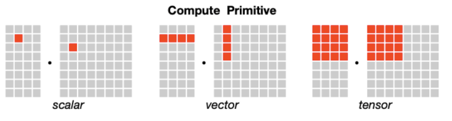
Schedule Optimizations
Bridge gap between Tensor Expression Language to hardware.
Achieve high performance on many back-ends.
Support schedule primitives to cover a diverse set of optimizations on different hardware back-ends.
Transform high level programs to specific accelerator back-ends.
Tensorization Challenge

Slide 18
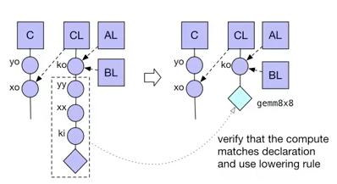
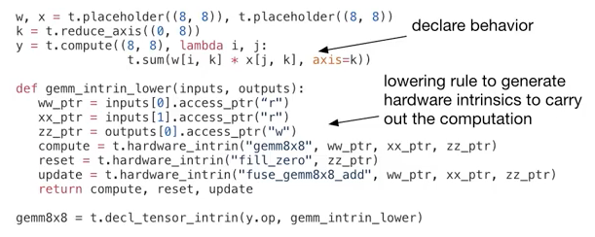
Tensorization Challenge
Different accelerators have different tensor utilization choices.
Declare tensor instruction interface.
Tensorize: Transform Program to use tensor instructions
Challenge: To Support emerging tensor instructions

Slide 19
Problem Statement: Why TVM?
Express an operator in a simple language to abstract away the hardware complexity.
Automatically optimize an operator for different hardware.
Find an efficient implementation of a new operator without thinking about hardware.
TVM

Slide 20
Tensor Virtual Machine
(TVM)

Slide 21
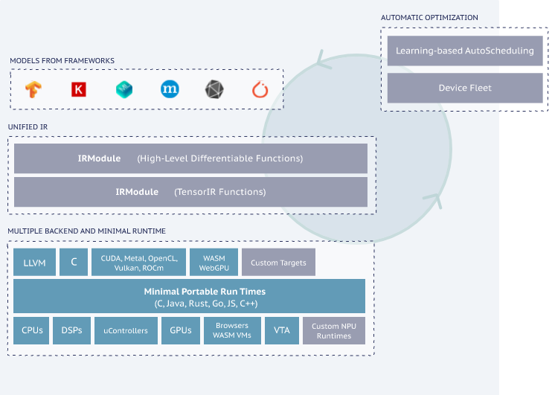
Apache TVM
Open Deep Learning Compiler Stack
Accessible, extensible, and automated open-source framework.
Automatically generates and optimizes deep learning models on multiple hardware backend with minimal runtime.
Compiles deep learning models into minimum deployable modules.

Slide 22
TVM: End to End Optimization Stack
High-level differentiable IR
Computational Graph Optimizations
Tensor Expression Language
Loop Transformations
Thread Bindings
Cache Locality
Previous Primitives
Optimization Search Space
...
Thread Cooperation
Tensorization
Latency Hiding
New Primitives for accelerators

Slide 23
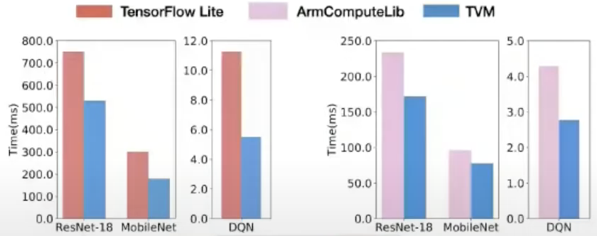
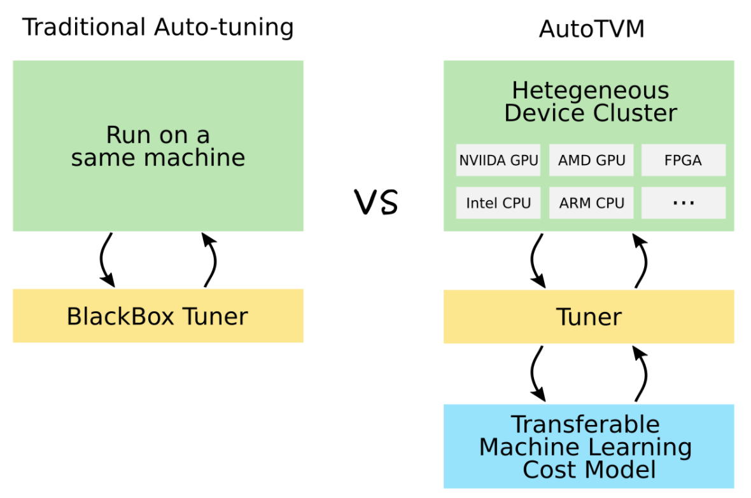
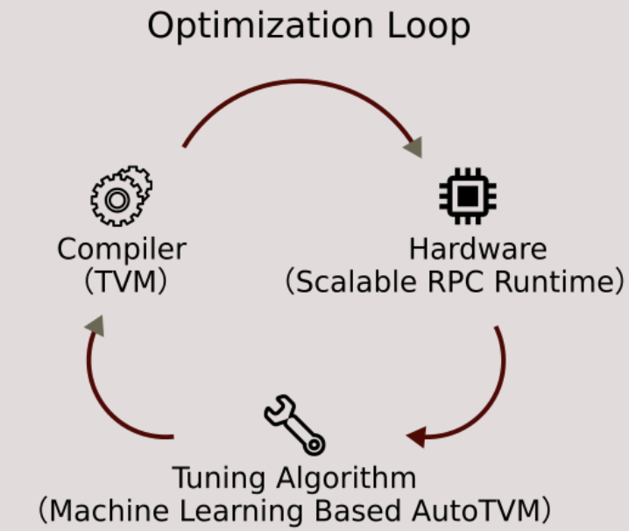
TVM: Key Features
Performance: Compilation with minimal runtime
Unified Runtime: in heterogeneous devices
Unified IR and library packaging
Compatibility: Automatically generates and optimizes tensor operators on multiple backends – CPUs, GPUs, Microcontrollers, FPGAs, browsers, etc.

Slide 24
TVM: Key Features cont...
Flexibility: Enables support for
Block Sparsity
Quantization
Classical ML and Random Forests
Memory Planning
MISRA-C, Python, C++, Rust, Java
Usability: Keras, MXNet, PyTorch, TensorFlow, CoreML, DarkNet, more.
Full-stack automation
Open source
Open development
Open governance

Slide 25
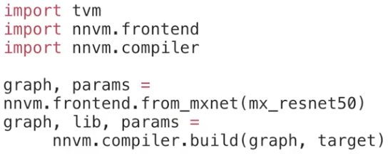
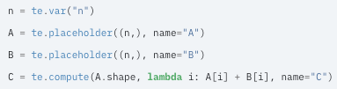
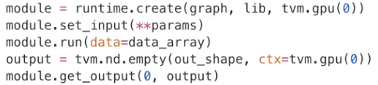



TVM: Usage
Create deployable module from a model
Tensor Expression
Describe Computation
Model In
Schedule the Computation
Module Out (Deployable)

Slide 26
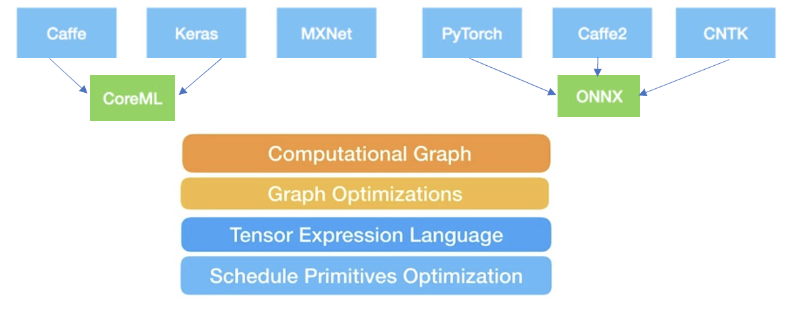




TVM: Automated End to End Optimizing Compiler

Slide 27
References
The deep learning compiler: a comprehensive survey: https://arxiv.org/abs/2002.03794
TVM: an automated end-to-end optimizing compiler for deep learning: https://arxiv.org/abs/1802.04799
Apache TVM: https://tvm.apache.org/
Apache TVM documentation: https://tvm.apache.org/docs/
2019 TVM and deep learning compilation conference: morning keynote & session1: https://www.youtube.com/watch?v=npqO0hVXZwU
Computer Architecture: https://www.elsevier.com/books/computer-architecture/hennessy/978-0-12-811905-1
Torch documentation: https://pytorch.org/docs/stable/generated/torch.nn.Conv2d.html
AWS DL AMIs: https://aws.amazon.com/machine-learning/amis/
Paper: https://homes.cs.washington.edu/~arvind/papers/tvm.pdf

