Slide 1
Design and Implementation of 16 bit RISC Processor using Harvard Architecture utilizing minimum area on FPGA

Slide 2
Project by:
Deepan Das
Kaushik Saha
Sagnik Raha
Rabindra Nath Sarkar
Rajarshi Chattopadhyay
Under the supervision of
Mr. Sohan Ghorai
Assistant Professor, Dept. of Electronics and Communication Engineering
Narula Institute of Technology, Kolkata

Slide 3
Motivating Background
INTEL 8085 microprocessor
8085 - based on
von Neumann architecture
Simple instructions for programs - RISC strategy - simplified CPU design.

Slide 4
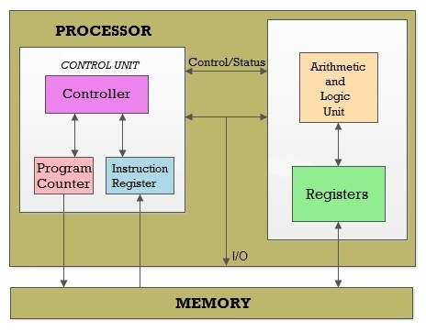
GENERIC PROCESSOR

Slide 5
The components of a generic processor
Control unit (CU)
Arithmetic and Logic unit (ALU)
Register
Program Counter
Instruction Register

Slide 6
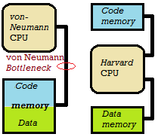
ARCHITECTURE
von Neumann
Harvard

Slide 7
COMPUTING
RISC
CISC
RISC = Reduced Instruction Set Computer
Simplified instructions => Faster Execution
More program storage memory
Lesser Hardware
CISC = Complex Instruction Set Computer
Complex instructions => Slower Execution
Lesser program storage memory
More Hardware

Slide 8
PROCESSOR DESRIPTION
RISC CPU – 16 bit Data – 12 Bit Address
Harvard architecture
2K bytes code memory ROM
2K bytes data memory RAM

Slide 9
Processor components:
Arithmetic and logic Unit (ALU)
Accumulator (Acc) - 16 bit register
Program Counter (PC) - 12 bit register
Instruction Register (IR) - 4 bit register
Memory Address Register (MAR) - 12 bit register
Control unit (CU)
Bus:
Data bus (16 bit)
Address bus (12 bit)
Memory:
Program memory (ROM) - 2K bytes)
Data Memory (RAM) – 2K bytes)

Slide 10
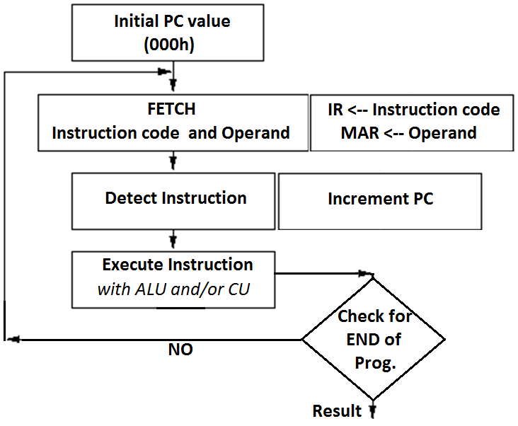
Operation Flow :

Slide 11
Instruction Set
Op-Code | Instruction | Operation
0h | ADD #Addr | A ← [A] + [ #Addr]
1h | SUB #Addr | A ← [A] - [#Addr]
2h | MUL #Addr | A ← [A] * [#Addr]
3h | DIV #Addr | A ← [A] / [#Addr]
4h | AND #Addr | A ← [A] AND [#Addr]
5h | OR #Addr | A ← [A] OR [#Addr]
6h | XOR #Addr | A ← [A] XOR [#Addr]
7h | NOTA | A ← NOT [A]
8h | LDA #Addr | A ← [#Addr]
9h | STA #Addr | #Addr ← [A]
Ah | JZ #Addr | PC ← #Addr if [A] = 0
Bh | JNZ #Addr | PC ← #Addr if [A] not = 0
Ch | JMP #Addr | PC ← #Addr
Dh
Eh
Fh | END | PC ← 000
**Hexadecimal ‘ 7h’
= 4 bit binary ‘0111’
**
#Addr =>
Hexadecimal value of
address (000 to FFF)
[#Addr] => The content
of memory address #Addr
A => Accumulator register
[A] => The content of the
Accumulator

Slide 12
ARITHMETIC GROUP
ADD #Addr
SUB #Addr
MUL #Addr
DIV #Addr
LOGIC GROUP
AND #Addr
OR #Addr
XOR #Addr
NOT Addr
BRANCH GROUP
JZ #Addr
JNZ #Addr
JMP #Addr
DATA TRANSFER GROUP
LDA #Addr
STA #Addr
OTHER
END

Slide 13
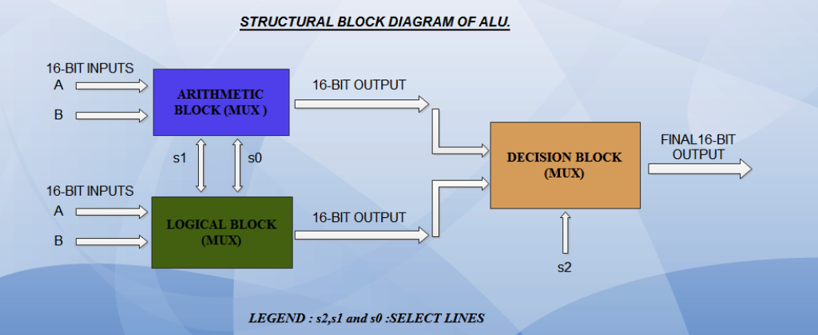
ALU Modeling

Slide 14
SELECT LINES
S2 | S1 | S0 | Operation
0 | 0 | 0 | ADD
0 | 0 | 1 | SUBTRACT
0 | 1 | 0 | MULTIPLY
0 | 1 | 1 | DIVIDE
1 | 0 | 0 | AND
1 | 0 | 1 | OR
1 | 1 | 0 | XOR
1 | 1 | 1 | NOT

Slide 15
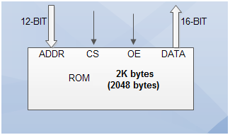
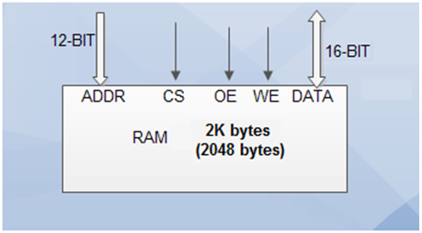
Memory Modeling
ROM
Inputs:
Chip Select - CS
Output Enable - OE
Address - ADDR 12bit
Output:
Data - DATA 16 bit
RAM
Inputs:
Chip Select - CS)
Output Enable - OE
Write Enable - WE
Address - ADDR 12 bit
Bidirectional:
Data - DATA 16 bit

Slide 16
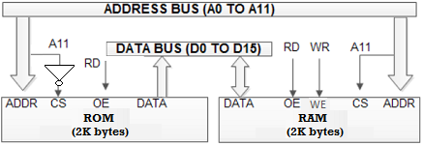
Memory Interfacing
A11 → chip select input for the ROM and the RAM.
When A11 is ‘0’ (low), then ROM gets selected
When A11 is ‘1’ (high), then RAM gets selected
ROM address 000h to 7FFh
RAM address 800h to FFFh

Slide 17
Control Unit Modeling
Different Control Unit functions are:
Phase generation
Read & Write signal generation
Transfer of specific address to Address Bus
Transfer of data into Data Bus
Program Counter update
Op-Code & Operand fetch
Accumulator Update

Slide 18
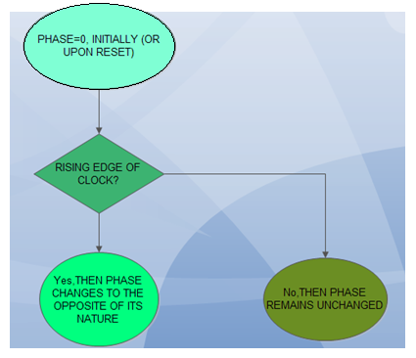
Phase generation

Slide 19
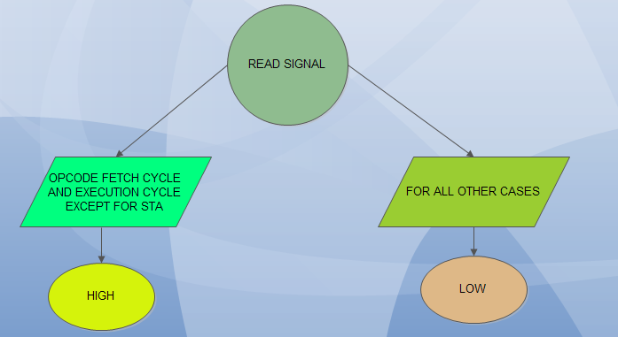
READ signal generation

Slide 20
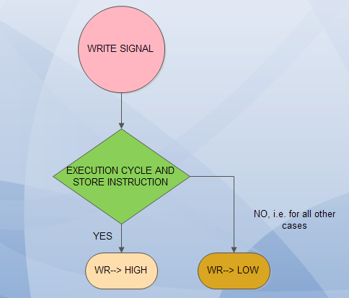
WRITE signal generation

Slide 21
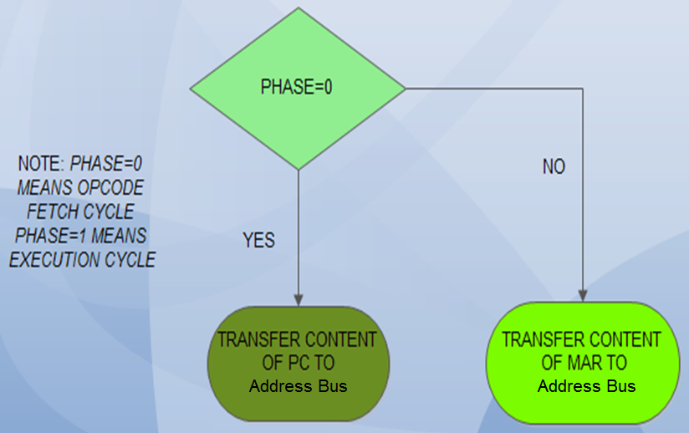

Slide 22
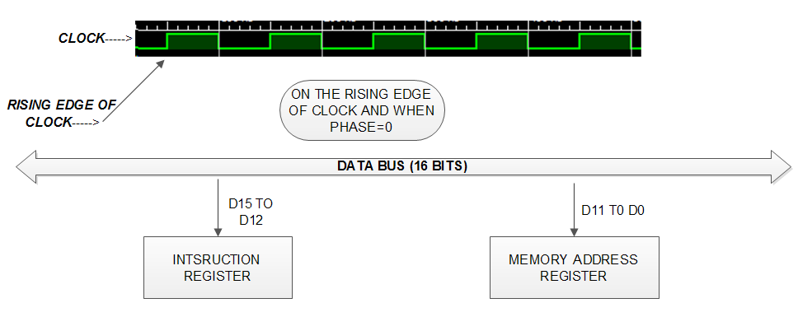
Op-Code and Operand Fetch

Slide 23
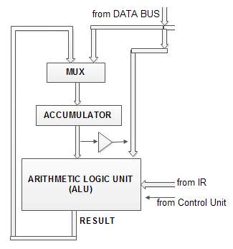
Schematic Operation Model of ALU

Slide 24
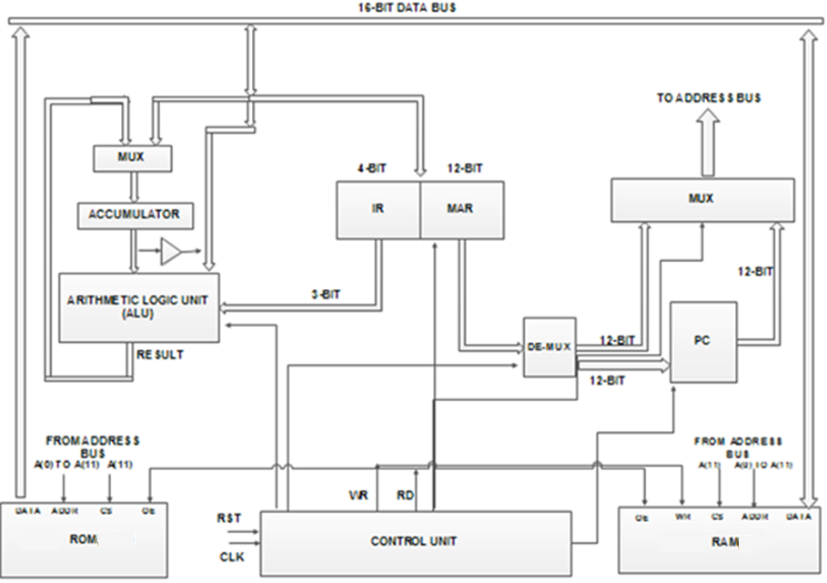
Schematic diagram of the CPU

Slide 25

Instruction
For instruction 5678h
5h is the Op-code
and
678h is the operand

Slide 26
Programming the Processor
The program code consists of instructions of 16 bit, which are placed one by one in ROM locations starting from 000h. The PC of the processor accesses the ROM for the Op-code starting from location 000h till the END instruction is encountered.
In the ROM memory, values 0 to 9 are permanently loaded in locations 700h to 709h respectively, for testing purpose.
Program code starts from location 000h.

Slide 27
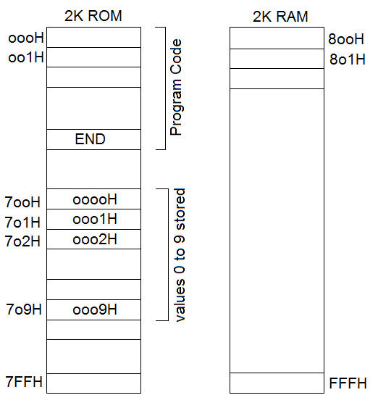

Slide 28
TEST OPERATION 1: ((1+2) x (4/2)) – 2
Expected Output: 4
TEST CODE:
LDA 701 - load value ‘1’ at ROM loc 701h to Acc
ADD 702 - add value ‘2’ at ROM loc 702h to content of Acc
STA 800 - store result in Acc to RAM loc 800h
LDA 704 - load value ‘4’ at ROM loc 704h to Acc
DIV 702 - divide content of Acc by value ‘2’
STA 801 - store result in Acc to RAM loc 801h
LDA 800 - load value in RAM loc 800h to Acc
MUL 801- multiply content of Acc by value at RAM loc 801h
STA 802 - store result in Acc to RAM loc 802h
LDA 802 - load value in RAM loc 802h to Acc
SUB 702 - subtract value ‘2’ at ROM loc 702h from Acc content
STA 803 - store result in Acc to RAM loc 803h
END - jump to ROM loc 000h i.e. start of program

Slide 29
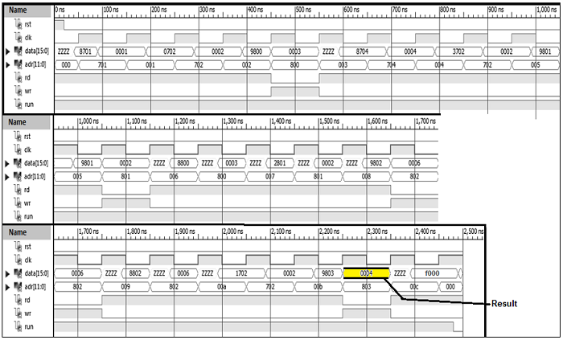
The hex code in ROM from 000h :
8701, 0702, 9800, 8704, 3702, 9801, 8800, 2801, 9802, 8802, 1702, 9803, F000
RESULT=
4 (0004)

Slide 30
TEST OPERATION 2: (2 OR 7) AND (6 XOR 9)
Expected Output: 7
TEST CODE:
LDA 702 - load value ‘2’ at ROM loc 702h to Acc
OR 707 - OR value ‘7’ at ROM loc 707h to content of Acc
STA 800 - store result in Acc to RAM loc 800h
LDA 706 - load value ‘6’ at ROM loc 706h to Acc
XOR 709 - XOR value ‘9’ at ROM loc 709h to content of Acc
STA 801 - store result in Acc to RAM loc 801h
LDA 800 - load value in RAM loc 800h to Acc
AND 801 - AND content of Acc by value at RAM loc 801h
STA 802 - store result in Acc to RAM loc 802h
END - jump to ROM loc 000h i.e. start of program

Slide 31
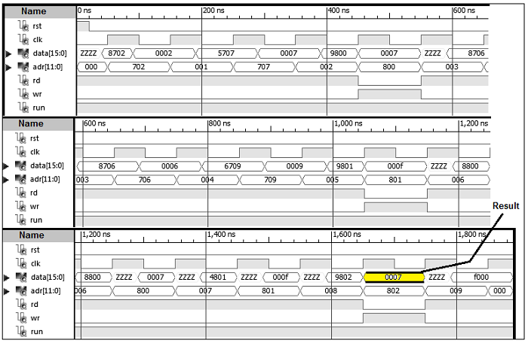
The hex code in ROM from 000h :
8702, 5707, 9800, 8706, 6709, 9801, 8800, 4801, 9802, F000
RESULT=
7 (0007)

Slide 32
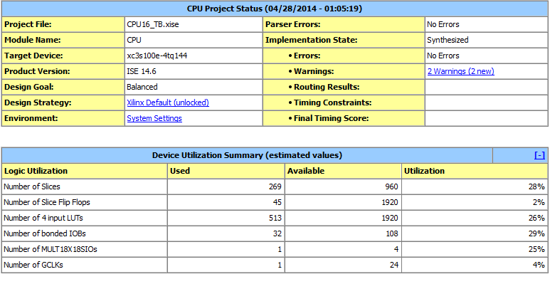
Synthesis Result an Performance Comparison

Slide 33
PROCESSOR | INSTRUCTIONS | GATES
8085 (CISC) | 246 | 6500
80286 | 20 K | 134 K
Our Processor | 14 | 10 K (including memory)
Future Research :
The CPU working on 16 bit data line and 12 bit address line is totally modifiable. The future target is to exploit the Harvard architecture for pipelining extensively using more instructions.

Slide 34
ACKNOWLEDGMENT
We express our deepest gratitude to our project supervisor Mr. Sohan Ghorai
Assistant professor, Electronics and Communication Engineering,
Narula Institute of Technology, Kolkata
We thank Prof. (Dr.) Maitreyi Roy Kanjilal
Head of the Department, Electronics & Communication Engineering, Narula Institute of Technology, Kolkata

