Slide 1

Data Visualization Using Python
Erin Howland & James Bartlett
Tech Camp 2023

Slide 2

An Interrogation
Why are you here?
What are you hoping to learn?
What do you know, or think you know, already?

Slide 3
Data X
What data-related roles have you heard of?
What do you think data roles have in common?
Data X Roles

Slide 4
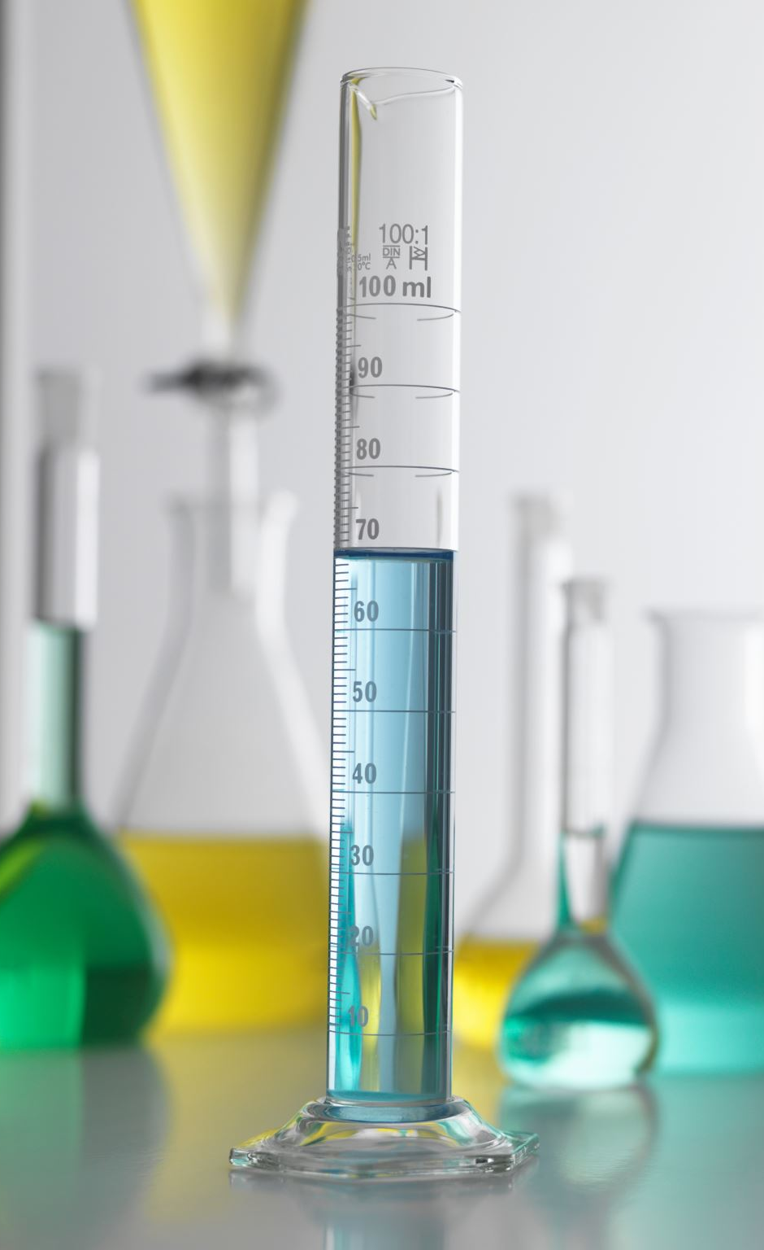
Jupyter Lab Setup

Slide 5

Visualizations
What kinds of visuals can you think of?
How do you know what visual to choose?
What makes a visual good or bad?
Visual Vocab

Slide 6
What Makes a Good Visual?
Know what you are trying to communicate
This will inform chart type, whether ordering is important, if guidelines would be useful, etc.
Understand your audience
Can inform labelling – technical v not technical, for example
Think about use of blank space v visual clutter
Scalability

Slide 7
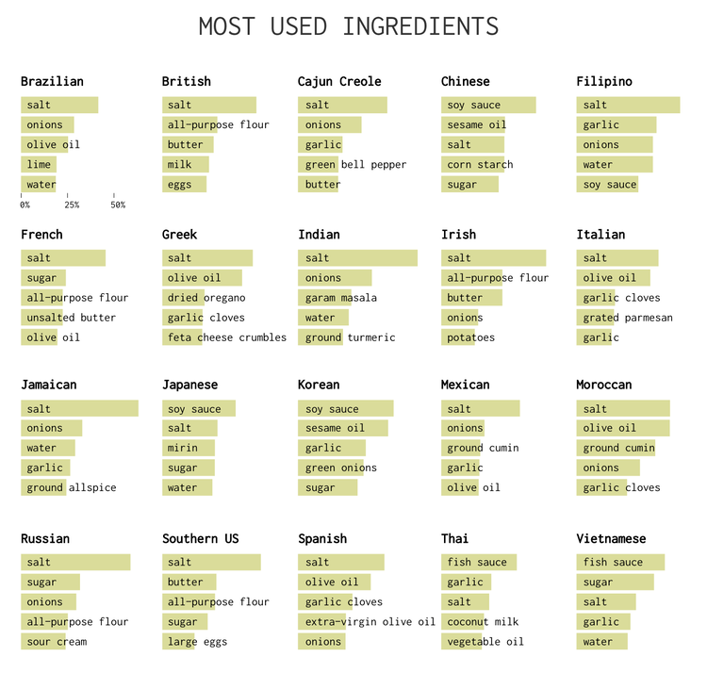
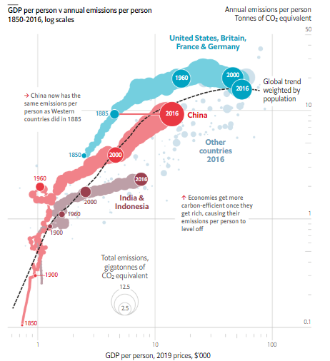
Good Visuals in the Wild, pt I

Slide 8
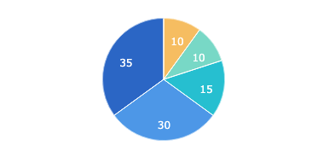
Good Visuals in the Wild, pt II
Want some more examples of good visualizations?
Guidelines for Good Visualizations (R)
Visme

Slide 9
Common Errors in Visualizations
Wrong type of chart/graph
Too many variables
Faulty/inconsistent scale
Scale breaks make small changes seem bigger
Unclear linear v logarithmic scale makes understanding of growth distorted
Inconsistent time intervals
Poor color choices
Poor labeling

Slide 10
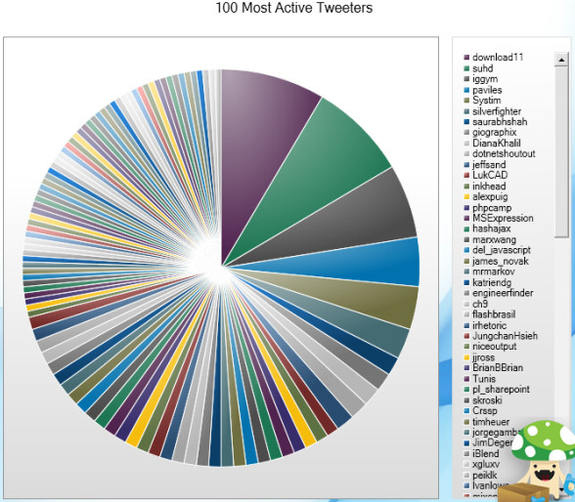
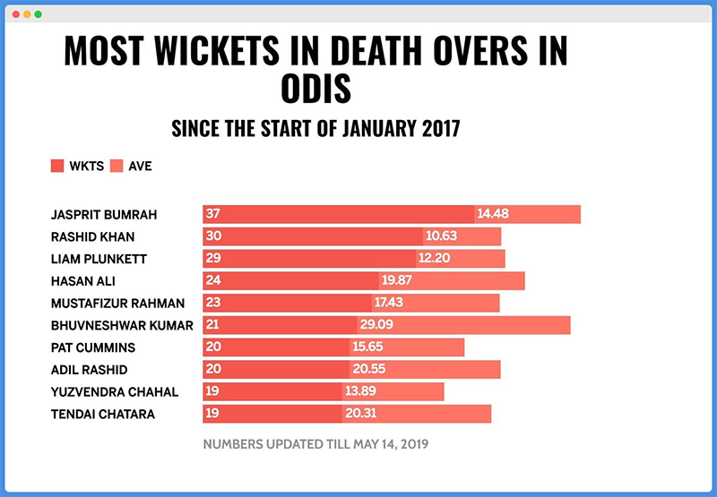
Bad Visuals in the Wild, pt I

Slide 11
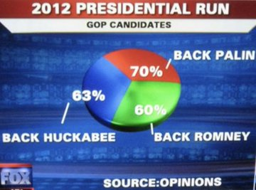
Bad Visuals in the Wild, pt II
The main thing to take away: numbers don’t lie (unless you’re as careless as whoever put together the chart to the left), but the methods by which the numbers are gathered and how those numbers are presented can be deceptive.
Want some more bad charts?
Business Insider - 27 Worst Charts (2013)
Bad Infographics

Slide 12
How to use Python to Make Visuals?
Python has a number of libraries that specialize in different tasks:
Data manipulation: Pandas, datatable, PandaPy, NumPy
Webscraping: BeautifulSoup, Scrapy
Visualization: Matplotlib, Seaborn, Plotly, GGplot
AI/ML/complex analysis: Scikit-Learn, Numpy, TensorFlow, PyTorch
Libraries we’ll use today:
Pandas
Matplotlib
Seaborn
Numpy
Squarify
Openpyxl – change everything to csv instead of xls

Slide 13
Let’s Make Some Visuals!
We’ll look at three small sample data sets with the following goals:
Learn how to open a flat file in Python and load to a dataframe
Consider what story you can tell with the data
Determine what visual(s) might be appropriate to communicate that story
Make some visuals
Different kinds of visuals
How to make labels
How to change colors
Scale
Notes:
Data: sample_1_YesNo

Slide 14
Loading Data
Pandas can read numerous file types
In all instances you will need a file path of some kind so the program knows where to look
We will read files into a dataframe (df), which is basically Pandas’ version of a spreadsheet, but way cooler
xls/xlsx: df = pd.read_excel(r’[insert file path here – brackets not needed])
csv: df = pd.read_csv(r’[insert file path here – brackets not needed])
I’ve loaded the data. Now what?
View dataframe
How may records (rows)? How many columns?
What data types do you have?
Is any information missing?
In short, think about the data!

Slide 15
Thinking About Data
Clean Data
Messy Data
No empty/missing values
Consistent data type in each column
Column headers are variable names, not values
Data is ready to use!
Messy data can include:
Empty/missing values
Mixed data types in each column
Multiples variables stored in one column
Data requires cleaning
This could be a course in and of itself!

Slide 16
Making Visuals With Less Than Perfect Data
The data we’ll use next isn’t terrible, but it’s not necessarily perfect
It’s also going to be a lot more data than we’ve looked at so far
What we’ll learn:
Datatypes
How to use Pandas when thinking about your data and how clean or messy it is
How to use visuals to display messy vs clean data

Slide 17
Let’s Make Some More Visuals!
Dataset: Earthquake
How would you describe this dataset? Messy? Clean? Somewhere in the middle?
We’ll have three primary steps:
Load dataframe
Summary info
Vizualizations
Think about these questions at each primary step:
Can you see any potential problems?
Why are these problems / What is the risk if these aren’t ultimately addressed (i.e. how might the story change)?

Slide 18
Handling Missing Data
If you are curious and want to play with this, here are two ways to address missing data:
Impute (fill in) missing data using fillna()
Drop rows with missing data
Any handling of missing data can have an effect on data analysis, so choose wisely
See sample_4_imdb for a smaller dataset to play with using these techniques

