Slide 1
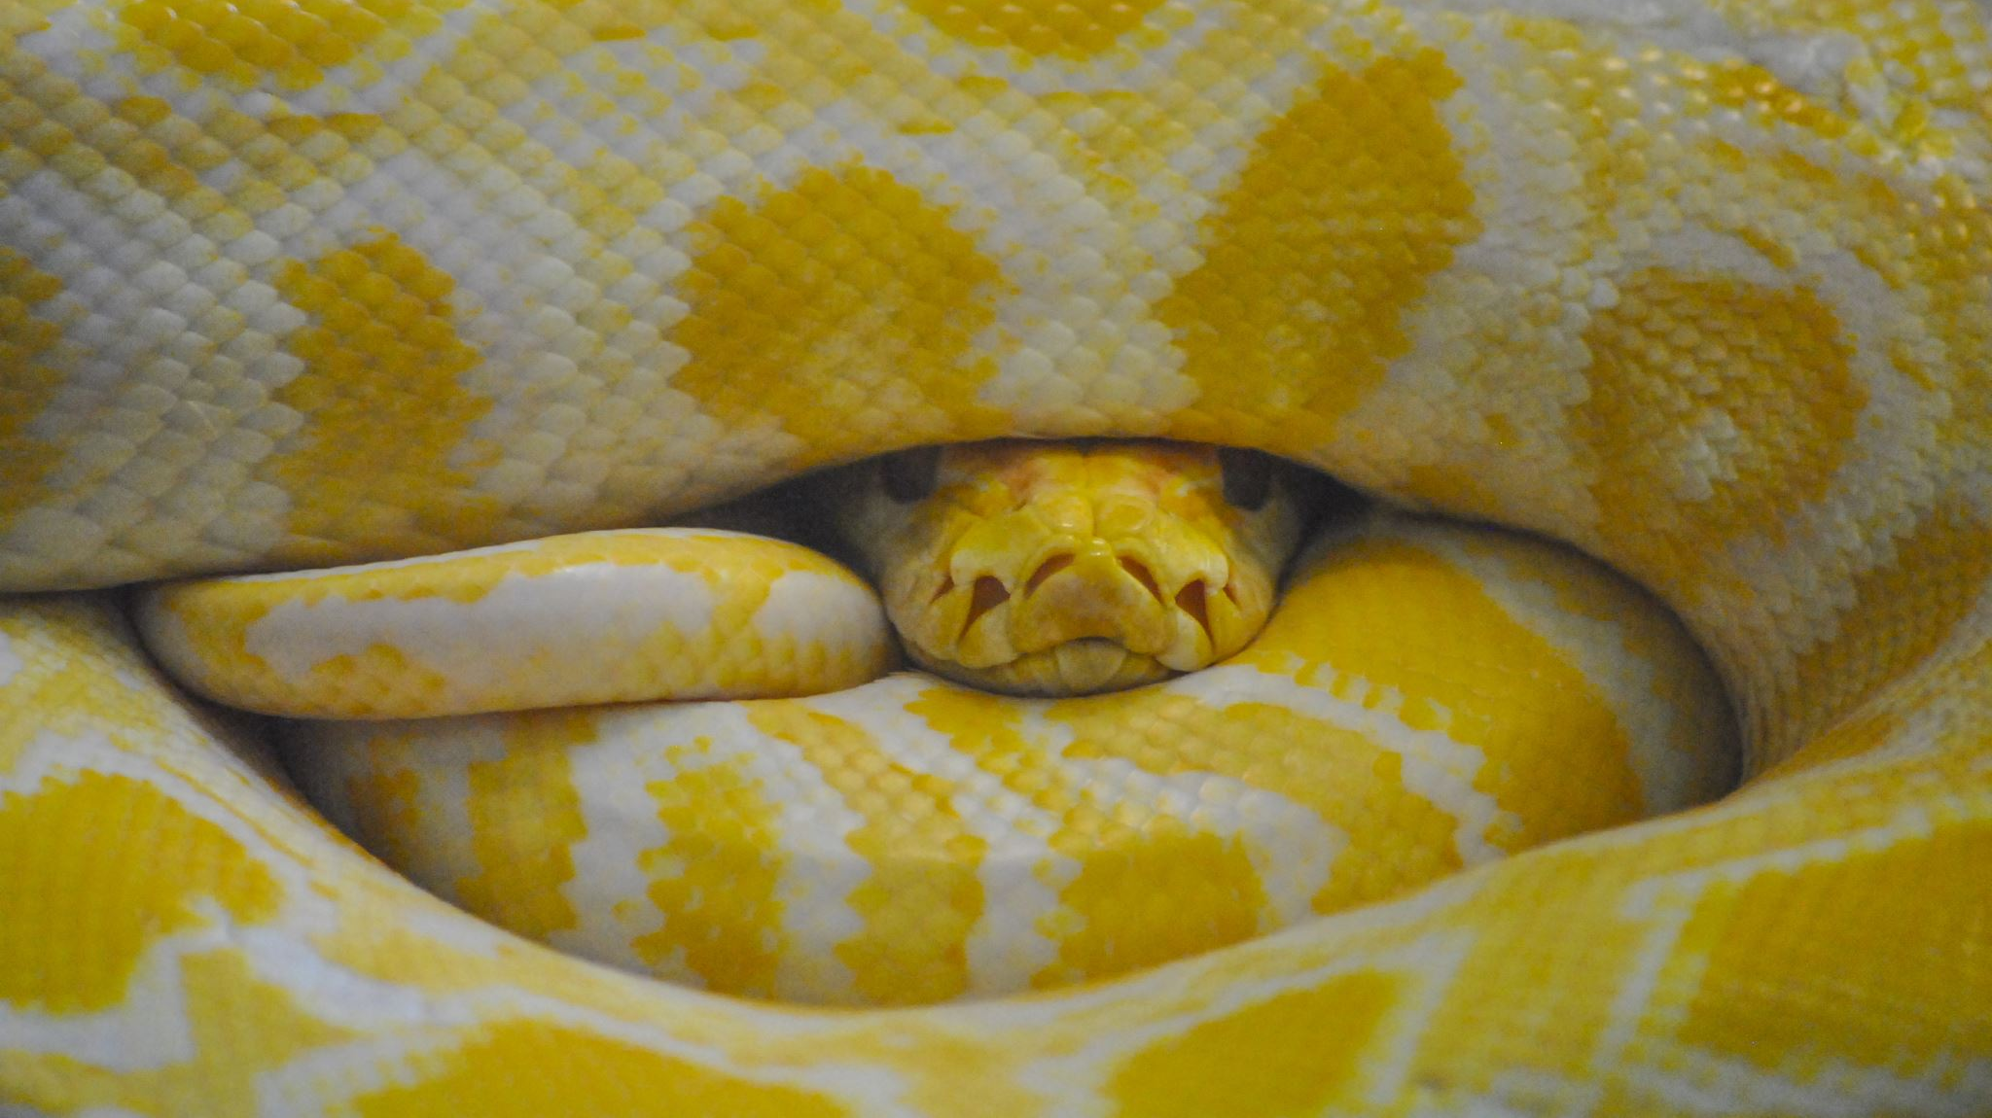
Data Visualization Using Python
Erin Howland & James Bartlett
Tech Camp 2023

Slide 2

An Interrogation
Why are you here?
What are you hoping to learn?
What do you know, or think you know, already?

Slide 3
Data X
What data-related roles have you heard of?
What do you think data roles have in common?
Data X Roles

Slide 4
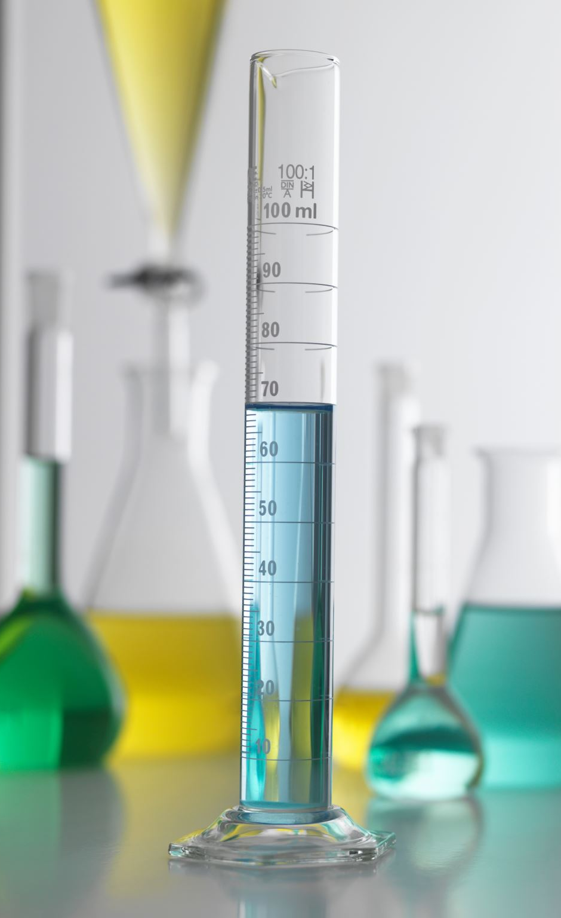
Jupyter Lab Setup

Slide 5

Visualizations
What kinds of visuals can you think of?
How do you know what visual to choose?
What makes a visual good or bad?
Visual Vocab

Slide 6
What Makes a Good Visual?
Know what you are trying to communicate
This will inform chart type, whether ordering is important, if guidelines would be useful, etc.
Understand your audience
Can inform labelling – technical v not technical, for example
Think about use of blank space v visual clutter
Scalability

Slide 7
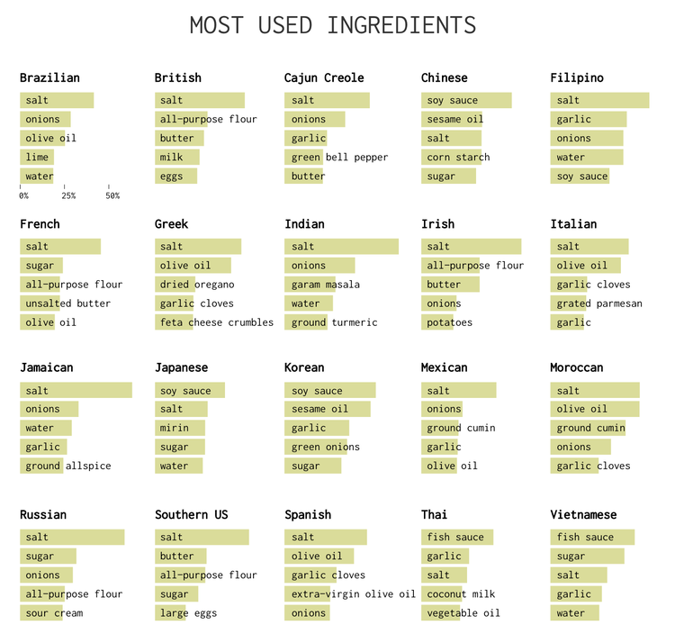
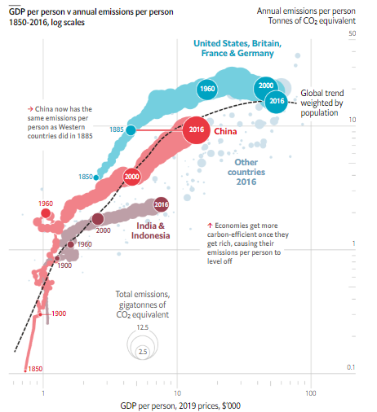
Good Visuals in the Wild, pt I

Slide 8
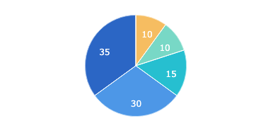
Good Visuals in the Wild, pt II
Want some more examples of good visualizations?
Guidelines for Good Visualizations (R)
Visme

Slide 9
Common Errors in Visualizations
Wrong type of chart/graph
Too many variables
Faulty/inconsistent scale
Scale breaks make small changes seem bigger
Unclear linear v logarithmic scale makes understanding of growth distorted
Inconsistent time intervals
Poor color choices
Poor labeling

Slide 10
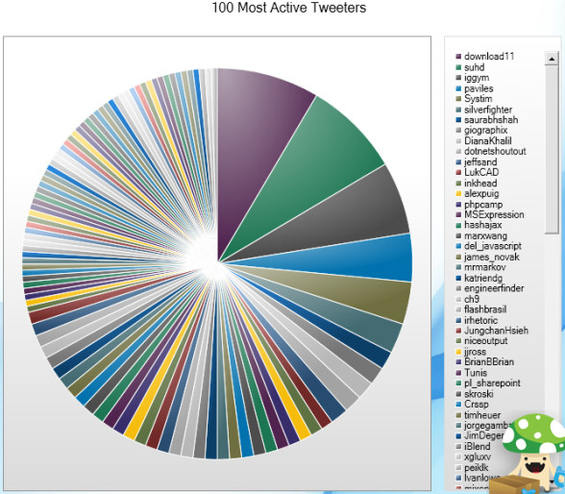
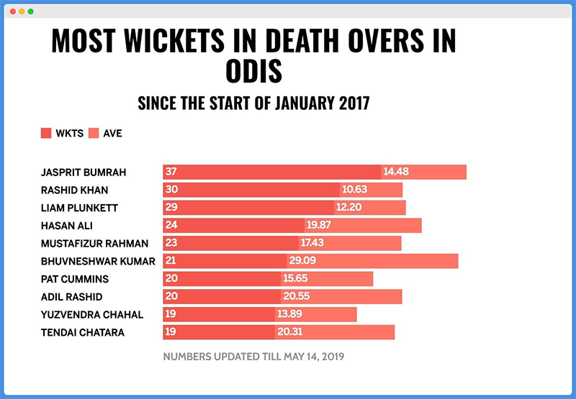
Bad Visuals in the Wild, pt I

Slide 11
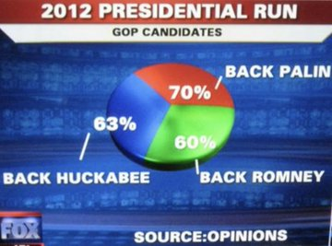
Bad Visuals in the Wild, pt II
The main thing to take away: numbers don’t lie (unless you’re as careless as whoever put together the chart to the left), but the methods by which the numbers are gathered and how those numbers are presented can be deceptive.
Want some more bad charts?
Business Insider - 27 Worst Charts (2013)
Bad Infographics

Slide 12
Python Libraries
What is a library?
A collection of books, journals, and other resources are stored for use
What is a Python library?
A collection of code – think of each Python library like a book you would check out at your local library
Allows us to code more efficiently in Python by not having to reinvent code blocks
Notes:
Data: sample_1_YesNo

Slide 13
What Kinds of Libraries are There?
Just as books in a library tend to focus on a specific subject or worlds (e.g. books about reptiles or the Harry Potter series), Python libraries tend to specialize in different kinds of tasks:
Data manipulation: Pandas, datatable, PandaPy, NumPy
Webscraping: BeautifulSoup, Scrapy
Visualization: Matplotlib, Seaborn, Plotly, GGplot
AI/ML/complex analysis: Scikit-Learn, Numpy, TensorFlow, PyTorch

Slide 14
How to use Python to Make Visuals?
Our focus is making visuals, but we’ll use some libraries that do other things. This is because we will also need to be able to view and manipulate our data in order to create visuals.
Libraries we’ll use today:
Pandas
Numpy
Matplotlib
Seaborn
Squarify

Slide 15
Let’s Make Some Visuals!
We’ll look at a sample data set with the following goals:
Learn how to open a flat file in Python and load to a dataframe
Consider what story you can tell with the data
Determine what visual(s) might be appropriate to communicate that story
Make some visuals
Different kinds of visuals
How to make labels
How to change colors
Scale
Notes:
Data: sample_1_YesNo

Slide 16
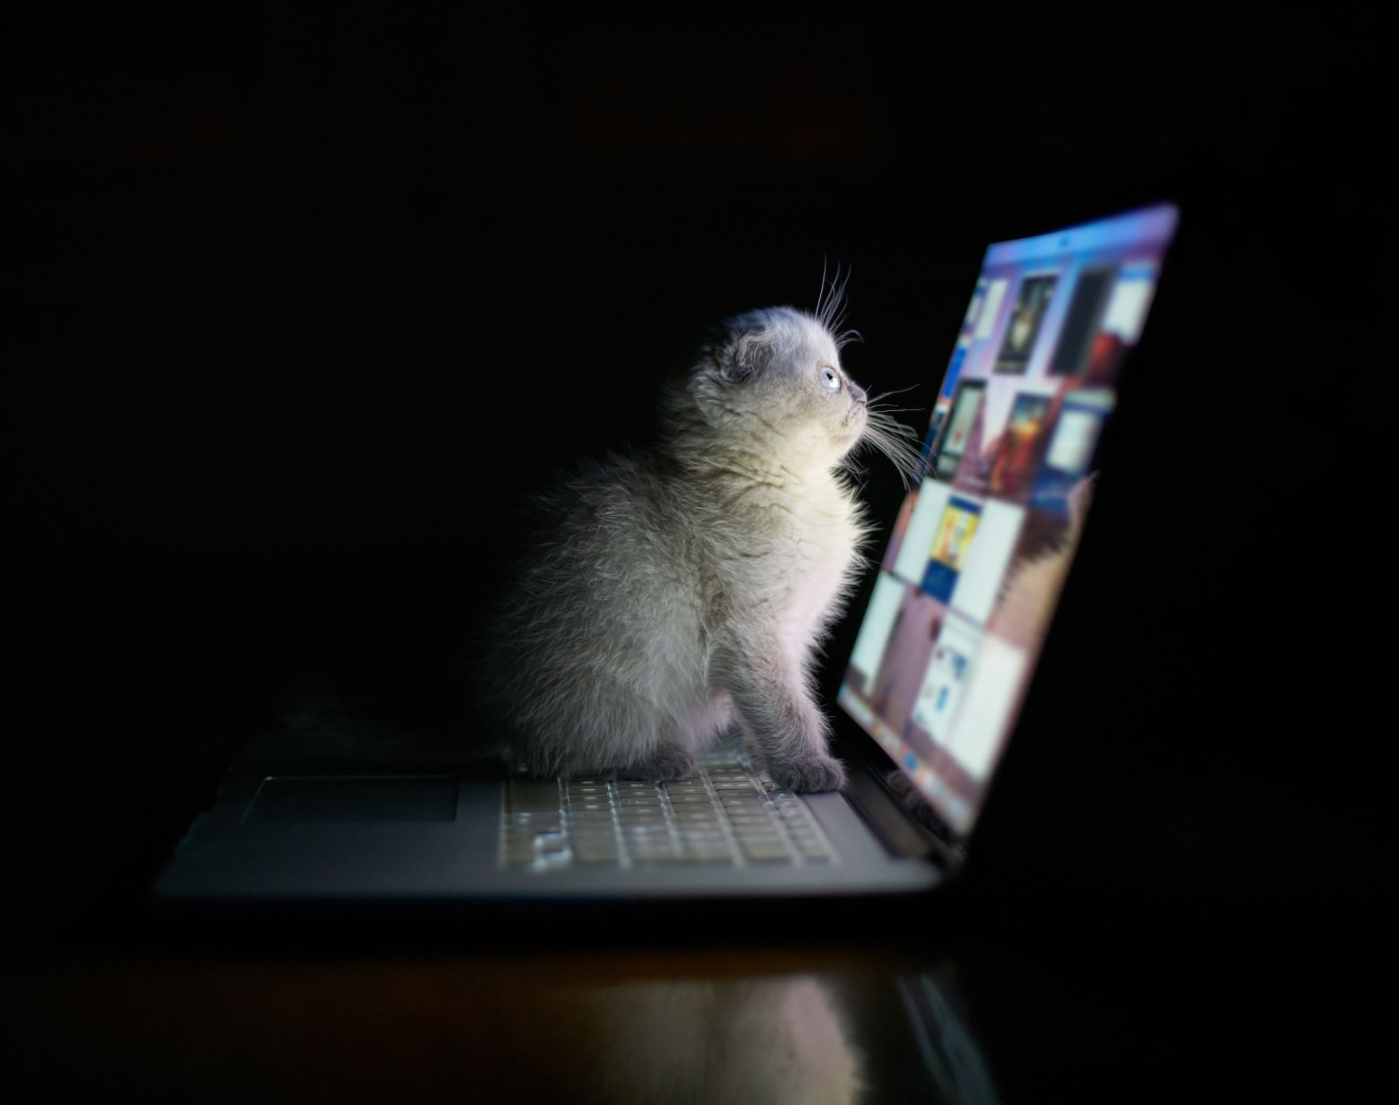
To The Code!
Dataset: cats.csv
File: cat_survey.ipynb

Slide 17
Reference: Loading Data & ‘What Now?’
Pandas can read numerous file types
In all instances you will need a file path of some kind so the program knows where to look
We will read files into a dataframe (df), which is basically Pandas’ version of a spreadsheet, but way cooler
csv: df = pd.read_csv(r’[insert file path here – brackets not needed])
I’ve loaded the data. Now what?
View dataframe
How may records (rows)? How many columns?
What data types do you have?
Is any information missing?
In short, think about the data!

Slide 18
Thinking About Data
Clean Data
Messy Data
No empty/missing values
Consistent data type in each column
Column headers are variable names, not values
Data is ready to use!
Messy data can include:
Empty/missing values
Mixed data types in each column
Multiples variables stored in one column
Data requires cleaning
This could be a course in and of itself!

Slide 19
Let’s Make Some More Visuals!
How would you describe this dataset? Messy? Clean? Somewhere in the middle?
Three primary steps:
Load dataframe
Summary/descriptive info
Visualizations
Think about these questions at each primary step:
Can you see any potential problems?
Why are these problems / What is the risk if these aren’t ultimately addressed (i.e. how might the story change)?

Slide 20
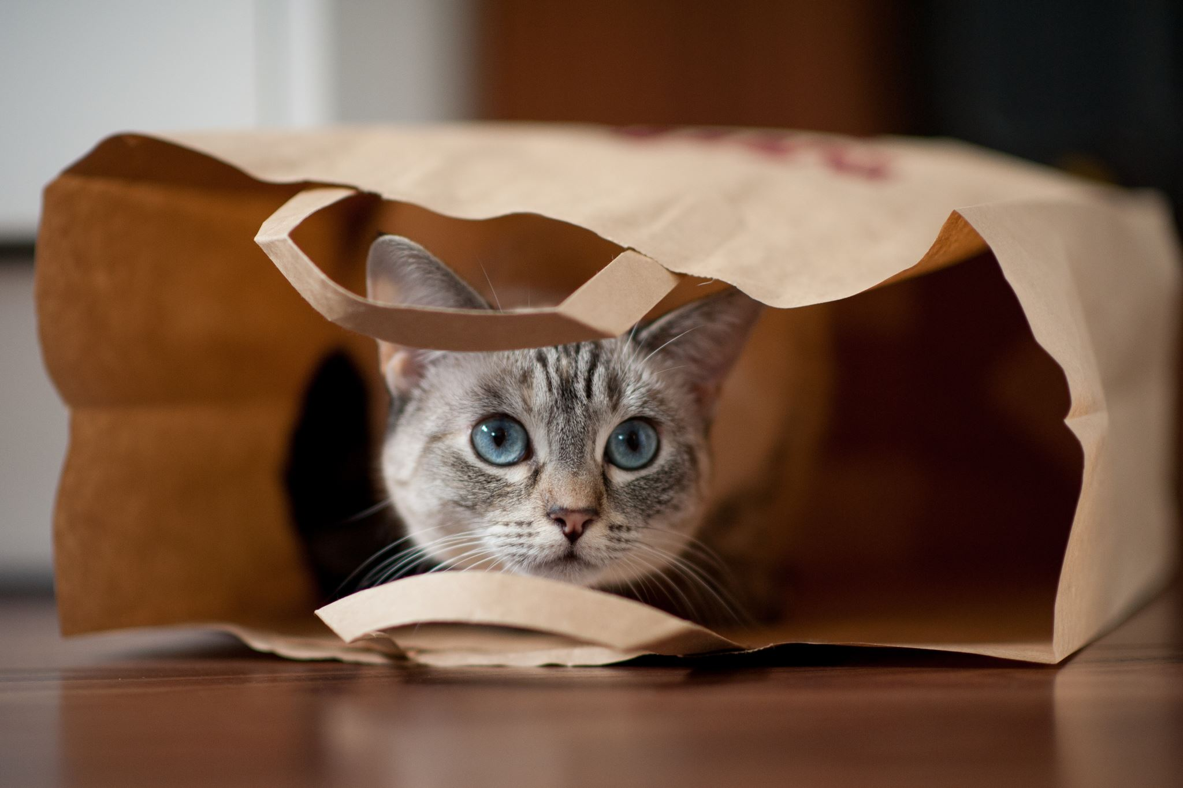
To The Code!
Dataset: imdb.csv
File: movie_ratings.ipynb
Focus: Ratings

Slide 21
Making Visuals With Less Than Perfect Data
As you may have noticed, the IMDB data was pretty good, but it wasn’t perfect – there were some missing values.
Depending on what you’re investigating, missing values may or may not be problematic. In the last example, because we looked at ratings, our visuals were not impacted since the missing data was not from the ratings column. But what if we were missing data from an area we wanted to investigate?

Slide 22
Handling Missing Data
If you are curious and want to play with this, here are two ways to address missing data:
Impute (fill in) missing data using fillna()
Drop rows with missing data
Any handling of missing data can have an effect on data analysis, so choose wisely!

Slide 23

To The Code!
Dataset: imdb.csv
File: movie_ratings.ipynb
How would you handle missing data from the Certificate and/or Metascore column(s)?

Slide 24
Visuals: Choose Your Own Adventure!
If you want to work with clean, perfect data and focus only on visuals and customization of visuals, see Visual-Ready List
If you want a little more of a challenge with data quality and Python coding beyond just what’s needed for visuals, see Challenge List
Keep in mind: you can use data from either set! Just be aware of your goals and what question(s) you are looking to answer with your visuals. There are no macho points ☺

Slide 25

To The Code!
Visual-Ready
cats.csv
imfgdp.csv
Challenge
imdb.csv
music.csv
earthquake_data.csv

Slide 27
To The Code!
Dataset: cats.csv
File: cat_survey.ipynb

Slide 29

To The Code!
Dataset: cats.csv
File: cat_survey.ipynb

Slide 31
To The Code!
Dataset: cats.csv
File: cat_survey.ipynb

Slide 33

To The Code!
Dataset: cats.csv
File: cat_survey.ipynb

