Slide 1
Blended learning system with syllabus mapping
Members: Sherry Lou Belanio
Margaux Emmanualle Nomat
Justine Joy Deniola
Cristian Demateo

Slide 2
STEP 1: DEFINING THE SYSTEM GOALS
* The proposed system aims to improve the current blended learning process at I-Tech College Inc.
* To provide a centralized platform for managing courses, learning materials, activities, and assessments.
* To integrate syllabus mapping by connecting Intended Learning Outcomes with lessons, activities, and assessments.
* To help instructors monitor the alignment and attainment of learning outcomes.
* To provide students with organized access to learning resources and assessments.

Slide 3

Step 2: Define Related Architectural Goals
Administrator
Instructor
Student
Manage users, add users, manage syllabus records, and monitor reports.
Create and manage courses
Encode syllabus and Intended Learning Outcomes
Upload learning materials
Map lessons, activities, and assessments to outcomes
Monitor student performance
Access courses and learning materials
Participate in activities
Take assessments
Monitor learning progress

Slide 4
Step 3: Apply System to Infrastructure Framework
* Translating the system requirements into the actual application, database, and technology infrastructure needed for the Blended Learning System.
* For the application — What system components are needed to support instructors, students, and administrators?
→ The system will provide user management, course management, syllabus mapping, learning materials, assessments, and progress monitoring.

Slide 5
Step 3: Apply System to Infrastructure Framework
* For the database — What information needs to be stored and managed?
→ MySQL will store user accounts, courses, syllabus details, learning outcomes, materials, assessments, and student progress.
* For the development environment — What technologies will support the system?
→ PHP and CSS will be used for system development, while XAMPP will provide the local server environment.

Slide 6
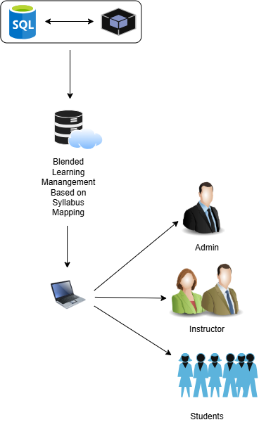
APPLICATION ARCHITECTURE
The application architecture shows how the users interact with the Blended Learning System. The administrator, instructors, and students access the system through their devices. The system processes and manages information using PHP and CSS, while MySQL stores user, course, syllabus, assessment, and progress data. XAMPP provides the local server environment used during development and testing.

Slide 7
STEP 4: EVALUATE ADDITIONAL ISSUES
System Evaluation Focus
* Functionality – Does each system feature work as intended?
* Usability – Can instructors and students use the system easily?
* Performance – Does the system respond properly during use?
* Syllabus Alignment – Are learning outcomes properly connected to lessons and assessments?
* User Feedback – What improvements are needed based on the users’ experience?

Slide 8
SYSTEM BENEFITS
Expected Benefits
Administrators
Instructors
Students
* Easier monitoring of courses and academic activities
* Organized records and reports
* Easier syllabus encoding and mapping
* Better organization of lessons and assessments
* Improved monitoring of learning outcomes
* Organized learning materials
* Clearer connection between lessons and assessments
* Easier monitoring of learning progress

Slide 9
SUMMARY
* The system integrates blended learning and syllabus mapping into one platform.
* It connects learning outcomes, lessons, activities, and assessments.
* The application uses PHP, CSS, MySQL, and XAMPP for development.
* Draw.io is used for system modeling and documentation.
* The system aims to improve course organization, syllabus alignment, and learning progress monitoring at I-Tech College Inc.

Slide 10
Thank you!

