Slide 1
Machine Learning
SL - Classification

Slide 2
Outline
Machine Learning
Data Sampling, Preparation, and Partitioning
Assessing the Fit of the Simple Linear Regression Model
The Multiple Linear Regression Model
Inference and Linear Regression
Categorical Independent Variables
Modeling Nonlinear Relationships
Model Fitting
Big Data and Linear Regression
Prediction with Linear Regression
Summary

Slide 3
Introduction
Machine Learning (ML) is a subset of artificial intelligence (AI) that focuses on developing algorithms and statistical models that enable computers to learn and improve from experience without being explicitly programmed.
Supervised Learning
SL is a type of ML where a model is trained on a labelled dataset.
Each training example in the dataset consists of input features (independent variables) and an associated output label (dependent variable).
The goal of supervised learning is for the model to learn a mapping from inputs to outputs so that it can predict labels for unseen data accurately.

Slide 4
Introduction
Machine Learning (ML) is a subset of artificial intelligence (AI) that focuses on developing algorithms and statistical models that enable computers to learn and improve from experience without being explicitly programmed.
Unsupervised Learning
Unsupervised ML is a type of machine learning where a model is trained on unlabelled data.
Unlike SL, there are no predefined labels or outcomes; the algorithm tries to identify patterns, structures, or relationships in the data without explicit guidance.

Slide 5
Introduction
Machine Learning (ML) is a subset of artificial intelligence (AI) that focuses on developing algorithms and statistical models that enable computers to learn and improve from experience without being explicitly programmed.
Reinforcement Learning
Reinforcement Learning (RL) is a type of ML where an agent learns to make decisions by interacting with an environment.
The agent takes actions in the environment to maximize cumulative rewards over time, learning through a process of trial and error.

Slide 6
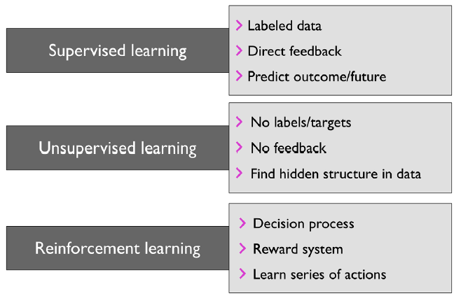
Introduction

Slide 7
Supervised Learning
Supervised Learning(SL)
The main goal in supervised learning is to learn a model from labelled training data that allows us to make predictions about unseen or future data.
The term “supervised” refers to a set of training examples (data inputs) where the desired output signals (labels) are already known.
Supervised learning is then the process of modelling the relationship between the data inputs and the labels.
We can also think of supervised learning as “label learning.”

Slide 8
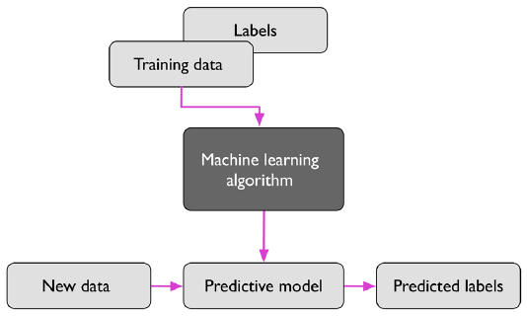
Supervised Learning
Supervised Learning(SL)

Slide 9
Supervised Learning
Supervised Learning(SL)
Example:
Considering the example of email spam filtering, we can train a model using a supervised machine learning algorithm on a corpus of labelled emails, which are correctly marked as spam or non-spam, to predict whether a new email belongs to either of the two categories.
A supervised learning task with discrete class labels, such as in the email spam filtering example, is also called a classification task.
Another subcategory of supervised learning is regression, where the outcome signal is a continuous value.

Slide 10
Supervised Learning
Classification
Classification is a subcategory of supervised learning where the goal is to predict the categorical class labels of new instances or data points based on past observations.
Those class labels are discrete, unordered values that can be understood as the group memberships of the data points.
In email spam example, detection represents a typical example of a binary classification task, where the machine learning algorithm learns a set of rules to distinguish between two possible classes: spam and non-spam emails.
Notes:
分类 分类是监督式学习的一个子类别，其目标是根据过去的观察结果预测新实例或数据点的分类类标签。 这些类标签是离散的、无序的值，可以理解为数据点的组成员身份。 在垃圾邮件示例中，检测代表了二元分类任务的典型示例，其中机器学习算法学习一组规则来区分两个可能的类别：垃圾邮件和非垃圾邮件。

Slide 11
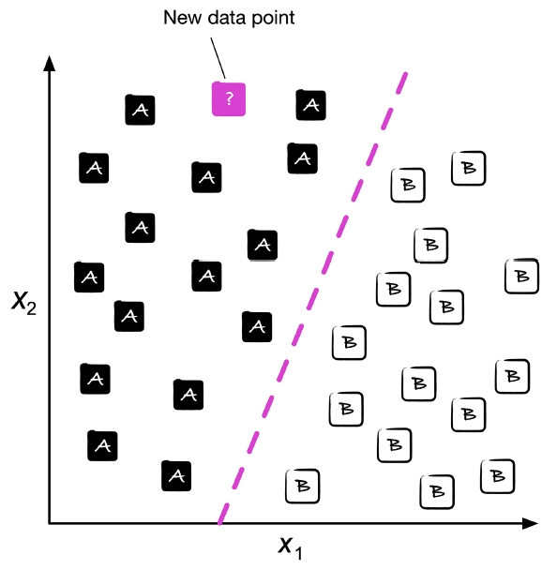
Supervised Learning
Classification

Slide 12
Supervised Learning
Classification
A typical example of a multiclass classification task is handwritten character recognition.
The letters (“A,” “B,” “C,” and so on) will represent the different unordered categories or class labels that we want to predict.
If a user provides a new handwritten character via an input device, our predictive model will be able to predict the correct letter in the alphabet with certain accuracy.
However, our ML system will be unable to correctly recognize any of the digits between 0 and 9, for example, if they were not part of the training dataset.
Notes:
分类 多类分类任务的一个典型示例是手写字符识别。 字母（“A”、“B”、“C”等）将代表我们想要预测的不同无序类别或类标签。 如果用户通过输入设备提供新的手写字符，我们的预测模型将能够以一定的准确性预测字母表中的正确字母。 但是，我们的 ML 系统将无法正确识别 0 到 9 之间的任何数字，例如，如果它们不是训练数据集的一部分。

Slide 13
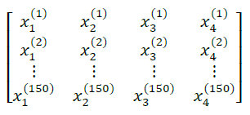
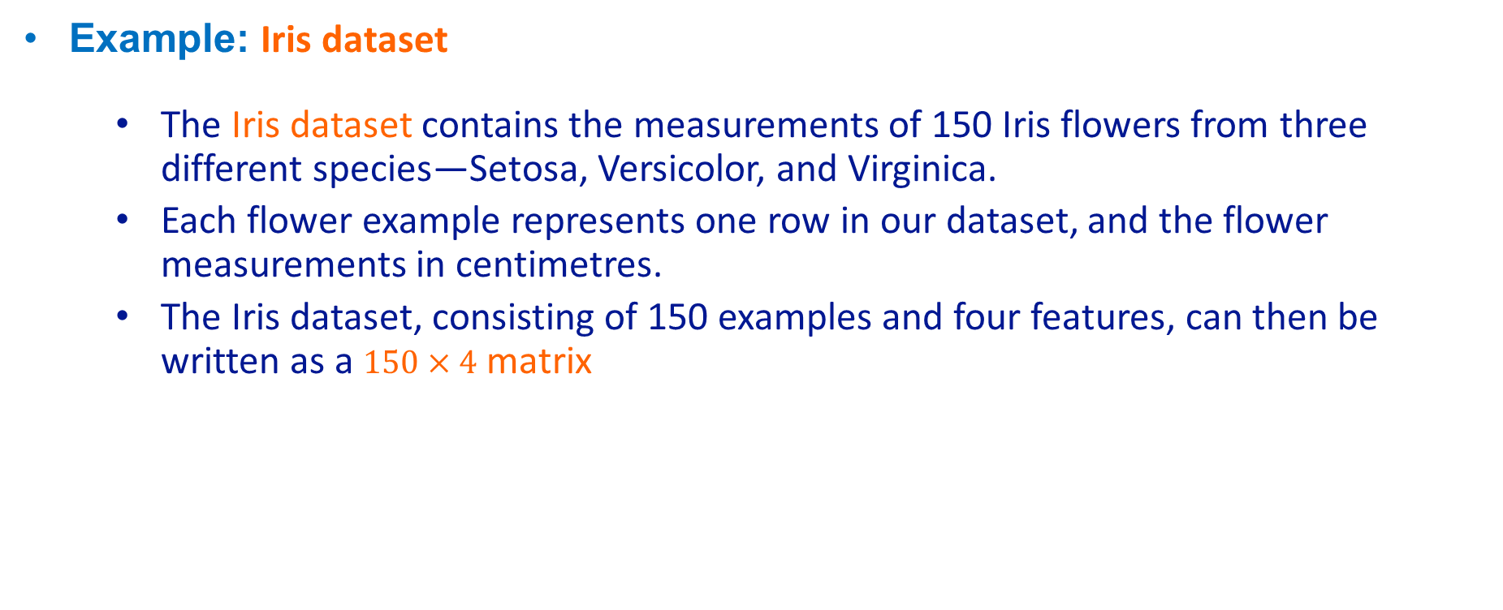
ML Notations & Conventions
Example: Iris dataset
The Iris dataset contains the measurements of 150 Iris flowers from three different species—Setosa, Versicolor, and Virginica.
Each flower example represents one row in our dataset, and the flower measurements in centimetres.
The Iris dataset, consisting of 150 examples and four features, can then be written as a $150×4$ matrix
Notes:
示例：Iris 数据集 Iris 数据集包含来自三个不同物种（Setosa、Versicolor 和 Virginica）的 150 朵鸢尾花的测量值。 每个花朵示例代表我们数据集中的一行，花朵测量值以厘米为单位。 Iris 数据集由 150 个示例和 4 个特征组成，然后可以编写为 150×4 矩阵

Slide 14
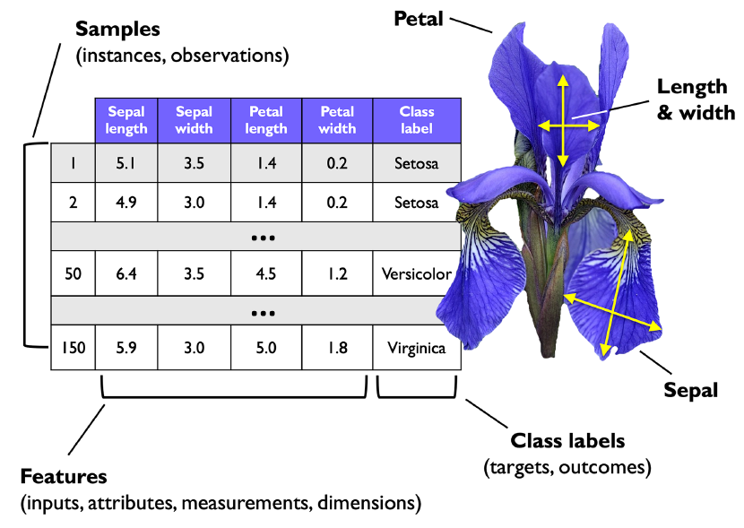
ML Notations & Conventions
Example: Iris dataset

Slide 15
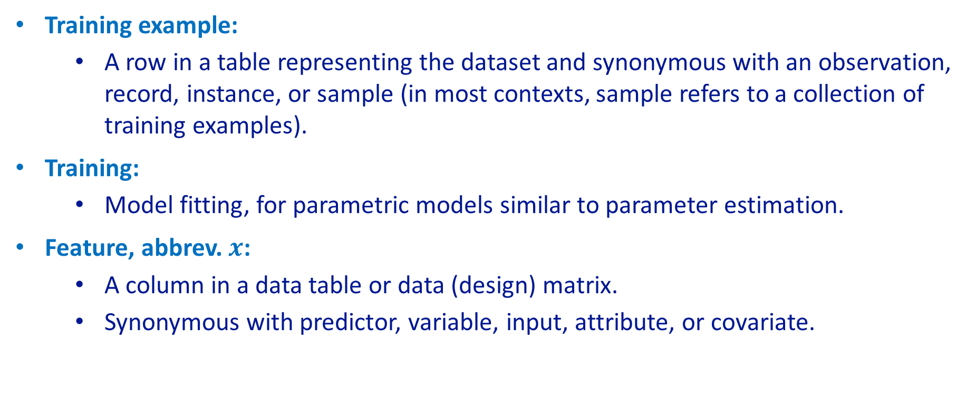
ML Notations & Conventions
Training example:
A row in a table representing the dataset and synonymous with an observation, record, instance, or sample (in most contexts, sample refers to a collection of training examples).
Training:
Model fitting, for parametric models similar to parameter estimation.
Feature, abbrev. $x$:
A column in a data table or data (design) matrix.
Synonymous with predictor, variable, input, attribute, or covariate.
Notes:
训练示例： 表中表示数据集的一行，与观察、记录、实例或样本同义（在大多数情况下，样本是指训练样本的集合）。 训练： 模型拟合，用于类似于参数估计的参数模型。 特征，缩写 x： 数据表或数据（设计）矩阵中的列。 与预测变量、变量、输入、属性或协变量同义。

Slide 16
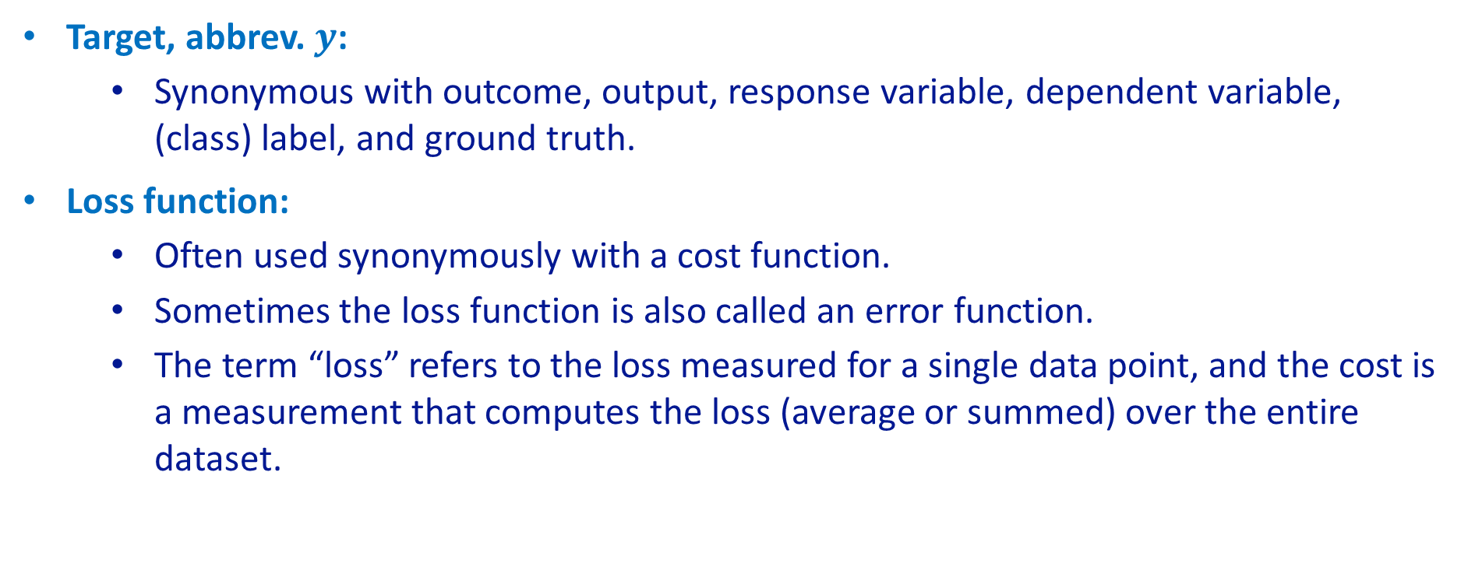
ML Notations & Conventions
Target, abbrev. $y$:
Synonymous with outcome, output, response variable, dependent variable, (class) label, and ground truth.
Loss function:
Often used synonymously with a cost function.
Sometimes the loss function is also called an error function.
The term “loss” refers to the loss measured for a single data point, and the cost is a measurement that computes the loss (average or summed) over the entire dataset.
Notes:
目标，缩写 y： 与结果、输出、响应变量、因变量、（类）标签和真实值同义。 损失函数： 通常与成本函数同义使用。 有时损失函数也称为误差函数。 术语 “loss” 是指针对单个数据点测量的损失，而 cost 是计算整个数据集的损失 （平均值或总和） 的度量。

Slide 17
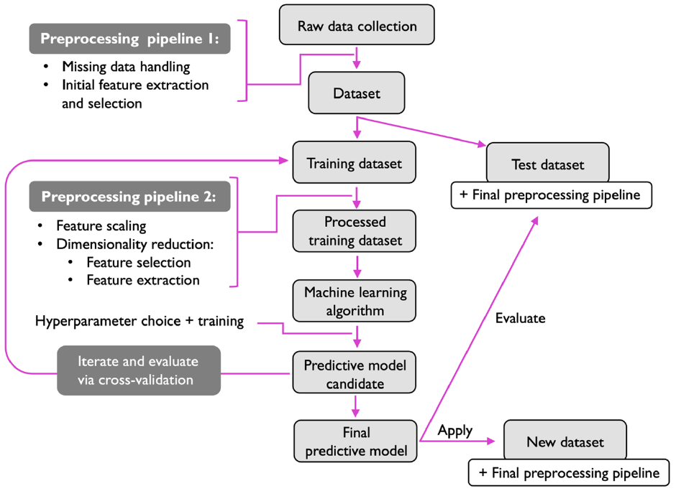
Roadmap – ML Systems

Slide 18
Roadmap – ML Systems
Preprocessing – Getting data into shape
Preprocessing data is critical for optimal machine learning performance, involving steps like feature extraction from raw data.
Features must often be scaled to a uniform range (e.g., [0, 1] or standard normal) for effective algorithm performance.
Dimensionality reduction techniques help remove redundant features, improve storage efficiency, and enhance algorithm speed.
Reducing dimensionality can also improve model predictions by filtering out irrelevant features and noise.
Splitting data into training and test sets ensures the model is optimized during training and evaluated on unseen data for generalization.

Slide 19
Roadmap – ML Systems
Training & Selecting a Predictive Model
No single classification algorithm is universally superior; comparing multiple algorithms is essential for selecting the best model.
A performance metric, like classification accuracy, must be chosen to evaluate models effectively.
Classification accuracy measures the proportion of correctly classified instances.
Cross-validation techniques divide the data into training and validation subsets to estimate model generalization.
Keeping the test dataset reserved for final evaluation ensures unbiased performance assessment on real-world data.

Slide 20
Roadmap – ML Systems
Training & Selecting a Predictive Model
Hyperparameter optimization is the process of systematically selecting the best combination of hyperparameters to improve model performance.
Hyperparameters are settings defined before training (e.g., learning rate, number of layers, regularization strength) that influence the model's behaviour.
Default hyperparameters in software libraries are often not optimal for specific tasks.
Fine-tuning hyperparameters improves the effectiveness of learning algorithms and avoids overfitting.
Techniques like grid search, random search, and Bayesian optimization are commonly used for hyperparameter tuning.

Slide 21
Roadmap – ML Systems
Evaluating Models & Predicting Unseen Data Instances
After training a model on the training dataset, we use the test dataset to estimate its generalization error.
If the model performs well, it can be used to predict future, unseen data.
Parameters for procedures like feature scaling and dimensionality reduction should be derived only from the training dataset.
These parameters must be consistently applied to the test dataset and new data to avoid overly optimistic performance estimates.

Slide 22
Predictive Data Mining
Regression is a set of data mining methods having the task of predicting a quantitative outcome using a set of input variables, or features.
Predictive data mining methods, also referred to as supervised learning, use known values of the outcome variable to “supervise” the learning process of how to use the input features to predict future values of the outcome variable.
The predictive data mining process comprises the following steps:
data sampling – extracts a relevant sample of data
data preparation – addresses missing data/errors and refine variable set
data partitioning – divides a sample into training, validation, and test sets.
model construction and assessment – trains a set of supervised learning models, validates their performance, and tests the best model.

Slide 23
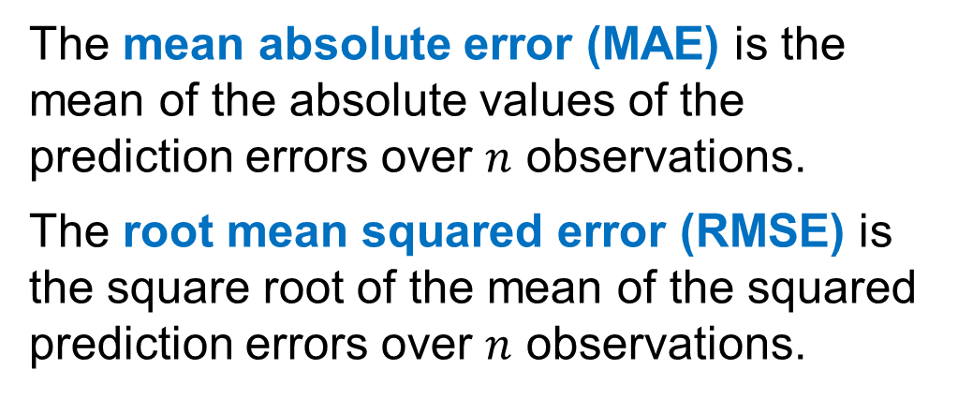
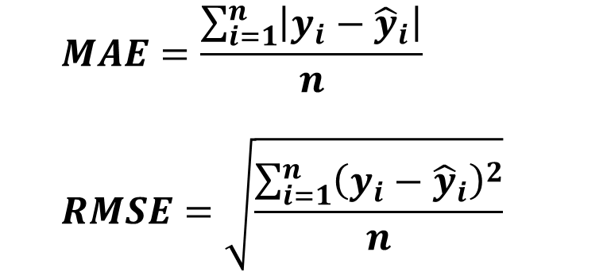
Regression Performance Measures
The prediction error of an observation is the difference between the actual value of an observation and the predicted value of an observation, $y_{i}−{\hat{y}}_{i}$.
The mean absolute error (MAE) is the mean of the absolute values of the prediction errors over $n$ observations.
The root mean squared error (RMSE) is the square root of the mean of the squared prediction errors over $n$ observations.
$$MAE=\frac{\sum_{i=1}^{n}{\left|y_{i}−{\hat{y}}_{i}\right|}}{n}$$
$$RMSE=\sqrt{\frac{\sum_{i=1}^{n}{{\left(y_{i}−{\hat{y}}_{i}\right)}^{2}}}{n}}$$
In most cases, MAE and RMSE will favor the same prediction, but not always.
In this chapter, we will be using the RMSE measure for all comparisons of predictive data mining models.

Slide 24
Data Sampling and Preparation
A sample for data analysis, extracted from a large volume of data, should be:
representative of the population of interest,
large enough to contain significant information, and yet
small enough to be manipulated quickly.
Typically, the larger the data set, the more precise the data mining algorithm.
During sampling, it is generally best to include as many variables as possible.
Variables that are not of interest can then be eliminated using data visualization and descriptive statistics.
Generally, a larger data set simplifies the process of assessing the accuracy of data−based estimates of variable effects.

Slide 25
Data Partitioning
Increasing volumes of data that simplify the process of assessing model performance can also lead to overfitting.
For a regression task, overfitting occurs when a model has a small RMSE or MAE for the data sample but a much larger RMSE or MAE outside of it.
We can use the abundance of data to guard against the potential for overfitting by partitioning the data set into different subsets for
the training (or construction) of candidate models,
the validation (or performance comparison) of candidate models, and
the testing (or assessment) of future performance of a selected model.
Static holdout and k−fold cross−validation are two methods for splitting the sample data into sets for the training and validation of prediction models.

Slide 26
Static Holdout Method
The training set is used to build the candidate models.
The validation set is used to identify the most accurate model within a promising set at predicting observations not used to build the model.
The test set should be applied to estimate the final model’s effectiveness when applied to data that have not been used to build or select the model.
For example,
a training set may be used to estimate the slope coefficients in several multiple regression models that differ in the set of selected variables,
the validation set is then used to identify the “best” model through the comparison of the RMSE or MAE measures, and finally
the “best” model is applied to the test set to evaluate its effectiveness.

Slide 27
The Palanquin Auto Data Set
Data file: preowned12
Palanquin Auto is a national pre−owned car retailer with an online marketplace.
Palanquin Auto wants to construct and assess a set of prediction methods for the regression task of predicting the sales price of a pre−owned car.
The data set for this chapter consists of the price, age, and miles for a set of 12 pre−owned cars.
Data on four additional pre−owned cars is also available for testing.
Car | Age (years) | Odom (miles) | Price
1 | 9 | 95,000 | 14,000
2 | 8 | 50,500 | 15,000
3 | 7 | 166,380 | 22,950
4 | 20 | 250,500 | 900
5 | 12 | 191,955 | 20,950
6 | 13 | 204,561 | 2,500
7 | 14 | 181,000 | 7,300
8 | 4 | 62,000 | 45,000
9 | 10 | 164,000 | 8,950
10 | 16 | 53,320 | 8,888
11 | 10 | 201,766 | 16,500
12 | 13 | 56,700 | 9,000

Slide 28
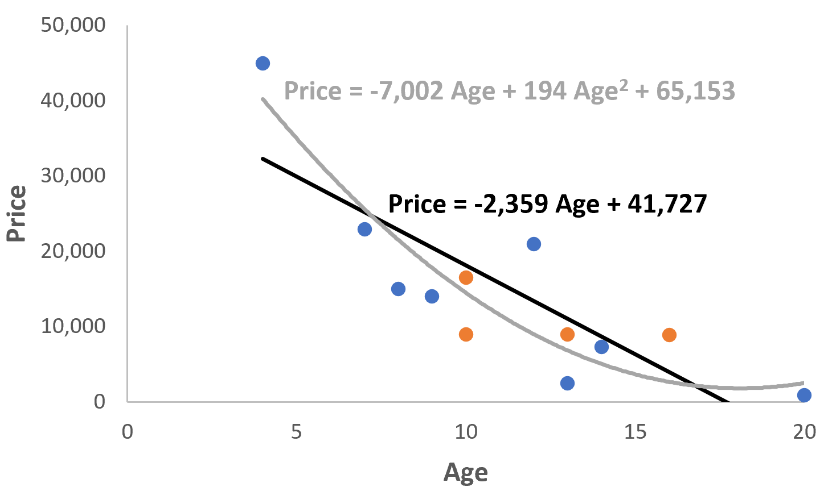
Palanquin Auto Data Static Holdout Method
Two models are being considered to predict the price ($y$) of a pre−owned car using its age as the independent variable $x$:
a simple linear regression model
a quadratic regression model
The sample is split into two static sets:
training – observations 1−8
validation – observations 9−12
The scatter chart to the right shows the two candidate regression models constructed on the static training set and assessed on the static validation set.

Slide 29
Calculations of RMSE on Static Validation Set
To assess the out−of−sample predictive accuracy of the two models, we compute the RMSE of their predictions on the four observations of the validation set.
The table below shows that based on the static validation set, the quadratic regression model (Model 2) has a smaller RMSE.
Car | Age (years) | Price | Pred. Price from Model 1 | Error of Model 1 | Pred. Price from Model 2 | Error of Model 2
9 | 10 | 8,950 | 18,139 | −9,189 | 14,485 | −5,535
10 | 16 | 8,888 | 3,986 | 4,902 | 2,662 | 6,226
11 | 10 | 16,500 | 18,139 | −1,639 | 14,485 | 2,015
12 | 13 | 9,000 | 11,063 | −2,063 | 6,832 | 2,168
 |  |  | RMSE = | 5,371 | RMSE = | 4,420

Slide 30
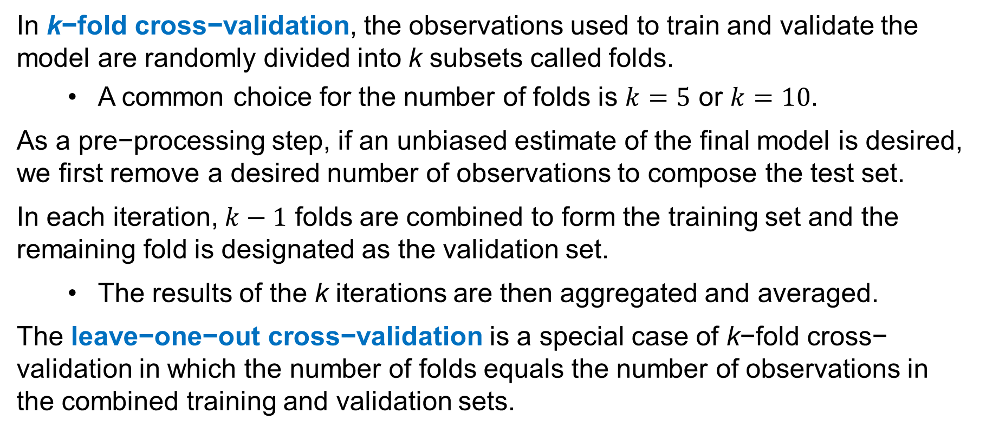
k−Fold Cross−Validation Method
In k−fold cross−validation, the observations used to train and validate the model are randomly divided into k subsets called folds.
A common choice for the number of folds is $k=5$ or $k=10$.
As a pre−processing step, if an unbiased estimate of the final model is desired, we first remove a desired number of observations to compose the test set.
In each iteration, $k−1$ folds are combined to form the training set and the remaining fold is designated as the validation set.
The results of the k iterations are then aggregated and averaged.
The leave−one−out cross−validation is a special case of k−fold cross− validation in which the number of folds equals the number of observations in the combined training and validation sets.

Slide 31
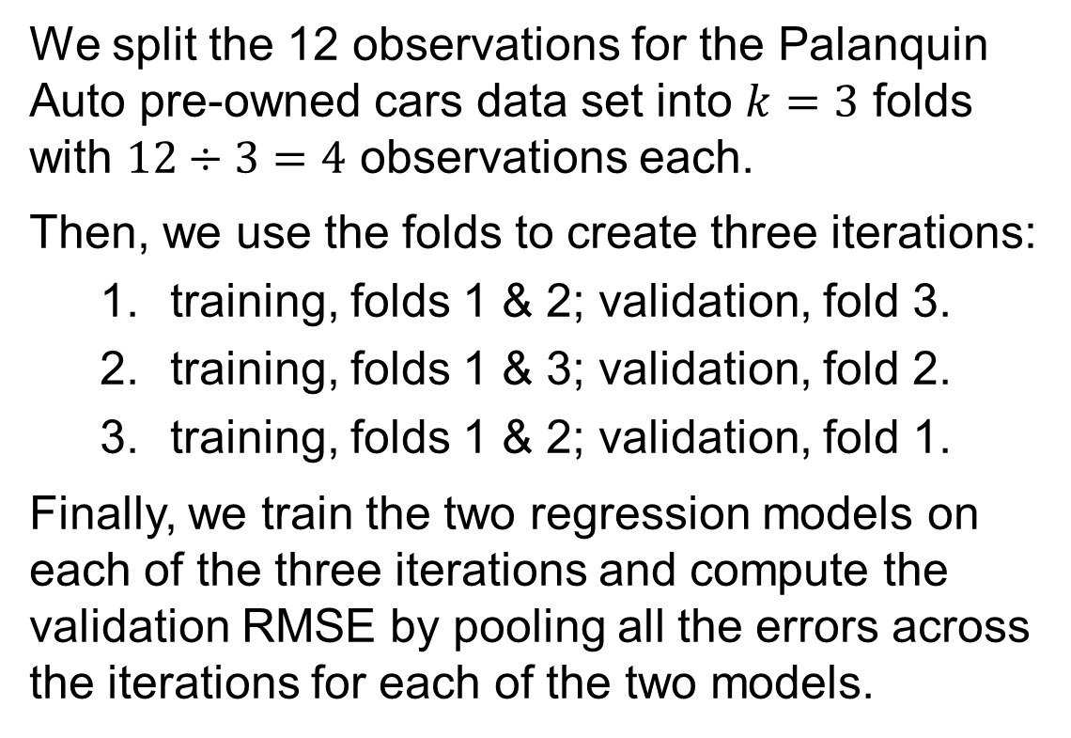
Palanquin Data 3-Fold Cross-Validation
We split the 12 observations for the Palanquin Auto pre-owned cars data set into $k=3$ folds with $12÷3=4$ observations each.
Then, we use the folds to create three iterations:
training, folds 1 & 2; validation, fold 3.
training, folds 1 & 3; validation, fold 2.
training, folds 1 & 2; validation, fold 1.
Finally, we train the two regression models on each of the three iterations and compute the validation RMSE by pooling all the errors across the iterations for each of the two models.
 | Car | Age (years) | Price
 | 1 | 9 | 14,000
Fold | 2 | 8 | 15,000
1 | 3 | 7 | 22,950
 | 4 | 20 | 900
 | 5 | 12 | 20,950
Fold | 6 | 13 | 2,500
2 | 7 | 14 | 7,300
 | 8 | 4 | 45,000
 | 9 | 10 | 8,950
Fold | 10 | 16 | 8,888
3 | 11 | 10 | 16,500
 | 12 | 13 | 9,000

Slide 32
Calculations of RMSE in 3-Fold Cross-Validation
 |  | Age |  | Model 1 |  | Model 2
 | Car | (years) | Price | Pred. Price | Error | Pred. Price | Error
Iteration #1 |  |  |  | Price = 41,727 − 2,359 Age |  | Price = 65,153 − 7,002 Age + 194 Age²
Training on | 9 | 10 | 8,950 | 18,139 | −9,189 | 14,485 | −5,535
folds 1 & 2 | 10 | 16 | 8,888 | 3,986 | 4,902 | 2,662 | 6,226
Validation | 11 | 10 | 16,500 | 18,139 | −1,639 | 14,485 | 2,015
on fold 3 | 12 | 13 | 9,000 | 11,063 | −2,063 | 6,832 | 2,168
Iteration #2 |  |  |  | Price = 27,186 − 1,304 Age |  | Price = 35,876 − 2,763 Age + 54 Age²
Training on | 5 | 12 | 20,950 | 11,534 | 9,416 | 10,533 | 10,417
folds 1 & 3 | 6 | 13 | 2,500 | 10,230 | −7,730 | 9,126 | −6,626
Validation | 7 | 14 | 7,300 | 8,926 | −1,626 | 7,829 | −529
on fold 2 | 8 | 4 | 45,000 | 21,969 | 23,031 | 25,692 | 19,308
Iteration #3 |  |  |  | Price = 51,099 − 3,149 Age |  | Price = 77,398 − 9,476 Age + 323 Age²
Training on | 1 | 9 | 14,000 | 22,758 | −8,758 | 18,295 | −4,295
folds 2 & 3 | 2 | 8 | 15,000 | 25,907 | −10,907 | 22,277 | −7,277
Validation | 3 | 7 | 22,950 | 29,056 | −6,106 | 26,905 | −3,955
on fold 1 | 4 | 20 | 900 | −11,880 | 12,780 | 17,159 | −16,259
 |  |  |  | RMSE = | 9,972 | RMSE = | 8,921

Slide 33
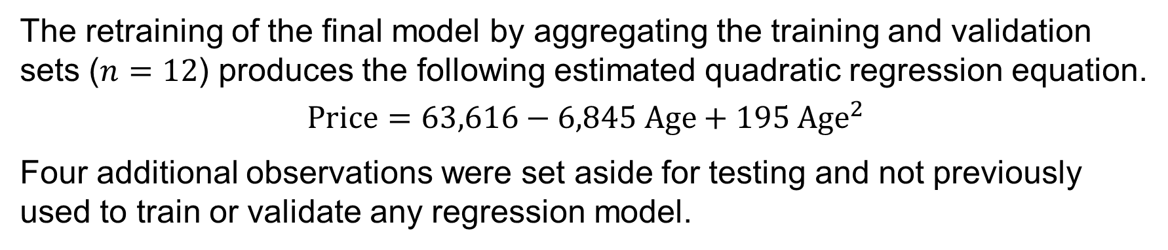
Evaluating the Best Model for Palanquin Auto
The retraining of the final model by aggregating the training and validation sets ($n=12$) produces the following estimated quadratic regression equation.
$$\text{Price}=63,616−6,845 \text{Age}+195 {\text{Age}}^{2}$$
Four additional observations were set aside for testing and not previously used to train or validate any regression model.
The RMSE of 18,576 on the test set provides a more conservative estimate than the RMSE on the validation sets.
Applying the model to a test set provides a separate and unbiased estimate of the model’s RMSE.
Car | Age | Price | Pred. Price | Error
13 | 6 | 23,495 | 29,552 | −6,057
14 | 5 | 12,995 | 34,256 | −21,261
15 | 7 | 32,999 | 25,237 | 7,762
16 | 3 | 15,999 | 44,832 | −28,833
 |  |  | RMSE = | 18,576

Slide 34
Final Considerations on Data Partitioning
Both partitioning methods produced a lower RMSE for the quadratic regression model. Thus, the previous testing results apply to both methodologies.
Because the purpose of evaluating a model on a test set is to provide a final estimate of the model’s future predictive performance,
the sample needs to be sufficiently large to obtain a stable estimate.
There are no firm rules for the size of the partitions, but the training set
is typically the largest partition, and
should have at least 10 times as many observations as variables.
In situations with a small data set, as it is the case for Palanquin Auto, an analyst may choose not to set aside observations for a test set.

Slide 35
k-Nearest Neighbors Regression
For a regression task, k-nearest neighbors (k-NN) predicts an observation’s quantitative outcome variable based on the k most similar observations from the training set.
Data mining software commonly employs Euclidean distance (as defined in Section 6.2) to measure the similarity between two observations.
The predicted value of an observation’s quantitative outcome variable is calculated as the average of the outcome variable’s values over its k nearest neighbors.
The k-NN method is called a lazy learner because it does not learn model parameters from the training set like linear regression does but instead uses the k most similar observations to make its prediction for the validation set.

Slide 36
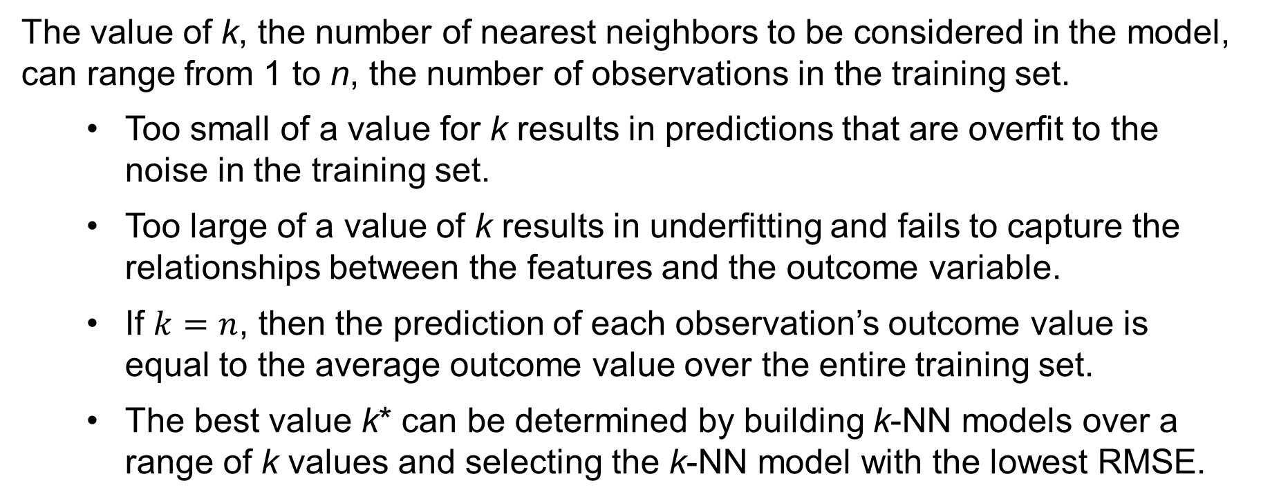
Choice of Number of Nearest Neighbors
The value of k, the number of nearest neighbors to be considered in the model, can range from 1 to n, the number of observations in the training set.
Too small of a value for k results in predictions that are overfit to the noise in the training set.
Too large of a value of k results in underfitting and fails to capture the relationships between the features and the outcome variable.
If $k=n$, then the prediction of each observation’s outcome value is equal to the average outcome value over the entire training set.
The best value k* can be determined by building k-NN models over a range of k values and selecting the k-NN model with the lowest RMSE.

Slide 37
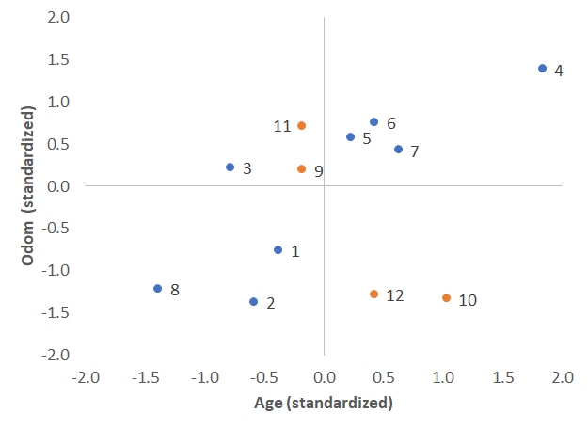
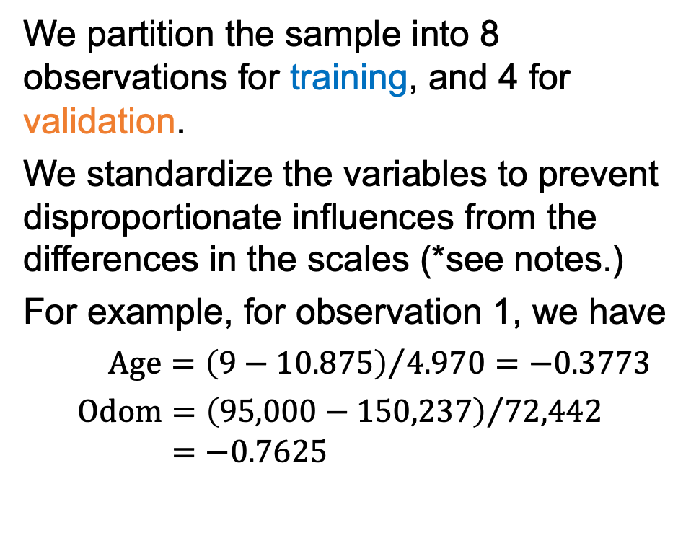
10.3 k-NN Regression for the Palanquin Auto Data
Consider the Palanquin Auto regression task of predicting the sales price of a pre-owned car, using age measured in years (Age) and the miles on the odometer of the vehicle (Odom.)
We partition the sample into 8 observations for training, and 4 for validation.
We standardize the variables to prevent disproportionate influences from the differences in the scales (*see notes.)
For example, for observation 1, we have
$$\text{Age}={\left(9−10.875\right)}/{4.970}=−0.3773$$
$$\text{Odom}={\left(95,000−150,237\right)}/{72,442}$$
$=−0.7625$
Notes:
*The variables for the observations in both the training (1-8) and validation (9-12) sets are standardized using the following means and standard deviations of the training set.
$$\text{Mean} \text{Age}=\sum_{i=1}^{8}{\frac{{\text{Age}}_{i}}{8}=10.875} \text{years}$$
$$\text{Standard} \text{Deviation} \text{Age}=\sqrt{\sum_{i=1}^{8}{\frac{{\left({\text{Age}}_{i}−\text{Mean} \text{Age}\right)}^{2}}{8−1}}}=4.970 \text{years}$$
$$\text{Mean} \text{Odom}=\sum_{i=1}^{8}{\frac{{\text{Odom}}_{i}}{8}=150,237} \text{miles}$$
$$\text{Standard} \text{Deviation} \text{Odom}=\sqrt{\sum_{i=1}^{8}{\frac{{\left({\text{Odom}}_{i}−\text{Mean} \text{Odom}\right)}^{2}}{8−1}}}=72,442 \text{miles}$$

Slide 38
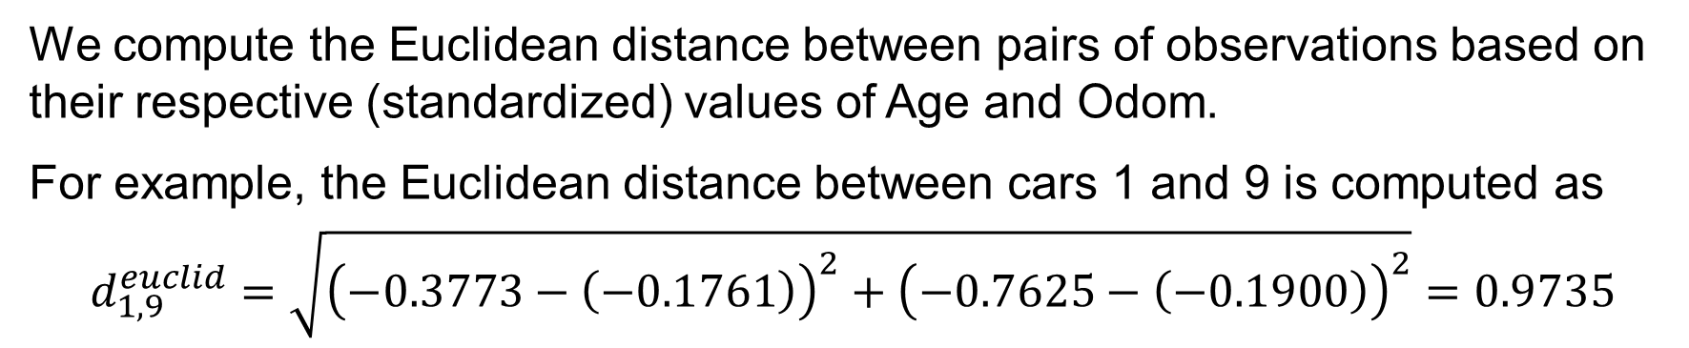
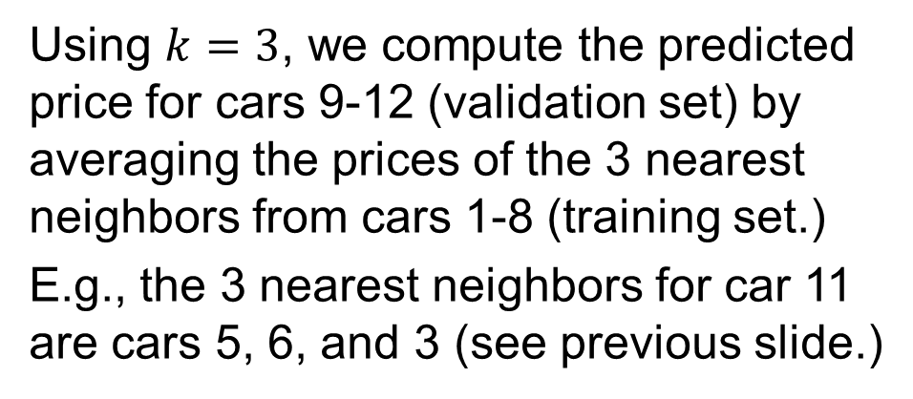
k-NN Prediction of Validation Set Observations
We compute the Euclidean distance between pairs of observations based on their respective (standardized) values of Age and Odom.
For example, the Euclidean distance between cars 1 and 9 is computed as
$$d_{1,9}^{euclid}=\sqrt{{\left(−0.3773−\left(−0.1761\right)\right)}^{2}+{\left(−0.7625−\left(−0.1900\right)\right)}^{2}}=0.9735$$
Using $k=3$, we compute the predicted price for cars 9-12 (validation set) by averaging the prices of the 3 nearest neighbors from cars 1-8 (training set.)
E.g., the 3 nearest neighbors for car 11 are cars 5, 6, and 3 (see previous slide.)
Car | Price | 3-NN | Pred. Price | Error
9 | 8,950 | 5, 3, 6 | 15,467 | −6,517
10 | 8,888 | 1, 2, 7 | 12,100 | −3,212
11 | 16,500 | 5, 6, 3 | 15,467 | 1,033
12 | 9,000 | 1, 2, 7 | 12,100 | −3,100
 |  |  | RMSE = | 3,983

Slide 39
Questions?

