Slide 1
Open-unmix
https://github.com/sigsep/open-unmix-pytorch
https://hal.inria.fr/hal-02293689/document

Slide 2
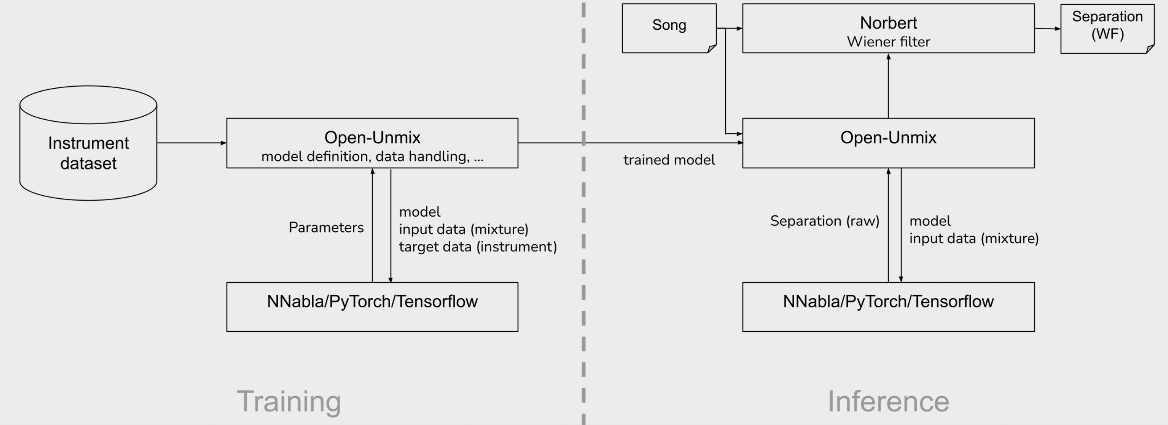

Slide 3
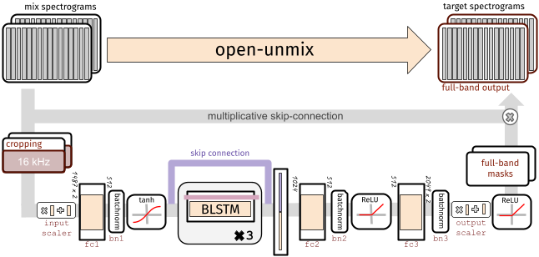

Slide 4
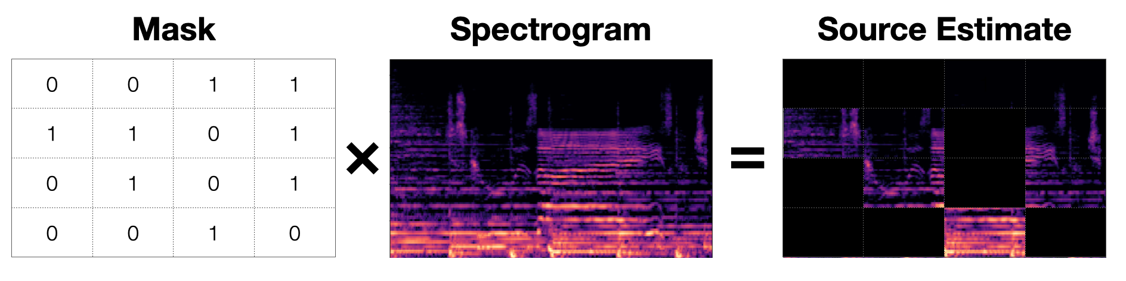

Slide 5
Open-Unmix operates in the time-frequency domain to perform its prediction. The input of the model is either:
models.Separator:
A time domain signal tensor of shape (nb_samples, nb_channels, nb_timesteps), where nb_samples are the samples in a batch, nb_channels is 1 or 2 for mono or stereo audio, respectively, and nb_timesteps is the number of audio samples in the recording. In this case, the model computes STFTs with either torch or asteroid_filteranks on the fly.
models.OpenUnmix:
The core open-unmix takes magnitude spectrograms directly (e.g. when pre-computed and loaded from disk). In that case, the input is of shape (nb_frames, nb_samples, nb_channels, nb_bins), where nb_frames and nb_bins are the time and frequency-dimensions of a Short-Time-Fourier-Transform.

Slide 6
Dimensionality reduction
The LSTM is not operating on the original input spectrogram resolution. Instead, in the first step after the normalization, the network learns to compresses the frequency and channel axis of the model to reduce redundancy and make the model converge faster.

Slide 7
The input spectrogram is standardized using the global mean and standard deviation for every frequency bin across all frames.
Furthermore, we apply batch normalization in multiple stages of the model to make the training more robust against gain variation.

Slide 8
Open-unmix comprises multiple models that are trained for each particular target.
Each Open-Unmix source model is based on a three-layer bidirectional deep LSTM.
Internally, the prediction is obtained by applying a mask on the input.
The model is optimized in the magnitude domain using mean squared error.

Slide 9
Wiener Filter?
models.Separator puts together Open-unmix spectrogram model for each desired target, and combines their output through a multichannel generalized Wiener filter, before application of inverse STFTs using torchaudio. The filtering is differentiable (but parameter-free) version of norbert. The separator is currently currently only used during inference.

Slide 10
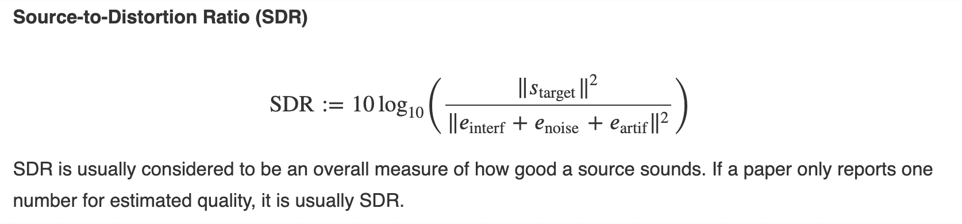
Metric

Slide 11
Results
target | SDR | SDR | SDR
model | UMX | UMXHQ | UMXL
vocals | 6.32 | 6.25 | 7.21
bass | 5.23 | 5.07 | 6.02
drums | 5.73 | 6.04 | 7.15
other | 4.02 | 4.28 | 4.89

Slide 12
Training API
Details in the link:
https://github.com/sigsep/open-unmix-pytorch/blob/master/docs/training.md
Examaple:
python train.py --root /data --dataset trackfolder_var --target-file vocals.flac --ext .wav

Slide 13
Changing the Model
Details in the link:
https://github.com/sigsep/open-unmix-pytorch/blob/master/docs/extensions.md

