Slide 1
Wave-U-Net
https://github.com/f90/Wave-U-Net-Pytorch
http://ismir2018.ircam.fr/doc/pdfs/205_Paper.pdf

Slide 2
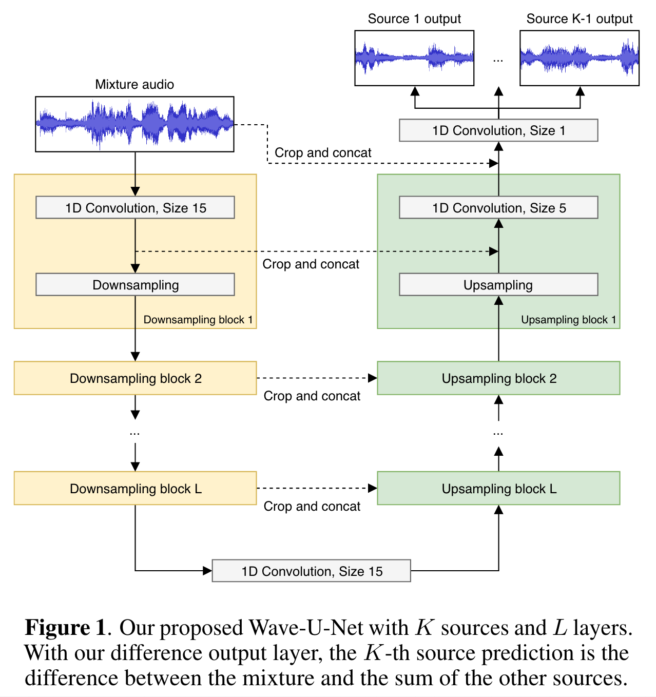

Slide 3
The network has L levels in total, with each successive level operating at half the time resolution as the previous one.
For K sources to be estimated, the model returns predictions in the interval (−1, 1), one for each source audio sample.

Slide 4
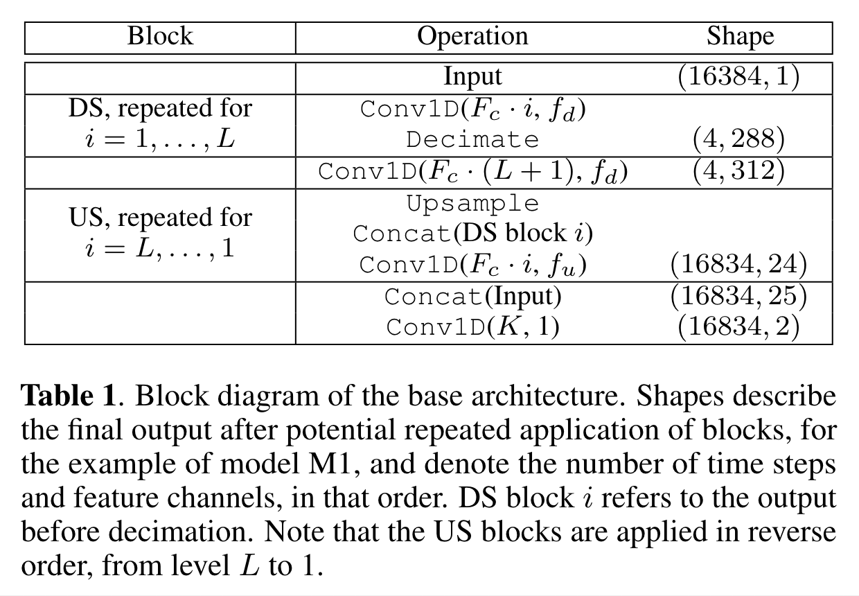
Downsample (DS), Upsample(US)

Slide 5
Downsample (DS)
Conv1D(x,y) denotes a 1D convolution with x filters of size y. It includes zero-padding for the base architecture, and is followed by a LeakyReLU activation (except for the final one, which uses tanh).
Decimate discards features for every other time step to halve the time resolution.

Slide 6
Upsample(US)
Upsample performs upsampling in the time direction by a factor of two, for which we use linear interpolation.
??? Concat(x) concatenates the current, high-level features with more local features x.

Slide 7
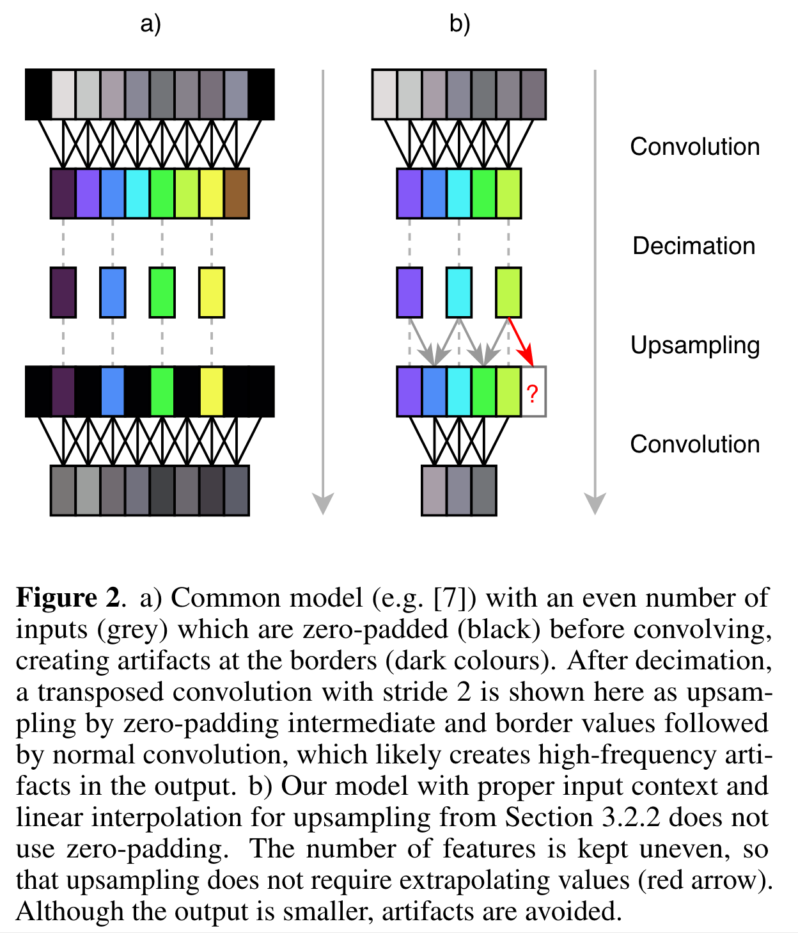

Slide 8
In extensions of the base architecture, where Conv1D does not involve zero-padding, x is centre-cropped first so it has the same number of time steps as the current layer.
We employ convolutions without implicit padding and instead provide a mixture input larger than the size of the output prediction, so that the convolutions are computed on the correct audio context (see Figure 2b). Since this reduces the feature map sizes, we constrain the possible output sizes of the network so that feature maps are always large enough for the following convolution.

Slide 9
Learned upsampling

Slide 10
Training
75 tracks from the training partition of the MUSDB [17] multi-track database are randomly assigned to our training set, and the remaining 25 tracks form the validation set, which is used for early stopping. Final performance is evaluated on the MUSDB test partition comprised of 50 songs. For singing voice separation, we also add the whole CCMixter database [9] to the training set.
As data augmentation for both tasks, we multiply source signals with a factor chosen uniformly from the interval [0.7, 1.0] and set the input mixture as the sum of source signals. No further data preprocessing is performed, only a conversion to mono (except for stereo models) and downsampling to 22050 Hz.

Slide 11
Training
During training, audio excerpts are sampled randomly and inputs padded accordingly for models with input context. As loss, we use the mean squared error (MSE) over all source output samples in a batch. We use the ADAM optimizer with learning rate 0.0001, decay rates β1 = 0.9 and β2 = 0.999 and a batch size of 16. We define 2000 iterations as one epoch, and perform early stopping after 20 epochs of no improvement on the validation set, measured by the MSE loss. Afterwards, the last model is fine-tuned further, with the batch size doubled and the learning rate lowered to 0.00001, again until 20 epochs without improvement in validation loss. Finally, the model with the best validation loss is selected.

Slide 12
Training
7 models with variation are trained. Details in the paper. Unorganized.

Slide 13
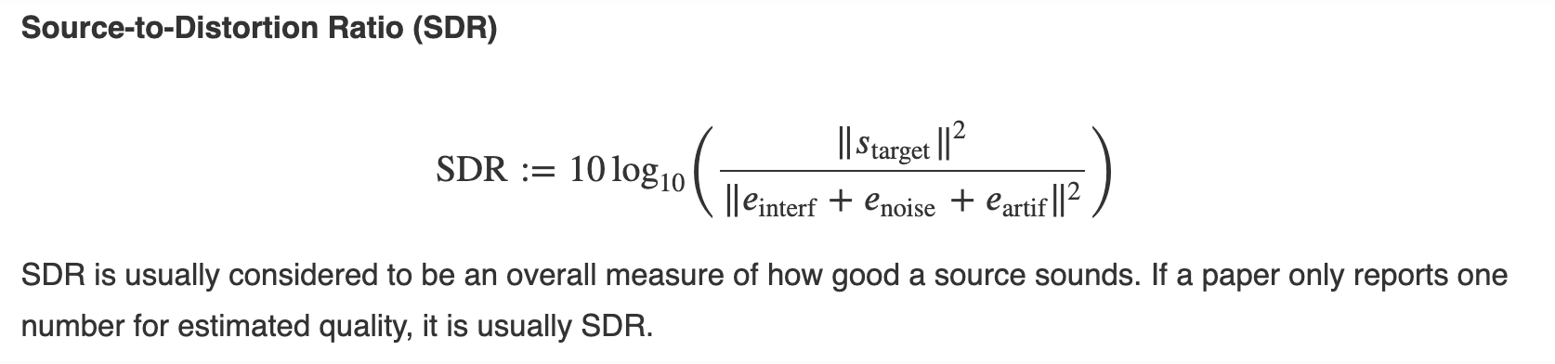
Metric

Slide 14
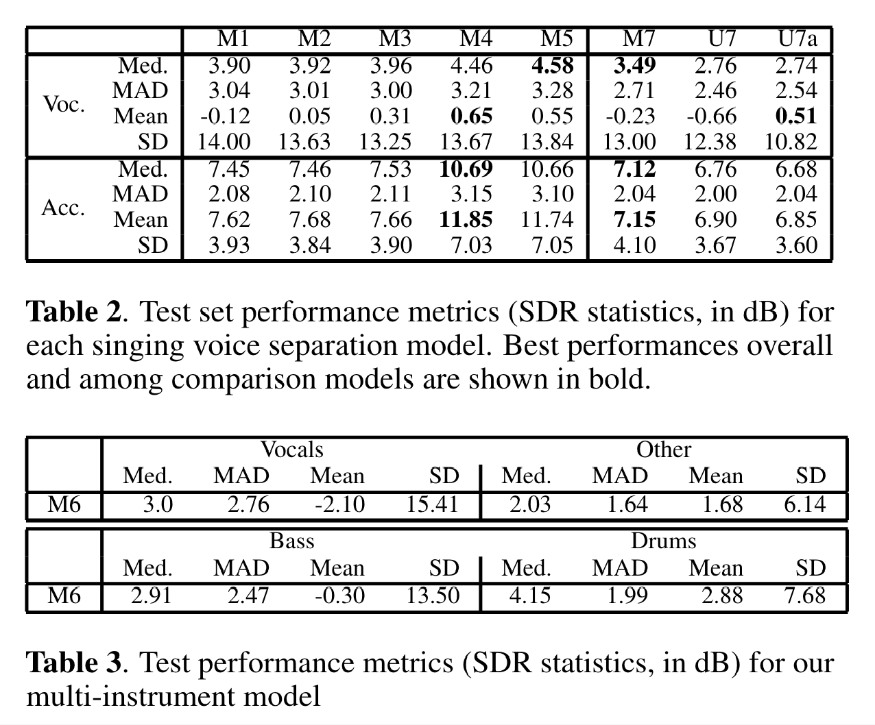
Results

Slide 15
Train
python3.6 train.py --dataset_dir /PATH/TO/MUSDB18HQ

