Slide 1
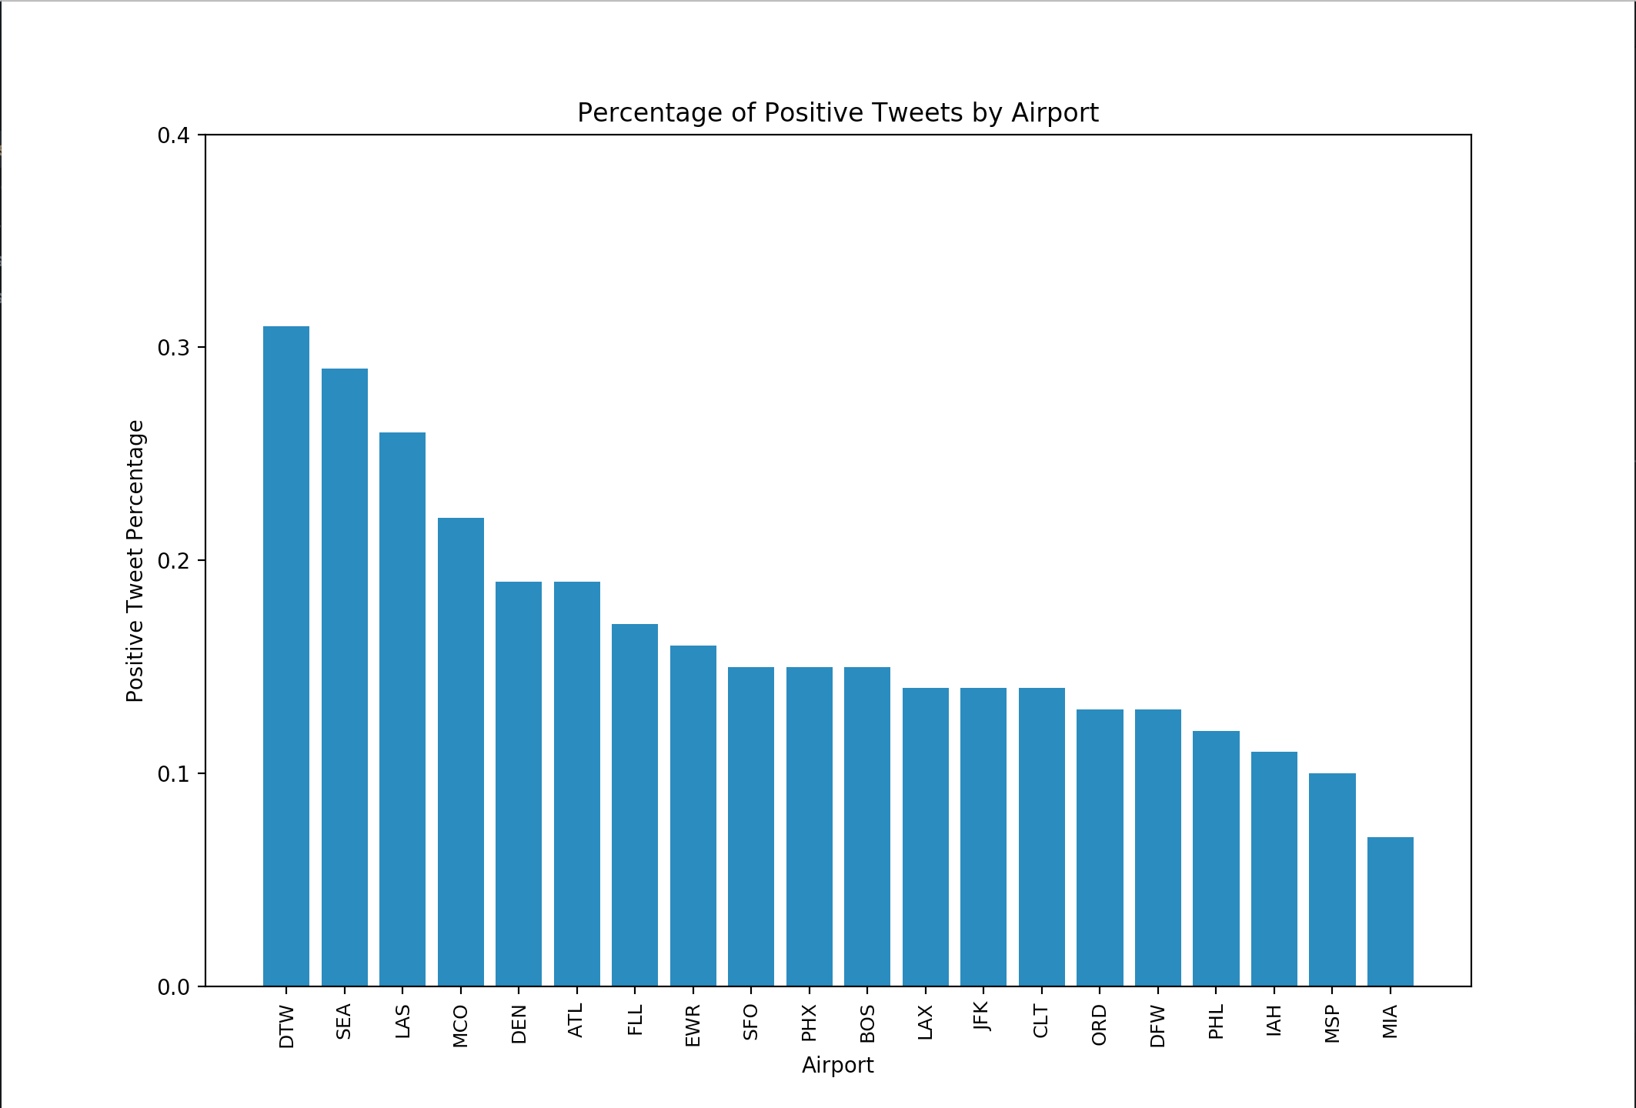
Tweet Sentiment Analysis for Airline Travel
Which airports are the most difficult to travel in and out of? Are there particular airlines that tend to have issues at certain airports?
Parsed tweets for airport codes and airlines. Sentiment analysis performed (+1 positive, -1 negative, 0 neutral)
KL553, AC958, CCY27

Slide 2
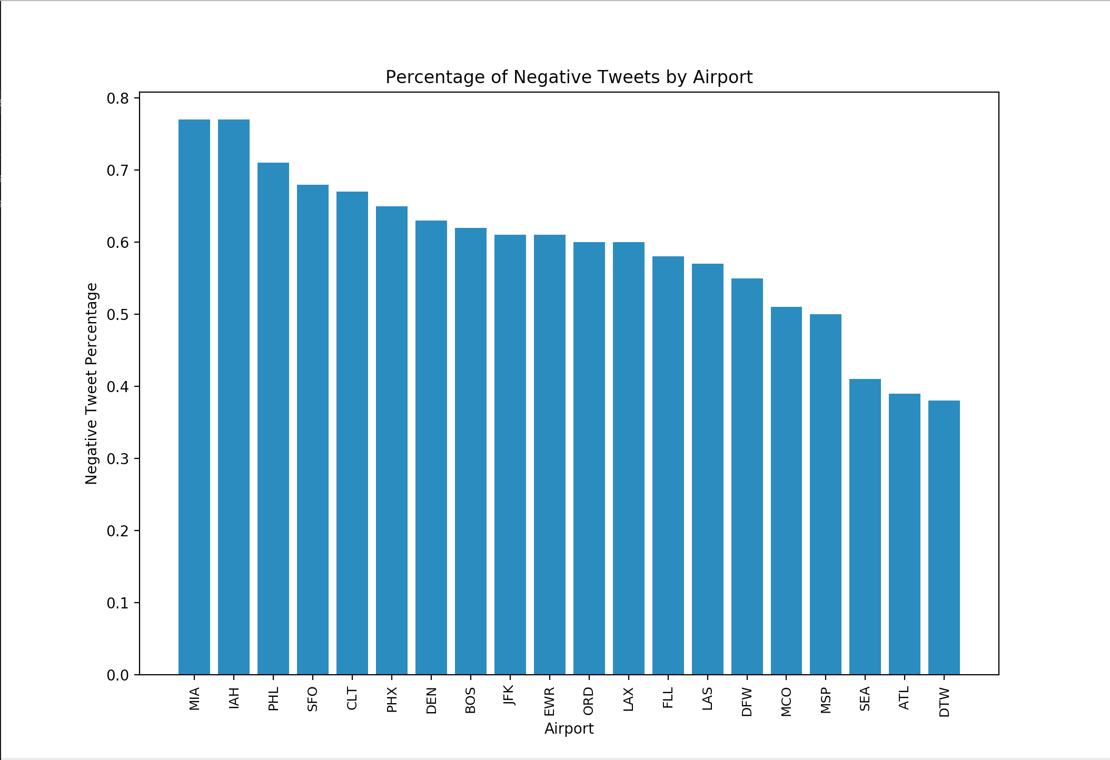
Worst 10 airports
MIA - American Airlines, Miami Air International, Xtra Airways
IAH - United Airlines
PHL - American Airlines, UPS Airlines
SFO - United Airlines, Alaska Airlines
CLT - American Airlines
PHX - American Airlines, Ameriflight
DEN - United Airlines, Frontier Airlines
BOS - Cape Air
JFK - American Airlines, Delta Air Lines, JetBlue Airways
EWR - Fedex Express, United Airlines
KL553, AC958, CCY27

