Slide 1
Future Workspace Loading….
An innovative assistant and compatible chair

Slide 2
Meet EVA
Reads Emails
Keeps track of our work
Reminds us for to go for walk
Schedules meeting for us
Completes small tasks without our help

Slide 3
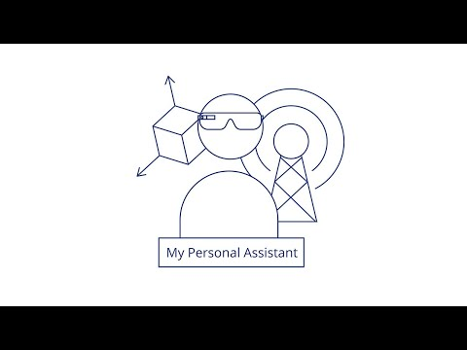

Slide 4
Meet Ergonomic Chair
Adjusts to our spinal posture
Adjusts automatically to reduce pressure on spine
The main goal is to reduce the back pain which is a top concern in IT employees.
Transform into chair to support wall if required.

Slide 5
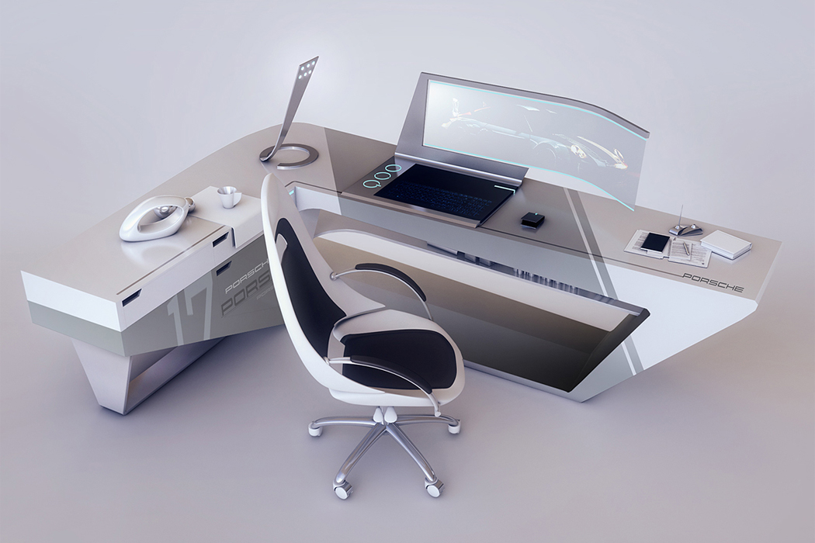
The GenZ workstation in future

