Slide 1




DESIGN AND SIMULATION OF A SMART HOME SECURITY AND INTRUDER DETECTION SYSTEM USING COMBINATIONAL LOGIC
2620030473 - S. Likhita
2620030502 - A. Akshara
2620040079 - T. Divya
GUIDE: Dr. Venkanna Isampalli
Department of Freshman Engineering Department
Koneru Lakshmaiah Education Foundation
Academic Year: 2026-2027

Slide 2


INTRODUCTION
why is home security important?
  Unauthorized entry and other hazards can threaten home safety.
  traditional security methods may not provide immediate detection.
  Sensors can continuously monitor different conditions.
  Digital logic can be used to process sensor signals.
  The proposed system provides a simple and quick alarm mechanism

Slide 3
OBJECTIVES
  Detect movement using a motion sensor.
  Detect unauthorized door opening.
  Detect smoke or possible fire.
  Combine sensor signals using combinational logic
  Activate an alarm whenever a threat is detected.
  Design and verify the circuit using Logisim.

Slide 4
COURSE OUTCOMES
  CO1: Understand computer organization and represent digital information using binary numbers and logic gates.
  CO2: Design and simulate combinational logic circuits and build simple ALUs.
  CO3: Understand sequential logic circuits, flip-flops, registers, counters, and finite state machines.
  CO4: Understand register files, memory systems, and memory hierarchy.
  CO5: Understand RISC-V instruction execution, assembly language, and processor datapaths.
  CO6: Extend a single-cycle RISC-V processor with additional instructions and peripheral interfaces.

Slide 5
REQUIRED COMPONENTS
  Logisim Evolution software
  Input pins/switches (Door, Window, Motion, Authorized Access)
  OR gates
  AND gate
  NOT gate
  Red LED (alarm indicator)
  Connecting wires
  Output pins (optional)

Slide 6
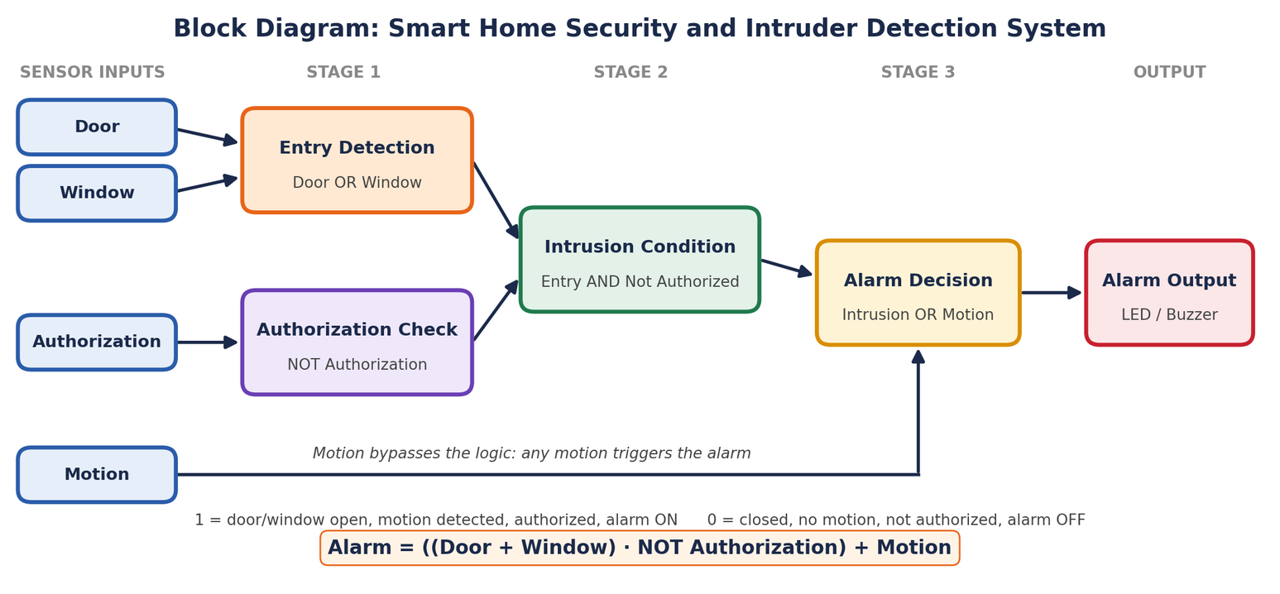
BLOCK DIAGRAM

Slide 7
CIRCUIT WORKING
Working of the Smart Home Security and Intruder Detection System
  Input Sensors: The system receives four binary inputs: Door (D), Window (W), Motion (M), and Authorized Access (P).
  Logic Gate Processing: OR, NOT, and AND gates process the sensor inputs according to the Boolean expression.
  Alarm Activation: The alarm turns ON when the door or window is opened without authorization, or when motion is detected.
  Output Indication: A red LED indicates the alarm status. When the output is 1, the LED glows; when the output is 0, it remains OFF.
Boolean Expression:
Alarm = ((D + W) . (NOT) P) + M
Result: The system detects potential intrusions using combinational logic and provides a visual alarm indication.

Slide 8
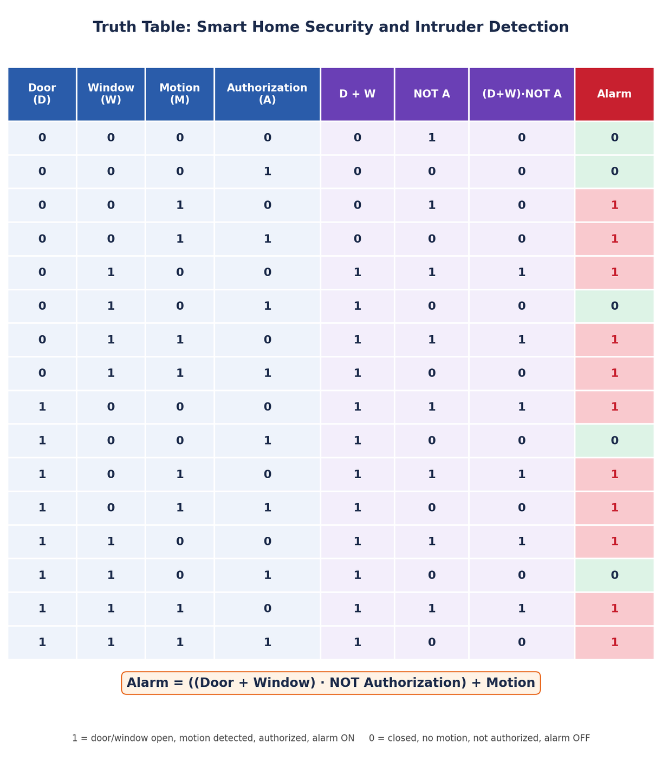
TRUTH TABLE

Slide 9
LOGIC DESIGN
Boolean Expression:
A = ((D OR W) AND (NOT P)) OR M
D OR W → X
NOT P → Y
X AND Y → Z
Z OR M → A (Alarm)
Symbol Meaning
OR Output is 1 if at least one input is 1
AND Output is 1 only if both inputs are 1
NOT Reverses the input: 0 becomes 1, and 1 becomes 0
A Final alarm output
Final output: A = 1 means the alarm is ON; A = 0 means the alarm is OFF.

Slide 10
SIMULATION/IMPLEMENTATION
  Circuit can be simulated using Logisim Evolution, Proteus, or Multisim.
  Connect input switches for Door (D), Window (W), Motion (M), and Authorized Access (P).
  Implement the Boolean expression using OR, AND, and NOT gates.
  Connect a red LED to the final output to indicate alarm activation.
  Test different input combinations to verify that the alarm turns ON during potential intrusion and remains OFF when no intrusion is detected.

Slide 11
ADVANTAGES
  Simple and cost-effective circuit design.
  Fast response due to combinational logic.
  Easy to implement and simulate using Logisim Evolution.
  Provides visual alarm indication through an LED.
  Can be extended with additional sensors and security features.

Slide 12
LIMITATIONS
  No memory to store previous intrusion events.
  Cannot send remote alerts or notifications.
  Depends on the accuracy of sensor inputs.
  No real-time hardware sensors are included in the simulation.
  May produce false alarms if sensor inputs are incorrect.

Slide 13
APPLICATIONS AND FUTURE SCOPE
  Home and apartment security systems.
  Door and window intrusion detection.
  Motion-based security monitoring.
  Access control in offices and laboratories.
  Basic security system prototyping and educational demonstrations.
  Integrate real sensors using a microcontroller.
  Add a buzzer for audible alarm alerts.
  Implement SMS or mobile app notifications.
  Store intrusion events using memory circuits.
  Incorporate password-based access and advanced authentication.
  Extend the design with sequential logic for alarm history and system control.

Slide 14
CONCLUSION
  Designed a smart home security system using combinational logic.
  Implemented the Boolean expression using OR, AND, and NOT gates.
  Simulated intrusion detection using binary sensor inputs in Logisim Evolution.
  Used a red LED to indicate alarm activation.
  Demonstrated the practical application of digital logic in home security.
  The system can be enhanced with real sensors, audible alarms, and remote notifications.

Slide 15
GITHUB REPOSITORY
REPOSITORY LINK: https://github.com/AkulaAkshara/DDCA_Smart-Home-Security-System

Slide 16
THANK
YOU

