Slide 1

Restaurant & Consumer Data Project

Slide 2
About me
Background? (B-tech or M-tech)
Why you want to learn Data Science
Any work experience
Share your LinkedIn and GitHub profile URLs

Slide 3
Agenda (This should be the PPT flow)
Objective of the Project
ER Diagram and schema explanation
Key analysis questions (use cases)
SQL query results with screenshots or summaries
Final business insights and recommendations
Conclusion (Key finding overall)
Q&A Slide
Your Experience/Challenges working on SQL – Data Analysis Project.

Slide 4
Objective
To organize restaurant-related consumer data from multiple CSV files into a relational SQL database.
To understand how consumers interact with restaurants through preferences and ratings.
To perform SQL-based data analysis using WHERE, JOINs, Aggregations, CTEs, Window Functions, Views, and Stored Procedures.
To derive actionable insights such as:
Consumer behavior patterns
Restaurant performance
Cuisine preferences
Rating trends
To prepare a recommendation-style analytical system using SQL.

Slide 5
Using the WHERE clause to filter data based on specific criteria.
List all details of consumers who live in the city of 'Cuernavaca'.

Slide 6
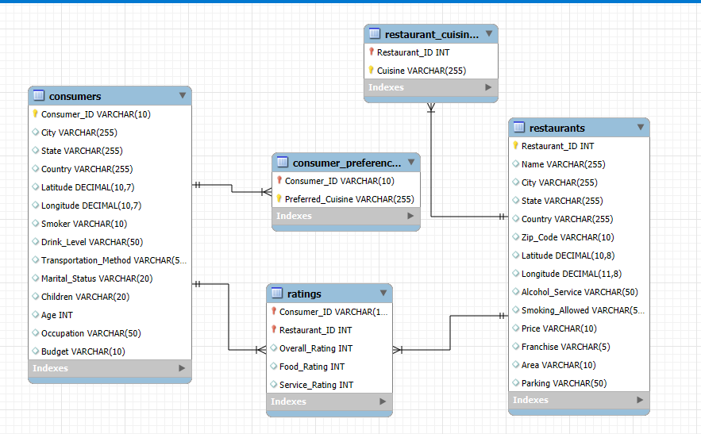
ER Diagram

Slide 8

THANK YOU

