Slide 1
Advanced Machine Learning (US15CS415)
Harshita Singh-01FB15ECS123
Likhita Navali-01FB15ECS156
Varnika Srivastava-01FB15ECS336

Slide 2
Introduction
GANs
GANs are class of artificial intelligence algorithms used in Unsupervised Learning. They consist of two neural networks , the generator and the adversarial (the discriminator model), that are pitted against each other in a mini-max framework. One network generates candidates (generative) and the other evaluates them (discriminative)
The generative network's training objective is to increase the error rate of the discriminative network
CNNs
CNNs are the convolutional neural networks that are used for feature detection using filters.
CNN is one of the main framework used to perform image recognition, image classification, Object detection, recognition of faces etc.

Slide 3
Part 1 – Object Detection
VGG

Slide 4
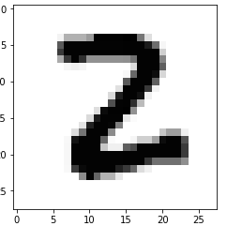
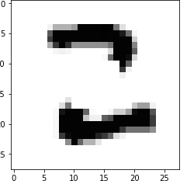
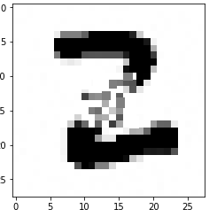
Part 2 – Object Reconstruction
Trained a GAN on MNIST data. Generated partial images to test the model. This image was reconstructed using the above model. The images in MNIST are loaded as one-hot format.
Actual Image Partial Image Reconstructed Image

Slide 5
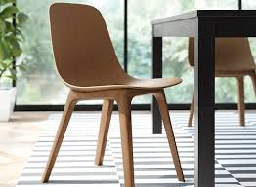
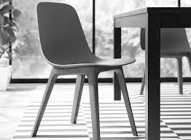
.. Contd Part - 2
An attempt to convert the chair dataset into MNIST data format is made so that it could be loaded to train the tensor-flow GAN model and not use pre-trained GAN model. First the chair images dataset were gray scaled. The MNIST dataset is already labeled but the issue with the chair images dataset was that it had to be manually labeled.
Original Image Gray Scaled Image

Slide 6
Thank You!

