Slide 1
Contextual Bandit Hybrid Bit-Semantic Transmission Selection for UAVs
Project Proposal & Literature Survey
Machine Learning (25SC2107E) | KLH University | A.Y. 2026-27
Likhita Sri Chakiri (2520040067) | Satwika Gunda (2520040051) | Soundarya Valli J (2520040043)
Guide: Mr. N Lava Prasad, Assistant Professor, Dept. of ECE

Slide 2
The Problem
A UAV must send many messages over a weak, changing air-to-ground link with limited battery
Option 1: send exact raw bits - reliable, but slow and energy-hungry
Option 2: send only the meaning (semantic) - cheap and fast, but fragile on a bad channel
Option 3: compressed semantic - cheapest, but lower quality ceiling
No single mode is always best: it depends on channel, urgency, deadline and quality needed
Contextual Bandit Hybrid Bit-Semantic Transmission Selection for UAVs | Project Proposal
2

Slide 3
Why It Matters
Search-and-rescue, disaster surveys and inspection UAVs have urgent, safety-critical messages
Wrong choice = missed deadline, lost message, or wasted battery
Fixed rules (e.g. 'always send bits') ignore the situation
There is no labelled dataset of 'correct' modes - the answer is only known after trying
So the system must LEARN the best choice online from reward feedback
Contextual Bandit Hybrid Bit-Semantic Transmission Selection for UAVs | Project Proposal
3

Slide 4
Literature Survey - What Exists
Area | Papers (refs) | Takeaway
Semantic communication | [1] Xu 2023, [2] Qin 2021, [4] Weng 2021 | Sending meaning degrades gracefully as the channel worsens
UAV task-oriented / semantic | [3] Kang 2022, [5], [6], [7] | Semantic transmission already studied on UAVs
Contextual bandits | [8] Li 2010 (LinUCB), [9] 2025 | Online learning with one action per context, no labels
Gap: prior work uses a fixed semantic codec OR a learned agent for a different decision (rate, AoI, power). Few treat the bit-vs-semantic choice itself as a learning problem.
Contextual Bandit Hybrid Bit-Semantic Transmission Selection for UAVs | Project Proposal
4

Slide 5
Objectives
Model a UAV channel + task environment with a realistic reward (success, latency, energy)
Formulate mode selection as a contextual multi-armed bandit
Implement LinUCB and Thompson Sampling from scratch; add a NumPy DQN baseline
Compare against an oracle and non-learning baselines with proper statistics (10 seeds)
Study robustness: ablation, sensitivity, and a battery-constrained setting
Contextual Bandit Hybrid Bit-Semantic Transmission Selection for UAVs | Project Proposal
5

Slide 6
Proposed Approach: Contextual Bandit
1. Observe context
2. Pick an arm
3. Get reward
4. Update model
SNR, urgency, delay budget, quality need, battery (13 features)
Bit / Semantic / Compressed semantic
Success - latency penalty - energy cost
LinUCB / Thompson Sampling learn online
This is reinforcement learning (reward feedback), not supervised learning - so no dataset is needed; a simulator generates tasks.
Contextual Bandit Hybrid Bit-Semantic Transmission Selection for UAVs | Project Proposal
6

Slide 7
Methodology & Evaluation Plan
Learners: LinUCB, Thompson Sampling, epsilon-greedy, DQN (pure NumPy)
Baselines: always-bit / semantic / compressed, random, threshold rule; Oracle as upper bound
Metrics: average reward, cumulative regret, success rate, energy
Protocol: tune on held-out seeds, evaluate on 10 other seeds, paired t-tests
Extra studies: feature ablation, parameter sensitivity, battery-limited sequential setting
Contextual Bandit Hybrid Bit-Semantic Transmission Selection for UAVs | Project Proposal
7

Slide 8
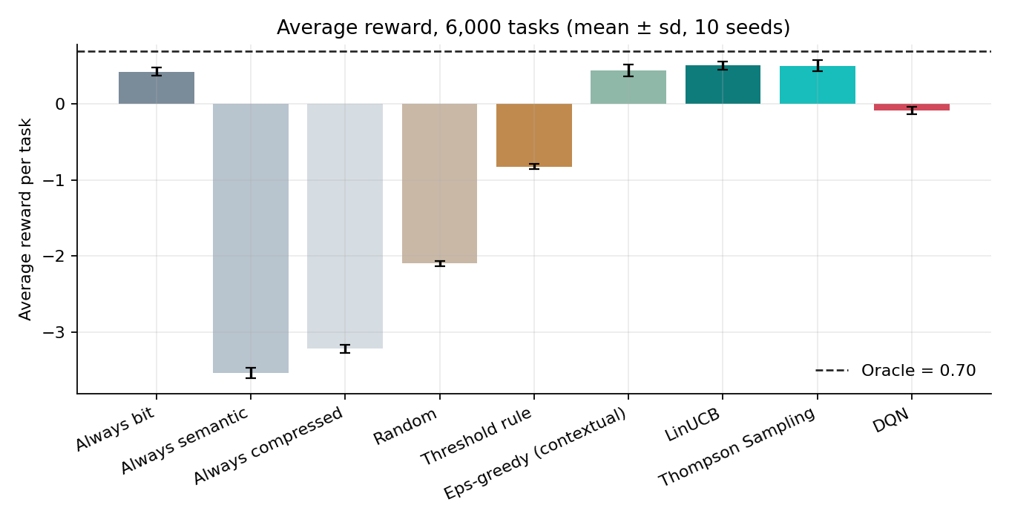
Result Preview: Does Learning Help?
LinUCB: 27% less regret than always-bit
Lower in 10/10 seeds (t = -3.83)
Matches oracle mode on 76.7% of tasks
Full results in the Review 2 deck and report
Simulated data; gains are moderate and honestly reported (see Limitations in the report).
Contextual Bandit Hybrid Bit-Semantic Transmission Selection for UAVs | Project Proposal
8

Slide 9
Key References
[1] Xu et al., Deep JSCC for Semantic Communications, IEEE Commun. Mag., 2023
[2] Qin et al., Semantic Communications: Principles and Challenges, arXiv:2201.01389
[3] Kang et al., Task-Oriented Image Transmission in UAS, IEEE TCOM, 2022
[4] Weng & Qin, Semantic Comm. Systems for Speech, IEEE JSAC, 2021
[5-7] UAV semantic / AoI / hybrid bit-semantic papers (arXiv 2023-2026)
[8] Li et al., Contextual-Bandit News Recommendation (LinUCB), WWW 2010
[9] Context-Aware Rate Adaptation for Flying Networks, arXiv:2504.05964
Contextual Bandit Hybrid Bit-Semantic Transmission Selection for UAVs | Project Proposal
9

