Slide 1
Artificial Intelligence Assignment
Submitted by: Likhit Gatagat
2022MT13057
Bits, Pilani, WILP Email: 2022MT13057@wilp.bits-pilani.ac.in
BITS Pilani
SSZC444 Artificial Intelligence
November 27, 2023
1

Slide 2
Custom Conversational AI agent (Chatbot) using OpenAI
Installations/Packages needed for this assignment:
Node - v20.10.0
NPM - 10.2.3
Express - 4.18.2 - Framework we'll use to spin up a Node server
Airtable - 0.11.6 -
OpenAI - 3.3.0 - Node.js library for the OpenAI API
Pre-requisites for the assignment:
OpenAI API Key
Air Table Base Id
Air Table API Key

Slide 3
Step 1 - Integrating OpenAI with Node.js/Express
Objective: Communicate with OpenAI API to generate responses.
Implementation: Utilized Node.js and Express to set up an endpoint for sending requests to OpenAI.
Key Points:
Backend Setup: Created a Node.js/Express server (index.js) to handle API requests.
OpenAI Integration: Configured an endpoint to communicate with OpenAI's API.
Random Response Generation: Utilized the OpenAI API to generate random responses based on prompts.
Impact: Facilitated seamless communication between the backend and OpenAI's powerful language processing capabilities.

Slide 4
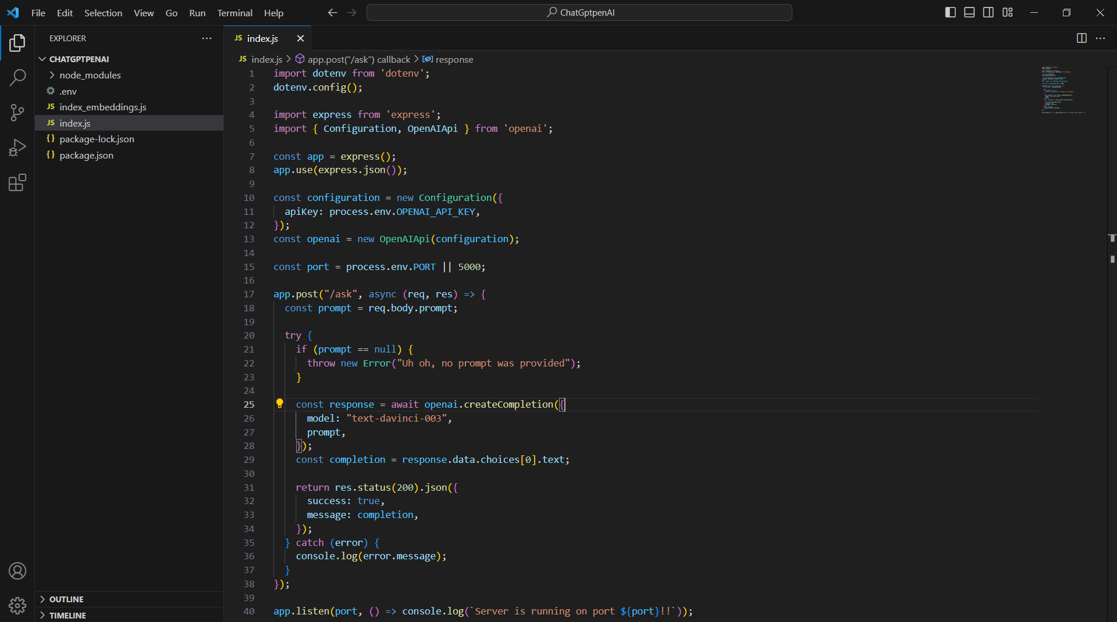
Step 1 – Code Snippet

Slide 5
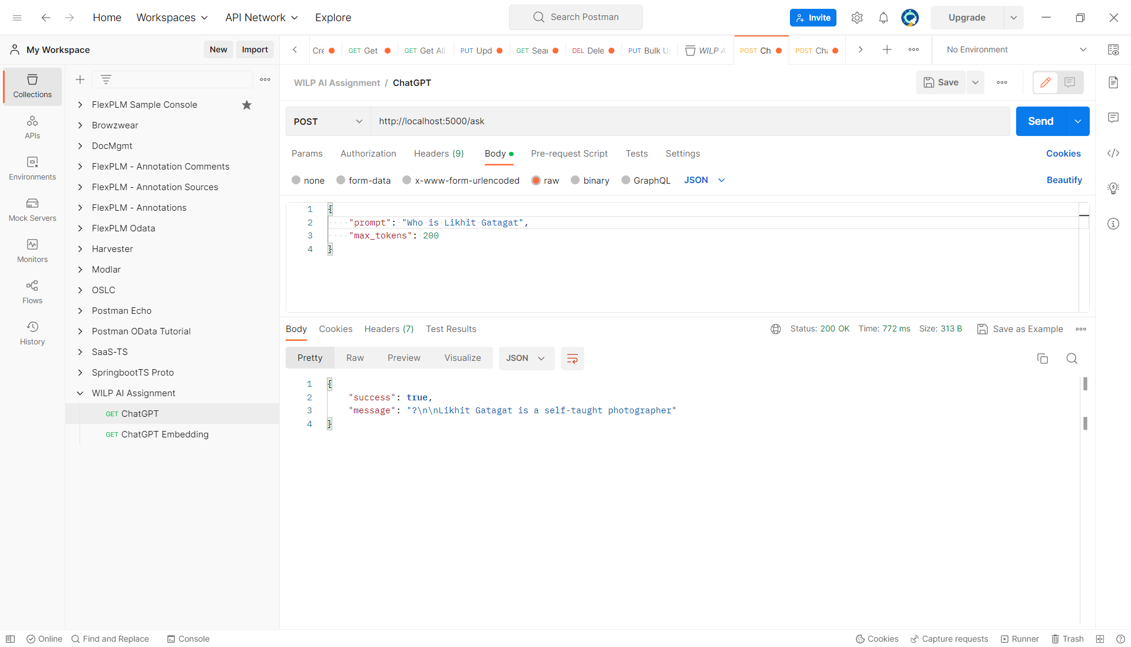
Step 1 – OpenAI Integration In Action

Slide 6
Step 2 – Front-end Setup with Vite + React
Objective: Develop a front-end interface to interact with OpenAI for AI-driven responses.
Technologies Used:
Front-end Framework: Vite + React
Other Technologies: HTML, CSS
Components and Navigation Logic:
Home Page: Serves as the launch point of the application.
Navigation Links: "Chat with AI Agent" and "Create Knowledge Base" are two main links.
Functionality:
Chat with AI Agent: Opens a prompt box for user queries, and fetches responses from OpenAI on enter.
Create Knowledge Base: To be discussed in the context of Embeddings.
Implementation:
Vite + React: Utilized Vite as a build tool and React for UI components.
HomePage: Manages navigation and links to different functionalities.
Prompt: Handles the interaction with OpenAI for user queries.
Impact: Created an intuitive front-end allowing users to engage with OpenAI for query-based responses.

Slide 7
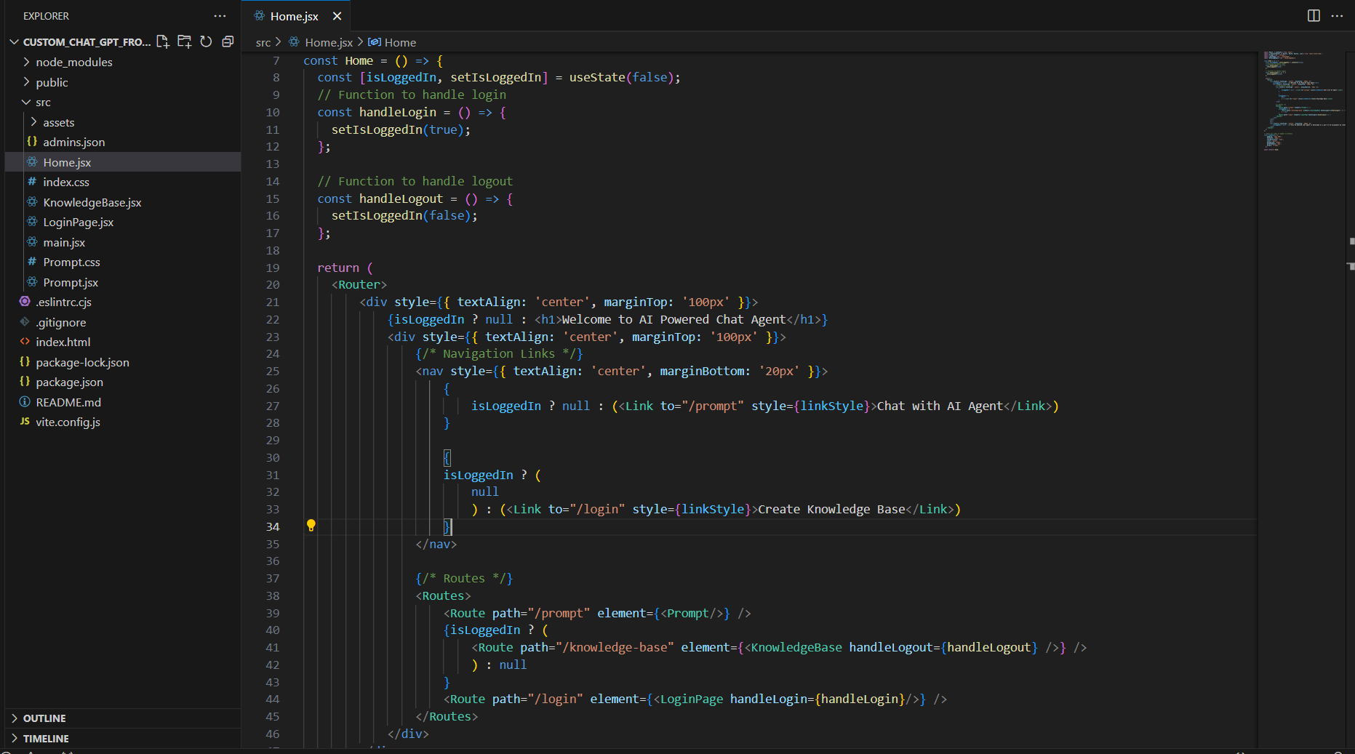
Step 2 – Code Structure Overview

Slide 8
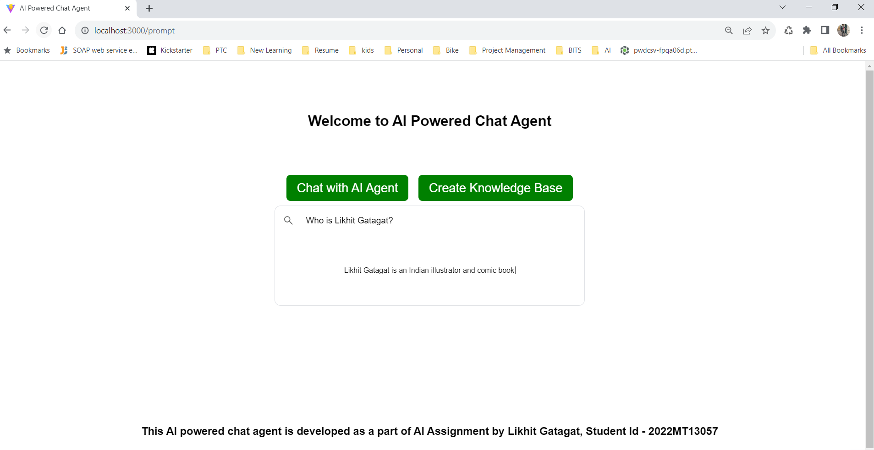
Step 2 – UI Screens

Slide 9
Integrated AI Agent with PDF Upload and Context Setting
Objective: Integration of PDF upload, context setting, and AI agent for enriched chatbot responses.
Process Overview:
Customizing Chatbot:
Used PDF content to enhance the chatbot's knowledge base.
Utilized OpenAI's text embeddings for measuring relatedness between text strings.
2. Embedding Model API Usage:
Generated embeddings for PDFs using OpenAI's embedding model API.
Stored embeddings in AirTable Base for domain-specific responses.
3. Cosine Similarity for Relevance:
Computed cosine similarity between prompt embeddings and stored database embeddings.
Identified the most similar text using the highest cosine score.
4. Super Prompt Construction:
Constructed a "super" prompt by embedding the most relevant text into a query.
Sent the refined prompt to OpenAI for a more contextually relevant answer.

Slide 10
Continued…
Features Integrated:
PDF Upload Functionality:
Users can browse and upload multiple PDFs within the application.
Uploaded PDFs are utilized to enrich the chatbot's knowledge base.
Embedding Model API Usage:
Users have the ability to set the context for the conversation.
Contextual information from uploaded PDFs guides the AI agent's responses.
AI Agent Integration:
The AI agent utilizes the supplied PDFs as a knowledge base for answering queries.
Responses are generated based on the collective information from uploaded PDFs.
GUI Description:
User Interface: A user-friendly interface allowing seamless PDF uploads and context setting.
Interaction Flow: Users navigate, upload PDFs, set context, and engage with the AI agent for responses.

Slide 11
Example Scenario
User Query: "Who is Likhit Gatagat"
Process Flow:
Received embeddings data for the specific prompt.
Computed cosine similarity with database embeddings.
Constructed a refined prompt for OpenAI based on the most relevant text.
Sent the refined prompt and obtained a more contextually relevant response.
Result:
Enhanced Relevance: Obtained more relevant responses by incorporating contextually relevant prompts.
Expanded Knowledge Base: Enabled users to contribute by uploading PDFs, enriching the chatbot's knowledge.

Slide 12
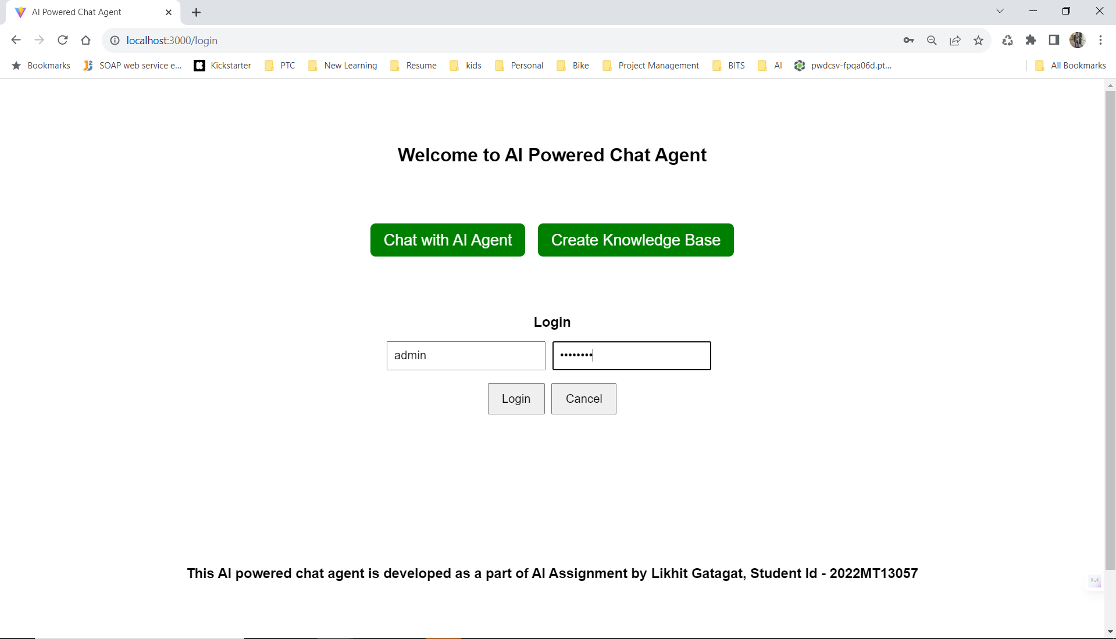
Step 3 – UI Screens – User Login

Slide 13
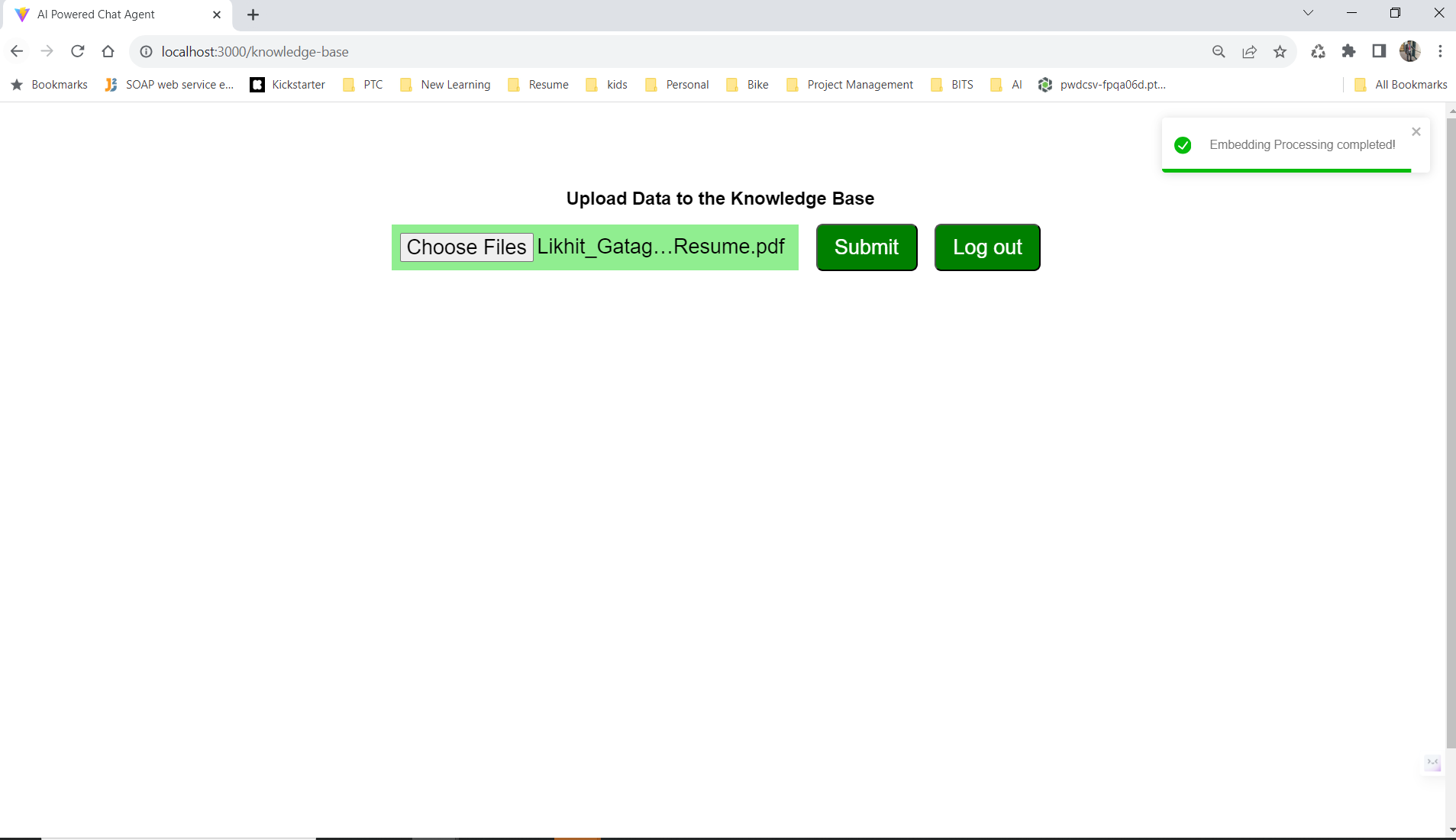
UI Screens – PDF Upload, Update Knowledge Base

Slide 14
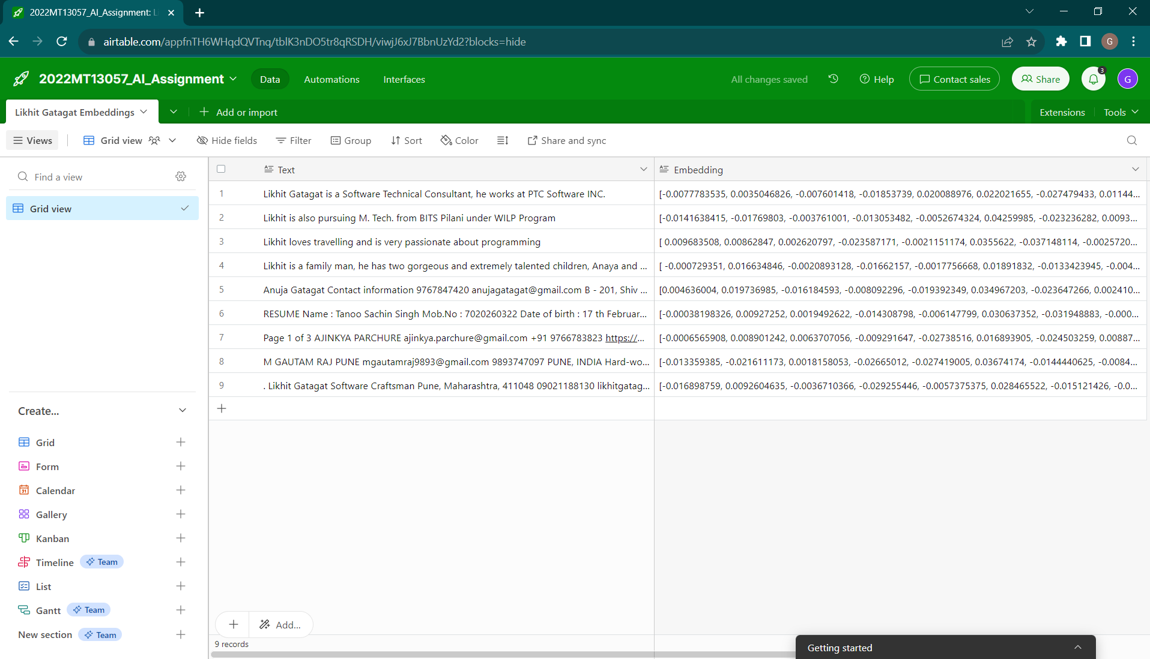
UI Screens – Embeddings Database (Excel)

Slide 15
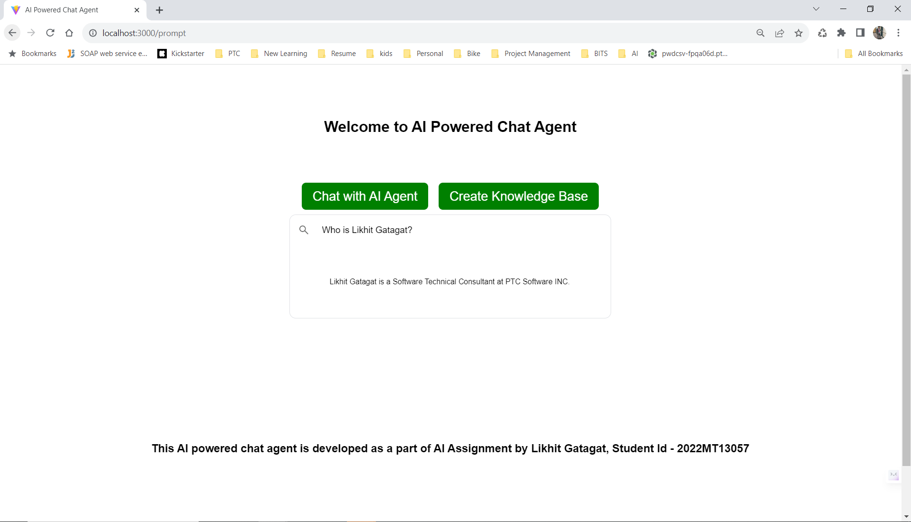
UI Screens – Relevant response as per knowledge base

Slide 16

Demo
Link to the Demo

Slide 17

Source Code
Link to the Source Code

Slide 18


