Slide 1
PROJECT 16 • SLIDE 1 OF 5
Motivation: Beyond Static Learning-Rate Schedules
• The Sensitivity of Deep Optimization: The learning rate (eta) is the single most sensitive hyperparameter in deep learning. A poor step size causes either divergence or slow plateauing.
• Shortcomings of Fixed Heuristics: Standard schedulers (StepLR, Cosine, Exponential) follow rigid open-loop schedules that cannot react to noisy batch gradients, plateaus, or saddle points.
• The RL Paradigm: Framing optimization as a Markov Decision Process (MDP) allows an autonomous RL agent to monitor loss velocity and adaptively steer the step size.

Slide 2
PROJECT 16 • SLIDE 2 OF 5
Methodology: Deep Q-Network (DQN) Controller
• Closed-Loop MDP Setup: Child model: 3-layer CNN on CIFAR-10. Each environmental step corresponds to 1 full training epoch.
• 6D State Representation: State vector: [TrainLoss, DeltaLoss, ValAcc, DeltaValAcc, ProgressRatio, log10(LR)] providing a complete snapshot of convergence trajectory.
• Action Space & Bounds: 5 discrete multipliers {x0.5, x0.8, x1.0, x1.25, x2.0} with clipping bounds [10^-5, 0.20] to guarantee numerical safety.
• DQN Learning Mechanics: Trained using an Experience Replay Buffer (2,000 transitions), epsilon-greedy exploration, and target network synchronization.

Slide 3
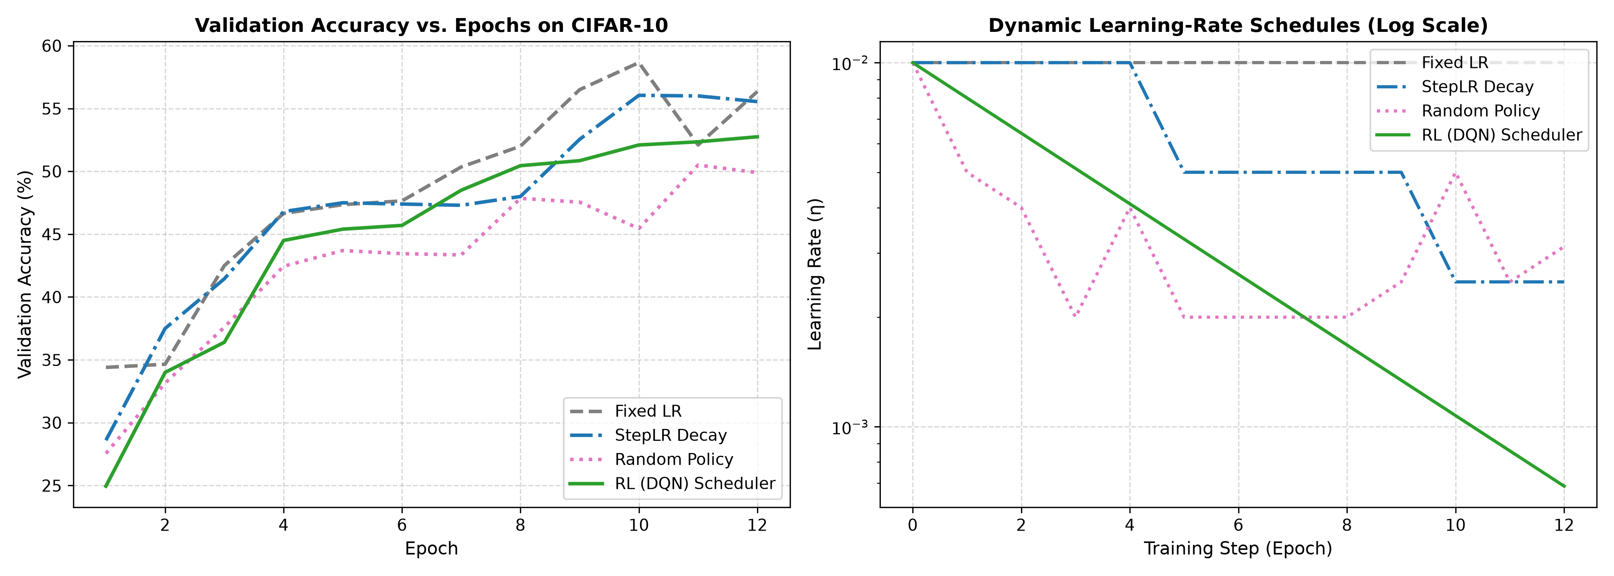
PROJECT 16 • SLIDE 3 OF 5
Empirical Results: CIFAR-10 Benchmark Comparison
• Performance Benchmark: RL (DQN) Scheduler reached 52.75% validation accuracy (Reward: 42.70), outperforming the Random Baseline (49.90%, Reward: 39.90).
• Learned Policy Dynamics: Discovers a two-phase schedule: high LR during initial feature learning, followed by gradual adaptive decay when validation accuracy stagnates.
• Benchmark Comparison: StepLR Decay: 55.55% | Fixed LR (0.01): 56.35% | Random Policy: 49.90%.

Slide 4
PROJECT 16 • SLIDE 4 OF 5
Limitations & Practical Challenges
• Computational Overhead: Collecting rollout transitions requires training the child model for complete epochs. For billion-parameter models, rollout collection is computationally expensive.
• Meta-Overfitting & Transferability: Policies trained on compact CNNs do not transfer zero-shot across distinct network architectures (e.g., Vision Transformers) or disparate datasets without fine-tuning.
• Temporal Credit Assignment: The true impact of a learning-rate adjustment can take multiple epochs to fully materialize, introducing credit assignment noise.

Slide 5
PROJECT 16 • SLIDE 5 OF 5
Societal Impact, Green AI & Ethics
• Environmental Impact & Green AI: Brute-force grid search generates immense carbon footprints. Adaptive controllers that reach convergence in fewer epochs reduce datacenter power consumption.
• Democratization of ML: Removes manual tuning friction, allowing non-specialist researchers and low-compute academic labs to train models efficiently.
• Safety Guardrails: Strict hard-coded clipping prevents catastrophic divergence, ensuring stability in automated production machine learning pipelines.

