Slide 1
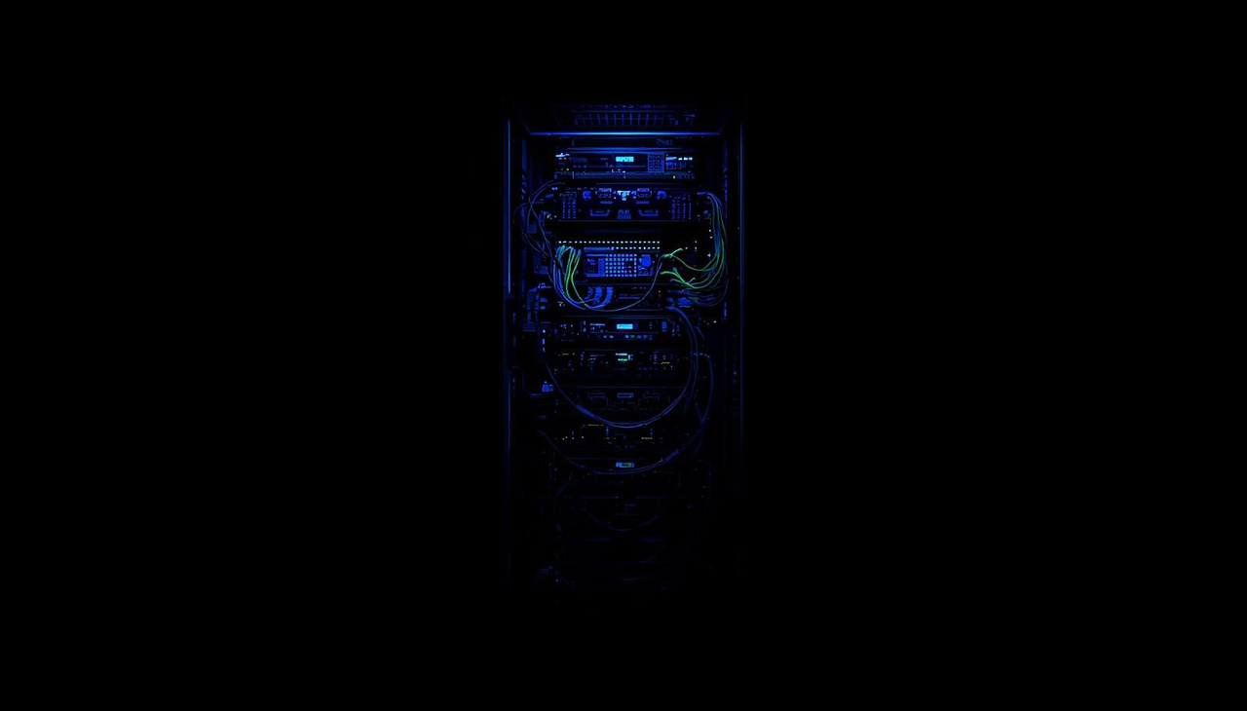
DISTRIBUTED DEEP LEARNING
INFERENCE SERVER

Slide 2
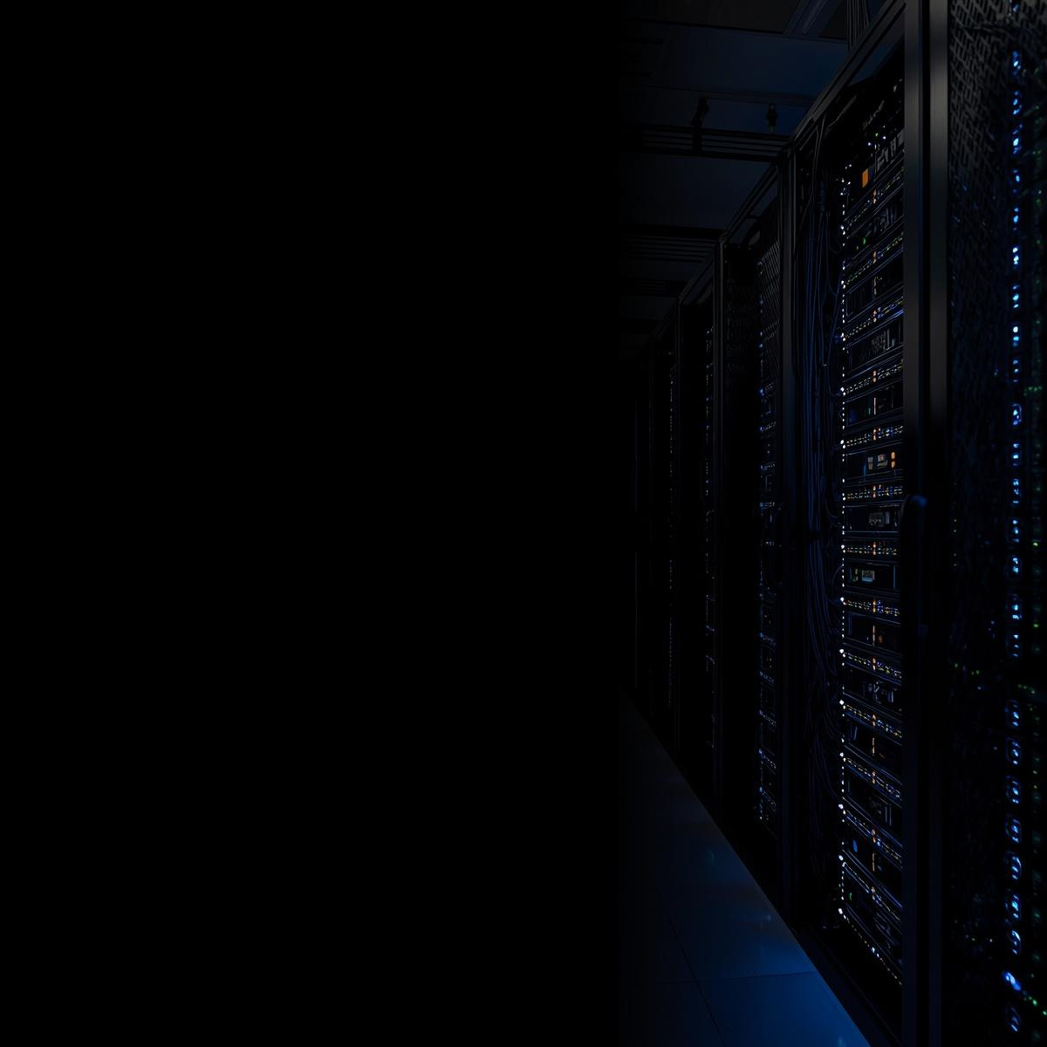

DISTRIBUTED
iNFERENCE
WHAT IS DISTRIBUTED DEEP LEARNING INFERENCE?
Distributed deep learning inference refers to the deployment of trained neural network models across multiple computing nodes to process prediction requests in parallel. As AI models grow increasingly complex—with billions of parameters—single-server deployments struggle to meet latency and throughput demands. Distribution enables horizontal scaling, fault tolerance, and efficient resource utilization across data centers.

Slide 3

1. Client selects image
│
▼
2. Client sends image over TCP
│
▼
3. Gateway receives request
│
▼
4. Thread created for client
│
▼
5. Load balancer selects worker
│
▼
6. Gateway forwards image to worker
│
▼
7. Worker processes image (ML model)
│
▼
8. Worker sends predictions to gateway
│
▼
9. Gateway sends response to client
│
▼
10. Client displays output
HOW IT
WORKS

Slide 4

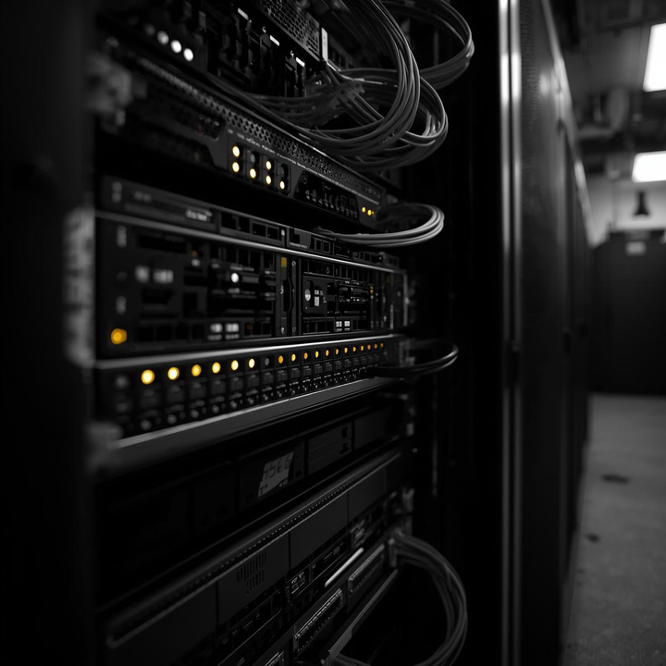
THE INFERENCE FLOW PIPELINE
REQUEST INGESTION & MODEL ROUTING
Incoming inference requests are received via REST/gRPC APIs, validated, and intelligently routed to the optimal model instance based on load and latency.
DISTRIBUTED EXECUTION
Requests are processed across multiple GPU nodes in parallel, with automatic load balancing ensuring optimal resource utilization and minimal latency.
RESPONSE AGGREGATION
Results from distributed workers are collected, merged, and formatted before being returned to the client with full tracing and performance metrics.

Slide 5
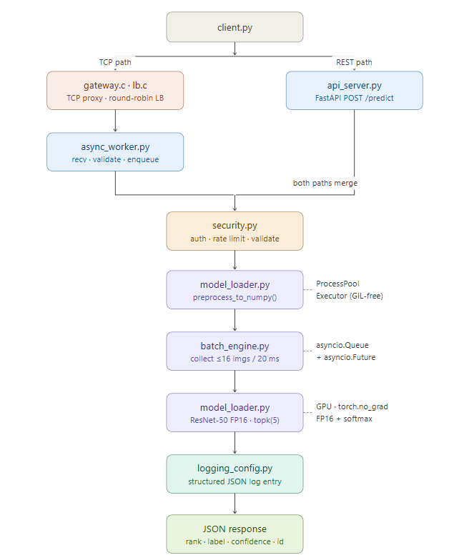
ARCHITECTURE

Slide 6


BUILDING BLOCKS OF DISTRIBUTED INFERENCE
Async TCP Server
CPU Preprocessing Pool
Dynamic Batch Engine
Inference Semaphore
Model (ResNet-50)
CORE
COMPONENTS

Slide 7


DISTRIBUTED DEEP LEARNING
ResNet-50 is a 50-layer deep convolutional neural network introduced in 2015.
It uses skip (shortcut) connections to solve the vanishing gradient problem.
Built using bottleneck blocks (1×1, 3×3, 1×1 convolutions) for efficiency.
Achieves high accuracy in image classification tasks.
Widely used with frameworks like TensorFlow and PyTorch.
ResNet-50 (Residual Neural Network)

Slide 8
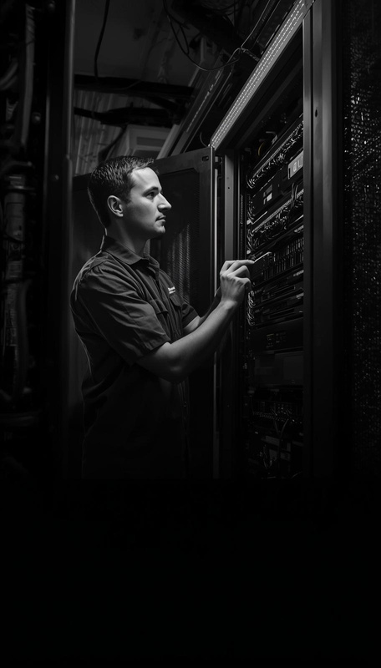
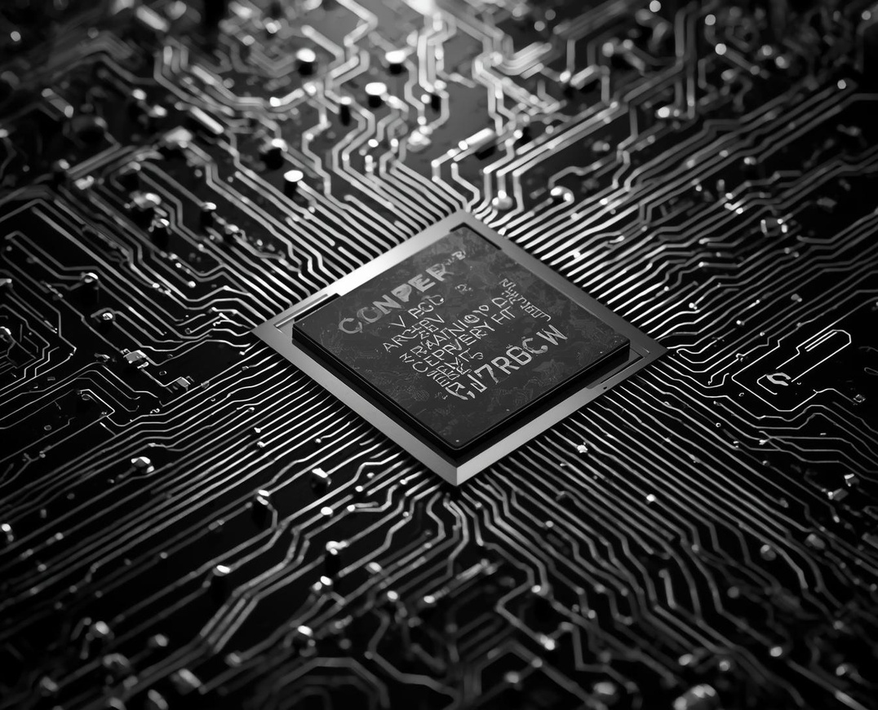

DISTRIBUTED DEEP LEARNING
OVERCOMING CENTRALIZED INFERENCE LIMITATIONS
Thread-per-client collapse
GPU Contention
GPU Underutilization
INFRASTRUCTURE
CHALLENGES

Slide 9
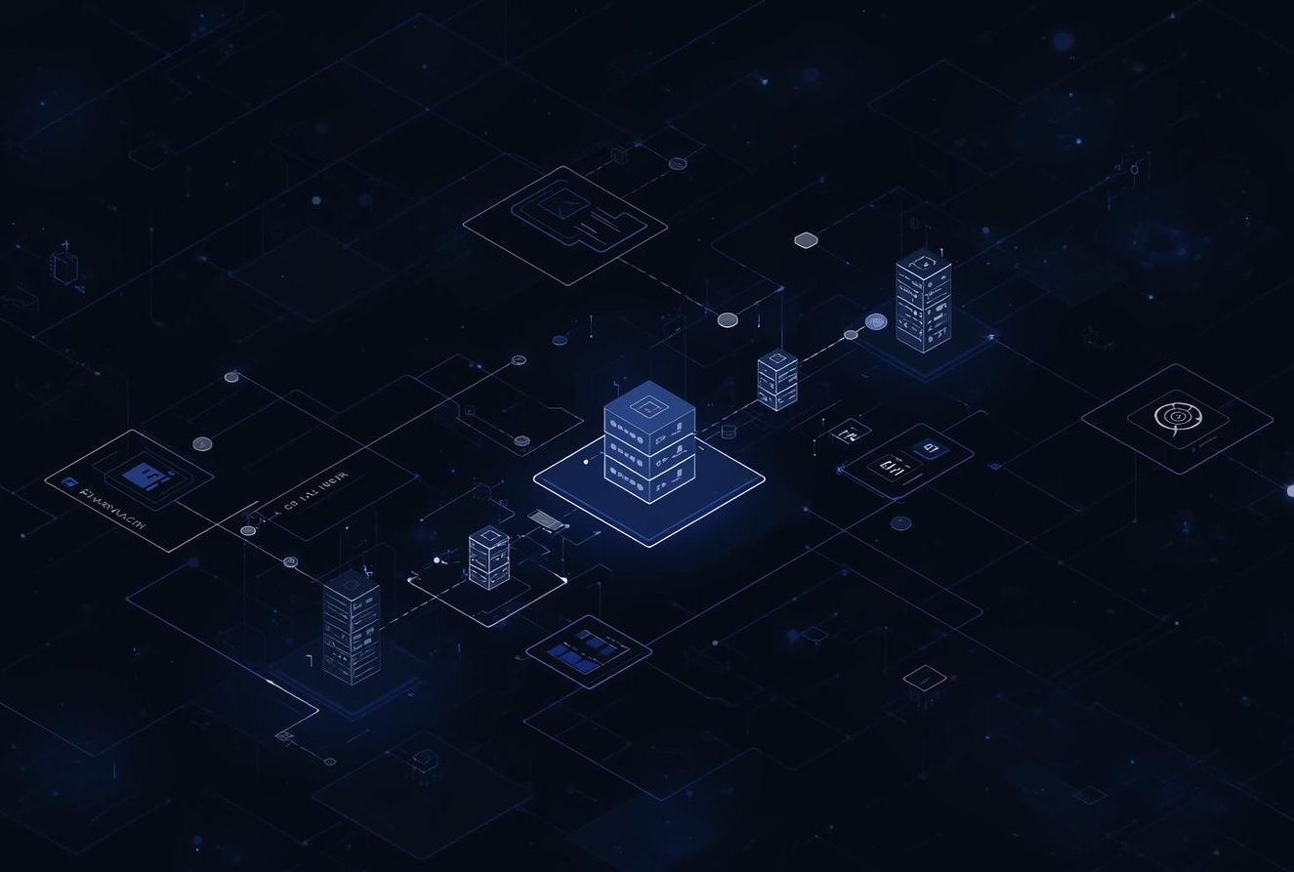
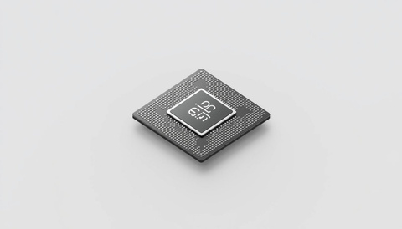
High-Level Overview
Layer 1 — Async Network I/O
Layer 2 — CPU Preprocessing Pool
Layer 3 — GPU Batch Engin
DISTRIBUTED DEEP LEARNING
Solution

Slide 10
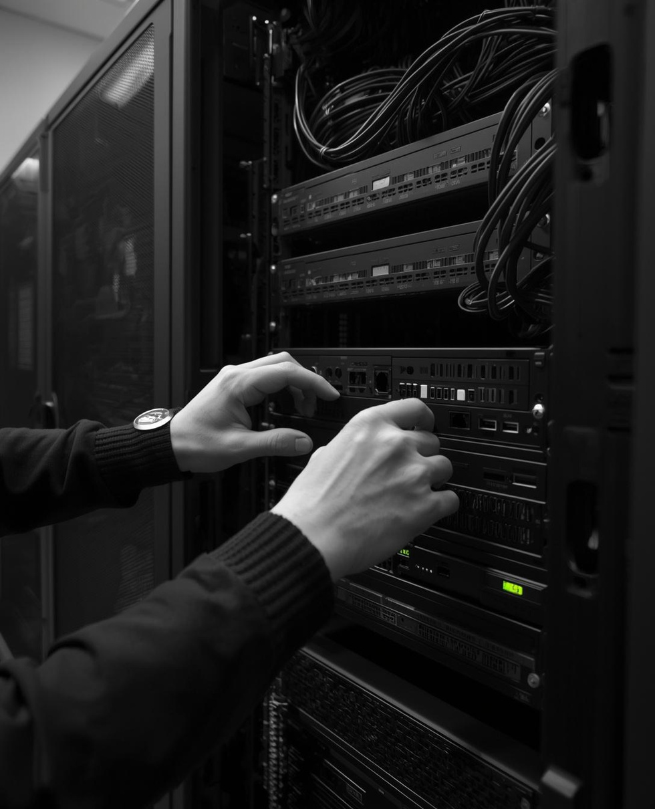

IMPLEMENTATION
INFERENCEOPS
PROCESS
FOUR STEPS TO PRODUCTION DEPLOYMENT
INFRASTRUCTURE SETUP
Configure compute clusters, set up container orchestration, and establish network infrastructure for distributed inference workloads.
MODEL DEPLOYMENT & TESTING
Deploy optimized models across nodes, configure load balancers, and validate endpoint connectivity with comprehensive stress testing protocols.
PRODUCTION ROLLOUT
Execute gradual traffic migration, monitor performance metrics in real-time, and scale resources dynamically based on inference demand patterns.

Slide 11


MEASURING THE IMPACT OF DISTRIBUTED DEEP LEARNING INFERENCE
85%
LATENCY REDUCTION
Optimized model partitioning and parallel processing dramatically reduce response times, enabling real-time inference at scale.
PERFORMANCE
10X
THROUGHPUT INCREASE
METRICS
Distributed architecture enables massive parallel processing, multiplying inference capacity across GPU clusters and edge nodes.
60%
COST SAVINGS
Intelligent resource allocation and auto-scaling minimize idle compute time, significantly reducing operational expenses.
99.99%
SYSTEM UPTIME
Redundant server architecture with automatic failover ensures continuous availability for mission-critical AI applications.

Slide 12

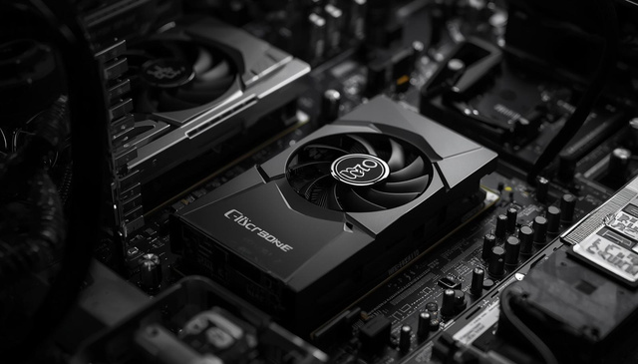
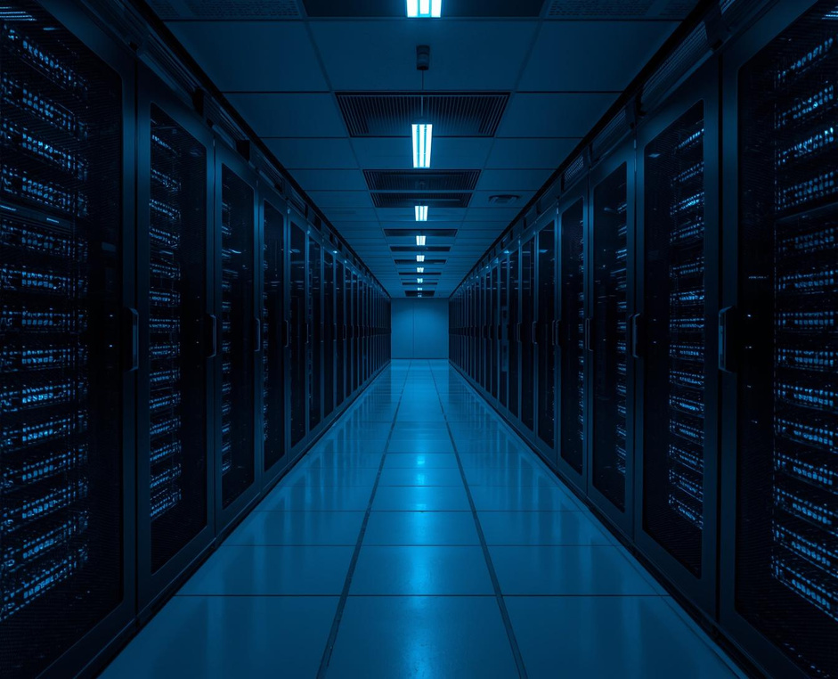
ENTERPRISE PERFORMANCE
CASE STUDY
RESULTS
ENTERPRISE DEPLOYMENT METRICS
LATENCY PERFORMANCE
SYSTEM RELIABILITY
Achieved 5ms p99 latency through optimized model sharding, intelligent request routing, and GPU memory pooling across distributed inference nodes.
Maintained 99.99% availability with automatic failover, health monitoring, and rolling updates ensuring zero-downtime deployments across global data centers.

