Slide 1
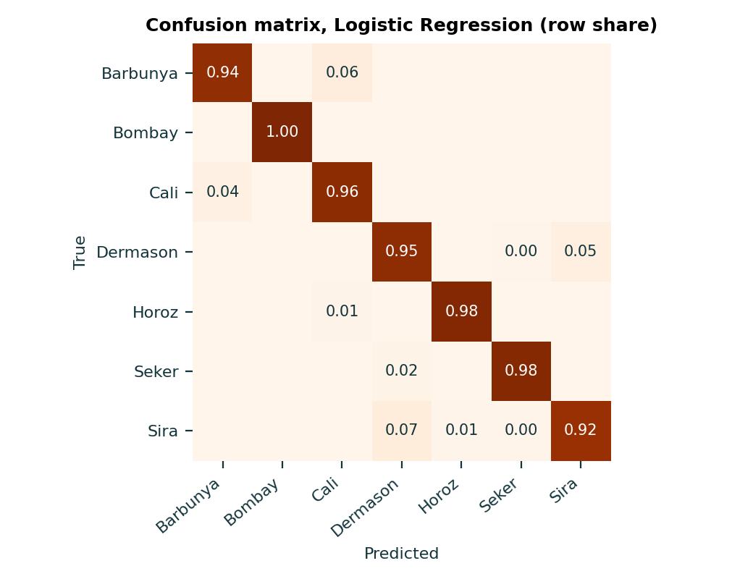
CLASSIFICATION | MODEL 1 OF 10
Logistic Regression
Models each variety's probability with a linear score passed through softmax, so the decision boundaries are flat in feature space.
0.9520
Accuracy
0.9520
F1 (weighted)
0.9595
F1 (macro)
0.9976
ROC-AUC (OvR)
Settings
C = 10.0
Ranks 3 of 10 on accuracy.
Dry Bean dataset | 11,878 beans after cleaning | 9,502 train, 2,376 test, stratified 80/20, seed 42

Slide 2
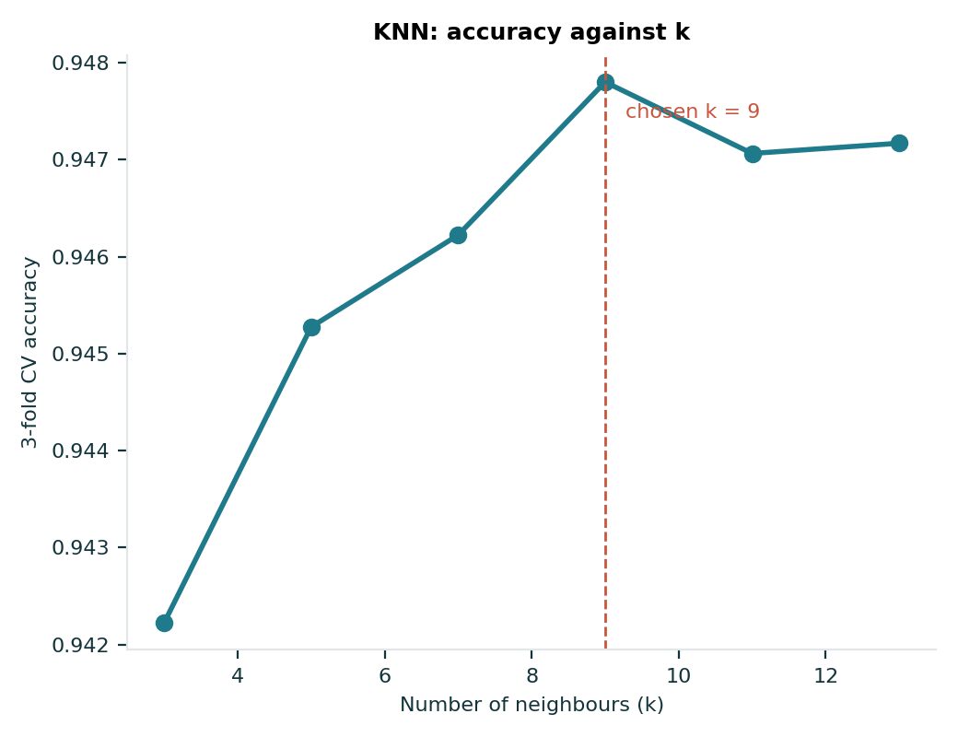
CLASSIFICATION | MODEL 2 OF 10
K-Nearest Neighbors
Labels a bean by majority vote of the k most similar training beans, measured by Euclidean distance on scaled features.
0.9491
Accuracy
0.9491
F1 (weighted)
0.9580
F1 (macro)
0.9953
ROC-AUC (OvR)
Settings
n_neighbors = 9
Ranks 7 of 10 on accuracy.
Dry Bean dataset | 11,878 beans after cleaning | 9,502 train, 2,376 test, stratified 80/20, seed 42

Slide 3
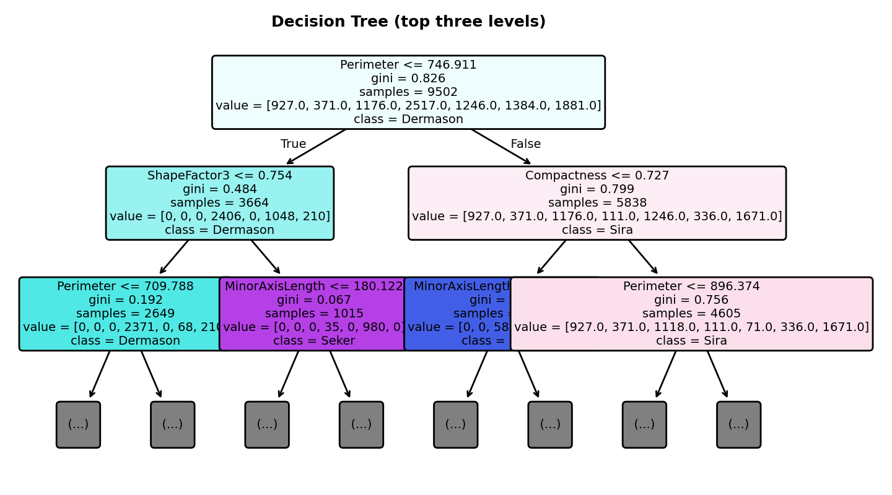
CLASSIFICATION | MODEL 3 OF 10
Decision Tree
Splits the data again and again on one feature threshold at a time, choosing each split to make the groups purer.
0.9377
Accuracy
0.9377
F1 (weighted)
0.9473
F1 (macro)
0.9876
ROC-AUC (OvR)
Settings
max_depth = 10, min_samples_split = 5
Ranks 8 of 10 on accuracy.
Dry Bean dataset | 11,878 beans after cleaning | 9,502 train, 2,376 test, stratified 80/20, seed 42

Slide 4
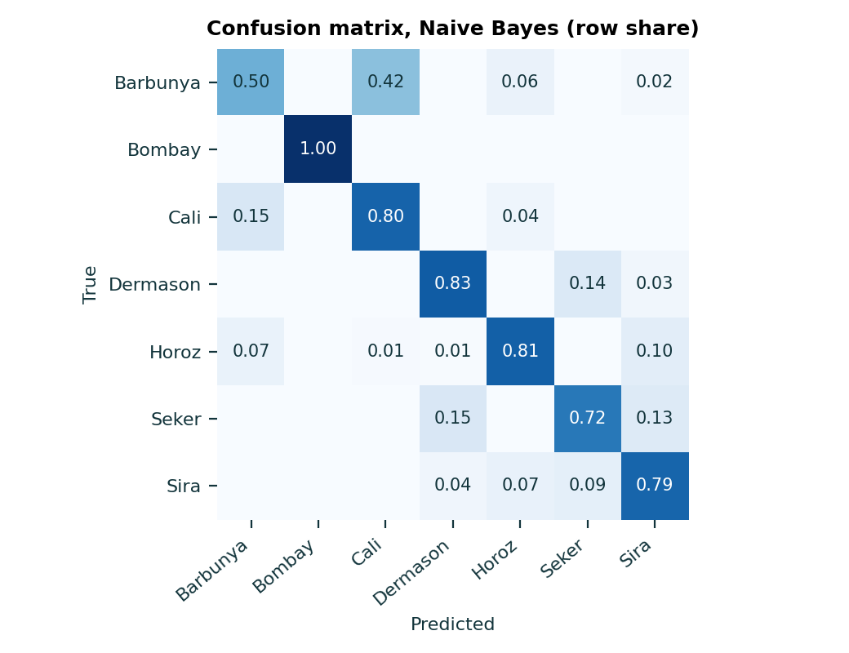
CLASSIFICATION | MODEL 4 OF 10
Naive Bayes (Gaussian)
Applies Bayes' theorem and treats every feature as independent given the variety, with a Gaussian curve for each.
0.7757
Accuracy
0.7746
F1 (weighted)
0.7779
F1 (macro)
0.9711
ROC-AUC (OvR)
Settings
Default (var_smoothing=1e-9)
Ranks 10 of 10 on accuracy.
Dry Bean dataset | 11,878 beans after cleaning | 9,502 train, 2,376 test, stratified 80/20, seed 42

Slide 5
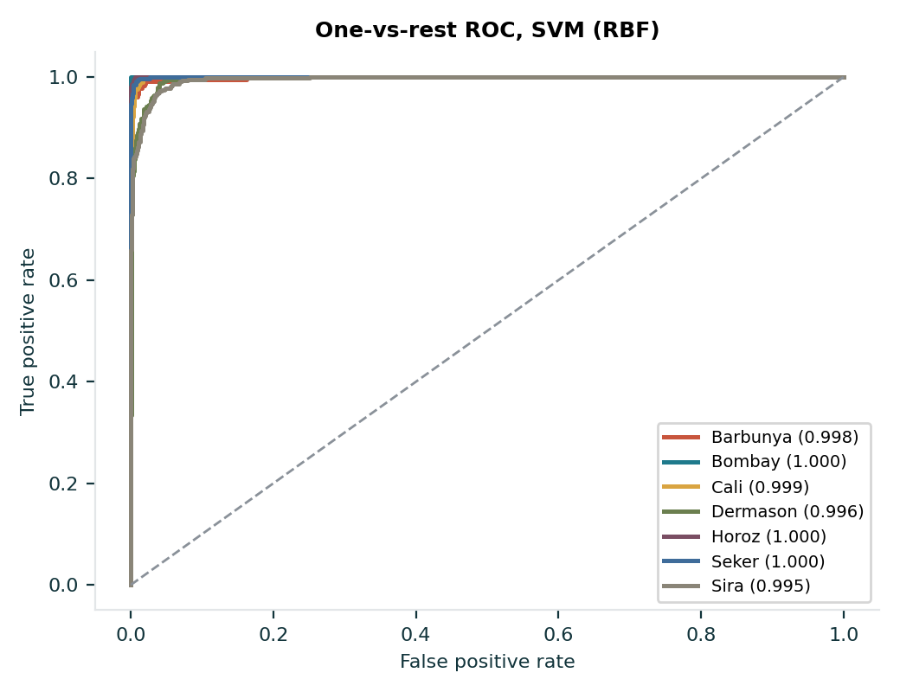
CLASSIFICATION | MODEL 5 OF 10
Support Vector Machine
Finds the boundary with the widest margin between varieties; the RBF kernel lets that boundary curve.
0.9533
Accuracy
0.9533
F1 (weighted)
0.9626
F1 (macro)
0.9977
ROC-AUC (OvR)
Settings
C = 10, kernel = rbf
Ranks 2 of 10 on accuracy.
Dry Bean dataset | 11,878 beans after cleaning | 9,502 train, 2,376 test, stratified 80/20, seed 42

Slide 6
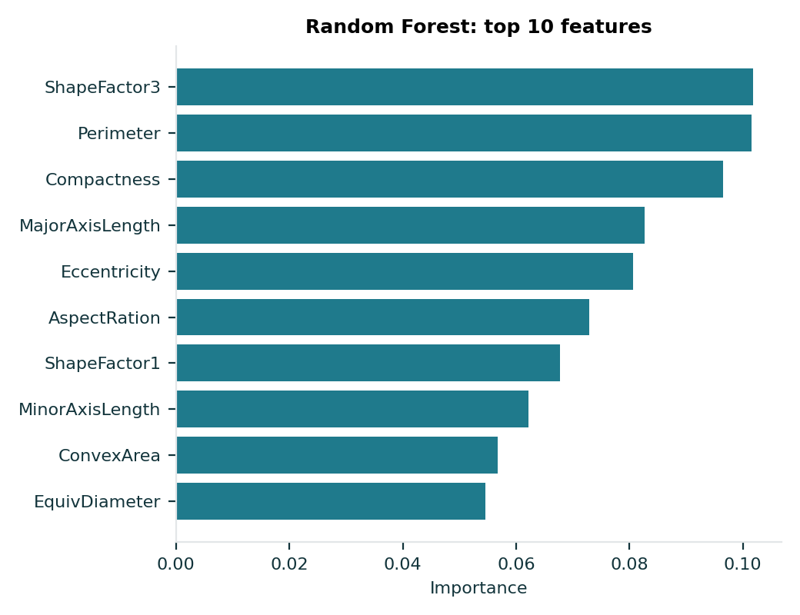
CLASSIFICATION | MODEL 6 OF 10
Random Forest
Averages many decision trees, each grown on a bootstrap sample with random feature subsets, to cut variance.
0.9520
Accuracy
0.9519
F1 (weighted)
0.9605
F1 (macro)
0.9975
ROC-AUC (OvR)
Settings
max_depth = 12, min_samples_split = 5, n_estimators = 200
Ranks 4 of 10 on accuracy.
Dry Bean dataset | 11,878 beans after cleaning | 9,502 train, 2,376 test, stratified 80/20, seed 42

Slide 7
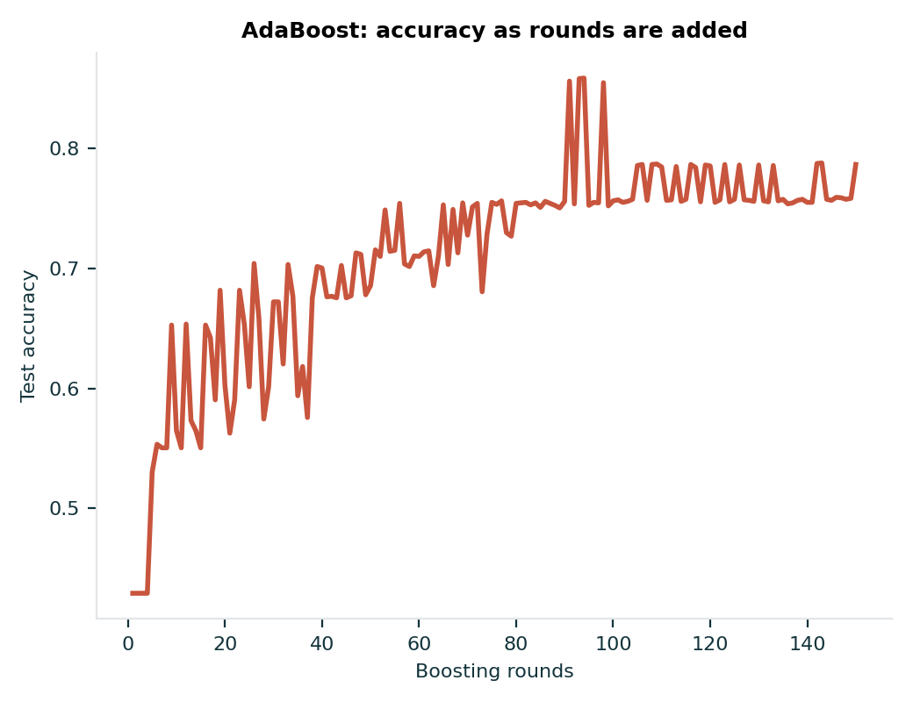
CLASSIFICATION | MODEL 7 OF 10
AdaBoost
Builds weak learners in turn, giving more weight to the beans the previous learners got wrong.
0.7866
Accuracy
0.7578
F1 (weighted)
0.7710
F1 (macro)
0.9753
ROC-AUC (OvR)
Settings
learning_rate = 0.5, n_estimators = 150
Ranks 9 of 10 on accuracy.
Dry Bean dataset | 11,878 beans after cleaning | 9,502 train, 2,376 test, stratified 80/20, seed 42

Slide 8
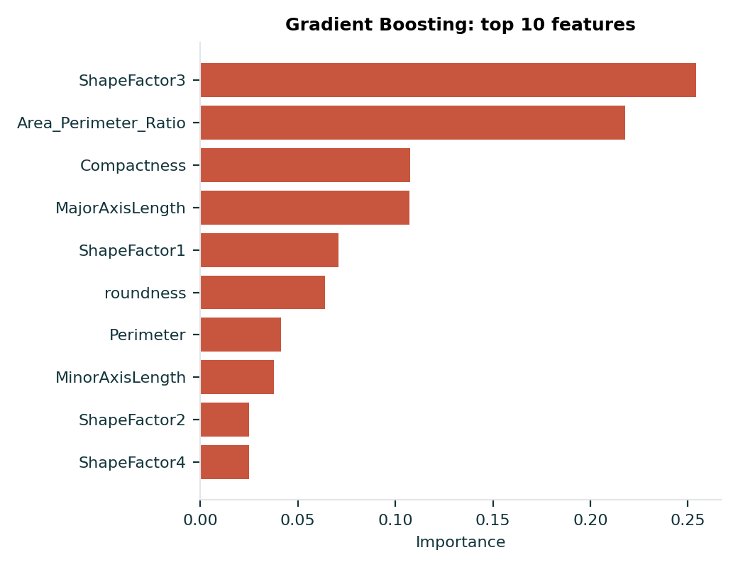
CLASSIFICATION | MODEL 8 OF 10
Gradient Boosting
Adds small trees one by one, each fitted to the errors of the ensemble so far.
0.9508
Accuracy
0.9507
F1 (weighted)
0.9589
F1 (macro)
0.9976
ROC-AUC (OvR)
Settings
learning_rate = 0.1, max_depth = 3, n_estimators = 100
Ranks 6 of 10 on accuracy.
Dry Bean dataset | 11,878 beans after cleaning | 9,502 train, 2,376 test, stratified 80/20, seed 42

Slide 9
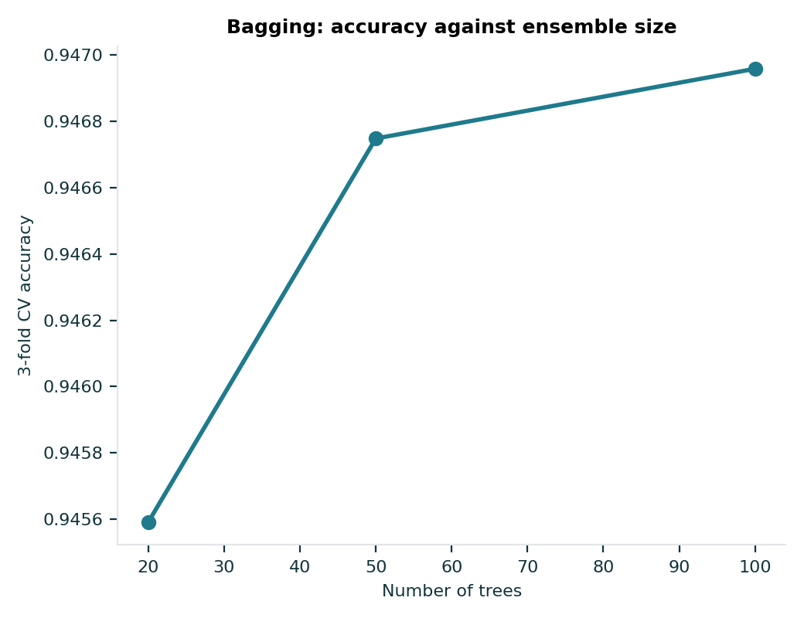
CLASSIFICATION | MODEL 9 OF 10
Bagging Classifier
Trains many decision trees on bootstrap samples of the data and takes a majority vote.
0.9520
Accuracy
0.9520
F1 (weighted)
0.9612
F1 (macro)
0.9970
ROC-AUC (OvR)
Settings
n_estimators = 100
Ranks 5 of 10 on accuracy.
Dry Bean dataset | 11,878 beans after cleaning | 9,502 train, 2,376 test, stratified 80/20, seed 42

Slide 10
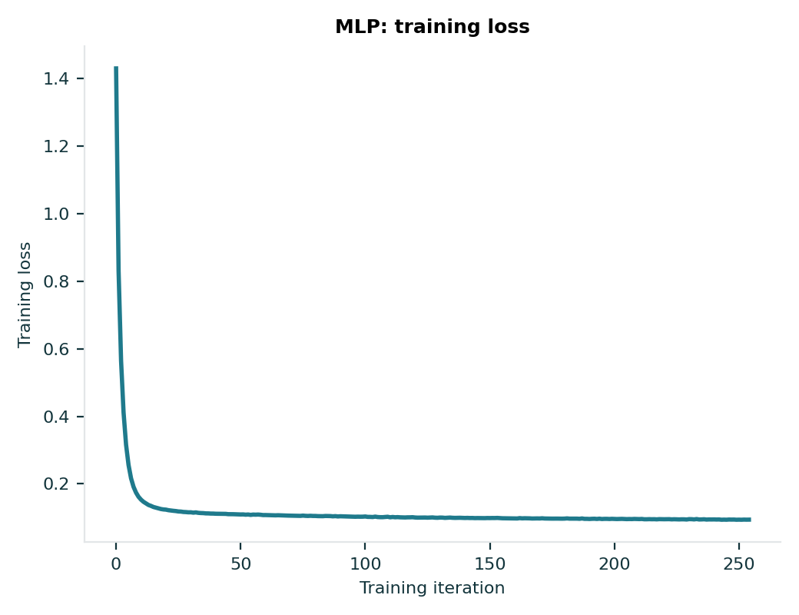
CLASSIFICATION | MODEL 10 OF 10
MLP Neural Network
Feeds the scaled features through layers of weighted units with non-linear activations, trained by gradient descent.
0.9541
Accuracy
0.9542
F1 (weighted)
0.9624
F1 (macro)
0.9978
ROC-AUC (OvR)
Settings
activation = relu, hidden_layer_sizes = (50,)
Ranks 1 of 10 on accuracy.
Dry Bean dataset | 11,878 beans after cleaning | 9,502 train, 2,376 test, stratified 80/20, seed 42

Slide 11
CLASSIFICATION | EVALUATION
All 10 classifiers compared
Every model is scored on the same held-out test beans, so the numbers are directly comparable.
Model | Acc. | F1 w. | F1 m. | AUC
MLP | 0.9541 | 0.9542 | 0.9624 | 0.9978
SVM (RBF) | 0.9533 | 0.9533 | 0.9626 | 0.9977
Logistic Regression | 0.9520 | 0.9520 | 0.9595 | 0.9976
Random Forest | 0.9520 | 0.9519 | 0.9605 | 0.9975
Bagging | 0.9520 | 0.9520 | 0.9612 | 0.9970
Gradient Boosting | 0.9508 | 0.9507 | 0.9589 | 0.9976
K-Nearest Neighbors | 0.9491 | 0.9491 | 0.9580 | 0.9953
Decision Tree | 0.9377 | 0.9377 | 0.9473 | 0.9876
AdaBoost | 0.7866 | 0.7578 | 0.7710 | 0.9753
Naive Bayes | 0.7757 | 0.7746 | 0.7779 | 0.9711
Dry Bean dataset | 11,878 beans after cleaning | 9,502 train, 2,376 test, stratified 80/20, seed 42

Slide 12
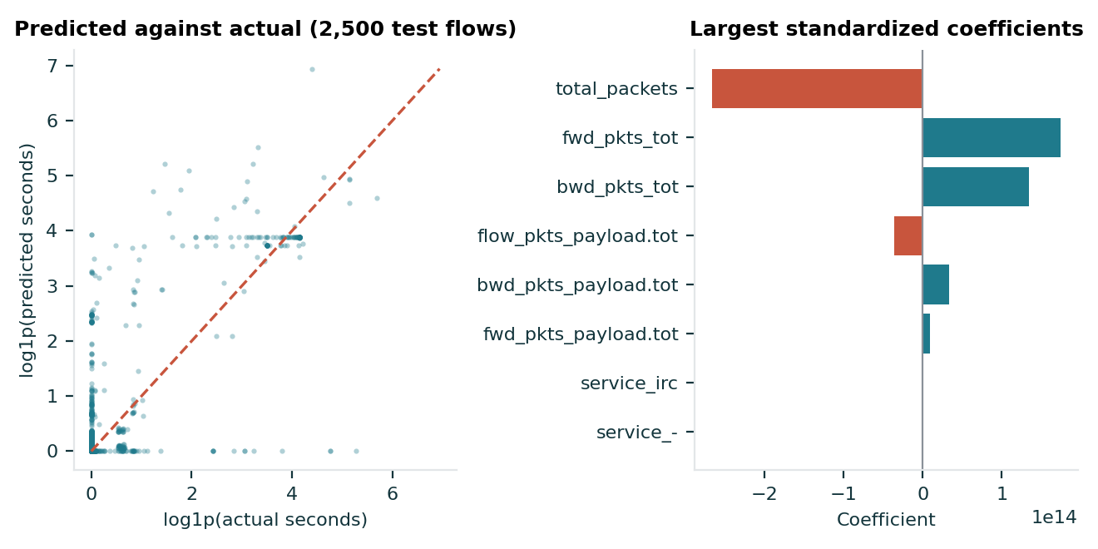
REGRESSION | MODEL 1 OF 10
Linear Regression
Fits one straight-line weight per feature by minimising squared error, the plainest baseline.
-4.436
Test R2
136.8 s
RMSE
4.66 s
MAE
0.6 s
Fit time
Settings
ordinary least squares, scaled inputs
Negative R2: worse than predicting the mean. (rank 7 of 10)
RT-IoT2022 network flows | predicting flow_duration | 94,337 train, 23,585 test rows, 53 leakage-free features

Slide 13
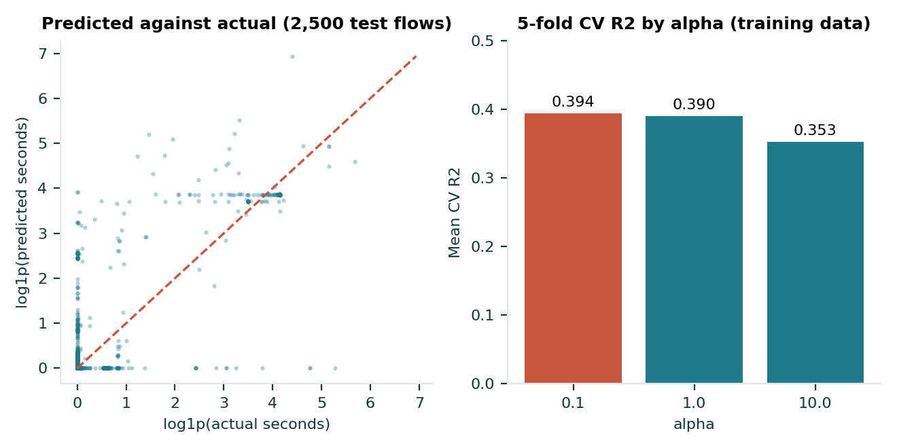
REGRESSION | MODEL 2 OF 10
Ridge Regression
Linear regression with an L2 penalty that shrinks coefficients, which steadies the fit when features overlap.
-4.338
Test R2
135.6 s
RMSE
4.66 s
MAE
0.2 s
Fit time
Settings
alpha = 0.1
Training-data CV preferred the smallest alpha. (rank 6 of 10)
RT-IoT2022 network flows | predicting flow_duration | 94,337 train, 23,585 test rows, 53 leakage-free features

Slide 14
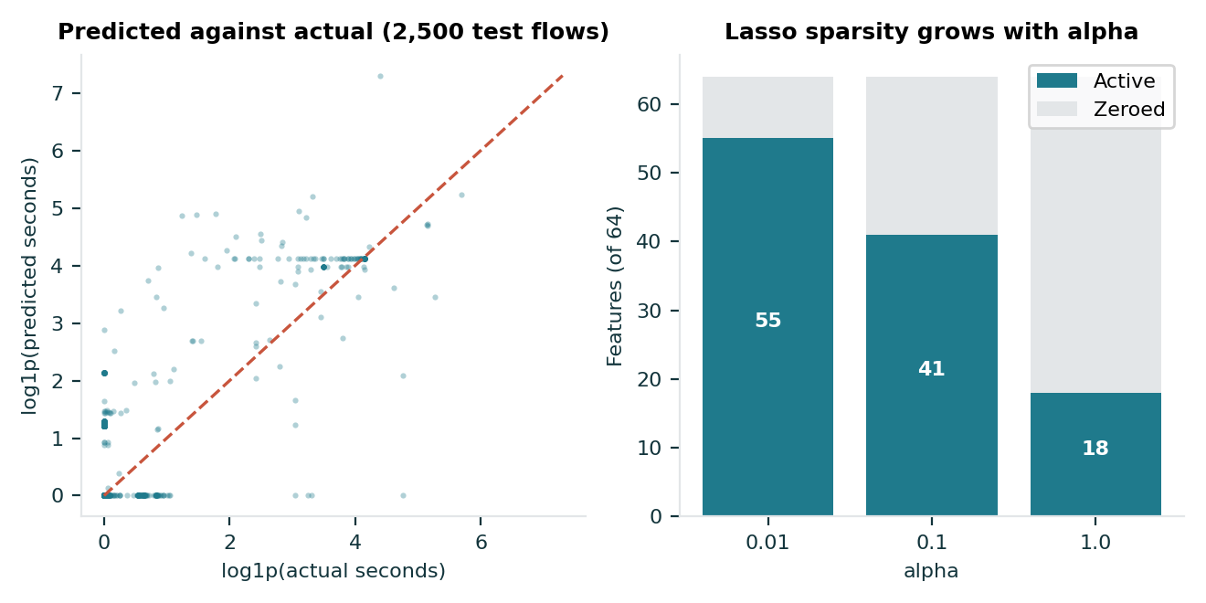
REGRESSION | MODEL 3 OF 10
Lasso Regression
Linear regression with an L1 penalty that pushes weak coefficients exactly to zero.
-63.845
Test R2
472.4 s
RMSE
7.04 s
MAE
4.2 s
Fit time
Settings
alpha = 1.0
At alpha 1.0, 46 of 64 features are zeroed. (rank 9 of 10)
RT-IoT2022 network flows | predicting flow_duration | 94,337 train, 23,585 test rows, 53 leakage-free features

Slide 15
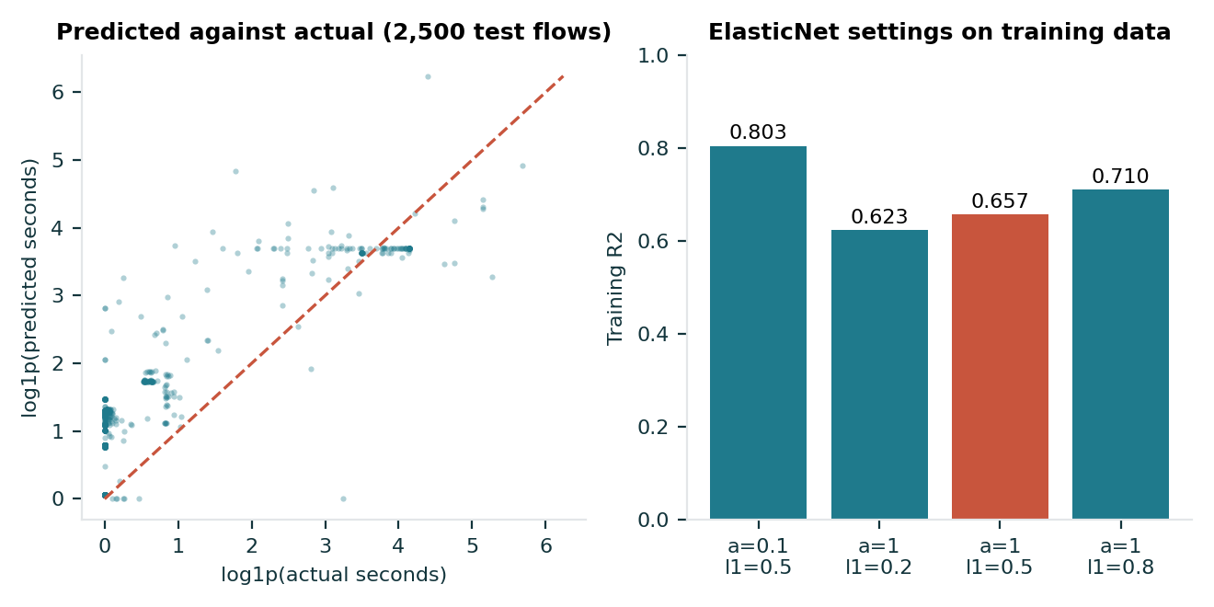
REGRESSION | MODEL 4 OF 10
ElasticNet Regression
Mixes the L1 and L2 penalties, so it drops features and also shrinks the ones it keeps.
-2.080
Test R2
103.0 s
RMSE
3.25 s
MAE
0.5 s
Fit time
Settings
alpha = 1.0, l1_ratio = 0.5
Best penalised linear model on the test set. (rank 5 of 10)
RT-IoT2022 network flows | predicting flow_duration | 94,337 train, 23,585 test rows, 53 leakage-free features

Slide 16
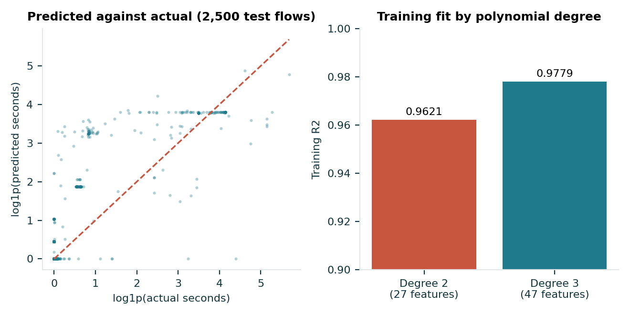
REGRESSION | MODEL 5 OF 10
Polynomial Regression
Expands four packet and header features into squares and interactions, then fits a linear model.
-3,020.9
Test R2
3225.2 s
RMSE
23.54 s
MAE
0.1 s
Fit time
Settings
degree 2 on 4 packet and header features
Train R2 0.962, but test R2 collapses. (rank 10 of 10)
RT-IoT2022 network flows | predicting flow_duration | 94,337 train, 23,585 test rows, 53 leakage-free features

Slide 17
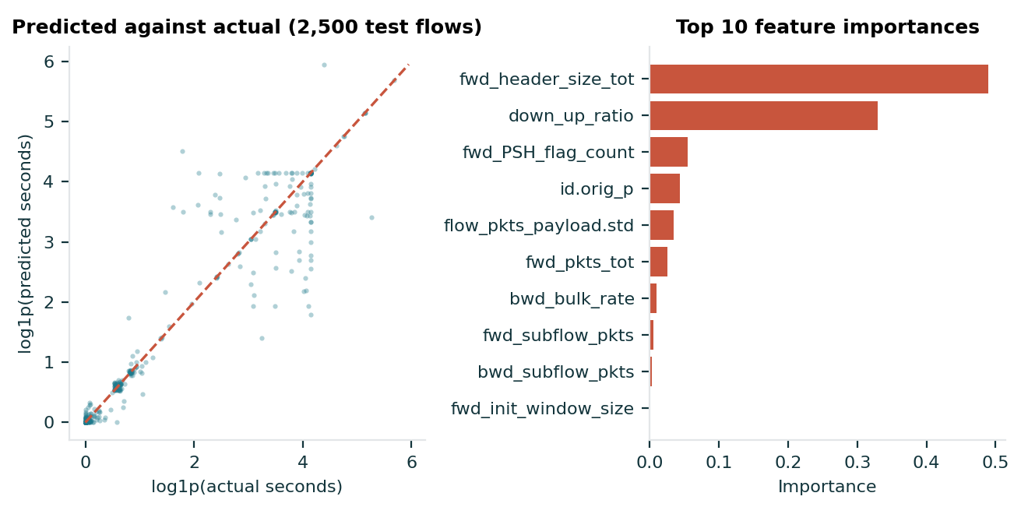
REGRESSION | MODEL 6 OF 10
Decision Tree Regressor
Splits the flows by packet-count thresholds and predicts the mean duration in each leaf.
0.621
Test R2
36.1 s
RMSE
1.32 s
MAE
2.0 s
Fit time
Settings
unconstrained depth
Best test R2 and best CV R2. (rank 1 of 10)
RT-IoT2022 network flows | predicting flow_duration | 94,337 train, 23,585 test rows, 53 leakage-free features

Slide 18
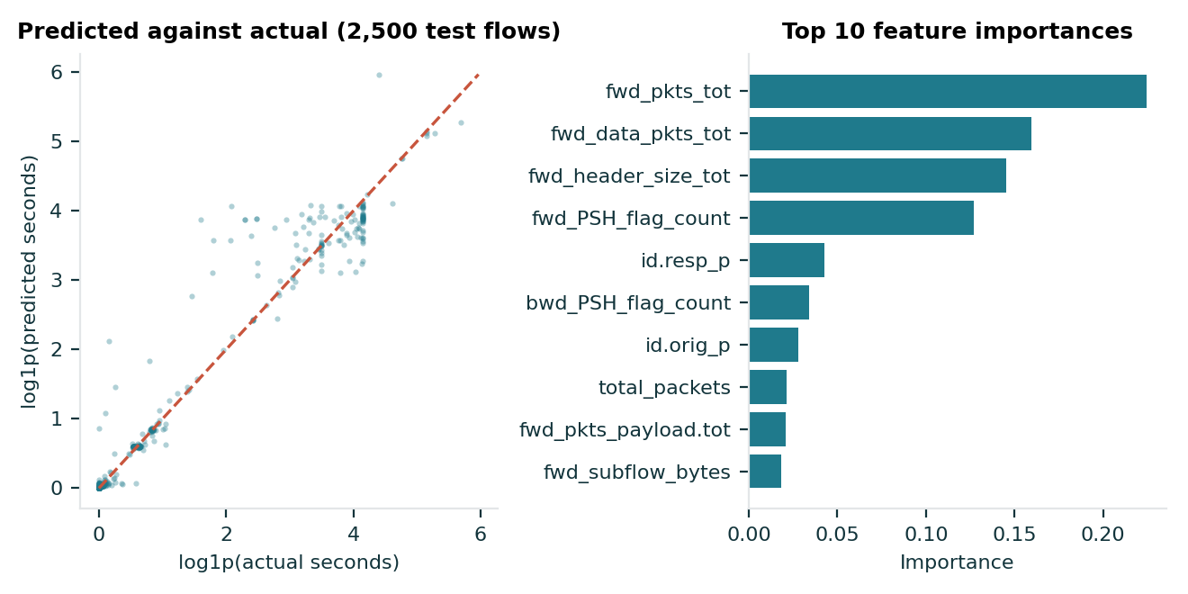
REGRESSION | MODEL 7 OF 10
Random Forest Regressor
Averages 100 deep trees grown on bootstrap samples, which smooths each tree's noise.
0.374
Test R2
46.4 s
RMSE
1.47 s
MAE
19.5 s
Fit time
Settings
100 trees, max_depth = 25
Tuned by 5-fold grid search. (rank 2 of 10)
RT-IoT2022 network flows | predicting flow_duration | 94,337 train, 23,585 test rows, 53 leakage-free features

Slide 19
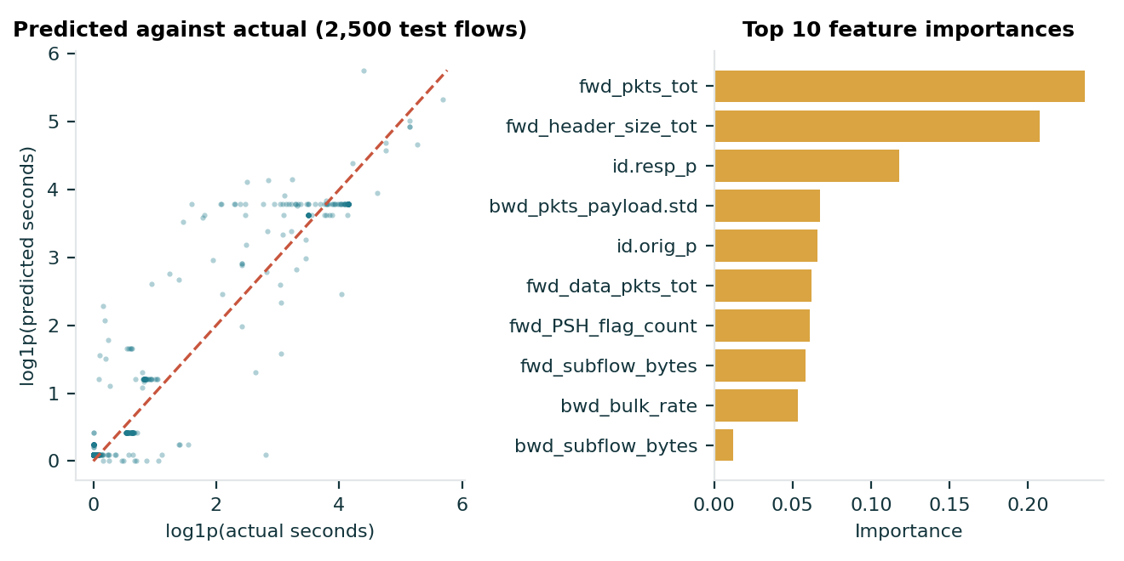
REGRESSION | MODEL 8 OF 10
Gradient Boosting Regressor
Adds shallow trees one by one, each fitted to the remaining errors of the ensemble.
-0.147
Test R2
62.8 s
RMSE
1.98 s
MAE
39.5 s
Fit time
Settings
100 rounds, learning rate 0.1
Tuning left the test score unchanged. (rank 4 of 10)
RT-IoT2022 network flows | predicting flow_duration | 94,337 train, 23,585 test rows, 53 leakage-free features

Slide 20
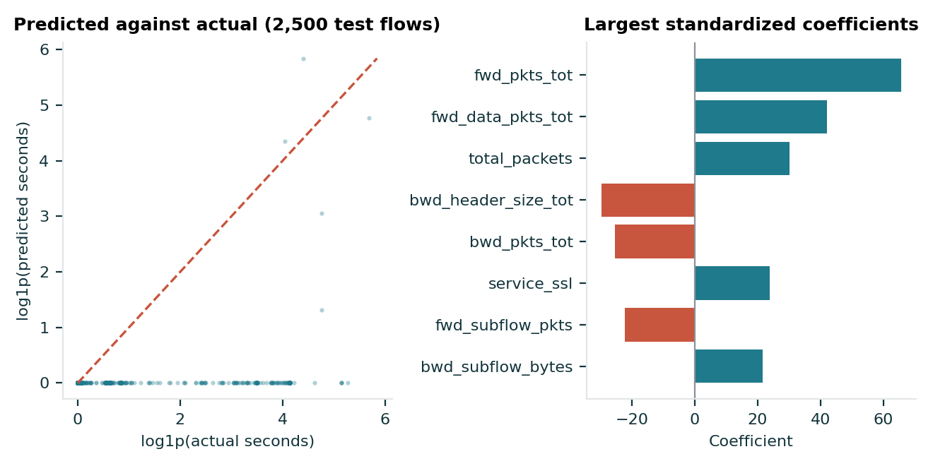
REGRESSION | MODEL 9 OF 10
Support Vector Regression
Fits a linear function inside an epsilon tube, ignoring errors smaller than the tube.
-6.590
Test R2
161.6 s
RMSE
64.72 s
MAE
16.4 s
Fit time
Settings
linear kernel, C = 1.0
Fitted on all 94,337 rows, capped iterations. (rank 8 of 10)
RT-IoT2022 network flows | predicting flow_duration | 94,337 train, 23,585 test rows, 53 leakage-free features

Slide 21
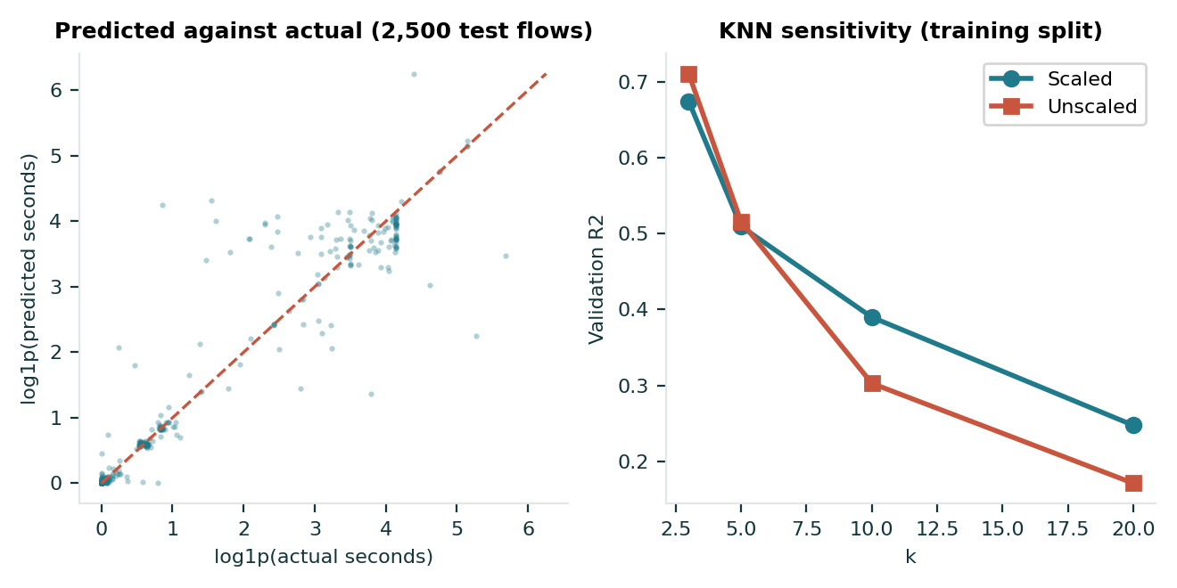
REGRESSION | MODEL 10 OF 10
K-Nearest Neighbors Regressor
Predicts the average duration of the five most similar training flows on scaled features.
-0.018
Test R2
59.2 s
RMSE
1.60 s
MAE
2.3 s
Fit time
Settings
k = 5, scaled inputs
Scaling helps at k = 10 and 20 only. (rank 3 of 10)
RT-IoT2022 network flows | predicting flow_duration | 94,337 train, 23,585 test rows, 53 leakage-free features

Slide 22
REGRESSION | EVALUATION
All 10 regressors compared
Scored on one test split. Only the tree models and KNN come close to a positive R2.
Model | R2 | RMSE (s) | MAE (s)
Decision Tree | 0.621 | 36.1 | 1.32
Random Forest | 0.374 | 46.4 | 1.47
KNN (k=5) | -0.018 | 59.2 | 1.60
Gradient Boosting | -0.147 | 62.8 | 1.98
ElasticNet | -2.080 | 103.0 | 3.25
Ridge | -4.338 | 135.6 | 4.66
Linear Regression | -4.436 | 136.8 | 4.66
SVR (linear) | -6.590 | 161.6 | 64.72
Lasso | -63.845 | 472.4 | 7.04
Polynomial (deg 2) | -3,020.9 | 3225.2 | 23.54
5-fold stratified CV, top two models
Decision Tree R2 0.6821 ± 0.1795
Random Forest (tuned) R2 0.6506 ± 0.2206
RT-IoT2022 network flows | predicting flow_duration | 94,337 train, 23,585 test rows, 53 leakage-free features

Slide 23
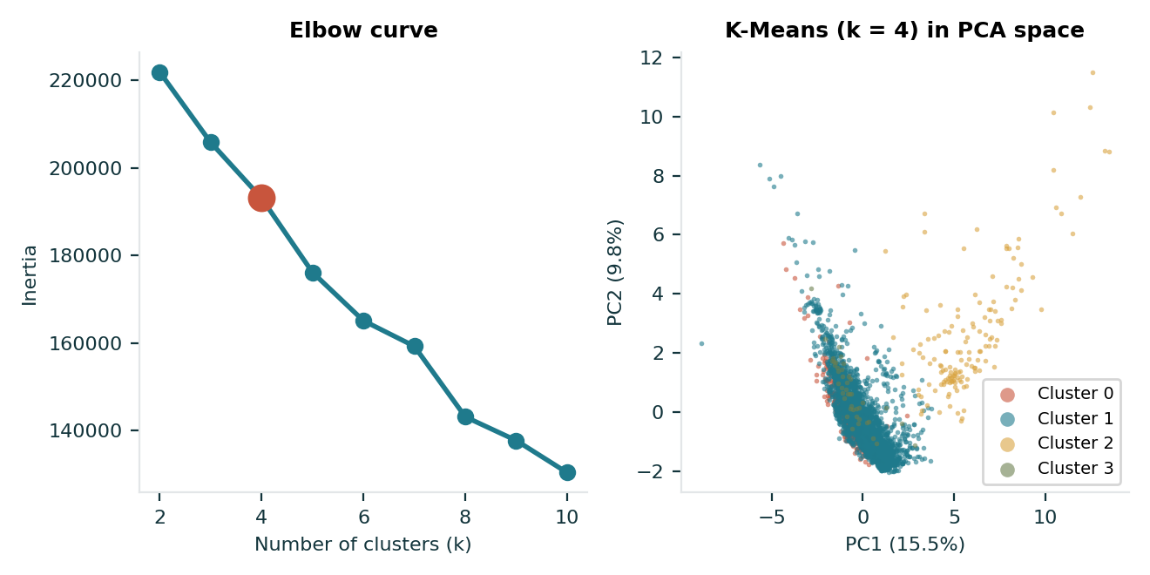
CLUSTERING | MODEL 1 OF 2
K-Means Clustering
Assigns each booking to the nearest of k centres and moves the centres until the groups stop changing, minimising inertia.
k = 4
Chosen clusters
0.2087
Silhouette
1.4673
Davies-Bouldin
1,469
Calinski-Harabasz
Settings
k tried from 2 to 10, 10 starts. Sizes 1,398, 12,807, 624, 171.
The elbow is gentle, so k = 4 came from silhouette and Davies-Bouldin.
Hotel Booking Demand | 15,000 sampled bookings, 48 features | dendrogram on 1,000, t-SNE on 5,000 of those

Slide 24
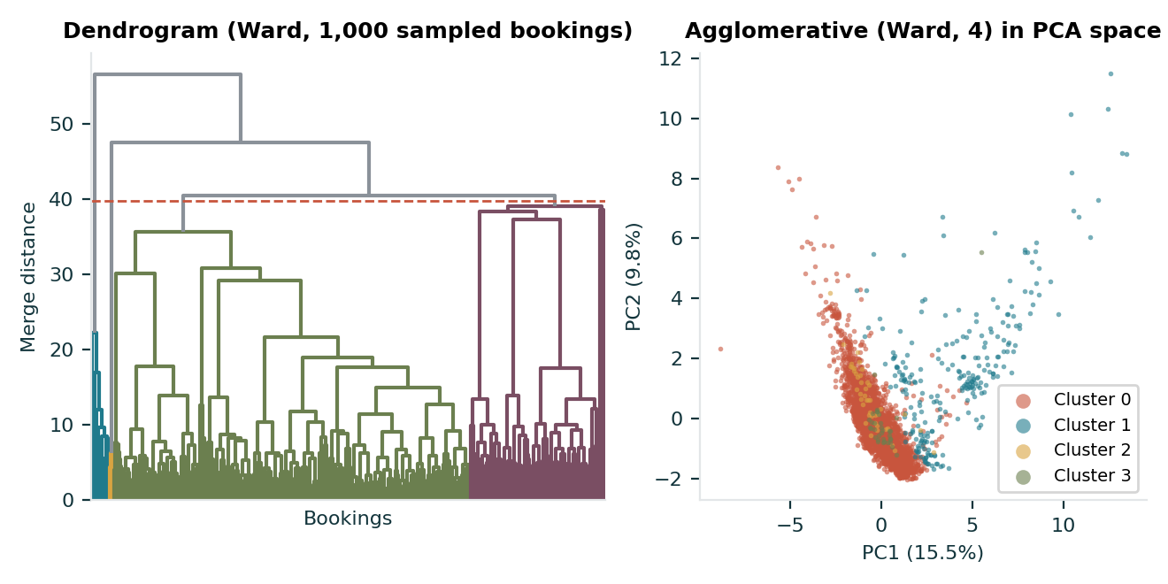
CLUSTERING | MODEL 2 OF 2
Agglomerative Clustering
Starts with every booking alone and keeps merging the closest pair of clusters; Ward linkage merges whichever pair adds the least variance.
4
Clusters (Ward)
0.4529
Silhouette
1.3782
Davies-Bouldin
1,345.4
Calinski-Harabasz
Settings
Ward, Euclidean. Sizes 13,707, 980, 171, 142.
Complete and average linkage were rejected: they isolate single bookings.
Hotel Booking Demand | 15,000 sampled bookings, 48 features | dendrogram on 1,000, t-SNE on 5,000 of those

Slide 25
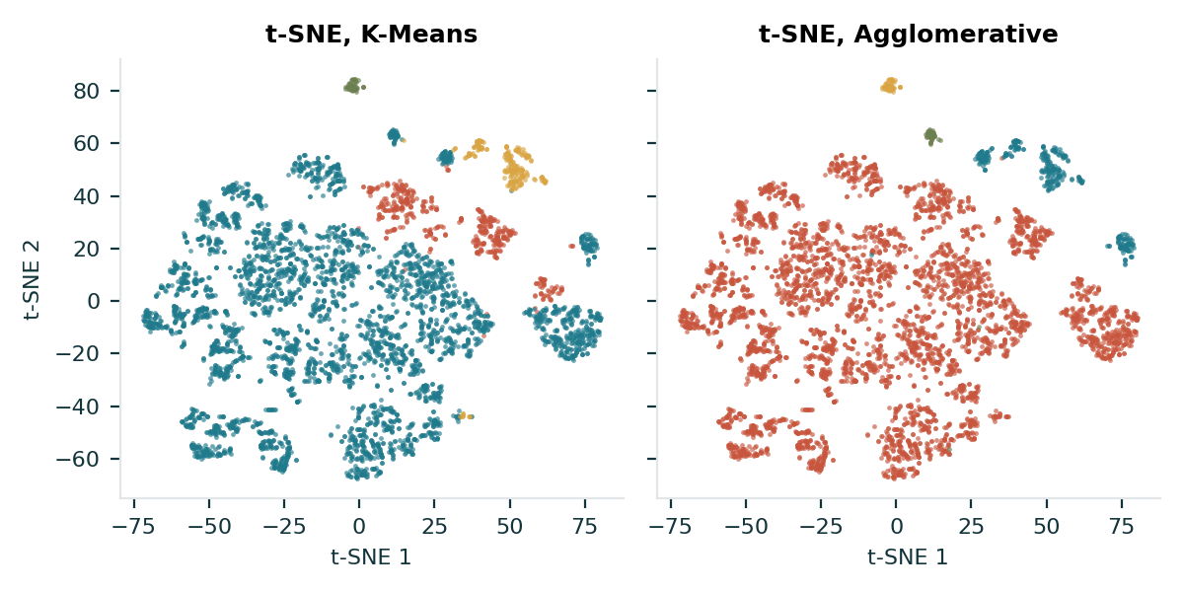
CLUSTERING | EVALUATION
K-Means against Agglomerative
Both were fitted and scored on the same 15,000 bookings. The three metrics do not agree on one winner.
Metric | K-Means | Agglom. | Better
Silhouette (higher) | 0.2087 | 0.4529 | Agglomerative
Davies-Bouldin (lower) | 1.4673 | 1.3782 | Agglomerative
Calinski-Harabasz (higher) | 1,469 | 1,345.4 | K-Means
Reading the result
Both methods return one dominant cluster (85% and 91% of bookings) plus a few small ones, so the higher Agglomerative silhouette should not be read as clearly better groups.
Hotel Booking Demand | 15,000 sampled bookings, 48 features | dendrogram on 1,000, t-SNE on 5,000 of those

