Slide 1

Machine Learning Capstone — Review 1
Model Development & Evaluation Across Regression and Classification Tracks
PROJECT TEAM
Likhith
CB.SC.U4CSE24135
Prudhvi
CB.SC.U4CSE24114
Semanth
CB.SC.U4CSE24134
Amrita Vishwa Vidyapeetham

Slide 2
PROJECT OVERVIEW
Objectives & Track Summary
Overview
REGRESSION TRACK
CLASSIFICATION TRACK
DATASET
DATASET
RT_IoT2022 (IoT network traffic)
Dry Bean Dataset (UCI Machine Learning Repository)
TASK
TASK
Predict flow_duration (seconds), a continuous target
Predict bean cultivar among 7 classes
CLEANED SIZE
CLEANED SIZE
117,922 rows × 53 leakage-free features
13,543 rows (68 duplicates removed) × 17 features
TRAIN / TEST SPLIT
TRAIN / TEST SPLIT
94,337 / 23,585 rows (80/20, random_state=42)
10,834 / 2,709 rows (80/20, stratified, random_state=42)
MODELS EVALUATED
MODELS EVALUATED
10: Linear, Ridge, Lasso, ElasticNet, Polynomial,
Decision Tree, Random Forest, Gradient Boosting, SVR, KNN
5 (Part A): Logistic Regression, KNN, Decision Tree,
Naive Bayes (Gaussian), SVM (linear & RBF)
EVALUATION PROTOCOL — COMMON TO BOTH TRACKS
• Deterministic 80/20 splits; all scalers and encoders are fit strictly on training data only.
• Hyperparameters tuned via GridSearchCV with cross-validation performed on training data only.
• Every model is evaluated exactly once on its held-out test set — no test-set model selection.
• Every metric, parameter and figure in this deck is transcribed directly from executed notebook output.
Amrita Vishwa Vidyapeetham • ML Capstone Review 1
02 / 22

Slide 3
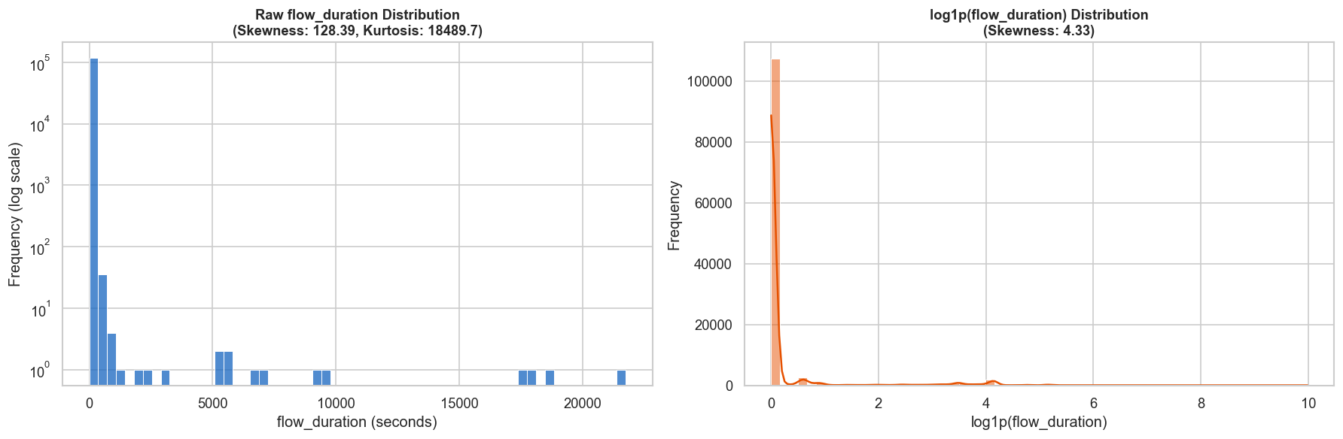
REGRESSION TRACK — NETWORK FLOW DURATION PREDICTION
Dataset & Preprocessing
Dataset
DATASET FACTS
• RT_IoT2022 IoT network-traffic dataset
• Raw shape: 123,117 rows × 85 columns, zero missing values
• Target: flow_duration (seconds) — continuous, extremely right-skewed
• Skewness = 128.39, Kurtosis = 18,489.7 (full cleaned dataset)
• Median duration ≈ 4 μs; maximum ≈ 21,728 s (≈ 6 hours)
CLEANING, LEAKAGE PREVENTION & SPLIT
• Dropped 'Unnamed: 0' (row index) and 'bwd_URG_flag_count' (zero variance)
• Removed 5,195 duplicate rows (4.22%) → 117,922 rows × 83 columns
• Purged 30 leakage columns: 15 IAT timing, 5 active, 5 idle, 4 rate-derived, + Attack_type label → 53 leakage-free features
• Engineered total_packets = fwd_pkts_tot + bwd_pkts_tot (r = 0.39 with target)
• 80/20 split (seed=42): 94,337 train / 23,585 test rows (JSON-persisted indices)
OBSERVATION
flow_duration spans microseconds to hours in the same column. 5-fold CV on training data showed inverting a log1p transform back to raw seconds causes catastrophic variance blowout for linear models, so all 10 regression models are trained and evaluated on the raw target scale.
Actual output — regression_preprocessing.ipynb, raw vs. log1p target distribution
Amrita Vishwa Vidyapeetham • ML Capstone Review 1
03 / 22

Slide 4
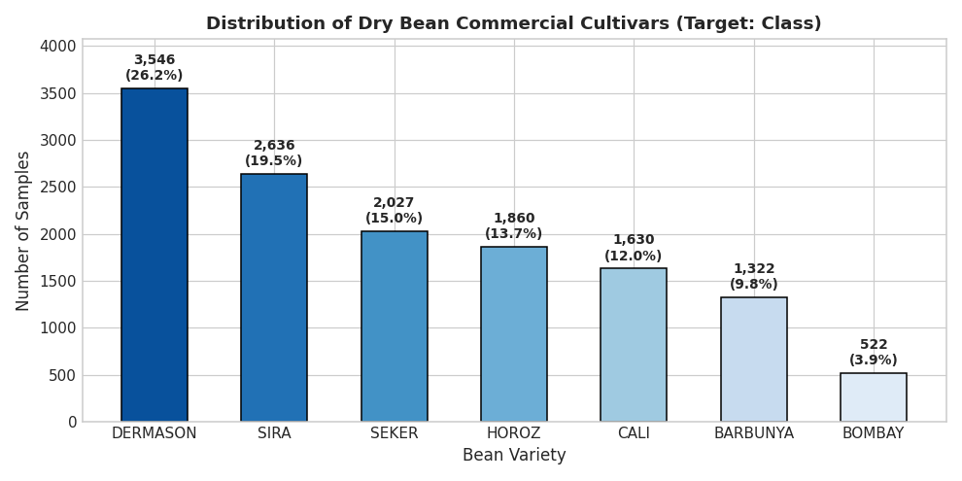
CLASSIFICATION TRACK — DRY BEAN VARIETY CLASSIFICATION
Dataset & Preprocessing
Dataset
DATASET FACTS
• Dry Bean Dataset (UCI Machine Learning Repository)
• Raw shape: 13,611 rows × 17 columns, zero missing values
• Target: Class — 7 cultivars (BARBUNYA, BOMBAY, CALI, DERMASON, HOROZ, SEKER, SIRA)
• 16 morphological features: size (Area, Perimeter, axis lengths) + shape (Compactness, Eccentricity, Shape Factors 1–4)
• Class imbalance: DERMASON largest (26.2%), BOMBAY smallest (3.9%)
CLEANING, LEAKAGE PREVENTION & SPLIT
• Removed 68 exact duplicates → 13,543 rows × 17 columns
• Engineered Area_Perimeter_Ratio = Area / Perimeter
• Target label-encoded to integers 0–6 via LabelEncoder
• Stratified 80/20 split (seed=42): 10,834 train / 2,709 test rows
• StandardScaler fit strictly on train, then applied to test
OBSERVATION
Because accuracy alone can hide poor minority-class performance, all 5 classifiers are additionally evaluated with weighted and macro F1-score, per-class precision/recall, and ROC-AUC — not accuracy alone.
Actual output — classification.ipynb, target class distribution
Amrita Vishwa Vidyapeetham • ML Capstone Review 1
04 / 22

Slide 5
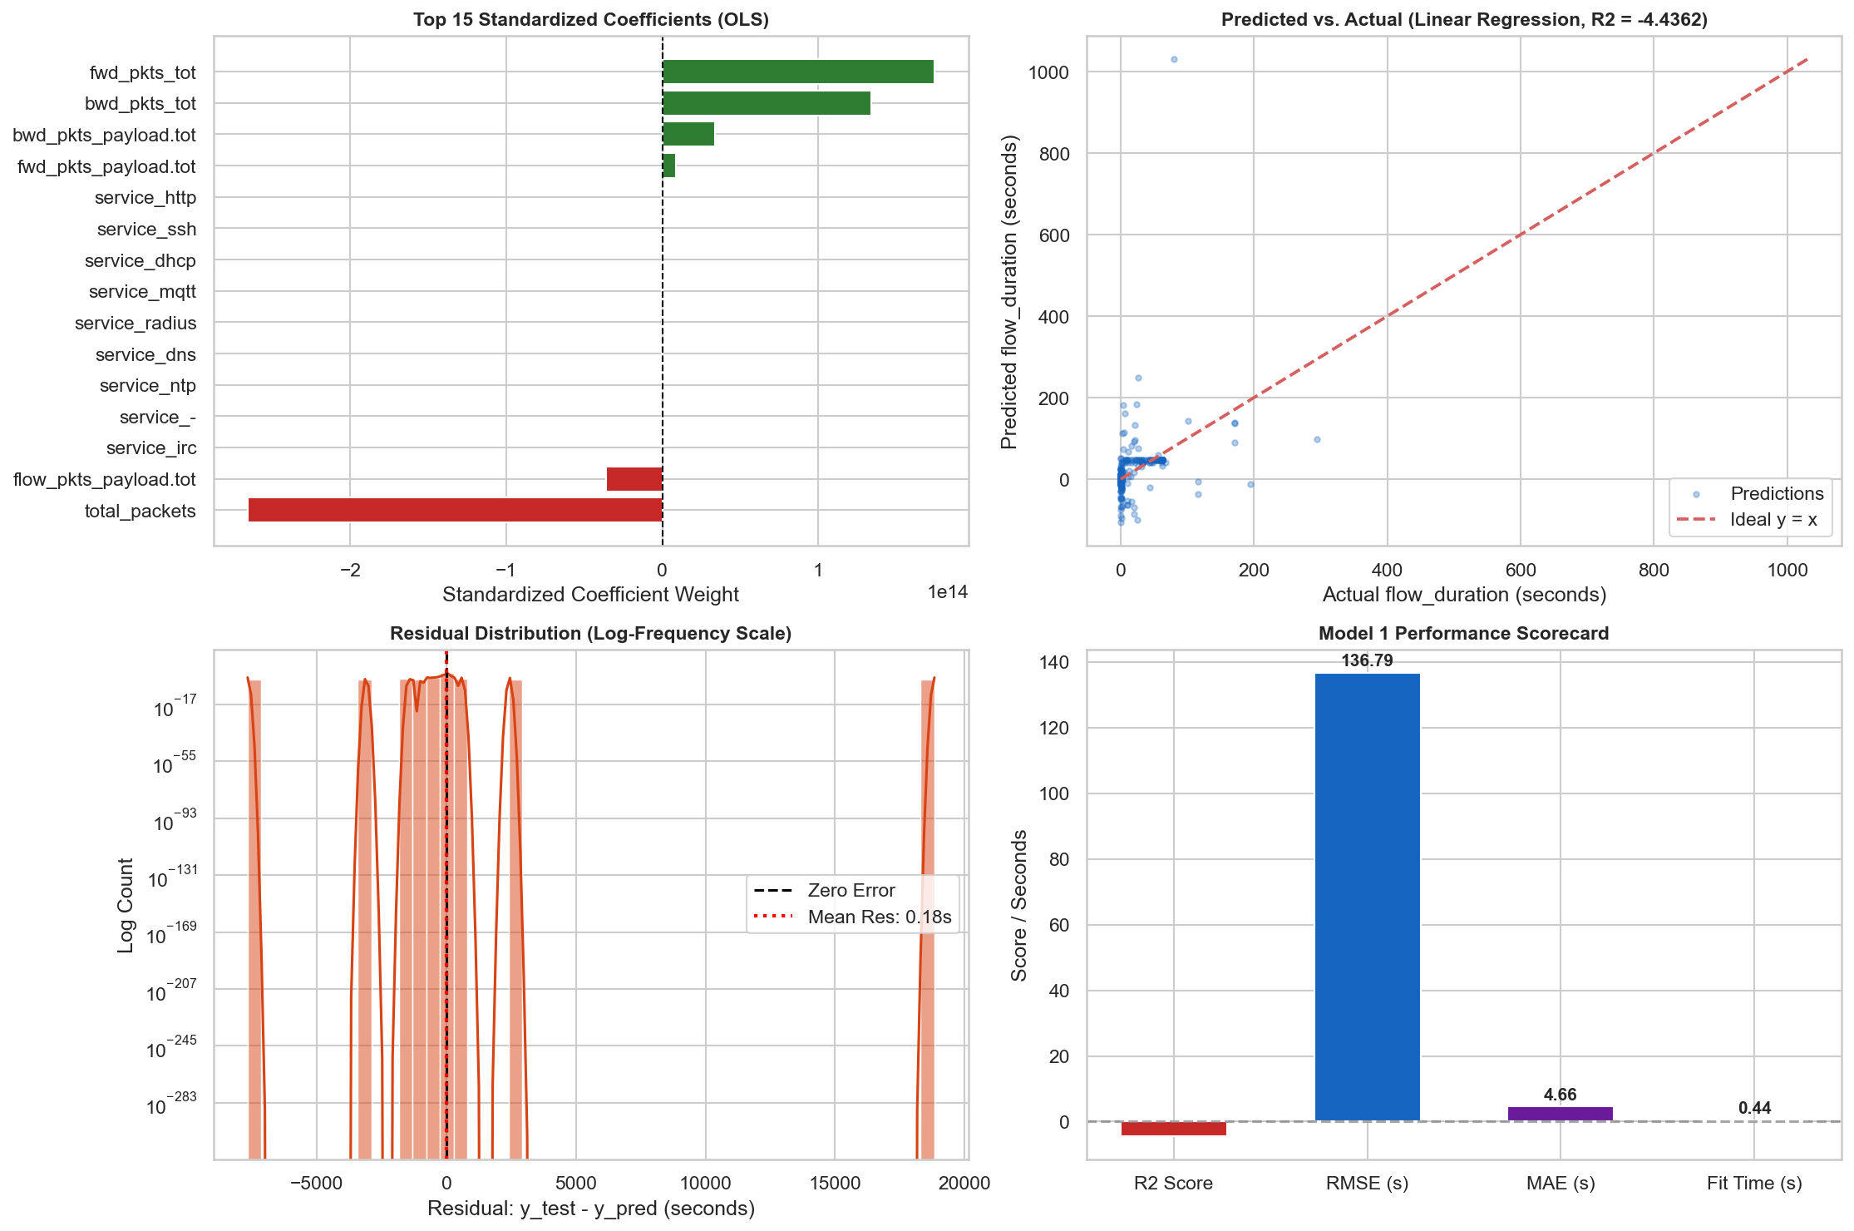
REGRESSION TRACK — NETWORK FLOW DURATION PREDICTION
Linear Regression
Regression 1/10
HOW IT WORKS
Ordinary Least Squares fits a single linear hyperplane that minimizes the sum of squared residuals between predicted and actual flow duration. Categorical features (proto, service) are one-hot encoded and numeric features standardized before fitting. It assumes a linear relationship between packet/header volume and duration, with no thresholds or interactions.
ACTUAL CONFIGURATION (from notebook)
• LinearRegression() — default parameters
• Preprocessing: OneHotEncoder (cat) + StandardScaler (num)
• 53 leakage-free features (timing/rate columns purged)
• Trained on 94,337 rows, evaluated once on 23,585-row test set
HELD-OUT TEST PERFORMANCE
Metric | R² | RMSE (s) | MAE (s)
Test (held-out) | -4.4362 | 136.7931 | 4.6552
OBSERVATION
Linear Regression produced a strongly negative R² on the held-out test set, performing far worse than simply predicting the mean flow duration. This confirms the relationship between packet volume and duration is non-linear.
Actual output — regression.ipynb, Model 1 diagnostic suite (coefficients, predicted-vs-actual, residuals, scorecard)
Amrita Vishwa Vidyapeetham • ML Capstone Review 1
05 / 22

Slide 6
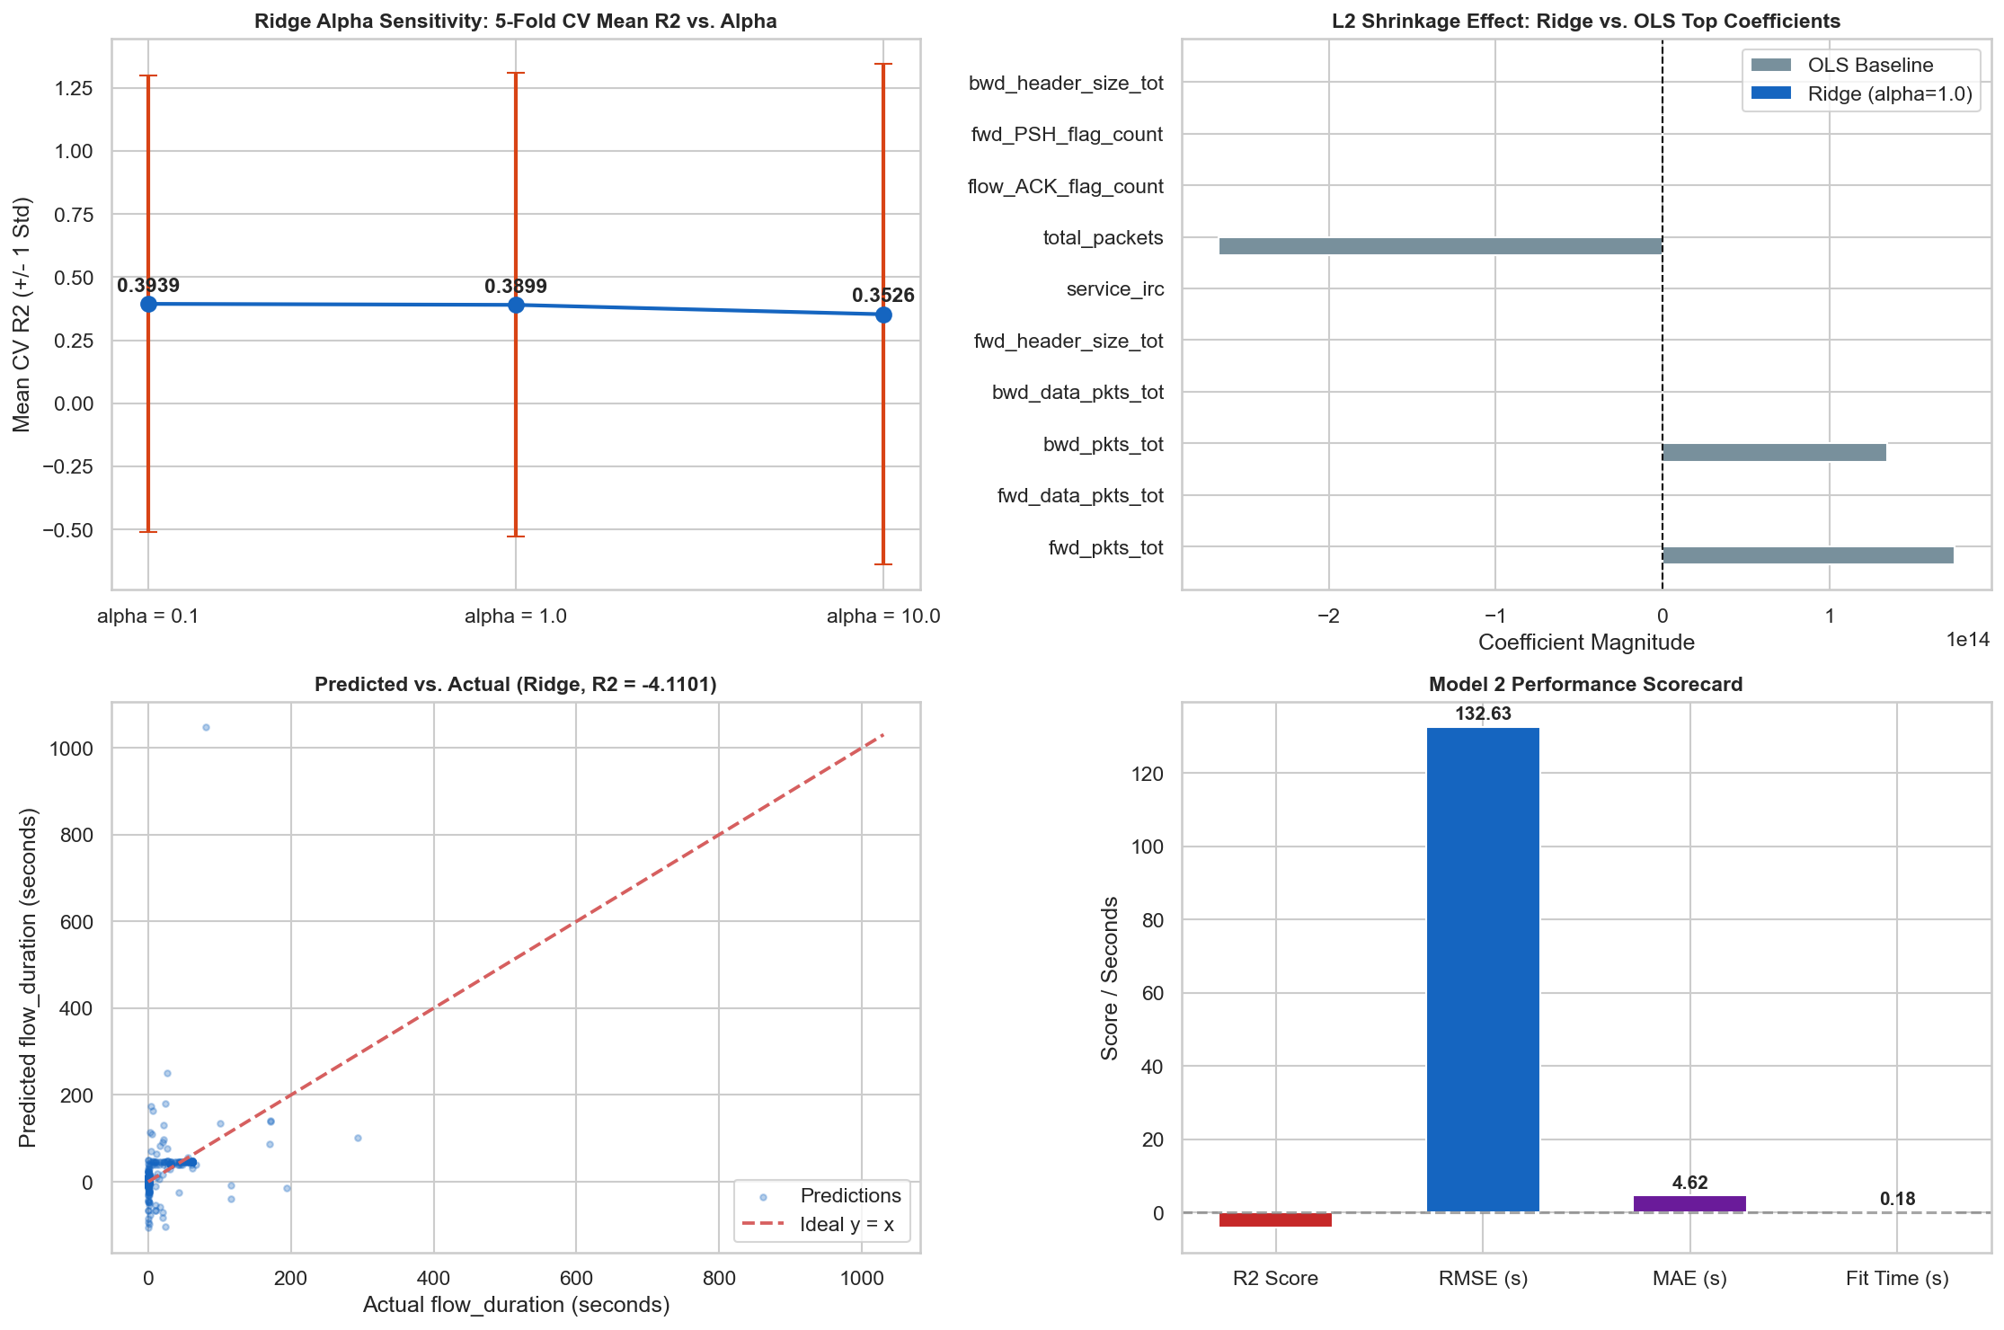
REGRESSION TRACK — NETWORK FLOW DURATION PREDICTION
Ridge Regression
Regression 2/10
HOW IT WORKS
Ridge regression adds an L2 penalty on coefficient magnitudes to the OLS objective, shrinking weights to reduce variance and stabilize collinear features such as header-size totals. It is still a linear model, so it can only rescale — not reshape — the OLS solution.
ACTUAL CONFIGURATION (from notebook)
• Ridge(alpha=1.0, random_state=42) — official baseline
• Alpha sensitivity checked at 0.1 / 1.0 / 10.0 via 5-fold CV (train only)
• GridSearchCV(alpha=[0.1,1.0,10.0], cv=5) → best alpha=0.1 (CV R²=0.2501)
• Preprocessing: OneHotEncoder + StandardScaler
HELD-OUT TEST PERFORMANCE
Metric | R² | RMSE (s) | MAE (s)
Baseline (α=1.0) | -4.1101 | 132.6261 | 4.6168
Tuned (α=0.1) | -4.3380 | 135.5515 | 4.6621
OBSERVATION
Ridge's L2 shrinkage cut RMSE by about 4 seconds versus OLS, but R² stayed strongly negative. The formally tuned alpha (selected by 5-fold CV) actually performed worse on the held-out test set — CV improvement did not carry over.
Actual output — regression.ipynb, Model 2 diagnostic suite (alpha sensitivity, predicted-vs-actual, scorecard)
Amrita Vishwa Vidyapeetham • ML Capstone Review 1
06 / 22

Slide 7
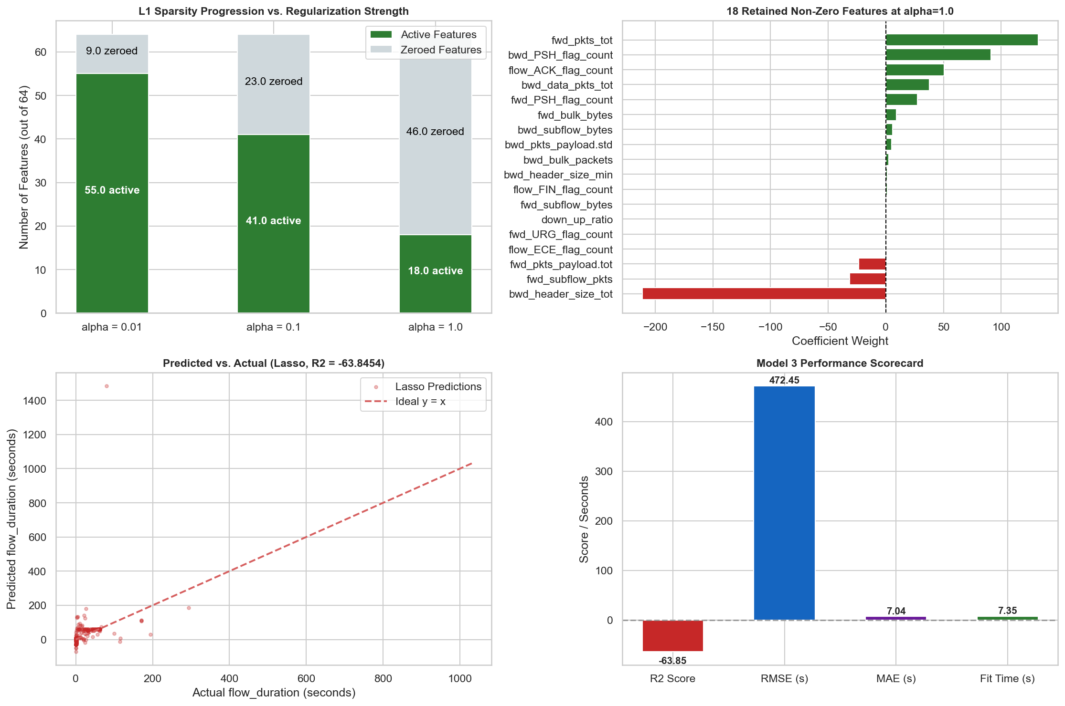
REGRESSION TRACK — NETWORK FLOW DURATION PREDICTION
Lasso Regression
Regression 3/10
HOW IT WORKS
Lasso regression uses an L1 penalty that can shrink coefficients exactly to zero, performing automatic feature selection. At high regularization strength it aggressively discards features, which can also discard information the model actually needs.
ACTUAL CONFIGURATION (from notebook)
• Lasso(alpha=1.0, max_iter=2500, random_state=42) — official baseline
• Sparsity checked at alpha = 0.01 / 0.1 / 1.0 (training data only)
• At alpha=1.0: 46 of 64 encoded coefficients zeroed (18 active)
• Preprocessing: OneHotEncoder + StandardScaler
HELD-OUT TEST PERFORMANCE
Metric | R² | RMSE (s) | MAE (s)
Test (held-out) | -63.8454 | 472.4483 | 7.0382
OBSERVATION
At alpha=1.0, Lasso zeroes out 72% of all features, discarding volumetric predictors the model needs. This produces the second-worst test R² of all ten regression baselines.
Actual output — regression.ipynb, Model 3 diagnostic suite (sparsity progression, predicted-vs-actual, scorecard)
Amrita Vishwa Vidyapeetham • ML Capstone Review 1
07 / 22

Slide 8
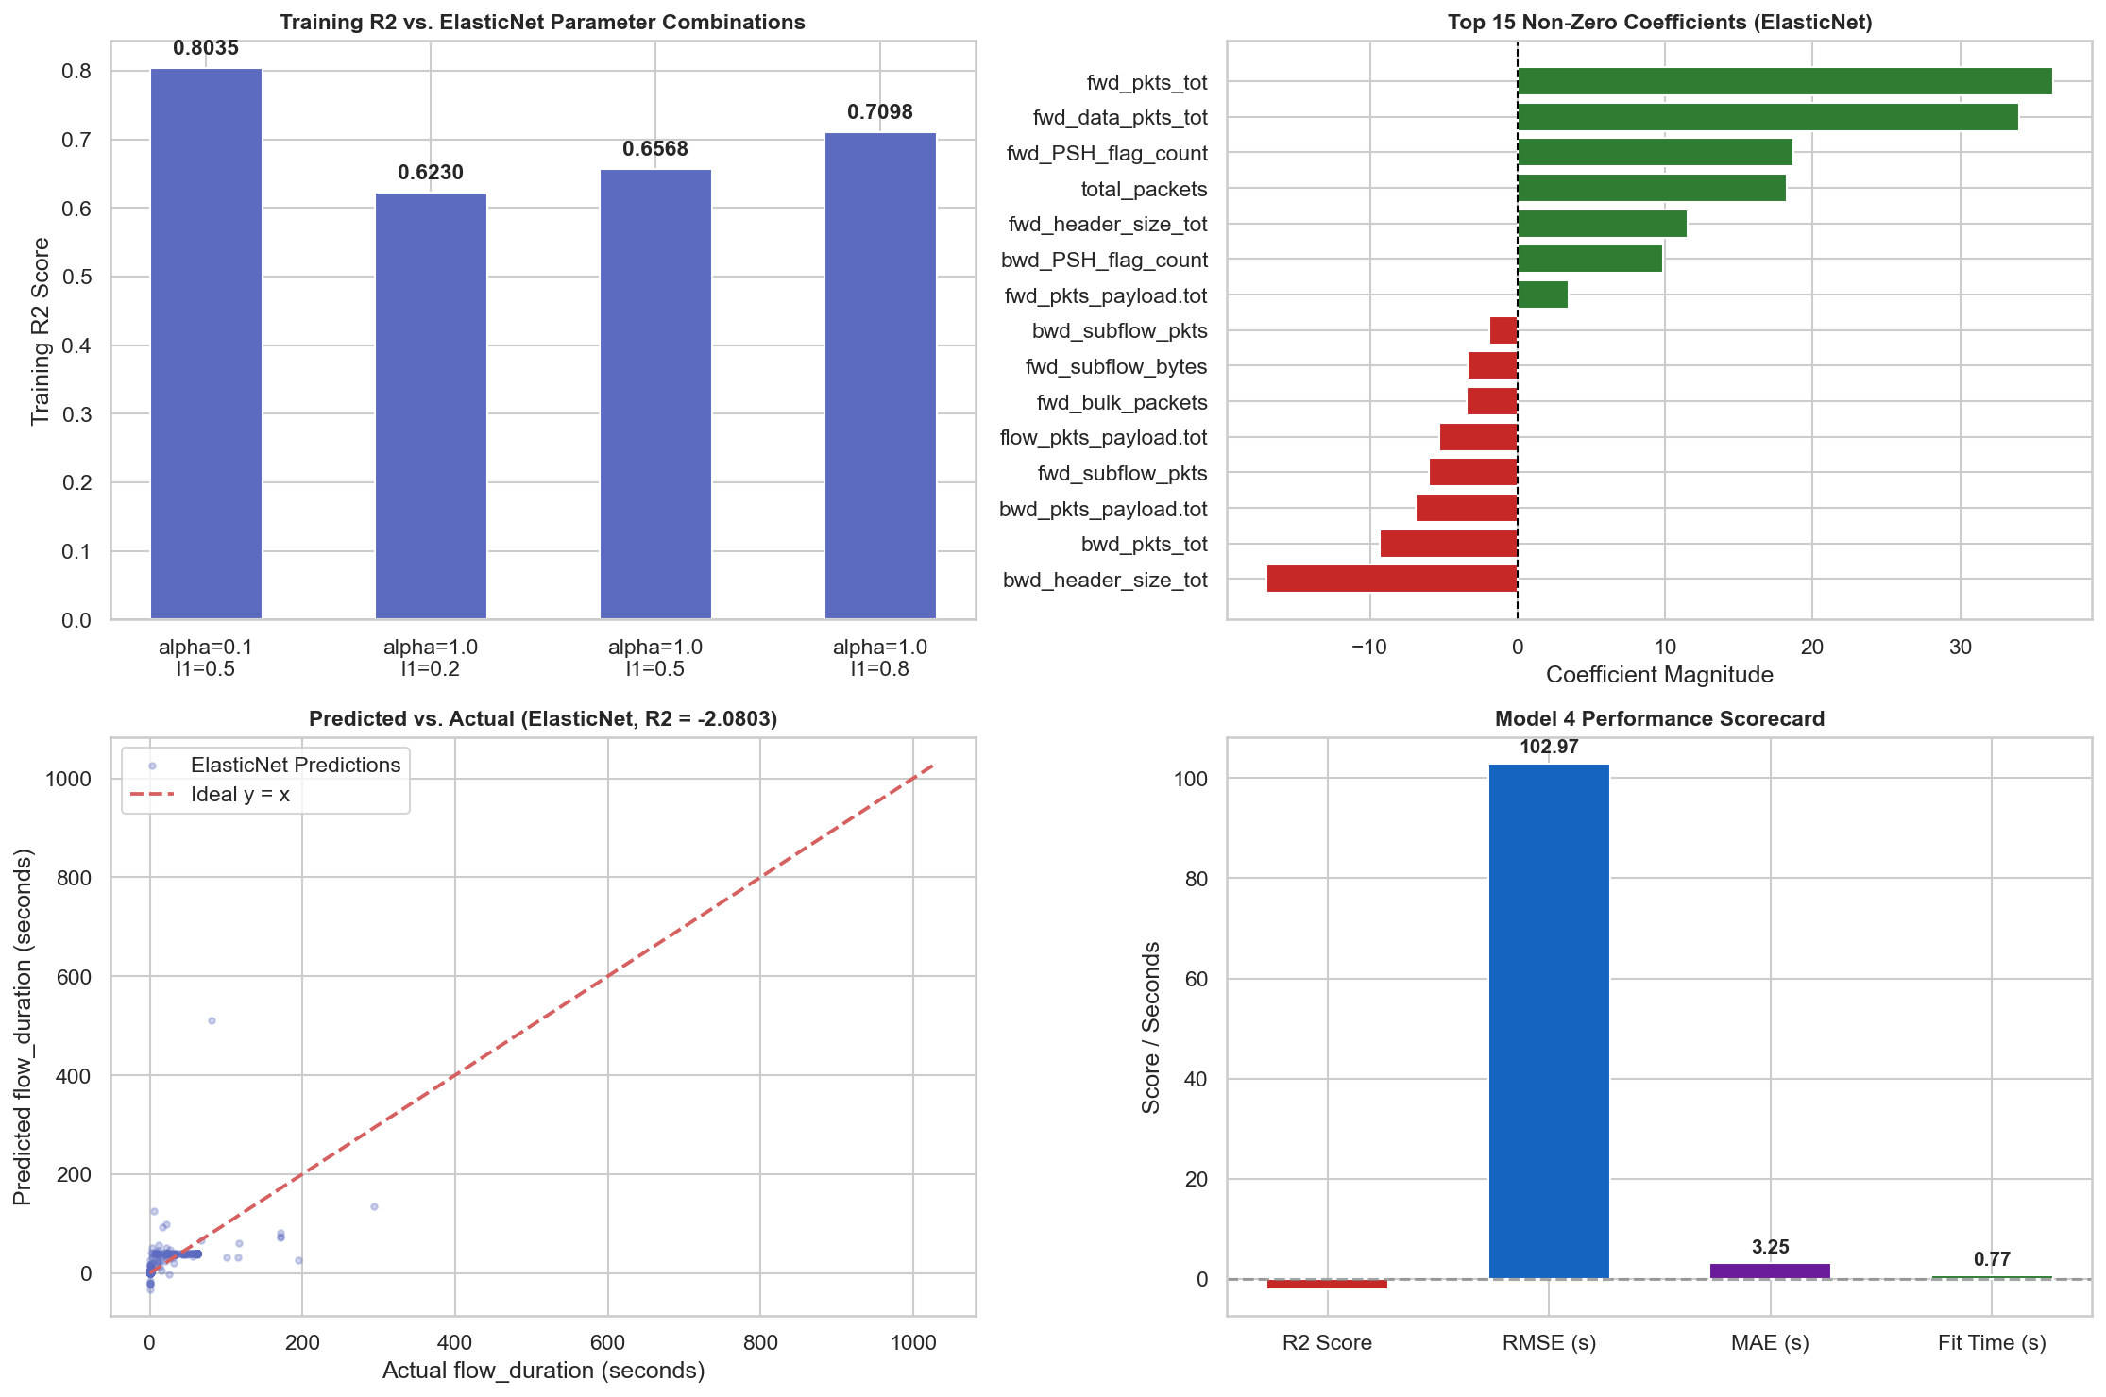
REGRESSION TRACK — NETWORK FLOW DURATION PREDICTION
ElasticNet Regression
Regression 4/10
HOW IT WORKS
ElasticNet linearly combines the L1 and L2 penalties, blending Lasso's feature selection with Ridge's coefficient shrinkage in a single tunable model.
ACTUAL CONFIGURATION (from notebook)
• ElasticNet(alpha=1.0, l1_ratio=0.5, max_iter=2500, random_state=42)
• Parameter behaviour explored at 3 additional (α, l1_ratio) pairs on training data
• Preprocessing: OneHotEncoder + StandardScaler
HELD-OUT TEST PERFORMANCE
Metric | R² | RMSE (s) | MAE (s)
Test (held-out) | -2.0803 | 102.9699 | 3.2478
OBSERVATION
ElasticNet is the best-performing regularized linear model, cutting test MAE to 3.25 s and outperforming OLS, Ridge, Lasso and SVR — but its test R² remains negative, since it is still fundamentally linear.
Actual output — regression.ipynb, Model 4 diagnostic suite (parameter grid, predicted-vs-actual, scorecard)
Amrita Vishwa Vidyapeetham • ML Capstone Review 1
08 / 22

Slide 9
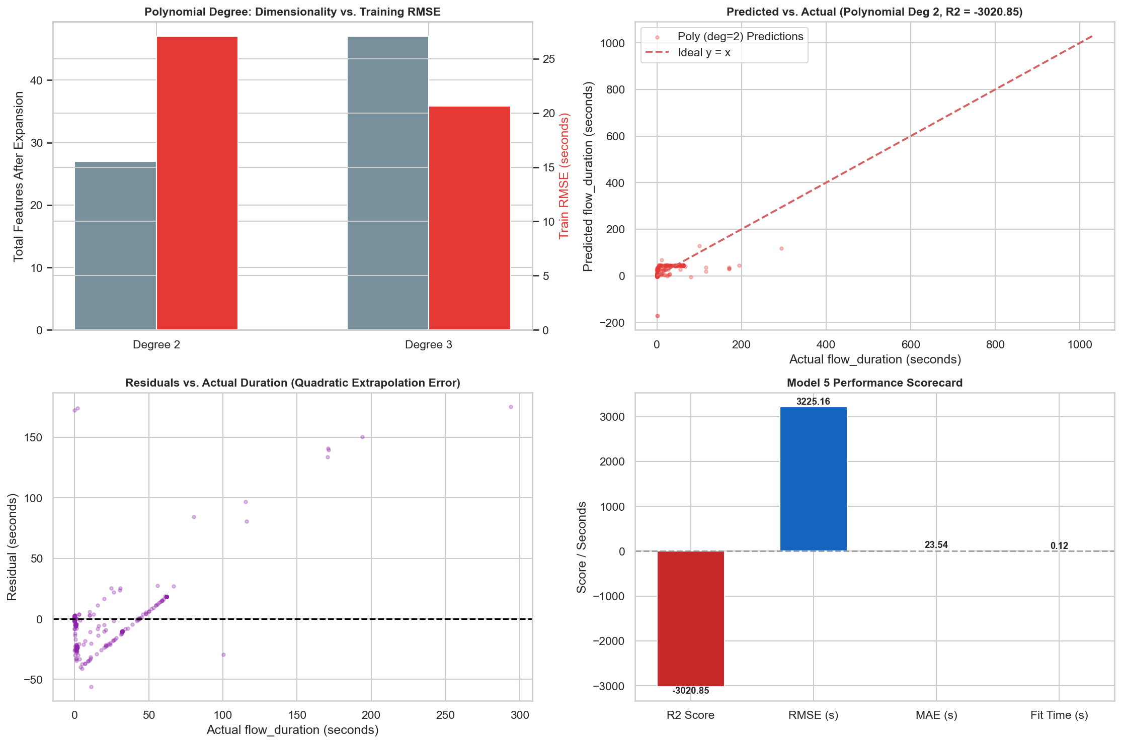
REGRESSION TRACK — NETWORK FLOW DURATION PREDICTION
Polynomial Regression
Regression 5/10
HOW IT WORKS
Polynomial regression expands a compact subset of four volumetric features into quadratic interaction terms, then fits ordinary least squares on the expanded set. It is restricted to 4 features to avoid a combinatorial blow-up of the full 53-feature space.
ACTUAL CONFIGURATION (from notebook)
• Features expanded: fwd_pkts_tot, bwd_pkts_tot, fwd_header_size_tot, bwd_header_size_tot
• PolynomialFeatures(degree=2, include_bias=False) → 27 features
• LinearRegression() on expanded features — Degree 2 is the official baseline
• Degree 3 (47 features) explored only on training data for comparison
HELD-OUT TEST PERFORMANCE
Metric | R² | RMSE (s) | MAE (s)
Train (deg=2) | 0.9621 | 27.06 | —
Test (held-out) | -3020.8537 | 3225.1623 | 23.5377
OBSERVATION
Despite explaining over 96% of variance on training data, unregularized quadratic terms extrapolate catastrophically once test samples fall slightly outside the training range — the worst result of all ten regression models.
Actual output — regression.ipynb, Model 5 diagnostic suite (degree comparison, predicted-vs-actual, scorecard)
Amrita Vishwa Vidyapeetham • ML Capstone Review 1
09 / 22

Slide 10
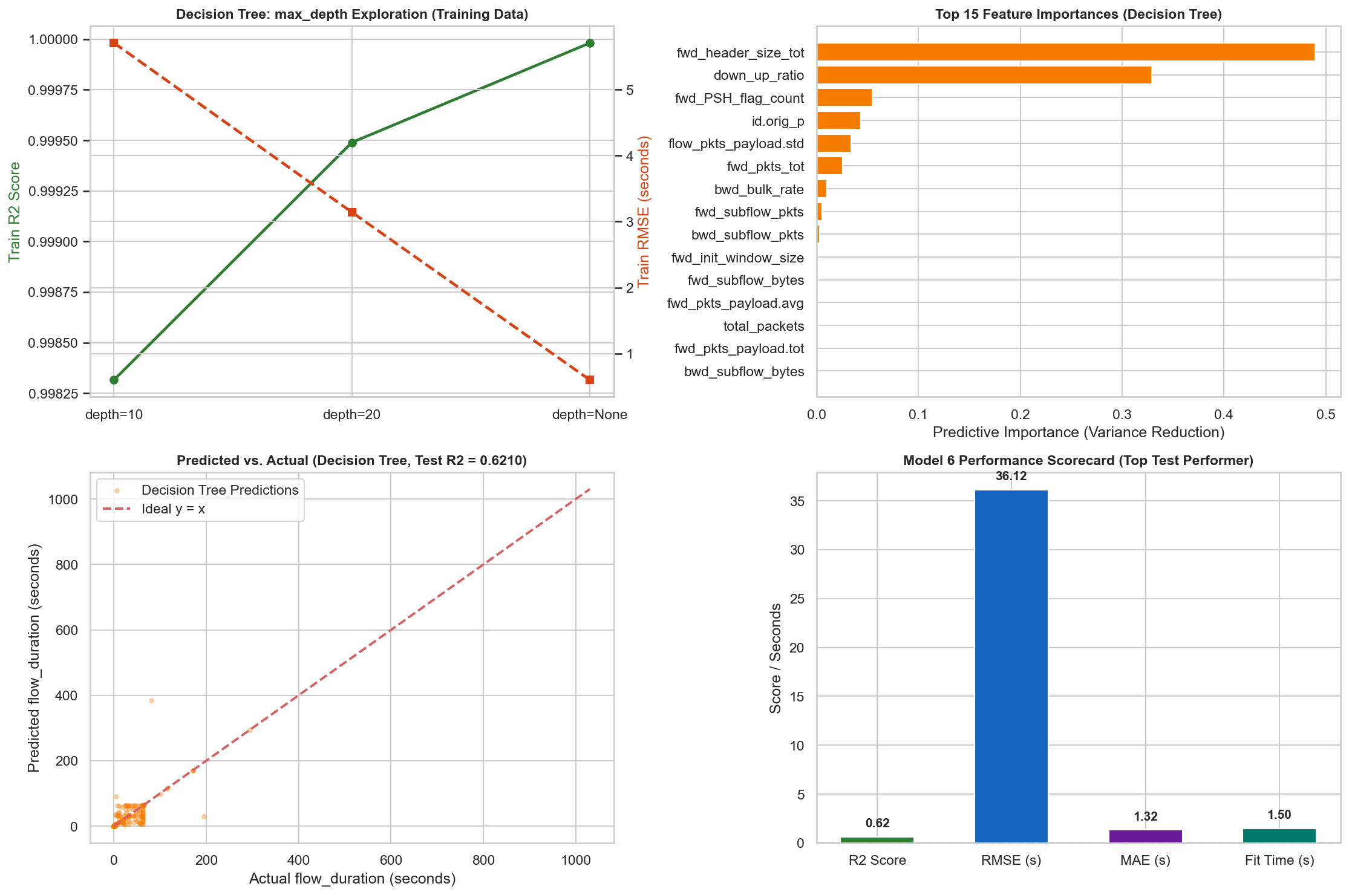
REGRESSION TRACK — NETWORK FLOW DURATION PREDICTION
Decision Tree Regressor
Regression 6/10
HOW IT WORKS
A decision tree recursively splits the feature space into regions, predicting the mean target value within each region. It naturally captures piecewise, non-linear relationships and step-function thresholds without feature scaling.
ACTUAL CONFIGURATION (from notebook)
• DecisionTreeRegressor(random_state=42) — unconstrained depth (official baseline)
• max_depth ∈ {10, 20, None} explored only on training data
• Preprocessing: OneHotEncoder + passthrough numerics
HELD-OUT TEST PERFORMANCE
Metric | R² | RMSE (s) | MAE (s)
Test (held-out) | 0.6210 | 36.1167 | 1.3245
5-Fold Stratified CV | 0.6821 ± 0.1795 | 63.31 ± 31.96 | 1.83 ± 0.57
OBSERVATION
Decision Tree is the top-performing model in the entire regression track — the only baseline with a strongly positive test R². Recursive partitioning matches the discrete handshake/protocol-state structure of network flows far better than any linear or margin-based model.
Actual output — regression.ipynb, Model 6 diagnostic suite (depth exploration, feature split behaviour, predicted-vs-actual, scorecard)
Amrita Vishwa Vidyapeetham • ML Capstone Review 1
10 / 22

Slide 11
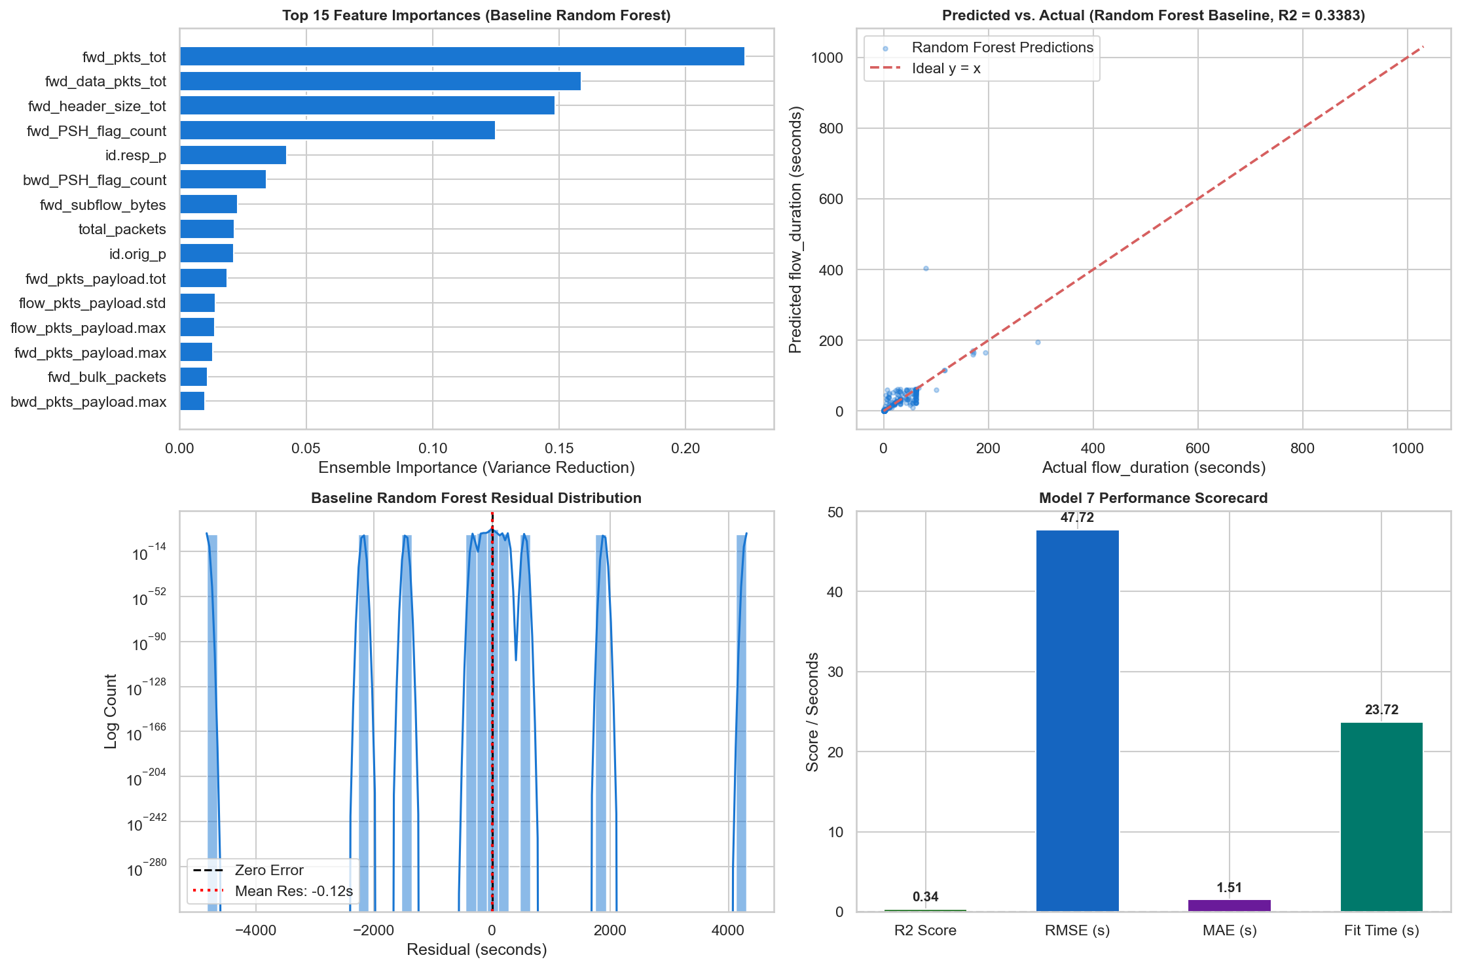
REGRESSION TRACK — NETWORK FLOW DURATION PREDICTION
Random Forest Regressor
Regression 7/10
HOW IT WORKS
Random Forest averages predictions across many decision trees, each trained on a bootstrap sample with a randomized subset of features at each split. Averaging decorrelated trees reduces variance relative to a single tree.
ACTUAL CONFIGURATION (from notebook)
• Baseline: RandomForestRegressor(n_estimators=100, random_state=42)
• GridSearchCV(cv=5): n_estimators ∈ {50,100}, max_depth ∈ {15,25}
• Best params: max_depth=25, n_estimators=100 (best CV R² = 0.7512)
HELD-OUT TEST PERFORMANCE
Metric | R² | RMSE (s) | MAE (s)
Baseline | 0.3383 | 47.7241 | 1.5114
Tuned | 0.3740 | 46.4201 | 1.4726
5-Fold CV (tuned) | 0.6506 ± 0.2206 | 67.68 ± 32.67 | 1.90 ± 0.63
OBSERVATION
Tuning improved test R² from 0.3383 to 0.3740, making Random Forest the top ensemble model. Leaf averaging across 100 trees still smooths out rare, extreme-duration outliers, keeping it well behind the single Decision Tree.
Actual output — regression.ipynb, Model 7 diagnostic suite (feature importance, predicted-vs-actual, scorecard)
Amrita Vishwa Vidyapeetham • ML Capstone Review 1
11 / 22

Slide 12
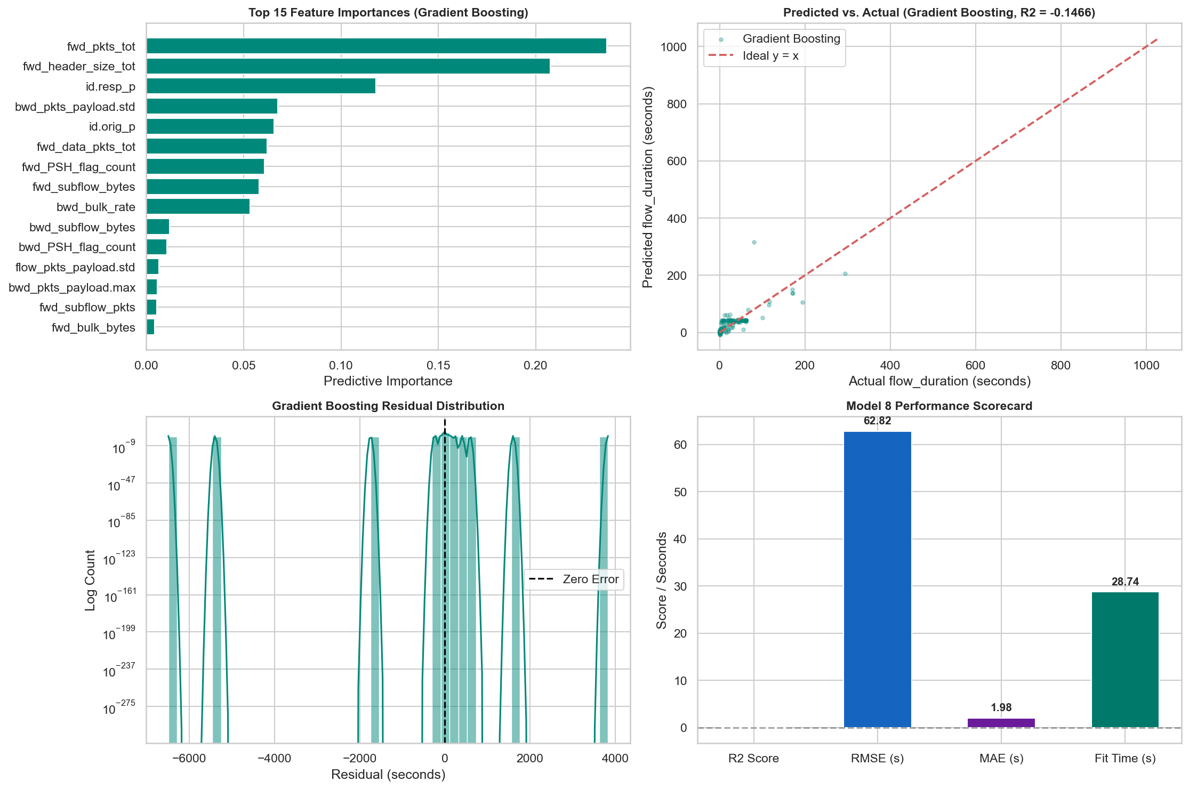
REGRESSION TRACK — NETWORK FLOW DURATION PREDICTION
Gradient Boosting Regressor
Regression 8/10
HOW IT WORKS
Gradient Boosting builds trees sequentially: each shallow tree fits the residual errors left by the current ensemble, scaled by a learning rate, letting the model incrementally correct its own mistakes.
ACTUAL CONFIGURATION (from notebook)
• Baseline: GradientBoostingRegressor(n_estimators=100, learning_rate=0.1, random_state=42)
• GridSearchCV(cv=5): learning_rate ∈ {0.05, 0.1}
• Best param: learning_rate=0.1 — identical to baseline (best CV R² = 0.6607)
HELD-OUT TEST PERFORMANCE
Metric | R² | RMSE (s) | MAE (s)
Baseline / Tuned | -0.1466 | 62.8243 | 1.9760
OBSERVATION
Gradient Boosting reaches a strong cross-validation R² (0.6607) but a slightly negative test R² (-0.1466). Sequential fitting under squared-error loss lets early trees overcorrect on rare training outliers, hurting generalization to unseen tail events.
Actual output — regression.ipynb, Model 8 diagnostic suite (feature importance, predicted-vs-actual, scorecard)
Amrita Vishwa Vidyapeetham • ML Capstone Review 1
12 / 22

Slide 13
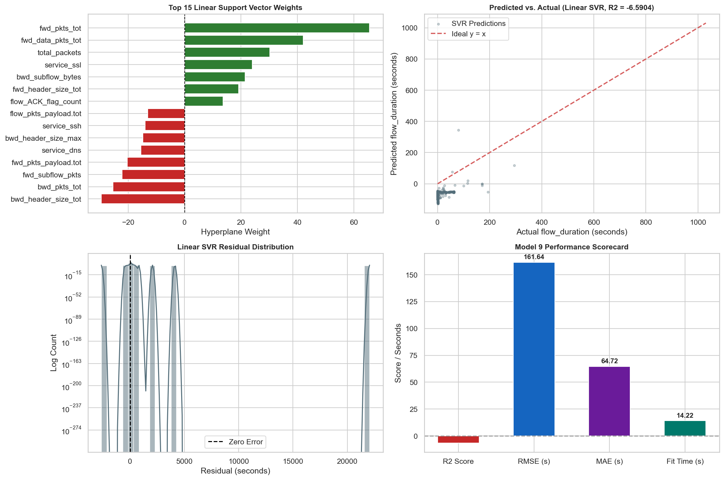
REGRESSION TRACK — NETWORK FLOW DURATION PREDICTION
Support Vector Regressor (SVR)
Regression 9/10
HOW IT WORKS
Support Vector Regression fits a linear function within an epsilon-insensitive margin, only penalizing predictions that fall outside that tube. A linear kernel was used on the complete, un-subsampled training set, since non-linear kernels scale quadratically and were computationally infeasible at this size.
ACTUAL CONFIGURATION (from notebook)
• SVR(kernel='linear', C=1.0, max_iter=2500)
• Trained on the full 94,337-row training set (no subsampling)
• Preprocessing: OneHotEncoder + StandardScaler
HELD-OUT TEST PERFORMANCE
Metric | R² | RMSE (s) | MAE (s)
Test (held-out) | -6.5904 | 161.6391 | 64.7178
OBSERVATION
Linear SVR posts the second-worst MAE (64.72 s) of any regression model. A single linear margin cannot represent both microsecond handshakes and multi-hour sessions in the same tube.
Actual output — regression.ipynb, Model 9 diagnostic suite (support vector weights, predicted-vs-actual, scorecard)
Amrita Vishwa Vidyapeetham • ML Capstone Review 1
13 / 22

Slide 14
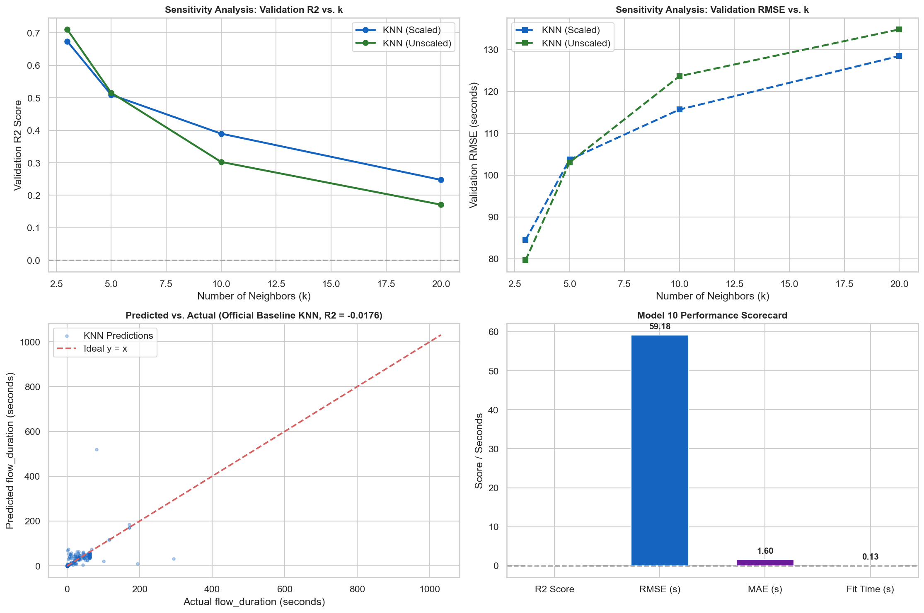
REGRESSION TRACK — NETWORK FLOW DURATION PREDICTION
K-Nearest Neighbors Regressor (KNN)
Regression 10/10
HOW IT WORKS
K-Nearest Neighbors predicts the average target value of the k closest training points in feature space, with no explicit training phase beyond storing the data.
ACTUAL CONFIGURATION (from notebook)
• KNeighborsRegressor(n_neighbors=5) — official baseline
• Preprocessing: StandardScaler (distance-based model)
• Sensitivity to k ∈ {3,5,10,20} and scaling checked on a 20% training-only split
HELD-OUT TEST PERFORMANCE
Metric | R² | RMSE (s) | MAE (s)
Test (held-out) | -0.0176 | 59.1827 | 1.6035
OBSERVATION
In 64-dimensional standardized space, distance concentration makes neighborhoods behave like a global average, pushing test R² near zero. Its MAE (1.60 s) stays competitive since most flows cluster around short durations.
Actual output — regression.ipynb, Model 10 diagnostic suite (k / scaling sensitivity, predicted-vs-actual, scorecard)
Amrita Vishwa Vidyapeetham • ML Capstone Review 1
14 / 22

Slide 15
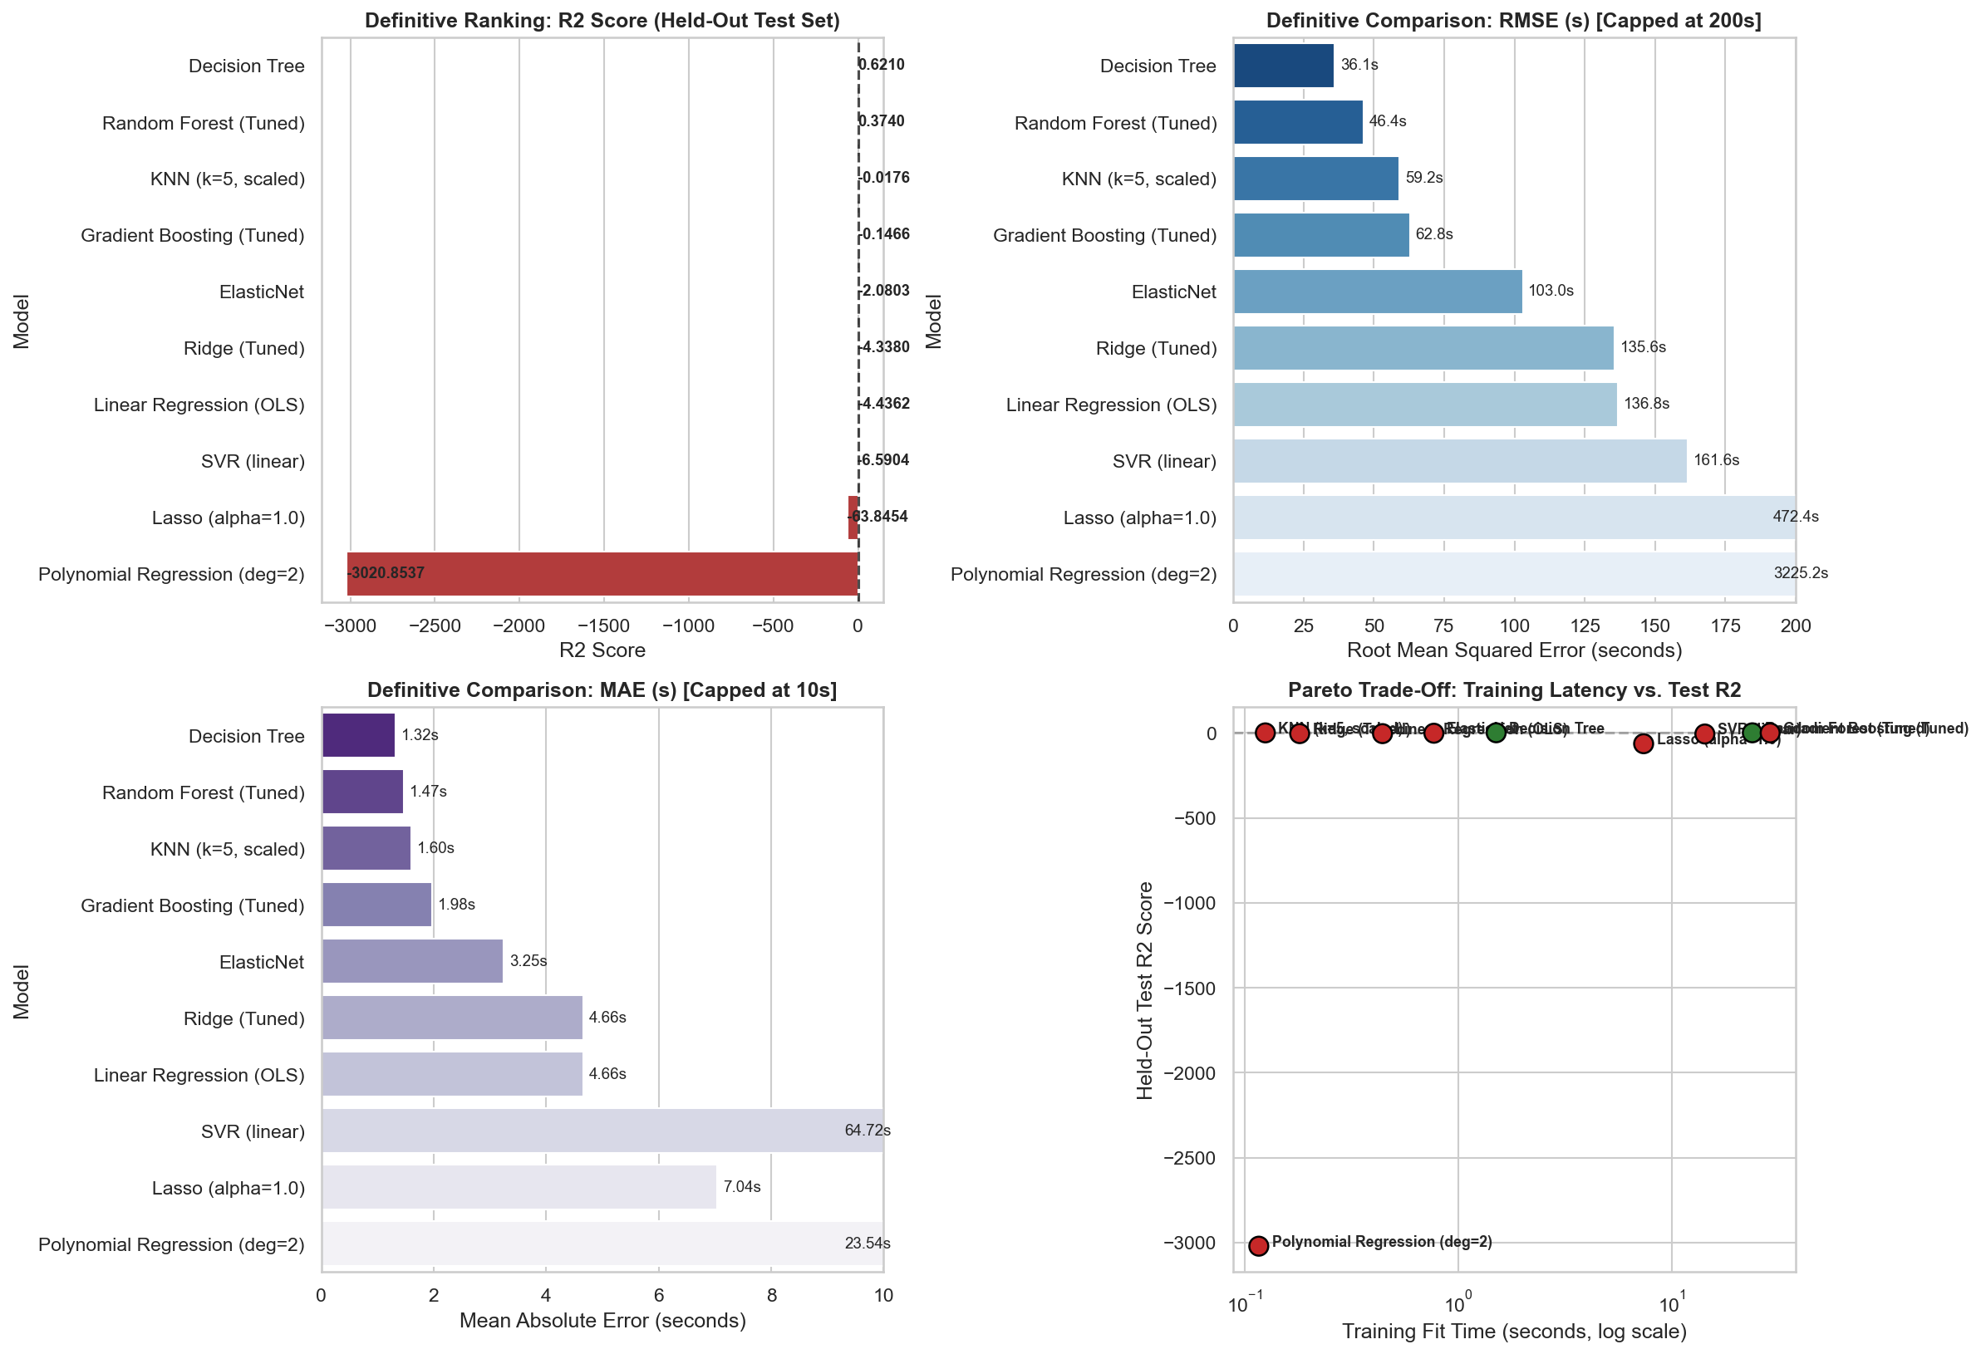
REGRESSION TRACK — NETWORK FLOW DURATION PREDICTION
Final Model Comparison & Ranking
Summary
FINAL RANKING (HELD-OUT TEST SET)
Model | R² | RMSE (s) | MAE (s)
Decision Tree | 0.6210 | 36.12 | 1.32
Random Forest (Tuned) | 0.3740 | 46.42 | 1.47
KNN (k=5, scaled) | -0.0176 | 59.18 | 1.60
Gradient Boosting (Tuned) | -0.1466 | 62.82 | 1.98
ElasticNet | -2.0803 | 102.97 | 3.25
Ridge (Tuned) | -4.3380 | 135.55 | 4.66
Linear Regression (OLS) | -4.4362 | 136.79 | 4.66
SVR (linear) | -6.5904 | 161.64 | 64.72
Lasso | -63.8454 | 472.45 | 7.04
Polynomial (deg=2) | -3020.85 | 3225.16 | 23.54
OBSERVATION
Decision Tree is the definitive top performer across the full regression benchmark — the only model with a strongly positive held-out R². Tuning meaningfully improved Random Forest (+0.0357 R²) but did not close the gap with the single tree. Formal cross-validated tuning did not help every model: tuned Ridge (α=0.1) actually underperforms its untuned baseline (α=1.0) on this held-out set, showing that CV improvement does not always generalize.
Actual output — regression.ipynb, definitive final ranking across all 10 models (R², RMSE, MAE, fit time)
Amrita Vishwa Vidyapeetham • ML Capstone Review 1
15 / 22

Slide 16
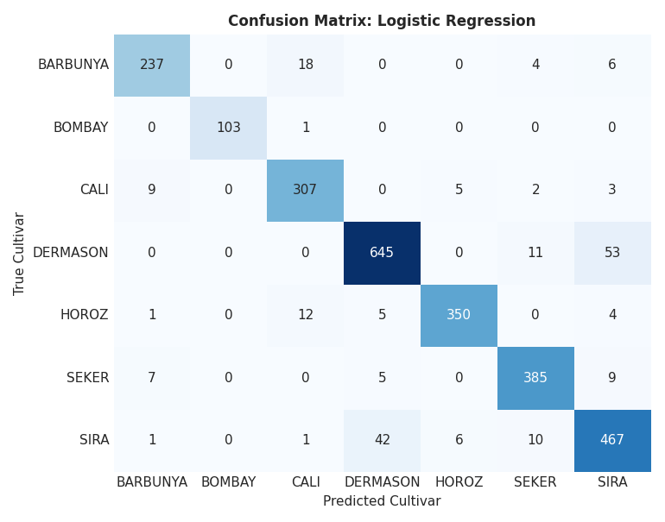
CLASSIFICATION TRACK — DRY BEAN VARIETY CLASSIFICATION
Logistic Regression
Classification 1/5
HOW IT WORKS
Multinomial Logistic Regression models the probability of each of the 7 bean cultivars using a softmax over linear combinations of standardized morphological features, producing linear decision boundaries between classes.
ACTUAL CONFIGURATION (from notebook)
• LogisticRegression(max_iter=1000, random_state=42)
• GridSearchCV(cv=3, stratified): C ∈ {0.1, 1.0, 10.0}
• Best param: C=10.0 (best CV accuracy = 0.9244)
• Preprocessing: StandardScaler fit on train only
HELD-OUT TEST PERFORMANCE
Accuracy | Precision (w) | Recall (w) | F1 (w) | F1 (macro) | ROC-AUC
0.9206 | 0.9213 | 0.9206 | 0.9208 | 0.9311 | 0.9936
OBSERVATION
Logistic Regression is a strong linear baseline, second only to SVM in test accuracy. Its near-perfect separation of BOMBAY (100% precision) reflects that variety's distinctly larger size, while most confusion is between SIRA and DERMASON.
Actual output — classification.ipynb, held-out test confusion matrix
Amrita Vishwa Vidyapeetham • ML Capstone Review 1
16 / 22

Slide 17
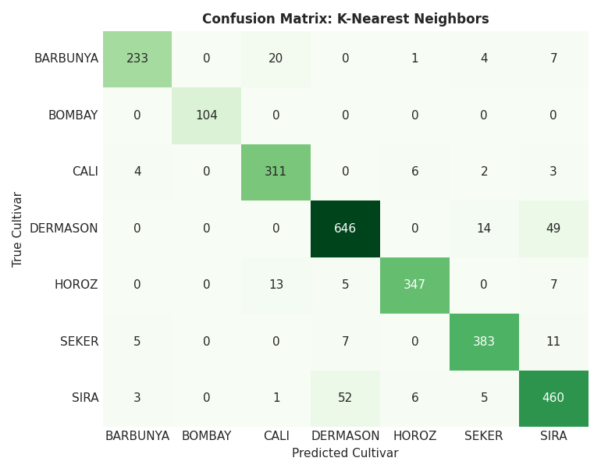
CLASSIFICATION TRACK — DRY BEAN VARIETY CLASSIFICATION
K-Nearest Neighbors (KNN)
Classification 2/5
HOW IT WORKS
KNN classifies each bean by majority vote among its k nearest neighbors in standardized feature space, based on Euclidean distance across all 17 features.
ACTUAL CONFIGURATION (from notebook)
• KNeighborsClassifier()
• GridSearchCV(cv=3, stratified): n_neighbors ∈ {3,5,7,9,11,13}
• Best param: n_neighbors=13 (best CV accuracy = 0.9232)
• Preprocessing: StandardScaler fit on train only
HELD-OUT TEST PERFORMANCE
Accuracy | Precision (w) | Recall (w) | F1 (w) | F1 (macro) | ROC-AUC
0.9169 | 0.9177 | 0.9169 | 0.9171 | 0.9293 | 0.9880
OBSERVATION
k=13 balances bias and variance best under cross-validation. KNN resolves compact clusters like SEKER cleanly, with most remaining errors concentrated where SIRA and DERMASON densities overlap.
Actual output — classification.ipynb, held-out test confusion matrix
Amrita Vishwa Vidyapeetham • ML Capstone Review 1
17 / 22

Slide 18
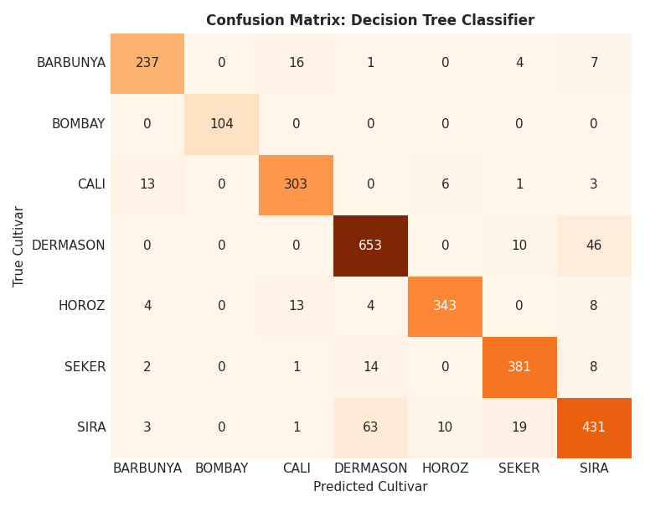
CLASSIFICATION TRACK — DRY BEAN VARIETY CLASSIFICATION
Decision Tree Classifier
Classification 3/5
HOW IT WORKS
A decision tree classifier recursively splits the feature space along single-feature thresholds, choosing splits that maximize Gini impurity reduction at each node, producing an interpretable set of if/then rules.
ACTUAL CONFIGURATION (from notebook)
• DecisionTreeClassifier(random_state=42)
• GridSearchCV(cv=3, stratified): max_depth ∈ {6,8,10,12,None}, min_samples_split ∈ {2,5,10}
• Best params: max_depth=12, min_samples_split=10 (best CV accuracy = 0.9055)
• No feature scaling required (tree-based)
HELD-OUT TEST PERFORMANCE
Accuracy | Precision (w) | Recall (w) | F1 (w) | F1 (macro) | ROC-AUC
0.9051 | 0.9051 | 0.9051 | 0.9049 | 0.9187 | 0.9629
OBSERVATION
Decision Tree is the weakest of the five classifiers, though still above 90% accuracy. Its axis-aligned splits struggle with diagonal covariance between features like Area and Perimeter, but the tree remains fully interpretable.
Actual output — classification.ipynb, held-out test confusion matrix
Amrita Vishwa Vidyapeetham • ML Capstone Review 1
18 / 22

Slide 19
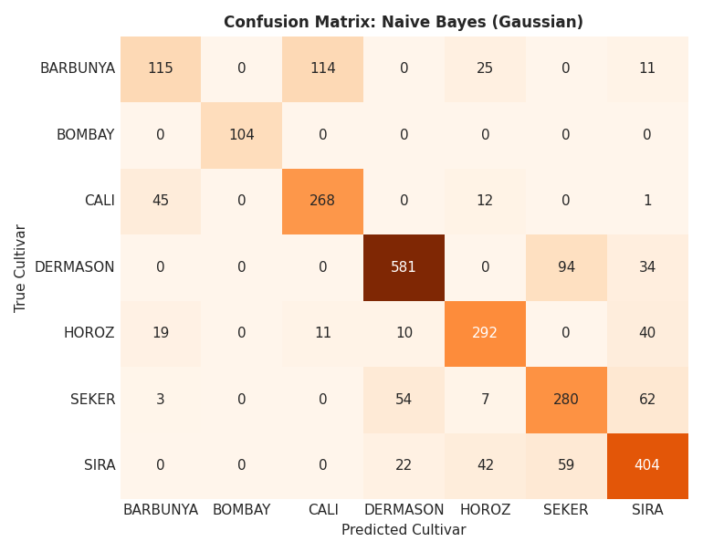
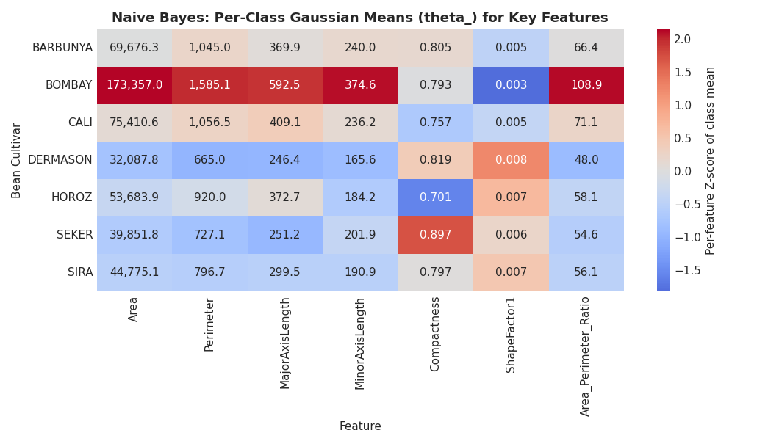
CLASSIFICATION TRACK — DRY BEAN VARIETY CLASSIFICATION
Naive Bayes (Gaussian)
Classification 4/5
HOW IT WORKS
Gaussian Naive Bayes applies Bayes' theorem under the “naive” assumption that all features are conditionally independent given the class. It fits an independent 1-D Gaussian per feature per class, then picks the class with the highest posterior probability.
ACTUAL CONFIGURATION (from notebook)
• GaussianNB() — default parameters (var_smoothing=1e-9)
• No hyperparameter search required per capstone guidelines for this model
• Trained on raw (unscaled) features — per-feature scaling does not change GaussianNB's decision boundary
HELD-OUT TEST PERFORMANCE
Accuracy | Precision (w) | Recall (w) | F1 (w) | F1 (macro) | ROC-AUC
0.7545 | 0.7556 | 0.7545 | 0.7521 | 0.7571 | 0.9622
OBSERVATION
Naive Bayes is the weakest of the five Part-A classifiers because its independence assumption is strongly violated — several size features correlate at r ≥ 0.95 (Section 6). It still reaches a respectable ROC-AUC (0.9622), but double-counting correlated evidence drags accuracy down to 75.45%, with heavy confusion between BARBUNYA and CALI.
Actual output — classification.ipynb, confusion matrix (top) and per-class Gaussian means theta_ (bottom)
Amrita Vishwa Vidyapeetham • ML Capstone Review 1
19 / 22

Slide 20
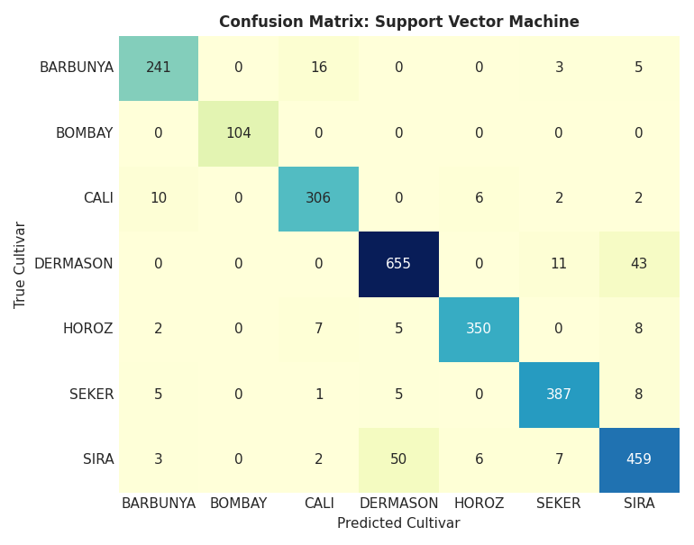
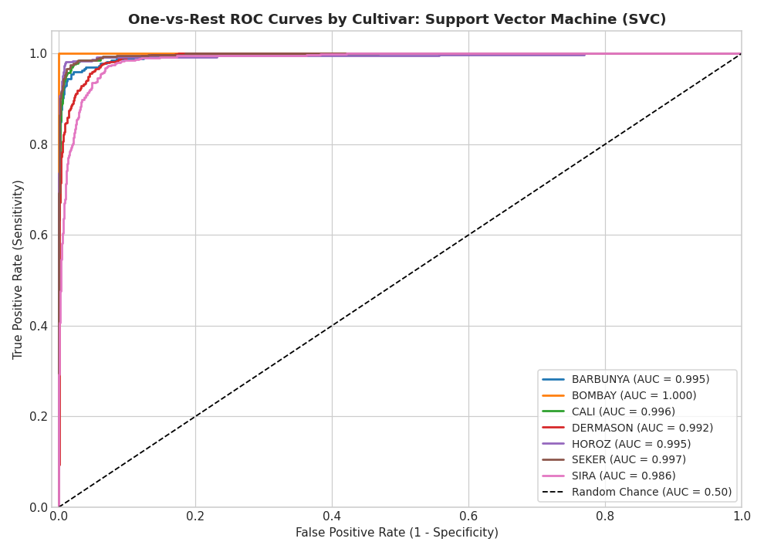
CLASSIFICATION TRACK — DRY BEAN VARIETY CLASSIFICATION
Support Vector Machine (SVM)
Classification 5/5
HOW IT WORKS
Support Vector Machine finds the hyperplane that maximizes the margin between classes; with the RBF kernel, it implicitly maps features into a higher-dimensional space where curved class boundaries become linearly separable.
ACTUAL CONFIGURATION (from notebook)
• SVC(probability=True, random_state=42)
• GridSearchCV(cv=3, stratified): C ∈ {1,10}, kernel ∈ {linear, rbf}
• Best params: C=10, kernel='rbf' (best CV accuracy = 0.9322)
• Preprocessing: StandardScaler fit on train only
HELD-OUT TEST PERFORMANCE
Accuracy | Precision (w) | Recall (w) | F1 (w) | F1 (macro) | ROC-AUC
0.9236 | 0.9237 | 0.9236 | 0.9236 | 0.9345 | 0.9931
OBSERVATION
SVM with an RBF kernel is the best-performing model in the classification track on every metric. The non-linear kernel resolves curved overlap between SIRA and DERMASON better than any linear model.
Actual output — classification.ipynb, confusion matrix (top) and one-vs-rest ROC curves (bottom)
Amrita Vishwa Vidyapeetham • ML Capstone Review 1
20 / 22

Slide 21
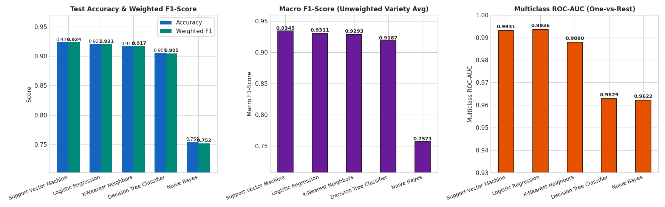
CLASSIFICATION TRACK — DRY BEAN VARIETY CLASSIFICATION
Final Model Comparison & Ranking
Summary
FINAL RANKING (HELD-OUT TEST SET)
Model | Accuracy | F1 (w) | F1 (macro) | ROC-AUC
SVM (RBF, C=10) | 0.9236 | 0.9236 | 0.9345 | 0.9931
Logistic Regression | 0.9206 | 0.9208 | 0.9311 | 0.9936
KNN (k=13) | 0.9169 | 0.9171 | 0.9293 | 0.9880
Decision Tree | 0.9051 | 0.9049 | 0.9187 | 0.9629
Naive Bayes (Gaussian) | 0.7545 | 0.7521 | 0.7571 | 0.9622
OBSERVATION
Four of the five Part-A classifiers exceed 90% test accuracy, confirming that morphological features are highly discriminative for cultivar identification. SVM with an RBF kernel is the best overall performer on accuracy, weighted F1 and macro F1, narrowly ahead of Logistic Regression's strong linear baseline. Naive Bayes trails substantially (75.45%) because its conditional-independence assumption is violated by highly correlated size features — though it still posts a strong 0.9622 ROC-AUC, showing its class ranking stays reasonable even as its calibrated accuracy suffers.
Actual output — classification.ipynb, comparative accuracy/F1/ROC-AUC across all 5 Part-A models
Amrita Vishwa Vidyapeetham • ML Capstone Review 1
21 / 22

Slide 22
CONCLUSION
Key Takeaways
Summary
REGRESSION TRACK
CLASSIFICATION TRACK
BEST MODEL
BEST MODEL
Decision Tree Regressor — R² = 0.6210, RMSE = 36.12 s, MAE = 1.32 s (the only baseline with a strongly positive test R²).
Support Vector Machine (RBF, C=10) — Accuracy = 92.36%, Macro F1 = 0.9345, ROC-AUC = 0.9931 — best on every reported metric.
WHY IT WINS
WHY IT WINS
flow_duration is extremely right-skewed (skew = 128.39) and piecewise in nature; recursive partitioning matches this far better than any linear, regularized, or margin-based model.
The RBF kernel resolves curved, overlapping boundaries between visually similar cultivars (SIRA vs. DERMASON) better than a linear decision surface.
ENSEMBLES
OVERALL TIER
Tuned Random Forest is the best ensemble (R² = 0.3740) but leaf-averaging smooths rare, extreme-duration outliers, keeping it behind a single tree.
4 of 5 Part-A classifiers exceed 90% test accuracy — morphological features (area, perimeter, shape factors) are highly discriminative for this task.
LINEAR MODELS
WEAKEST MODEL
OLS, Ridge, Lasso, ElasticNet and linear SVR all post negative R² — the packet-volume-to-duration relationship is fundamentally non-linear.
Naive Bayes (Gaussian) trails at 75.45% accuracy — its independence assumption is violated by size features correlated at r ≥ 0.95, though it still reaches a strong 0.9622 ROC-AUC.
CLASS IMBALANCE
BOMBAY (3.9% of data) is classified near-perfectly by every model due to its distinctly larger size; confusion concentrates in SIRA vs. DERMASON.
Both tracks followed a leakage-free, single held-out-evaluation protocol with cross-validated hyperparameter tuning — results here are reproducible end to end.
Amrita Vishwa Vidyapeetham • ML Capstone Review 1
22 / 22

