Slide 1




CareCue: Your Intelligent Health Companion
Empowering Your Health Journey
Team Members:
NANDIKONDA LIKHITH REDDY
PREM KUMAR BAJARU
BHARATH VEGGALAM

Slide 2

Agenda
Abstract
Technologies Utilized
Detailed Feature Presentation
Future Enhancements
Conclusion

Slide 3



Problem Statement
Many people struggle to find clear and reliable healthcare information. Our project, the CareCue Health Companion, aims to make it easier. We're creating a website that's easy to use and packed with helpful features like MediScan for understanding medicine, a friendly chatbot, a voice assistant, and updates on health news. Our goal is to help everyone make better decisions about their health.

Slide 4

Abstract
CareCue is an AI-driven healthcare website that aims to redefine user well-being by integrating cutting-edge features for a comprehensive healthcare experience. The problem it addresses is the need for a more informed, personalised, and efficient approach to managing health.
The primary goal of CareCue is to empower users to manage their health effectively. It aims to provide instant access to medication details, locate nearby hospitals, offer personalised interactions through a healthcare chatbot and voice assistant, and keep users updated with curated health tips and news.

Slide 5









Technologies Utilized
Frontend Development: HTML, CSS, JavaScript (JS)
Backend Development: Python with Flask framework
Integration:
APIs: News API for health-related news retrieval, OpenAI API for advanced natural language processing capabilities
OpenCV: Utilized for medicine image classification
Symptom-based Chat: Implemented using decision tree algorithm
Data Handling: JSON and CSV files for dataset management

Slide 6

Overview of Features
1. Health Care News
NEWS
API
BACKEND
FLASK
FRONTEND
HTML/CSS
Features:
For every 30 Seconds New News
User Friendly Design
Only health related News

Slide 7

2. Mediscan
JSON
MEDICINE DATA
MEDICINE NAME
BACKEND
FLASK
FRONTEND
HTML/CSS
MEDICINE
IMAGE
IMAGE CLASSIFICATION
OPENCV
Features:
Get the Uses and Side Effects
Created our own dataset for 70+ medicines
Trained a image classification model.

Slide 8

3. CareCue Chatbot
NORMAL CHAT
BASIC HEALTH CHAT DATASET
SYMPTOM
CHAT
TRAINED
ML MODEL
BACKEND
FLASK
FRONTEND
HTML/CSS
OPENAI
CHAT
OPENAI
API
Features:
User friendly Design
Get Detailed Symptom Report
Ask any Health Related Information

Slide 9

4. Voice Assistant
NO API
BASIC HEALTH CHAT DATASET
VOICE
INPUT
SPEECH TO TEXT
TEXT TO SPEECH
API
TEXT TO QUERY FOR
OPENAI API
Features:
User friendly Design
Voice based Interaction
Quick Response

Slide 10
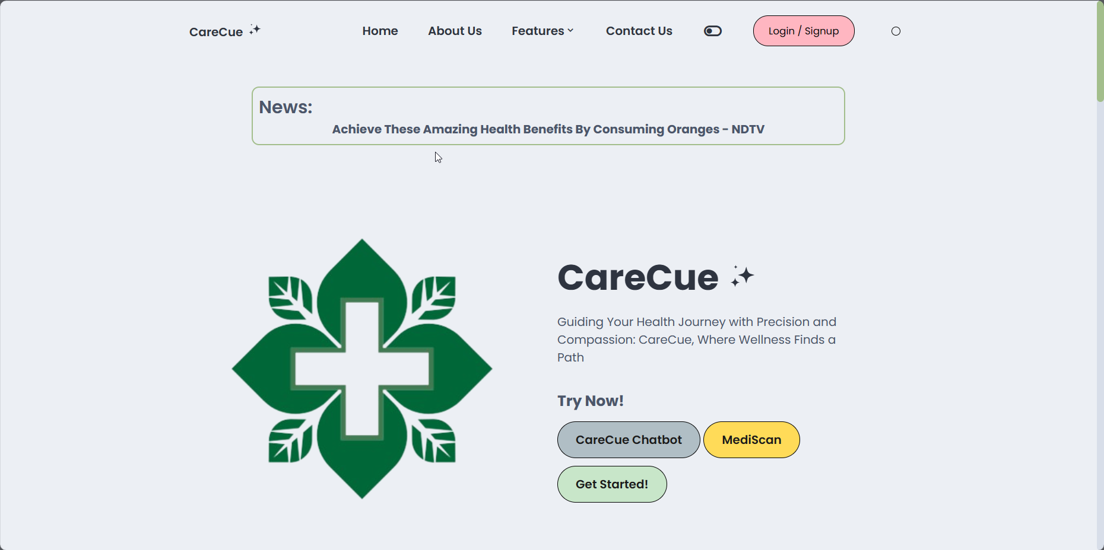
CareCue Website

Slide 11

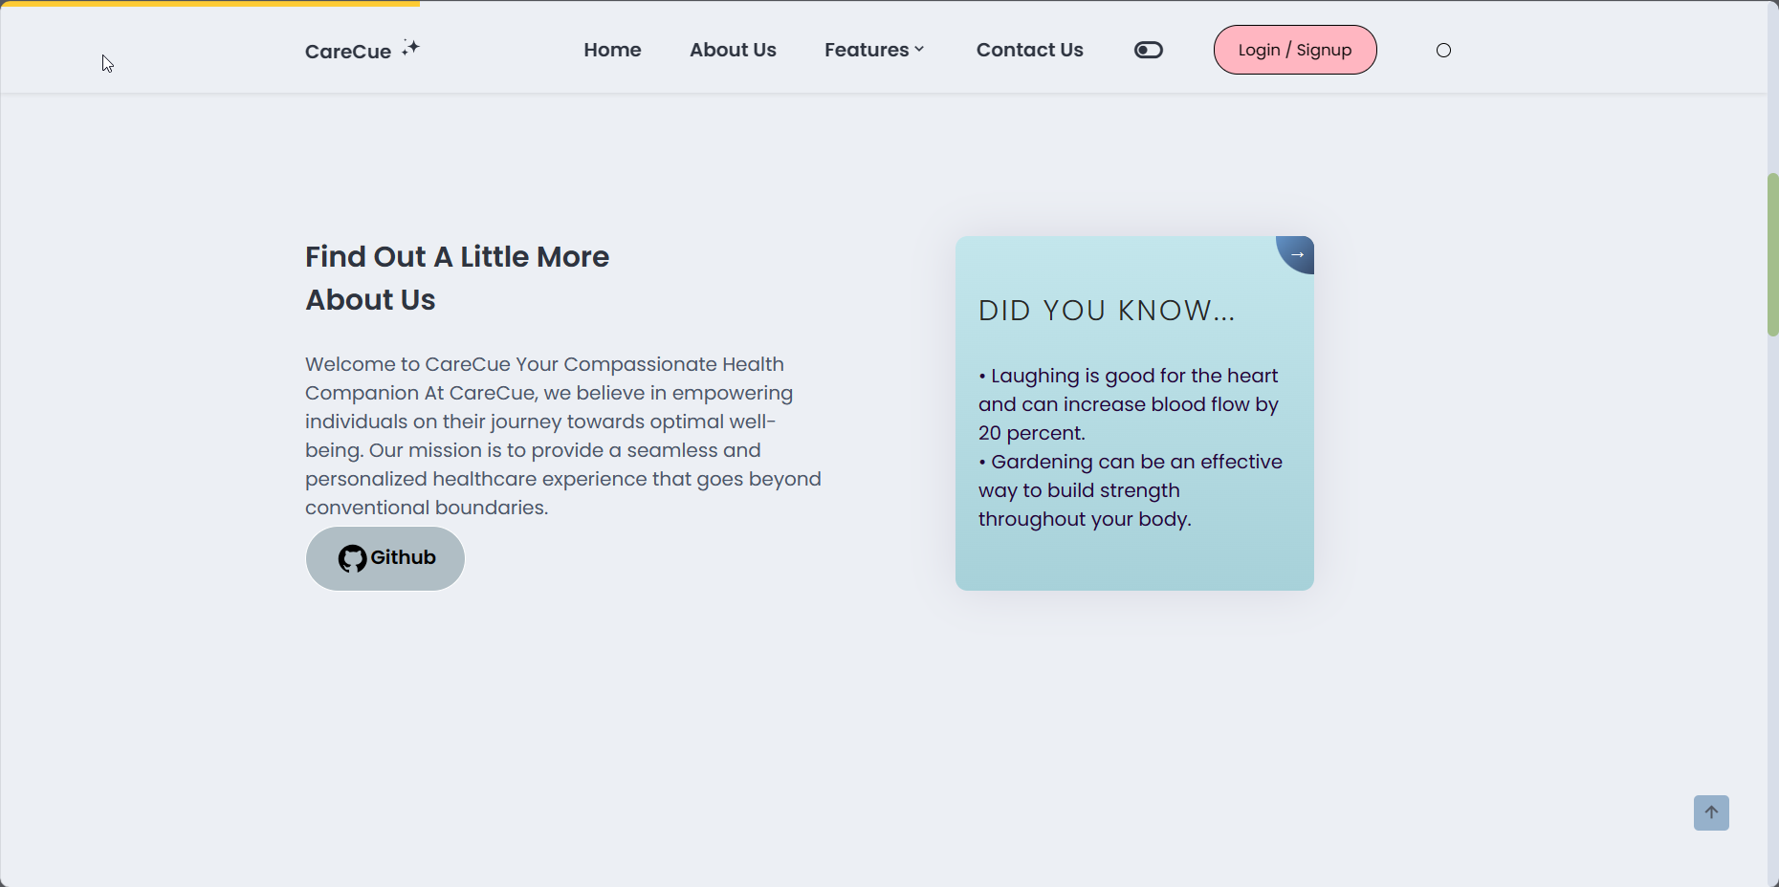

CareCue Website

Slide 12
Future Enhancements
Develop an App
We are also considering the implementation of CareCue App. This upcoming app will provide you with effortless access to all our features directly from your smartphone or tablet.
Multiple Languages Support
We're thrilled to announce our next big step in breaking down language barriers. Our platform is gearing up to support multiple languages, ensuring accessibility for a global audience.
Nearby Hospital Locations
We are also considering the implementation of Nearby Hospital Locations get your Nearby Hospital Locations based on your place.

Slide 13
Future Enhancements
Emotion-Based Chat
As part of our roadmap for future improvements, we are excited to announce our plans to implement an Emotion-Based Chat feature. This innovative addition will allow our chatbot to dynamically adjust its responses based on the user's emotional state, fostering more empathetic and personalized interactions.
Eye Sight Prediction
we are also considering the implementation of an Eye Sight Prediction feature. This feature aims to leverage technology to provide users with valuable insights into their eye health by conducting various tests to assess their vision and offering relevant information and recommendations based on the results.

Slide 14
Conclusion
In summary, CareCue serves as a beacon of innovation in healthcare, utilizing cutting-edge AI technology to provide personalized and compassionate companion care. By harnessing the power of artificial intelligence, CareCue enhances the healthcare experience for individuals, offering support, guidance, and companionship tailored to their unique needs. With CareCue, the future of healthcare is not only smarter but also more empathetic and accessible, paving the way for a healthier and happier society.

Slide 15
THANK YOU

