Slide 1
TABLEAU DASHBOARD
Data Analytics Project By Pavithra L

Slide 2

Introduction
Manufacturing Defects Dashboard – 2024
This project presents a detailed analysis of manufacturing defects recorded in 2024. The study focuses on understanding the types of defects, their severity, associated repair costs, monthly trends, and the effectiveness of different inspection methods.

Slide 3

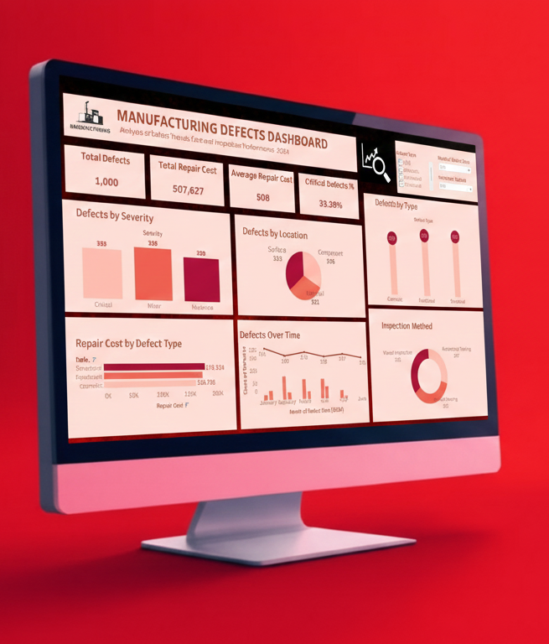
Project Objectives
Identify defect types and severity levels
Measure repair cost impact
Study monthly defect trends
Evaluate performance of inspection methods
Provide data-driven recommendations
Notes:
The main objective of this project is to get a complete quality overview of the manufacturing process. I wanted to understand what types of defects occur, their severity, cost impact, and how trends change over months. It also helps identify which inspection method works best and what improvements can be recommended.

Slide 4
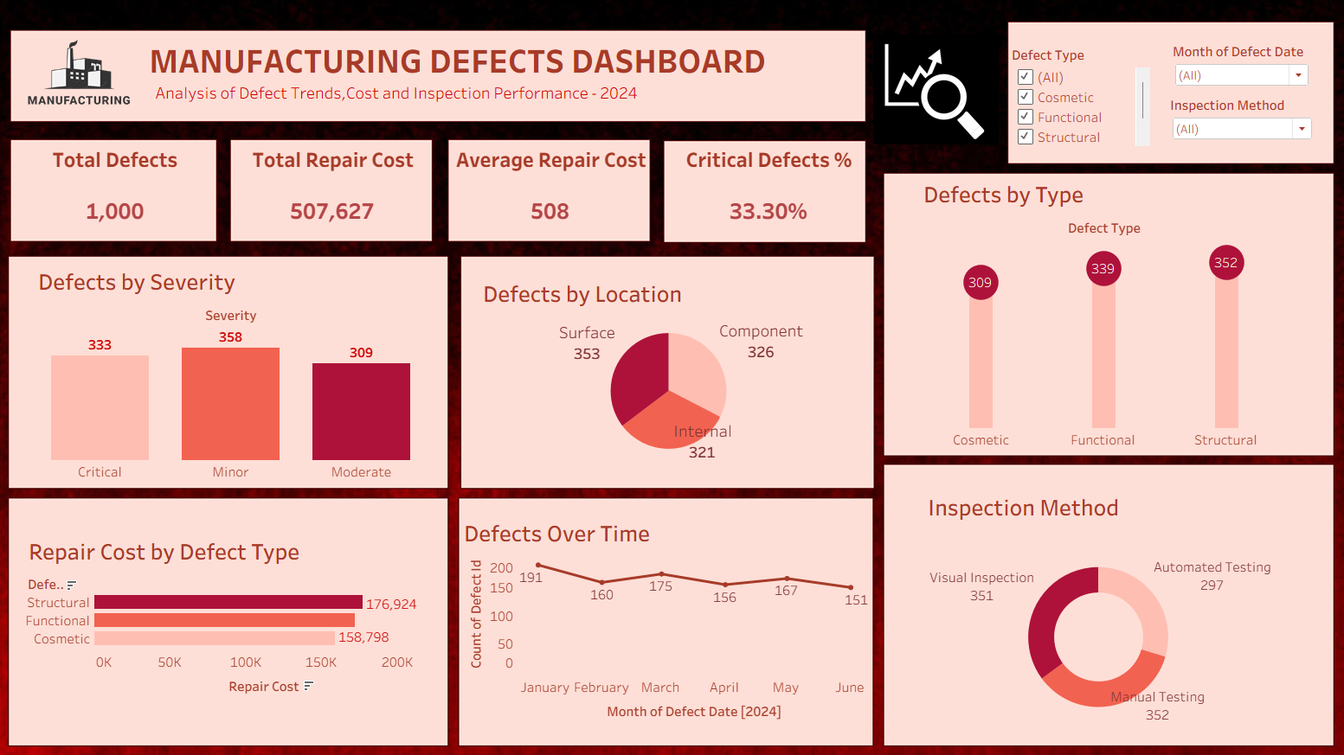

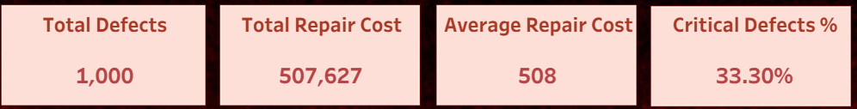
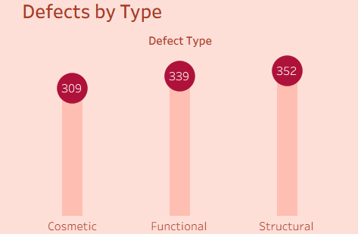
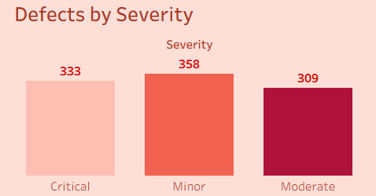
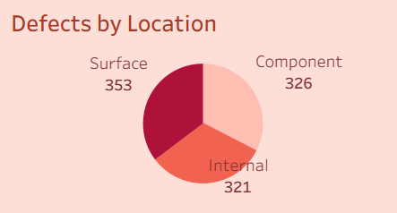
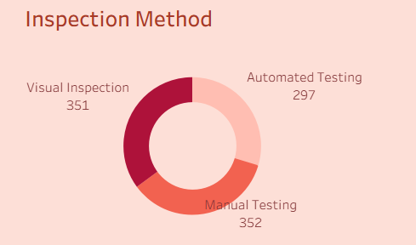
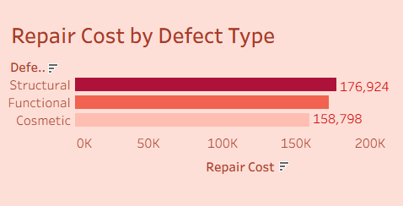
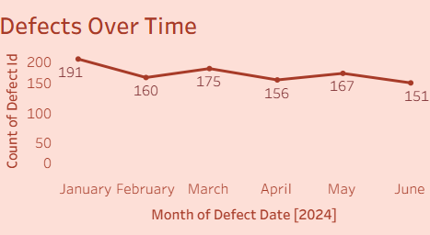
Notes:
This slide shows the full dashboard I created. It includes KPIs, bar charts, line charts, and distribution charts. The layout is designed to quickly highlight defects, costs, and trends. Management can use this dashboard for monitoring and decision-making

Slide 5
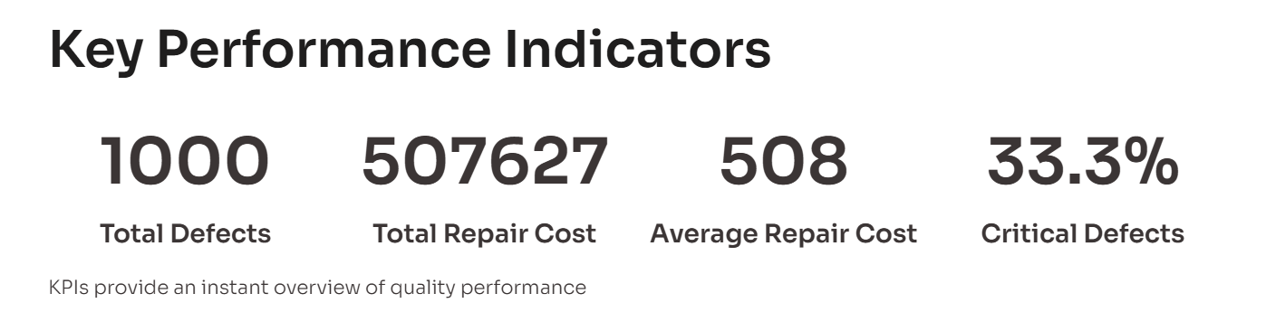
Notes:
These KPIs give a quick summary of the dataset: We have 1000 total defects. The total repair cost is 507,627 and the average repair cost per defect is 508. Critical defects make up 33.3% of total defects, which is a major concern for product quality

Slide 6
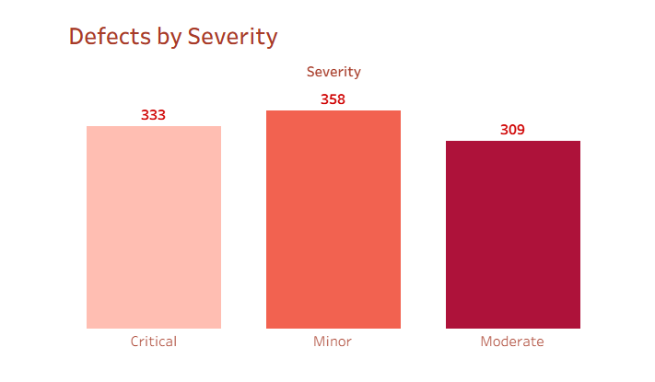
Insight: Minor issues occur frequently, pointing to smaller process-level mistakes. But a high number of critical issues still indicates safety concerns.
Notes:
In this chart, minor defects are the highest at 358. However, critical defects are also very high at 333 — which indicates high risk and immediate attention. Moderate defects are slightly lower. Severity analysis helps understand where quality issues are more serious.

Slide 7
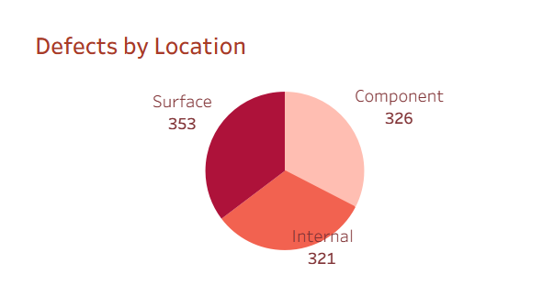
Insight: Surface defects dominate → problems in finishing, polishing, coating, handling, or packaging.
Notes:
In this chart, surface defects are the highest at 353. This may indicate issues in handling, finishing, polishing, or packaging stages. Component and internal defects are slightly lower but still significant. Location analysis helps find where the manufacturing process needs improvement.

Slide 8
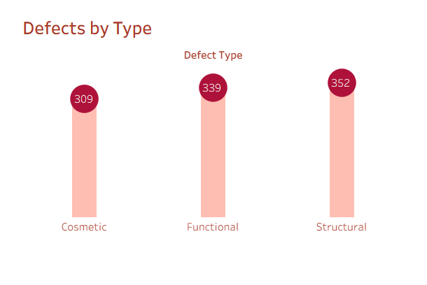
Insight: Structural defects are the most severe and most costly → root-cause analysis required.
Notes:
Structural defects are the highest at 352. Structural issues usually cost more to repair and can affect product safety. Functional defects come next, followed by cosmetic defects. This helps prioritize which defect types need urgent action

Slide 9
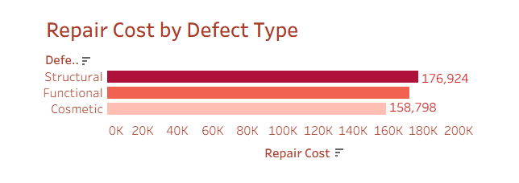
Insight: Structural defects have the worst financial impact. Cost saving is possible by reducing structural problems first.
Notes:
Repair cost is also highest for structural defects, which matches the previous slide. This means reducing structural issues can save a lot of money. Functional defects have moderate cost and cosmetic defects have the lowest. This slide shows how defect type affects financial impact.”

Slide 10
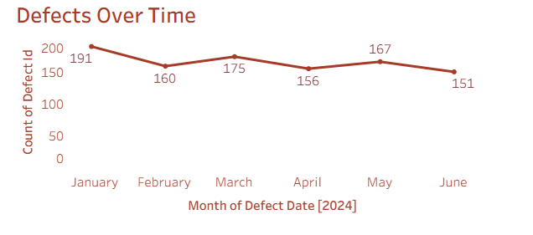
Insight: Defects show a downward trend → consistent improvement in production
quality.January 191 to june 151
Notes:
From January to June, the number of defects consistently reduces from 191 to 151. This is a positive trend showing that quality control measures are working. Time-series analysis helps management track improvement over months.

Slide 11
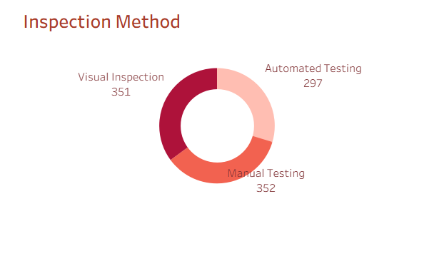
Insight: Manual and visual methods capture more defects. Automation is useful but needs enhancement to detect complex defects.
Notes:
Manual and visual inspections have almost equal defect counts. However, automated inspection shows the lowest defects — only 297. This means automation is more reliable and has less human error. The company can consider increasing automated inspection.

Slide 12
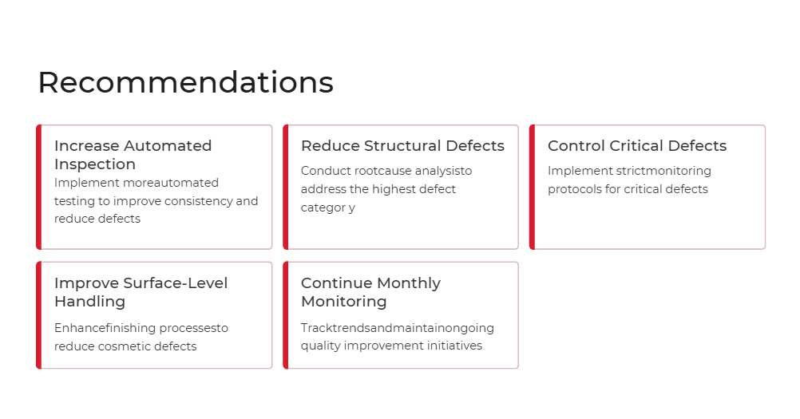
Notes:
Based on the findings, I recommend increasing automated inspection, focusing on structural defect reduction, and performing root cause analysis on critical defects. Surface-level handling and finishing should be improved. Monthly monitoring should continue to maintain quality improvements.

Slide 13

Conclusion
360° Quality View
Dashboard provides a comprehensive view of manufacturing quality
Cost Reduction
Supports cost reduction and quality improvement initiatives
Data-Driven Decisions
Helps management with clear, data-driven decisions
Better Efficiency
Ensures better efficiency and fewer defects
Notes:
In conclusion, this dashboard provides a complete 360-degree view of manufacturing quality. It helps the company reduce defects, control repair cost, and improve product quality. The insights support data-driven decision-making for manufacturing management. Thank you!

Slide 14
Thank you

