Slide 1

Student details: NAME :beri likhitha sriniveda EMAIL :likhitha681@gmail.com college :Aditya college of engineering and technology state : andhrapradesh internship : artificial intelligence project title: employment burnout analysis

Slide 2
PROJECT ON EMPLOYEES BURNOUT ANALYSIS AND PREDICTION

Slide 3
EMPLOYEES BURNOUT ANALYSIS AND PREDICTION Occupational burnout is intertwined with individual, cultural, and social factors, the resolution of which requires methods that can deal with large amounts of data. Through machine learning techniques, new theoretical models of burnout can be created. Applying machine learning methods in reducing burnout can also provide socio-economic benefits such as help to reduce employee turnover and improve general working conditions. Applying machine learning to data from various source might help to identify and predict burnout in workers. The results obtained with these methods can be more accurate because they provide more techniques to examine non-linear relationships in the data than traditional statistical techniques.

Slide 4
AGENDA
the Employee burnout is a complex issue that requires a multi-faceted approach for effective resolution. The following solutions can help organizations address and mitigate employee burnout:
Using import dataset
Perform EDA(Exploratory Data analysis)
Use PCA(Principal Component Analysis)
Implement Regression Supervised Algorithm

Slide 5
PROJECT OVERVIEW The analysis begins by defining employee burnout and highlighting its prevalence in today's workforce. It explores various causes of burnout, including excessive workload, lack of control, inadequate support, and work-life imbalance. These factors contribute to employees feeling overwhelmed and drained, leading to burnout. Recognizing the signs and symptoms of burnout is crucial for early intervention. The presentation provides a comprehensive list of indicators, encompassing physical, emotional, and behavioral aspects. By being aware of these signs, managers and colleagues can identify burnout in their team members and offer appropriate support. Employee burnout has severe consequences for individuals. It diminishes productivity, job satisfaction, and overall well-being. Moreover, it can have long-term effects on mental and physical health.

Slide 6
WHO ARE THE END USERS?
In the context of an employee burnout analysis, the end users can vary depending on the purpose and scope of the analysis. Here are some potential end users who may benefit from the findings and recommendations Organizational Leaders and Managers, Human Resources Professionals, Employee Assistance Program (EAP) Providers, Occupational Health and Safety Professionals, Employees and Employee Representatives.

Slide 7
SOLUTION AND PRESENTATION
Organizations should tailor the solutions to their specific context and continuously evaluate and adapt their strategies based on employee feedback and changing needs. By prioritizing employee well-being and actively addressing burnout, organizations can create a healthier and more productive work environment. Review and revise policies that contribute to burnout, such as excessive overtime expectations or limited time off.Encourage policies that support work-life integration, flexibility, and employee well-being.Educate employees about the importance of self-care, stress management, and maintaining a healthy work-life balance.Promote regular exercise, healthy eating, and adequate sleep to support overall well-being.

Slide 8
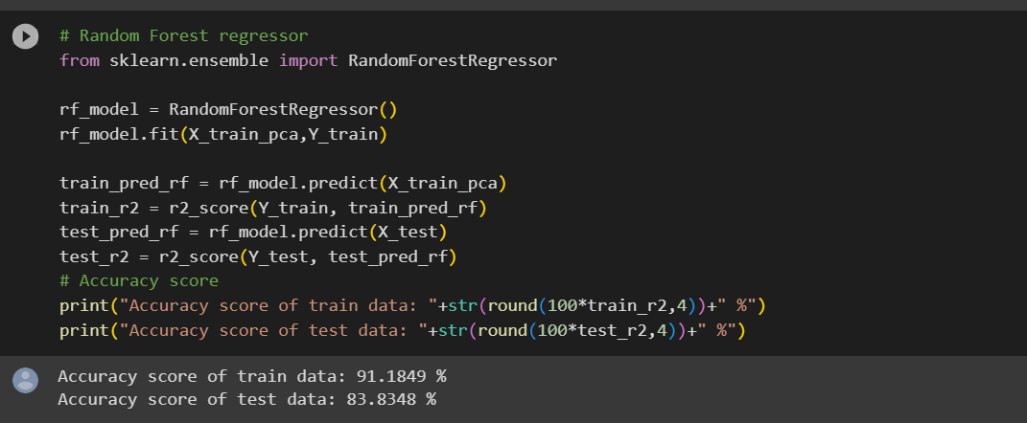
MODELLING
Flexibility
Remote management
Real-time notifications
Improved security
Convenient digital communication
Cost and time savings
Scalability
Data and analytics

Slide 9
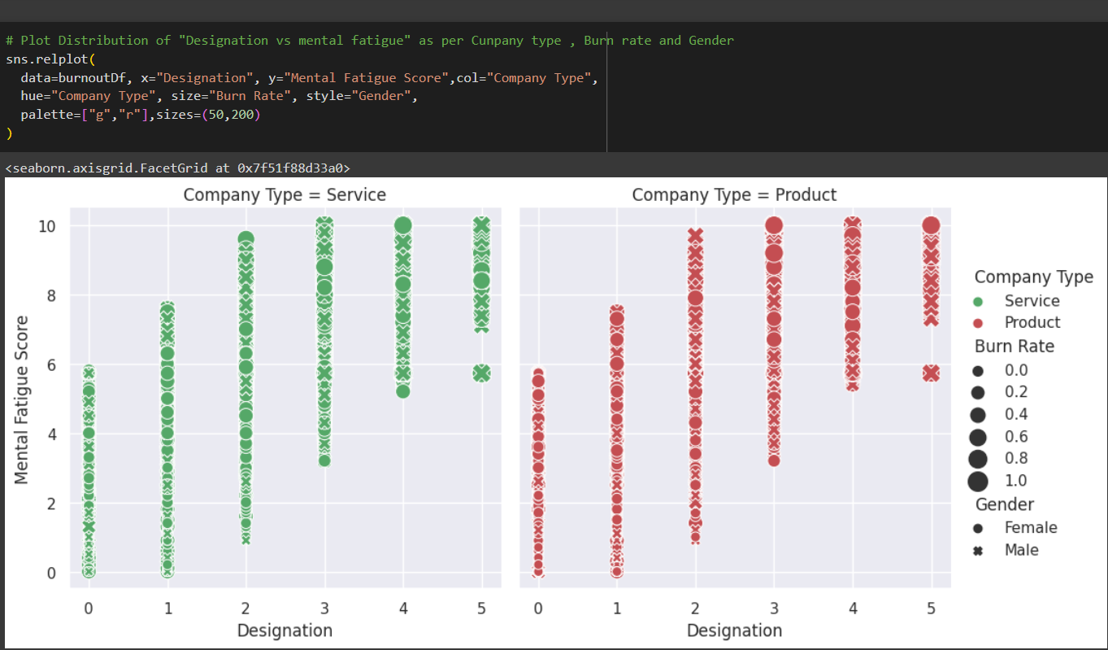
MODELLING
Screenshots of code/graphs/UI/techniques/frameworks

Slide 10
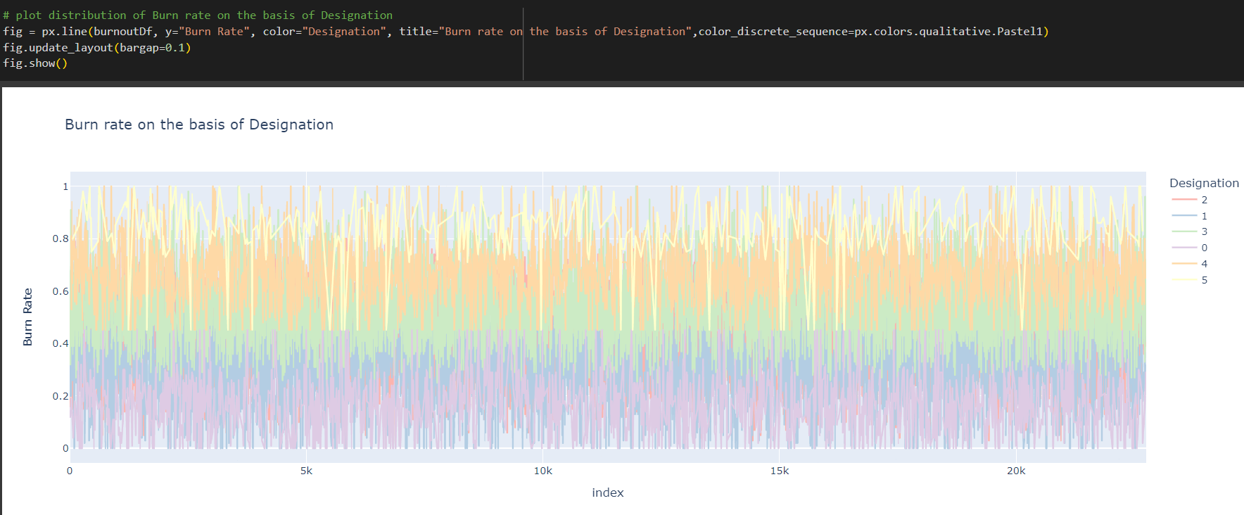

Slide 11
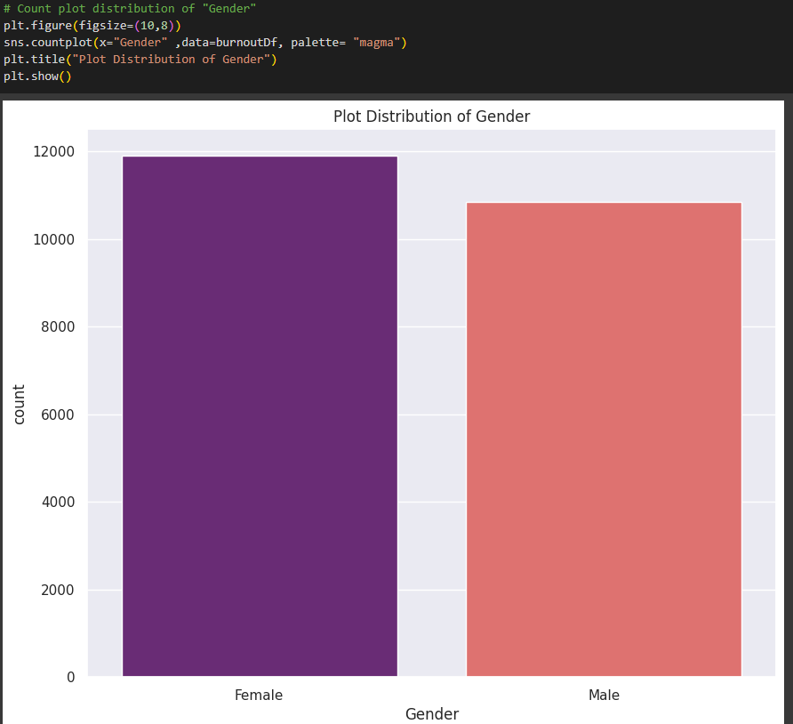

Slide 12
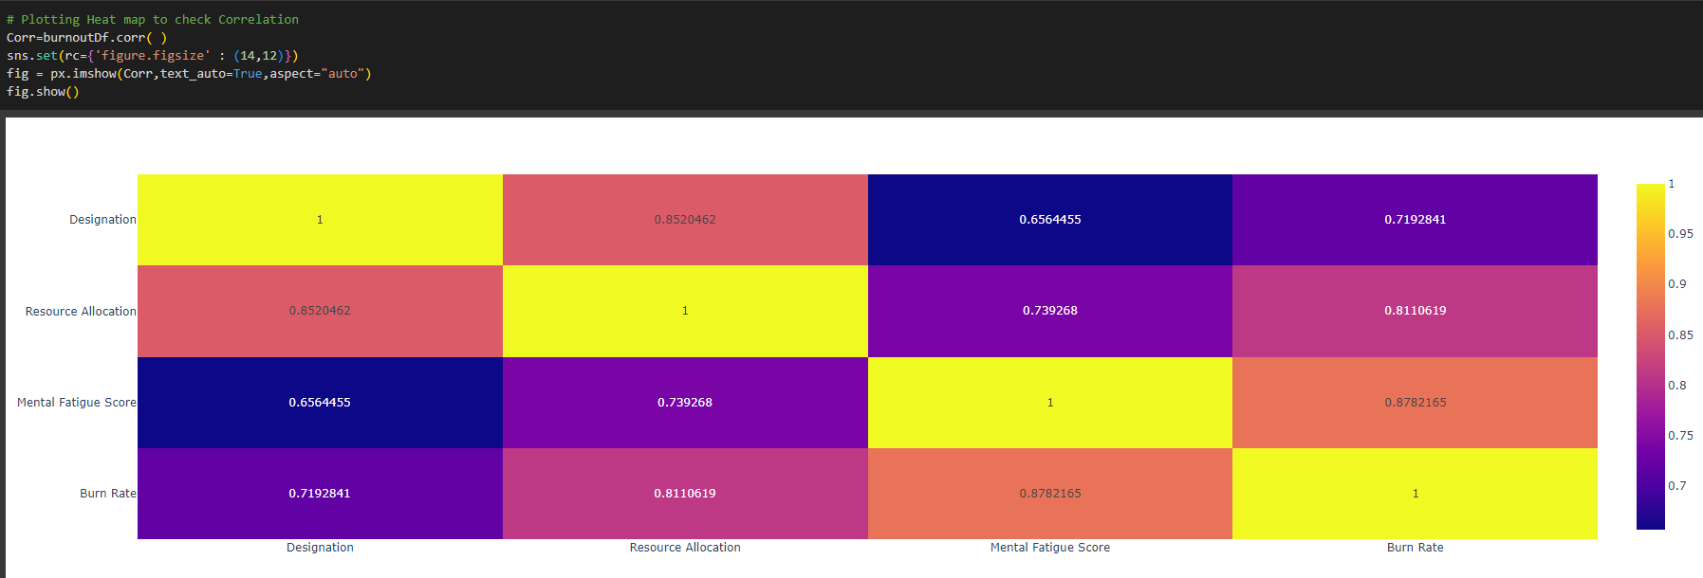

Slide 13
RESULTS
Through surveys, interviews, or other data collection methods, the analysis can provide insights into the current burnout levels within the organization. This information can be quantified and used as a benchmark to track progress over time. The analysis can assess the effectiveness of existing programs or interventions aimed at reducing burnout. This evaluation can provide insights into areas of improvement and guide the development of more targeted and impactful initiatives.the results and predictions of an employee burnout analysis should be treated as informed assessments rather than definitive outcomes. The complex nature of burnout and individual differences make it challenging to predict with absolute certainty. Nevertheless, a well-executed analysis can provide valuable insights and guide evidence-based interventions to support employee well-being and reduce burnout.

Slide 14
Github project link:
https://github.com/likhitha0416/ai--internship

Slide 15
THANK YOU

