Slide 1
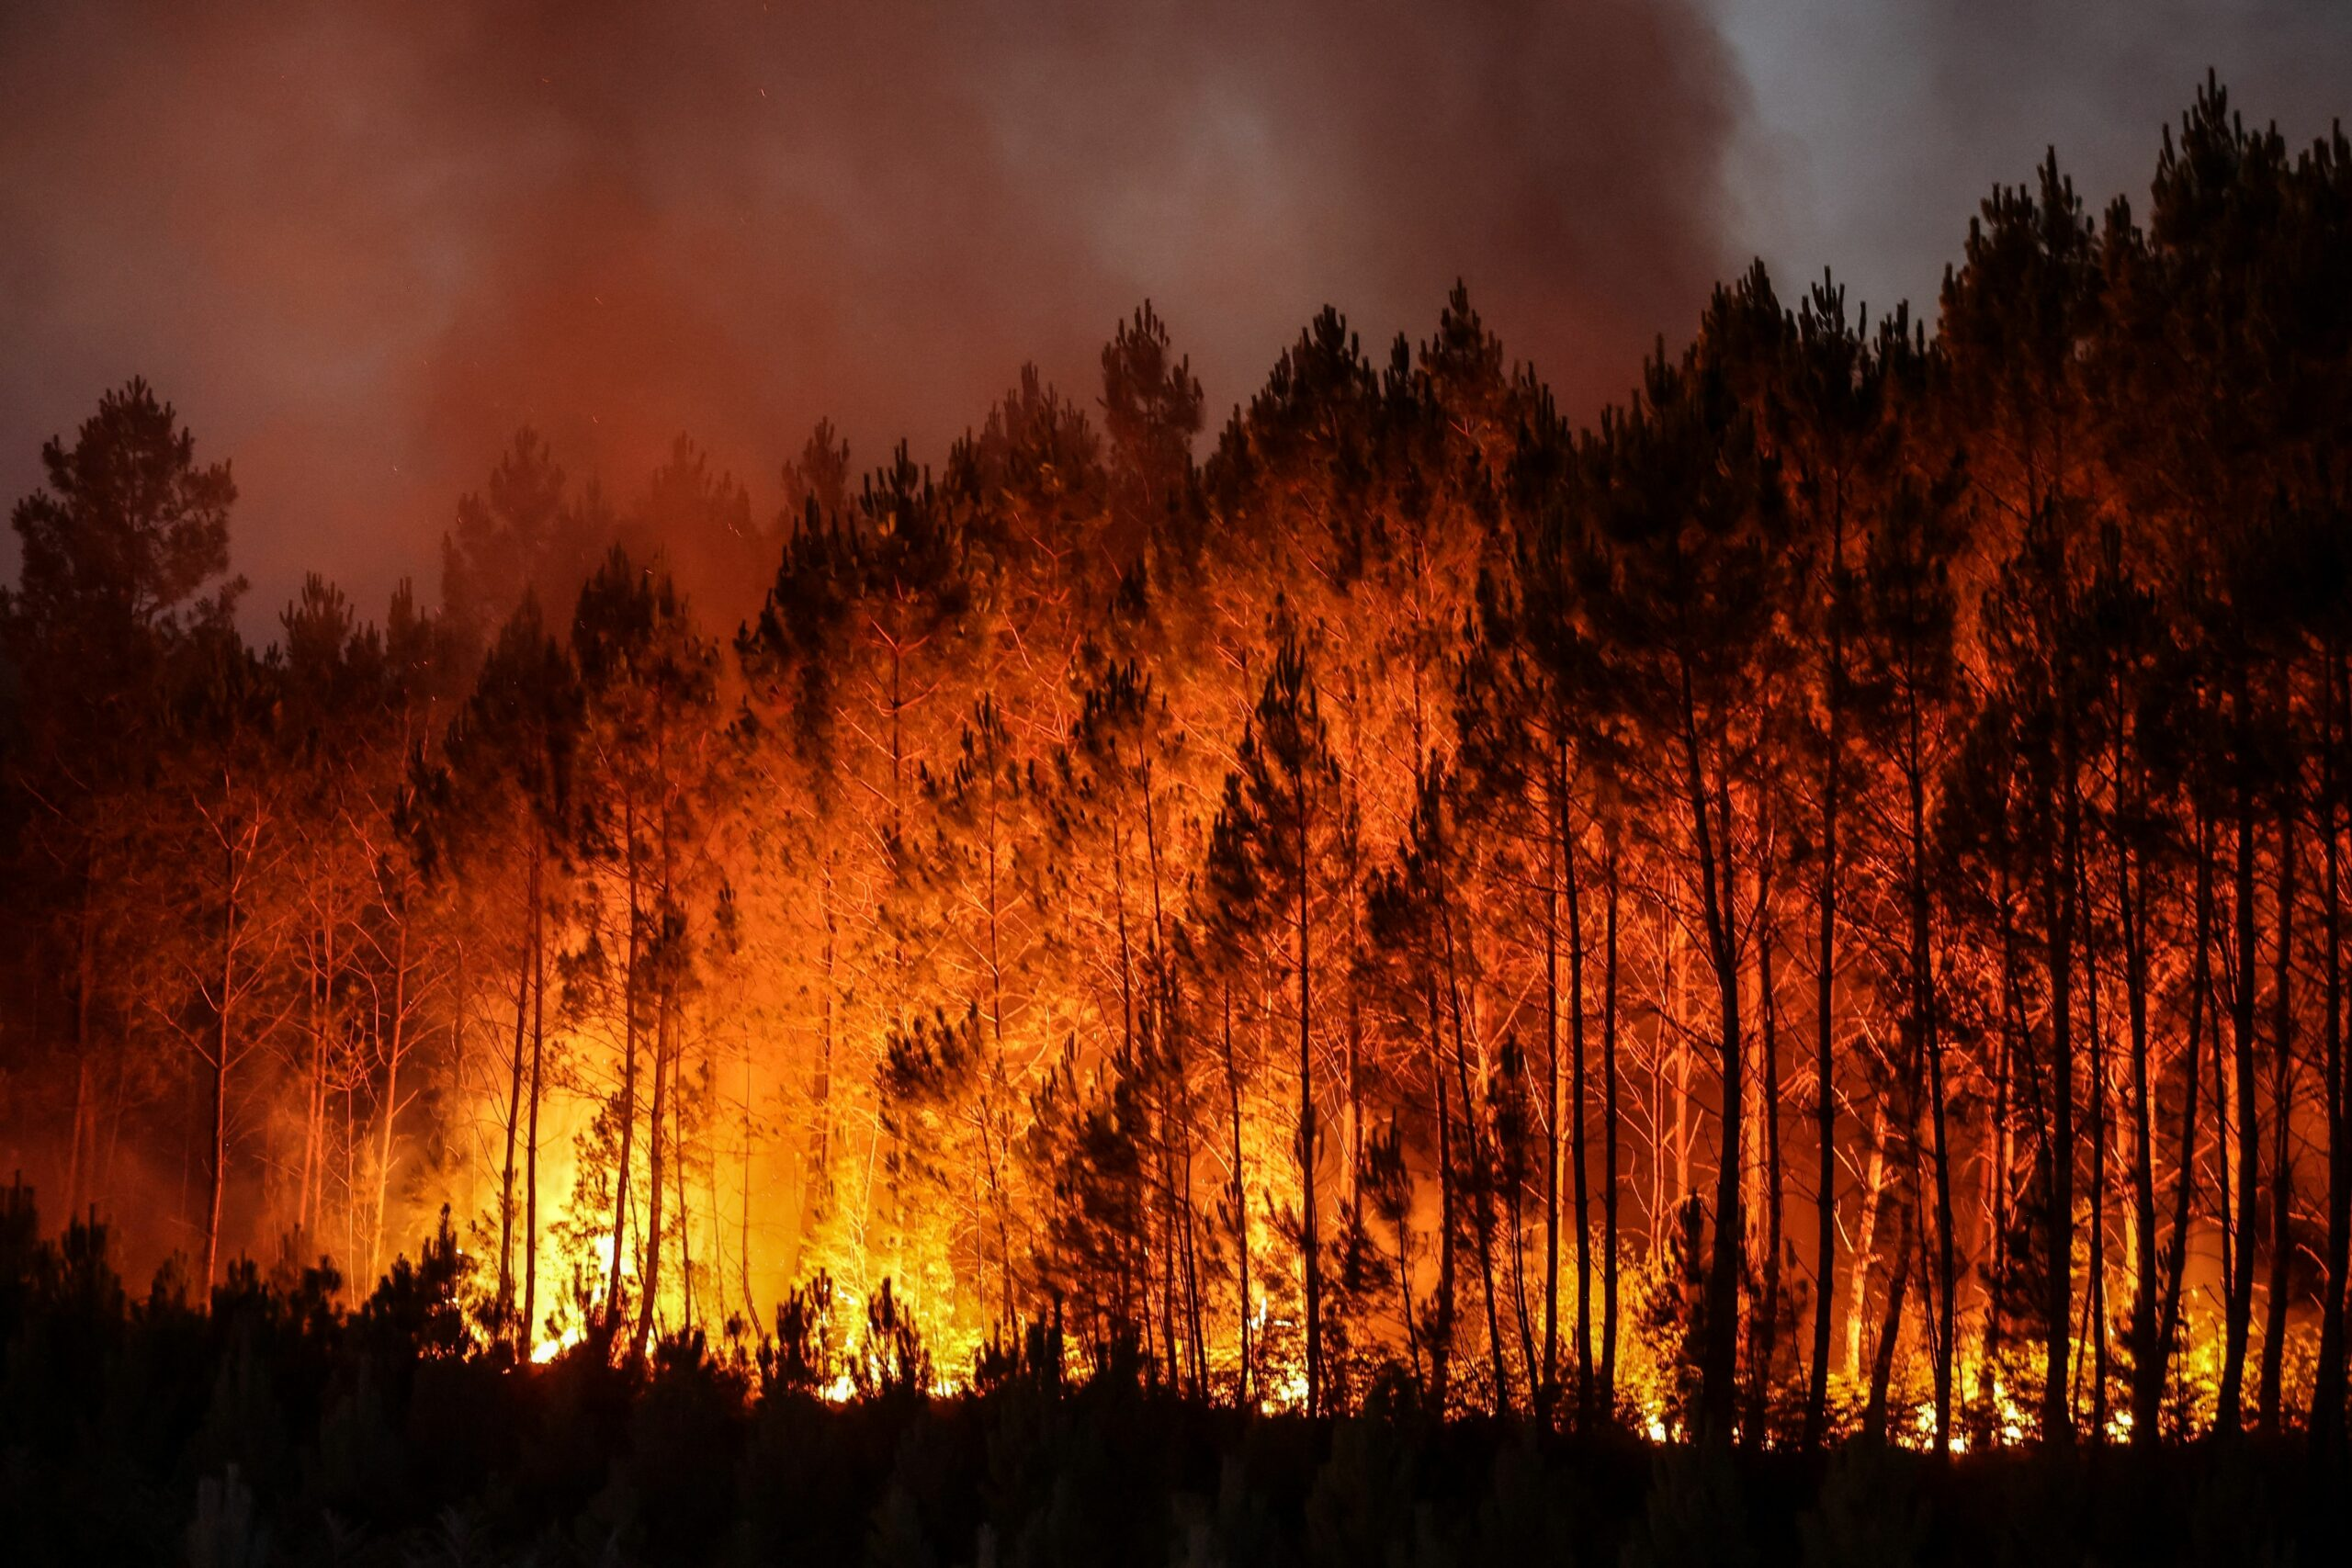
Wildfire Dynamics: Visual Insights For Strategic Action
LIKHITHASREE KOMMINENI
ROHITA JAHNAVI JALA

Slide 2
Background
Wildfires: A Growing Challenge
Understanding Wildfires
Our Presentation Objective
Target Audience
Key Takeaways
Together Towards Safer Communities

Slide 3
Data
DATA.GOV, State of Oregon
Wildfire dataset from 2000-2022
Water bodies dataset by using CBI Studio
Exploratory Data Analysis

Slide 4
Persona Diagram
PEOPLE
STATE GOV
WILDFIRE
FIRE FIGHTERS

Slide 5
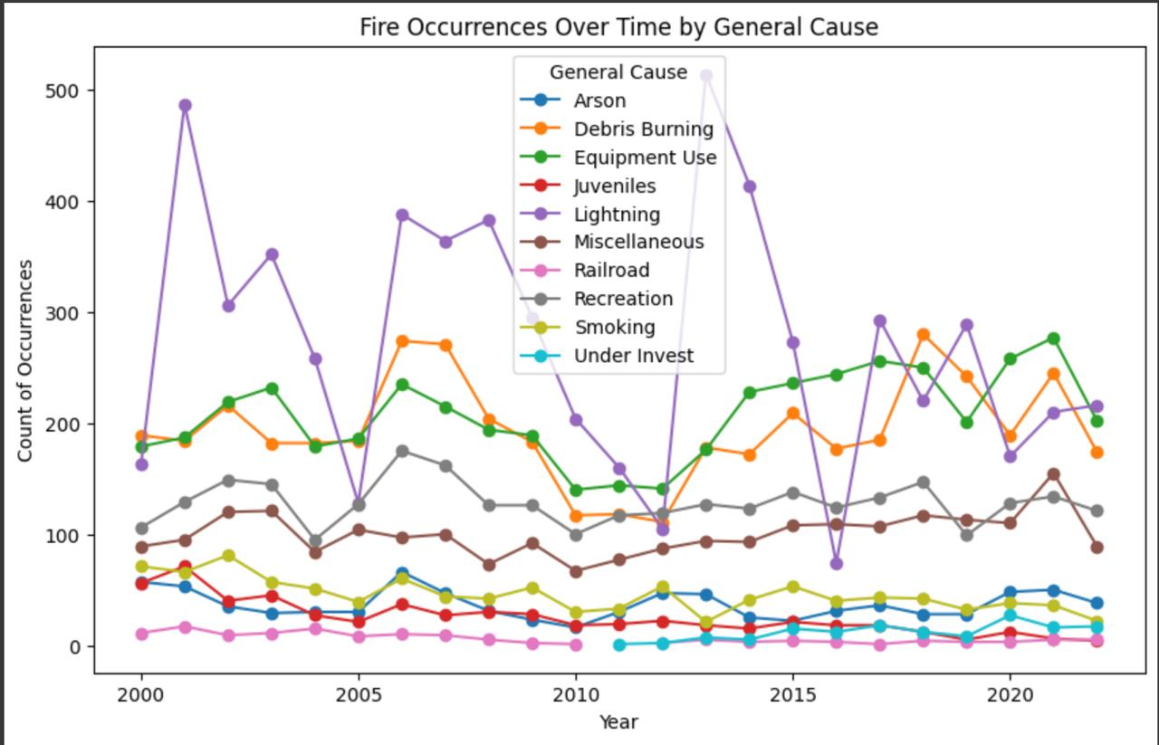
Task 1 Firefighters and government organisations
Task: Understanding Fire Trends
Persona: Firefighters and Government Organizations
Insight: We're studying how fires change over time and what causes them. By figuring out patterns, like which causes are common, we can help firefighters and government groups prevent fires.
Description: Our goal is to see how often fires happen and why. By noticing patterns, we can help firefighters and governments prepare better, like by warning about common causes such as lightning strikes.

Slide 6
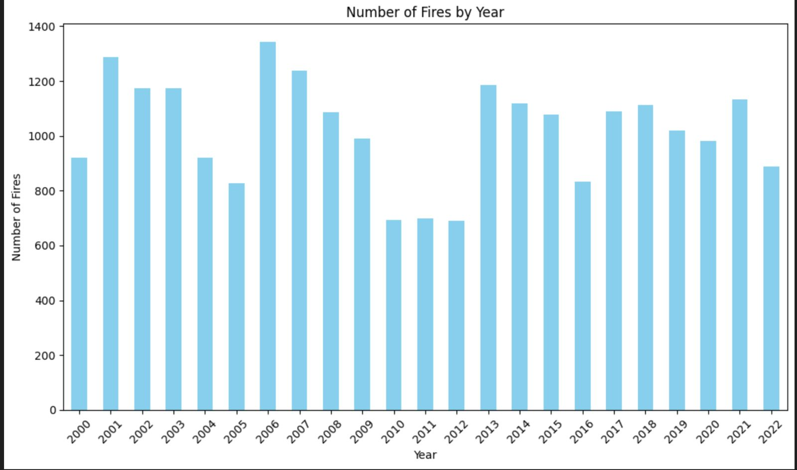
Task 2 Firefighters and Emergency Responders
Task: Understanding Fires Occurrences Over Time
Persona: Firefighters and Emergency Responders
Insight: We think there are patterns in when wildfires occur, changing from year to year and season to season. Knowing these patterns helps us plan ahead and get ready for fires.
Description: We're looking at how often fires happen over time. By knowing when they're more likely to occur, firefighters and emergency responders can be better prepared and allocate resources wisely. This helps us manage wildfires more effectively.

Slide 7
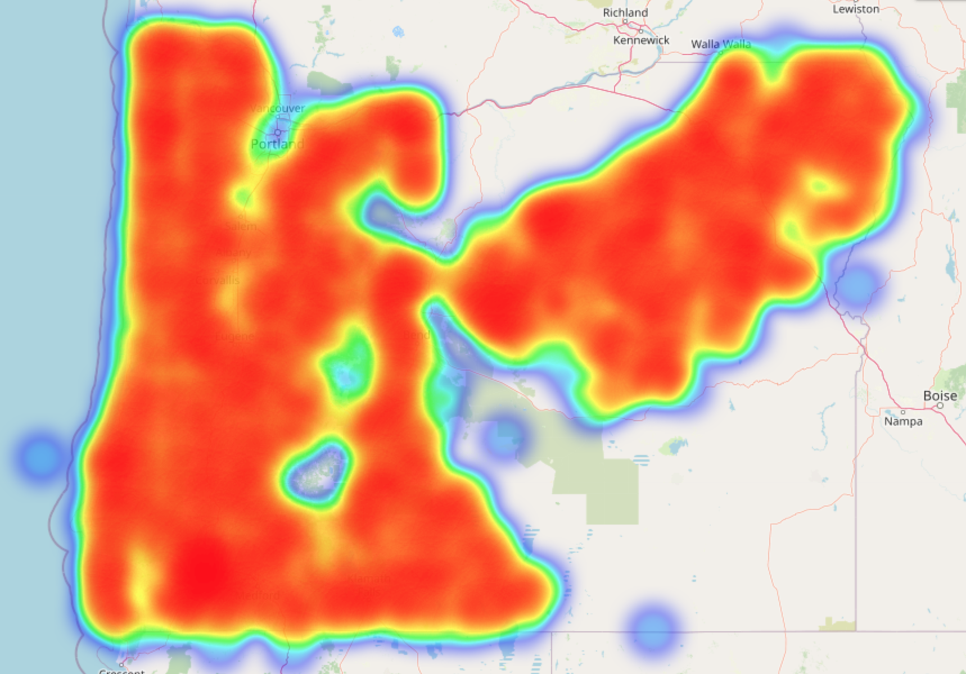
Task 3 GIS Analysts and Spatial Planners
Task: Understanding Fire Hotspots
Persona: GIS Analysts and Spatial Planners
Insight: We believe that environmental factors greatly affect how wildfires behave. By looking at where fires are happening on maps, we can respond quickly and plan better to fight them.
Description: Our job is to study where wildfires are popping up on maps. This helps GIS analysts and spatial planners respond fast and plan smart strategies to fight the fires. We think that by understanding how the environment influences wildfires, we can better protect communities from their impacts.

Slide 8
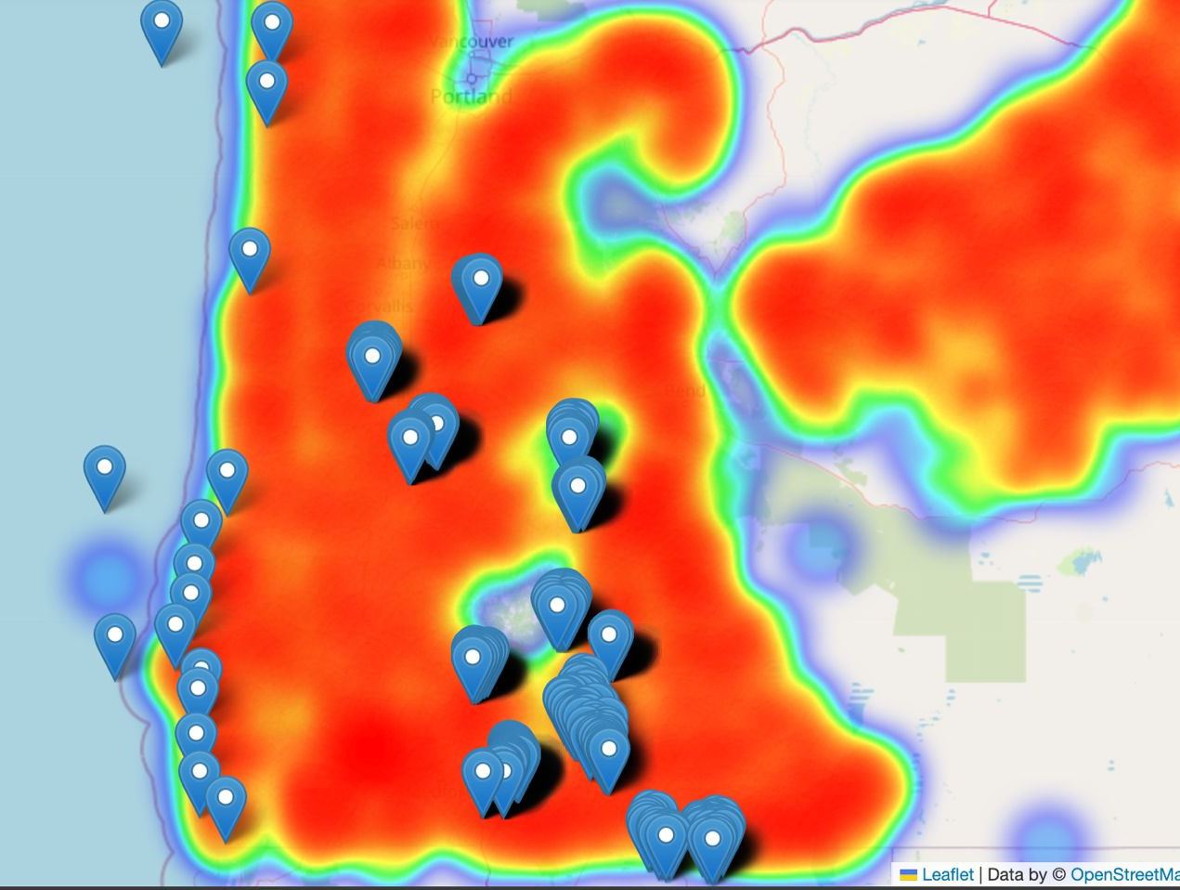
Task 4 Environmental Researchers and Scientists
Task: Analyzing Water Body Distribution for Firefighting
Persona: Firefighting Strategist
Insight: Understanding the proximity of water bodies to fire spots informs firefighting accessibility. Nearby lakes, rivers, or reservoirs facilitate operations, while scarcity poses challenges requiring strategic resource allocation.
Description: We examine water body distribution near fires to optimize firefighting. Mapping relationships between fire locations and water sources guides resource allocation, enhancing effectiveness and coordination.

Slide 9
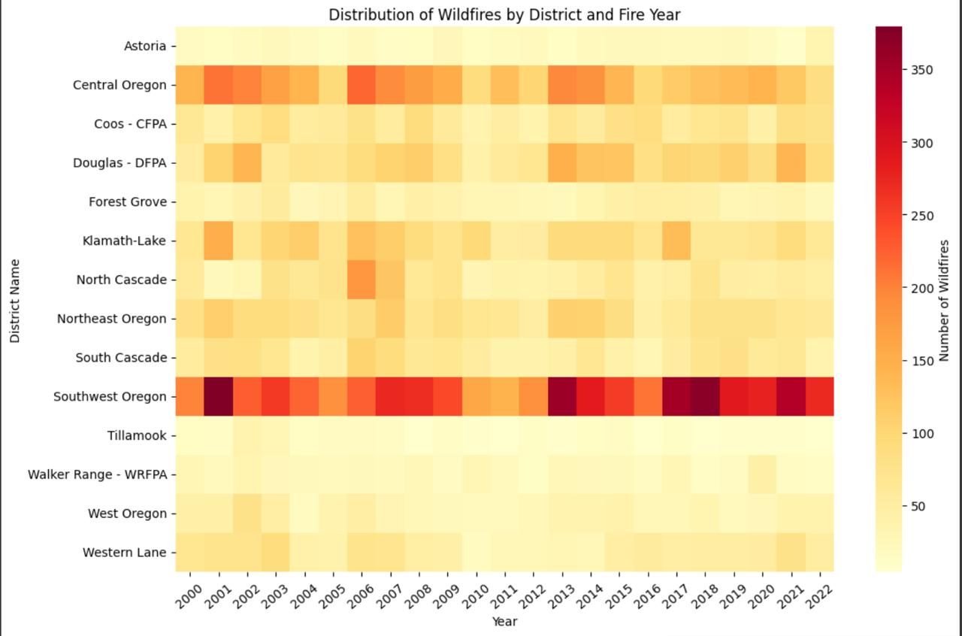
Task 5 Government Officials and Policy Makers
Task: Assessing Wildfire Risks for Government Decision Makers
Persona: Government Decision Makers
Insight: By studying past wildfire occurrences and using mapping technology, we can pinpoint areas at high risk of wildfires. This knowledge is vital for improving wildfire readiness. By focusing resources and policies on these areas, we can reduce the impact of wildfires.
Description: Our task involves analyzing historical wildfire data and mapping techniques to identify districts prone to wildfires. This information helps government decision makers allocate resources effectively and develop policies to mitigate wildfire risks. To adapt to changing conditions, ongoing monitoring and flexible strategies are essential for building resilient communities.

Slide 10
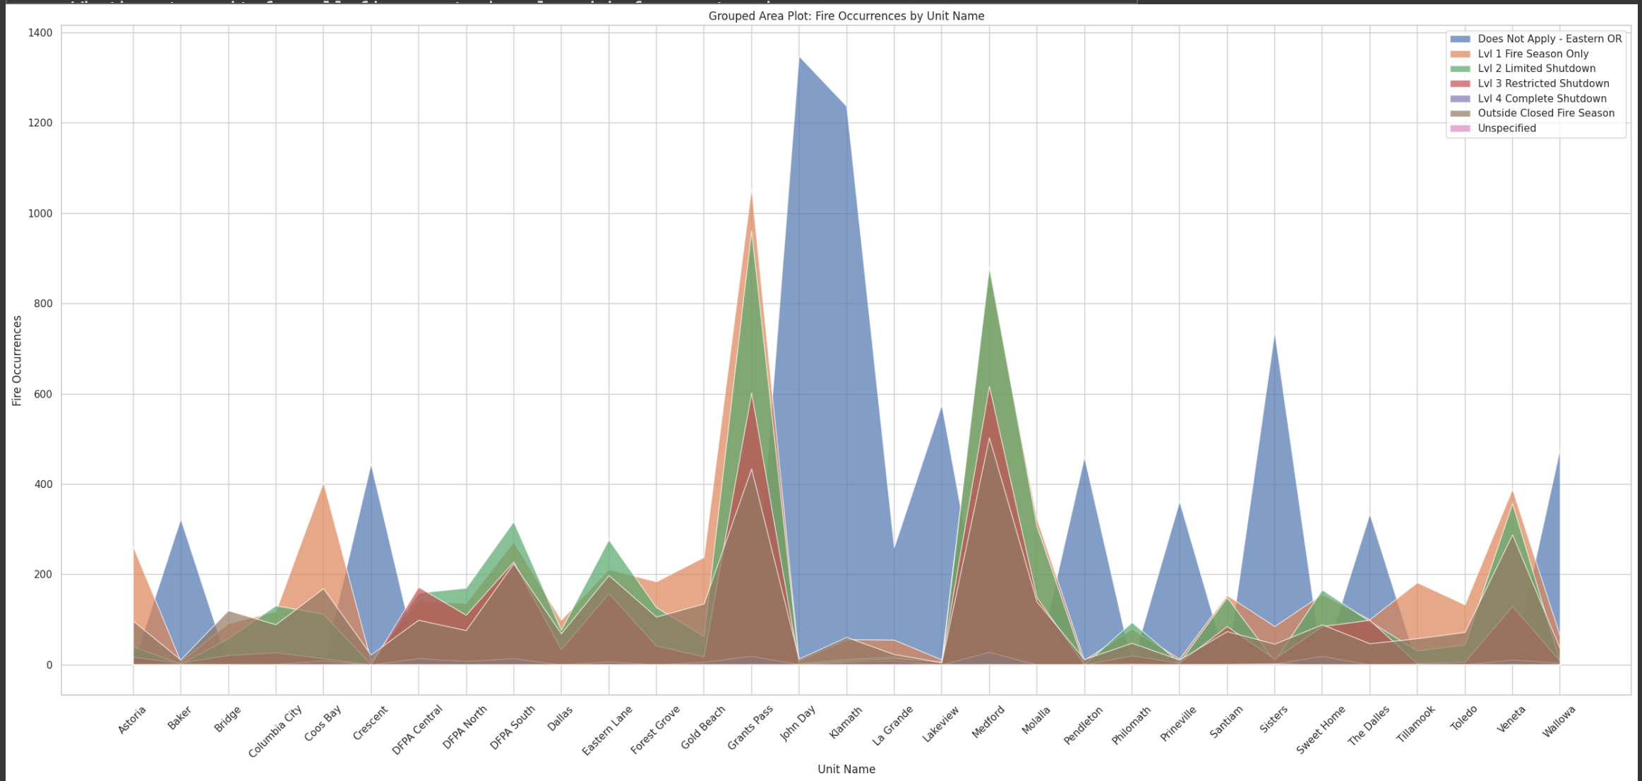
Task 6 Wildfire Data Analysts
Task: Understanding Wildfire Data
Persona: Wildfire Analysts
Insight: Grouped area plots are like maps showing firefighters, analysts, and government agencies where fires are happening and where resources are needed most. By looking at these plots alongside rules about where people can't do certain activities, like burning, decision-makers can figure out how to stop fires before they start.
Description: We're using grouped area plots to study wildfire data. They help us see where fires are happening and where to send help. When we combine this with rules about where people can't do certain things, like burn stuff, we can make smarter plans to prevent fires. This teamwork makes it easier to manage fires and keeps communities and nature safer.

Slide 11
Summary
Wildfires are not just a local issue; they're a global challenge. By sharing our findings with other researchers, firefighters, and government agencies, we're contributing to a collective effort to fight wildfires and protect our planet. By analyzing wildfire data, these analysts contribute to the development of predictive models, early warning systems, and risk assessment tools that enable proactive wildfire management and emergency planning.
To sum it up, our study has provided us with invaluable insights into wildfire management. From locating water sources for firefighting to analyzing wildfire trends and implementing preventive measures, our work is helping to build more resilient communities and safeguard our environment against the devastating effects of wildfires. But our journey doesn't end here. As wildfires continue to pose a growing threat, it's essential that we remain vigilant, proactive, and collaborative in our efforts to address this challenge.

Slide 12
Thank you
LIKHITHASREE KOMMINENI
ROHITA JAHNAVI JALA

