Slide 1
Heart Health Analysis with R

Slide 2
TEAM MEMBERS
2110030022-N. Vivek Raja
2110030043-A. Likhitha
2110030098-S. Sai Nikhitha
2110030201-Rohith Reddy

Slide 3
INTRODUCTION
The heart health analysis project addresses the pressing need to understand, prevent, and manage cardiovascular diseases (CVDs), a leading global cause of mortality.
Utilizing advanced statistical techniques and R programming, the project explores key factors impacting cardiovascular health through comprehensive data analysis and visualization.
By examining demographic, clinical, and lifestyle variables, the project provides valuable insights into heart disease risk and prognosis, empowering stakeholders to make informed decisions.
The creation of dummy variables enhances predictive modeling capabilities, facilitating tailored interventions and personalized healthcare approaches.
Accessible and informative, the project serves as a valuable resource for healthcare professionals, researchers, policymakers, and individuals seeking to optimize heart health and promote healthier communities.

Slide 4
PROBLEM STATEMENT
Cardiovascular diseases (CVDs) are a leading cause of mortality globally, accounting for a significant burden on healthcare systems and societies.
Despite advances in medical science, the prevalence of CVDs remains high, necessitating effective strategies for prevention, early detection, and management.
Need for Effective Strategies:
The project aims to address the challenges posed by CVDs through comprehensive data analysis and evidence-based approaches.
By understanding the underlying factors contributing to heart diseases, the project seeks to develop and implement targeted interventions to reduce the incidence and impact of CVDs on individuals and communities.

Slide 5
OBJECTIVES
1.Analyze heart health data to identify risk factors: Conduct comprehensive analysis of heart health dataset to identify demographic, clinical, and lifestyle factors associated with cardiovascular diseases.
2.Visualize key variables influencing cardiovascular health: Utilize data visualization techniques to present insights into the distribution and relationship of key variables, such as age, sex, blood pressure, cholesterol levels, and lifestyle habits.
3.Create predictive models to assess disease probability: Develop predictive models using machine learning algorithms to assess the probability of individuals developing cardiovascular diseases based on their demographic and clinical characteristics.
4.Provide insights for preventive measures and interventions: Generate actionable insights and recommendations for preventive measures and interventions aimed at reducing the incidence and impact of cardiovascular diseases in at-risk populations.

Slide 6
DATASET OVERVIEW
1.Source of the Dataset:
The dataset consists of 303 rows and 14 columns with label Target. Data contains categorical as well as continuous data.
The heart health dataset is sourced from a CSV file containing comprehensive data related to cardiovascular health, including demographic, clinical, and lifestyle factors.
2.Data Cleaning:
Before analysis, the dataset undergoes a thorough data cleaning process.
Missing values are checked using colSums(is.na(df)) function.
Rows with missing data are dropped using na.omit(df) function to ensure data integrity and accuracy in subsequent analysis.

Slide 7
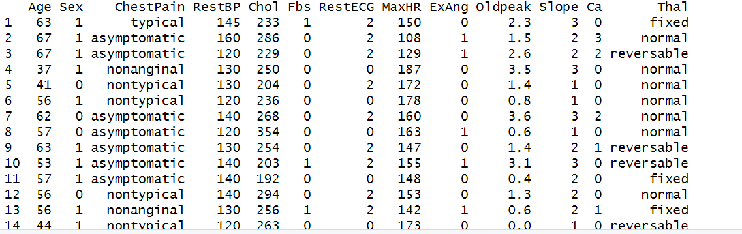
DATASET

Slide 8
DATA VISUALIZATION
1.Visualizing Target Variable Distribution
Bar Plot of Target Variable "Target“
A bar plot is used to visualize the distribution of the target variable "Target.“
The bar plot provides insights into the prevalence of cardiovascular disease within the dataset.
2.Visualizing Age Distribution and Disease Probability
Density Plots
Density plots are utilized to visualize the distribution of age within the dataset.
Additionally, density plots are faceted by the target variable "Target" to visualize disease probability across different age groups.

Slide 9
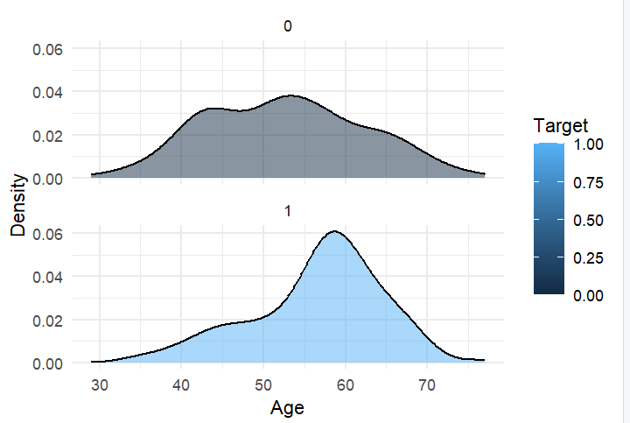
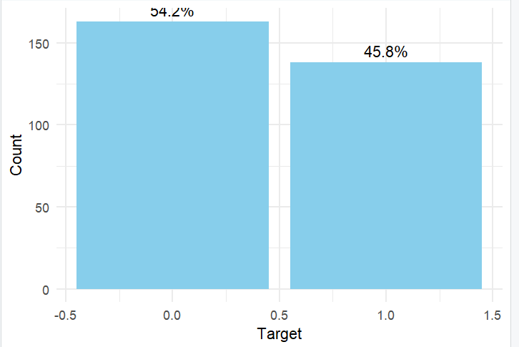
Bar Plot of Target Variable & Density Plot

Slide 10
CONCLUSION
the heart health analysis project provides valuable insights into the factors influencing cardiovascular health.
By leveraging comprehensive datasets and employing advanced analytical techniques, the project aims to address the challenges posed by cardiovascular diseases (CVDs).
Through data cleaning, exploratory data analysis (EDA), visualization, and predictive modeling, key risk factors associated with CVDs are identified.
This information is crucial for developing targeted interventions and preventive measures to reduce the incidence and impact of heart diseases.

