Slide 1
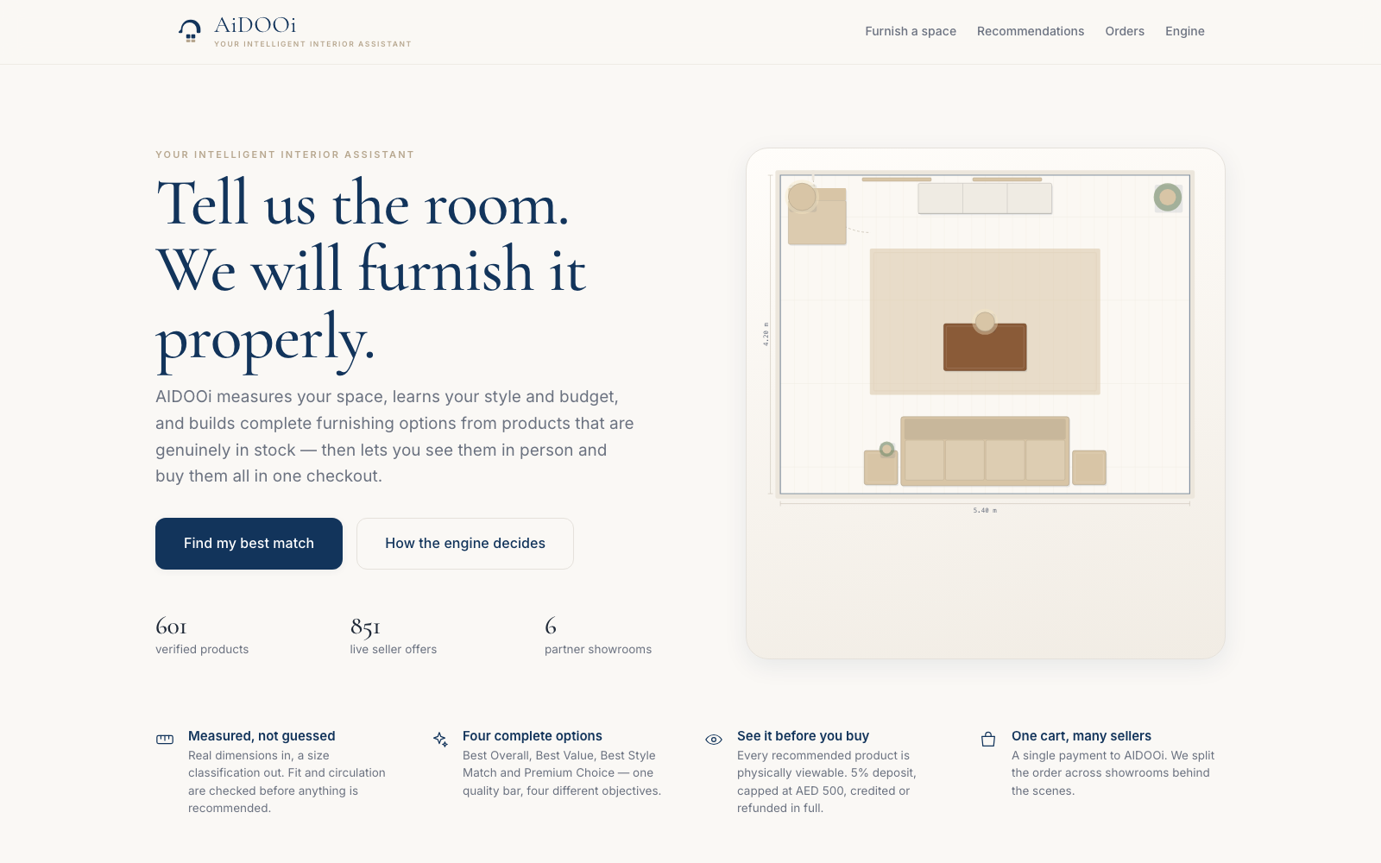
AIDOOi · MVP BUILD REVIEW
Tell us the room.
We will furnish it properly.
An AI furnishing assistant and multi-seller marketplace for the UAE — profile a space, generate complete furnishing options from real stock, view the products in person, and buy from several showrooms in one checkout.
The live build — running today, no slides required
601
851
47
verified products
live seller offers
MVP standards
Notes:
OPENING — about 60 seconds.
"Thank you for the 52 documents. I read all of them — the Master Plan, the eight core workflows and all 47 standards — and then I did the thing they were written for: I built it.
Everything you are about to see is running software, not a mock-up. What is on screen behind me is the AIDOOi MVP, served from my laptop, and I will drive it live in a moment.
The one-line version of AIDOOi, which is the version I would use with an investor: a customer tells us the room — the real dimensions, the style they like, the budget they have — and AIDOOi returns complete, coordinated furnishing options built only from products that are genuinely in stock. The customer can go and sit on the sofa before they buy it, and then pay for everything from every showroom in a single transaction.
Two numbers to anchor the scale: six hundred and one verified products, eight hundred and fifty-one live seller offers, across six partner showrooms. And all of it governed by your forty-seven standards."
[Pause. Move to slide 2.]

Slide 2
“MVP” means a working product — not a deck
Settled by your own documents, not by preference.
1
Master Plan §7
THE EIGHT CORE WORKFLOWS — ALL BUILT
Lists developer deliverables: Frontend Web/PWA, Product Data Service, Recommendation Service, Viewing, Commerce, Settlement.
01
Profiling & project setup
02
Matching & recommendation
Master Plan §8
03
Review, visualize, replace
04
Viewing, deposit, attribution
2
An eight-phase build sequence that opens with “database/entity model, IDs, taxonomy, authentication”.
05
Purchase, checkout, payment
06
Fulfilment & receipt
3
Master Plan §9
Acceptance gates are runtime behaviours: “no capture before all required seller validations”.
07
Issues, cancellation, refund
08
Partner admin & settlement
Zero console errors across a full click-through of all eight.
Notes:
SCOPE — about 75 seconds. This is the slide that answers the question someone in the room is already thinking.
"Before the demo, I want to settle one thing, because it is the question I was asked and I suspect it is the question in this room: when the documents say 'MVP', do they mean a presentation, a design, or a product?
They mean a product. And that is not my opinion — it is your own documents.
Section seven of the Master Plan is titled 'Development Modules and Handoff', and the column heading is literally 'Developer Deliverable'. It names a frontend web app, a product data service, a recommendation service, a viewing service, a commerce service and settlement.
Section eight is an eight-phase build sequence that starts with a database and entity model, IDs, taxonomy and authentication. You cannot deliver that in slides.
And section nine, the acceptance gates, are all runtime behaviours. 'No capture before all required seller validations.' 'Master order splits correctly with locked transaction snapshots.' Those are state transitions. The only way to pass them is to run code.
So the deliverable is the product. A deck like this one is a wrapper around it — useful for five minutes, which is roughly how long I plan to spend here before I open the app.
On the right: the eight core workflows from your own document. All eight are built and working end to end, with zero console errors on a full click-through."
[Move to slide 3 and get ready to switch to the live app.]

Slide 3
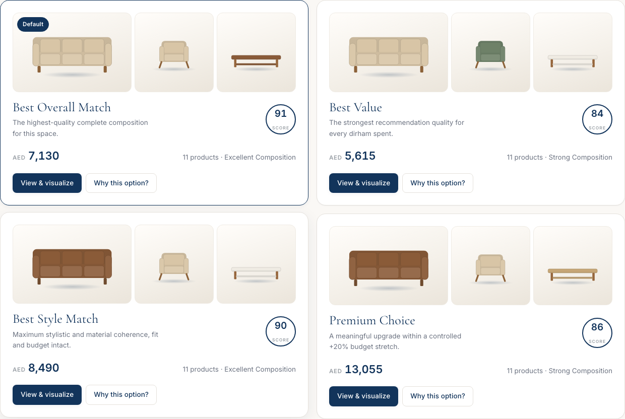
Four options, scored by your standards
AID-LOG-009 ranks products. AID-LOG-010 scores whole compositions. Nothing below threshold is ever shown.
PRODUCT MATCH SCORE
Fit quality
30%
Style match
25%
Colour match
15%
Budget / value
15%
Practical match
10%
Availability
5%
THE QUALITY FLOOR
≥ 60
minimum product match
≥ 70
minimum composition score
+20%
premium stretch ceiling
Nothing below 60 enters a composition.
Notes:
DEMO — about 2 minutes on this slide, then SWITCH TO THE LIVE APP.
"This is the heart of the product, so I want to be precise about it.
AID-LOG-009 scores each individual product against the customer: fit at thirty percent, style at twenty-five, colour fifteen, budget fifteen, practical ten, availability five. Those are your weights, not mine — I implemented them exactly.
AID-LOG-010 then scores whole compositions, because a recommendation is a coordinated room, not a pile of individually good products.
And here is the part I want you to hold on to, because it is what makes AIDOOi different from a filter on a furniture site: there is a quality floor. A product scoring below sixty never enters a composition — not even to fill an empty slot. A composition below seventy is never shown. If the inventory cannot support four good options, the system shows three and tells the customer why. It does not pad.
I will show you that live in a second, because on a Luxury budget the system actually refuses to build a Premium Choice and says so — there is no meaningful upgrade available, so it does not invent one. That behaviour is straight out of AID-LOG-010 section seven, and most teams would have quietly faked a fourth card."
[SWITCH TO THE LIVE APP NOW. Five-minute demo path:
1. Find my best match → Living Room
2. 5.5 × 4.5 — point out: 24.8 square metres, classification Medium, derived by the system, never chosen by the customer
3. Scandinavian, Beige, Standard — point out the representative product image on each budget card
4. Generate → four options, four different anchor sofas
5. Open Best Overall → the measured plan, drawn to scale from verified dimensions
6. Click the sofa on the plan → the Product Card with the full score breakdown
7. Replace it → only eligible alternatives, revalidated before it applies
8. Request viewing → deposit, five percent capped at five hundred dirhams, QR pass
9. Checkout → one payment, split into seller orders with locked snapshots
10. Orders → advance a line to Receipt Confirmed, watch settlement flip to Eligible
Then return to slide 4.]

Slide 4
Where we are, and what I need from you
WORKING TODAY
NEXT, IN ORDER
THREE DECISIONS I NEED
All eight customer paths, end to end
Real AID-LOG-009 and 010 scoring
Viewing, deposit, QR and attribution
One checkout, order split, settlement
Issues, refunds and settlement holds
Engine console: every gate, live
Schema and catalogue ingestion
Recommendation as a service
Payment provider and refunds
Admin back office and audit trail
Catalogue standardisation with an owner
Automated tests per acceptance gate
Compatibility maps
Who signs off style and colour? They drive 40% of every score.
Villa budget rule
AID-LOG-008 publishes no table. Sum the modules, or publish one?
Quality factor
AID-LOG-009 has none — so budget routinely goes unspent.
14 gaps found by executing the standards rather than reading them
AID-VIS-001 is referenced but does not exist · AID-LOG-001 §1 points studio and villa budgets at the wrong standard · “available placement space” is required for fit but never defined · the style and colour compatibility maps AID-LOG-009 §12 mandates are not supplied. Every one is documented, with the decision I took, in docs/05-gaps-and-decisions.md.
Notes:
CLOSE — about 90 seconds.
"So where does that leave us.
On the left: what works today. All eight customer paths end to end. The real scoring logic, not a sketch of it. Viewing with the capped deposit and the attribution trail. One checkout that splits into seller orders with locked price and commission snapshots, and a settlement run that only pays out on receipt-confirmed lines.
In the middle: what comes next, in the order I would do it. Schema and catalogue ingestion first, because nothing is testable until real AID and AIO records exist — and I want to flag that standardising partner catalogues to AID-DATA-001 through 014 is a data-quality project with a human owner, not a form. Then the recommendation engine as a service. Then payments. Then the admin back office.
On the right, the part I actually need from you today. Three decisions.
One: the style and colour compatibility maps. AID-LOG-009 section twelve says they must be controlled maps maintained by AIDOOi — but no map was supplied. I have written a first draft and it is working, but it drives forty percent of every product score, so it needs your sign-off and a review cadence.
Two: the villa budget rule. AID-LOG-008 deliberately publishes no table because villa budget follows composition, not floors. I implemented exactly that — I sum the actual room modules. I need you to confirm that is the production rule.
Three, and this is the interesting one: AID-LOG-009 has no craftsmanship or build-quality factor. Fit, style, colour, budget, practical, availability — that is the whole score. So when a lower-tier product matches perfectly, the engine correctly leaves money unspent. You will see the app say 'one thousand three hundred and seventy dirhams of your budget is unspent' and explain why. That is standards-correct, and it may also not be what you want commercially. If quality should influence ranking, LOG-009 needs a new factor, and that is your call, not mine.
And along the bottom: I found fourteen places where the standards are silent, ambiguous or contradict each other. You only find those by executing the rules, not by reading them. AID-VIS-001 is referenced twice but does not exist. LOG-001 points studio and villa budgets at LOG-003, which is bedroom logic. 'Available placement space' is required for fit and never defined. All fourteen are written up with the decision I took and why.
That is the build. Happy to take questions, or go back into the app and break it in whatever way you like."
[End. Offer the laptop.]

