Slide 1
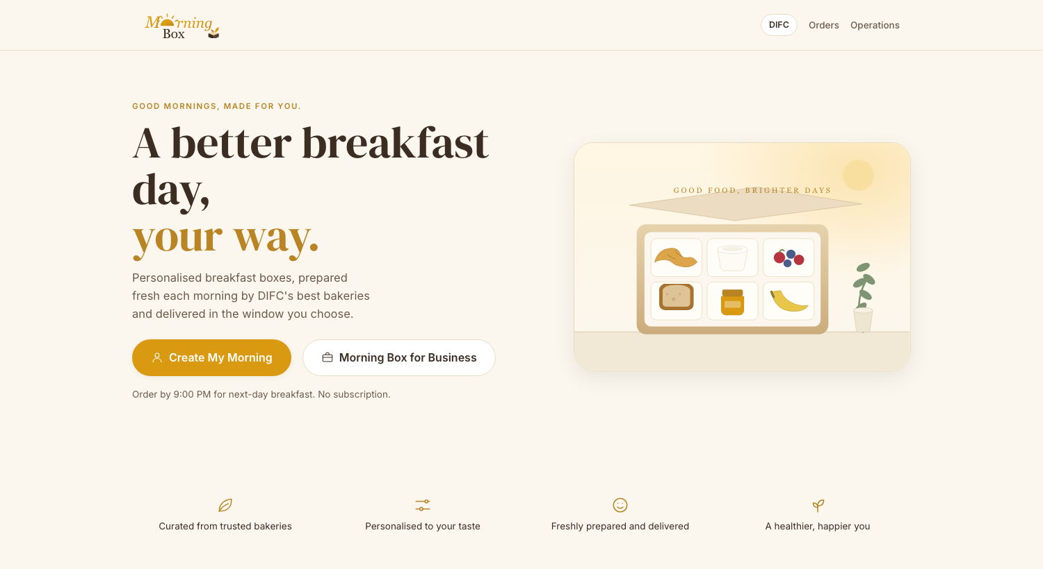
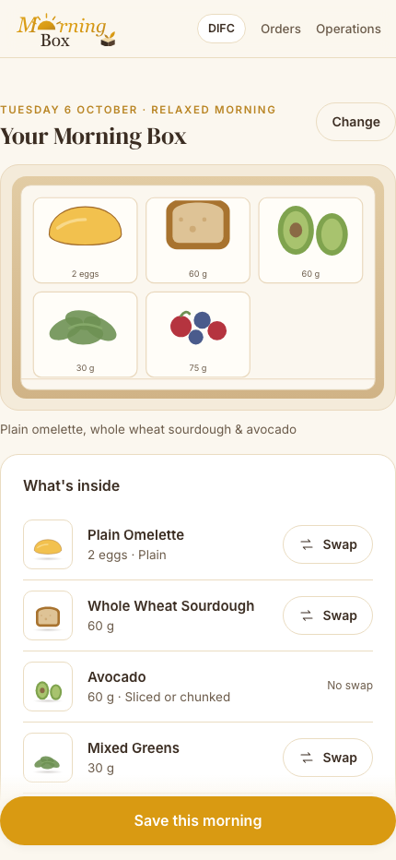
MORNING BOX · MVP BUILD REVIEW
A better breakfast day,
your way.
Not a food marketplace — a personal breakfast assistant. Three questions, one confident recommendation, produced fresh by an approved DIFC bakery and delivered in the window the customer chose.
32
35
12
base recommendations
approved components
locked standards
Running today, mobile-first, from a laptop
Notes:
OPENING — about 60 seconds.
"Thank you for the Master Plan and the twelve locked standards. I read all of them, and then I did the thing they were written for: I built it.
What is behind me is running software, not a mock-up. It is served from my laptop and I will drive it live in a moment.
The one-line version, and I would use this one with an investor: Morning Box is not a food-delivery marketplace. It is a personal breakfast assistant. A customer answers three short questions — how they eat, what they enjoy, and anything they must avoid — and Morning Box returns one confident, complete breakfast, produced fresh by an approved DIFC bakery and delivered inside the window they picked.
Three numbers to anchor it. Thirty-two approved base recommendations. Thirty-five approved components, each with an allergen record. Twelve locked standards governing all of it.
And one framing I want to put down early, because it shapes everything you are about to see: the engine is deterministic. Same inputs, same recommendation, every time. That is MB-REC-001 section 1.4, and it is a stronger claim than 'we used AI' — because we can show you exactly why it chose what it chose."
[Move to slide 2.]

Slide 2
“MVP” means a working product — not a deck
Settled by your own Master Plan, not by preference.
§8
Names six surfaces to build: Customer Web/PWA, Recommendation Engine, Admin/Operations, Bakery View, Delivery Coordination, Data Layer.
THE JOURNEY, BUILT END TO END
1
Three profile questions
2
Choose your mornings
3
Daily context, per day
4
Your Morning Box + alternative
§8.1
Lists the required customer screens in order, from Landing through to Feedback.
5
Swap · Size · Add-ons
6
Weekly summary, then sign up
Roadmap phase C is “Technical build — core functional QA passed”, and it is a launch gate.
7
Delivery window, then pay
8
Orders, cancel, feedback
§12 / §18
9
Business Breakfast, 6 steps
10
Operations: cutoff to reconciliation
Zero console errors across a full click-through of all ten.
Notes:
SCOPE — about 75 seconds. This answers the question someone in the room is already thinking.
"Before the demo I want to settle one thing: when the Master Plan says 'MVP', does it mean a presentation, a design, or a product?
It means a product, and that is your document, not my opinion.
Section eight names six things to build — a customer web app, the recommendation engine, admin and operations, a bakery view, delivery coordination and a data layer.
Section eight-point-one lists the required customer screens in order, from Landing through to Feedback. That is a build list.
And section twelve makes 'technical build, core functional QA passed' phase C of the roadmap — with section eighteen turning it into a launch gate. You cannot pass functional QA on a deck.
Your Master Plan also names what comes immediately after it: a screen-by-screen UX and functional specification. I have written that too — it is document three in the pack — and the demo you are about to see is the thing it describes.
On the right: the whole journey, built. Personal and business, plus the operations console that runs the night-before cycle. Ten flows, zero console errors on a full click-through."
[Move to slide 3, then switch to the live app.]

Slide 3
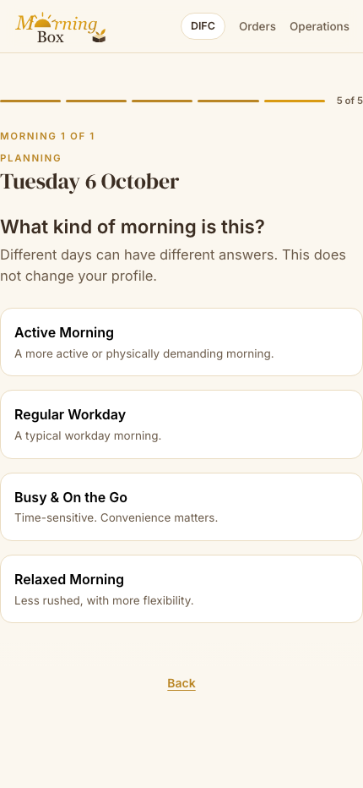
Safety first, then preference — and never a forced result
MB-REC-001 implemented exactly: four stages, ten locked rules, one deterministic answer.
Understand
Filter
Match
Recommend
Profile + daily context
→
Safety, diet, approved substitution
→
Eating style, context, preference pool
→
Your Box + Another Option
THE RULES THAT MAKE IT DEFENSIBLE
Same inputs → same recommendation
Deterministic and rule-based. No randomness, no unsupported AI claims.
A substitution never leaves the approved library
If none exists, the breakfast leaves the pool. Safety is never relaxed.
Multiple preferences expand the pool
They are never combined into one hybrid breakfast.
No eligible match beats a forced one
The system returns nothing and offers to review your inputs.
Notes:
DEMO — about 2 minutes here, then SWITCH TO THE LIVE APP.
"This is the heart of it, so I want to be precise.
The engine runs four stages: understand, filter, match, recommend. Safety and dietary filtering happen before any preference matching — that ordering is in the standard and it is not negotiable.
Four rules make it defensible in front of a customer, a bakery or a regulator.
One: same inputs, same recommendation. It is deterministic. Ask it the same question twice and you get the same answer, and we can show you the decision trace.
Two: if a component is unsafe for you, the engine looks for an approved substitute inside the Morning Box library — never the bakery's general menu. If there isn't one, the whole breakfast leaves the pool.
Three: picking several preferences widens the pool; it never blends savory and sweet into one strange box.
Four, and this is the one most products get wrong: no eligible match is better than a forced one. If nothing is safe, it says so and offers to review your inputs. It does not quietly relax your allergy to fill the screen.
Let me show you."
[SWITCH TO THE LIVE APP — at phone width. Five minutes:
1. Create My Morning → Health-Conscious
2. Savory + Fresh & Wholesome — "multi-select widens the pool"
3. Peanut allergy — "a hard filter, applied before anything is recommended"
4. Pick two dates — "exact dates, 9 PM cutoff"
5. Relaxed Morning
6. The box appears — tap a compartment, show the allergen record
7. Point at the substitution notice if one fired
8. Swap the bread — "only eligible alternatives, price does not move"
9. Size → Large — "quantity, not composition"
10. Save → day two offers "Same as yesterday" — an independent copy
11. Summary → register → delivery window → pay
12. Orders — "Prepared by the bakery. Free cancellation until 9 PM"
13. Business: 35 people, add Vegan + Tree nut × 3 — it cannot be matched
14. Operations: run the cutoff, show Production vs Packing view, try Ready before QC
Then come back to slide 4.]

Slide 4
What works, and the one decision I need
WORKING TODAY
NEXT, IN ORDER
THE DECISION I NEED
All ten flows, personal and business
The real MB-REC-001 engine over 32 recommendations
Allergen filtering with approved substitution
9 PM cutoff, refunds, proof of delivery
Proximity-first allocation with eligibility
Production vs packing views, QC gate, exceptions
Resolve the dietary gap on the right
Schema and per-bakery allergen records
Engine as a service, with fixtures
Mobile + OTP, payments, refunds
Bakery view and courier integration
Closed DIFC pilot
0 of 32
approved breakfasts can be served to a gluten-free or coeliac customer.
MB-BOX-001 §9 names Gluten-Free as supported. The Core Library has no gluten-free bread or grain. Add products, or remove the option?
Dietary coverage across all 32 approved Base Recommendations
32
32
28
24
22
12
9
8
0
None
Peanut
Vegetarian
Tree nut
Egg
Dairy
Dairy-free
Vegan
Gluten-free
Notes:
CLOSE — about 90 seconds. This is the slide that earns the next meeting.
"So, where are we.
On the left: what works today. All ten flows. The real engine over all thirty-two base recommendations. Allergen filtering with approved substitution. The nine PM cutoff, the refund rules, proof of delivery. Proximity-first bakery allocation with eligibility filtering. And the operations console: production view, packing view, the QC gate and the exception queue.
In the middle: what I would do next, in order. And notice what is first — it is not code.
Because on the right is the thing I most need to tell you.
I ran every dietary requirement against all thirty-two approved base recommendations. No restrictions: thirty-two of thirty-two. Peanut allergy: thirty-two — your library handles that well. Vegetarian: twenty-eight. Dairy allergy: twelve. Vegan: eight.
Gluten-free: zero. Not one. A coeliac customer cannot be served a single approved Morning Box.
And this is not a bug in my engine. MB-BOX-001 section nine names Gluten-Free as a supported requirement and says a bakery must be specifically eligible to handle it. But the Core Item Library contains only wheat breads, and all three approved grains — oats, granola and muesli — carry gluten. There is no gluten-free product of any kind in the approved library. The engine refuses to invent one from outside, exactly as the standard tells it to, so it returns the no-match message.
You only find that by executing the standards, not by reading them.
There are three ways to resolve it. Add a gluten-free bread and grain to the Core Library. Or declare gluten-free out of MVP scope and take it off the profile question. Or keep it, and accept that those customers always get a no-match. Only the first matches what MB-BOX-001 currently promises.
The same shape of question applies, less severely, to vegan at eight and dairy-free at nine — there is no plant yogurt and no vegan pastry in the library.
That is the decision I need. Everything else on this slide I can get on with.
I found fourteen gaps like this in total — all written up with the decision I took and why. Happy to take questions, or go back into the app and break it however you like."
[End. Offer the laptop.]

