Slide 1

Retail Banking Transaction Analysis

Slide 2
About us
Name : Likhitha Jami
Background: B.Tech in Computer Science and Engineering.
Linkedin: Likhitha Jami | LinkedIn
Name : Vyshnavi Mulle
Background: B.Tech in Computer Science and Engineering
Linkedin: Vyshnavi Mulle | LinkedIn
Name : R. Naina Patel Yadav
Background: B.Tech in Computer Science and Engineering
Linkedin: Naina Patel | LinkedIn

Slide 3
Table of contents
Project Overview
Business Scenario
Business Objectives
Dataset & Database Overview
ER Diagram & Database Structure
Basic Analysis
Analysis of the Objectives
Overall Key Findings
Business Recommendations & Data Quality Notes
Conclusion

Slide 4
Project Overview
A retail bank serves customers through accounts, cards and loans across 40 branches.
The bank handles thousands of customer transactions and loan payments.
Management wants data-driven answers about customers, account activity, transaction patterns, loan performance and product usage.
As a Data Analyst supporting the Retail Banking team, I built the database in MySQL, analysed the data with SQL and recorded business insights.

Slide 5
Business Scenario
The Customer team needs to understand who the customers are and how segments differ.
Management wants to see how accounts are used and how branches perform.
Operations wants to understand how money moves through transactions and channels.
The Loans team wants to know whether customers repay on time.
The Cards team wants to understand card usage and product engagement.

Slide 6
Business Objectives
Understand the customer profile and segmentation.
Understand account usage and branch activity.
Analyze transaction patterns across types, channels and time.
Evaluate loan performance and repayment behaviour.
Understand card usage and product engagement across the customer base.

Slide 7
Dataset & Database Overview
Table Name | No. of Rows | No. of Columns
customers | 500 | 13
accounts | 700 | 10
branches | 40 | 7
loans | 300 | 13
loan_payments | 2,000 | 11
cards | 600 | 10
transactions | 5,000 | 10

Slide 8
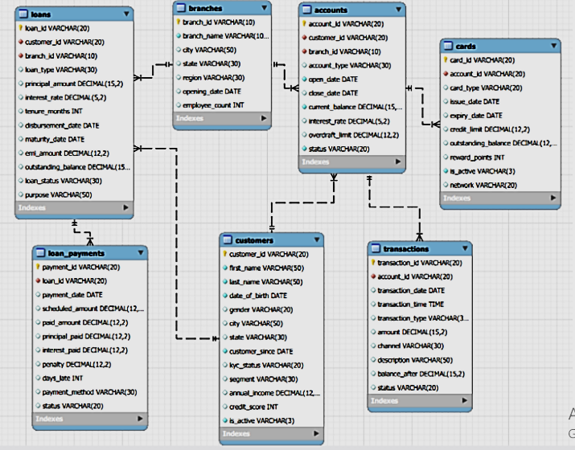
ER Diagram & Database Structure

Slide 9
Basic Analysis
Question | Result
Total customers | 500
Total accounts | 700 (1.4 per customer)
Account types | 6: Business Checking, CD, Checking, IRA, Money Market, Savings
Active customers | 375 of 500 (75.0%)
Transaction types | 6: ATM Withdrawal, Credit, Debit, Fee, Interest, Transfer
Completed transactions amount | $10,976,552.36 (1,688 transactions)
Loan types | 6: Auto, Business, Credit Builder, Education, Home, Personal
Total loans | 300
Card types | 2: Credit, Debit
Outstanding loan balance | $53,441,891.25 (74.0% of $72.21M lent)

Slide 10
4.1 Customer Profile & Segmentation
Output:
Key Insights:
Segments: Student is largest (100, 20%); average income is $140K-$159K and credit score 679-687 in every segment, so labels do not reflect customer value. Redefine segments.
Geography & demographics: 56 cities, top 10 hold only 27%; gender is balanced; 30-44 is the largest age group (33.6%), Under 30 only 14%.
KYC risk: Only 28.6% of customers are fully verified; 241 of 375 active customers (64.3%) have Partial/Pending KYC. Run a KYC completion drive.
Credit quality: 58.6% are Good/Excellent (cross-sell cards and loans); 41.4% are Fair/Poor (credit-builder products). Average tenure is 6.9 years.

Slide 11
4.2 Account Usage & Branch Activity
Output:
Key Insights:
Deposits: $10.2M in total; IRA, CD and Money Market hold 69% at higher rates (3.3%-4.6%). Savings and Checking are popular but small.
Relationships: 211 customers (57.7% of account holders) hold more than one account; 134 customers (26.8%) hold none.
Branches: Balances vary ~8x (BR025 Atlanta $501,926 vs BR010 Memphis $58,688); accounts per employee range 0.30-1.75. Rebalance staff.
Closures: 29% of accounts are closed, highest for Business Checking (33.6%) and CD (33.1%); IRA is stickiest (24.3%). Add retention offers.

Slide 12
4.3 Transaction Patterns
Output:
Key Insights:
Completion problem: Only 33.8% of transactions complete; 33.7% are Pending and 32.6% Failed in every channel. Only 57 of 206 large transactions completed.
Channels & types: Online and Mobile carry 49.9% of activity, Branch 22.9%; types are evenly spread. Fee and Interest averages (~$7,000) need validation.
Usage: Investment, Utility and Rent dominate; Salary is only 5.6% (payroll opportunity). Business is the most active segment, Premium the least.
Trend: Volume grew 1,279 (2022) to 1,723 (2023) to 1,933 (2024), but growth is slowing; there is no data for Jan 2025.

Slide 13
4.4 Loan Performance & Repayment
Output:
Key Insights:
Loan book: $53.44M of $72.21M (74%) is still outstanding; 169 loans (56.3%) are Defaulted or In Arrears, holding 73.3% of balances. Auto (62.5%) and Home (59.5%) are worst.
Repayment: Only 28.7% of payments are on time (25% late, 23.4% missed); 84.5% of borrowers paid late at least once; penalties total $93,961.
Payment method: Cash (28.3%) and Cheque (26.3%) are late most; Auto Debit only 19.6% but just 5.6% of payments. Promote Auto Debit.
Recovery: 31 matured loans still owe $8.04M (17 In Arrears, 14 Defaulted). Escalate to recovery and provision.

Slide 14
4.5 Card Usage & Product Engagement
Output:
Key Insights:
Cards: 93.8% of cards are inactive and 74.2% have expired; target the 118 unexpired inactive cards first. Credit utilization is healthy at 41.8%, with 90 cards above 50%.
Rewards: Debit and Credit earn almost the same points; the top 10 balances all sit on inactive cards. Review rewards design and offer redemption.
Engagement: 63% use two or more products and 124 use all three, but 74 use none, 60 borrowers have no account and 99 account holders have no card.
Segments: Premium customers use the fewest products (1.55 vs Senior 1.93). Design a premium bundle.

Slide 15
Overall Key Findings
1
Customers
500 customers, 75% active, spread over 56 cities; only 28.6% fully KYC-verified.
2
Accounts
$10.2M in deposits, concentrated in IRA, CD and Money Market; 29% of accounts closed.
3
Transactions
Growing yearly and led by Online/Mobile, but only 33.8% complete.
4
Loans
56.3% Defaulted or In Arrears holding 73.3% of $53.4M; 48.4% of payments late or missed.
5
Cards
93.8% inactive and 74.2% expired; 74 customers hold no product.

Slide 16
Business Recommendations
Collections: Restructure Defaulted/In Arrears loans, starting with the 31 matured loans owing $8.0M; tighten Auto, Home and Business underwriting.
Transactions: Fix processing failures; two thirds of transactions fail or stay pending in every channel.
KYC: Complete KYC for the 241 active Partial/Pending customers.
Repayment: Push Auto Debit (19.6% late vs 28.3% for cash) and send pre-due reminders.
Cards & cross-sell: Reactivate and renew cards; offer cards to 99 account holders and accounts to 60 loan-only customers.
Operations: Rebalance branch staffing (0.30-1.75 accounts per employee) and redefine customer segments.

Slide 17
Data Quality Notes
close_date was blank for 497 open accounts; loaded through a staging table using NULLIF().
All 7 files passed key checks: no duplicate primary keys and no orphan foreign keys.
13 of 40 branches share a name, so branch analysis groups by branch_id.
paid_amount exceeds scheduled_amount in 308 of 1,073 paid/late payments; status and days_late were used instead.
Transaction status is split almost equally, Fee/Interest amounts match debits, and balance_after looks inconsistent: treat with caution.
98.7% of transactions fall in 2022-2024 and none in Jan 2025; customer segments do not differ in income or credit score.

Slide 18
Conclusion
SQL analysis turned 7 tables into clear answers on customers, accounts, transactions, loans and cards.
The customer base is balanced and active, but segment labels are weak and KYC completion is the most urgent compliance issue.
Deposits are healthy in IRA, CD and Money Market, while branch performance and staff workload are very uneven.
The biggest risks are the troubled loan book (56.3% Defaulted or In Arrears) and a transaction completion rate of only 33.8%.
Card engagement is weak but cross-sell potential is large, supporting data-driven decisions to improve retail banking performance.

Slide 19

THANK YOU

