Slide 1
Zomato EDA -Indian Restaurents
ZOMATO Exploratory data analysis – IDIAN RESTAURANTS
TEAM MEMBERS
22NE1A05D0 - NEELAMSETTY PRAMEELA
22NE1A0597 - KOLLI LIKHITHA
22NE1A05D2 - PADALA TEJA HARIKA
22NE1A0522 - BHIMISETTY SUREKHA

Slide 2
PROJECT DESCRIPTION
* This project aims to perform an Exploratory Data Analysis (EDA) on the dataset of Indian restaurants listed on Zomato, a popular online food delivery and restaurant discovery platform. The analysis will provide insights into various aspects of the restaurants, such as their geographical distribution, ratings, cuisines offered, cost for two, and customer reviews. By leveraging data visualization techniques, we aim to uncover patterns and trends that can help restaurant owners, customers, and Zomato itself. The study will also explore factors influencing customer ratings and the popularity of different cuisines across various cities in India. The ultimate goal is to derive meaningful conclusions that can enhance decision-making processes for stakeholders in the food and beverage industry.

Slide 3
Introduction
Exploratory Data Analysis (EDA) is a preliminary step of Machine Learning and is used extensively in this field. Although it is not necessary to perform EDA to build models, but it is definitely recommended as it helps to know the data better. If performed correctly, it gives us insights which are not easy to witness directly.
"If you find this EDA notebook usefull, please consider giving it a upvote to show your support and help others discover the insights presented here."
In this notebook, I have performed a detailed analysis on Indian Restaurants Dataset from Zomato(link). This notebook can be used as a manual to perform basic to intermediate EDA on any dataset. Following are the things that you will learn from this project :-
Knowing basic composition of data

Slide 4
Advantages:
* Data-Driven Insights: Helps businesses make informed decisions. * Customer Preferences: Understand trends and preferences in different regions. * Strategic Planning: Aid in planning marketing strategies and expansions. * Competitive Analysis: Benchmarking against competitors.

Slide 5
Software requirements:
Operating System : Windows
Software : python (3.6 or later)
jupyter Notebook
anaconda navigator
Hardware : Minimum 4GB RAM
Dual-Core Processor
At least 10GB free disk space
Programming Language : Python
Libraries : pandas
numpy
matplotlib
seaborn
plotly

Slide 6
Uses of Data Analysis library
Pandas:
Data Manipulation: Cleaning, transforming, and analyzing data.
Data Structures: Series and DataFrames for efficient data storage and operations.
Data Aggregation: Grouping, merging, and joining datasets.
File I/O: Reading and writing data from various file formats (CSV, Excel, SQL, etc.).
NumPy:
Numerical Operations: Efficient mathematical computations on large arrays and matrices.
Array Manipulation: Creating, reshaping, and indexing arrays.
Statistical Functions: Basic statistical operations like mean, median, and standard deviation.
Integration: Seamless integration with other libraries like Pandas and Matplotlib.
Matplotlib:
Data Visualization: Creating static, interactive, and animated plots.
Plot Types: Line plots, bar charts, histograms, scatter plots, and more.
Customization: Detailed control over plot appearance (colors, labels, styles).
Integration: Works well with Pandas DataFrames and NumPy arrays.
Seaborn:
Statistical Data Visualization: Enhanced visualizations based on Matplotlib.
Themes and Color Palettes: Predefined styles and colors for attractive plots.
Plot Types: Advanced plots like heatmaps, pair plots, violin plots, and more.
Ease of Use: Simplifies complex visualizations with concise syntax.

Slide 7
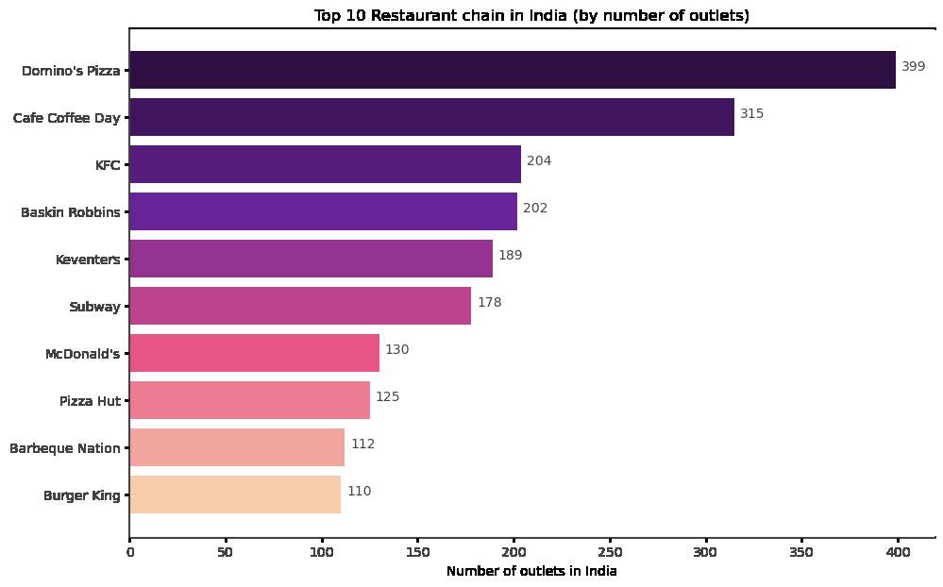
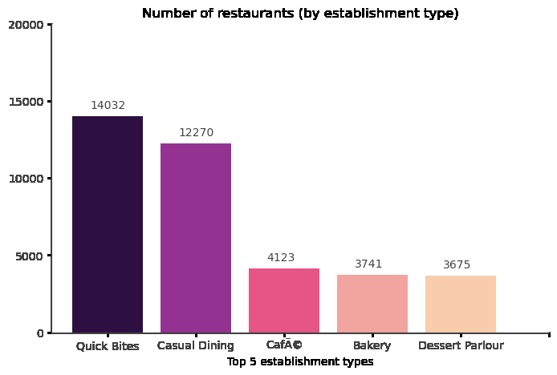
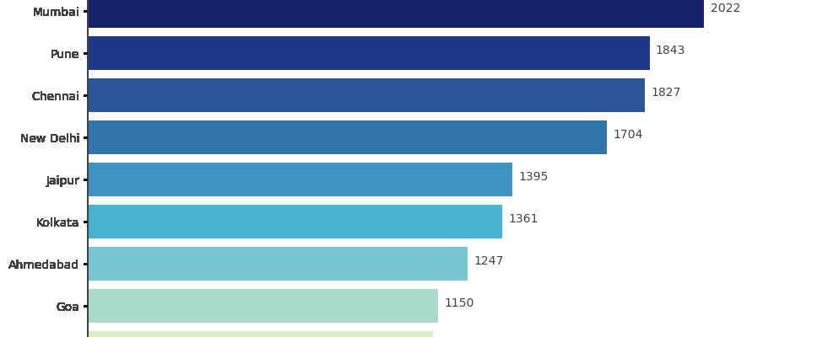
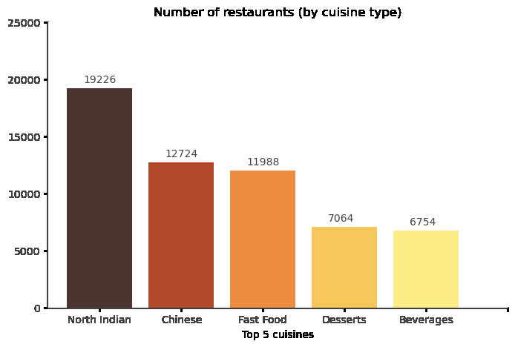

Slide 8
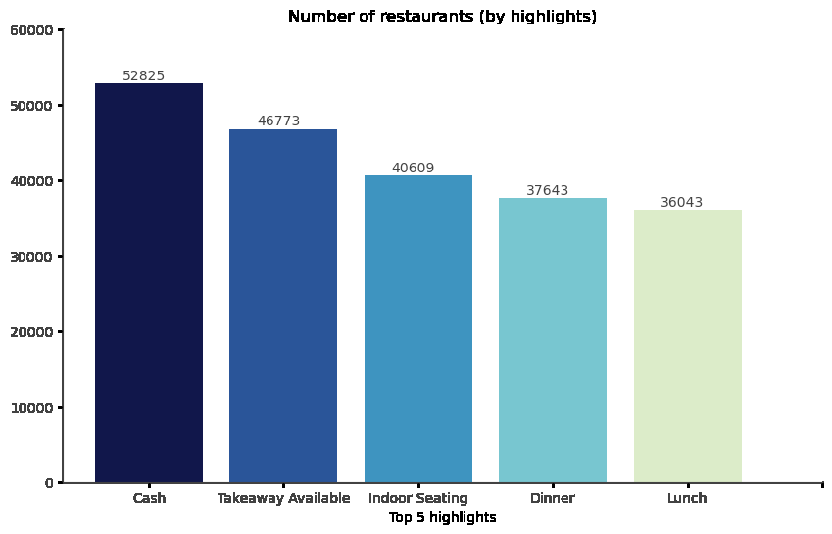
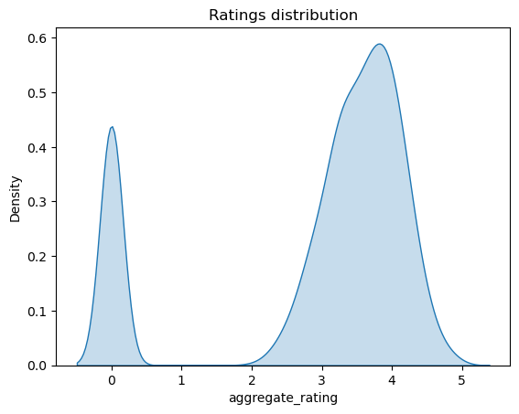
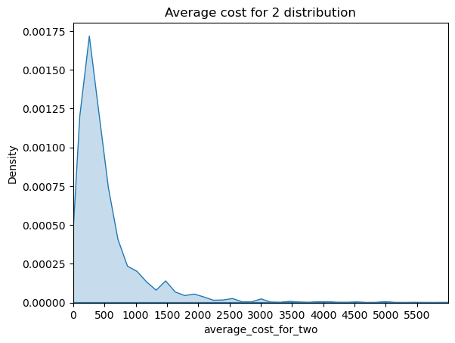
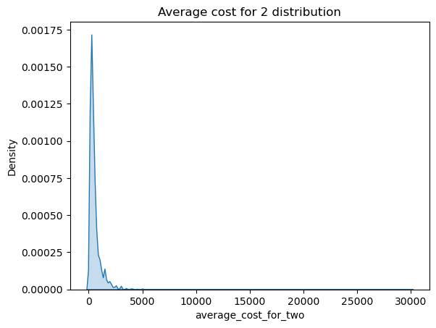

Slide 9
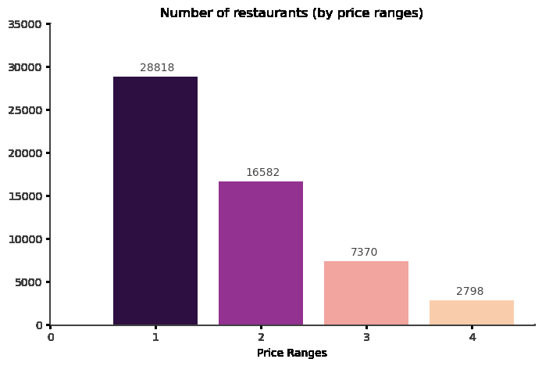
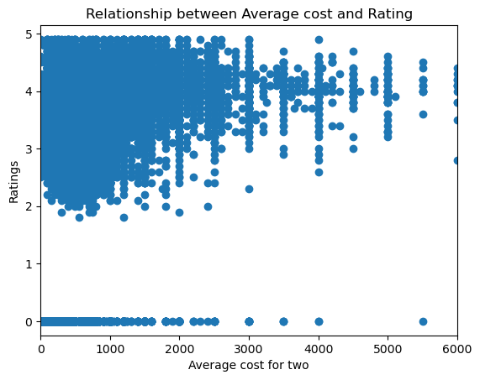
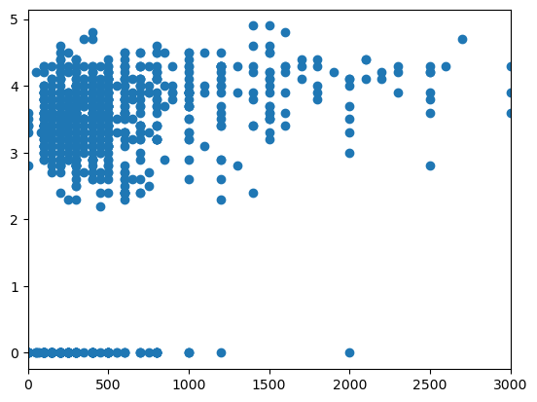
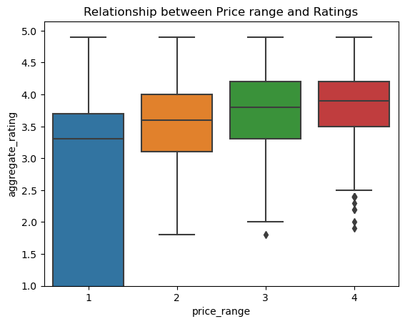

Slide 10
conclusion
After working on this data, we can conclude the following things:-
Approx. 35% of restaurants in India are part of some chain
Domino's Pizza, Cafe Coffee Day, KFC are the biggest fast food chains in the country with most number of outlets
Barbecues and Grill food chains have highest average ratings than other type of restaurants
Quick bites and casual dining type of establishment have most number of outlets
Establishments with alcohol availability have highest average ratings, votes and photo uploads
Banglore has most number of restaurants
Gurgaon has highest rated restaurants (average 3.83) whereas Hyderabad has more number of critics (votes). Mumbai and New Delhi dominates for most photo uploads per outlet
After North Indian, Chinese is the most prefered cuisine in India
International cuisines are better rated than local cuisines
Gastro pub, Romantic Dining and Craft Beer features are well rated by customers
Most restaurants are rated between 3 and 4
Majority of restaurants are budget friendly with average cost of two between Rs.250 to Rs.800
There are less number of restaurants at higher price ranges
As the average cost of two increases, the chance of a restaurant having higher rating increases
Now we have come to the end of this project.
[ ]:

Slide 11
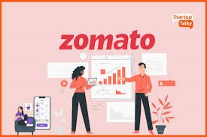
Data set reference link:
https://www.kaggle.com/datasets/rabhar/zomato-restaurants-in-india

Slide 12

.

