Slide 1

1

Slide 2

TALLA PADMAVATHI COLLEGE OF ENGINEERING
Autonomous
SOMIDI,KAZIPET,WARANGAL-URBAN,506003
NAAC Accredited-An ISO 9001-2015 Certified Institution
DEPARTMENT OF COMPUTER SCIENCE AND ENGINEERING (AI&ML)
Mini Project Presentation
On
Online Booking system for Sports Turf Playground
Batch-2
TEAM MEMBERS:
UNDER THE GUIDANCE OF:
Mr. E.AJITH KUMAR
Assistant Professor,TPO
K.MANILAXMI SISVAS 21UC1A6613
K.DAKSHITHA 21UC1A6611
R.POOJITHA 21UC1A6619
S.PARISHUDHA 22UC5A6602
2

Slide 3
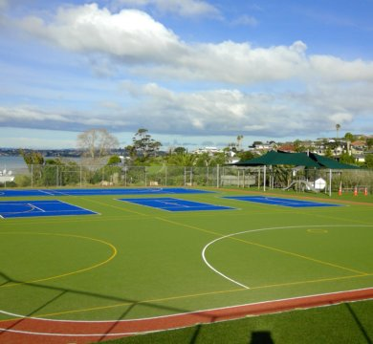
CONTENTS:-
Abstract
Introduction
Literature Survey
System Analysis
a)Existing system & Proposed system
b)System Specifications
3

Slide 4
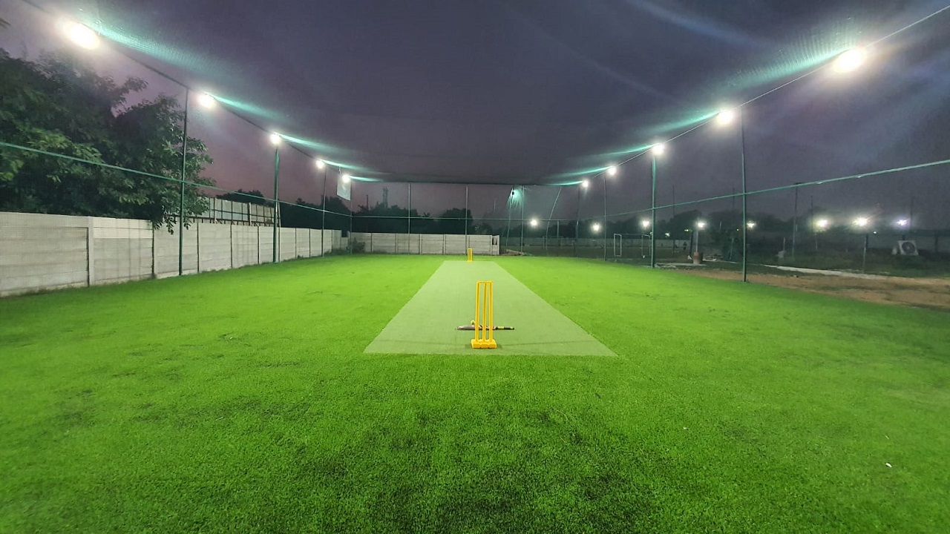
ABSTRACT:-
The Grounds presently run a manual reservation system. As customers are desirous to find a handy application for booking or any other services to avoid physical walking to the ground or contacting by call or reserving through a middle man, current research was aimed to design a web application for online booking system for grounds.
4

Slide 5
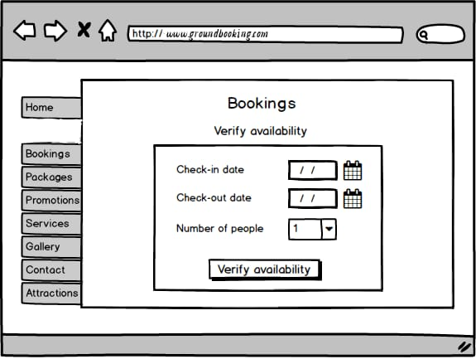
INTRODUCTION:-
Many school teams and clubs prefer turf playground
for practice and training purpose.
Sometimes it becomes difficult to book turf playground because
of timing issue or the slot getting booked previously
This sports ground booking website is proposed for
booking the turf in an easy and efficient way
5

Slide 6
LITERATURE SURVEY:-
Sir,syed hasan,scholar from Asia Pacific Institution of Innovation
Proposed online hotel booking in 2014
The early adoption of online booking systems can be
traced back to the late 1990s
Online booking systems for sports and recreational grounds
began gaining attraction in the mid-2000s
This shift was driven by the success of online
systems in other sectors
Private sports facilities started adopting these systems
6

Slide 7

SYSTEM ANALYSIS:- EXISTING SYSTEM:-
The system being used for ground booking is an internal system
which is manually used in bookings
LIMITATIONS :
The customer needs to know the location of the ground
manually by him/herself
Customer have to queue up for long time in order to secure a slot
7

Slide 8
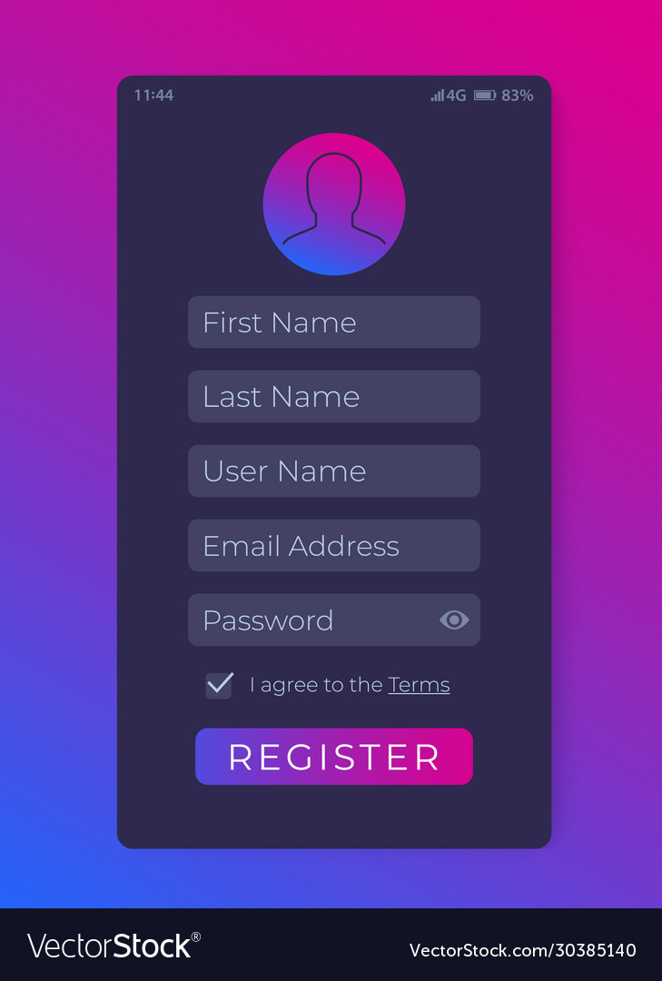

PROPOSED SYSTEM:-
In the new system the user will be asked to register once at the start
The application proposed will allow users to book any sports amenity if available
ADVANTAGES
Slot booking can be done from any where at any time
More productive than manual booking system
User friendly interface
8

Slide 9
SYSTEM SPECIFICATIONS:-
HARDWARE SPECIFICATIONS SOFTWARE SPECIFICATIONS
Processor : Intel i3/i5 Operating system: Windows 7/8/10
Hard disk : 120GB Tools :VS CODE, Gmail
RAM : 8 GB Front-end : HTML,CSS
Back-end : Javascript , SMTP, Cdnjs
9

Slide 10

Any queries
Feedback!
10

Slide 11
THANK YOU
11

