Slide 1

WHAT REALLY DRIVES
Student Success?
Predicting and Understanding the Factors Behind Secondary Student Performance
Likhitha Potluri · Manish Nair · Aditya Singh Panwar
University of San Diego | AAI-500: Applied Probability and Statistics for AI | June 21, 2026
Notes:
Good [morning/afternoon], everyone. Thank you for having us. Today we're presenting our project on what really drives student success in secondary school. We dug into a dataset of almost 2,400 students to figure out which everyday factors -- attendance, study habits, family support -- actually predict how well a student does, and what schools could realistically do about it. We've tried to keep this as non-technical as possible, so don't worry if you're not a data or stats person -- that's exactly who this is for.

Slide 2

The Question We Set Out to Answer
Out of everything that shapes a student’s grades — attendance, study habits, family support, even gender and background — which ones actually move the needle?
We studied 2,392 student records to find out — and, more importantly, what schools could actually do about it.
2
Notes:
So here's the question that started this whole project. There are dozens of things that supposedly affect how well a student does in school -- how much they study, whether their parents are involved, their gender, their background, whether they show up to class. We wanted to cut through the noise and find out: which of these actually matter, and which ones are just noise? To answer that, we looked at records for almost 2,400 students -- their grades, their habits, and their circumstances -- and let the data tell us the story.

Slide 3






The Data Behind Our Study
2,392
15
0
students studied
details tracked per student
missing or messy records
Five kinds of information were collected on every student:
Attendance
Study Habits
Family Support
Activities
Background
3
Notes:
A quick word on the data itself, because it matters for how much we can trust the results. We had records for 2,392 students, with 15 pieces of information on each one -- and not a single record was missing or broken, which is rare and made our job a lot easier. Broadly, the information fell into five buckets: how often a student showed up to school, how much they studied each week, how involved their family was, what activities they were part of, and basic background details like age and parental education.

Slide 4
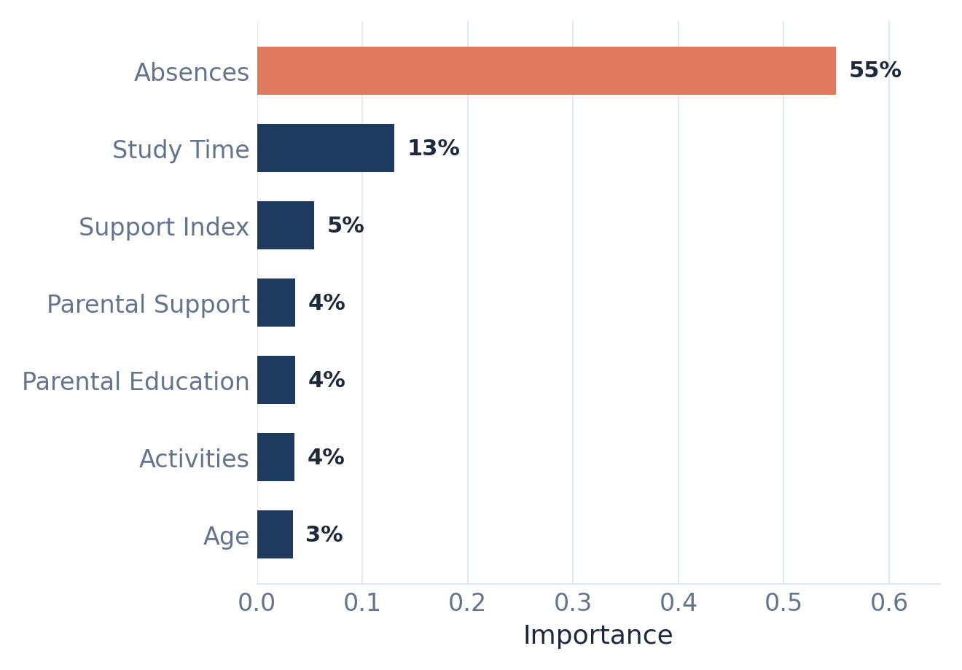
Finding #1: Attendance Beats Everything Else
Miss more school → lower grades, almost without exception. The pattern was nearly a straight line.
What our model found mattered most
Absences were, by a wide margin, the single strongest signal of how a student would perform — stronger than study time, family support, or anything else we measured.
Share of predictive weight per factor, from our prediction model
↓ 0.29 GPA points gained by cutting absences just 20%
4
Notes:
Here's the headline finding of the entire project, so I want to slow down on this one. Of everything we looked at, nothing came close to attendance. When we compared how often a student missed school to their grades, the relationship was almost a straight line -- miss more school, get a lower grade, almost without exception. This wasn't a small effect mixed in with everything else -- it was the dominant factor, by far, more powerful than study time, family support, or any background factor combined. The chart on the right shows this directly -- that's our model ranking every factor it considered, and absences alone account for more than half of its decision-making weight. If you remember one thing from this whole talk, remember this: showing up to school is, far and away, the biggest lever on a student's grades.

Slide 5

What Else Helps?
Study Time
Family Support
More weekly study time was linked to better grades — a real, positive effect, but a modest one compared to attendance. Putting in the hours helps, but it isn’t a substitute for showing up.
Students with more parental involvement earned higher grades — and that support also softened the damage caused by absences. Engaged families act like a safety net.
5
Notes:
Now, attendance wasn't the only thing that mattered -- it was just the biggest. Two other factors showed real, positive effects. First, study time: students who studied more each week tended to earn better grades. It's a real effect, just a much smaller one than attendance -- you can't out-study chronic absenteeism. Second, and this one's interesting: family support. Students whose parents were more involved did better overall, and on top of that, strong family support actually cushioned some of the damage caused by missing school. In other words, an engaged family doesn't just help directly -- it helps protect kids who are already struggling to attend regularly.

Slide 6

Grades Were Fair Across the Board
We checked whether gender or ethnic background made a difference in grades. They didn’t. Boys and girls scored almost identically, and the four ethnic groups in the data performed about the same.
That’s genuinely good news: it means performance gaps come down to daily habits and circumstances — things schools and families can actually influence — not who a student is.
6
Notes:
We also wanted to check something important from a fairness standpoint: does gender or ethnic background predict grades, once you account for everything else? And the answer was no. Boys and girls earned almost identical average grades, and the difference between ethnic groups wasn't statistically meaningful either. We see this as a genuinely encouraging finding -- it tells us that performance gaps in this data aren't about who a student is, they're about daily habits and circumstances like attendance and support, which is exactly the kind of thing a school can actually do something about.

Slide 7
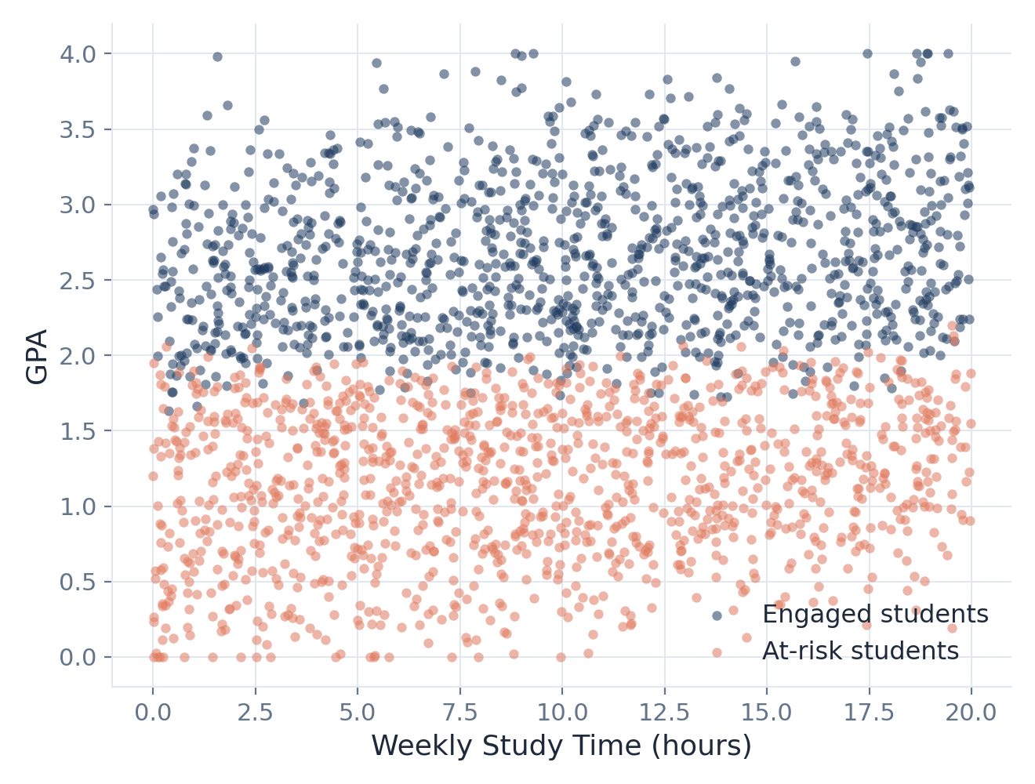

Two Types of Students Emerged
The Engaged Student
Rarely absent · studies consistently · strong family support → higher GPA overall.
The At-Risk Student
Frequently absent · less engaged · limited support at home → lower GPA overall.
Every dot is one student, grouped by attendance, study habits, and support
7
Notes:
When we grouped students by their overall patterns -- not by what they were told they were, but by what their actual behavior looked like -- two clear types emerged naturally from the data, which you can see right here in this chart -- the navy dots and the coral dots barely overlap. One group we'd call the Engaged Student: good attendance, consistent study habits, strong family support, and higher grades to show for it. The other group is the At-Risk Student: frequent absences, lower engagement, less support at home, and lower grades. The value here is practical -- it tells schools that a single, generic support program probably isn't the right approach. These two groups need different kinds of help.

Slide 8

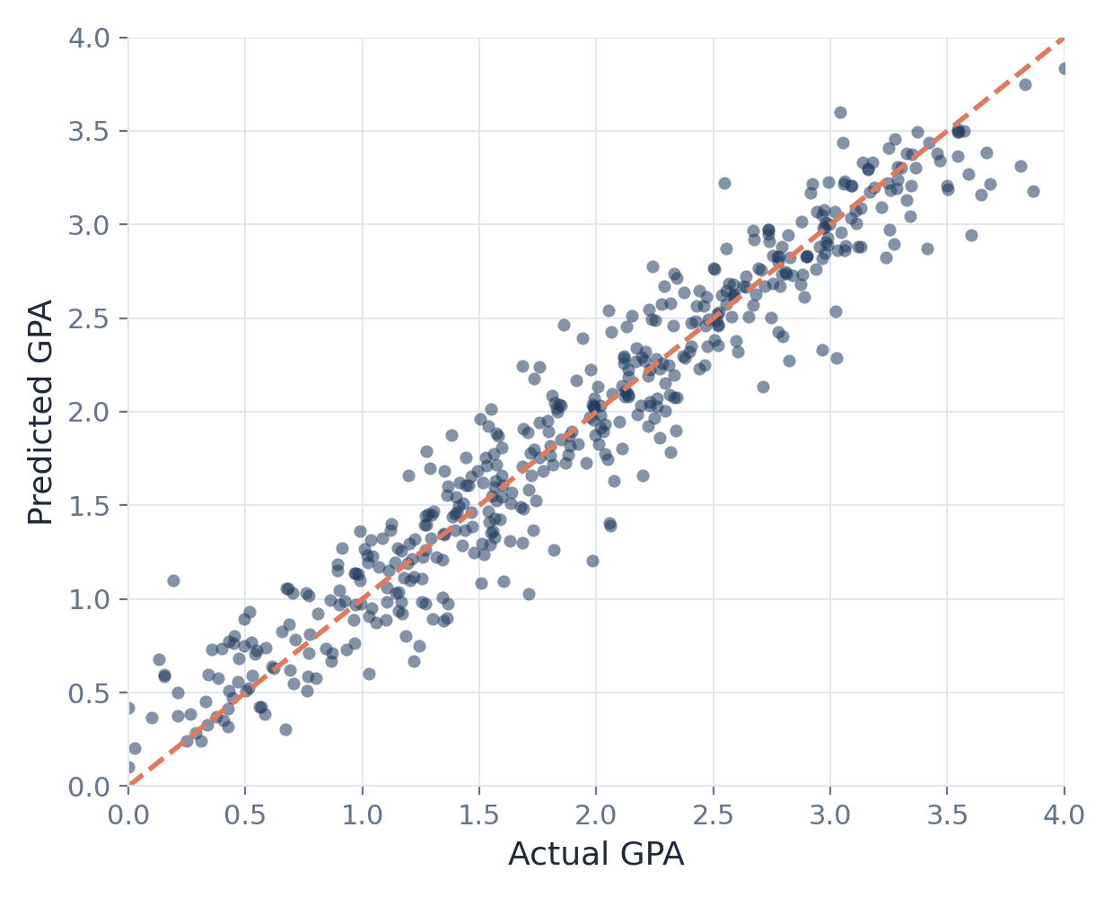
Yes — We Can Predict It, With Confidence
93%
Predicted GPA vs. actual GPA (held-out students)
of the differences in students’ grades explained, just from these everyday factors
96%
of the time, our model correctly flagged students on track for top grades
Dots on the line are predictions that matched reality
8
Notes:
So, beyond just describing patterns, can we actually predict outcomes? Yes, and the results were strong. Using the handful of factors we've talked about -- attendance, study time, family support -- we built a model that explained 93% of why students' grades differed from each other. That's a very high number for this kind of real-world prediction. You can see it in this chart on the right -- every dot is a real student, and the closer a dot sits to that dashed line, the more accurate our prediction was for them. Most dots hug that line closely. We also built a second tool focused specifically on spotting top-performing students, and it correctly identified them 96% of the time. Importantly, we tested both of these on students the model had never seen during training, so we're confident this isn't just memorizing the data -- it generalizes.

Slide 9

If Schools Take Action — What Happens?
Cutting absences by just 20% raised average grades more than doubling study-time gains or boosting parental support — the single highest-leverage action available to schools.
9
Notes:
This next part is the most actionable slide of the whole presentation. We took our model and asked it a 'what if' question: if schools made specific changes, how would average grades move? The starting point, today, is an average GPA of about 1.91. If we simulate cutting absences by just 20% across the board, the average GPA jumps to about 2.20 -- that's the tallest bar you see here. Compare that to a 10% increase in study time, which barely moves the needle, or boosting parental support by one level, which helps some but not nearly as much. The takeaway is clear: if a school only has the resources to focus on one thing, attendance is where the dollars and effort pay off the most.

Slide 10
What This Means for Schools
Treat attendance as an early-warning sign
Flag rising absences immediately and follow up on the underlying cause — health, family, or disengagement.
Invest in parent engagement
Family involvement cushions the damage of missed school days — pair attendance pushes with outreach to parents.
Target tutoring at the at-risk group
Concentrate tutoring resources on the high-absence, low-support student profile identified in our analysis.
10
Notes:
So what do we actually recommend schools do with this? Three things. First, treat attendance like a vital sign -- the moment a student's absences start climbing, that should trigger a quick, supportive check-in, not a wait-and-see approach. Second, invest in parent engagement alongside attendance efforts, since we showed that engaged families soften the blow of missed school. And third, don't spread tutoring resources evenly -- concentrate them on the at-risk group we identified, the students with high absences and low support, since that's where the resource will do the most good.

Slide 11
A Few Honest Caveats
This dataset was synthetically generated to resemble a real school — it wasn’t collected from an actual classroom, so real-world results may look noisier.
Our findings show strong patterns, not proof of cause and effect — we can’t say for certain that fixing attendance alone will fix grades.
Some real-world factors — teacher quality, peer influence, mental health — simply weren’t in this data.
11
Notes:
Before we close, a few honest caveats, because we think good research should be upfront about its limits. First, this dataset was synthetically generated to resemble a realistic school population -- it wasn't pulled from an actual school's records, so real-world data would likely be messier. Second, what we found are strong patterns and associations, not airtight proof of cause and effect -- we can't say with certainty that fixing attendance alone will fix grades, only that they're very strongly linked. And third, there are real-world factors we simply didn't have access to, like teacher quality, peer influence, or student mental health, which surely matter too.

Slide 12
Thank You
Questions & Discussion
Likhitha Potluri · Manish Nair · Aditya Singh Panwar
University of San Diego | AAI-500: Applied Probability and Statistics for AI
Notes:
To sum up: attendance is, far and away, the strongest single driver of student performance in our data, study time and family support help meaningfully on top of that, and grades didn't differ unfairly by gender or background. Most importantly, our simulation shows that getting students into the classroom more often is the highest-leverage move a school can make. Thank you for your time -- we're happy to take any questions.

