Slide 1

Vel Tech Rangarajan Dr. Sagunthala R&D Institute of Science and Technology
School of Computing
Department of Computer Science and Engineering
10211CS224 / FULL STACK APPLICATION DEVELOPMENT
PROJECT REVIEW : MILESTONE PROJECT – 2
Date: 20-04-2026
Smart Event Management & Ticket Booking System for Campus Events
SDG: 9 – Industry , Innovation and Infrastructure
SDG: 12- Responsible Consumption and Production
Presented By:
N.LIKHITHA KUMARI – VTU26510 – 23UECS0823
Courses Handling Faculty:
Dr. S. Hemamalini, Assistant.Professor
(Sr Grade)-M.E,ph.D

Slide 2
INTRODUCTION
1
The Event Ticket Booking System is a web-based application developed using React JS and Node.js.
The system allows users to:
View available events
Select event and book tickets
Enter student details
Proceed to payment
Get booking confirmation
Admin can:
Add events
Delete events
View student bookings
2
3
4
5
6
7
8
9

Slide 3
PROBLEM STATEMENT
1
Manual event booking systems are inefficient and lack proper organization, leading to difficulties in managing events and tracking participants. There is no centralized platform to handle bookings, resulting in errors, duplication, and lack of real-time updates. Therefore, an automated system is required to streamline the booking process, manage data efficiently, and provide better control for administrators.
Manual event booking leads to:
No centralized system
Ticket mismanagement
Data duplication
No proper tracking of students
No real-time availability
So, there is a need for:
Automated booking process
Centralized data storage
Real-time updates
Admin management system
2
3
4
5
6
7
8
9

Slide 4
OBJECTIVE(S)
1
2
.
To develop a React-based ticket booking UI
To implement event booking system
To store event & booking data
To provide admin control panel
To implement payment simulation
To display booking confirmation
3
4
5
6
7
8
9

Slide 5
PROPOSED SYSTEM
1
The proposed system is a React + Node.js web application
Features:
Event listing
Ticket booking form
Payment page
Booking confirmation
Admin dashboard
System automatically:
Stores booking data
Displays event availability
Shows confirmation after payment
2
3
4
5
6
7
8
9

Slide 6
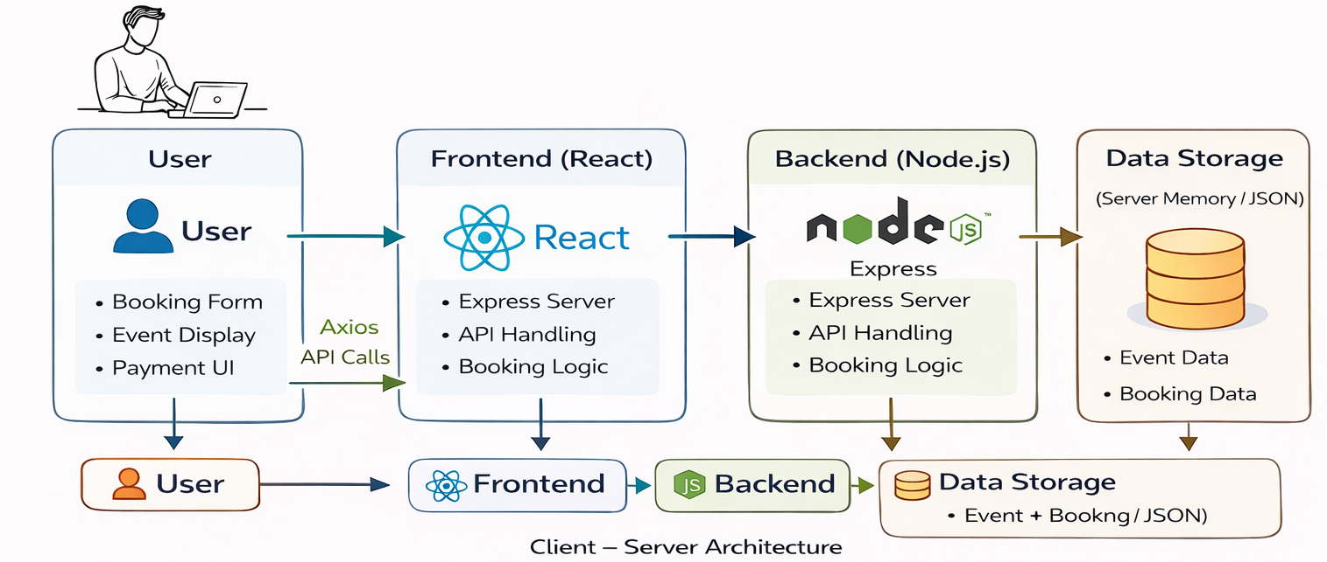
PROPOSED SYSTEM ARCHITECTURE
1
2
3
4
5
6
7
8
User → React Frontend
React → Axios API Calls
Backend → Node.js (Express)
Data → Stored in server
9

Slide 7
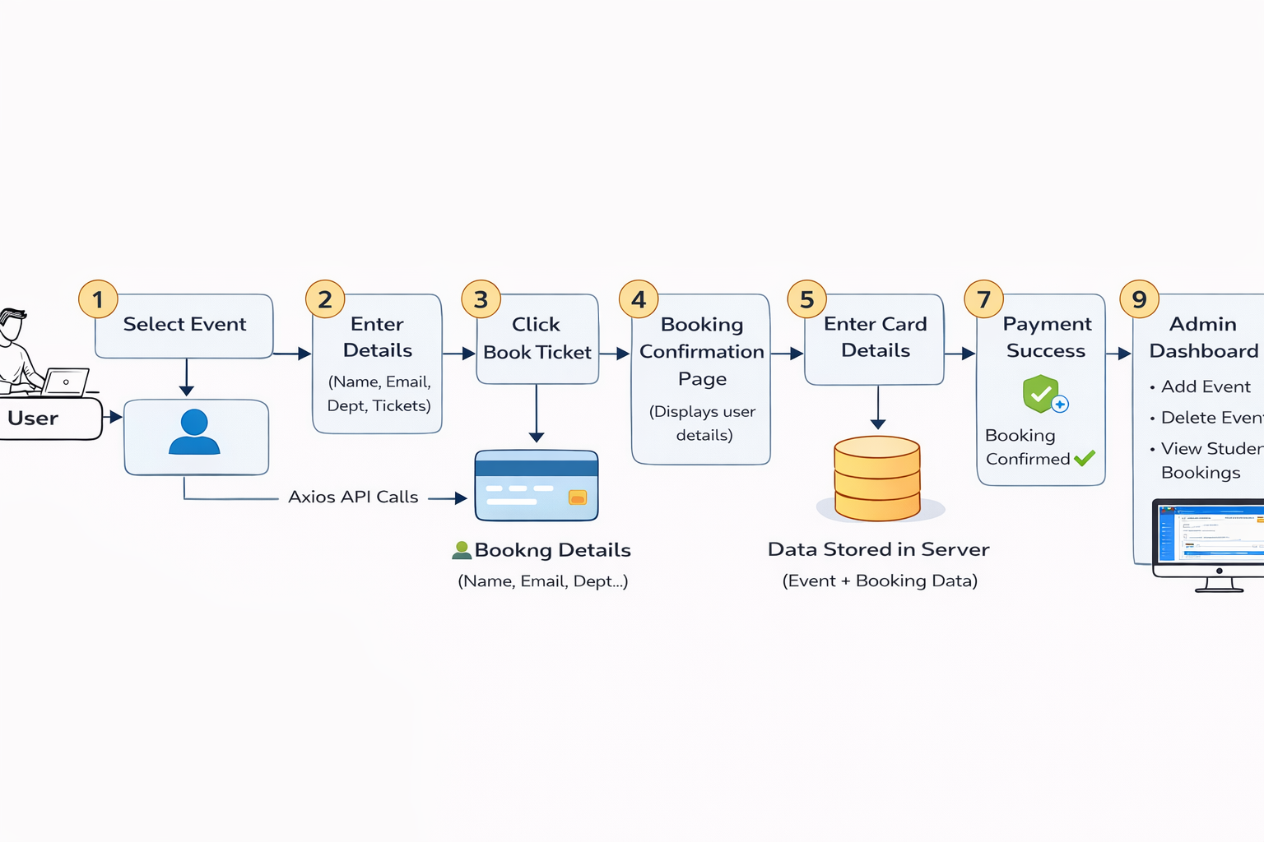
WORKFLOW
1
2
3
4
5
6
7
8
9

Slide 8
TECHNOLOGIES USED
Frontend:
React JS
CSS
HTML
Backend:
Node.js
Express.js
Database:
JSON/Local Storage(or server memory)
Tools:
VS Code
Chrome Browser
Axios
1
2
3
4
5
6
7
8
9

Slide 9
MODULE DESCRIPTION
Module 1 – User Booking
Select event
Enter details
Book ticket
Module 2 – Confirmation
Displays user details
Shows event info
Proceed to payment
Module 3 – Payment
Enter card details
Simulated payment
Booking confirmation alert
Module 4 – Admin Panel
Add event
Delete event
View bookings
1
2
3
4
5
6
7
8
9

Slide 10
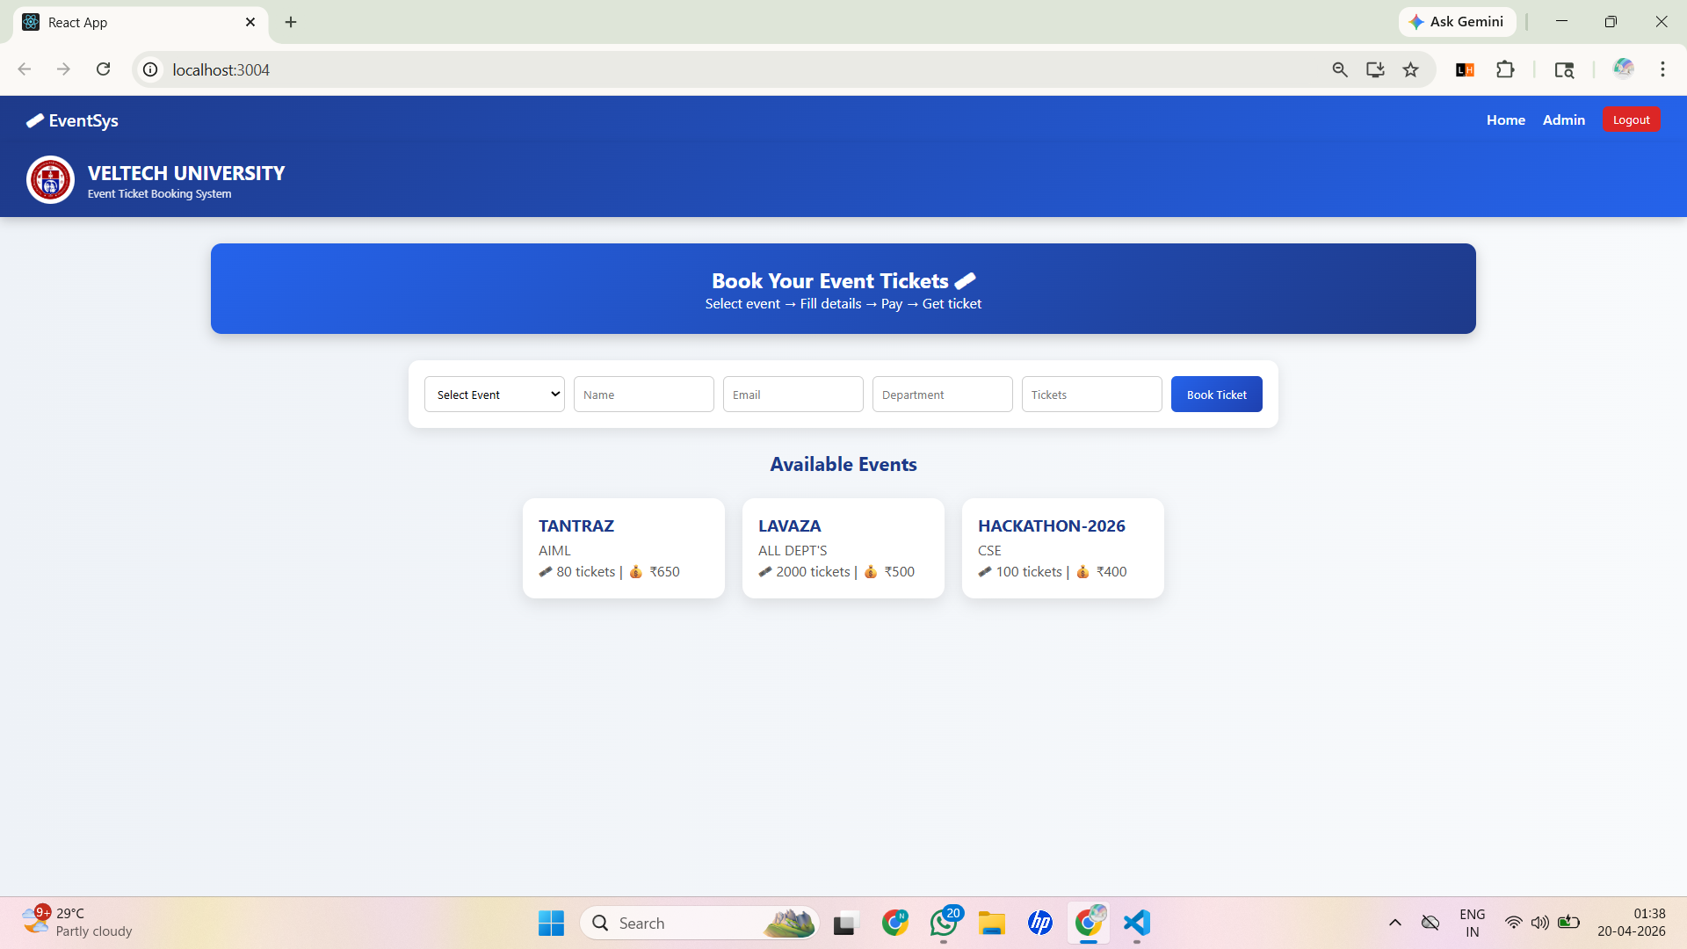
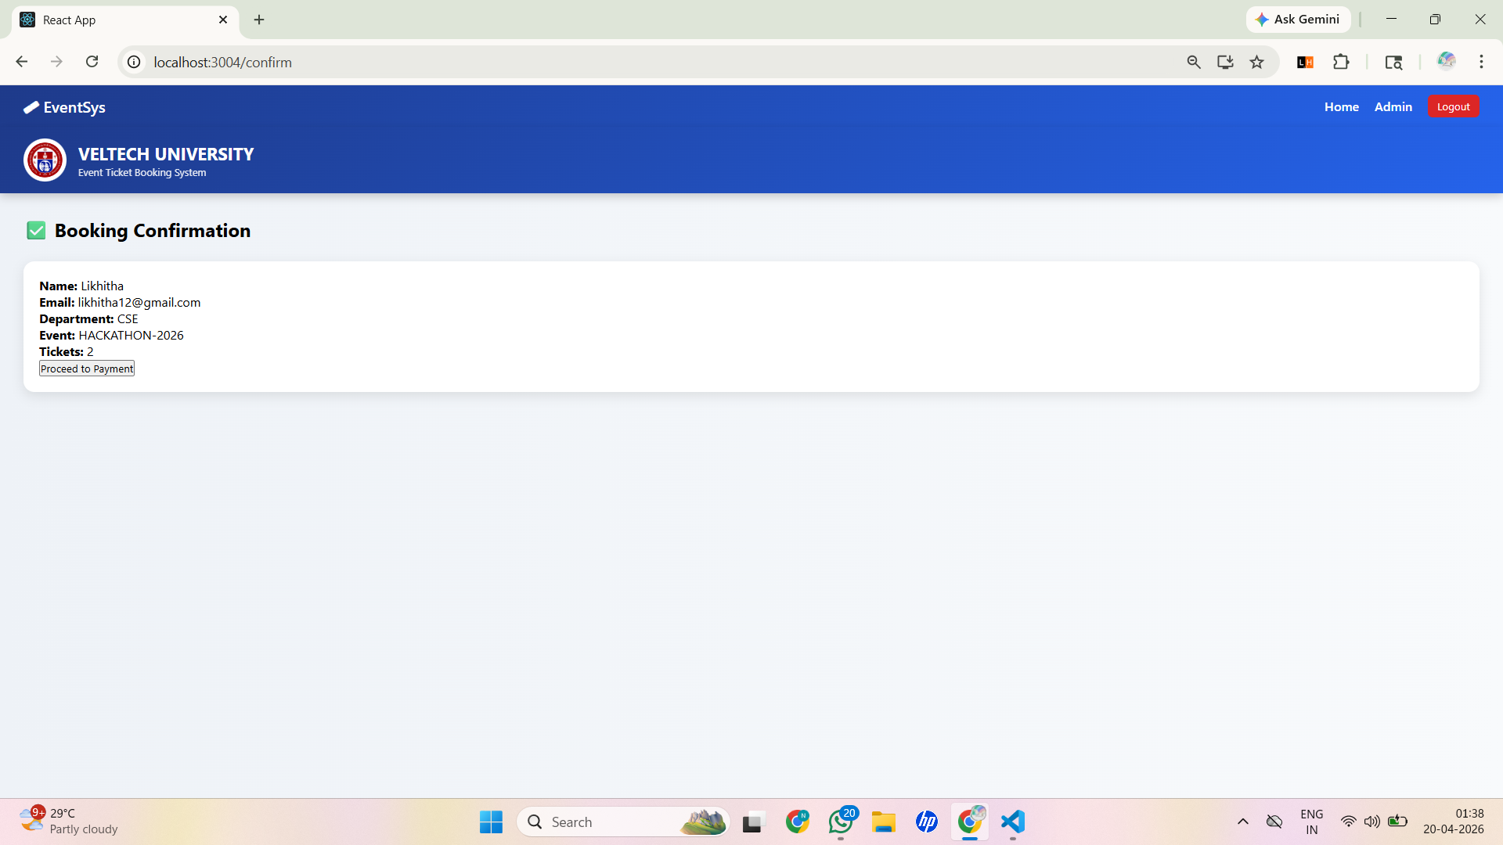
IMPLEMENTATION SCREENSHOTS
1
2
3
4
5
6
Home Page: User interface displaying events and ticket booking form
7
8
9
Booking Confirmation Page: Displays entered user details before proceeding to payment

Slide 11
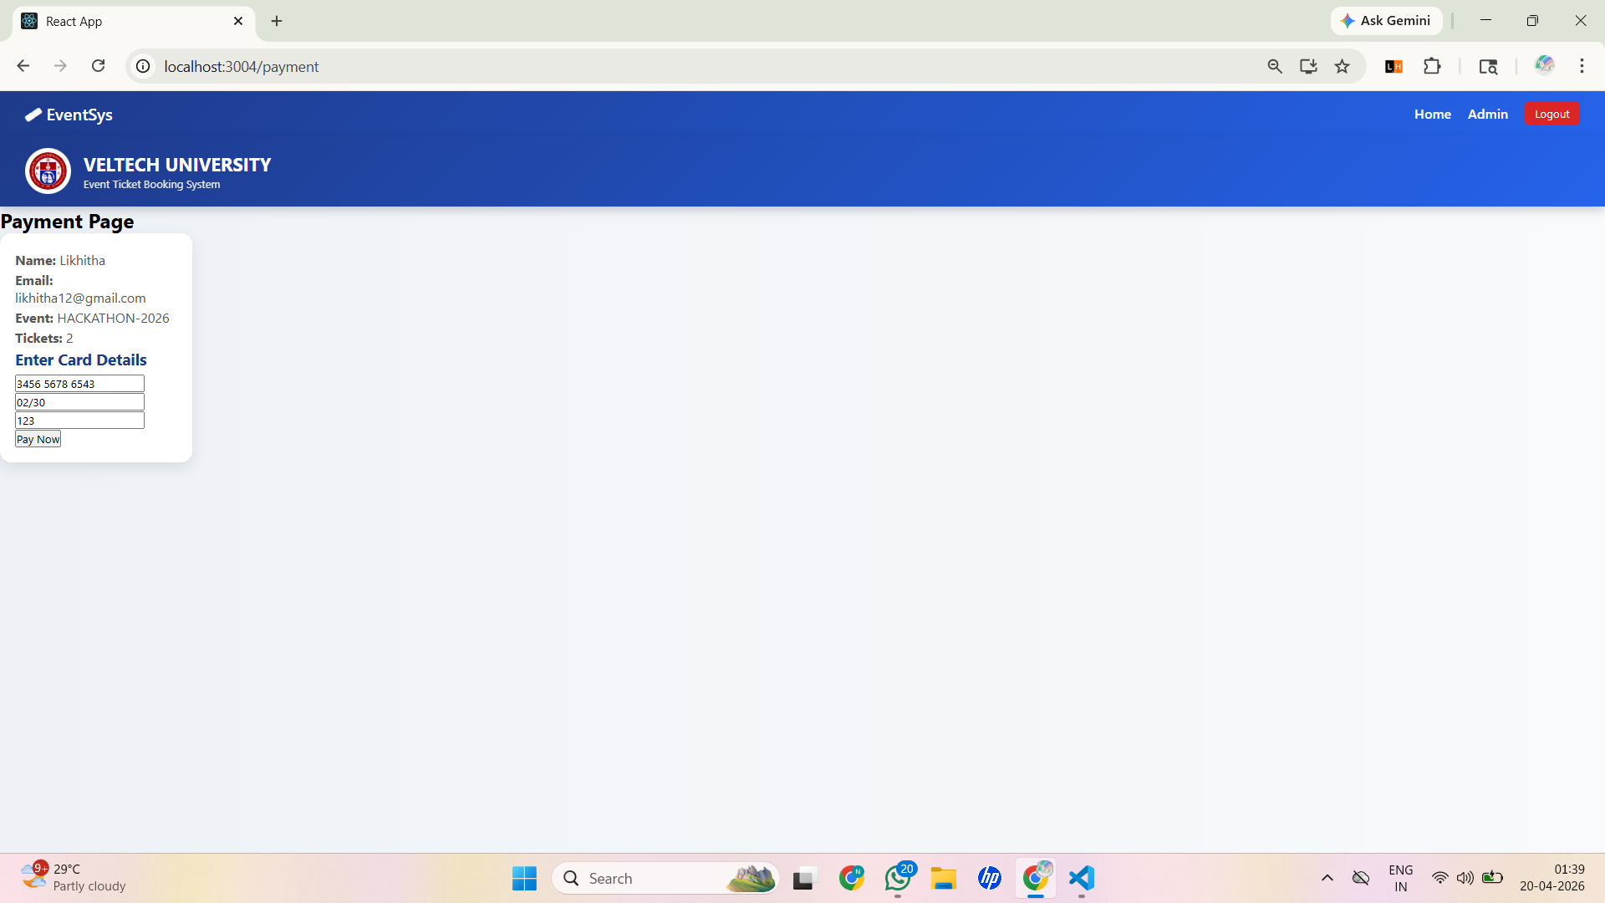
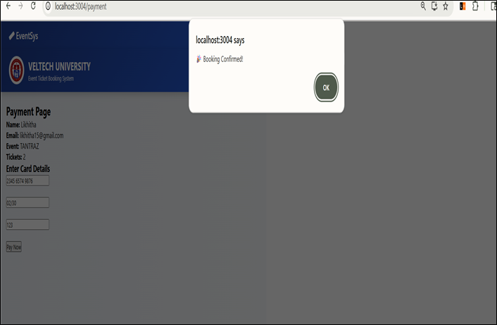
IMPLEMENTATION SCREENSHOTS
1
2
3
4
5
6
Payment Page: User enters card details to complete ticket booking
7
8(A)
9
Payment Success Alert: Confirmation message indicating successful ticket booking

Slide 12
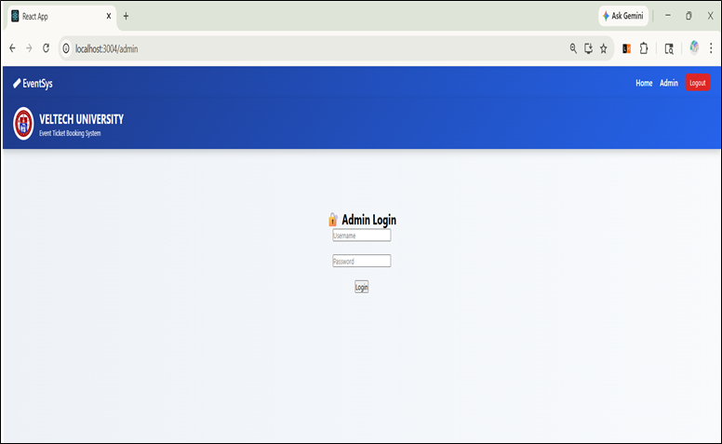
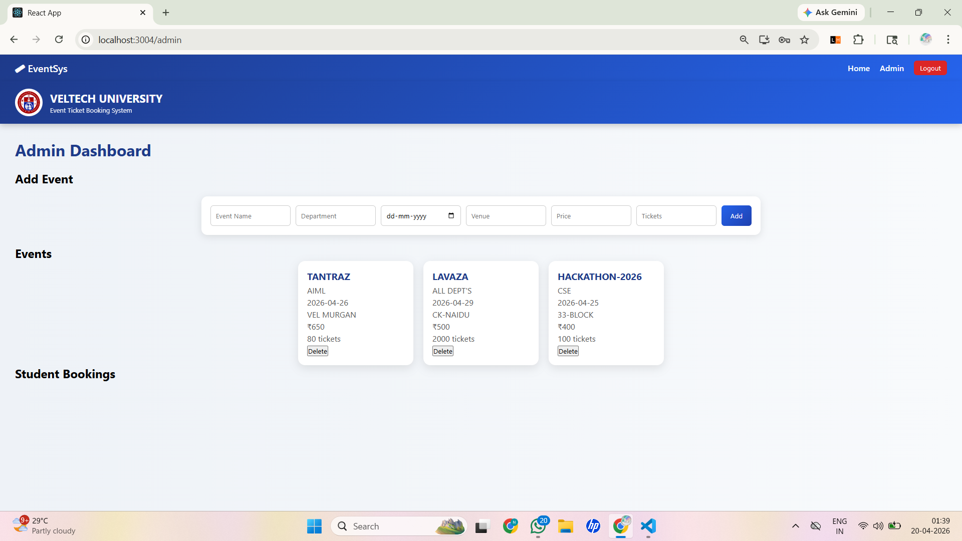
IMPLEMENTATION SCREENSHOTS
1
2
3
4
5
6
Admin Login Page: Secure login interface for administrator access
7
8(B)
9
Admin Dashboard: Admin panel to add, manage, and delete events

Slide 13
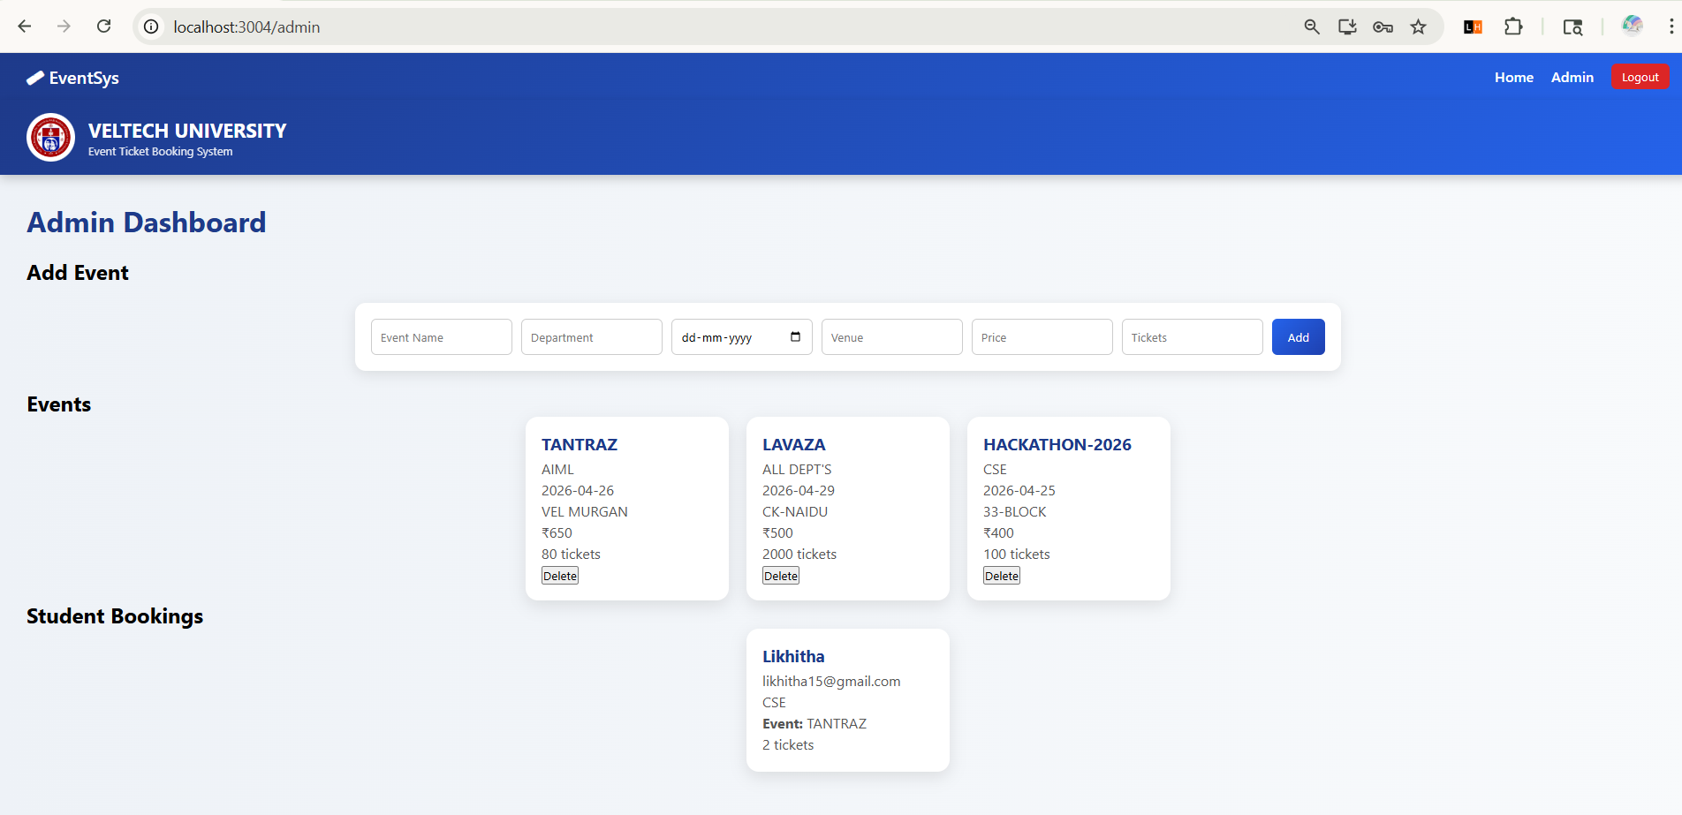
IMPLEMENTATION SCREENSHOTS
1
2
3
4
5
6
7
8(C)
9
Student Bookings: Displays list of students who booked tickets for events

Slide 14
ADVANTAGES & LIMITATIONS
1
Advantages:
Limitations:
No real payment gateway
No database
Single admin system
No authentication security
2
Easy ticket booking
Centralized system
Admin control
Real-time event display
Simple UI
3
4
5
6
7
8
9

Slide 15
Thank you

