Slide 1

Vel Tech Rangarajan Dr. Sagunthala R&D Institute of Science and Technology
School of Computing
Department of Computer Science and Engineering
10211CS224 / FULL STACK APPLICATION DEVELOPMENT (JAVA)
PROJECT REVIEW : MILESTONE PROJECT – 1
Date: 23-03-2026
Track Wise: Relational Expense Analytics Platform
SDG: 8 – Decent Work and Economic Growth
Presented By:
N.LIKHITHA KUMARI – VTU26510 – 23UECS0823
Courses Handling Faculty:
Dr. S. Hemamalini, Assistant.Professor
(Sr Grade)-M.E,ph.D

Slide 2
INTRODUCTION
1
Track Wise – Expense Tracker is a web-based application developed using Spring Boot and Maven.
The system allows users to:
Securely login
Add expenses
Edit and delete expenses
View budget summary
Generate monthly financial report
Download report as PDF
The system automatically calculates:
Total Expenses
Remaining Balance
Financial Health Status
It helps users manage salary and spending efficiently.
2
3
4
5
6
7
8
9

Slide 3
PROBLEM STATEMENT
1
Traditional expense tracking methods are inefficient and error-prone, lacking real-time visibility and proper organization. Therefore, a secure and automated system is required to manage expenses accurately, monitor budgets instantly, and generate structured reports with PDF export.
Managing personal expenses manually leads to:
Calculation errors
Poor tracking
No real-time balance visibility
No centralized storage
No structured reporting
So there is a need for:
A secure login-based system
Automated expense calculation
Real-time budget monitoring
Structured database storage
Report generation with PDF export
2
3
4
5
6
7
8
9

Slide 4
OBJECTIVE(S)
1
2
.
To build a secure login system using Spring Security
To develop CRUD operations (Add, Edit, Delete expenses)
To implement real-time budget calculation
To store expense data in a relational database
To generate a monthly expense report
To allow PDF report download
3
4
5
6
7
8
9

Slide 5
PROPOSED SYSTEM
1
The proposed system is a Spring Boot based web application.
Features:
User authentication
Budget summary dashboard
Add Expense
Edit Expense
Delete Expense with confirmation
Expense exceeded warning
Monthly report generation
PDF download
The system automatically:
Calculates total expenses
Displays remaining balance
Shows financial health message
2
3
4
5
6
7
8
9

Slide 6
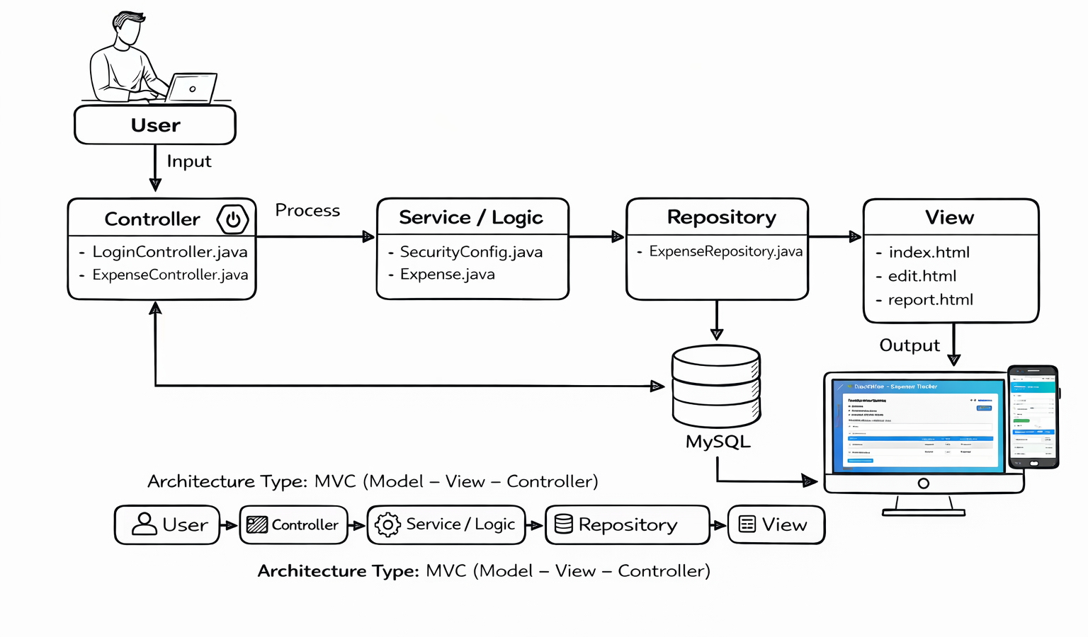
PROPOSED SYSTEM ARCHITECTURE
1
2
3
4
5
6
7
8
Input: User enters expense and salary details through the web interface.
Processing: The system validates data and calculates total expenses and remaining balance.
Database: All expense records are stored and managed in a MySQL relational database.
Database: All expense records are stored and managed in a MySQL relational database.
9

Slide 7
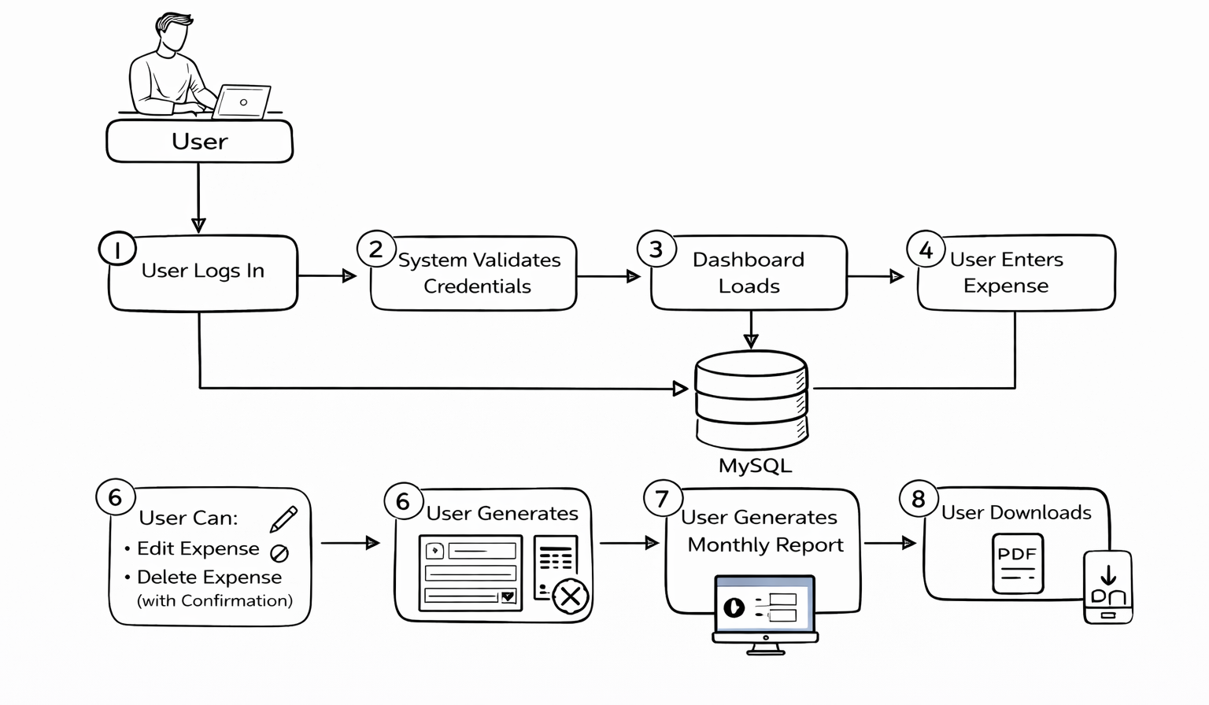
WORKFLOW
1
2
3
4
5
6
7
8
9

Slide 8
TECHNOLOGIES USED
Frontend:
HTML
CSS
Backend:
Java
Spring Boot
Spring MVC
Spring Security
Database:
MySQL
Tools:
Eclipse IDE
Maven
Chrome Browser
1
2
3
4
5
6
7
8
9

Slide 9
MODULE DESCRIPTION
Module 1 – User Authentication
Login page
Username & password validation
Spring Security implementation
Module 2 – Expense Management
Add Expense
Edit Expense
Delete Expense (confirmation popup)
Module 3 – Budget Summary
Displays:
Salary
Total Expense
Remaining Balance
Shows:
"Great! You saved ₹..."
"Expenses Exceeded Salary!"
Module 4 – Report Generation
Displays monthly report
Shows financial health
Allows PDF download
1
2
3
4
5
6
7
8
9

Slide 10
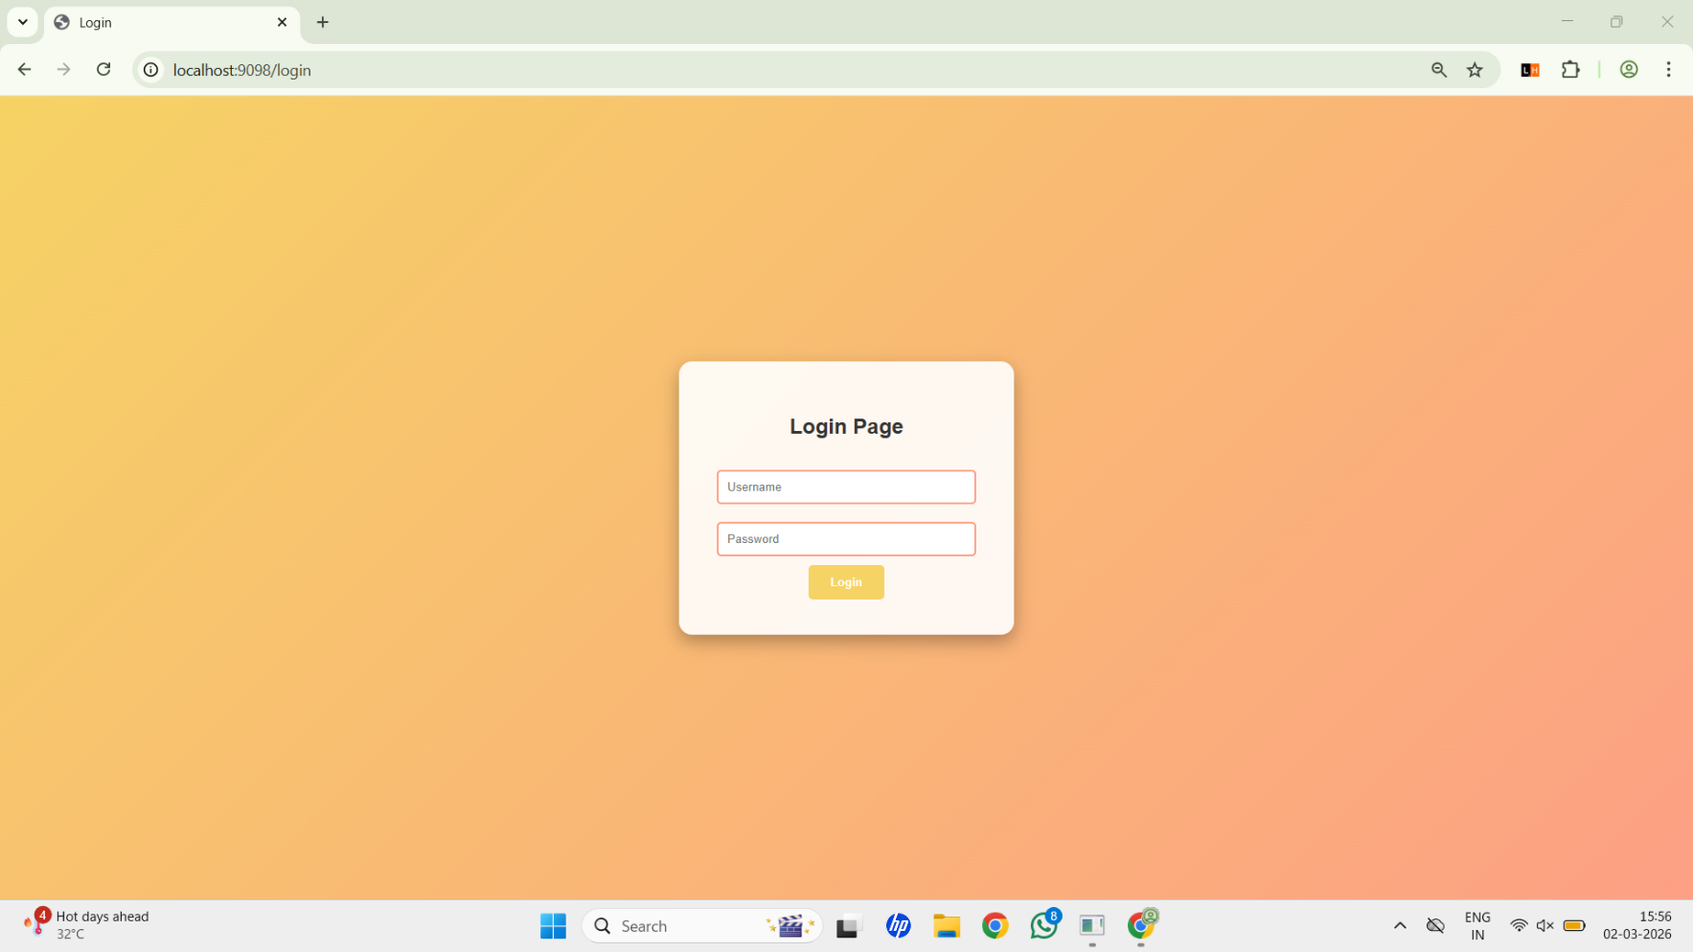
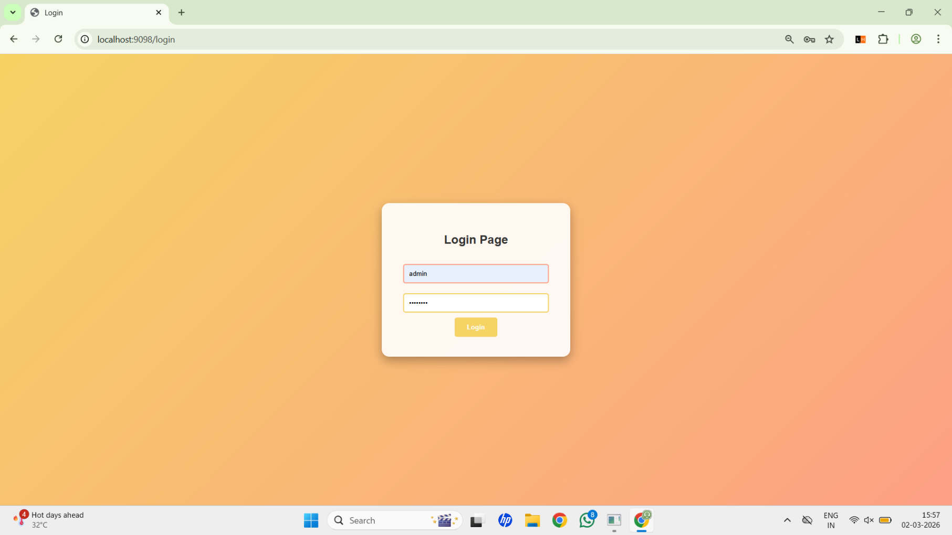
IMPLEMENTATION SCREENSHOTS
1
2
3
4
5
6
Login Page: Secure Login Page implemented using Spring Security for user authentication.
7
8
9

Slide 11
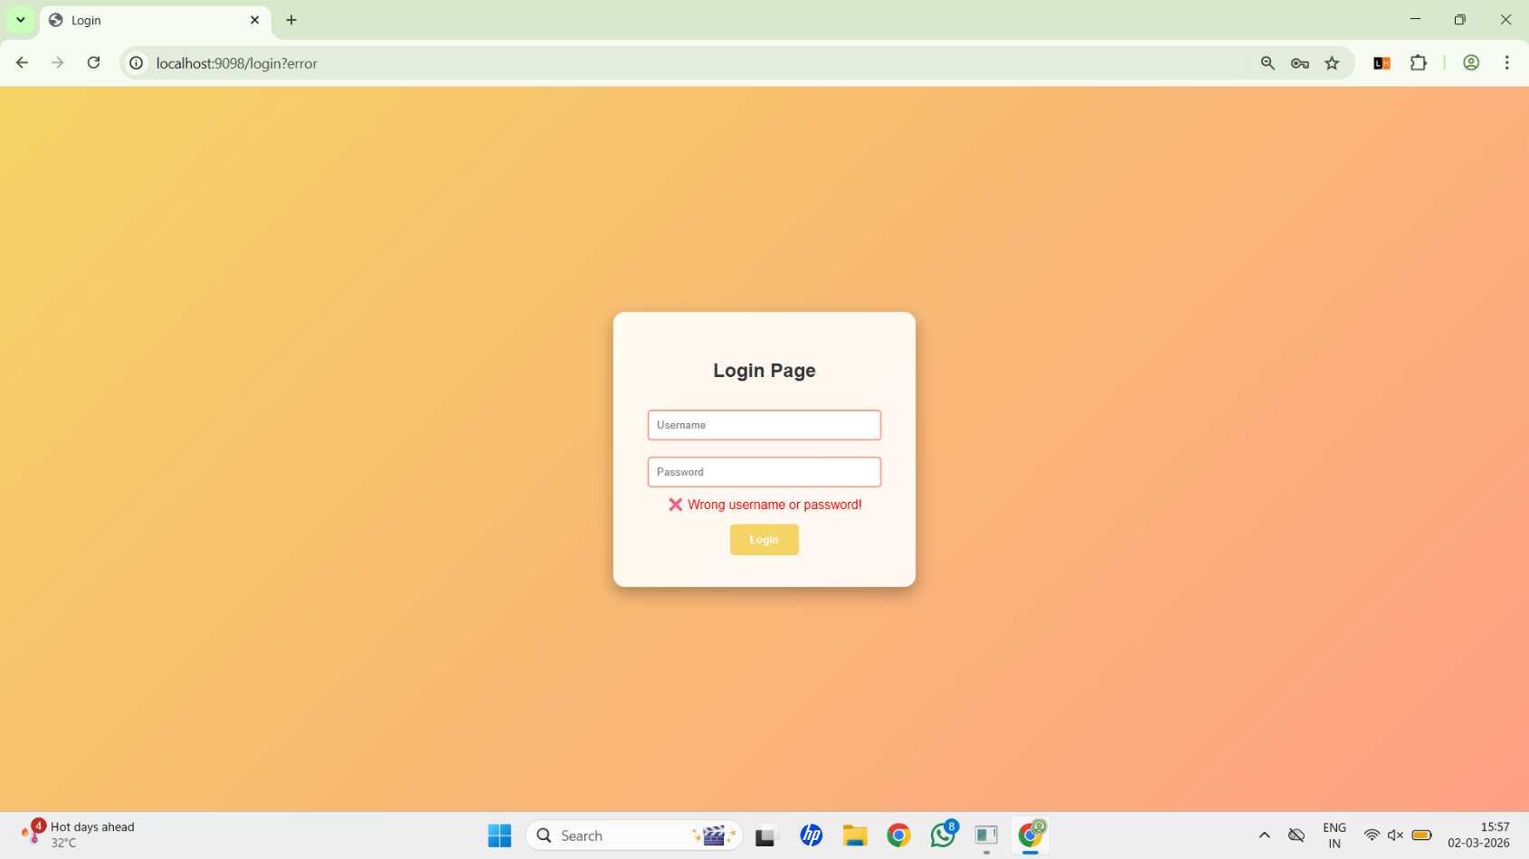
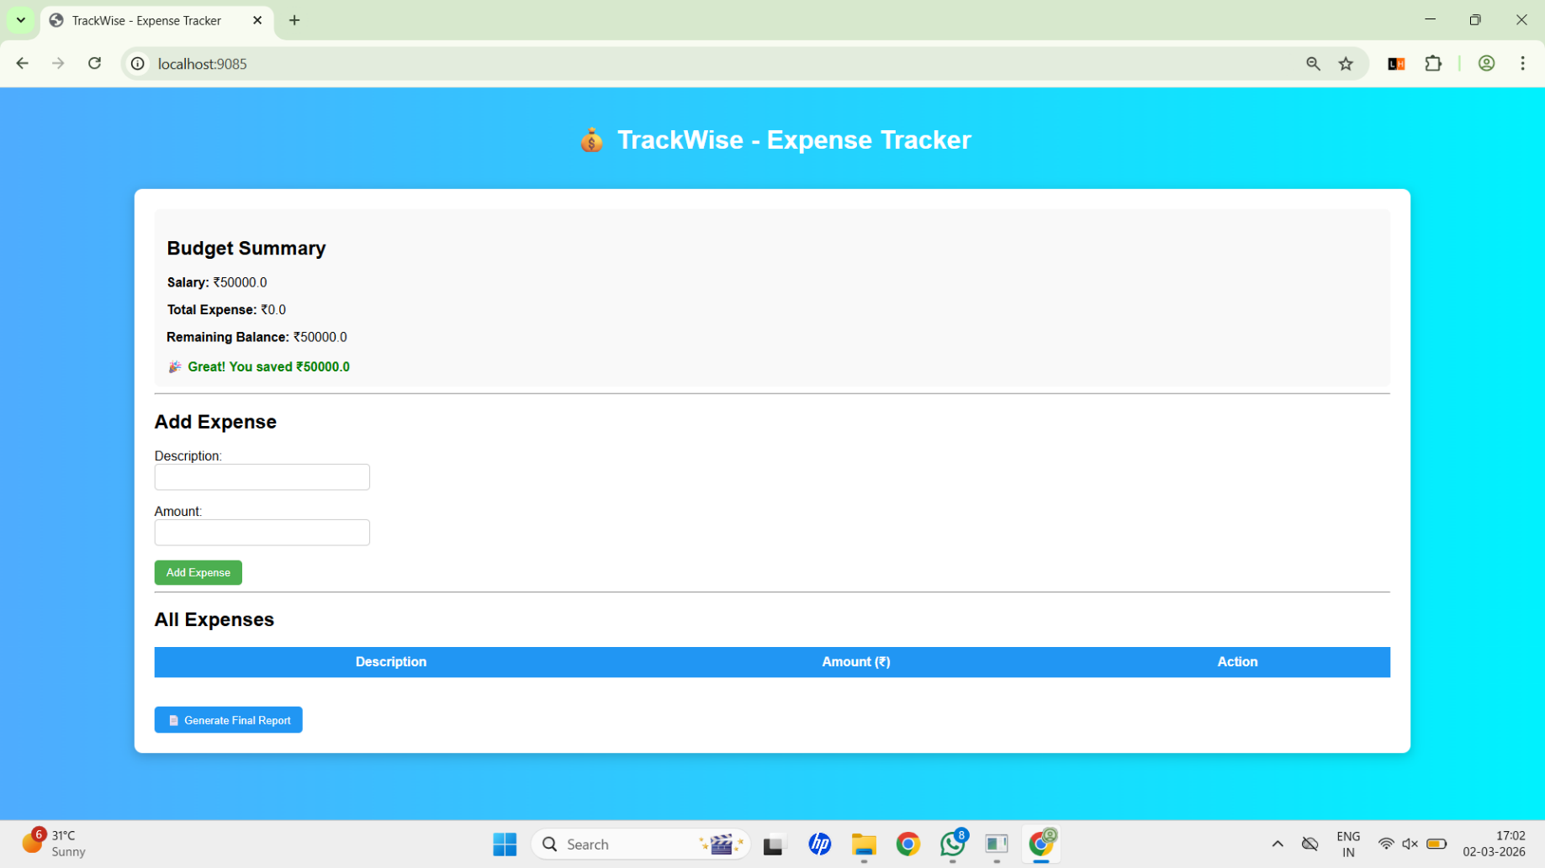
IMPLEMENTATION SCREENSHOTS
1
2
3
4
5
Login Error Page: Login Error Message displayed for invalid username or password credentials.
6
7
8(A)
9
Dashboard (Home Page): Dashboard displaying Budget Summary including Salary, Total Expenses, and Remaining Balance.

Slide 12
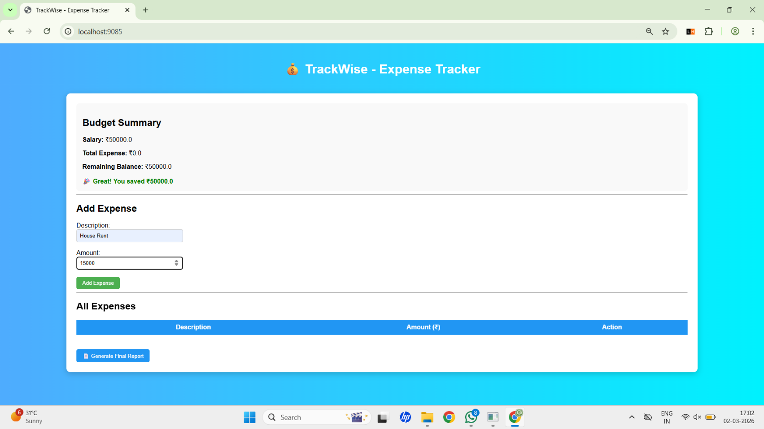
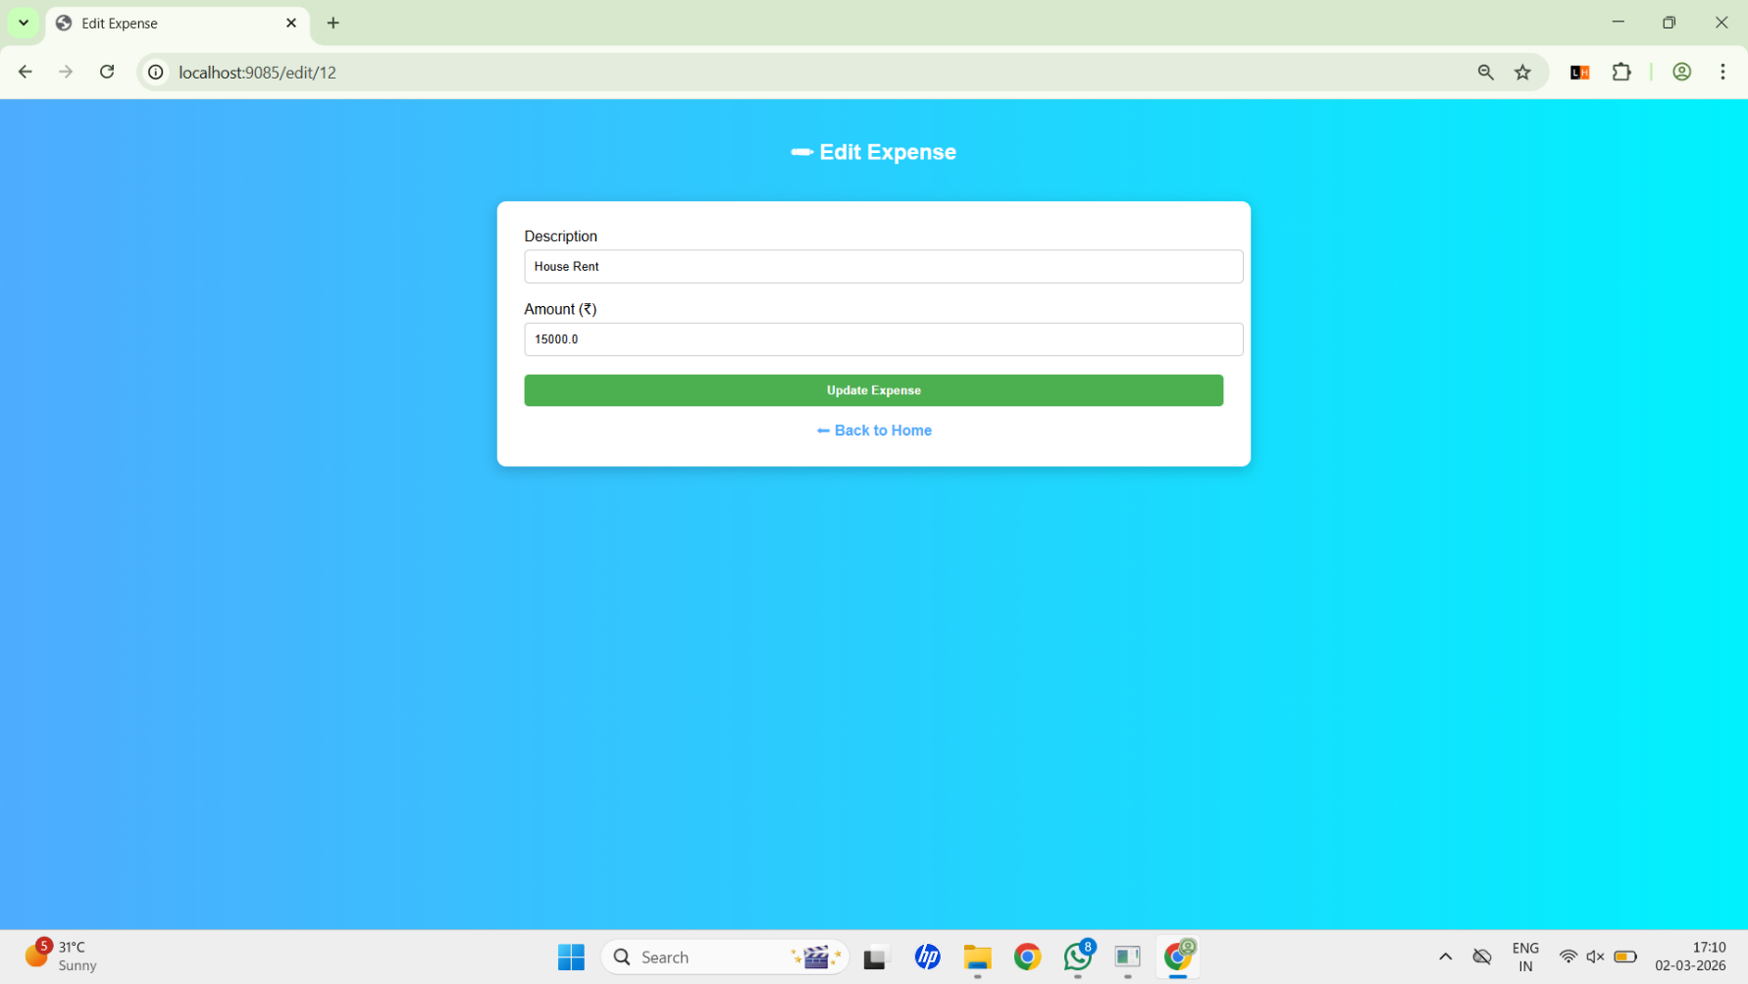
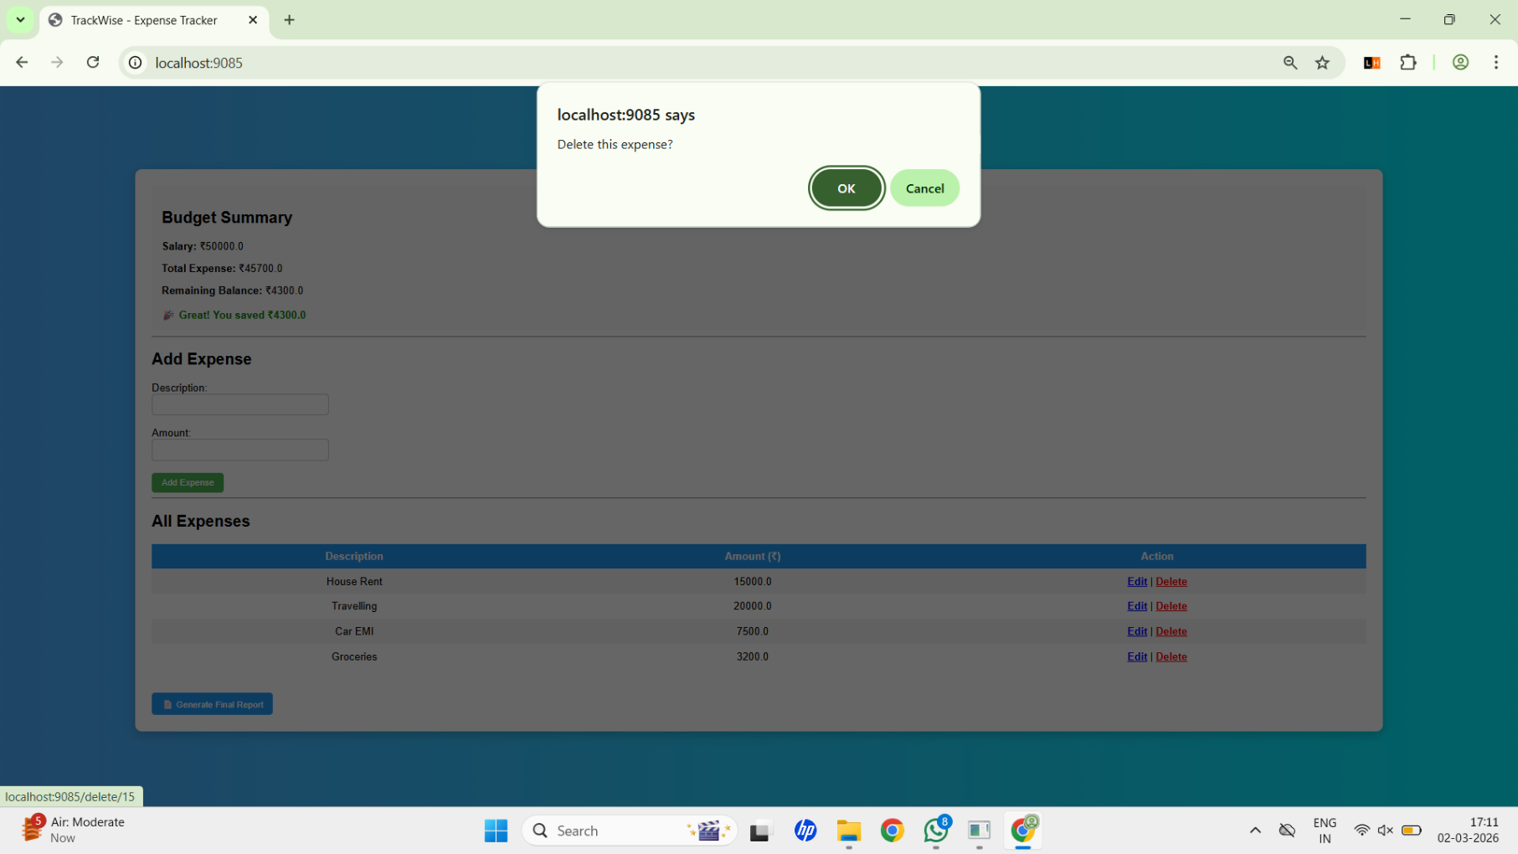
IMPLEMENTATION SCREENSHOTS
1
2
3
4
5
Add Expense: Add Expense Module allowing users to enter description and
amount for new transactions.
Edit Expense: Edit Expense Page enabling modification of existing expense records.
6
7
8(B)
9
Delete Confirmation: Delete Confirmation Popup ensuring secure removal of selected expense records.

Slide 13
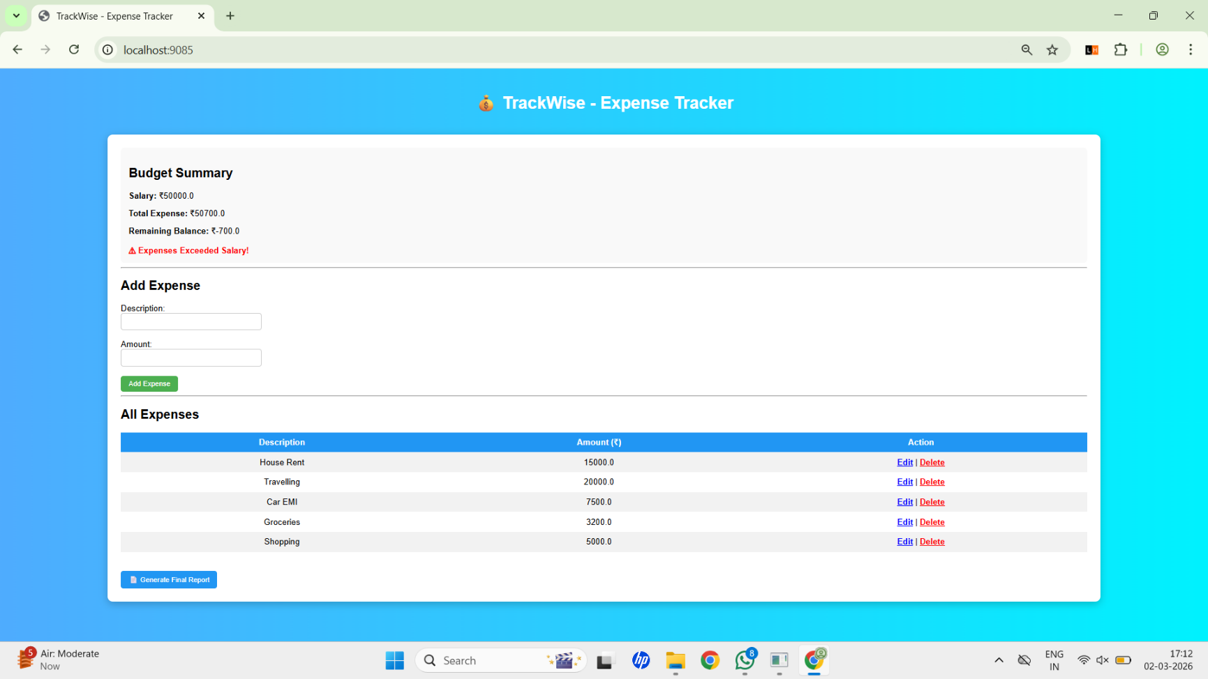
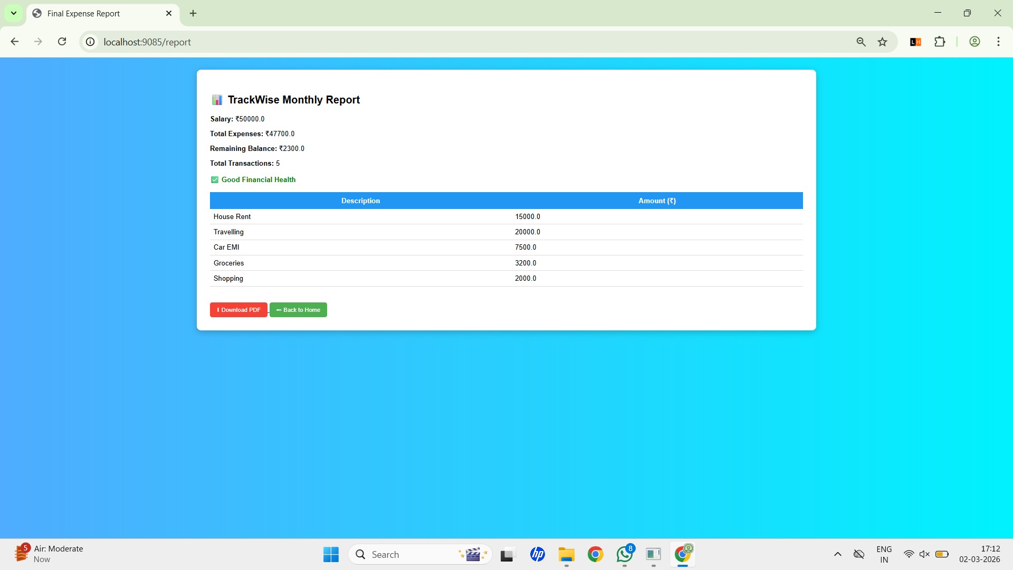
IMPLEMENTATION SCREENSHOTS
1
2
3
4
5
6
Expense Exceeded Warning: Alert Message displayed when total
expenses exceed the defined salary limit.
7
8(C)
9
Final Report Page: Monthly Expense Report summarizing total transactions and financial health status.

Slide 14
ADVANTAGES & LIMITATIONS
1
Advantages:
Limitations:
Single user system
No multi-user roles
No cloud deployment
No advanced analytics
No mobile app version
2
Secure login system
Real-time expense calculation
Relational database storage
CRUD operations implemented
Financial health indicator
PDF report generation
Clean UI design
3
4
5
6
7
8
9

Slide 15
Thank you

